Slide 1




PHENIX results on collectivity tests in high-multiplicity p+p and p+Au collisions at √s_{NN}=200 GeV
RIKEN/RBRC
Itaru Nakagawa

Slide 2
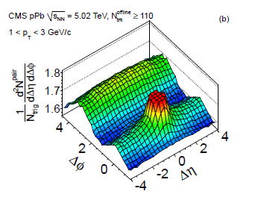
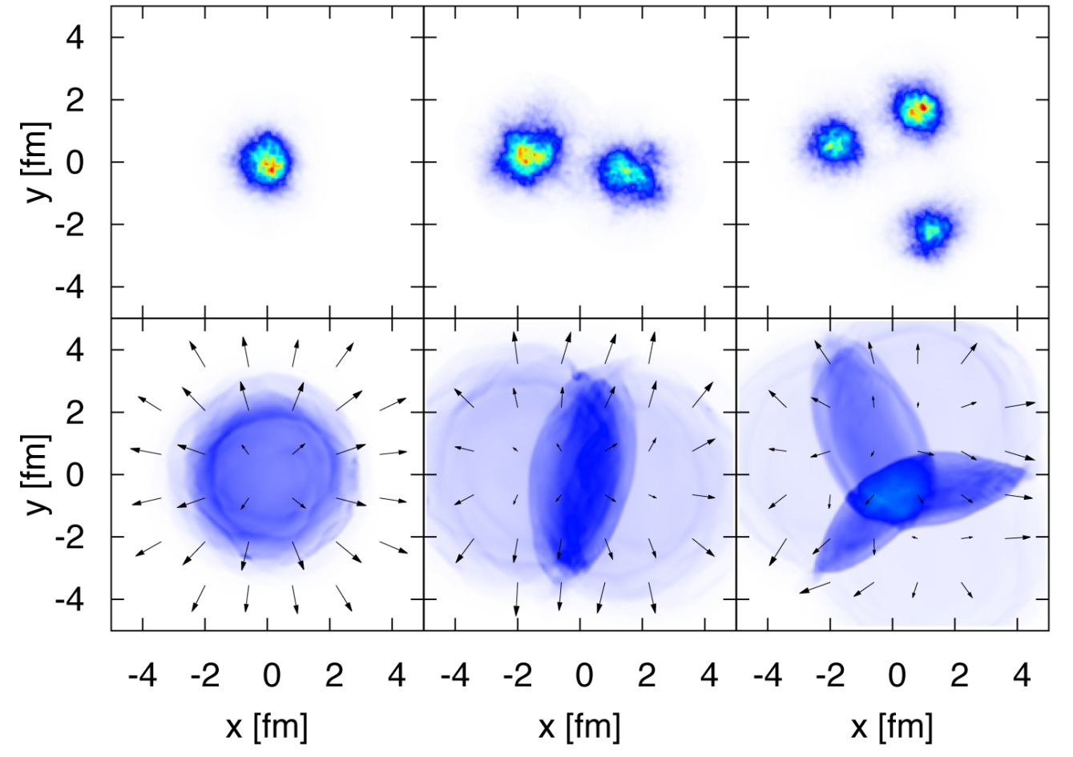
Origin of “ridge” for Small Colliding Systems
CMS: Phys. Lett. B 7198(2013)
Different small system nuclei provide distinctive initial geometries
p+Au(2015)
d+Au(2008)
³He+Au(2014)
Initial State
Intrinsic eccentricity caused by initial state fluctuation
Ground state wave function
Initial state momentum correlation : CGC
convolution
Final State
Hydro dynamics
Viscosity
graphic from Bjoern Schenke

Slide 3
High Multiplicity Events is the key!
The final state #tracks>110 plays key role. The initial energy √s may not be the critical condition.
Multiplicity is lower at RHIC energy, therefore statistically challenging.
I
Need trigger development

Slide 4
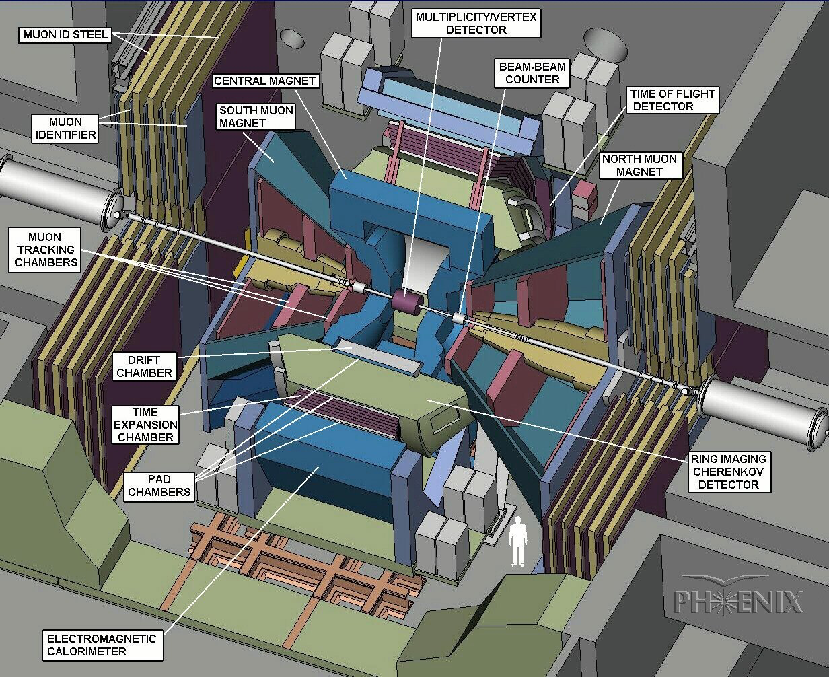
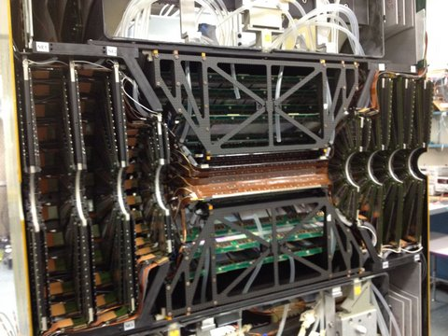
High Multiplicity Trigger for PHENIX
South
FVTX
North
FVTX
CMS: N_{ch}>110
FVTX: N_{ch}>23/arm
Implement New High Multiplicity Trigger Capability in Existing Readout Electronics for Run15 p+p Run

Slide 5
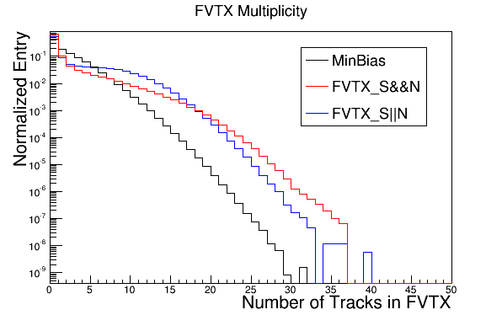
Trigger Performance for p+p
Coarse Online Tracking
Trigger events above multiplicity threshold
Good turn on response is observed for different thresholds
Up to 3 orders of magnitudes enhanced sensitivity to high multiplicity events compared to MB.
Accumulated 500M events in p+p
Number of Offline Tracks in FVTX/arm
x10³
Number of Offline Tracks in FVTX/arm
Poster presentation:
Toru Nagashima (1391), SeYoung Han (1392)

Slide 6

Run15 Data Analysis Status
Data Production
Long Range Correlation Analysis
Results
p+p, p+Al
p+Au

Slide 7
Run15 p+Au

Slide 8
BBC Multiplicity in Small Systems
BBC Charge Distribution
BBC centrality trigger for Au-going direction (South) was used for p+Au analysis to enhance high multiplicity events.
p+Au MB
p-p
BBC centrality trigger
BBC South
p,d,³He
Au
BBC North
x40

Slide 9



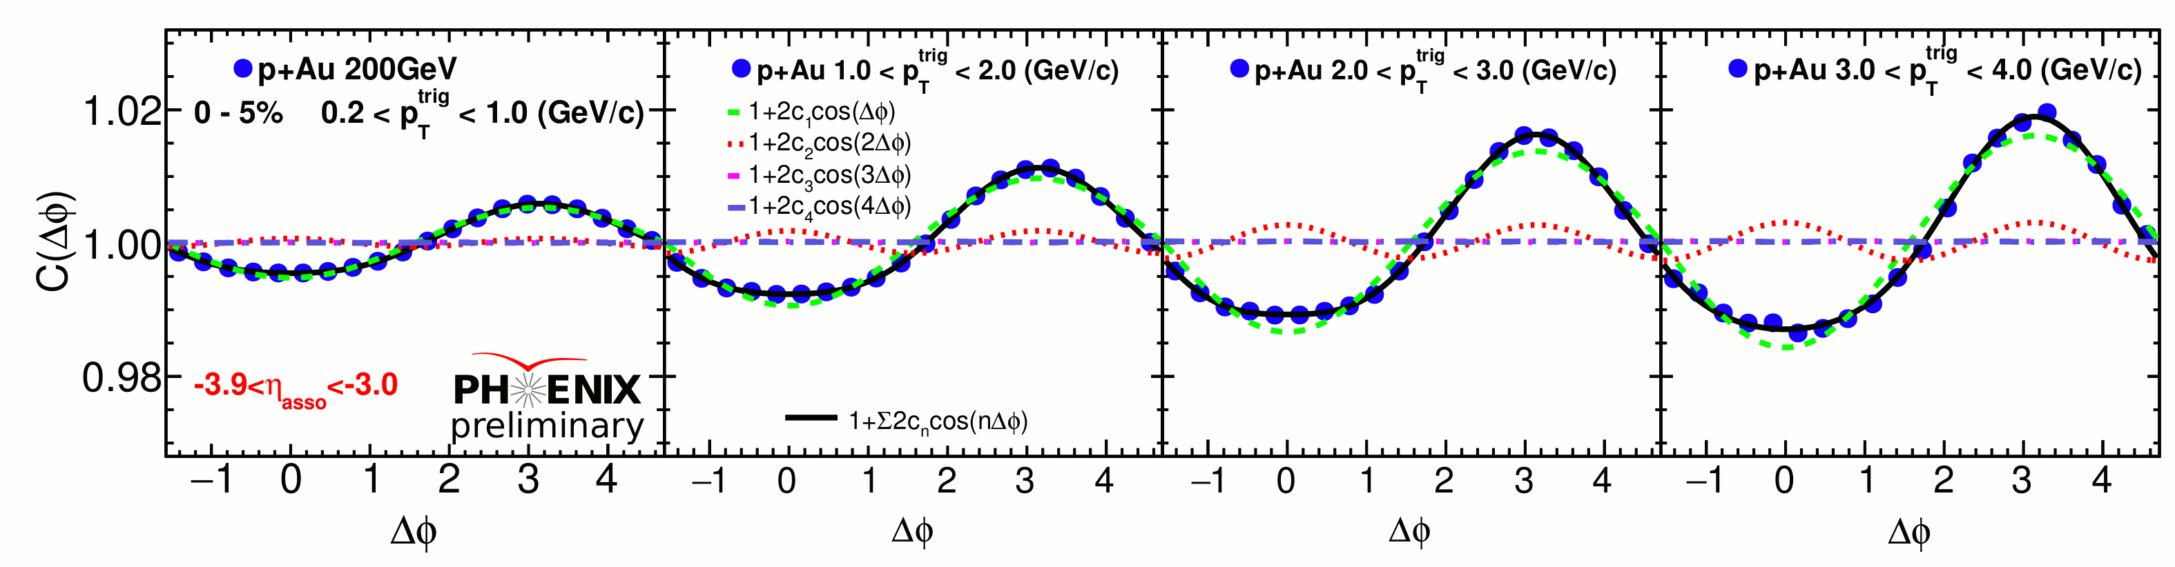
Long Range Two Particle Correlation
Two Particle Correlation
Event Mixing

Slide 10

c₂ and elementary process contribution
The Fourier coefficients from 0-5% central p-Au collisions
Non-flow effects are estimated by MB p+p scaled by dilution factor ~ 12.
~25%
~10%
Contribution from elementary process is estimated to be 10 % at small P_{T} and grows in higher P_{T} region up to 25%.
Assigned as systematic uncertainty
The following data sets are analyzed:
Run 15 p+Au collisions at $\sqrt{s_{NN} }$= 200 GeV
1.42 billion high-multiplicity events triggered by BBC, corresponding to 0-5% most central collisions
Run 5,6,8,9 p+p collisions at $\sqrt{s_{NN} }$= 200 GeV
3.09 billion events from a minimum bias trigger based on BBC
The following data sets are analyzed:
Run 15 p+Au collisions at $\sqrt{s_{NN} }$= 200 GeV
1.42 billion high-multiplicity events triggered by BBC, corresponding to 0-5% most central collisions
Run 5,6,8,9 p+p collisions at $\sqrt{s_{NN} }$= 200 GeV
3.09 billion events from a minimum bias trigger based on BBC
The following data sets are analyzed:
Run 15 p+Au collisions at $\sqrt{s_{NN} }$= 200 GeV
1.42 billion high-multiplicity events triggered by BBC, corresponding to 0-5% most central collisions
Run 5,6,8,9 p+p collisions at $\sqrt{s_{NN} }$= 200 GeV
3.09 billion events from a minimum bias trigger based on BBC
The following data sets are analyzed:
Run 15 p+Au collisions at $\sqrt{s_{NN} }$= 200 GeV
1.42 billion high-multiplicity events triggered by BBC, corresponding to 0-5% most central collisions
Run 5,6,8,9 p+p collisions at $\sqrt{s_{NN} }$= 200 GeV
3.09 billion events from a minimum bias trigger based on BBC
The following data sets are analyzed:
Run 15 p+Au collisions at $\sqrt{s_{NN} }$= 200 GeV
1.42 billion high-multiplicity events triggered by BBC, corresponding to 0-5% most central collisions
Run 5,6,8,9 p+p collisions at $\sqrt{s_{NN} }$= 200 GeV
3.09 billion events from a minimum bias trigger based on BBC

Slide 11
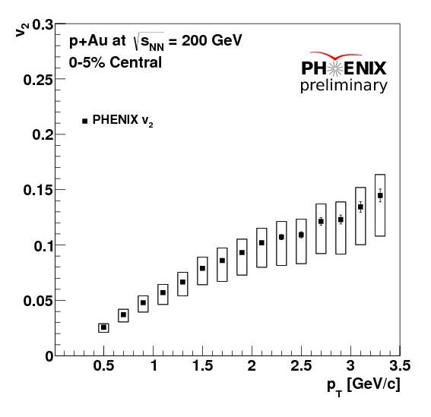
v₂ Extraction via Event Plane Method
Event plane by FVTX
Second order anisotropic flow coefficient
Resolution Res(Ψ_{2,FVTXs}) is calculated by
three sub-events method using BBC-South event plane and central arm event plane based on low P_{T} tracks.
For details see PHENIX poster (0218, QGP in small systems) by Qiao Xu

Slide 12
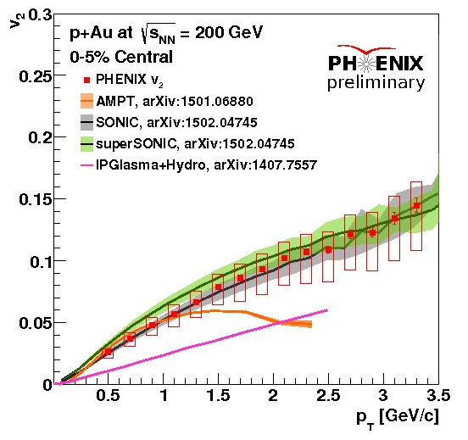
Comparison with Model Predictions
"SONIC and superSONIC with Glauber initial conditions agrees with data within uncertainties"
"Hydrodynamics with IPGlasma initial conditions underpredicts v2 by x2."
"AMPT agrees up to pT ~ 1 GeV/c, then underpredicts"

Slide 13
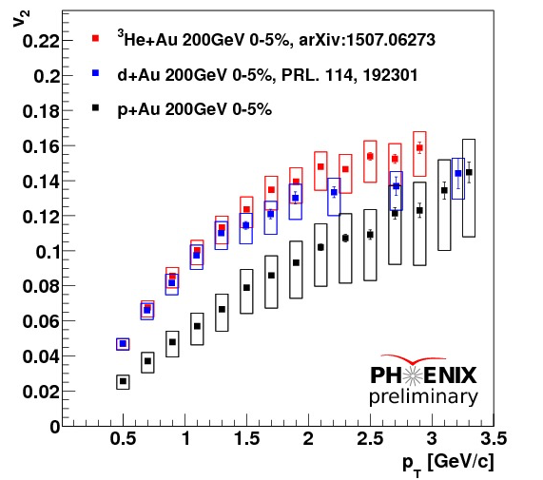
Comparison with p+Au, d+Au, ³He+Au
Data sets are 0-5% centrality.
This ordering is expected from initial state eccentricities
-> smallest ε₂ in p+Au

Slide 14
IP-Glasma Calculations
IP-Glasma calculations overestimate v₂ of d+Au and ³He+Au by > 5σ
However it underestimates v₂ of d+Au and ³He+Au
by ~ 2.5σ

Slide 15
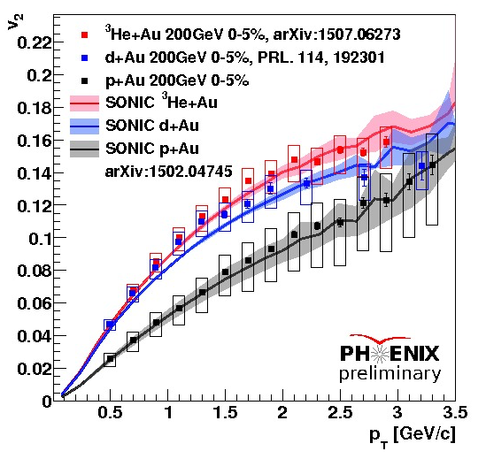
SONIC Calculations
Glauber-like initial condition hydro + hadronic cascade
SONIC Calculations reproduce v₂ for p+Au, d+Au, ³He+Au within systematic errors.

Slide 16
Eccentricity Scaling
ε₂ : Glouber (Round nucleon)
The ordering now changes and p+Au becomes largest due to round nucleon assumed in Glouber calculation.
Small system with shorter lifetime would not fully reflect initial geometry information

Slide 17
Summary
Developed the FVTX high multiplicity trigger for the collective motion study in p+p,p+Au, p+Al system. The analysis is now underway.
Long range two particle correlations are observed in central p+Au at √s=200GeV.
v2 ordering may make sense from initial state eccentricity
Simultaneous theory comparisons of v₂ from p+Au, d+Au, ³He+Au :
  SONIC predictions match data within uncertainties
  AMPT predictions match data up to p_{T} ~ 1 GeV/c
  IPGlasma initial conditions + hydro underpredict p+Au v₂
  Proposal of proton 3 constituent quark model version of IPGlasma needs full calculations and comparison.

