Slide 1

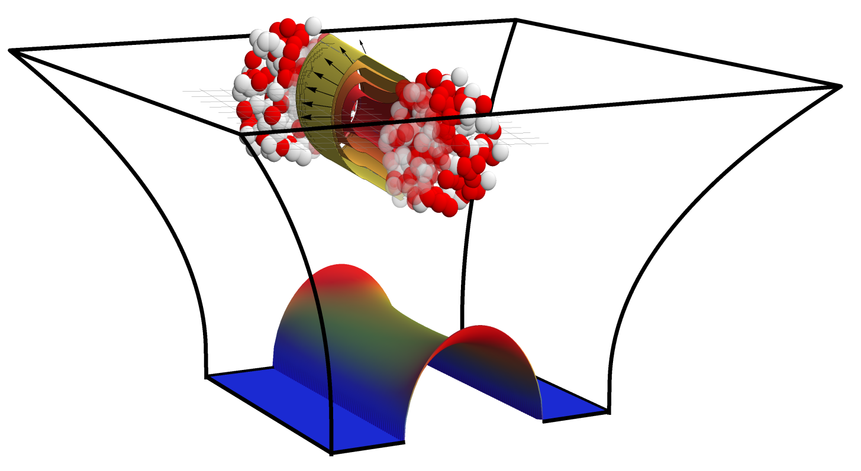
Initial state from holography
Towards more realistic models of QGP Formation
Based on work with Michał Heller, David Mateos, Jorge Casalderrey, Miquel Triana,
Paul Romatschke, Scott Pratt, Peter Arnold, Paul Chesler and Steve Gubser,
With Björn Schenke
References: 1507.02548, 1507.06789
Wilke van der Schee
Quark Matter
Kobe, 28 September 2015

Slide 2
General idea
Wilke van der Schee, MIT
AdS/CFT: very successful for learning qualitative lessons:
  Small viscosity over entropy density
  Fast applicability of viscous hydrodynamics
    What should be initial condition for hydrodynamics?
Goal: use AdS/CFT in quantitative models for quark-gluon plasma
  First to leading order, i.e. infinitely strong coupling benchmark
  A lot of room for improvement
  (baryon charge, confinement, intermediate coupling, fluctuations etc)
Not necessarily close to QCD (uncontrolled approximation)
  Different field content: perhaps not so bad in thermal phase?
  Initial stage at high energy, i.e. weak or intermediate coupling
Notes:
Many states + linearized

Slide 3
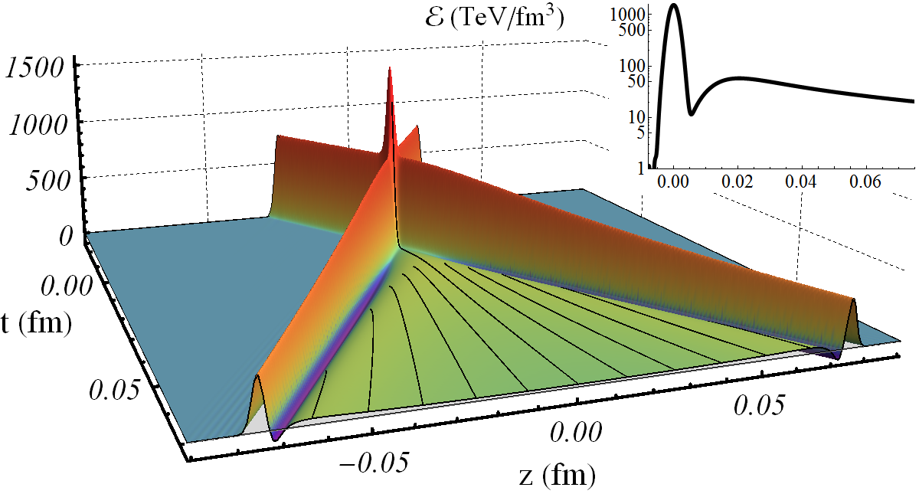

Collisions at infinitely strong coupling
Wilke van der Schee, MIT
Match longitudinal profile of energy density to nuclei
Approximately homogeneous in transverse plane
Benchmark:
J. Casalderrey-Solana, M.P. Heller, D. Mateos and WS, From full stopping to transparency in a holographic model of heavy ion collisions (2013)

Slide 4
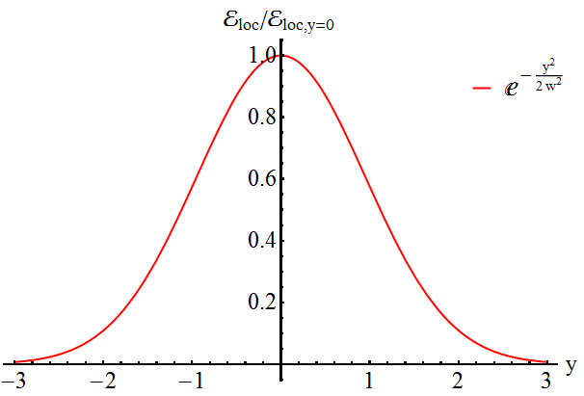
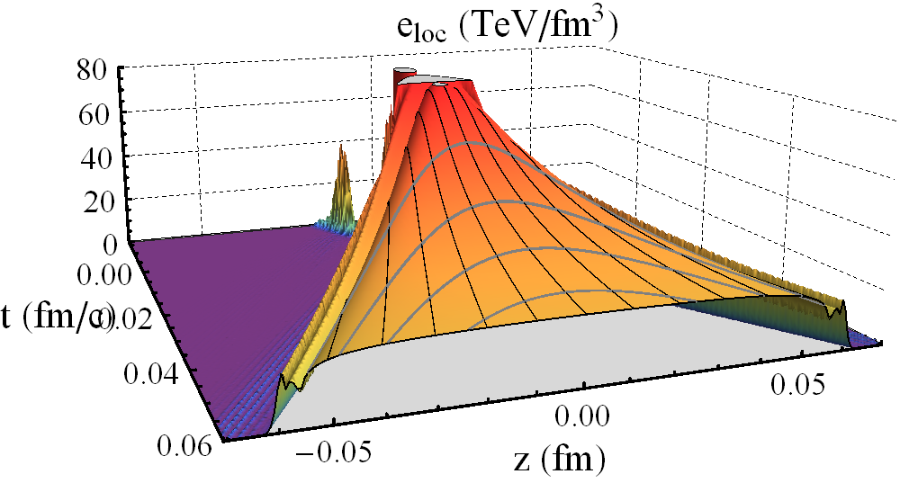
A universal rapidity profile
Wilke van der Schee, MIT
Local energy density, flat in z, Gaussian-like in rapidity
Universal profile at high energies (compare with pQCD)
Profile ~ 30% narrower at 200 GeV
J. Casalderrey-Solana, M.P. Heller, D. Mateos and WS, Longitudinal coherence in a holographic model of asymmetric collisions (2013)
P.M. Chesler, N. Kilbertus and WS, Universal hydrodynamic flow in holographic planar shock collisions (2015)

Slide 5
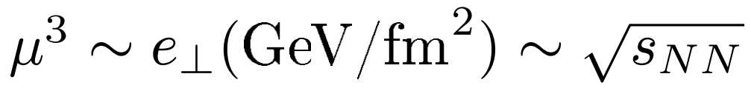

Off-central collisions
Wilke van der Schee, MIT
Everything depends only on:
More non-trivial:
rapidity profile + Bjorken velocity (shift to c.o.m.!)
fast thermalisation → decoupling of transverse dynamics
Take favourite model for transverse plane:
Here integrated Wood-Saxon (no fluctuations)
Does not follow from AdS

Slide 6
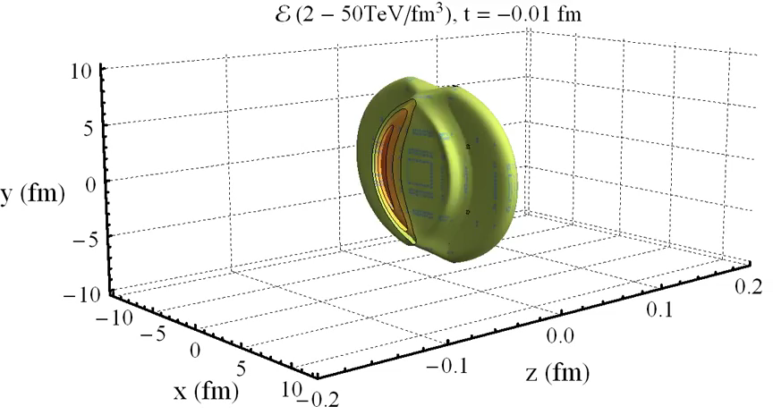
Colliding two nuclei:
Wilke van der Schee, MIT
Locally in transverse plane: use shock waves (i.e. ~Gaussian rapidity)
→ Go and run hydro (MUSIC) and get particle spectra ☺

Slide 7
caveats
Wilke van der Schee, MIT
Initial stage in heavy ion collisions is at intermediate coupling
  Expect over-estimate of stopping, more particles at mid-rapidity
  Expect (small) effects of confinement scale and net baryon number
  In future include things as rapidity dependence quarks/gluons
Event-by-event changes picture qualitatively
  Less entropy production (last slide)
  Somewhat more energy at higher rapidities
  Full 4+1D AdS evolution needed (not included)
Nevertheless:
  Perhaps only model which has hydrodynamics as natural output
  Simple model can easily be improved to get more realistic settings
  In this case: no free parameters!

Slide 8
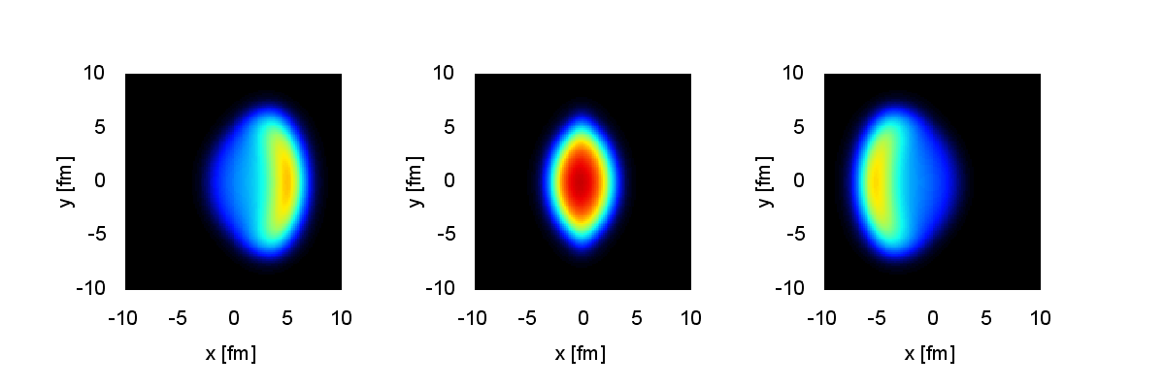

MUSIC Results
Wilke van der Schee, MIT
η = - 4 η = 0 η = 4
Impact parameter 8 fm, time 0.1 fm/c to 10 fm/c
Pre-flow in transverse plane by `AdS/CFT pre-flow’:
WS, P. Romatschke and S. Pratt, Fully Dynamical Simulation of Central Nuclear Collisions (2013)
M. Habich, J.L. Nagle, P. Romatschke, Particle spectra and HBT radii for simulated central nuclear collisions (2014)

Slide 9
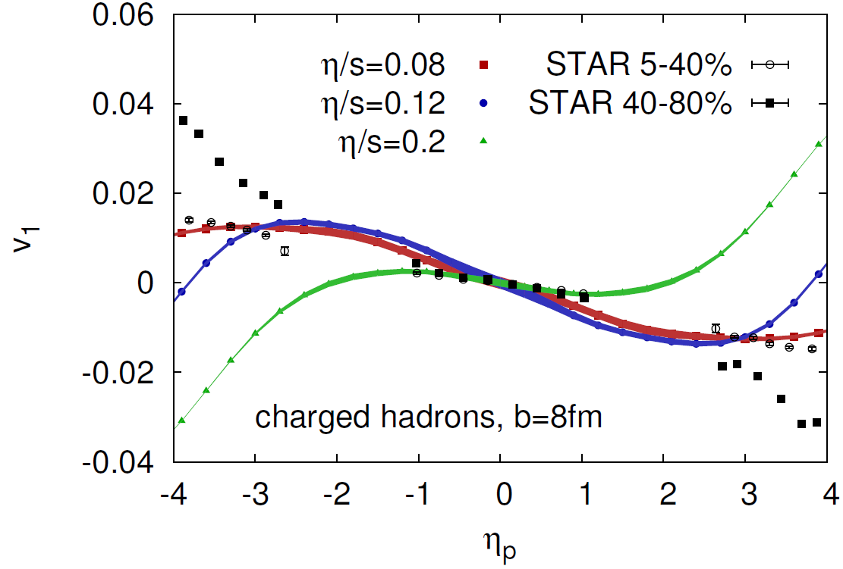
MUSIC Results, RHIC
Wilke van der Schee, MIT
Directed flow: right ball-park values
Note: somewhat subtle to measure; event-plane etc
Could be very sensitive to viscosity

Slide 10
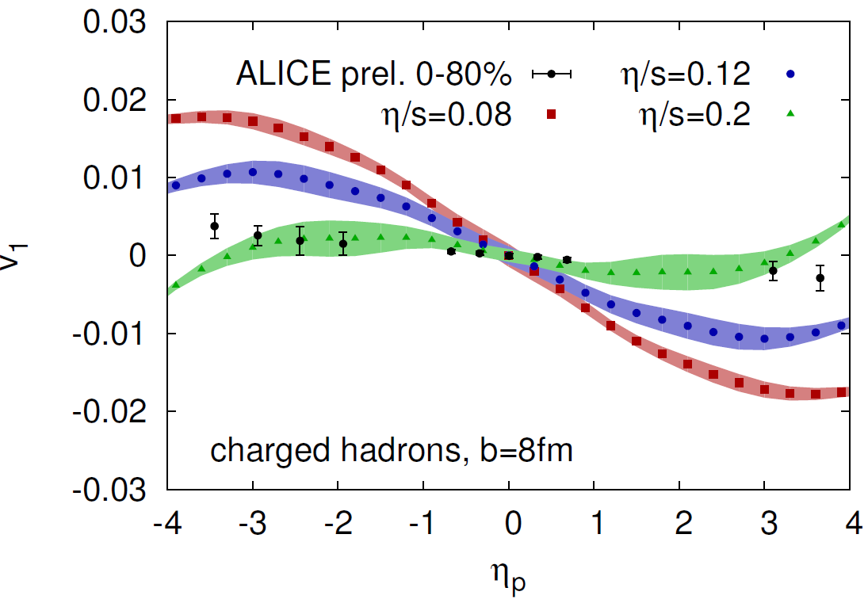
MUSIC Results, LHC
Wilke van der Schee, MIT
Directed flow: right ball-park values
Note: somewhat subtle to measure; event-plane etc
Could be very sensitive to viscosity
ALICE, Directed flow of charged particles at mid-rapidity relative to the spectator plane in Pb–Pb collisions at √s_{NN} = 2.76 TeV (2013)

Slide 11
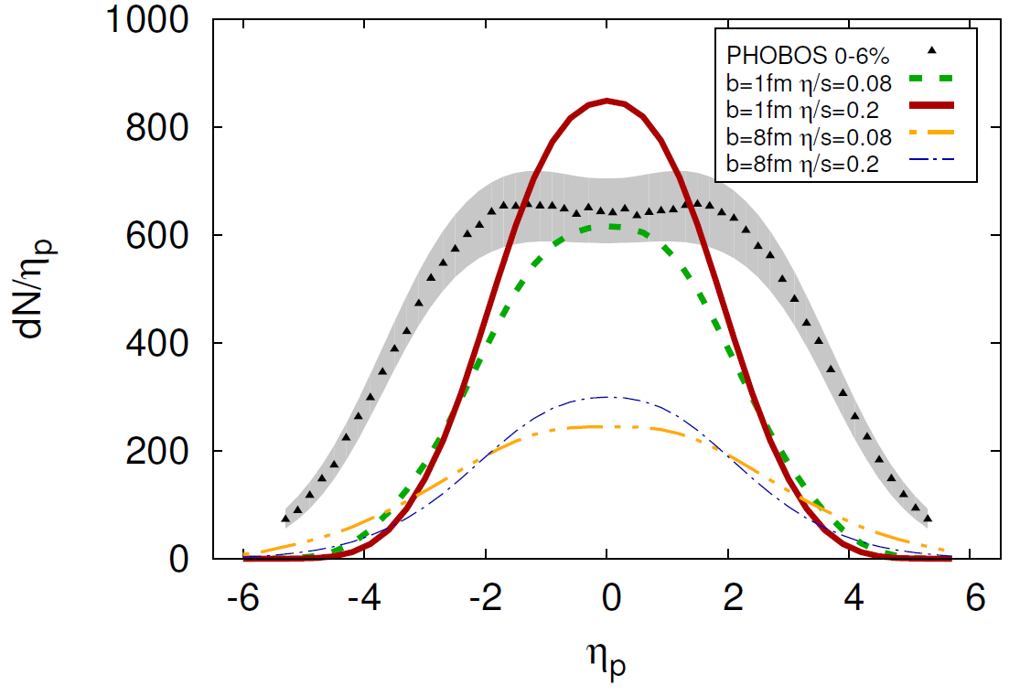
MUSIC Results, RHIC
Wilke van der Schee, MIT
Particle spectra in longitudinal direction:
Width comes out too narrow, rescaled initial energy by factor 6
Includes `dynamical cross-over’ (i.e. non-universal rapidity)

Slide 12
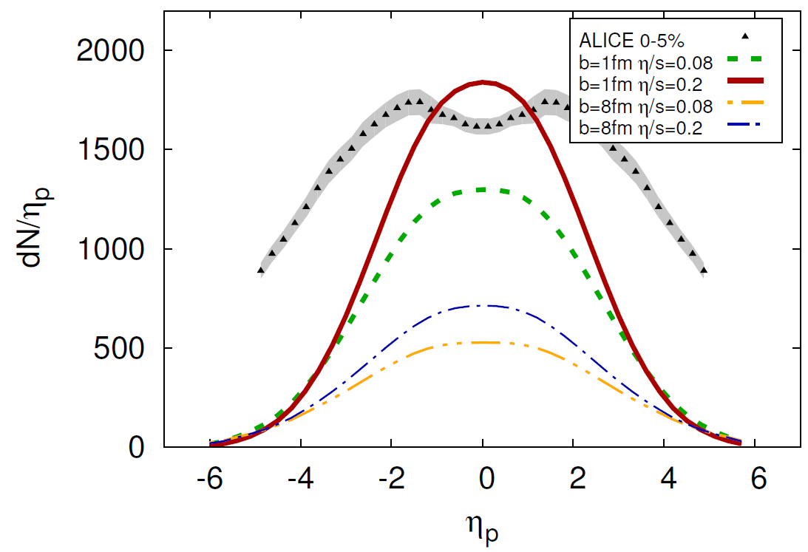
MUSIC Results, LHC
Wilke van der Schee, MIT
Particle spectra in longitudinal direction:
Rescaled initial energy density by factor 20
Profile is significantly too narrow
ALICE, Bulk Properties of Pb-Pb collisions at √s_{NN} = 2.76 TeV measured by ALICE (2011)

Slide 13
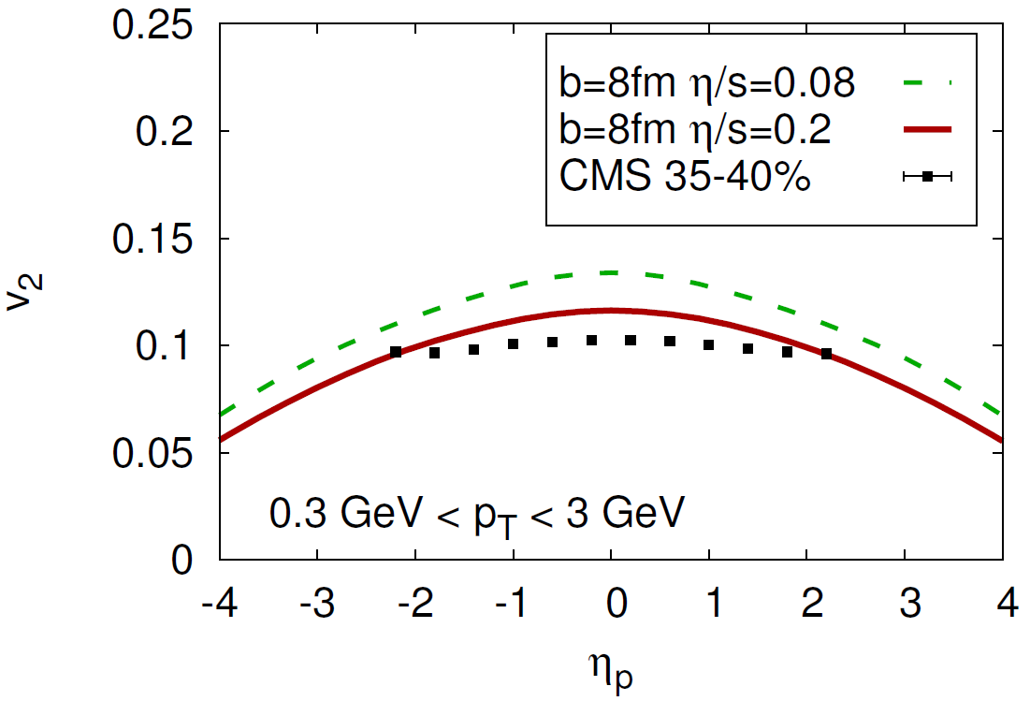
MUSIC Results, elliptic flow
Wilke van der Schee, MIT
Elliptic flow: also right order of magnitude, but a bit too narrow
ALICE, Initial State conference

Slide 14
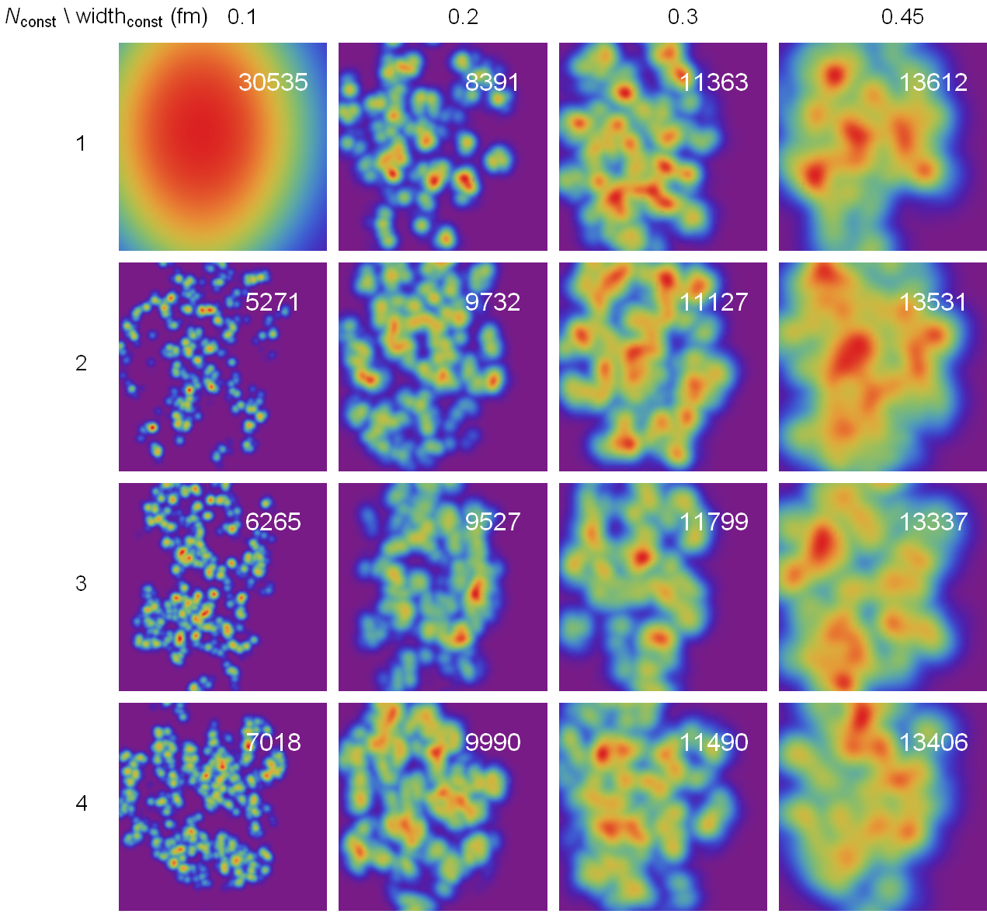
Event-by-event
Wilke van der Schee, MIT
Unknown: nucleon structure: # constituents, width constituent
20-30%
Total N_{ch} in white
(7300 from ALICE)
(from initial entropy)
Averaged: top-left
Implications for v_{n}?

Slide 15
Discussion
See PhD thesis (1407.1849) for info/notebooks on AdS numerics
Wilke van der Schee, MIT
A universal rapidity profile
  Initial state: universal rapidity profile, with Bjorken velocity
  AdS/CFT: simple and strong predictions: fits some data??
  Current model only fitted overall energy density, very constrained
AdS/CFT plus MUSIC 3+1 hydro exciting: stay tuned ☺
  Directed flow as function of rapidity
  Test different transverse plane models? p-Pb collisions? Fluctuations?
  Rapidity dependence perhaps not studied enough?
Future is open: correct for infinite coupling approximation, finite baryon density, non-conformal theories, confining theories……
Notes:
Future: obvious

Slide 16
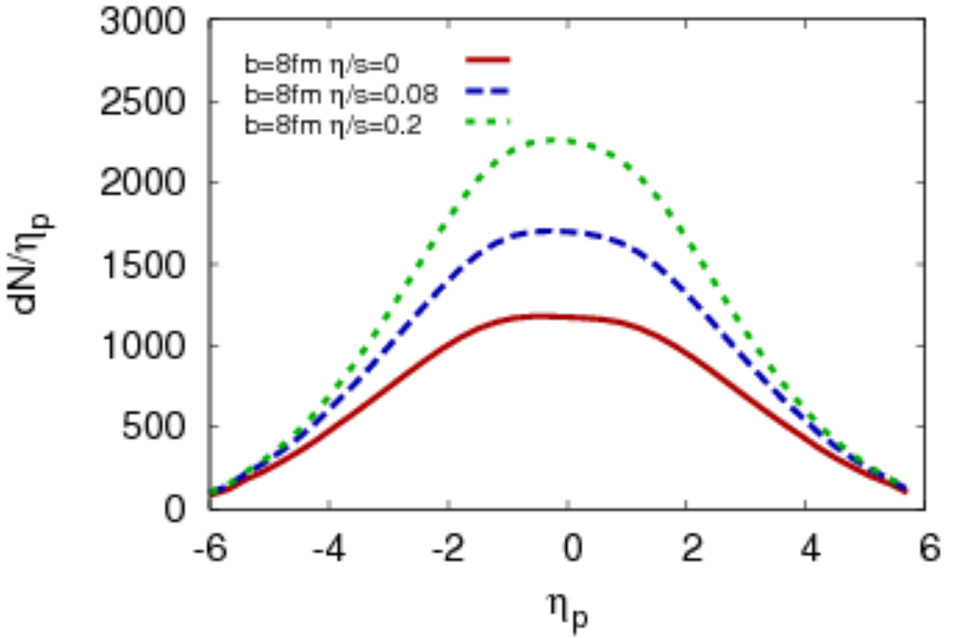
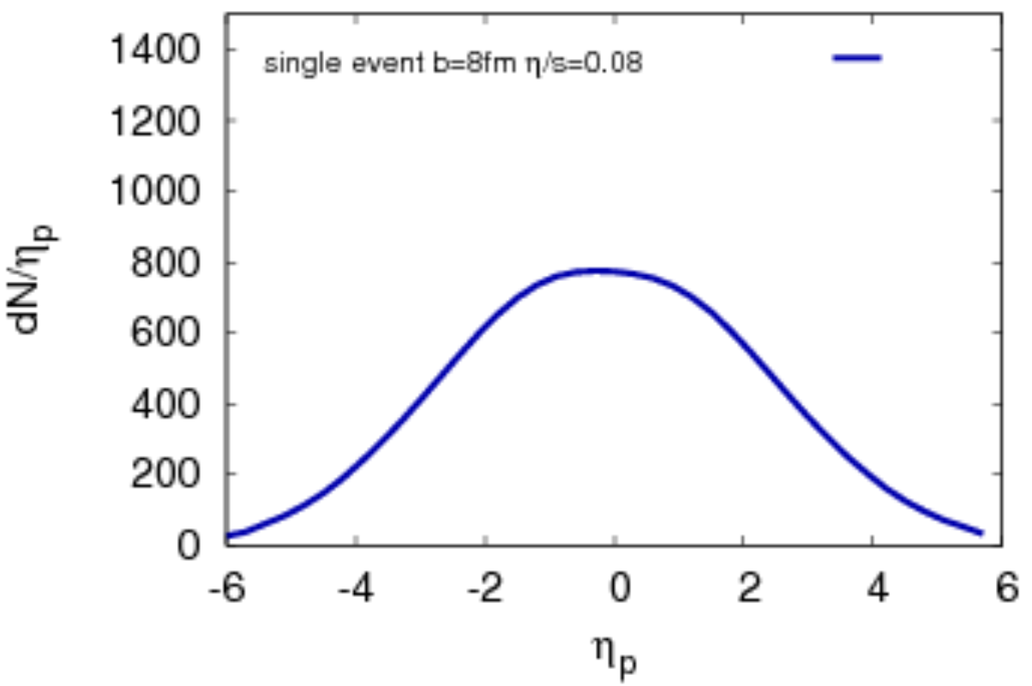
Event-by-event
Wilke van der Schee, MIT
Without fluctuation: With fluctuation:
Big decrease in total multiplicity
relates back to old computations by Gubser/Pufu/Yarom/Lin/Shuryak
i.e. dN/dη very sensitive to energy distribution of a nucleon

Slide 17

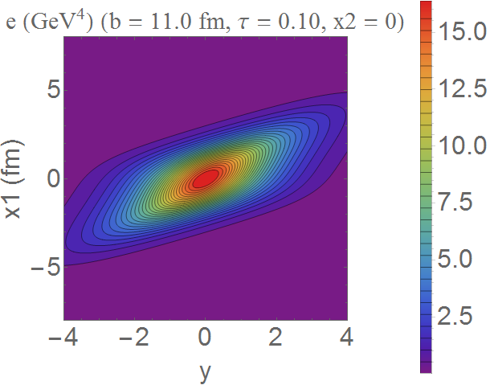
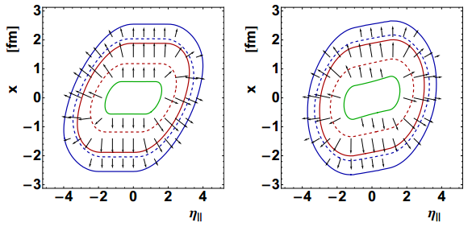
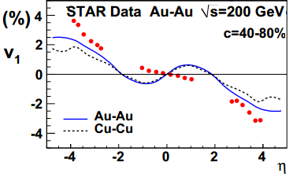
directed flow and longitudinal dynamics
Wilke van der Schee, MIT
In non-central collisions there is directed flow:
‘Standard’ boost-invariant coherent model conflicts with experiment
  Either tilt,
  Or use narrow rapidity profile
P. Bozek, I. Wyskiel, Directed flow in ultrarelativistic heavy-ion collisions (2010)

Slide 18
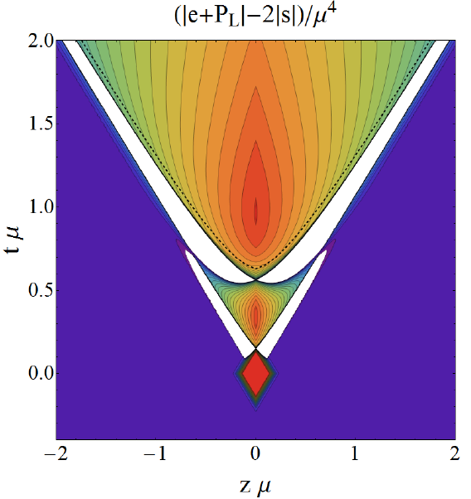
Regions without a rest frame (thin shocks)
Wilke van der Schee, MIT
Work with Paul Romatschke and Peter Arnold (1408.2518)
Regions with negative energy density
Regions where no Lorentz boost
can diagonalise stress tensor!
  Also found in other systems
But no pathologies:
well-defined quantum phenomenon
  Still curious:
  possibly present in HIC!
  (consequences??!)

Slide 19
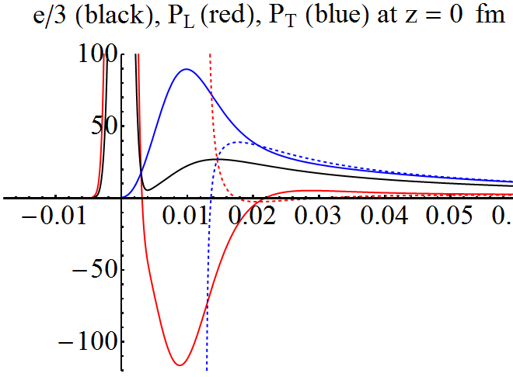
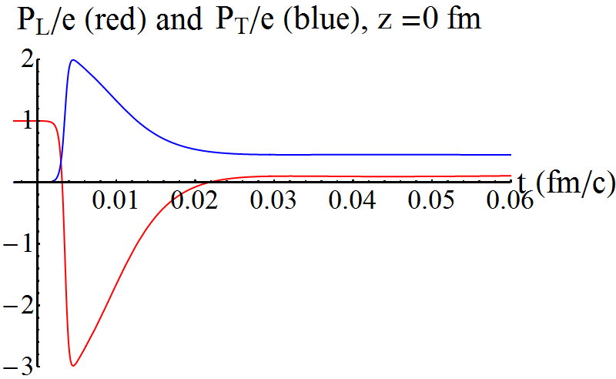
Thermalisation/pressures
Wilke van der Schee, MIT
Pressures, energy starts at zero, grows (unique to holography?)
Thermalises very fast (hydro applies in perhaps 0.02 fm/c)
  Thermalisation = relaxation non-hydro modes
  Gradients + viscous corrections are big
M.P. Heller, R.A. Janik and P. Witaszczyk, Hydrodynamic Gradient Expansion in Gauge Theory Plasmas (2013)

Slide 20
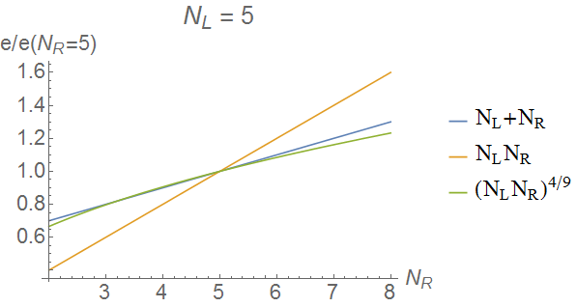
Wounded vs binary
Wilke van der Schee, MIT
Produced energy at mid-rapidity:
  I.e. no “wounded” or “binary” scaling (but close to wounded in AA(!))

Slide 21
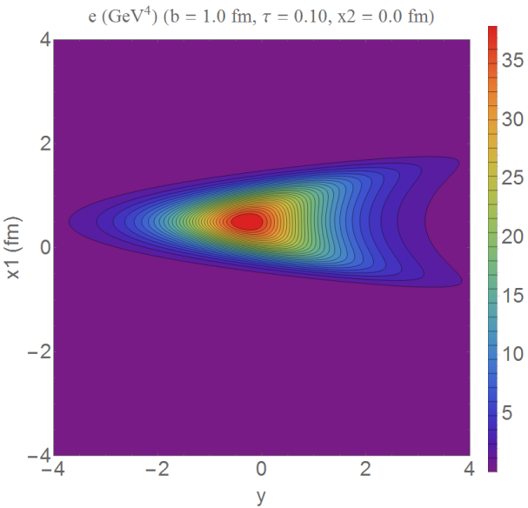
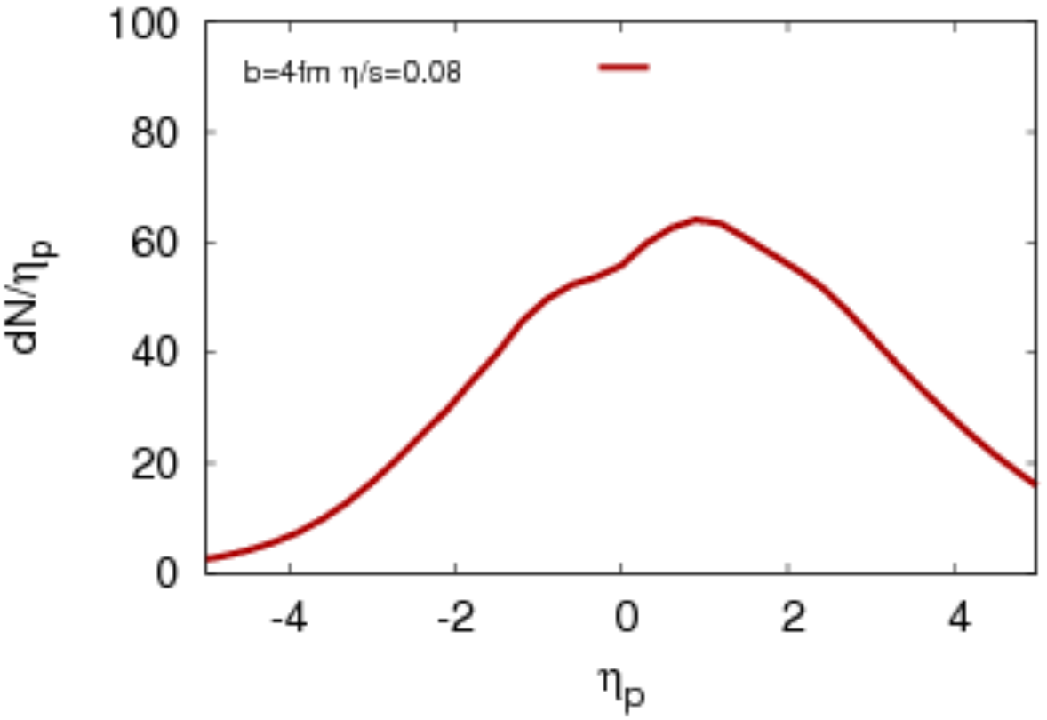
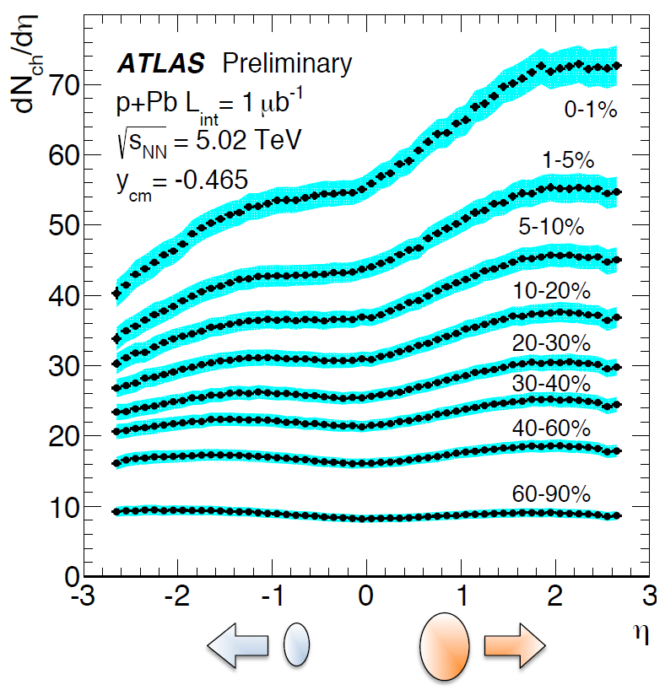
p-Pb: even more non-trivial?
Wilke van der Schee, MIT
Shift rapidity profile to local c.o.m.
Correct shape, a bit too narrow again
  See also old article by Peter Steinberg
P. Steinberg, Inclusive Pseudorapidity Distributions in p(d)+A Collisions Modeled With Shifted Rapidity Distributions (2007)

Slide 22
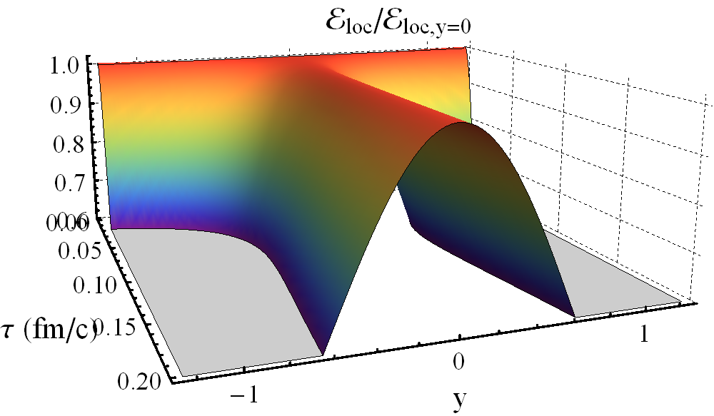
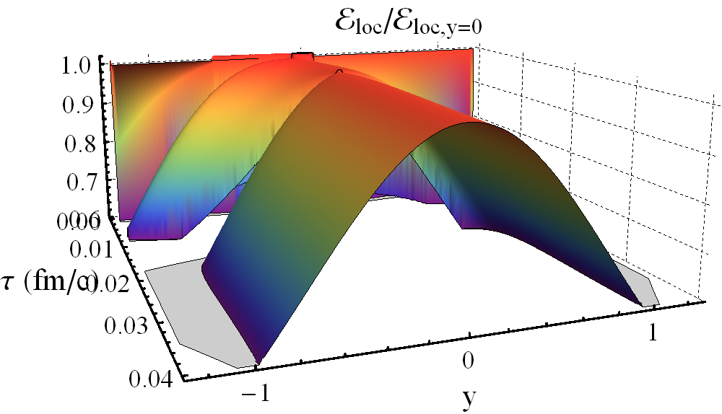
A universal rapidity profile
Wilke van der Schee, MIT
How is plasma energy distributed in longitudinal direction?
Coherence: high energy profile is universal!
Low energy:
High energy:

Slide 23
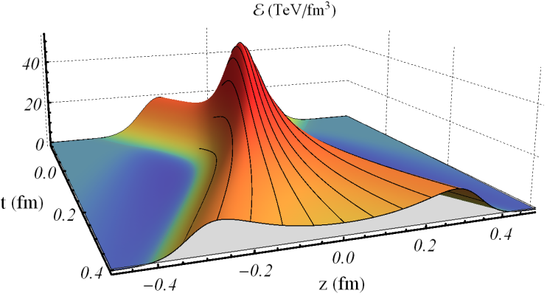
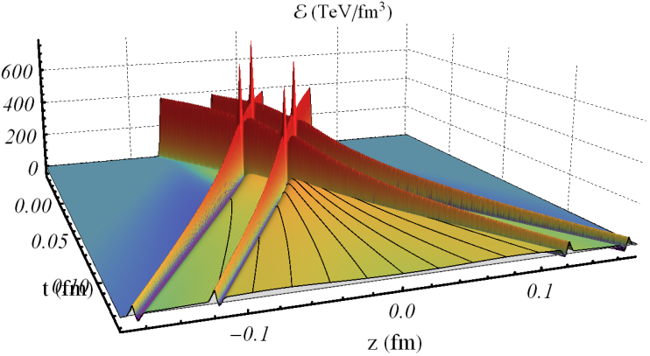
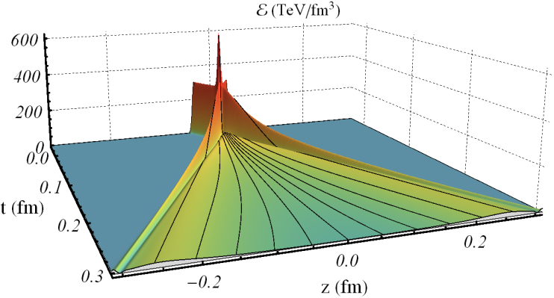
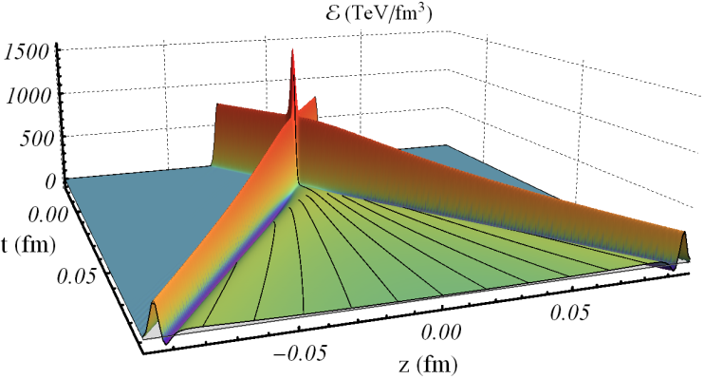
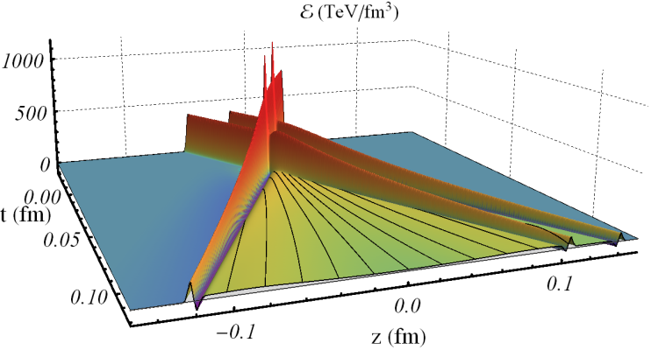
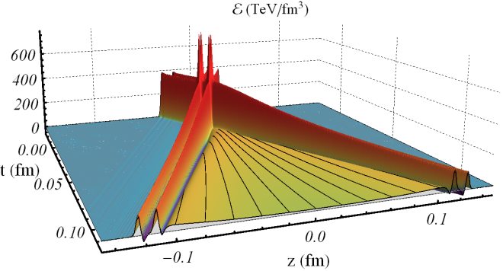
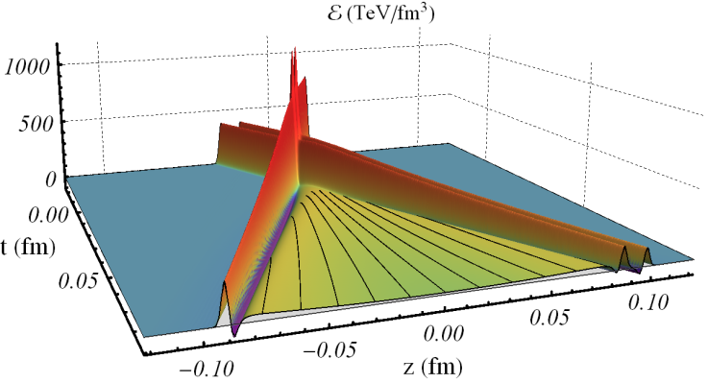
Important conclusion
Wilke van der Schee, MIT
Longitudinal dynamics takes place in c.o.m. of participating nucleons
In particular, it is symmetric around mid-rapidity

Slide 24
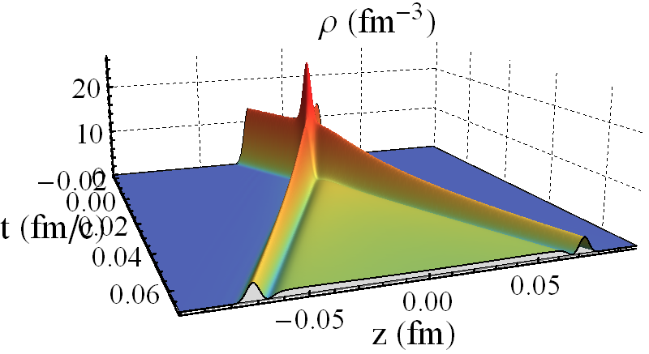
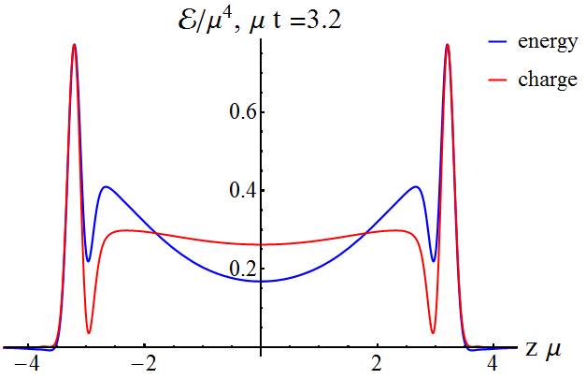
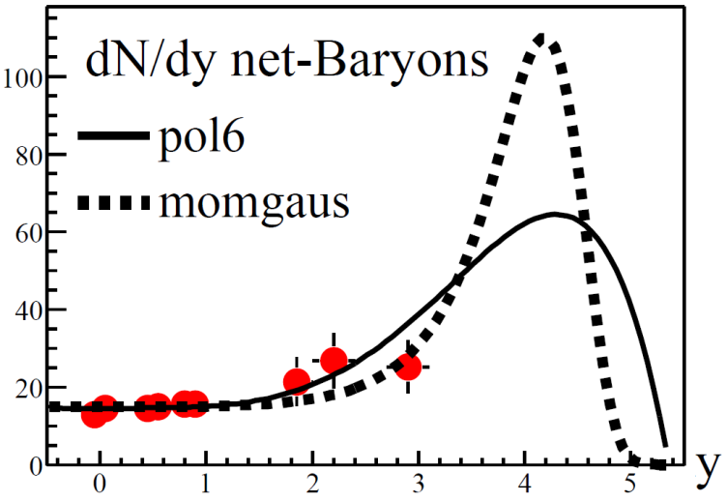
Baryon number and conserved charge
Wilke van der Schee, MIT
Pure gravity doesn’t have conserved charge
  Add vector field
Does net charge end up at high y?
  Preliminary: no or maybe...
BRAHMS, Nuclear Stopping in Au+Au Collisions at √s_{NN} = 200 GeV(2003)

Slide 25
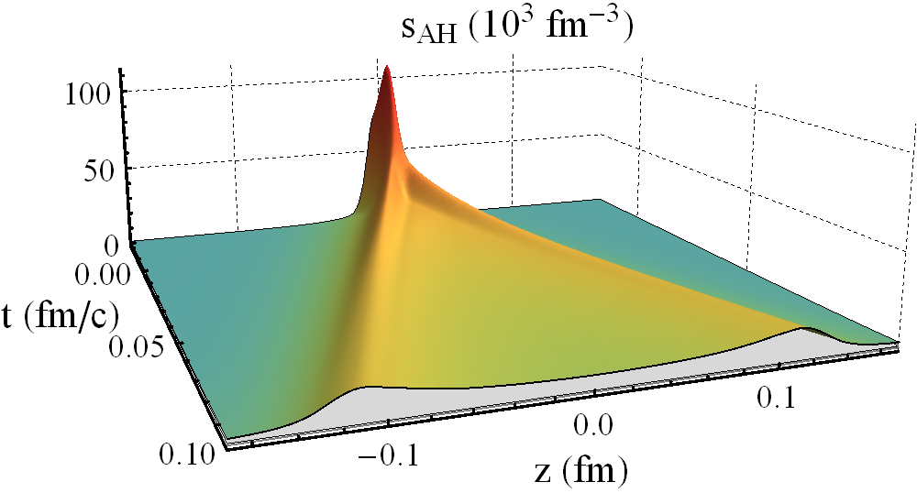
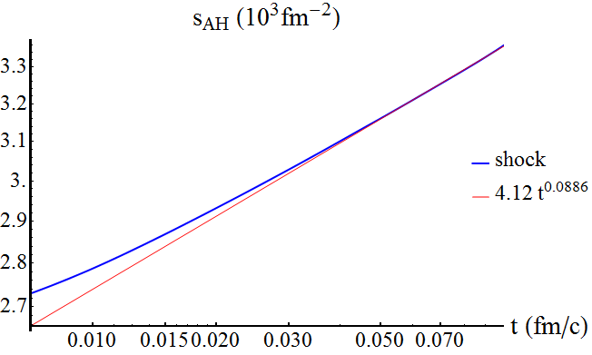
Entropies and multiplicities
Wilke van der Schee, MIT
Plasma hadronises around T~170MeV
# of particles ~ local energy or entropy (~E/T)
Entropy is approximately conserved (η small)

Slide 26
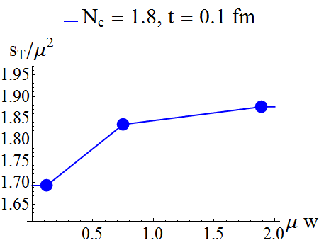
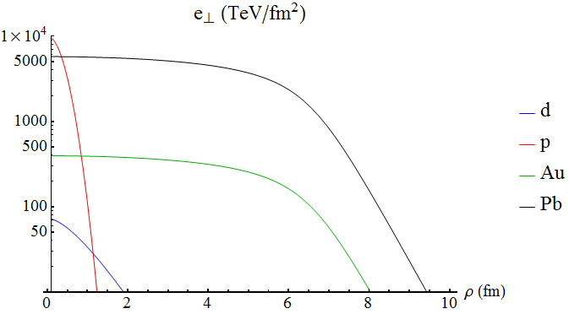
Apparent horizon
Wilke van der Schee, MIT
Total entropy (per transverse area) mildly depends on w
Step: assume small gradients in transverse plane

Slide 27
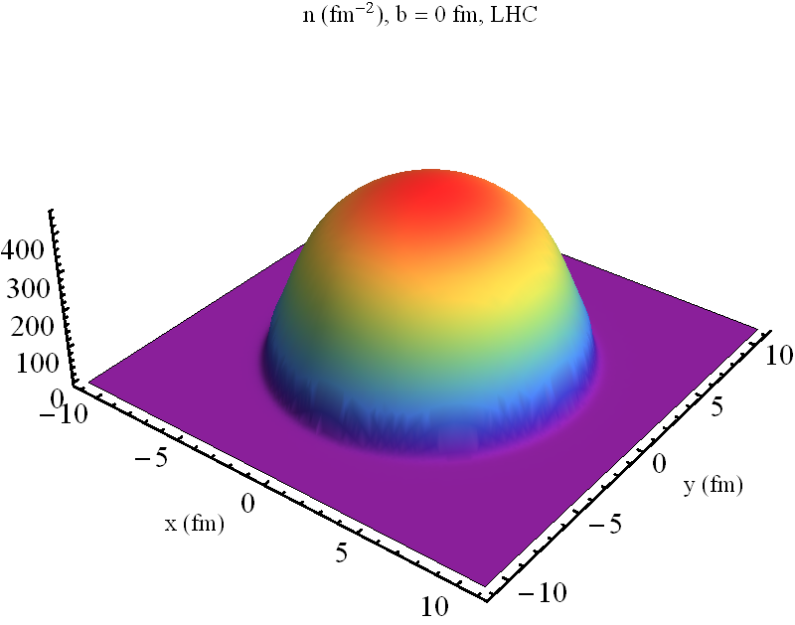
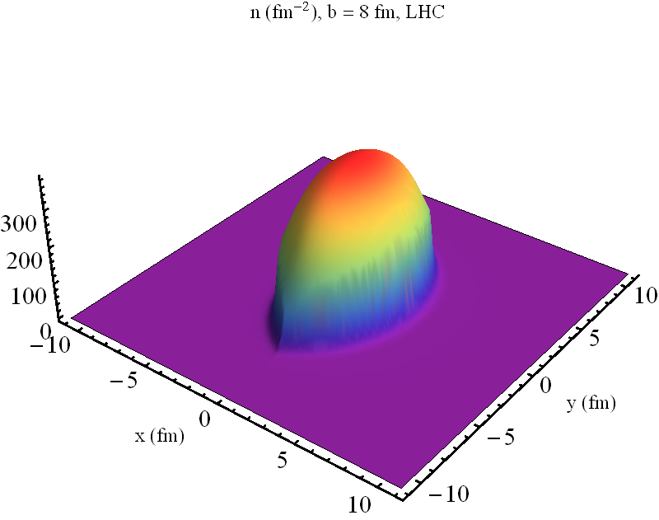
Example multiplicities
Wilke van der Schee, MIT
Two examples of entropy per transverse area

Slide 28
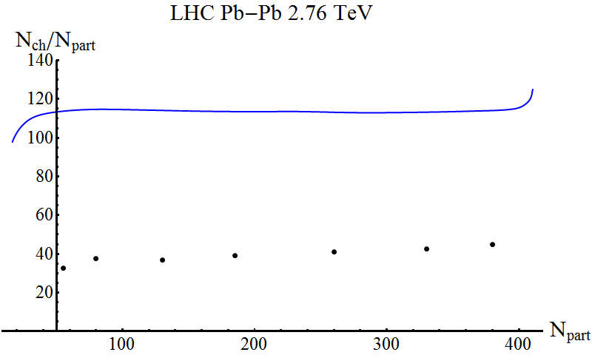
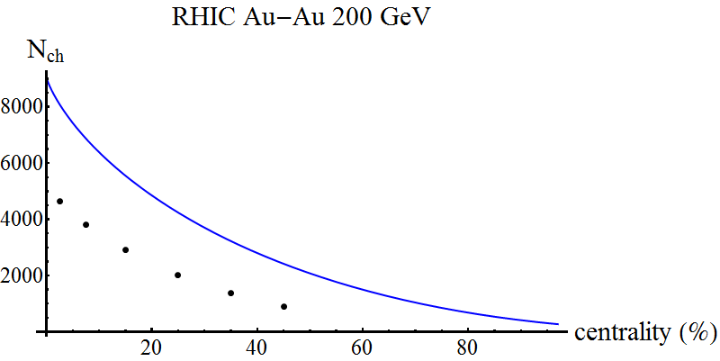
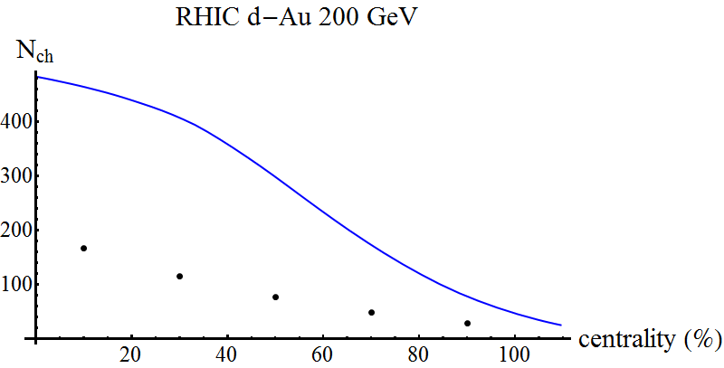
Multiplicity plots
Bulk Properties of Pb-Pb collisions at √s_{NN} = 2.76 TeV measured by ALICE (2011)
Pseudorapidity distributions of charged particles from Au+Au collisions at the maximum RHIC energy, √s_{NN} =200 GeV (2001)
Wilke van der Schee, MIT
Several corrections:
  No spectators (-15%)
  Event-by-event fluctuations
  More viscous effects?
  Shape deuteron? N_{part}?
  Weak coupling effects

Slide 29
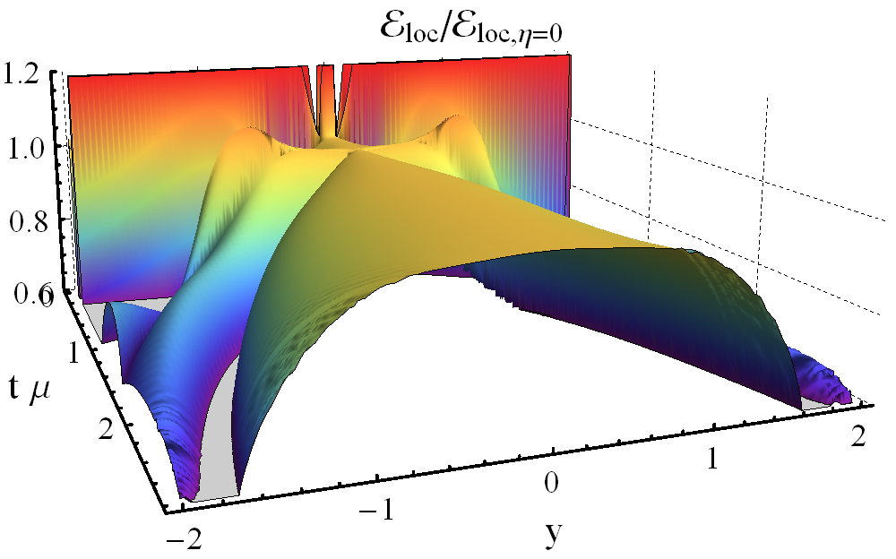
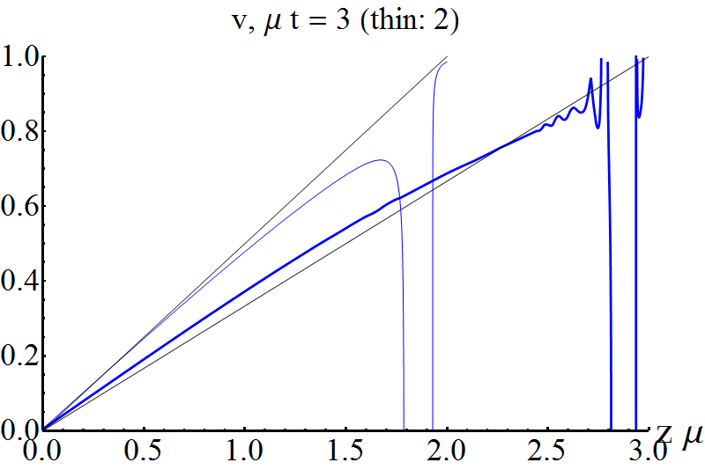

Local energy density flatter in real time!
Wilke van der Schee, MIT
Instead of proper time, try real time local energy density:
Numerically hard at high rapidities
  Perhaps constant local energy density in real time?
  Velocity seems close to boost-invariant: (but changes?)

Slide 30
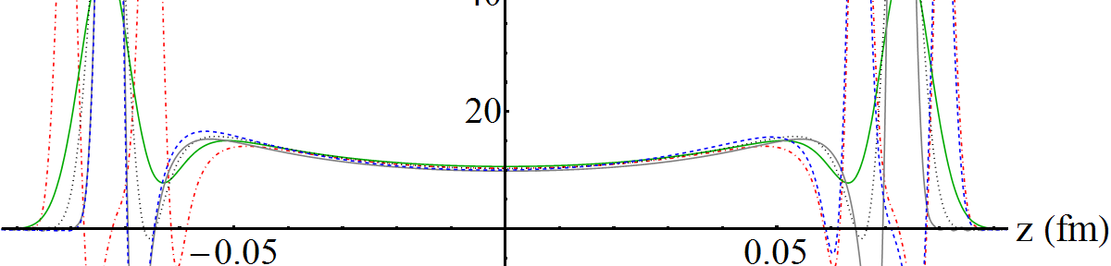
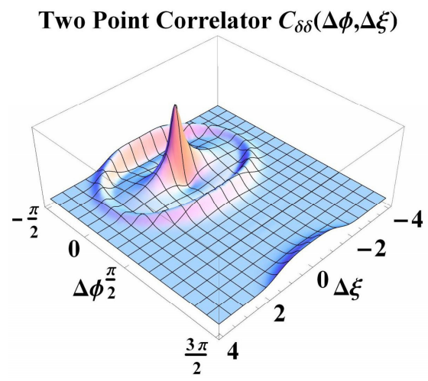

Initial state versus thermal fluctuations
Wilke van der Schee, MIT
Result: little longitudinal initial state fluctuations
  As opposed to transverse fluctuations!
T. Springer and M. Stephanov, Hydrodynamic ﬂuctuations and two-point correlations (2012)

