Slide 1

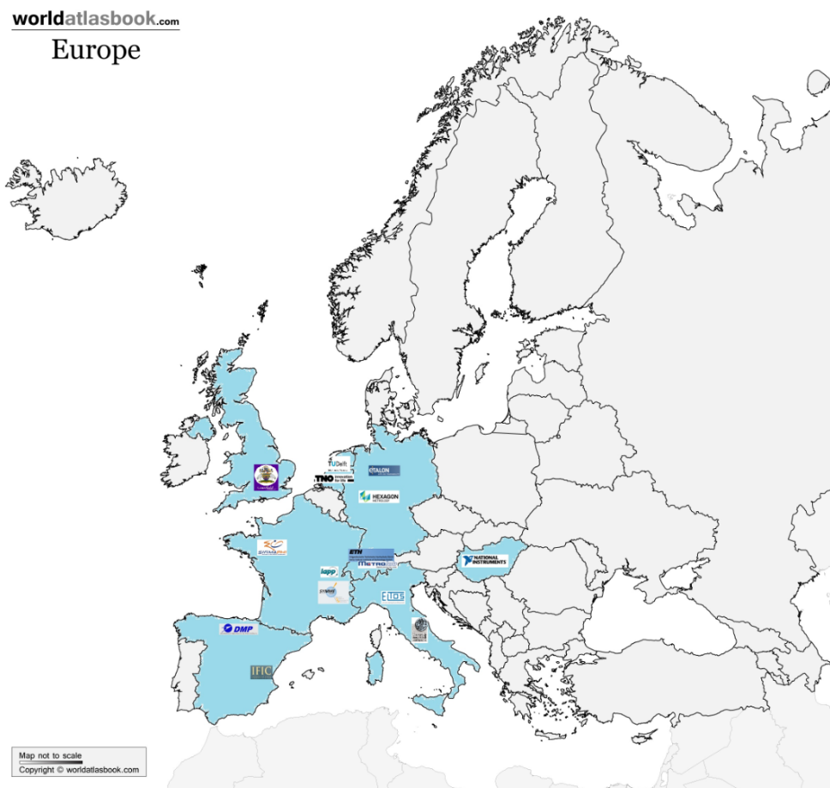
Introduction
PACMAN = Particle Accelerator Components Metrology and Alignment to the Nanometre Scale.
EC- funded ITN based at CERN
10 PhD (IDP) students
8 universities & research centres
8 industrial partners

Slide 2

Goals
Create highly skilled scientists (advanced engineering & transferable skills)
Develop high accuracy metrology & alignment tools
Integrate technologies in a single automatic test stand
Validate methods and tooling on CLIC components

Slide 3
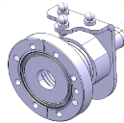
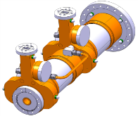
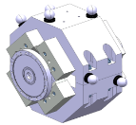
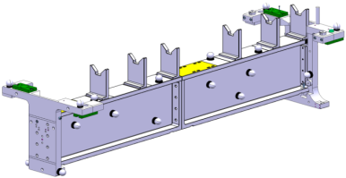
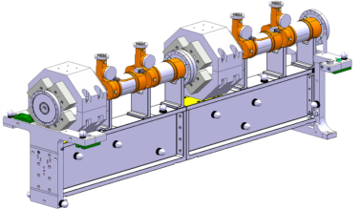
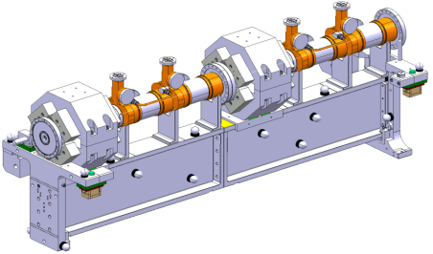
CLIC requirements
Pre-alignment of CLIC modules to 10 microns over a 200m sliding window
Current alignment strategy
Fiducialisation
Alignment on common support
Alignment in tunnel

Slide 4
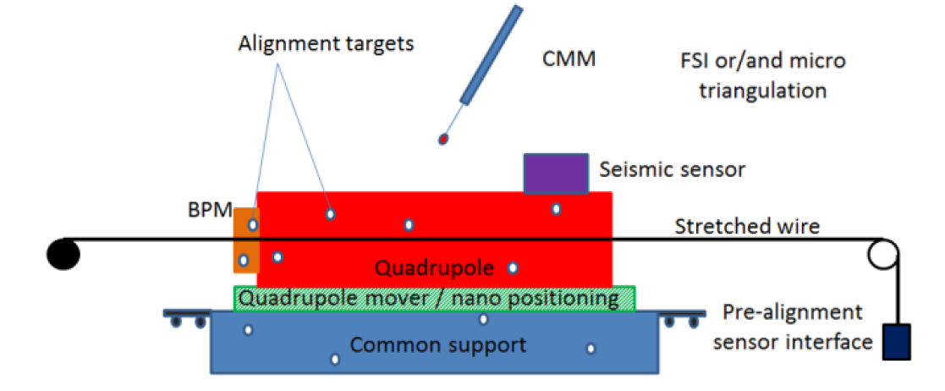
PACMAN alignment strategy
  Amalgamate all the pre-alignment steps at the same time and location.
  Integrate metrology, survey and alignment, nano-positioning, beam instrumentation, magnetic measurements, radio frequency.

