Slide 1


4-Slides Challenge
Silvia Zorzetti

Slide 2















PACMAN CLIC Scientific Project The Team
PACMAN – Marie Curie Action
PACMAN (Particle Accelerator Components Metrology and Alignment to the Nanometer Scale)
Ph.D. training action
The technical goal of the program is to develop very high accuracy metrology and alignment tools to be integrated in a single standalone test bench
Academic and Industrial NETWORK

Slide 3
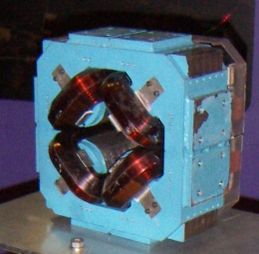
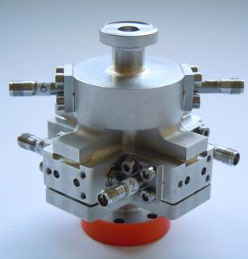
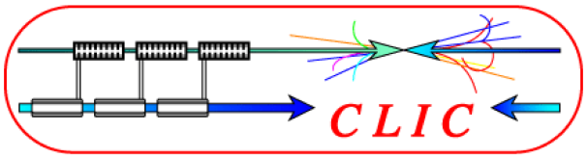
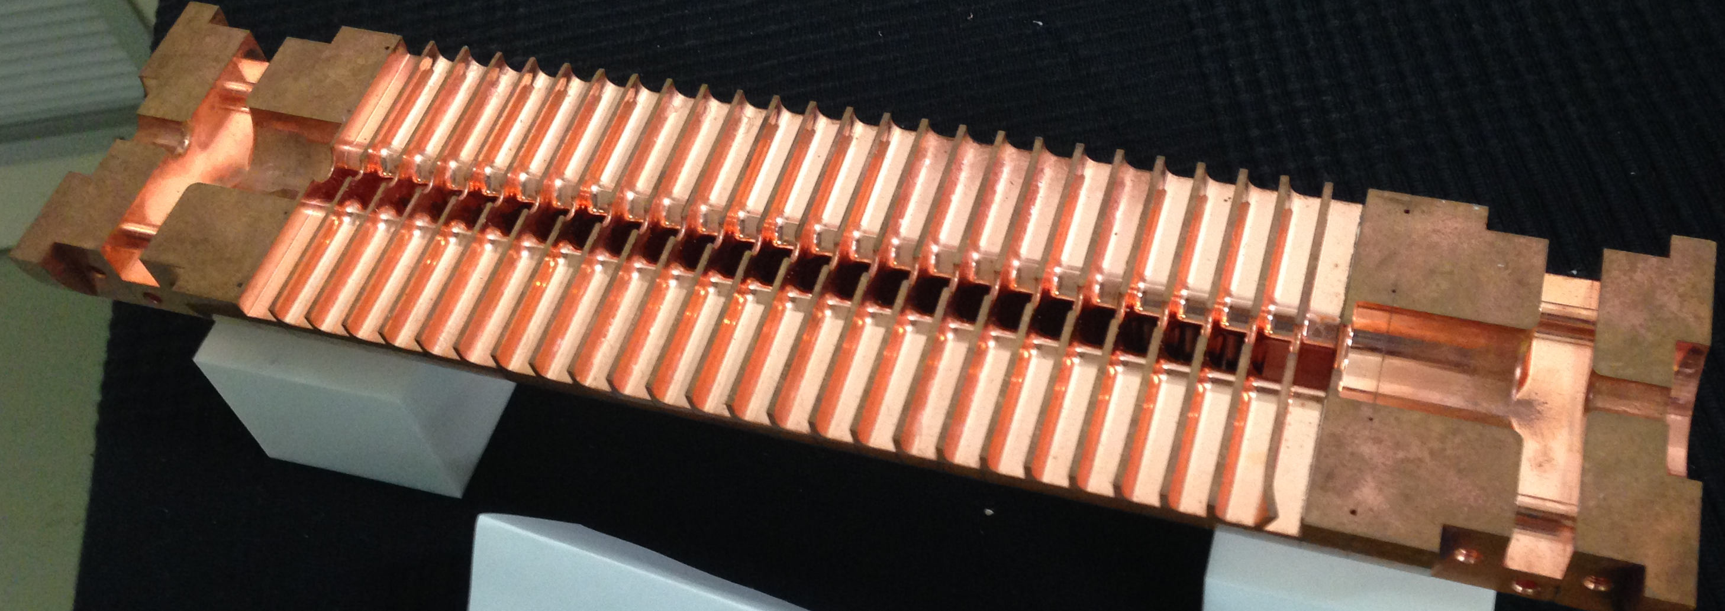
PACMAN CLIC Scientific Project The Team
CLIC – Linear Accelerator
For the future electron/positron linear collider CLIC at CERN, an ultra-low emittance is required to produce a high number of particle collisions (luminosity) at high energy.
Main Beam Quadrupole:
to focus the beam
Main Objective:
To align the CLIC accelerator components in the sub-um regime
Beam Position Monitor - BPM: to detect the beam position
Wakefield monitor - WFM: to measure and minimize wakefields in the accelerating structures and perform a more precise alignment

Slide 4

PACMAN CLIC Scientific Project The Team
Scientific Project
Separately characterize the WFM, the BPM, and the Magnet to investigate innovative high precision and stretched wire measurement methods;
Integrate the Magnet and the BPM in a single stretched wire high precision test bench to align the respective electric and magnetic centers:
  Alignment in the sub-um regime
  Seismic and other sensors to analyse environmental effects
  Improve the resolution to the nm to study the nano-metric displacement of the beam
Measure the position of the wire with respect to external fiducials
  Metrology Equipment
  Coordinate Measuring Machine (CMM)
Multidisciplinary Team

Slide 5
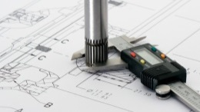
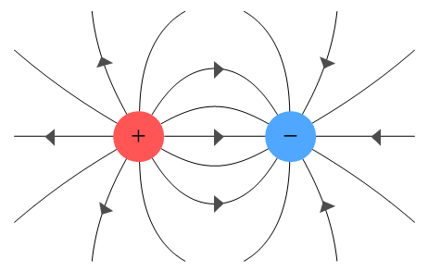




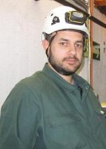




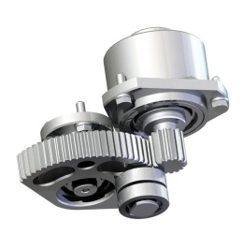


PACMAN CLIC Scientific Project The Team
The PACMAN Team
High Precision Metrology
ESR 1.1 - Claude Sanz
ESR 1.2 - Solomon William Kamungasa
ESR 1.3 - Vasileios Vlachakis
WP 1
WP 2
WP 3
WP 4
High precision RF Measurements
ESR 4.1 - Silvia Zorzetti
ESR 4.2 - Natalia Galindo Munoz
Ultra precise mechanical design
ESR 3.1 - Iordan Doytchinov
ESR 3.2 - Peter Novotny
ESR 3.3 - David Tshilumba
Magnetic Measurements
ESR 2.1 - Domenico Caiazza
ESR 2.2 - Giordana Severino
http://pacman.web.cern.ch/

Slide 6
PACMAN CLIC Scientific Project The Team
ESR 1.1 – CMM
Back

Slide 7
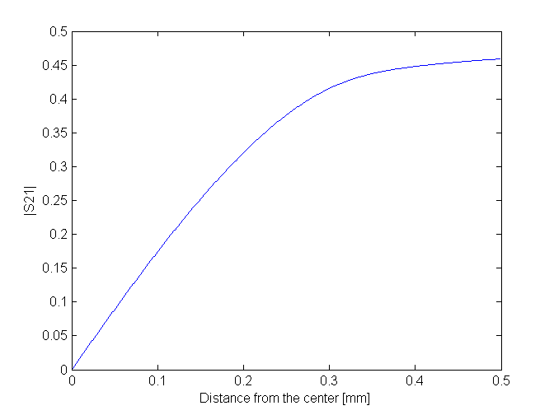
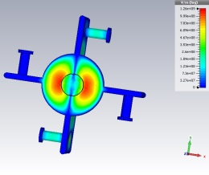
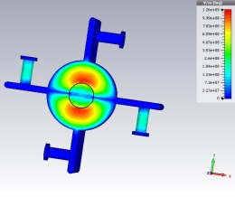
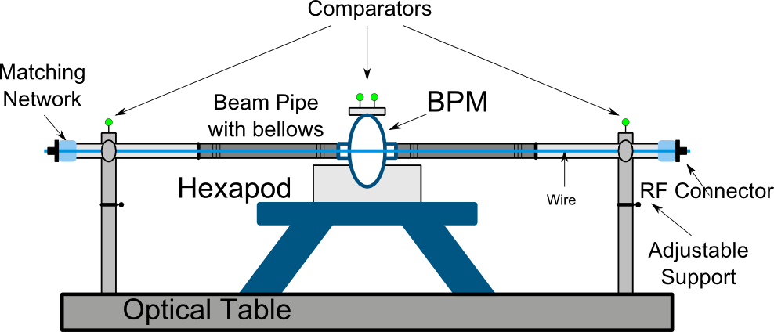
PACMAN CLIC Scientific Project The Team
ESR 4.1 – BPM alignment
The Beam Position Monitor (BPM) is a diagnostic instrument to measure the transverse position of the beam with respect to the vacuum chamber
Position Resolution: the smallest detectable change of the beam position (<50nm)
E-field at 15GHz – TM110 Dipole Mode
BPM Test Bench
Working Principle:
The output voltage is proportional to the position in the so-called linear zone, Dp=0.3mm from the center
Back

Slide 8
PACMAN CLIC Scientific Project The Team
ESR 4.2 – WFM
Back

