Slide 1


















PACMAN
=
a study on Particle Accelerator Components’ Metrology and Alignment to the Nanometer scale
= Innovative Doctoral Training Network
= Marie Curie Initial Training Network
Universities and Research Institutions Partners
Industrial partners

Slide 2
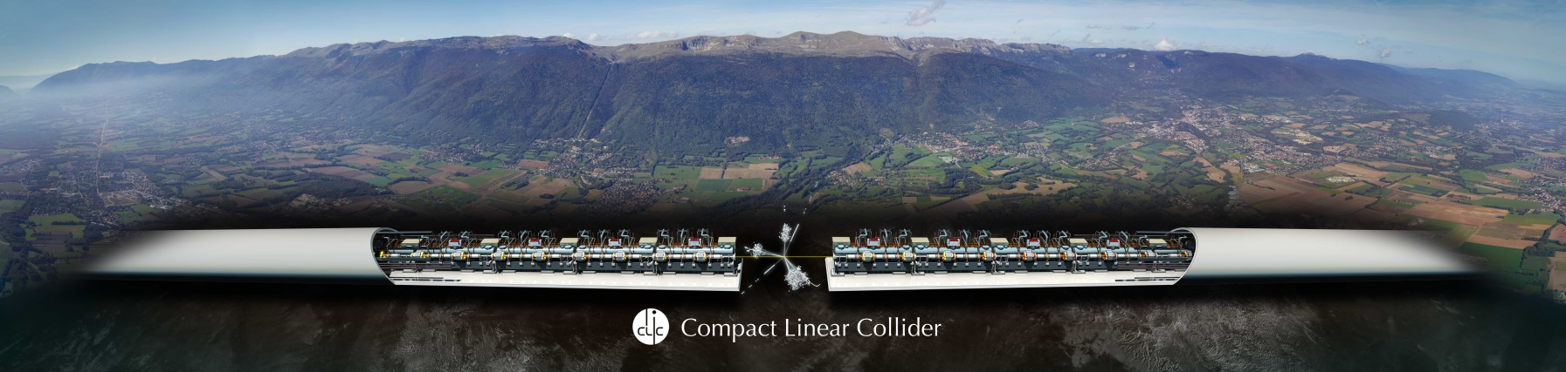
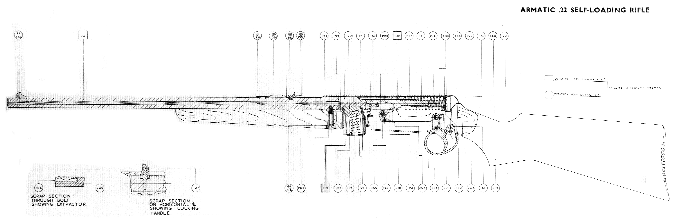
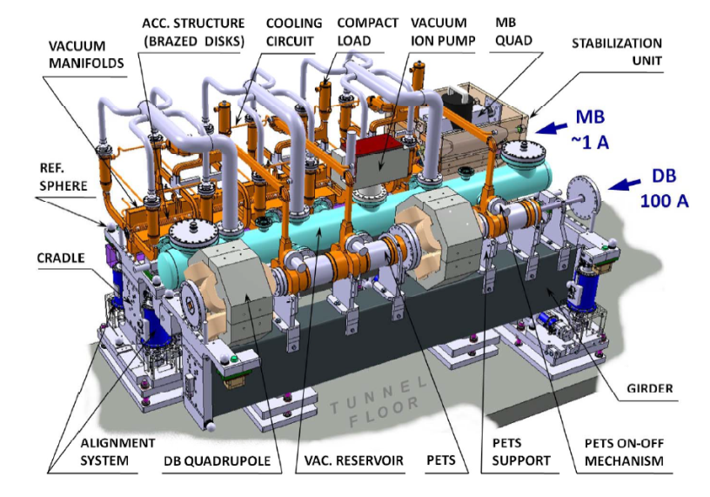
CLIC and how to make it possible?
48.3 km straight line assembly of 2 accelerators “particle guns” shooting at each other
To make it possible (atchive Beam collision at required energy and focus precision):
Each of more 20 000 of ‘2 meter-modules’ to be manufactured and assembled to the highest precision
Each component of those 20 000 modules to be aligned with the uttermost precision
Each critical component of those 2000 to be actively stabilised and guarded from unwanted vibration influences
2 meter section of the Accelerator

Slide 3
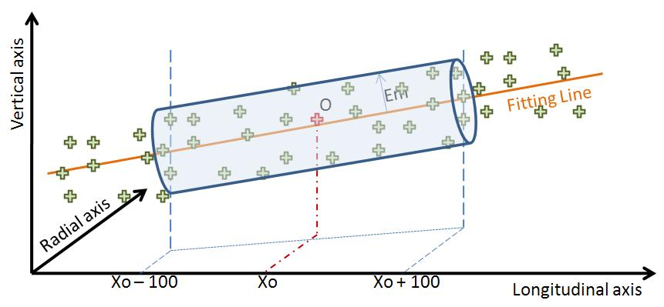

What is the PACMAN challenge?
Never done before. Needed for ~50km future colliders!
17µm
200m
2m
PACMAN Challenge:
Calibrate and pre-align all critical components to allow maximum error of 17µm (diameter of cylinder volume) over 200 meters length of sliding window of assembled components
To answer this challenge:
10 PhD Candidates on 10 R&D areas required for challenge realisation
10 CERN supervisors
Numerous Research, University and Industrial Partners
2 meter section of the Accelerator

Slide 4
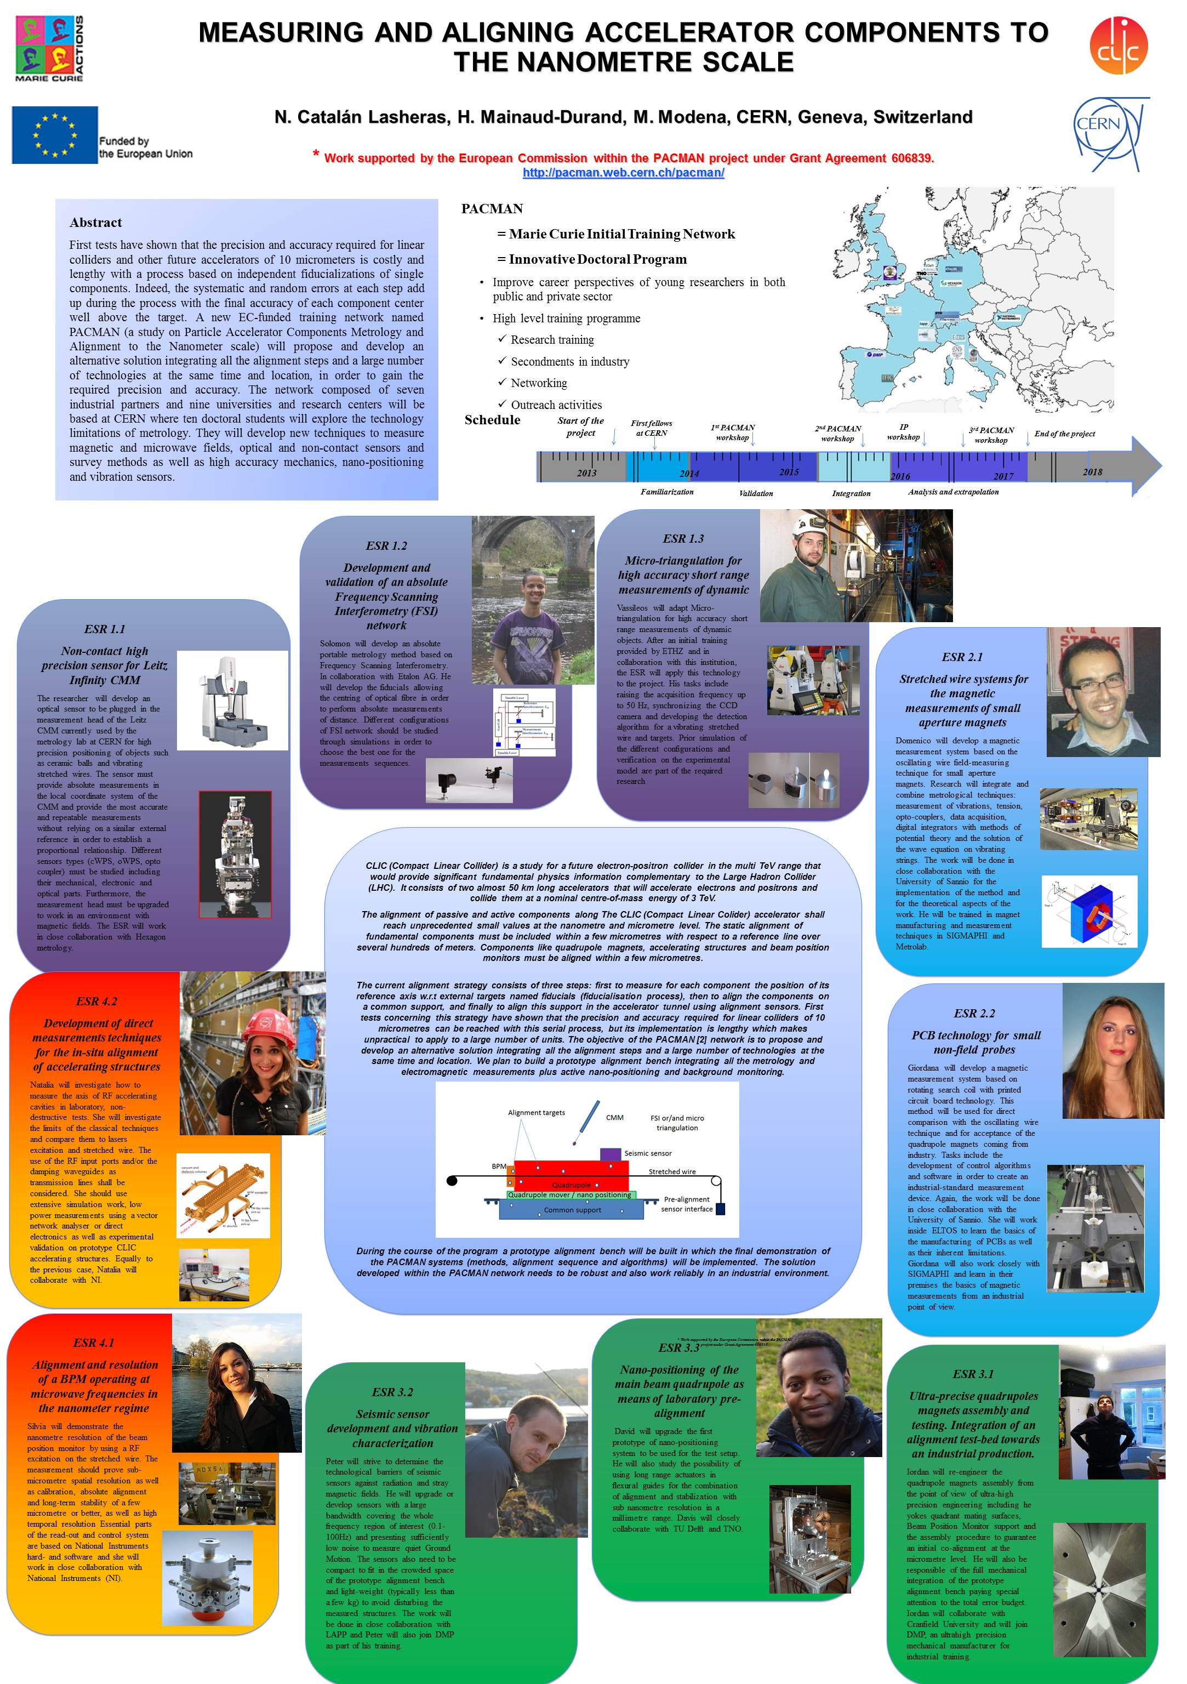
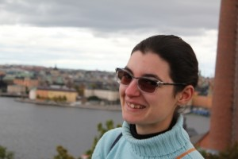


Outcome of Project
10 successful PhD titles and Innovative trainings from the 10 students in their research field
Integrate all 10 research subjects into a common
pre-alignment bench which proves challenge is possible
“If you grasp the principles – myths fall & Ideas take-off” David Lentink (TUDELFT) TED Conference Amsterdam

