Slide 1
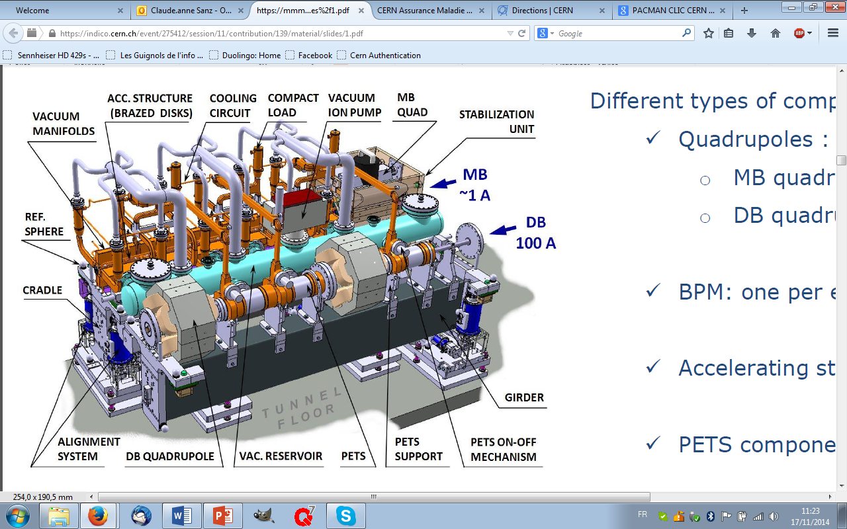

The Compact LInear Collider (CLIC) project
The CLIC is based on a two-beam-acceleration concept: the Drive Beam (DB) brings energy to the Main Beam (MB) which accelerates the particles. To make this operational, the work is distributed in 4 Work Packages (WP):
  WP1: Metrology and alignment to pre-align the elements on the 2m long girder and align them in the tunnel
  WP2: Magnetic measurements to determine the centres of the magnets and the quality of their fields
  WP4: Beam instrumentation to assure the quality of the beam and its boost along the accelerator length
  WP3: Precision mechanics & stabilisation to assemble the different elements and keep them at the right place
Quad: Quadrupole magnet
PETS: Power Extraction and Transfert Structures

Slide 2
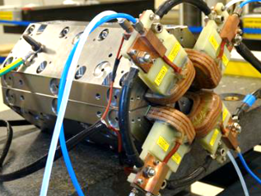
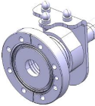
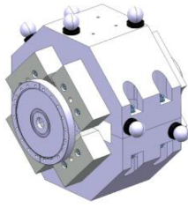
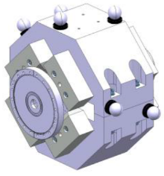
Particle Accelerator Component Metrology and Alignment to the Nanometer scale (PACMAN)
The key point in linear colliders is to get the highest number of particles well focused in the smallest collision point. To achieve this, all the centers of the different elements must be pre-aligned so that they fit within a 200m long cylinder sliding along the CLIC length, with a radius depending on the elements:
MB Quad BPM & RF structure: 14µm
  MB Quad: 17µm
  DB Quad: 20µm
The PACMAN project has been created to reach these requirements improving the state of the art in different fields.
CLIC: Compact Linear Collider
DB: Drive Beam
Quad: Quadrupole magnet
BPM: Beam Position Monitor
MB: Main Beam
RF: Radio Frequency

Slide 3
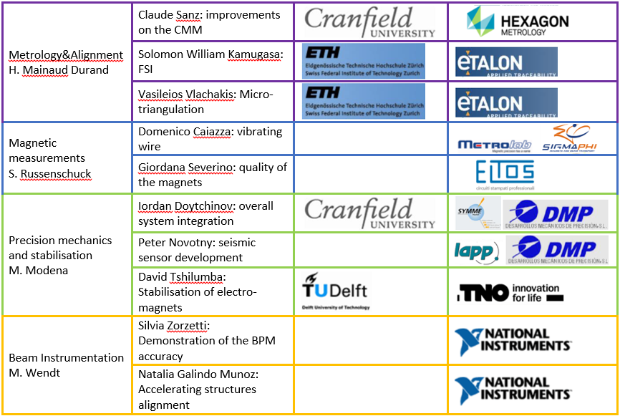
Precision has a name… the PACMAN team
The team is composed by 10 PhD students surpervised by 10 accademical supervisors, 10 supervisors from CERN and supported by 10 compagnies during their secondments.
CMM: Coordinate Measuring Machine
FSI: Frequency Scanning Interferometry
BPM: Beam Position Monitor

Slide 4
Rome was not built in a day… Planning
Particle
Components’
and
to
Alignment
the
Nanometer
scale
Metrology
Accelerator
2014:
  Arrival of the students
  Familiarisation
  First trainings
  Start of the secondments
2015:
  First results
  Validation & Integration
  More trainings
  Secondments
  First workshop
  Conferences
  Becoming a guide in CERN
  Making visits
  Researcher’s night
  PACMAN open days
  PACMAN students working in a common building
2016:
  More results
  Integration & Analysis
  No more training
  End of the secondments
  Second workshop
  More conferences
  Universal ambassador
  Making the last visits
  Researcher’s night
  Exhibitions in schools
  Building of the mock-up
  Women at CERN event
2017:
  Last results
  Analysis & Extrapolation
  Universal ambassador
  End of the PhDs
  Final workshop

