Slide 1





Slide 2


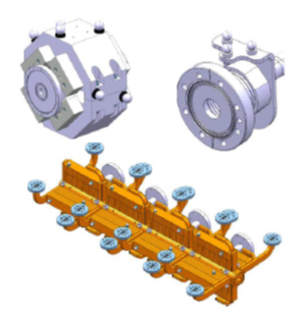
CLIC and Alignment Challenges
CLIC = Compact Linear Collider
Sub-micrometric beam size = challenging alignment tolerances
Alignment tolerances
Final product
Components to be aligned
Improvement and implementation of technologies
Notes:
Red ones has something in common and that is they use mag. principle so might not be good for use in mg. environment

Slide 3
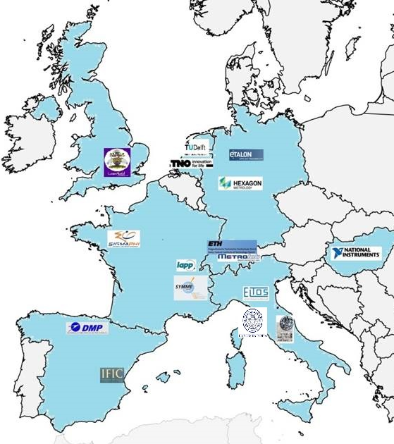
What and who is PACMAN
PACMAN = Initial Training Network supported by EC
With two main goals:
1. Training: Create new generation of scientists
2. Scientific: Automate alignment procedure
Who creates PACMAN?
  10 doctoral students based at CERN
  Their supervisors at CERN and at Universities
  7 industrial partners
Notes:
Red ones has something in common and that is they use mag. principle so might not be good for use in mg. environment

Slide 4
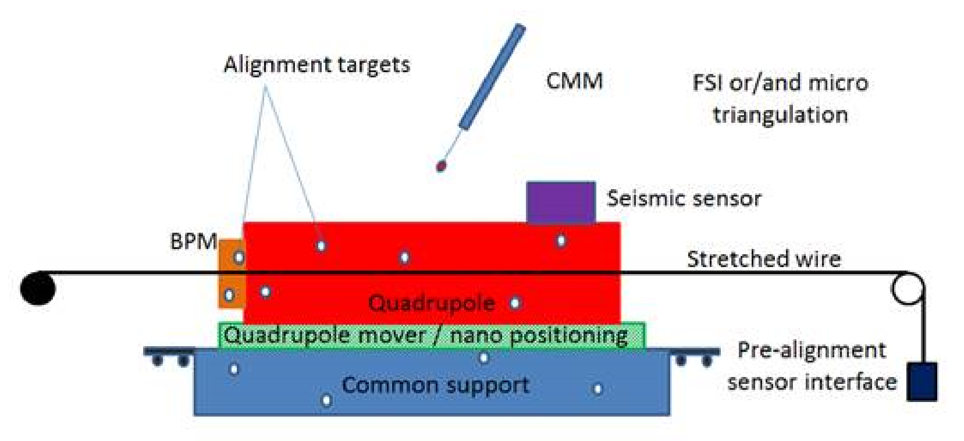
Alignment challenges and PACMAN
PACMAN = Particle Accelerator Components’ Metrology and Alignment to the Nanometre scale
Involved technologies:
  Coordinate Measuring Machine
  Magnetic field measurements
  Microwave field measurement
  Precise assembly
  Nano-positioning
  Vibration measurement
  Micro-triangulation
  Frequency scanning interferometry
  PACMAN = how to combine them into one bench
???
Notes:
Red ones has something in common and that is they use mag. principle so might not be good for use in mg. environment

Slide 5
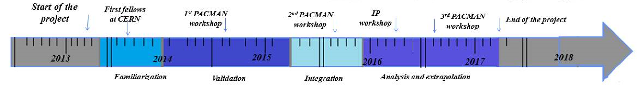
Time Scale and expectations
✓
???
Notes:
Red ones has something in common and that is they use mag. principle so might not be good for use in mg. environment

Slide 6
notes
Use same style
Keep it simple
Notes:
Red ones has something in common and that is they use mag. principle so might not be good for use in mg. environment

