Slide 1










Particle Accelerator Components’ Metrology and Alignment to the Nanometer scale
Program funded by the EU within the Seventh Framework Programme
Goal of the project: training of 10 researchers in beam instrumentation, metrology, micrometric alignment, magnetic measurements, nano-positioning and high precision engineering
A wide academic and industrial network

Slide 2

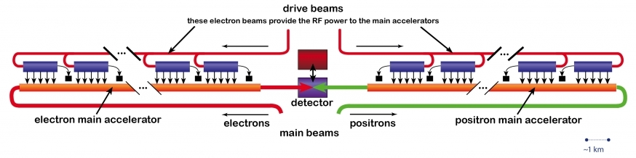
Scientific challenge
Development of very high accuracy metrology and alignment tools for particle accelerators
Integration in a single test stand
Validation on the components of the future Compact Linear Collider
Metrological challenges imposed by CLIC
  Small beam size and impact section (non-hadronic machine: e+/e-): submicron range
  Requires high precision in focusing the beam
Tight specifications on the components (10 μm accuracy over 200 m)
Active stabilization of MB quadrupoles in the nanometer range

Slide 3
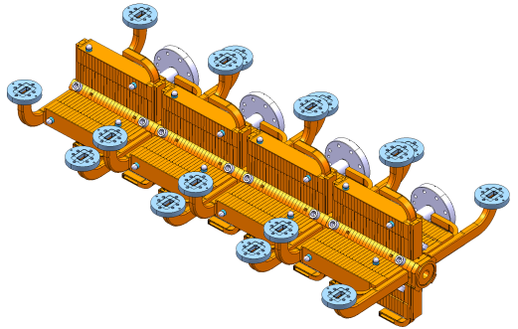
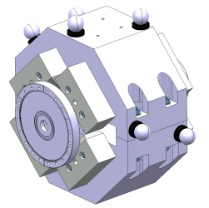
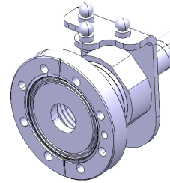
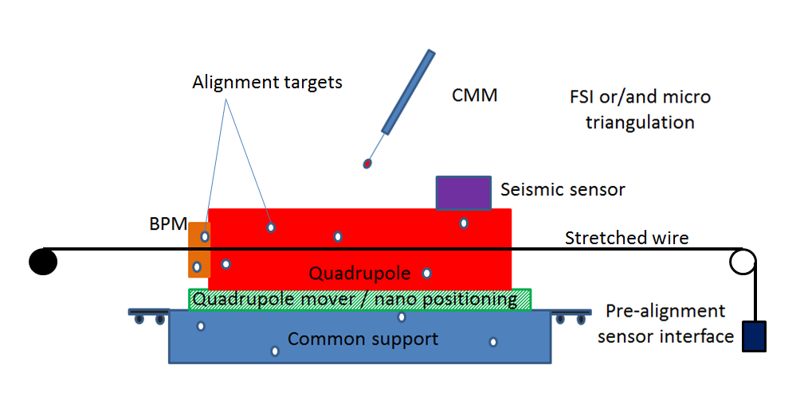
Strategy
Different components to be aligned
  Main quadrupoles, beam position monitor, accelerating structures
A single integrated solution to align at the same time all the components
  improve precision
  optimize the measuring time
Develop separate subsystems and then proceed to integration

Slide 4








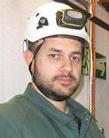

The team
WP1 Metrology & Alignment
H. Mainaud Durand
WP2 Magnetic Measurements
S. Russenschuck
WP3 Precision mech. & stabilization
M. Modena
WP4 Beam Instrumentation
M. Wendt
Claude
Iordan
Solomon
Domenico
Giordana
Peter
Silvia
Natalia
Stretched wire systems
PCB rotating coils
BPM alignment and resolution
Accelerating structures alignment
Vasileios
David
Coordinates Measuring Machine
Frequency Scanning Interferometry
Micro-triangulation
Precise quad assembly and test stand integration
Seismic sensors development
Nano-positioning of main quads

