Slide 1
CLIC Layout update
G. Riddone, D. Schulte, 2008.06.13

Slide 2
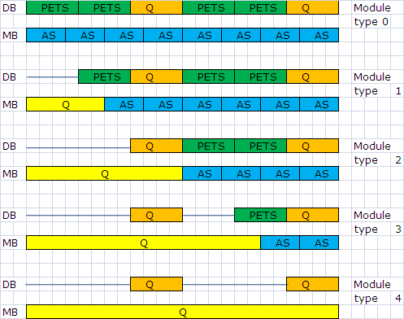
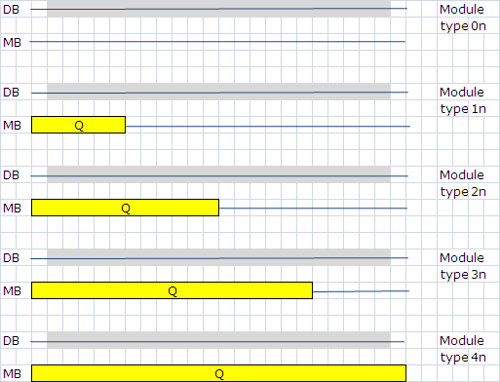
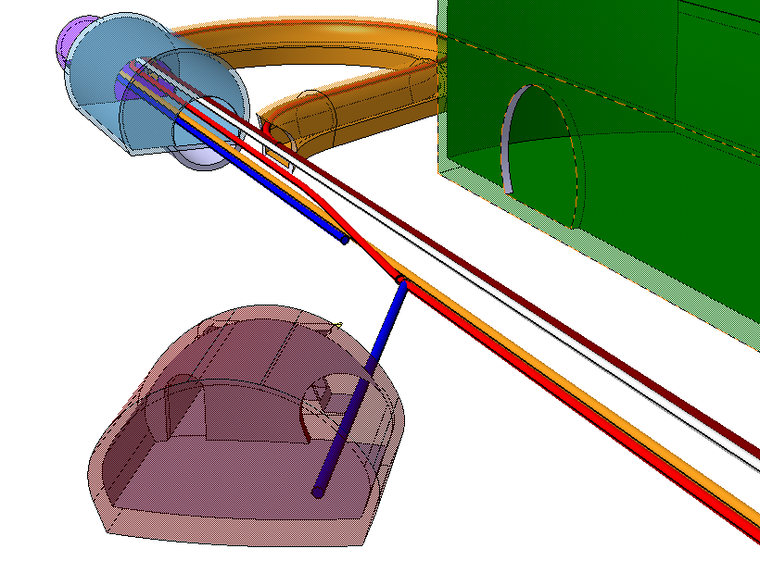
Module types
Module length: 2.010 m
Type xn: in the injection/extraction regions,
4 per extraction region
2

Slide 3
Module main components
Ref. PWG in April 2008 ➔ decision to chose option #2
➔ end of the sector ➔ same state of deceleration

Slide 4
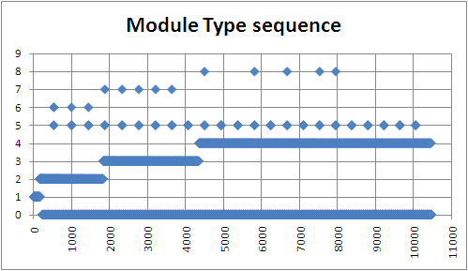
4n
3n
2n
0n

Slide 5
