Slide 1
HL-LHC/LARP:
International Review of the Inner Triplet Quadrupole (MQXF) Design
Executive Committee Report
International Review Committee
held at CERN on 10-12 December, 2014
URL: https://indico.cern.ch/event/354499/timetable/#20141208

Slide 2
Review Committee Members
Joe Minervini (MIT, Co-Chair),
Jim Kerby (ANL),
Shlomo Caspi (LBNL),
Alexander Zlobin (FNAL)
Akira Yamamoto (CERN & KEK, Chair),

Slide 3
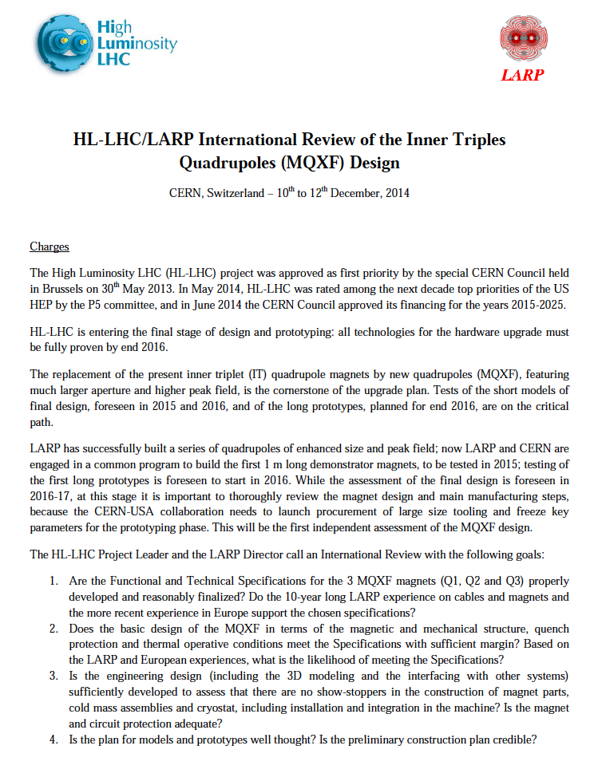
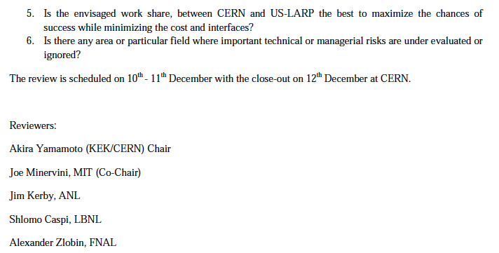
Charges to Inner Triplet (MQXF) Review

Slide 4
Charges to the Review Committee
Are the Functional and Technical Specifications for the 3 MQXF magnets (Q1, Q2 and Q3) properly developed and reasonably finalized? Do the 10-year long LARP experience on cables and magnets and the more recent experience in Europe support the chosen specifications?
Does the basic design of the MQXF in terms of the magnetic and mechanical structure, quench protection and thermal operative conditions meet the Specifications with sufficient margin? Based on the LARP and European experiences, what is the likelihood of meeting the Specifications?
Is the engineering design (including the 3D modeling and the interfacing with other systems) sufficiently developed to assess that there are no show-stoppers in the construction of magnet parts, cold mass assemblies and cryostat, including installation and integration in the machine? Is the magnet and circuit protection adequate?
Is the plan for models and prototypes well thought? Is the preliminary construction plan credible?
Is the envisaged work share, between CERN and US-LARP the best to maximize the chances of success while minimizing the cost and interfaces?
Is there any area or particular field where important technical or managerial risks are under evaluated or ignored?

Slide 5
Agenda: 10-11 December
Prof. Lucio ROSSI et al.
Welcome and review charge
Dr. Ezio TODESCO
MQXF Requirements and conceptual design
Dr. Ezio TODESCO
Feedback from conductor review
Dr. GianLuca SABBI
LARP and other programs' experience
Dr. Helene FELICE
MQXF support structure as extension of LARP experience
Dr. Paolo FERRACIN
MQXF overall design
Dr. Susana IZQUIERDO BERMUDEZ
Magnetic design and analysis
Dr. Miao YU
Coil design and fabrication
Dr. Mariusz JUCHNO
Mechanical design and analysis
Dr. Giorgio AMBROSIO
Quench protection and radiation damage
Dr. Rob VAN WEELDEREN
Cooling and thermal analysis
Dr. Juan Carlos PEREZ
CERN Q2 assembly procedure
Dr. Daniel CHENG
LARP prototypes assembly toward Q1-Q3 magnets
Dr. Herve PRIN
Cold mass, cryostat and integration in the LHC
Dr. Pierre MOYRET
Feedback on MQXFS structure fabrication
Marta BAJKO et al.
Readiness of test stations for design validation
Dr. Giorgio AMBROSIO et al.
Short model and prototype plans

Slide 6
General Comments
Congratulations on an excellent progress achieved in the MQXF design.
We recognize an excellent team work between CERN and US-LARP, and especially the significant contributions by young scientists and engineers to ensure future project success.
The integrated luminosity needs to be maximized. As the MQXF is the hardest magnet to be accessed, this condition needs to be taken into account when defining the magnet operating margins.
We agree the 150mm aperture of MQXF provides space needed for a sufficiently thick beam screen and significantly suppresses the radiation heat load into the magnet.

Slide 7
General Comments (contd)
Both the 11 T and the MQXF programs are critical proofs of Nb3Sn magnet technology for high energy accelerators. We believe that it is very important for these programs to be successful.
Given the current understanding of the design and technology, and the risks associated with the implementation of this design in the LHC Inner Triplets, we recommend as a target an operating point of ~75% on the load line for the production magnets. This may be achieved by extending the magnetic length and reducing the nominal gradient.
The full production magnet should be tested to 105% or higher current of the nominal operational current, in order to demonstrate a reasonable safety margin.
The current Q2A/B magnet design length of about 7m has yet to be demonstrated. We therefore recommend the half-length magnet should be maintained as a backup option.
We commend the CERN and US-LARP teams for the recognition of the need for expanded test facilities needed for this program. It is imperative that they be completed on time.

Slide 8
Responses to Charges (1)
Are the Functional and Technical Specifications for the 3 MQXF magnets (Q1, Q2 and Q3) properly developed and reasonably finalized? Do the 10-year long LARP experience on cables and magnets and the more recent experience in Europe support the chosen specifications?
Not yet, however, the design is converging, based on the excellent long-term cooperative effort between US-LARP and CERN. Some optimization of IR optics and magnet parameters is needed to reduce the risk of magnet production and LHC operation. Magnet acceptance parameters need to be formulated and included in the specs. The interfaces across work packages need to be defined and integrated into the specifications. The LARP experience is being well employed. For the case of component manufacturing tolerances, the committee recommends to take account of the tolerances achieved during the fabrication of the US-LARP HQ magnet which could allow for some relaxation of the tolerances for cost savings.

Slide 9
Responses to Charges (2)
Does the basic design of the MQXF in terms of the magnetic and mechanical structure, quench protection and thermal operative conditions meet the Specifications with sufficient margin? Based on the LARP and European experiences, what is the likelihood of meeting the Specifications?
The Specs are not finalized yet. Further optimization shall be investigated in the short model program to confirm sufficient margin, including: PIT cable has not yet met the I_{c} requirements. The coil cross-section is being corrected for use of PIT cable and cable expansion during reaction needs to be better understood and implemented in coil cross-section design. The coil preload level needs to be coordinated with the ultimate design gradient. The quench protection analysis should include the voltage distribution during quench in the nominal and heater failure scenario, and the cryostat quench protection analysis. The inner-layer and inter-layer heater concepts needs to be critically evaluated including their impact on magnet production and operation risks. The thermal analysis needs to include sensitivity to heat load variation due to uncertainty with beam absorber design and parameters. The likelihood of meeting specifications, when fully developed, is reasonable.

Slide 10
Responses to Charges (3)
Is the engineering design (including the 3D modeling and the interfacing with other systems) sufficiently developed to assess that there are no show-stoppers in the construction of magnet parts, cold mass assemblies and cryostat, including installation and integration in the machine? Is the magnet and circuit protection adequate?
The design is sufficiently developed for this stage of the project, and there is considerable experience to draw on to develop it further. That said, we were limited in our scope largely to the magnet work package and the interfaces to other work packages need to be further developed. The procedure of the magnet replacement under high radiation environment, including fixtures, tools, and remote handling and transportation, should be well established in the design stage. Overall safety issues with respect to design and inspection should be confirmed as soon as possible. Development of alignment specifications and the overall scheme was not covered in detail at this review but should start soon. Magnet quench protection has sufficient redundancy level taking into account traditional protection heaters and CLIQ.

Slide 11
Responses to Charges (4)
Is the plan for models and prototypes well thought? Is the preliminary construction plan credible?
Yes, but some aspects need improvement. The number of planned models and tests is minimal. (For comparison, both MQXA and MQXB model programs each included 3 magnets just to confirm reproducibility.) In this situation each model in the MQXF program should have clear list of design and performance goals. The two full scale prototype program looks adequate. The availability of PIT that meets the requirements may require more time to be ready for magnet production. The current schedule is extremely tight in order to install the MQXF in the LS3 (No failures are assumed in the model work.) Contingency plans need to be developed to hold the schedule.

Slide 12
Responses to Charges (5)
Is the envisaged work share, between CERN and US-LARP the best to maximize the chances of success while minimizing the cost and interfaces?
The work sharing and cooperation between CERN and US-LARP are exemplary. We note that the cooperative work and the close communication are enhanced by current IT technology that maximizes work efficiency. Design credibility is enhanced by using common tools by each side, especially in magnetic and structural design and analysis, thermal modeling, powering, and quench protection. CERN and US-LARP have many excellent resources and they seem well integrated, enthusiastic, and organized to carry out this upgrade project. We are very pleased to see many young scientist/engineers involved in this project with an extremely good atmosphere.

Slide 13
Responses to Charges (6)
Is there any area or particular field where important technical or managerial risks are under evaluated or ignored?
Evaluation of the overall failure mode scenario is missing, but should not be ignored. The time-period and work-flow sequence should be well established especially because the MQXF is not easily replaced under the high-radiation and confined environment in the tunnel. The loss of integrated luminosity should be well studied and the information shared among the relevant persons. Technical risks can be minimized by focusing on these issues: Magnet operation margin and ultimate acceptance plan Beam screen design and integration with quadrupoles Necessity of coil cross-section change for the US quadrupoles based on RRP cable Use of PIT conductor in CERN quadrupoles Inner-layer protection heaters and their effect on coil cooling. Safety requirements. Management risks can be minimized by focusing on these issues: Improving the design decision process and responsibilities within the WP and among related WPs.

Slide 14

Many thanks for your excellent reports, discussions, and
the opportunity for the MQXF review.

