Slide 1
OUTPUT OF THE CABLE REVIEW
CERN, 10th December 2014
QXF design review, CERN
E. Todesco and the QXF team
CERN, Geneva Switzerland

Slide 2
CONTENTS
Report
Actions on critical current
Actions on margin
Actions on cable size

Slide 3
REPORT
Introduction
Critical and important project; unique opportunity to make higher performance, space effective accelerator magnets using Nb₃Sn
Enthusiastic transatlantic team, bringing a new generation
Good communication between Hi-Lumi and LARP
Great recent progress
It has to move from an R&D effort to a construction project!

Slide 4
REPORT
Overall/schedule - 1
Design goals shall be conservative because Nb₃Sn accelerator magnet technology is still not sufficiently matured and impregnated Nb₃Sn coils operated at 1.9 K are prone to self-field instabilities
Therefore: optimize margin by all means, such as: increasing length, revisiting Cu-to-non-Cu ratio, and so on.
Make use of model/prototype phase for finalizing specifications essential for success, including of acceptance criteria

Slide 5
REPORT
Overall/schedule - 2
Keep 2 strand suppliers; if one supplier has less maturity, it will require more resources
Schedule is challenging; there should be some clearly defined articulations and decision points between the phases
Address plan B

Slide 6
REPORT
Technical specs: Not complete at this time
Relationship of superconductor properties to magnet performance has not been clearly defined
Add requirement on strand cleanliness and surface conditions (especially for bare copper strands)
Clarify billet/unit length approval
Benefit from model/prototype program to confirm that the following specs are correct:
  - strand I_{c}: 361 A at 4.2 K and 15 T
  -RRR: 150 on virgin strand/100 on extracted strand
Address R_{a} and R_{c} on cable

Slide 7
REPORT
RRP
Go ahead with 132/169 lower Sn content; final decision in one year concerning series production contract (back up being 108/127)
Consider proposal to reduce keystone angle
PIT
Promote a substantive development program with BEAS to optimize strand properties and establish performance baseline for series production
In the meantime, CERN should go ahead with RRP for model magnet production and should optimize phasing of strand/cable deliveries between RRP and PIT.
Reduced keystone angle is a must

Slide 8
REPORT
Conclusion
1. Are the Functional or Technical Specification for conductor strand and cable adequate to the scope of the MQXF ?
Incomplete
Are they sufficiently developed and reasonably finalized ?
Incomplete
2. Does the design of strand and cable meet the specifications in terms of minimum Ic, maximum allowed degradation, minimum RRR, maximum Deff, stability request, cable size, and unit length ?
I_{C} and minimum RRR have to be revisited
D_{eff} is not critical around 50 μm

Slide 9
REPORT
Assess the likelihood of meeting – with adequate margin – the chosen specifications and requirements based on the decade long experience acquired by LARP in cables and magnet construction and the most recent experience in Europe.
Very optimistic, needs more optimization
4. Is the plan for two types of strand architecture (RRP and PIT) correctly managed inside the program?
PIT needs more support
5. Is the procurement schedule, with associated QA and test plan, credible and adequate for the prototyping phase (where applicable) and for the construction phase?
No yet, need to better articulate the different project phases and the decision points

Slide 10
Critical current
First major point: the critical current is not there
  Specifications are not met – further optimization should be done
  We are >5% lower, I guess (340 A looks confortable)
Ic vs RRR for 132/169 RRP strand [A. Ghosh]

Slide 11
Critical current
First major point: the critical current is not there
  Specifications are not met – further optimization should be done
  We are >5% lower, I guess (340 A looks confortable)
Reduced Tin
Nb/Sn=3.6
Ic for 132/169 RRP strand [B. Bordini]

Slide 12
Critical current
Possible actions: change heat treatment
  Best solution, no change of strand layout, no impact on protection ☺
Change of heat treatment for RRP to increase
critical current [B. Bordini]
Ic vs RRR for 132/169 RRP strand [A. Ghosh]

Slide 13
Critical current
Possible actions: decrease the copper ratio to 1.1
  To recover 5% one has to reduce from 1.2 to 1.1 – impact on protection small (6-7 K in hotspot), small change of layout :-/
Engineering current density vs Cu/ no Cu ratio

Slide 14
Critical current
Possible actions: increase filament size
  i.e. go to 108/127 – this is possible from the point of view of field quality, but
    Change of layout is not favourite option ☹
    No guarantee of getting more current

Slide 15
Critical current
Possible actions: accept the reduction of spec
  Decrease from 361 to 340 A
    Surrender … ☹ ☹
    Loss of 1.5% precious margin (from 80% to 81.5% on the loadline)
Short sample gradient vs Cu/ no Cu ratio

Slide 16
MARGIN
Second major point: margin
  Review of LARP results gives some optimism that this margin can be met [G. L. Sabbi talk]
But (my point of view)
  Working at 80% on the loadline we take unnecessary risks for the first or second massive (more than 100 m of magnets) application of Nb₃Sn to accelerator
    In the triplet we can increase the length, and the risk reduction is strong
  Replacement of a magnet requires at least 6 months
Possible solution: increase 5% the length: from 4 to 4.2 m for the Q1/Q3 magnets and from 6.8 to 7.15 m for Q2a/Q2b
    This brings the operational point from 80% to ∼75%, with limited performance loss
    Impact on cost, and limits from the test station

Slide 17
MARGIN
Second major point: margim - reviewers asked to consider plan B in case of major problems
Mechanical structure allows easy replacement of limiting coils [G. Ambrosio talk]
  Already done in LARP, requires more coils
  Plan is already assuming 25% limiting coils (5 coils to make one quadrupole)
  Risk reduction factor: early test to intercept problems before final assembly
Mixed magnets option not wise
  Solution with Nb-Ti and Nb₃Sn entails large loss of performance …
  … and a huge overhaed of fully developing another very long Nb-Ti magnet

Slide 18
MARGIN
Others solutions look less viable
  Example 1: decrease copper – to get 5% more margin you need to lower from 1.2 to 0.8 – non negligible impact on quench protection, which is already tigth
Engineering current density and short sample gradient vs Cu/ no Cu ratio

Slide 19
MARGIN
Others solutions look less viable
  Example 2: increase current density (already not there) – ∼20% more needed to get 5% more margin
short sample gradient vs engineering current density

Slide 20
MARGIN
Others solutions look less viable
  Example 3: increase cable width
    We are at 40 strands, limit for CERN cabling machine, so this would imply go to larger strands (0.9 to 1 mm diameter) – major change
    Moreover, to get 5% more we would need 46 mm width (,three layers +30% cable cost)
short sample gradient vs coil width

Slide 21
CABLE sIZE
There is some evidence that a fine tuning of the cable dimension provides less degradation (jc and RRR)
  Mainly for PIT, could beneficial for RRP
  Proposal to reduce keystone angle from 0.65° to 0.4°
  Minimal impact on cross-section, but a new cross-section
  Reduction of the risk associated to degradation due to cabling
Overhead
  Coils are already being fabricated, but no test done yet
  If we go now with the fine tuning, we lose one/two model for statistics of reproducibility
    Or better, we lose the statistic on b₆, but not on a₃, b₃, a₄, b₄, which are the most worrying
  Otherwise we wait for the end of the model, get statistic, and make fine tuning for the production

Slide 22
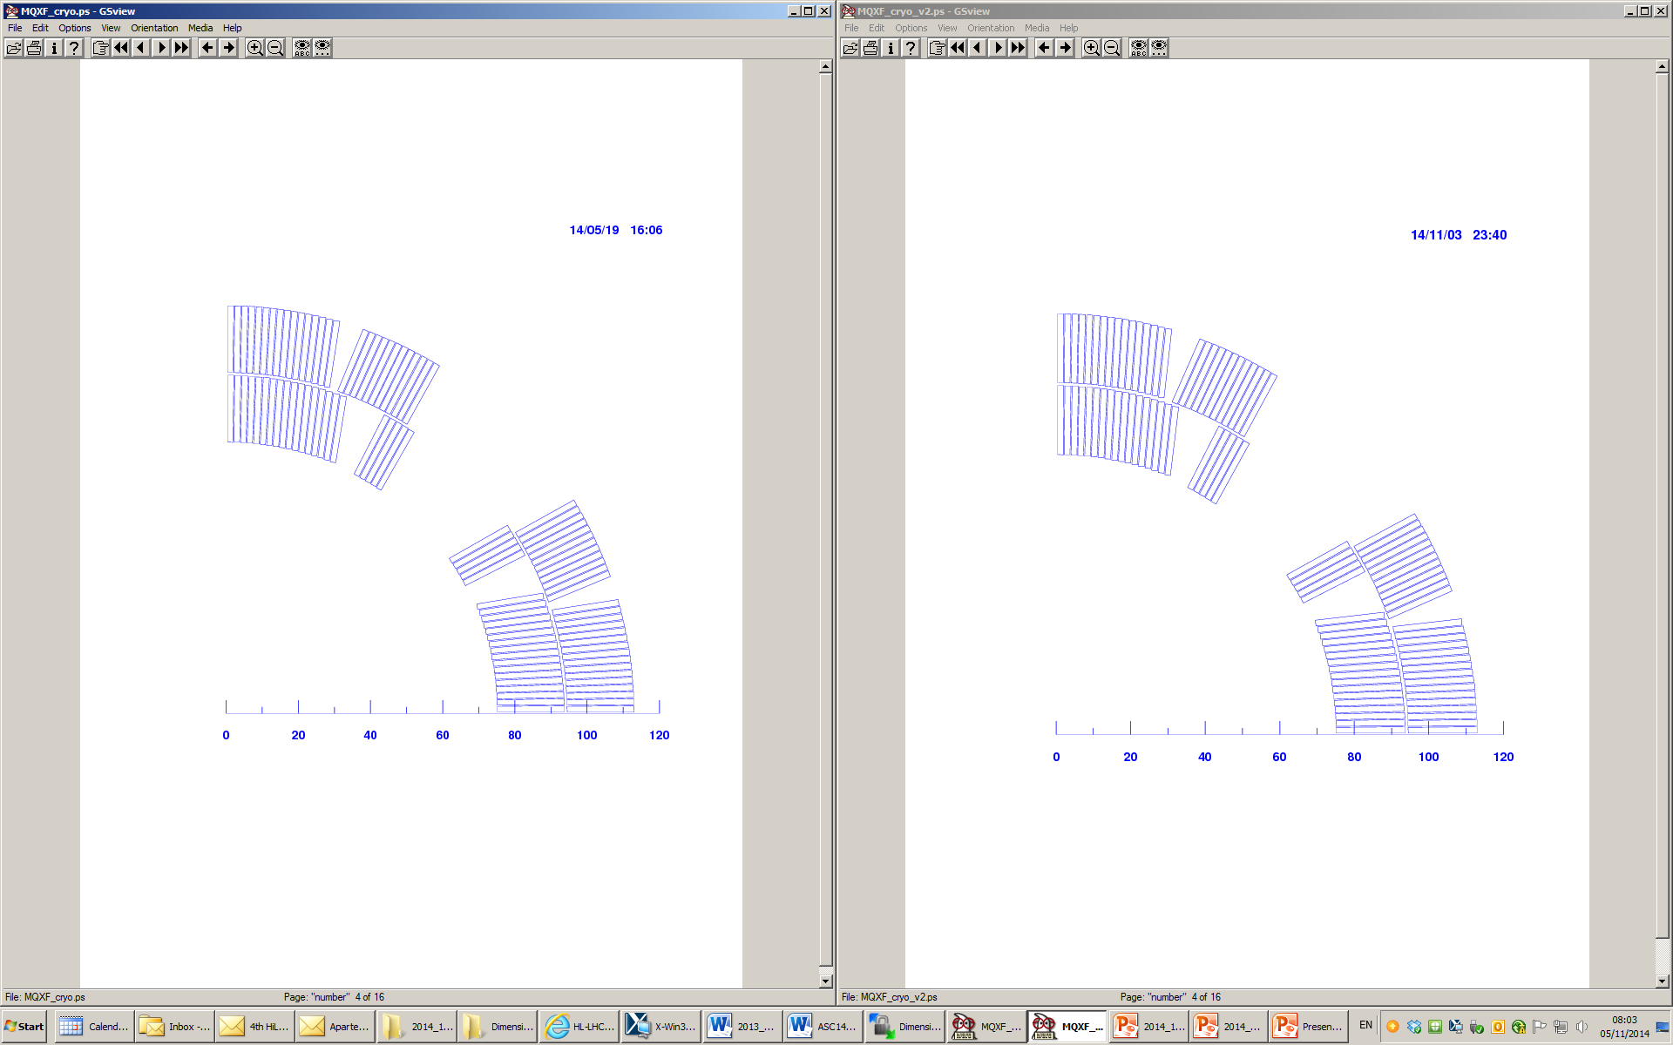
CABLE sIZE
I would call this a fine tuning, not a change of cross-section
Baseline cross-section (0.65° keystone angle cable)
Possibl fine tuning (0.4° keystone angle cable)

Slide 23
CONCLUSIONS
Critical issues seen by the review
  Current density not there
  Margin too optimist
Actions to improve current density
  Guideline: keep the spec and try to get there
  Actions (heat treatment and/or increase copper) in 2015
Actions to improve margin
  To be discussed in this review (longer magnet?)
  Decision to be taken in January 2015
Advice to minimize risk on RRR
  Fine tuning on cable dimension
  Decision to be taken in January 2015 (after more data and feedback of US colleagues on impact of change for the RRP)

