Slide 1

Magnetic design
Susana Izquierdo Bermudez for the QXF team
Acknowledgements: G. Ambrosio, P. Ferracin, P. Hagen, M. Juchno, G. L. Sabbi, E. Todesco, X. Wang

Slide 2
Contents
Introduction
Magnet parameters
Coil cross section
Iron saturation
Manufacturing tolerances
Magnetic shimming
  Coil shimming
  Passive shimming with ferromagnetic material
Persistent currents
Eddy currents
Coil deformation during powering
3D effects:
  Field in the coil
  Integrated field harmonics
  Magnetic and physical lengths
Summary

Slide 3
Introduction
Magnetic design and field quality targets
(from E. Todesco talk):
Large difference between injection and top energy
  At injection the triplet is nearly transparent to the beam → loose requirements of ∼ 10 units
  At top energy the LHC becomes the triplet → tight requirements of ∼ 1 units
Consequences on magnet design
  Large tolerance on persistent currents (∼20 units)
  Tight control of saturation
  The most critical components are random (b₃, a₃, b₄, a₄) associated to the coil asymmetry

Slide 4
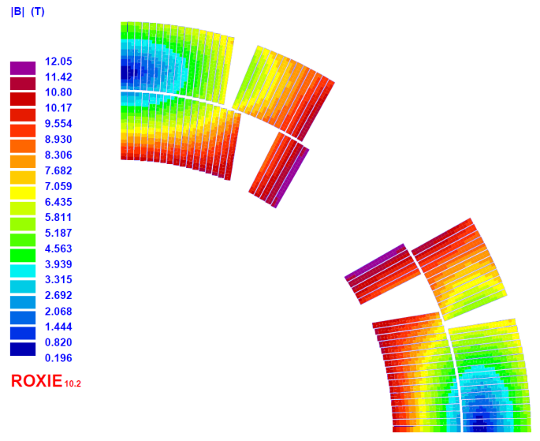
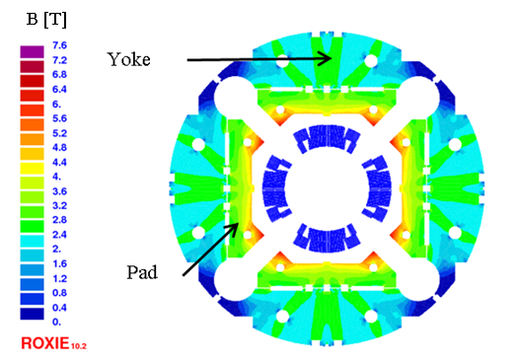
Magnet parameters
Parameters |  | Units
Operational temperature | 1.9 | K
Clear aperture diameter | 150 | mm
Nominal gradient | 140 | T/m
Nominal current | 17.46 | kA
Nominal peak field on the coil | 12.1 | T
Stored energy at I_{nom} | 1.32 | MJ/m
Temperature margin | 4.5 | K
Differential inductance at I_{nom} | 8.22 | mH/m
Superconductor current density (j_{sc}) | 1635 | A/mm²
Engineering current density (j_{eng}) | 770 | A/mm²
Overall current density at (j_{overall}) | 490 | A/mm²
Forces x | 2.64 | MN/m
Forces y | -3.88 | MN/m
B [T]
Yoke
The magnetic structure is made out of two parts, the “pad” and the “yoke”. Details will be addressed [M. Juchno].
Pad

Slide 5
Coil Cross Section
Criteria for the selection
  Maximize gradient and # of turns (protection)
  Distribute e.m. forces and minimize stress
[F. Borgnolutti]
Magnetic design optimization of a 150 mm aperture Nb3Sn low-beta quadrupole for the HiLumi LHC. IEEE Trans. Appl. Sup., vol. 24, no. 3, 2014.
All harmonics below 1 units at R_{ref} = 50 mm
Field harmonics computed assuming the conductor is aligned in the outer diameter.
Units at Rref = 50 mm | Conductors aligned in the winding mandrel | Conductors aligned in the outer diameter
b6 | -1.13 | 0.32
b10 | -0.98 | -0.40
b14 | -0.65 | -0.67
b18 | -0.26 | -0.28

Slide 6
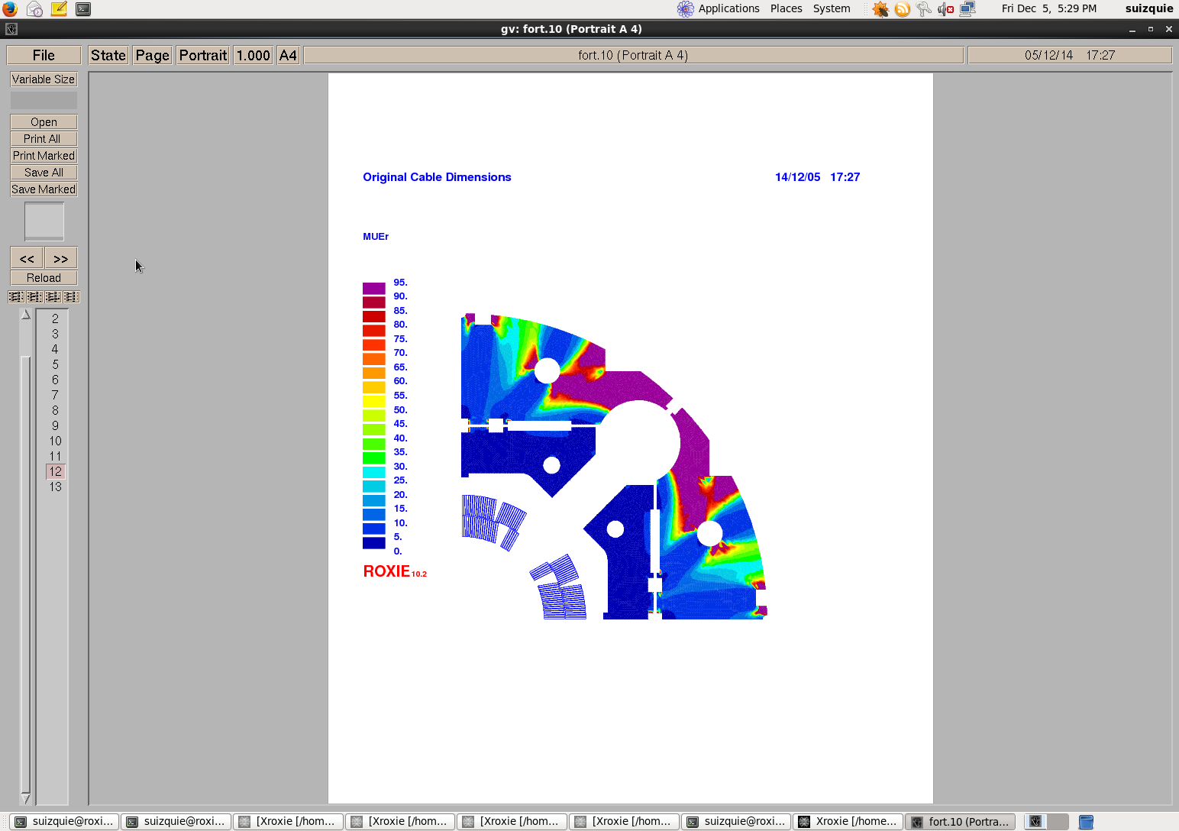
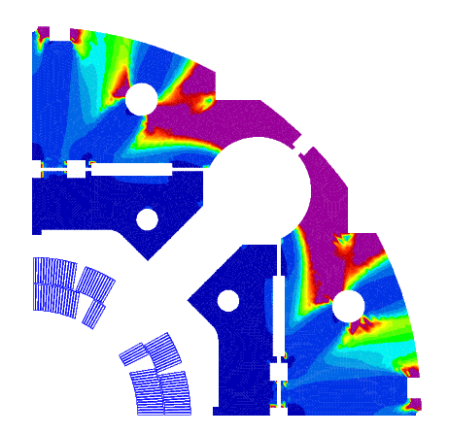
Iron saturation
  Important impact of the iron saturation in the transfer function and b₆
  All field quality optimized at top field (7 TeV)
  Going to 6.5 TeV we add a fraction of unit of b6
  Having 10% less on the top of this (ABP request) would give a 1 systematic unit of b6
  Optimization at 6.5 TeV instead of 7 TeV new guideline (November 14)
Allowed harmonics
(Only geometric + Iron saturation effects)
Transfer function
(Only geometric + Iron saturation effects)
7 TeV
6.5 TeV
90 % 6.5 TeV

Slide 7
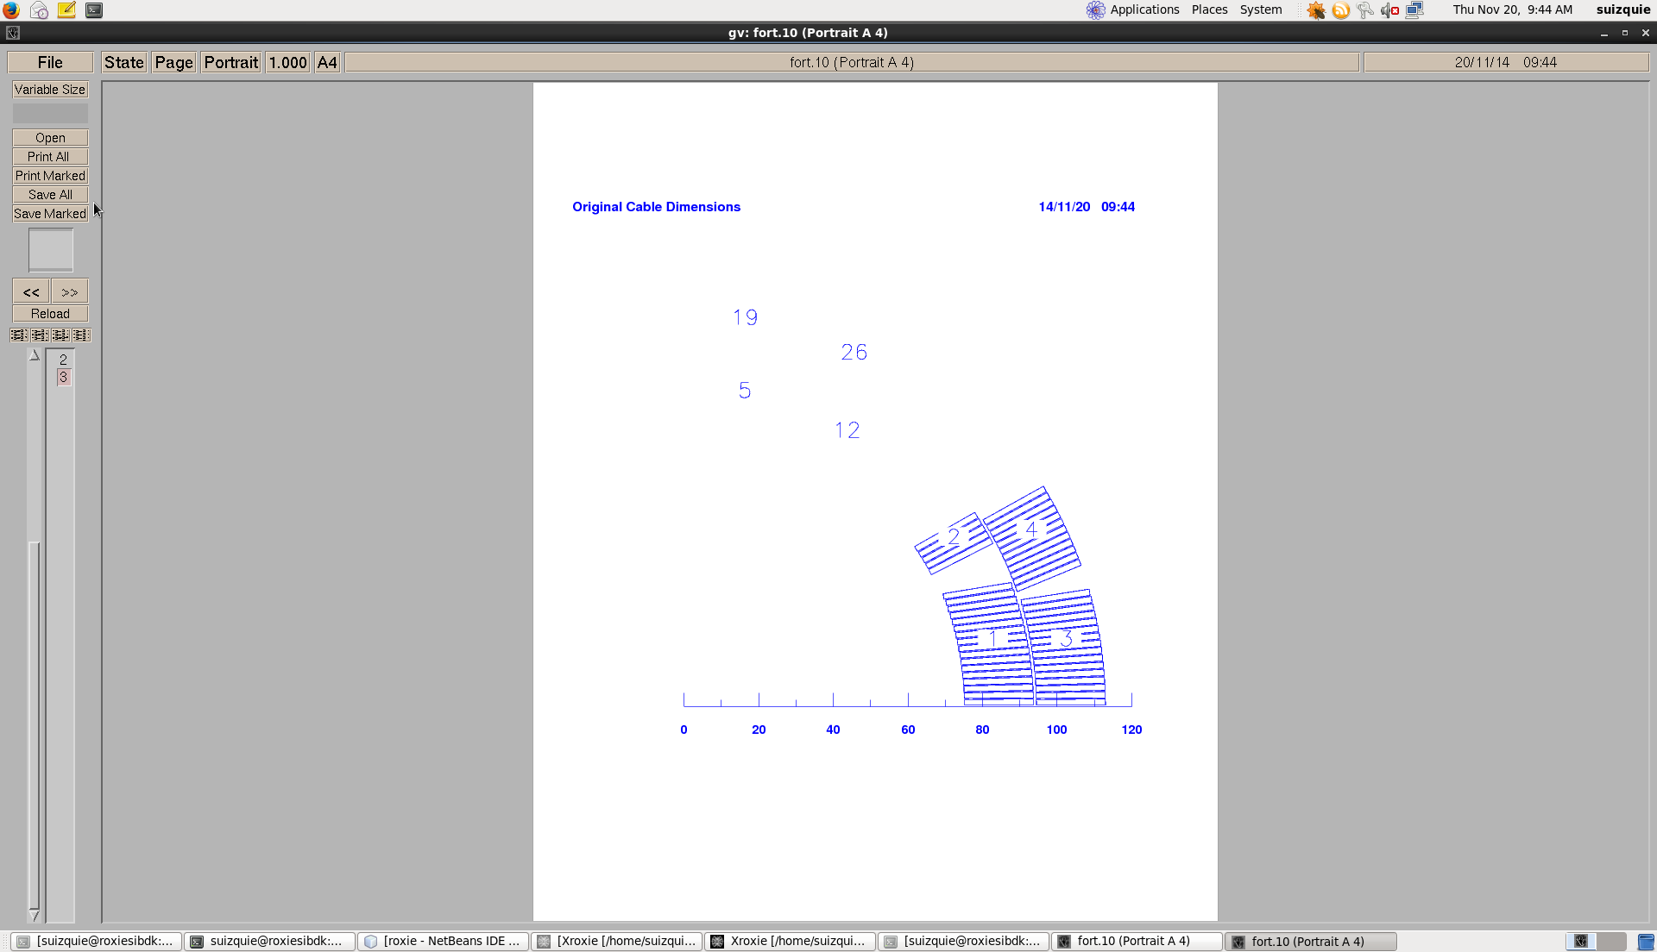
Manufacturing tolerances
30 µm tolerances on blocks position
The amplitude of the allowed multipoles have been increased based on the experience from LHC.
α₂
r₂
φ₂
RANDOM COMPONET
Order | Normal | Skew
3 | 0.82 | 0.80
4 | 0.57 | 0.65
5 | 0.42 | 0.43
6 | 1.10 | 0.31
7 | 0.19 | 0.19
8 | 0.13 | 0.11
9 | 0.07 | 0.08

Slide 8
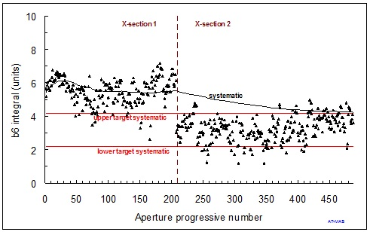
Magnetic shimming
Two main aspects to worry about:
Having a 1 units tolerance on b₆, one could need one fine tuning after the construction of the first models - possibility of changing b₆ by 3 units is requested - this can be done through coil shimming.
But, we have a small production, so the change should be made at a very early stage, and once only.
Intervention on the Main Quadrupoles cross section during LHC production
The size of non allowed multipoles (a₃, b₃, a₄, b₄)
  This parameter is difficult to estimate.
  (you need an homogeneous set of few magnets)
  First data HQ shows we are a factor two-three off
    Similar results on the first MQXC Nb-Ti magnet (no it is not specific to Nb3Sn technology)
    Good result considering we are on a short model, first iteration
  Plan B: passive shimming with ferromagnetic material

Slide 9
Coil shimming
Possibility of changing b₆ by 3 units is requested.
Using a 100 µm shim, we can correct up to 4 units without impact on the coil compaction.
The impact on b₁₀ is less than 1 unit.
+100 µm Mid plane IL
-100 µm Pole IL
Δb₆ = -3.4
+100 µm Pole IL
-100 µm Mid plane IL
Δb₆ = 3.1
+100 µm Mid plane OL
-100 µm Pole OL
Δb₆ = -1.0
+100 µm Pole OL
-100 µm Mid plane OL
Δb₆ = 1.1

Slide 10
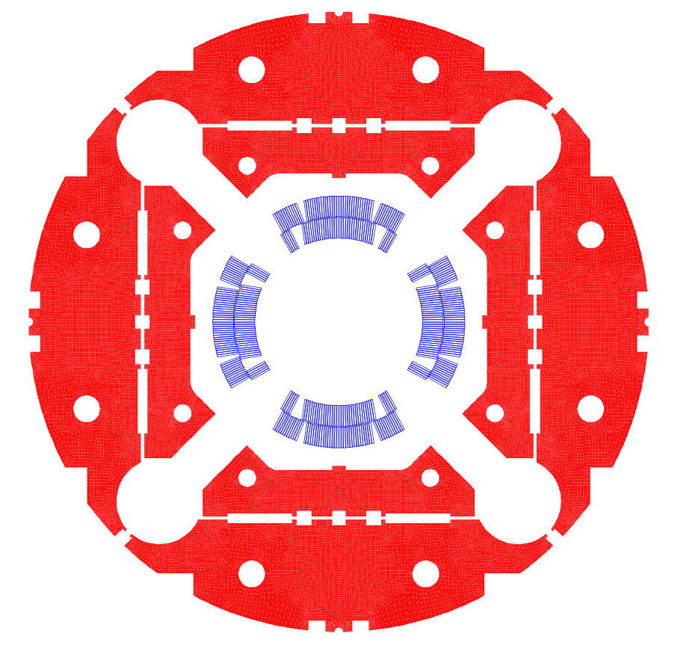
Ferromagnetic shims
In order to correct the non allowed multipoles (a₃, b₃, a₄, b₄) three families of shims have been explored:
Rods in the collars. Not interesting because the iron strongly saturates, they are transparent.
Shims in the bladder slots, very interesting.
Shims in the yoke slots. They are too far from the coil to act.
[P. Hagen]

Slide 11
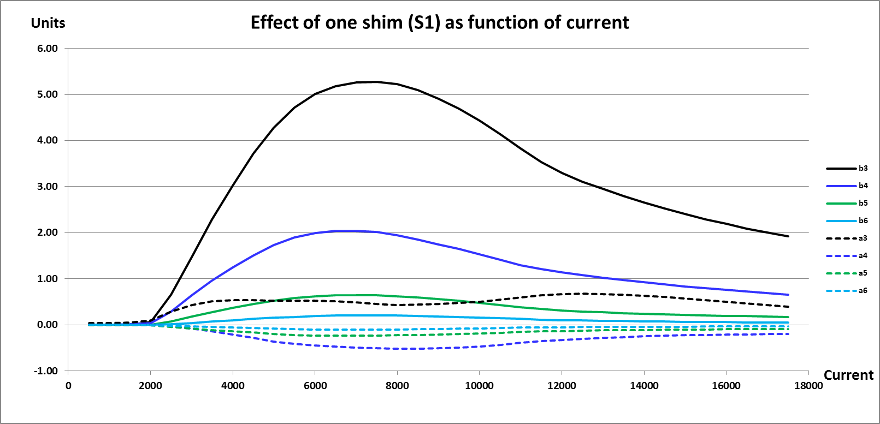

Ferromagnetic shims
Different shim configuration in the bladders slots allow us to correct up to
    ±5 units of b₃ and a₃
    ±3 units of b₄
    ±1 units of a₄
  Fine tuning is possible:
  Changing the size of the shim
  Varying the permeability of the shims along the Z-axis
Example of the impact of one shim placed in the bladder slot
[P. Hagen]

Slide 12
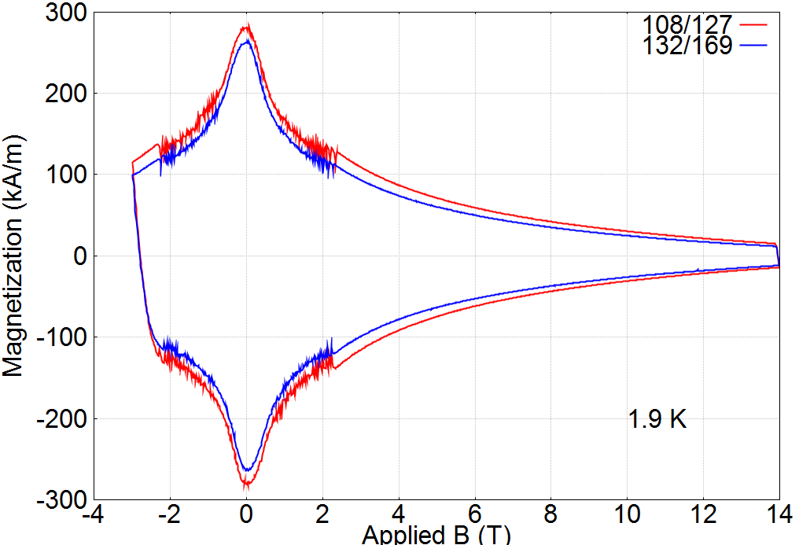
Persistent Currents
Estimates using magnetization measurements of actual QXF 169 wires performed at Ohio State University
Harmonics are provided for second up-ramp following a pre-cycle corresponding to the one used for strand measurements
Measured magnetization (OSU)
Calculated b₆ (after pre-cycle)
[X. Wang]

Slide 13
Persistent Currents
Persistent current harmonics | b₆ |  | b₁₀
 | Nominal | D(+20%M) | Nominal | D(+20%M)
1.0 kA (injection) | -10.0 | -2.4 | 3.4 | +0.8
17.5 kA (high field) | -0.97 | -0.12 | -0.1 | 0.0
Effect of ±20% magnetization on b₆, b₁₀ included
  Nominal b₆ value of -10 units can be adjusted using current reset level during pre-cycle
  Dynamic aperture simulations accept b₆ up to 20 units at injection
Present value of magnetization average and spread are compatible with field quality requirements
For future study: assessment of the variability in wire magnetization and resulting uncertainty
[X. Wang]

Slide 14
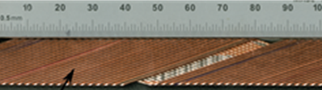
Eddy Currents
Stainless Steel Core to control the cross-over resistance R_{c}
Pros:
Suppression of ramp-rate dependence of field quality
Increased reproducibility
Cons:
Less quench back for protection
Stability (current sharing among layers)
HQ experience
(HQ01e: no core/HQ02a: 60 % cov.)
Two options to choose initial value for SQXF01:
scaling from HQ (~60% coverage, giving ~10 mm width) or
scaling from 11 T (~80% coverage, giving ~14 mm width)
Choice: 12 mm x 0.025 mm (~70 % coverage)
[G. L. Sabbi]

Slide 15
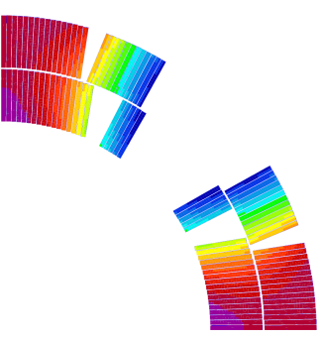
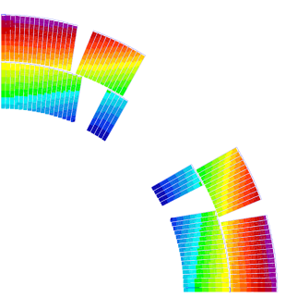
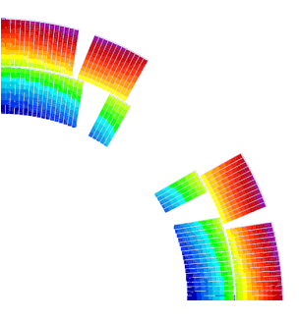
Coil deformation during powering
Cross section is optimized for the warm coil in relax state, assuming the conductors are aligned in the outer diameter.
In operation conditions, we expect 0.7 % more gradient and +0.93 units of b_{6.}
Most of the contribution is coming from cool down: the variation of the field quality during powering due to electromagnetic forces is negligible.
Warm coil in relax state
Loading at RT
max.0.066 mm
min. 0.041 mm
Cool down
max.0.508 mm
min. 0.360 mm
Powering
max.0.471 mm
min. 0.239 mm
Displacements relative to coil in relax (warm) state
[M. Juchno]

Slide 16
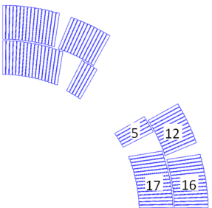
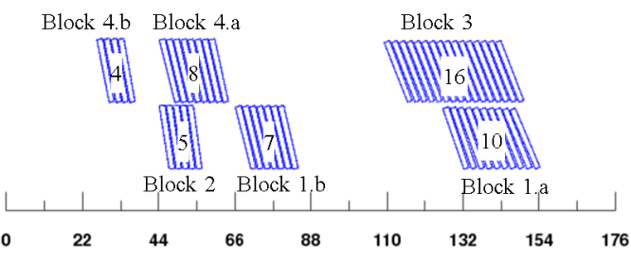
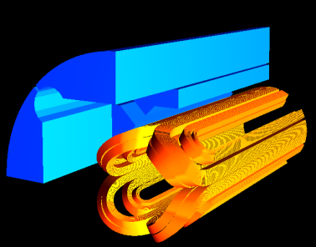
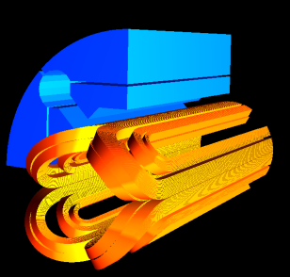
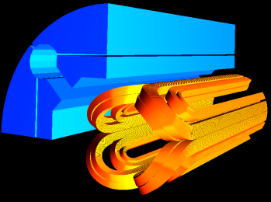
3D: Field in the coil
3D magnetic optimization to reduce the peak field enhancement at the ends:
1. Conductors placing at the ends
Design solution: 6 blocks in the ends
Peak field enhancement in the outer layer is reduced by 0.3 T by splitting block 4 in 2
Block 1 is divided to minimize the integrated harmonics
Block 4
Block 2
Block 1
Block 3
2. Reduction of the magnetic extension of the yoke
  Design solution: Only magnetic pad is shortened
  Peak field in the ends is lower than in the straight section
  Compared to the solution with yoke and pad shortened :
    More uniform stress distribution in the coil
    Lower reduction on the magnetic length
  HQ design
ΔB_{p} = 0.3 T
ΔB_{p} = -0.1 T
ΔB_{p} = -0.3 T
Δl_{mag} = 0 mm
Δl_{mag} = -18 mm
Δl_{mag} = -23 mm

Slide 17
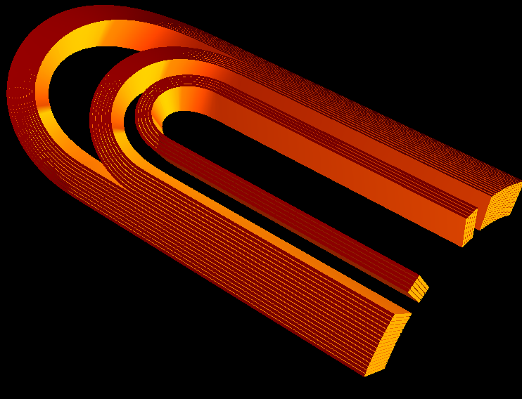
3D: Field in the coil
Straight part
Pole tip
Pole tip
Arc length of the conductor
Straight part
40
20
0
0
50
100
150
200
250

Slide 18
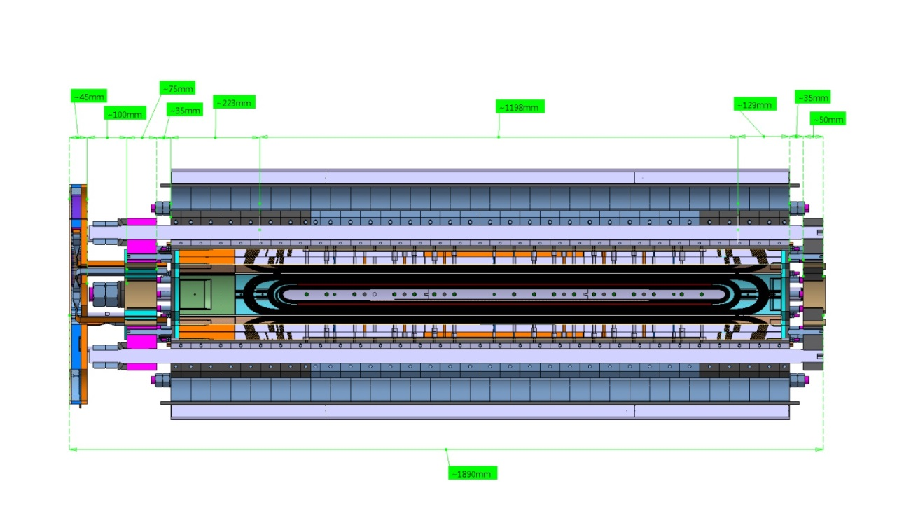
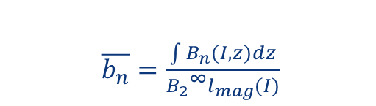
3D: effects on field quality
Integrated field harmonics
$\overline{b_{n}}=\frac{\int{B_{n}(I,z)dz}}{{B_{2}}^{∞}l_{mag}(I)}$
main field in the straight section
Integral over the magnet yoke extension:
 | b6 | b10 | b14 | a2 | a6
2D | 0.32 | -0.40 | -0.66 | 0.00 | 0.00
3D-SQXF | 8.06 | -0.54 | -0.70 | -8.90 | 0.60
3D-LQXF – 4 m | 2.65 | -0.44 | -0.67 | -2.67 | 0.18
3D-LQXF – 6.8 m | 1.69 | -0.42 | -0.67 | -1.57 | 0.10
Yoke Extension
Layer jump
Splice

Slide 19

3D: effects on field quality
The contribution of the NbTi leads should be also taken into account:
NbTi leads
210 mm
Yoke Extension
NbTi leads contribution:
 | Δb6
3D-SQXF | 4.13
3D-LQXF – 4 m | 1.23
3D-LQXF – 6.8 m | 0.73
Plans for the next iteration:
  Minimize the length of the splice region and NbTi leads extension
    Nuts on the axial tie rods will be shifted from lead end to the return end
  Partial compensation optimizing the block position in the lead end
  Partial compensation in the straight section

Slide 20
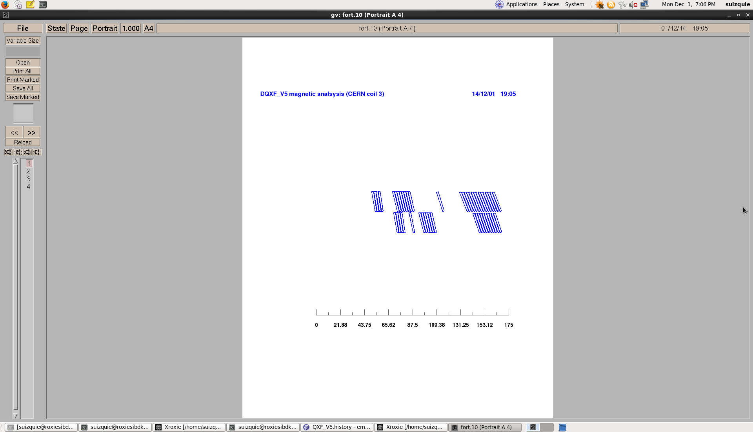
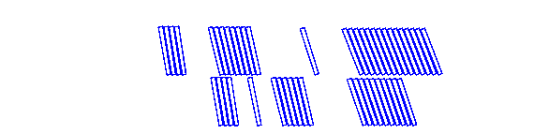
3D: effects on field quality
  Partial compensation of the splice and leads contribution by optimizing the block position in the lead end:
Original block position
Approach: Minimize harmonic content in the end region
Shifted block position
Approach: Minimize harmonic content including splice region
 | b6 original | b6 shifted
2D | 0.32
3D-LQXF – 4 m | 3.9 | 2.3
3D-LQXF – 6.8 m | 2.4 | 1.5
Remark: One half of the integrated b₆ is coming from the 210 mm NbTi leads
  The rest, will be compensated with the magnet cross section

Slide 21

Magnetic and Physical Lengths
  Gradient = 140 T/m at RT
  Magnetic Length at 1.9K :
  (assuming longitudinal thermal contraction = 3 mm/m )
    LQXF CERN = 6.8 m
    LQXF LARP = 4.0 m
Magnetic Pad
Magnetic Length
Coil length
Magnetic Yoke
Parameters | Units | SQXF | LQXF LARP | LQXF CERN
Magnetic length at RT | mm | 1198 | 4012 | 6820.5
Magnetic length at 1.9 K | mm | 1194.4 | 4000 | 6800
Coil length at RT (from conductor to conductor) | mm | 1313 | 4127 | 6935.5
Overall coil length at RT (including splice extension) | mm | 1510 | 4324 | 7132.5
Magnetic yoke extension at RT | mm | 1550 | 4364 | 7172.5
Magnetic pad extension at RT | mm | 975 | 3789 | 6597.5
225 mm
350 mm

Slide 22
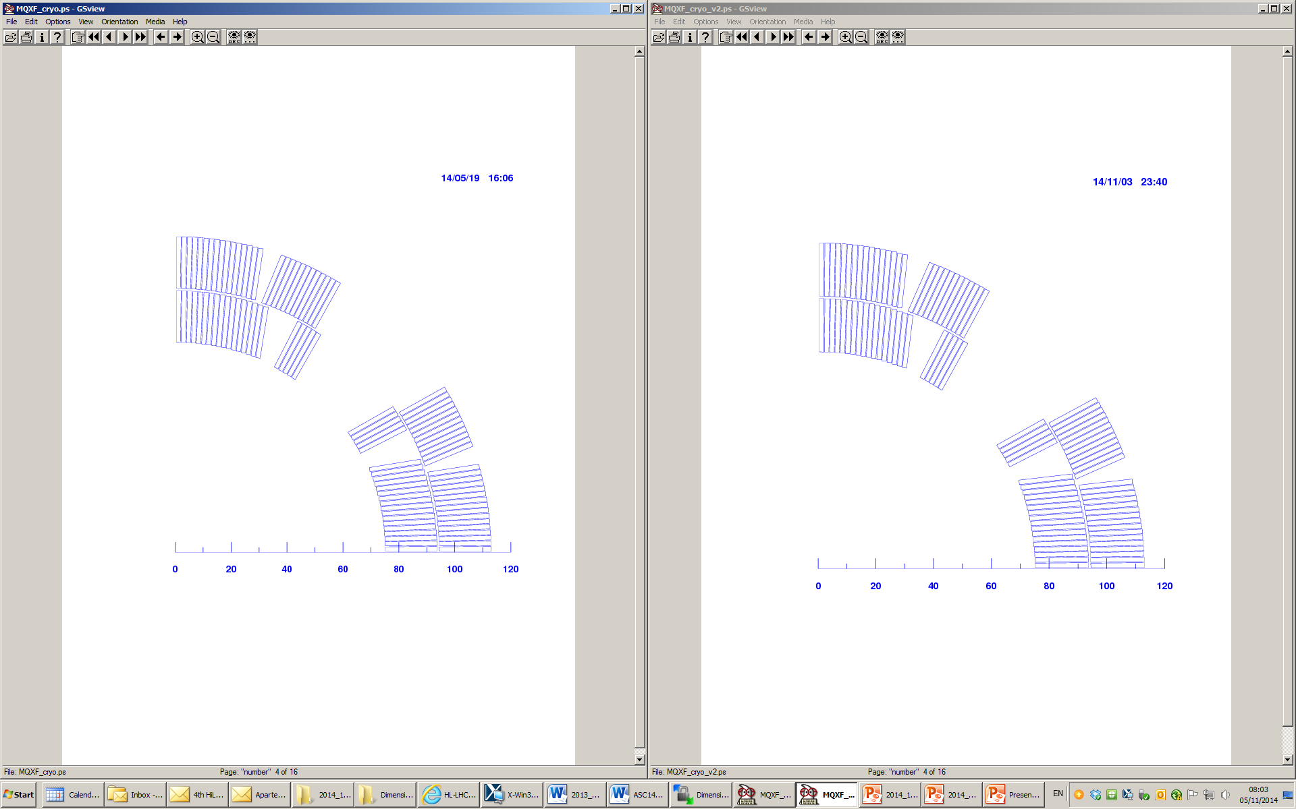
Possible “New” Coil Cross Section
For PIT, reduction of keystone angle from 0.55 to 0.4 deg., with same cable mid-thickness, under consideration
  Thin/thick edge 0.025 mm thicker/thinner
  Cross-section as close as possible to baseline
    Still, new wedges, poles and spacers
      8-9 months from cable geometry definition to beginning of winding
Baseline
0.55 keystone
0.150 mm ins.
0.4 keystone
0.145 mm ins.

Slide 23
Summary
Magnet parameters have been selected taking into account many years of magnet R&D in the US and at CERN.
Coil cross section is a scale up of HQ, keeping the same coil lay out (4-blocks, 2-layer with same angle) and similar cable width/aperture.
Present value of magnetization average and spread are compatible with field quality requirements.
    Based on HQ experience, stainless steel core covering ~ 70 % of the cable width will reduce the eddy current effects to acceptable limits.
    100 µm provide the flexibility to correct up to +- 4 units of b₆ without an impact on the coil compaction. This is enough to account for 3D effects and impact of coil deformation during powering.
    Ferromagnetic shims to be placed in the bladder slots provide enough flexibility to correct the low order non allowed multipoles.
    The option of reducing the keystone angle from 0.55 to 0.4 deg., with same cable mid-thickness has been explored. The resulting cross section is close to the present design but still, new wedges, poles and spacers are needed.

Slide 24
Additional slides

Slide 25
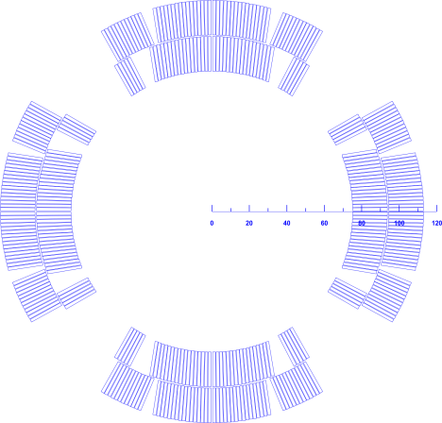
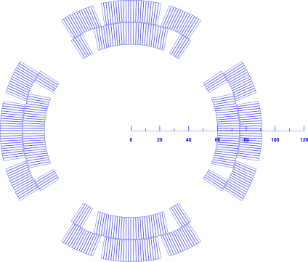

Coil Cross Section
The cable width/aperture (w/r) is approximately maintained
  Aperture from 120 mm to 150 mm
  Cable from 15 to 18 mm width
  Similar stress with +30% forces
Same coil lay-out: 4-blocks, 2-layer with same angle
  Optimized stress distribution
Similar peak field → Lower J_{overall}
  Positive side effect for quench protection (from 580 to 490 A/mm²)
$$B_{p}=r∙G=r∙j∙log⁡(1+w/r)$$
HQ
MQXF

Slide 26
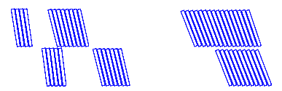
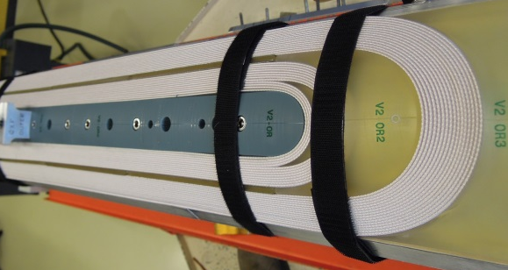
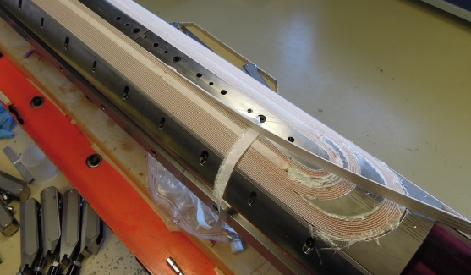
Mechanical Optimization of the ends
WP3 meeting
Review End Parts Design
2013 |  |  |  |  |  |  |  |  |  |  | 2014
October |  |  | November |  |  |  | December |  |  |  | January |  |  |  |  | February |  |  |  | March |  |  |  | April |  |  |  |  | May |  |  |  | June |  |  |  |  | July |  |  |  | Aug
42 | 43 | 44 | 45 | 46 | 47 | 48 | 49 | 50 | 51 | 52 | 1 | 2 | 3 | 4 | 5 | 6 | 7 | 8 | 9 | 10 | 11 | 12 | 13 | 14 | 15 | 16 | 17 | 18 | 19 | 20 | 21 | 22 | 23 | 24 | 25 | 26 | 27 | 28 | 29 | 30 | 31 | 32 | 33
 | SPC1 |  |  |  |  |  |  |  |  |  |  |  |  | SPC2 |  |  |  |  | Preparation |  |  |  | SQXF1IL |  |  |  |  | OL |  |  |  |  | SQXF2 |  |  |  |  |  |  |  | SQXF3
V1
SPC1 IL
Cu
Oct-2014
V2
SPC1 OL
Cu
Oct-2014
V3
SPC2 and SQXF1
Cu
Jan 2014 April 2014
V4
SQXF2
Bad Nb3Sn
June 2014
(delayed ~ 1 month)
V5
SQXF3
Nb3Sn
End July 2014
Increase de Harmonic Order of the baseline ellipse (more roundish)
Pole converged to BEND design
Change angle last block IL
Minor changes:
Radius on the edges
Flexible features
Modify spacing among cables last block IL
68.5˚→71˚
71.5˚→67.3˚
Shorter coils with plastic end spacers to optimize ends
SQXF coils

Slide 27
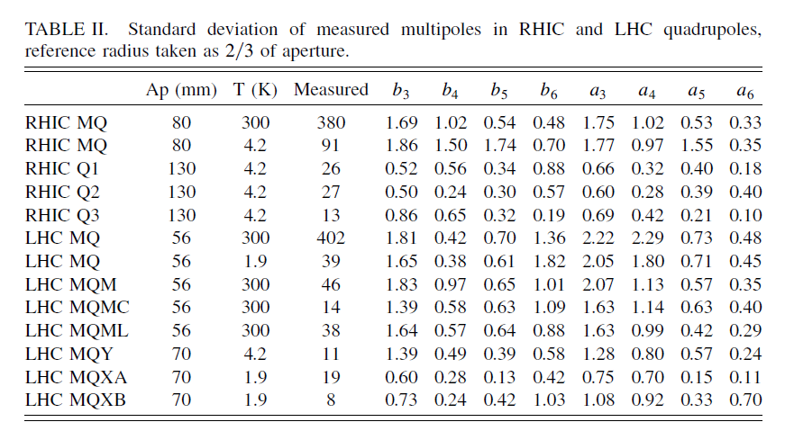
Field quality
Field quality in low- superconducting quadrupoles and impact on the beam dynamics for the Large Hadron Collider upgrade
Boris Bellesia, Jean-Pierre Koutchouk, and Ezio Todesco

Slide 28
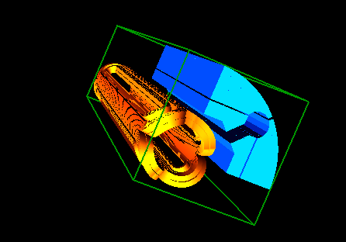
Impact of block subdivision in peak field
Remark: analysis done in MQXF_V0 cross section, strand self field not included
Configuration
Magnetic yoke z = [0-700] mm
Magnetic pad z = [0-500] mm
Non-magnetic pad z = [500-700] mm
 |  | INNER LAYER |  |  | OUTER LAYER
 |  | Block 1A | Block 1B | Block 2 | Block 3 | Block 4A | Block 4B
3D peak field | 4 Blocks | 10.43 |  | 11.85 | 8.53 | 11.96
 | 6 Blocks | 9.70 | 10.43 | 11.85 | 7.34 | 9.98 | 11.63
2D peak field |  | 10.41 |  | 11.82 | 6.78 | 11.17

Slide 29

Magnet lengths

