Slide 1

Quench Protection &
Radiation Damage Protection
G. Ambrosio
on behalf on the MQXF team
MQXF International Design Review
December 10-12, 2014
CERN

Slide 2
Outline
Quench Protection
Protection against Radiation Damage and Energy Deposition

Slide 3
Quench Protection

Slide 4
First Attempt (presented at MT23)
Simulations performed with QLASA and ROXIE using MATPRO property database
  Using preliminary MQXF requirements
  Assuming heaters only on the outer layer
  With conservative assumptions
    Slow layer-layer propagation
    Only copper (no bronze) in strands
    No dynamic effects
➔ Hot spot temp. ~ 350 K (max acceptable temp.)
  Without margin and redundancy
G. Manfreda, et al., “Quench Protection Study of the Nb3Sn low-beta quadrupole for the LHC luminosity upgrade,” IEEE Trans. Appl. Supercond., vol. 24, no. 3, Jun. 2014, Art. ID. 4700405.
G. Ambrosio, “Maximum allowable temperature during quench in Nb3Sn accelerator magnets”, Yellow Report CERN-2013-006, pp. 43–46, WAMSDO 2013, CERN, Geneva, CH.

Slide 5
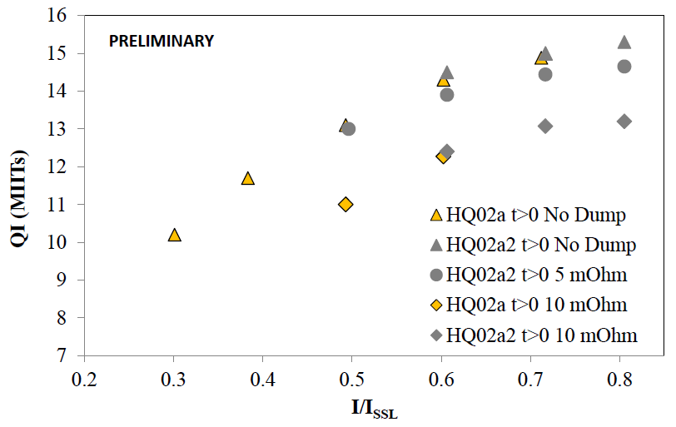
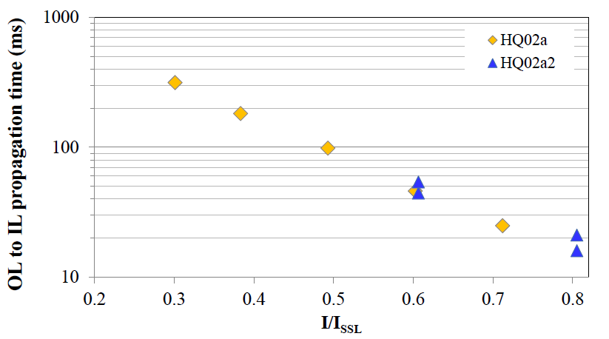
Feedback from HQ02 test
120 mm aperture, 1 m long quadrupole
Reached 98% SSL at 4.5K & 95% SSL at 1.9K
Measurement of quench propagation OL to IL
Measurement of Quench Integral vs. dump res.
Degradation vs. Hot Spot temperature (incomplete)
H. Bajas, et al., “Cold Test Results of the LARP HQ02b magnet at 1.9 K”, to be published in TAS

Slide 6
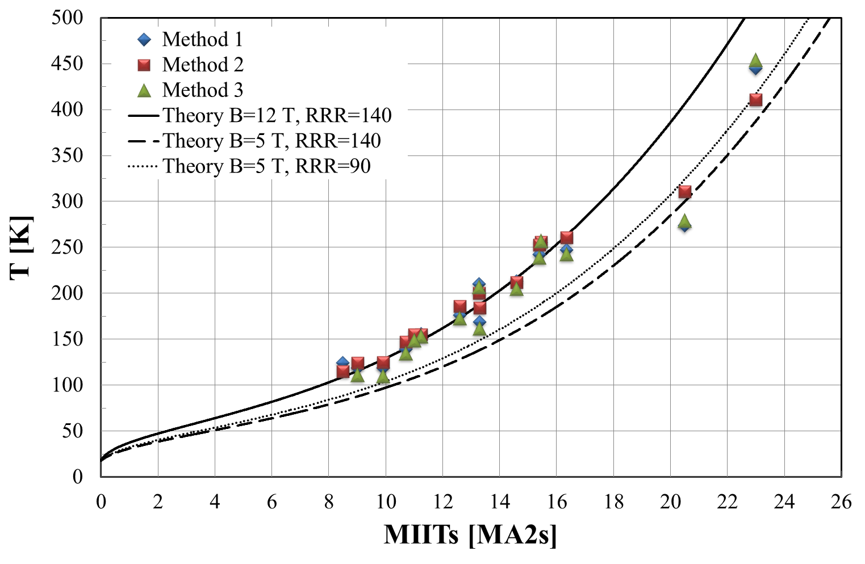
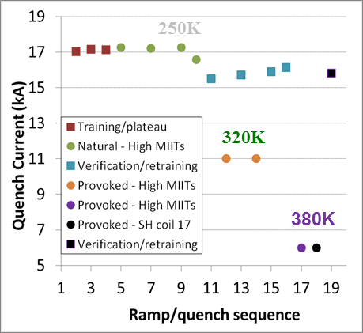
HQ02 – Max Hot Spot Temperature
380+ K hot spot temperature without significant degradation
H. Bajas, G. L. Sabbi, G. Chlachidze, M. Martchevsky, F. Borgnolutti, D. Cheng, H. Felice, et al.

Slide 7
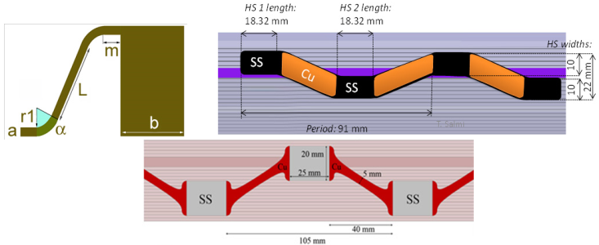
Quench Protection Improvements
Understanding “dynamic effects” = energy extraction and quench propagation caused by inter-filament losses
Development of heaters with copper-cladding
Development of heaters for inner layer (to be demo.)
If the 11T project successfully demonstrates inter-layer heaters,
we will be happy to use them
Courtesy J. C. Perez
Courtesy M.Marchevsky, E.Todesco, D.Cheng, T.Salmi
M. Marchevsky, "Design optimization and testing of the protection heaters for the LARP high-field Nb3Sn quadrupoles", presented at ASC2014.

Slide 8
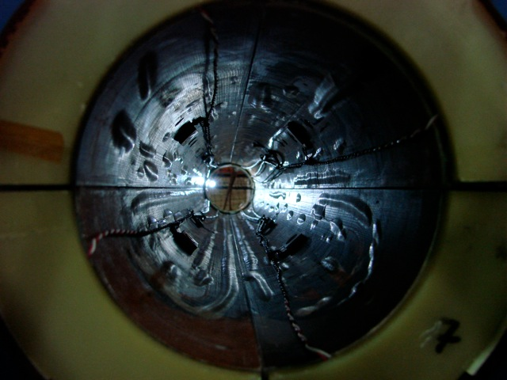
Post-HQ02b Test: Bore, viewed from RE
Coil 17
Coil 20
Heater bubble
Coil 15
Coil 16

Slide 9
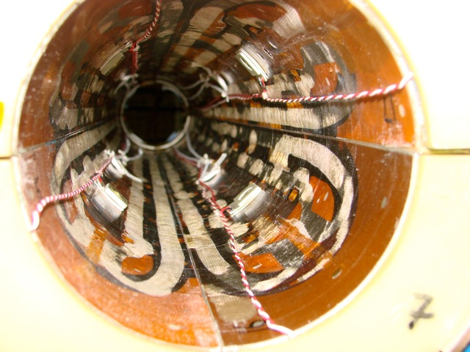
Post-HQ02b Test: Bore, viewed from RE
Coil 17
Coil 20
Crazing/cracking of epoxy
Coil 15
Coil 16

Slide 10
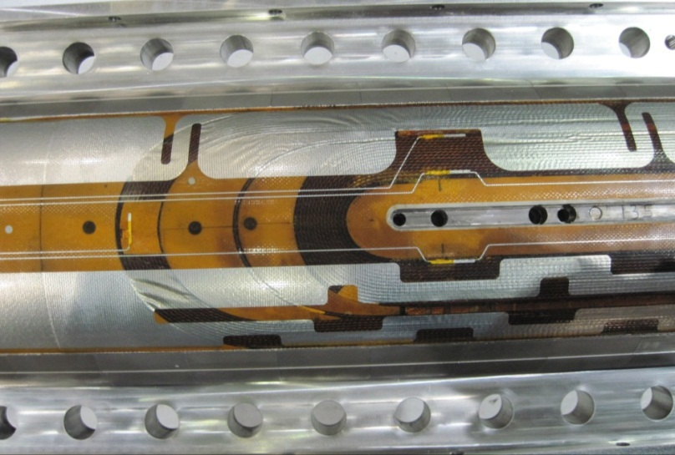
LHQ Coil
LHQ coil #3 has all the features of MQXF coils not tested in previous long coils (90 mm, 3 m)
  Ti ternary RRP strands
  Stainless steel core (25 um thick)
  Braided insulation
  Stainless steel end parts
  Use of tool and binder during winding
  Flexible features in saddles
Different protection heaters for MQXF optimization
  5 kV electrical strength
  with 50 um polyimide

Slide 11
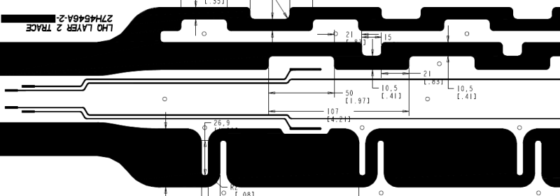
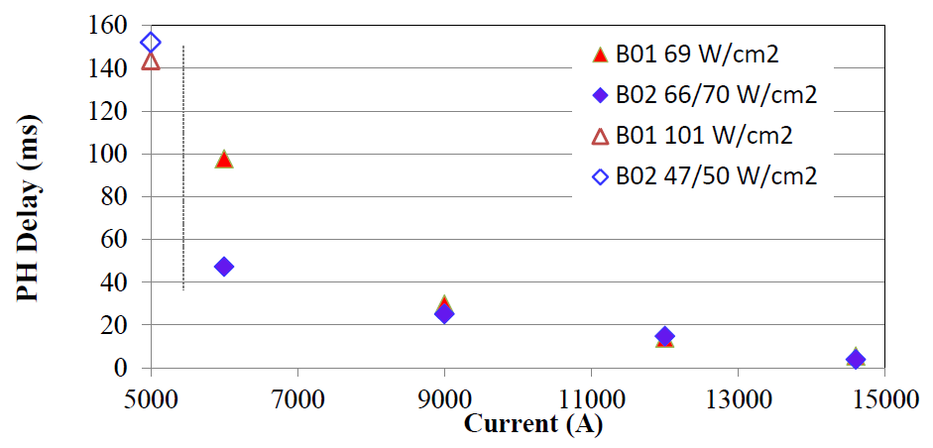
Protection Heater Studies
G. Chlachidze, 11/14/14 LARP Mtg
Both heaters are very efficient (delay < 10 ms) at operating current
Similar performance under similar conditions
B02
Analysis in progress
B01

Slide 12
Updated Simulations
Demonstrated real beneficial effect of bronze
  ➔ Hot spot temp lower by ~ 30K
Compared property databases
  ➔ MATPRO is most conservative
Fine tuned by comparing HQ tests data with simulations
  See examples in next slides
V. Marinozzi, et al., “Study of quench protection for the Nb3Sn low-beta quadrupole for the LHC luminosity upgrade (HiLumi-LHC)”, to be published in IEEE Trans. Appl. Supercond., 2015.

Slide 13
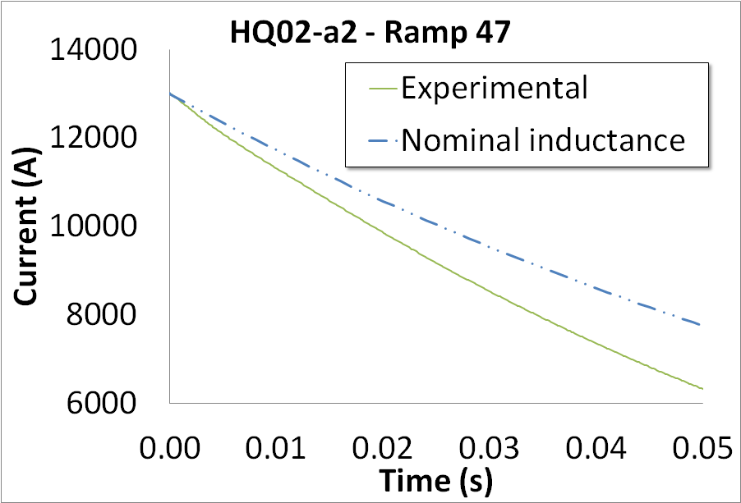
MQXF Quench Protection Analysis – Vittorio Marinozzi
Inductance reduction for high dI/dt
HQ simulation using the nominal inductance, experimentally measured at low dI/dt (<50 A/s)^{[1]}
R_{d}=60mΩ
No PH
~100 kA/s
There is an evident disagreement, starting from the very beginning
Similar behavior has been experimentally observed in various HQ and LQ decays
It is not due to quench back, because of its suddenness
It has benefic effects on the protection, therefore its simulation in MQXF could be very useful
The explanation has been investigated as an electromagnetic coupling with Inter-Filament-Coupling-Currents (IFCC) in the strand, due to high dI/dt, which causes a considerable inductance reduction
[1] H. Bajas et al., “Cold Test Results of the LARP HQ Nb3Sn quadrupole magnet at 1.9 K”. Presented at the Applied Superconductivity Conference, Portland, Oregon, USA, 2012.

Slide 14
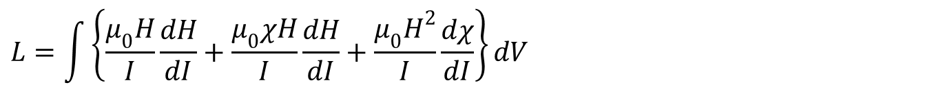

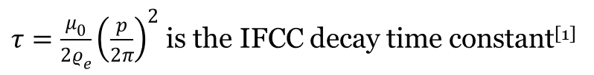
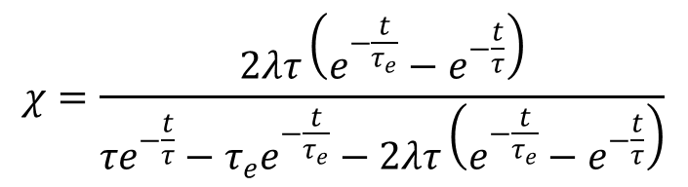
MQXF Quench Protection Analysis – Vittorio Marinozzi
IFCC as magnetization currents
The differential inductance can be computed as:
$$L=\int{\left\{\frac{μ_{0}H}{I}\frac{dH}{dI}+\frac{μ_{0}χH}{I}\frac{dH}{dI}+\frac{μ_{0}H^{2}}{I}\frac{dχ}{dI}\right\}dV}$$
Static inductance
Magnetic susceptibility related to IFCC
Under exponential assumptions, the magnetic susceptibility related to the IFCC can be computed as:
$$χ=\frac{2λτ\left(e^{−\frac{t}{τ_{e}}}−e^{−\frac{t}{τ}}\right)}{τe^{−\frac{t}{τ}}−τ_{e}e^{−\frac{t}{τ_{e}}}−2λτ\left(e^{−\frac{t}{τ_{e}}}−e^{−\frac{t}{τ}}\right)}$$
$τ=\frac{μ_{0}}{2ρ_{e}}{\left(\frac{p}{2π}\right)}^{2}$ is the IFCC decay time constant^{[1]}
$τ_{e}=\frac{L}{R_{d}}$ is the current decay time constant
$λ$ takes into account the insulation and the packing in the strand
This model has been implemented in QLASA^{[2]}
[1] M. N. Wilson, “Superconducting Magnets”, Clarendon Press Oxford, 1983.
[2] L. Rossi and M. Sorbi, “QLASA: A computer code for quench simulation in adiabatic multicoil superconducting windings”, Nat. Inst. of Nucl. Phys. (INFN), Rome, Italy, Tech. Rep. TC-04-13,2004.
Notes:
Dire che tau è la solita costante di tempo, taue la costante di scarica

Slide 15
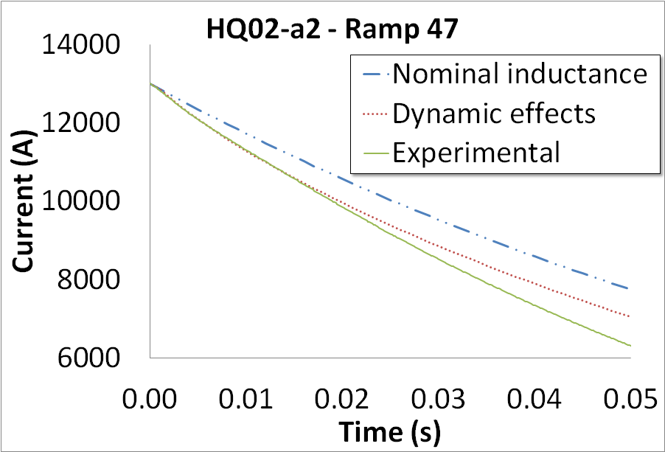
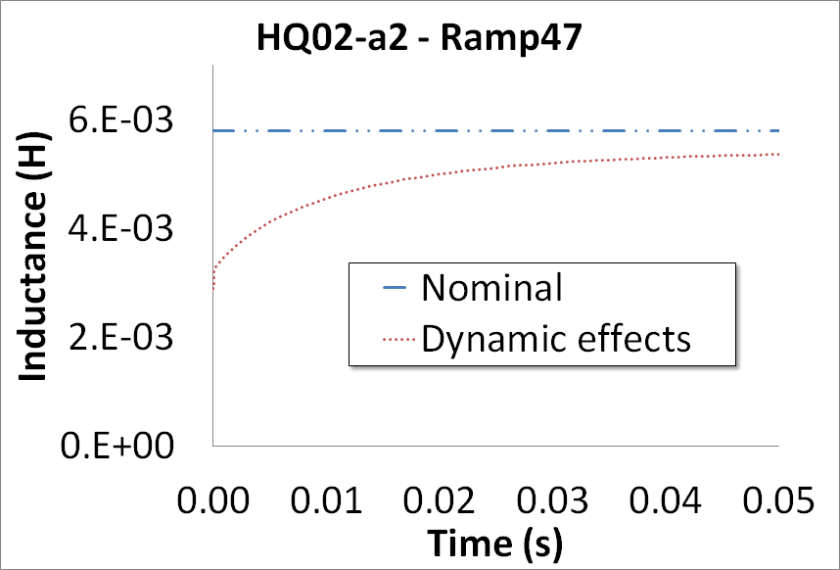
MQXF Quench Protection Analysis – Vittorio Marinozzi
HQ simulation
Considering dynamic effects allows to simulate well the experimental decay from the very beginning to t=~15 ms
In this decay, the MIITs produced considering dynamic effects are ~20% less then using nominal inductance
The disagreement after 15 ms could be due to quench back
~30%

Slide 16
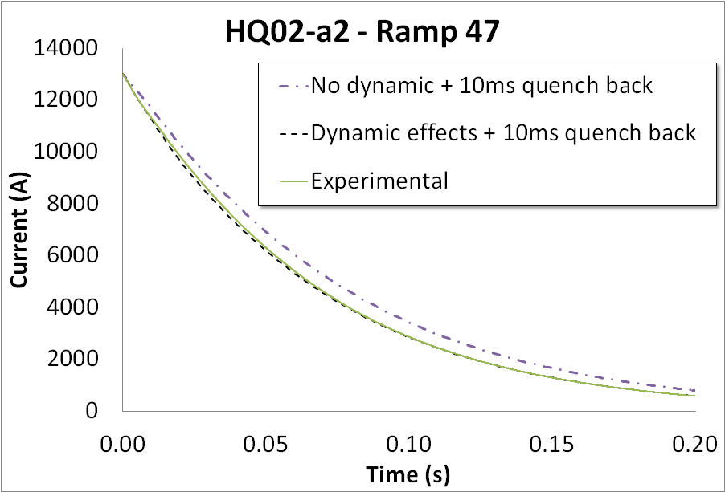
MQXF Quench Protection Analysis – Vittorio Marinozzi
IFCC and quench back
Quench back after 10 ms together with dynamic effects allow to reproduce the decay until its end
Conclusions:
Both quench back and dynamic effects are needed in order to reproduce the decay until the end
Quench back alone is not enough
QLASA cannot predict the time of quench back occurring, but it can now predict the inductance reduction due to dynamic effects. Improvement of QLASA is under way.

Slide 17
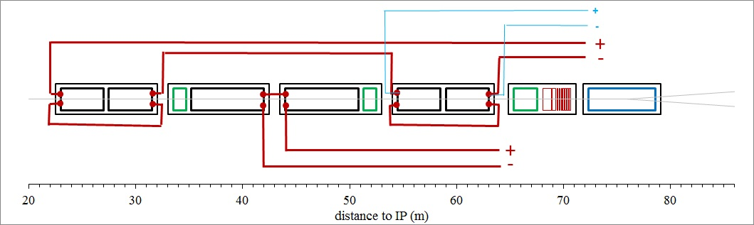
MQXF Quench Protection Analysis – Vittorio Marinozzi
MQXF protection scheme
Dumping resistance | 48 mΩ
Maximum voltage to ground | 800 V
Voltage threshold | 100 mV
Validation time | 10 ms
Heaters delay time from firing (inner layer) (CoDHA)^{[1]} | 12 ms
Heaters delay time from firing (outer layer) (CoDHA)^{[1]} | 16 ms
[1] T. Salmi et al., “A Novel Computer Code for Modeling Quench Protection Heaters in High-Field Nb3Sn Accelerator Magnets”, IEEE Trans. Appl. Supercond. vol 24, no 4, 2014.

Slide 18
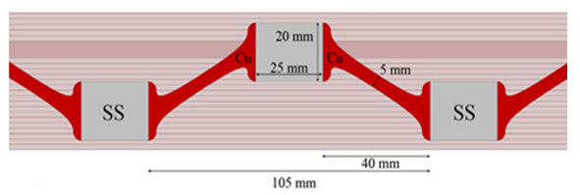
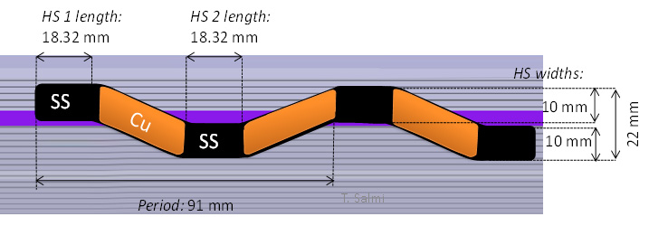
MQXF Quench Protection Analysis – Vittorio Marinozzi
MQXF protection with IL-PH
Dynamic effects are not yet considered in these simulations
No inner layer PH | Inner Layer PH
330 K | 290 K
The MQXF hot spot temperature decreases of ~40 K inserting inner layer protection heaters

Slide 19
MQXF Quench Protection Analysis – Vittorio Marinozzi
Updated MQXF protection w and w/o IFCC
No inner layer PH | No inner layer PH+ IFCC | Inner Layer PH | Inner Layer PH + IFCC
330 K (365 K) | 306 K (342 K) | 290 K (311 K) | 266 K (288 K)
The numbers between parentheses show impact of failure of half of the heaters
IFCC dynamic effects decrease the MQXF hot spot temperature of 20-30 K. The effect is therefore appreciable, but we do NOT take it into account because it is not yet demonstrated in MQXF magnets, and the powering system is still under design.
Further improvements could come from quench back, which has not been considered (work in progress)

Slide 20
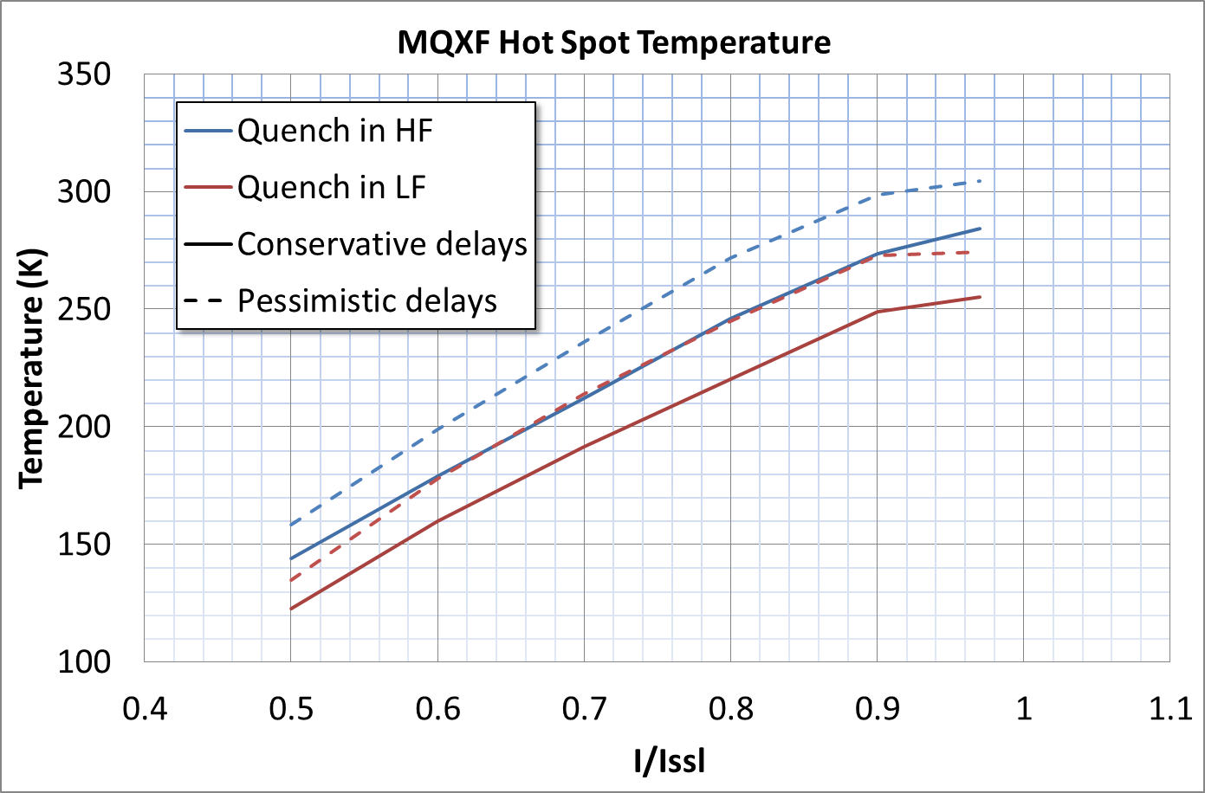
MQXF Quench Protection Analysis – Vittorio Marinozzi & Tiina Salmi
Protection assumptions
Voltage threshold | 100 mV
Dump resistor | 46 mΩ
Validation time | 10 ms
IL heaters | Yes
Dynamic effects | yes
Quench back | no
Peak Temperature vs. Location and Current

Slide 21
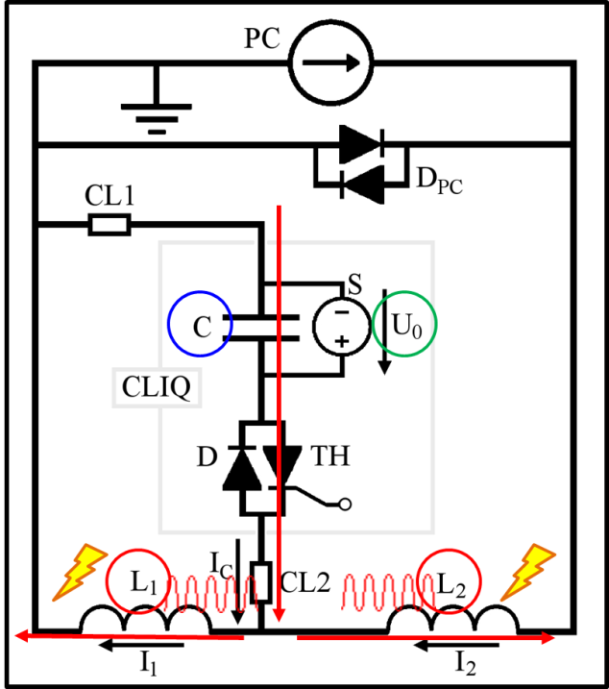
CLIQ - I
Coupling-Loss Induced Quench System
Very effective on HQ02 test
Courtesy of E. Ravaioli
E. Ravaioli, et al., “Protecting a Full-Scale Nb3Sn Magnet with CLIQ, the New Coupling-Loss Induced Quench System”, to be published in IEEE Trans. Appl. Supercond. 2015.

Slide 22
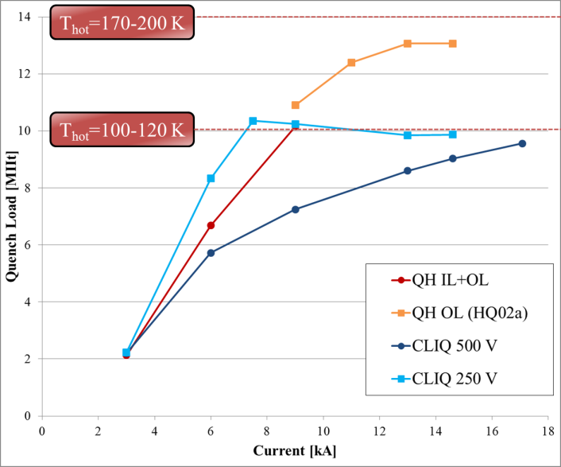
CLIQ - II
Very effective at mid-high current
Courtesy of E. Ravaioli
E. Ravaioli, et al., “Protecting a Full-Scale Nb3Sn Magnet with CLIQ, the New Coupling-Loss Induced Quench System”, to be published in IEEE Trans. Appl. Supercond. 2015.

Slide 23
CLIQ Plans
Could provide perfect redundancy with heaters on outer layer
  In case of “bubble” issue with heaters on inner layer
To be demonstrated for long magnets:
  MQXFS1 with reduced CLIQ voltage and dump res.
  MQXFL1 with reduced dump res.
Study of “tunnel readiness” in progress:
  Capacitor banks based on present system for heaters
  Protection of magnets powered in series

Slide 24
Voltages
Requirements (preliminary):
Heater-Coil Hi-pot: 2 kV
Coil Impulse test: 2 kV
Heater-Coil Hi-pot tests:
5 kV (LHQ coil 3 and MQXFS coil 1)
Impulse test:
> 3 kV (LHQ coil 3); 4.6 kV (MQXFS coil 1)

Slide 25
Conclusion
Quench Protection is no more a big concern
We can optimize the protection system based on upcoming test results and optimization of the whole system.

Slide 26
Protection against
Radiation damage
& energy deposition

Slide 27
The Strategy
Simulations and code cross-check
  Fluka and MARS
Extensive literature survey, consultation with experts, workshops
  Fluckiger, Weber
  WAMSDO 2011
Irradiations and material tests
  EuCARD program
Optimization of solution in progress

Slide 28
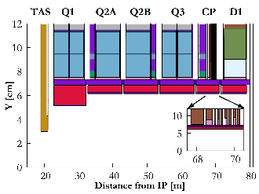
The Solution
Tungsten shielding inside coil aperture
  Mostly on midplanes
16 mm in Q1 and
6 mm elsewhere
tungsten inserts
on the beam screen
N. V. Mokhov and I. L. Rakhno, “Mitigating radiation loads in Nb3Sn quadrupoles for the CERN Large Hadron Collider upgrades” Phys. Rev. ST Accel. Beams 9, 101001, 2006.

Slide 29
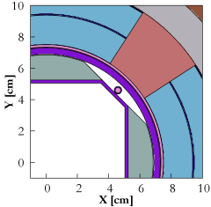
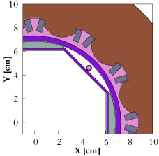
SHIELDING THE NEW TRIPLET – CP – D1 [II]
tungsten inserts
on the beam screen
16 mm in Q1 and 6 mm elsewhere
larger values for increasing crossing angle
HL-LHC vs LHC
First iteration with conceptual beam screen insert for 3000 fb⁻¹
beam screen gap in the interconnects is critical
(BEFORE vs AFTER LS3)
tungsten in the BPM’s
more than 600 W in the cold masses
as well as in the beam screen
(i.e. 1.2-1.3 kW in total)
more details in the N. Mokhov’s talk
WP3 session tomorrow early afternoon

Slide 30
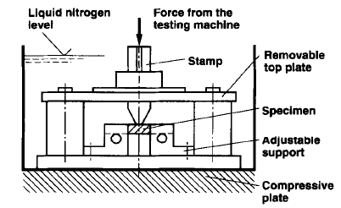

Relative mechanical properties for CTD-101K
Outline
Note: 41 references!
Structural req + energy deposition
Measurement techniques
ILSS₀ ≈ 120 MPa
30% degradation at 50 MGy
CTD-101K + CE-epoxy results
70% degradation at 90 MGy
Shear strength degradation with irradiation is the most sensitive property
G10 SBS Test
95% degradation at 160 MGy
Plan
End
UTS: 35% reduction at 180 MGy from UTS₀ ~ 1050 MPa
Compressive strength = 1080 MPa at 160 MGy (Loss 20%)
Fracture Resistance G_{IC}: 66% reduction at 230 MGy
SBS test gives «apparent ILSS»
[29]+[30]+[31]
TE-MSC-MDT
Elvis Fornasiere | CERN, 26th February 2013
30

Slide 31
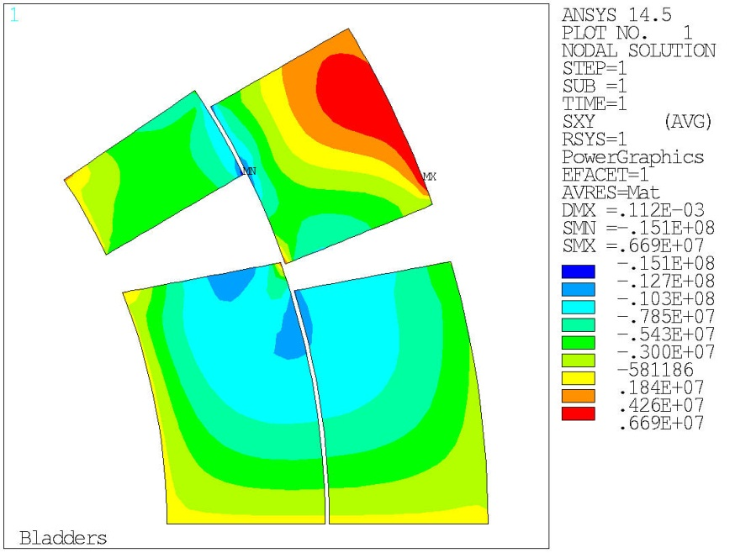
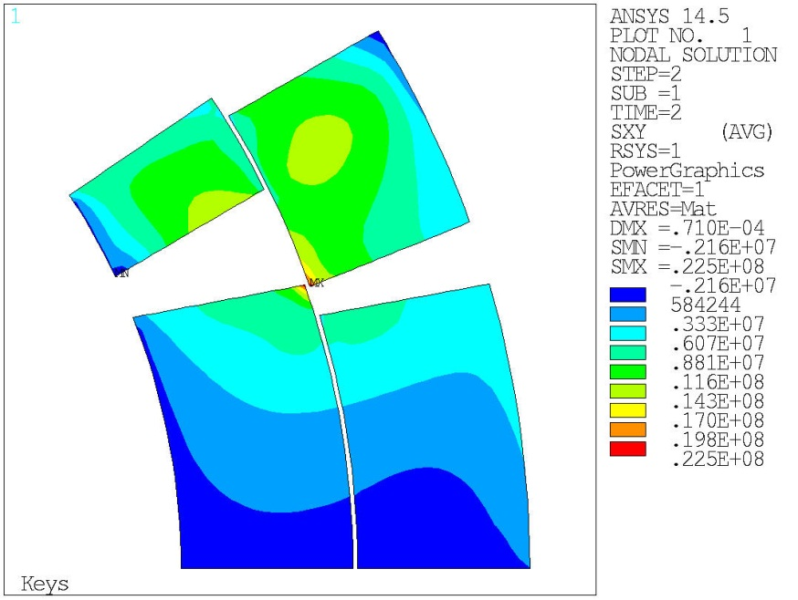
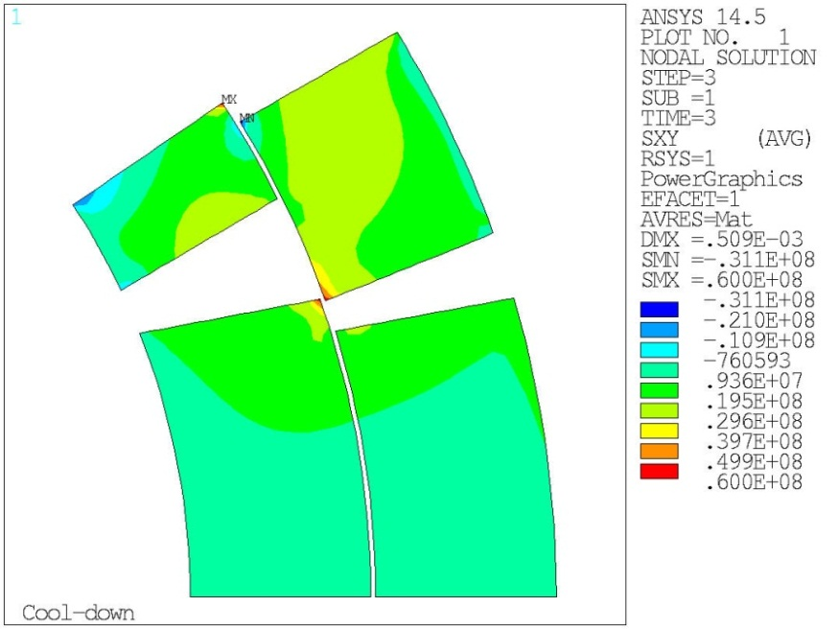
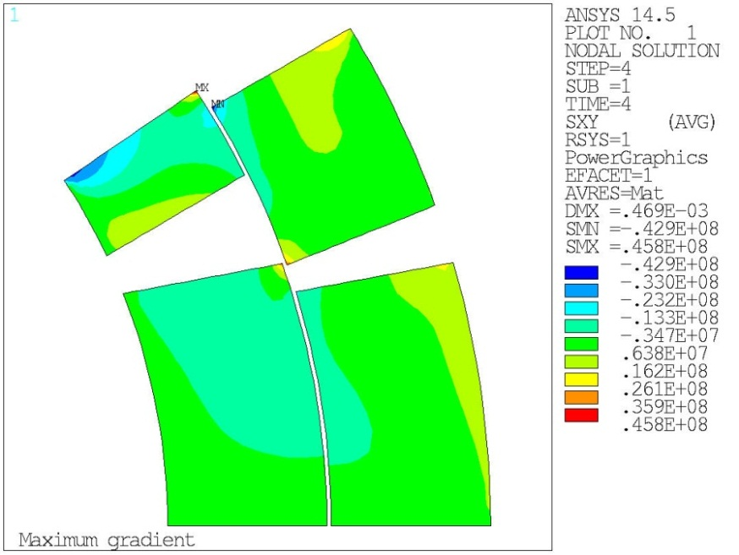

150 mm Nb₃Sn Shear stress
Outline
Structural req + energy deposition
Measurement techniques
Observation of Shear stress between turns and shear between inner and outer layers
CTD-101K + CE-epoxy results
Cool-down
Max-gradient (155 T/m)
G10 SBS Test
30-40 MPa shear
τ
50-60 MPa shear
singularity?
τ
Plan
τ
τ
τ
End
τ
τ
τ
τ
τ
τ
τ
~0 MPa shear
With courtesy of M. Juchno and P. Ferracin [4]
TE-MSC-MDT
Elvis Fornasiere | CERN, 26th February 2013
31

Slide 32
Task 2: Support studies (1)
Macej Chorowski & Jarek Polinski (PWR) PWR, CEA, CERN
7.2.1 Radiation studies for insulation and impregnation (PWR with CEA and CERN)
Aim: Certify radiation resistance of coil insulation and impregnation
Situation in 2009:
Most work (outside ITER) on insulator rad resistance >15 years ago
Scattered literature
High dose expectations for HL-LHC low beta zones ( ≥50 MGy)
Work done in the 4 years:
Literature study
Identification of HL-LHC radiation dose situation
Inventory of insulator candidates for HL-LHC Nb₃Sn coils
Selection of irradiation test beam and conditions
Design and construction of irradiation cryostat
Design and construction of material property measurement equipment (mechanical cold test, electrical insulation cold test, thermal conductivity cold test)
Irradiations at Swierk (Pl) and material test (PWR & CEA)
32

Slide 33
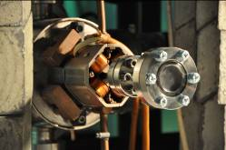
Irradiation set-up
designed and commissioned at PWR and transferred to NCBJ, Swierk
Accelerator 0.2 mm thick Ti window
Irradiation set-up

Slide 34
Radiation certification electrical tests summary
4 material types irradiated with 6 MeV e- beam 50 MGy dose
LARP technology has large margin

Slide 35
Radiation certification mechanical tests
Requirement: 20 MPa (at pole)
LARP technology has large margin
2 materials (Mix71 and LARP) irradiated (50 MGy)
2 materials (Mix237 and CE-epoxy mix) following by autumn 2013
@50MGy LARP mix reduces 50 %
but Mix 71 is unusable
35

Slide 36
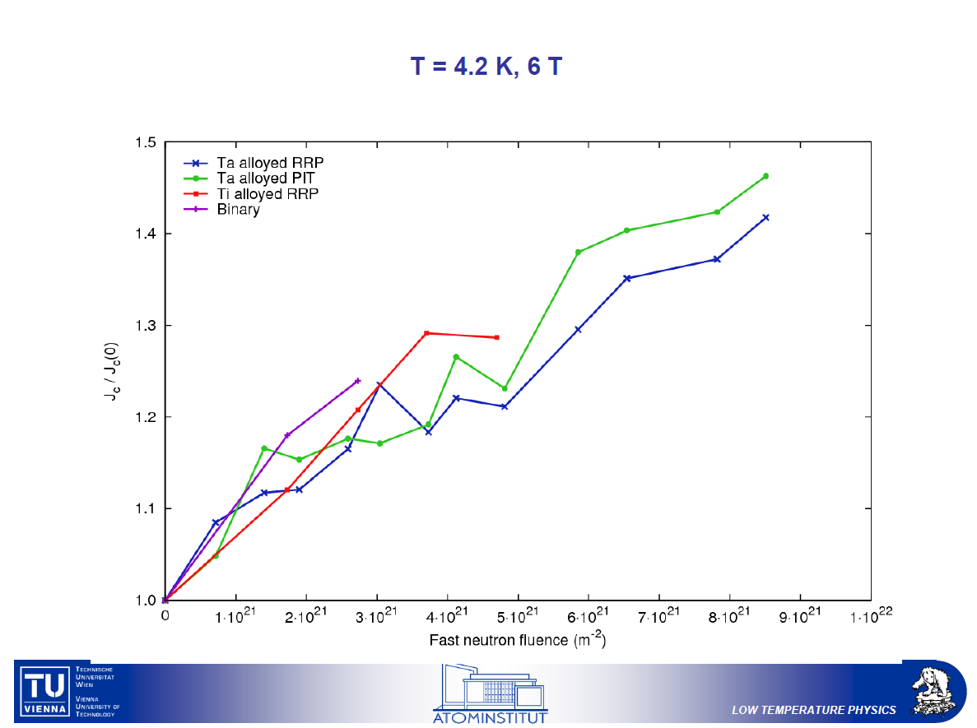
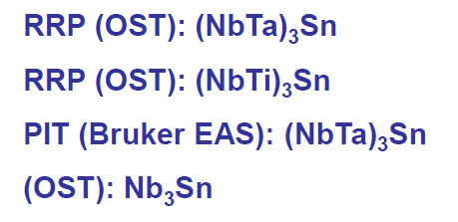
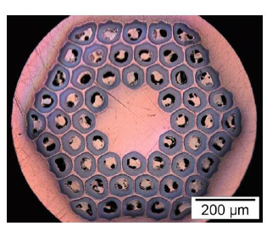
Effect on Critical Current
Jc of high-Jc strands increases with irradiation
Peak fluence in Q1

Slide 37
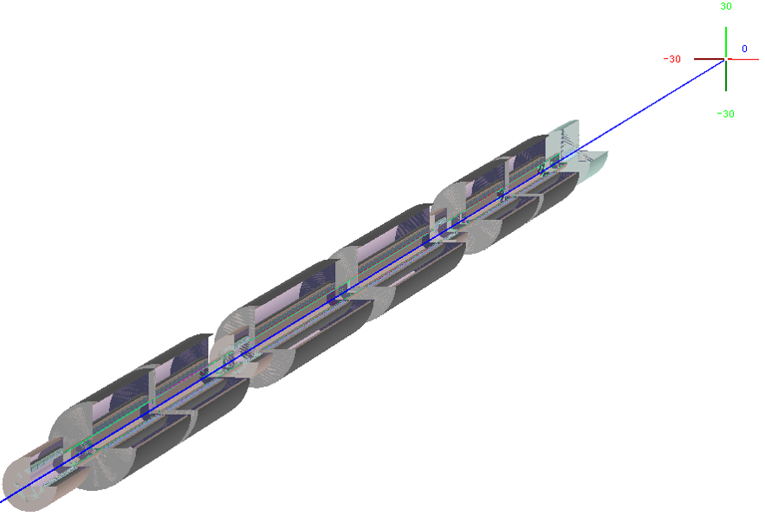
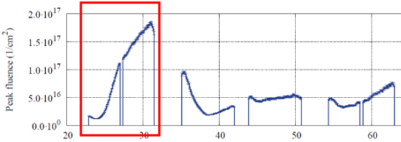
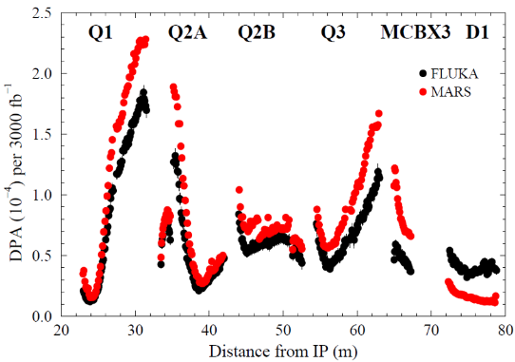
DPA ESTIMATE
After these peak DPA
Copper RRR starts degrading
but ~80% is recovered after warm up
3000 fb⁻¹ [A. Lechner]
[N. Mokhov and his team]
[A. Lechner]
“These numbers should be acceptable for the superconductors and copper stabilizer provided periodic annealing during the collider shutdowns” PDR

Slide 38
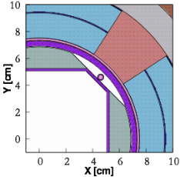
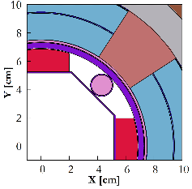
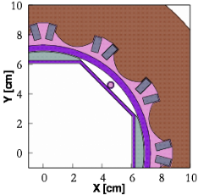
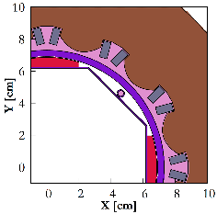
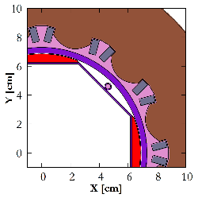
BEAM SCREEN AND ABSORBER DESIGN
conceptual version
(BS #1)
executive version
(BS #2)
revisited version
(BS #3)
≡
16 mm absorbers
6 mm absorbers

Slide 39
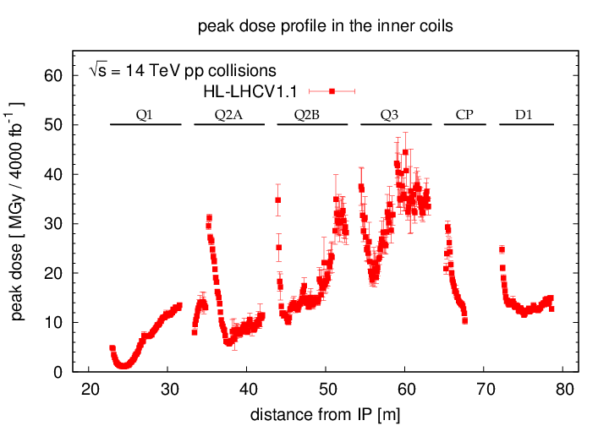
Peak Dose @ Ultimate Lifetime w Latest Absorber
2-3 mm radial resolution
50cm BS gap in the ICs

Slide 40
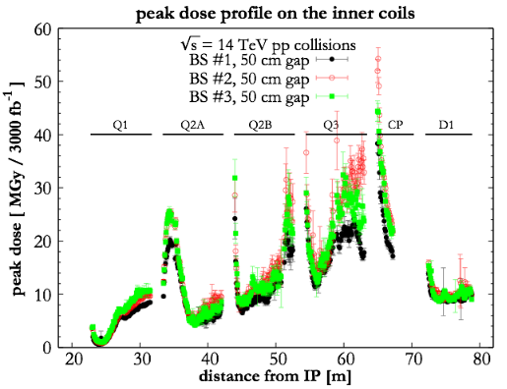
INERMET IMPACT

Slide 41
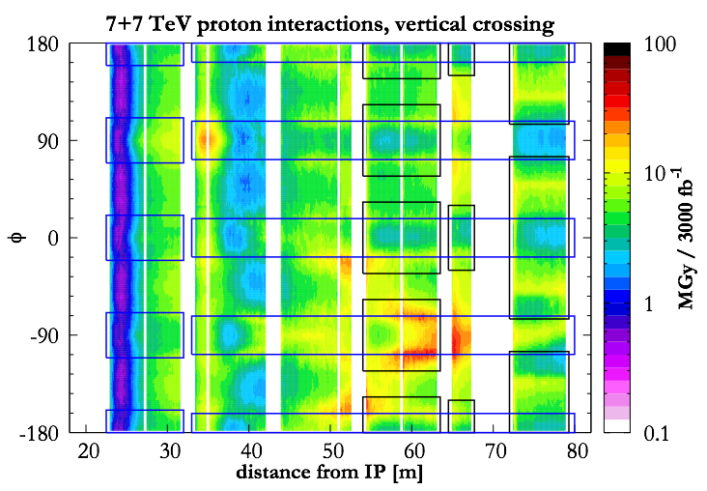
2D VIEW [IV]
Blue rectangles indicate the azimuthal regions shielded by the tungsten absorbers
Black rectangles indicate the azimuthal regions covered by coils
Needs design optimization

Slide 42
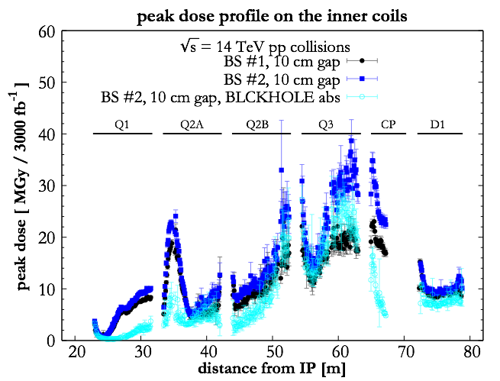
More design-simulation iterations are needed
DESIGN IMPACT

Slide 43
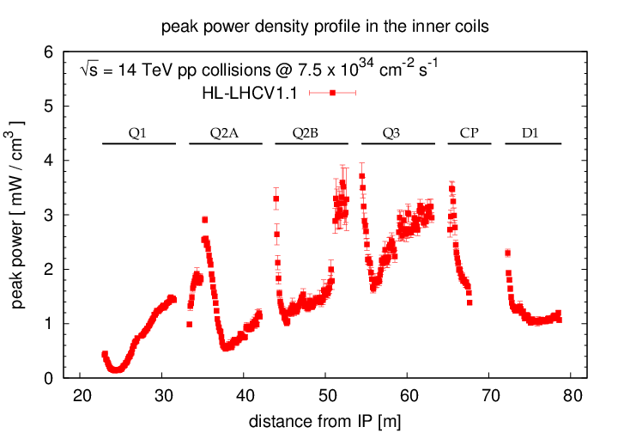
Cooling and thermal analysis in next talk
Energy Deposition
radially averaged over the cable thickness
50cm BS gap in the ICs

Slide 44
Conclusions – Where we are now
The optimization of the radiation absorber is in progress.
The target is to keep the peak dose < 25/33 MGy at nominal/ultimate luminosity, far from the pole turns.
Under these conditions the LARP/MQXF technology meets requirements with sufficient margin.
Your feedback is very welcome!

Slide 45
Back up splides

Slide 46
RADIATION SOURCE
700 MJ per beam (7 TeV protons, 2.2 10¹¹ p per bunch, ~2800 bunches)
14 kW delivered in collisions (L=7.5L₀)
5 mm
54 mm
21 m
on each side of ATLAS and CMS,
a 54mm aperture TAS absorber takes 750W
and let 5kW impact the machine
295 urad half vertical crossing angle

Slide 47
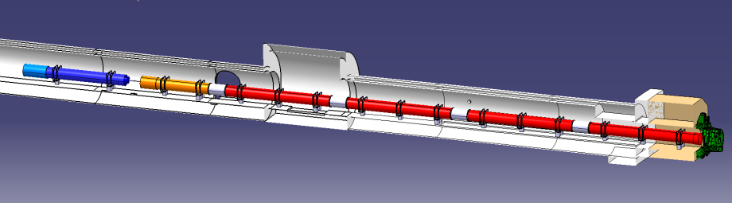





MQXF Main Parameters
140 T/m in 150 mm coil aperture
Q1/Q3 length: 8 m
Q2 length: 6.8 m
Max outer diameter: 630 mm
1.9 K operating temperature
Radiation strength: > 33 MGy
Field quality: see WP3 page at https://espace.cern.ch/HiLumi/WP3/SitePages/Home.aspx
ATLAS
CMS

Slide 48
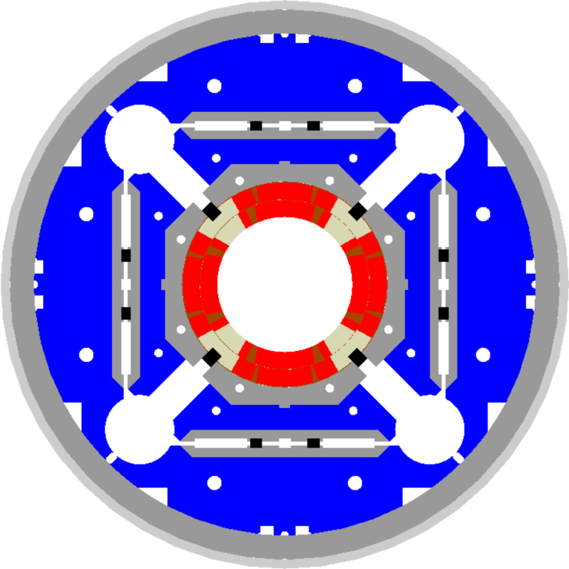

MQXF Main Design Features
Same design for Q1/Q3 and Q2s:
Two-layer coils
  Without internal splice
  With one wedge per layer
Al shell structure preloaded by bladders and keys
  Segmented Al shell
Axial preload by tie-rods
Quench protection by active heaters
  and possibly CLIQ
P. Ferracin, et al., “Magnet design of the 150 mm aperture low-β quadrupoles for the high luminosity LHC,” IEEE Trans. Appl. Supercond., vol. 24, no. 3, p. 4002306, Jun. 2014

Slide 49


Latest success: LARP HQ02
4LOr2C-06 “Cold Test Results of the LARP HQ02-b magnet at 1.9 K”; H. Bajas, et al.,
90 mm aperture, 1 m long quadrupole
Tested at FNAL & CERN
Reached 98% SSL at 4.5K & 95% SSL at 1.9K
R. Hafalia
H. Bajas, G. Chlachidze, M. Martchevsky,
F.Borgnolutti, D. Cheng, H. Felice, et al.

Slide 50
Conclusions
The MQXF design has successfully addressed previous concerns:
  Quench protection, 3D stress analysis, …
The short model program is at full speed
  Coils fabrication, structure procurement and QC, …
  At next Hi-Lumi Collab Mtg we will discuss test results
The long prototype program is starting soon
  The 120mm magnets/coils have provided risk reduction
Test of QXF coils is starting in a few months
The demonstration of MQXF magnets for HL-LHC upgrade is getting closer and closer!

Slide 51



High Field Quadrupole (HQ)
Goal: demonstrate all performance requirements for Nb₃Sn IR Quads in the range of interest for HL-LHC (magnetic, mechanical, quench protection etc.)
Main design parameters and features in the latest models tested (HQ02a/b):
Conductor and cable
Strand diam. (mm) | 0.778
Cu/Sc | 1.2
No. strands | 35
Cable width (mm) | 14.8
Cable thickness (mm) | 1.375
Keystone angle (deg.) | 0.75
Al shell
Iron yoke
Coil
Al
collar
Short Sample Performance
Param. | 4.5K | 1.9K
I_{ss} [kA] | 16.4 | 18.2
B_{pk} [T] | 12.9 | 14.2
G_{ss} [T/m] | 186 | 205
Bladder
locations
Alignment key

Slide 52



HQ02 Results
Quench performance
HQ02: 98% at 4.5K
HQ02b: 95% at 1.9K with 200 MPa pre-load
Accelerator Quality
Order of magnitude reduction of dynamic effects (ramp rate, field quality) with cable core
Quench protection
380K quench temperature without degradation
Successful first test of the CLIQ system in Nb₃Sn
250K
320K
380K
H. Bajas, et al., “Cold Test Results of the LARP HQ02-b magnet at 1.9 K”,
to be published in IEEE Trans. Appl. Supercond., 2015.

Slide 53
Simulations vs. Measurements
Under the assumptions used for MQXF, the heaters-induced quench simulations are conservative.
At the current of interest (0.8 of SSL), the MIITs are overestimated by about 13 % (~ 65 K)
Margin is due to:
  dI/dt effects
  conservative assumptions in modeling of heaters and propagation OL to IL
Current/SSL | 0.8 | 0.7 | 0.6 | 0.5 | 0.4
MIITs difference % (no dump case) | 14.5 | 13.2 | 9.6 | 10.7 | 8.1
MIITs difference % (3 mΩ dump case) | 13.4 | 11.1 | 6.4 | 5.3 | 0.9
Most significant case for MQXF

Slide 54

LHQM01 Quench Training
Quench training at 20 A/s
89% of SSL
90% of SSL
QP study
2.2 K
4.5 K
2.2 K
G. Chlachidze, 11/14/14 LARP Mtg

Slide 55

MQXF Quench Protection Analysis – Vittorio Marinozzi
3.1 MQXF inner-layer quench heaters
In order to improve the protection, various quench heaters for the inner layer have been designed^{[1]}
The protection heaters are designed in order to avoid as best as possible the damages coming from helium bubbles
[1] M. Marchevsky, "Design optimization and testing of the protection heaters for the LARP high-field Nb3Sn quadrupoles", presented at ASC2014.

