Slide 1
Canada Foundation for Innovation and Subatomic Physics
Guy Levesque, Incoming Vice-President, Programs and Planning
Olivier Gagnon, Senior Programs Officer

Slide 2
Agenda
CFI Funding in Physics over the last 15 years
  Subatomic Physics
    Nuclear Physics
    Neutrino Physics
    High Energy Physics

Slide 3
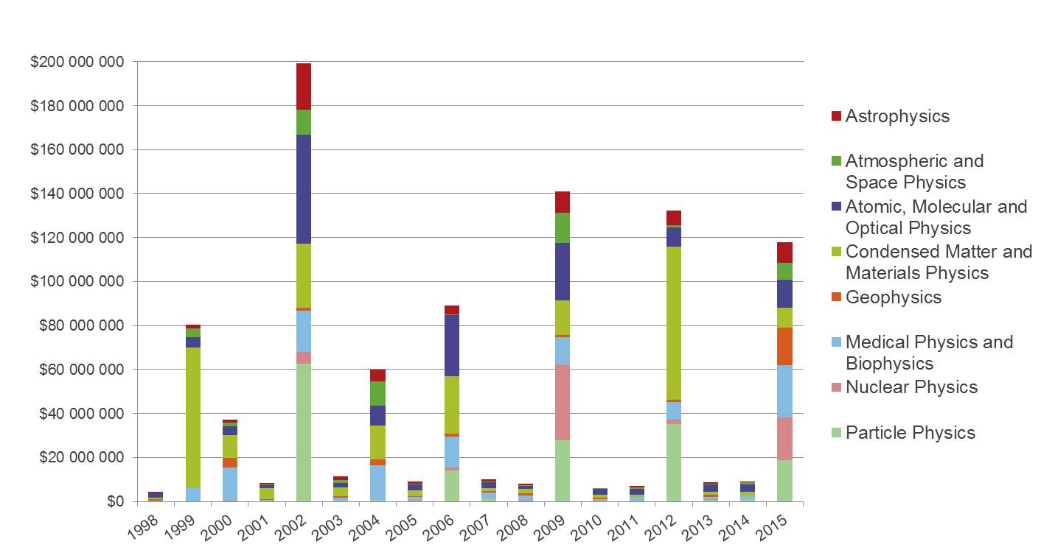
CFI Funding in Physics
Notes:
727 projects (8%) for $940M (14%)
1999: CLS ($56M)
2000: Montreal Consortium for Brain Imaging Research ($12M)
2002: SNOLAB ($55M), COPL ($22M), ALLS ($21M), Oak Ridge Spallation Neutron Source ($15M), SCUBA-2 on James Clerk Maxwell Telescope ($12M)
2006: IQC ($23M), Brockhouse beamline at CLS ($15M), ATLAS Tier-1 Data Center ($14M), Biomedical Multimodality Hybrid Imaging ($13M)
2009: ARIEL-I ($23M), DEAP-3600/SNO+ ($14M), Perimeter Institute ($13M), Resolute Bay Incoherent Scatter Radar ($13M)
2012: CLS 5-year O&M ($46M), SNOLAB 5-year O&M ($29M)
2015: ARIEL-II ($18M), Churchill Marine Observatory ($17M), Neurophotonics Initiative ($14M)

Slide 4
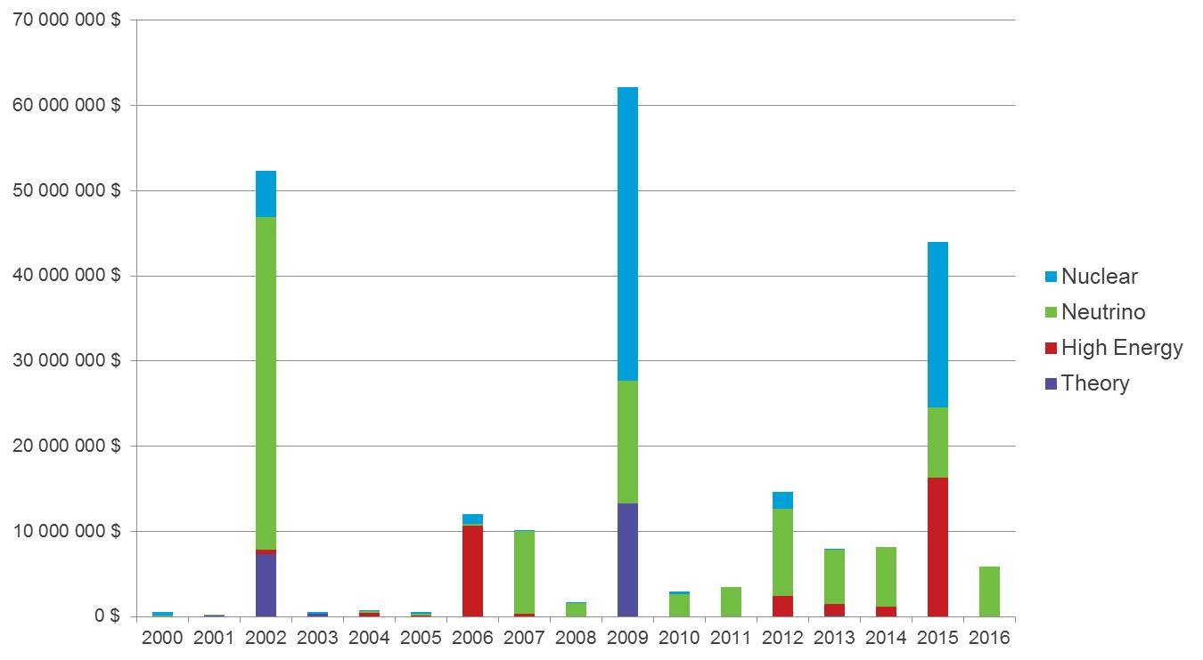
Subatomic Physics
Notes:
68 projects (0.8%) for $228M (3.5%)
$14M per year
NSERC for 2015: $23M
SNOLAB in 2002 ($39M), 2007 ($8M), 2009 ($14M)
SNOLAB O&M 2007-2017 ($1.4 to $5.9M per year)
Perimeter Institute in 2002 ($7M) and 2009 ($13M)
CERN in 2006 ($11M) and 2015 ($16M)
TRIUMF in 2009 ($34M) and 2015 ($19M)
Aligned with NSERC funding
CFI expert committees use LRP to inform their decisions
CFI welcomes major new capital investment in Canada or abroad as well as R&D projects
If RTI-eligible, it’s also CFI-eligible
R&D phase: CFI (equipment) and NSERC (people) funding at the same time
Construction phase: CFI funding at the beginning, NSERC funding spread out over many years
Operation phase: CFI (O&M) and NSERC (research costs, e.g. people) funding at the same time

Slide 5
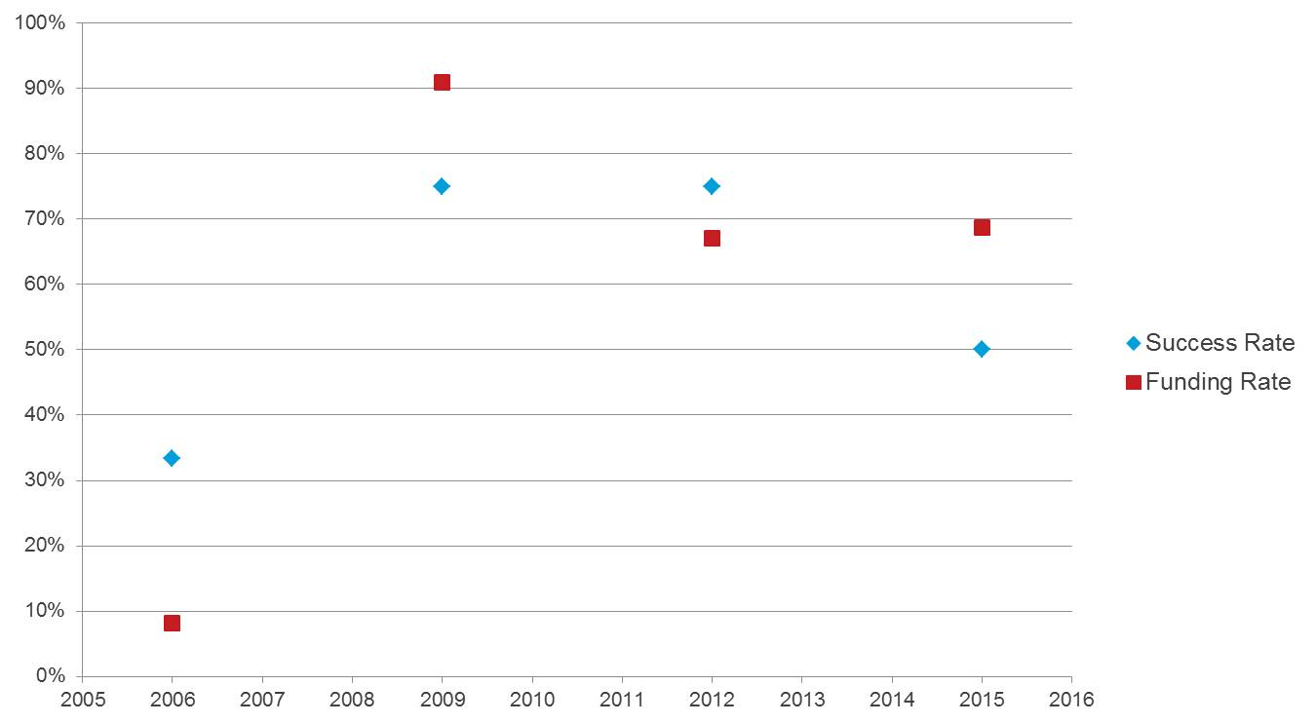
Success and Funding Rates
Notes:
2006: 3 projects
2009: 8 projects
2012: 4 projects
2015: 10 projects
Overall success and funding rates: 33%

Slide 6
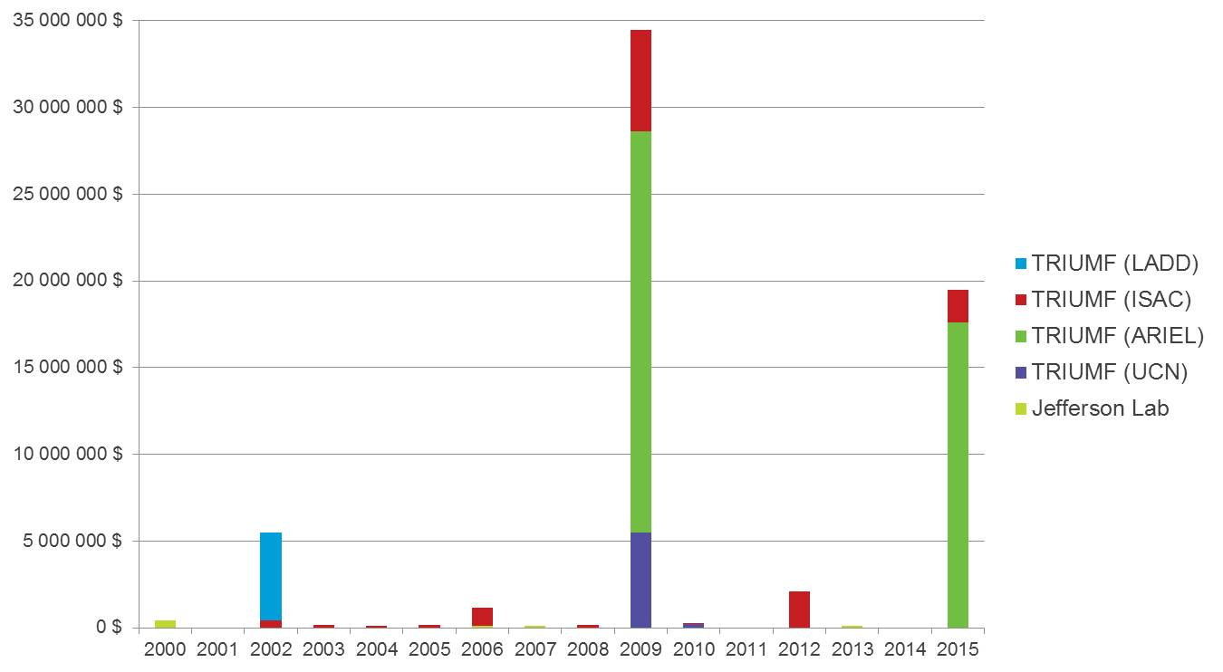
Nuclear Physics
Notes:
22 projects for $64M
2002: TRIUMF Laboratory for Advanced Detector Development ($5M)
2009: ARIEL-I ($23M), UCN ($5M) and GRIFFIN ($5)
2015: ARIEL-II ($18M)

Slide 7
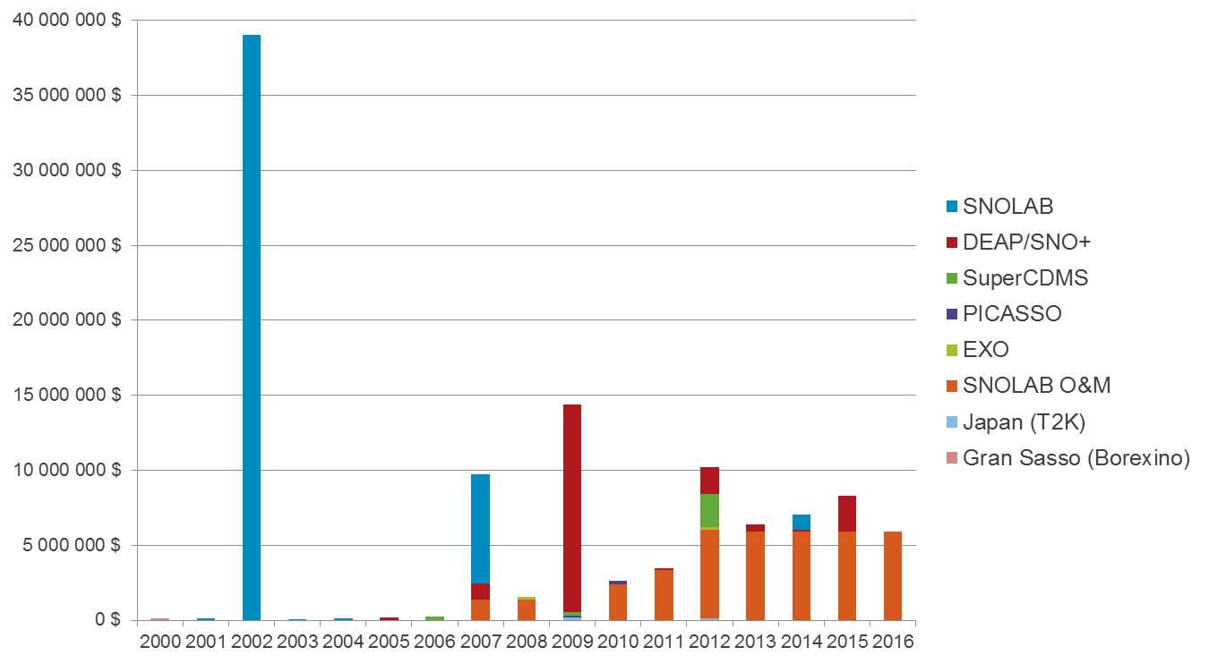
Neutrino Physics
Notes:
28 projects for $110M
2002 ($39M) and 2007 ($8M): SNOLAB
2007-2017: SNOLAB O&M ($1.4 to $5.9M per year)
2009: DEAP-3600 and SNO+ ($14M)

Slide 8
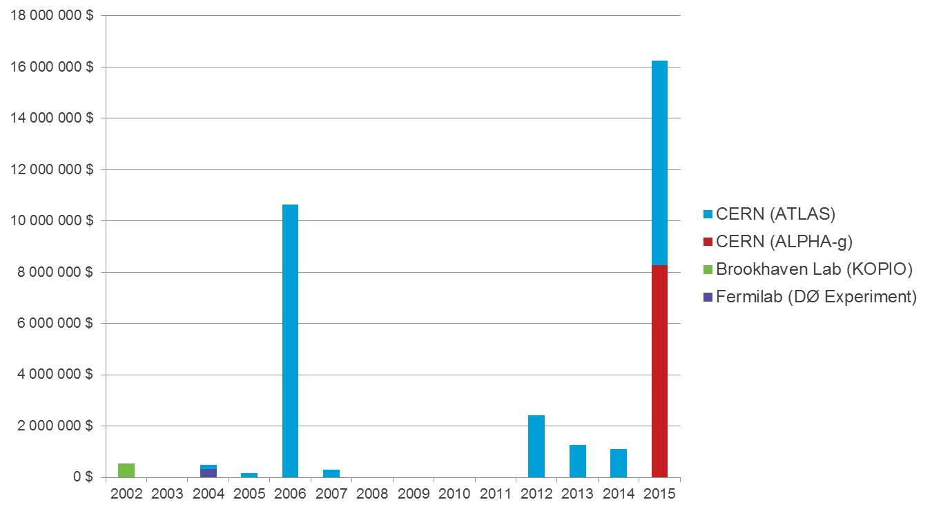
High Energy Physics
Notes:
12 projects for $33M
2006: ATLAS Tier-1 Data Center ($11M) + 2012-2015 O&M ($1.1M per year)
2015: ATLAS Upgrade ($8M) and ALPHA-g ($8M)

