Slide 1
Virtual Reality Educational Games: a Case Study in Large Scale Particle Physics Research
An Educational Game for the KATRIN experiment Till Bergmann
(Download-Link: http://www.ipe.fzk.de/~bergmann/katringame/ or http://www.tillbergmann.de/ )

Slide 2
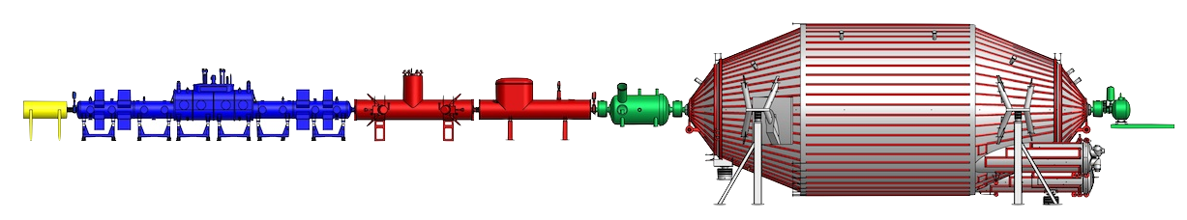
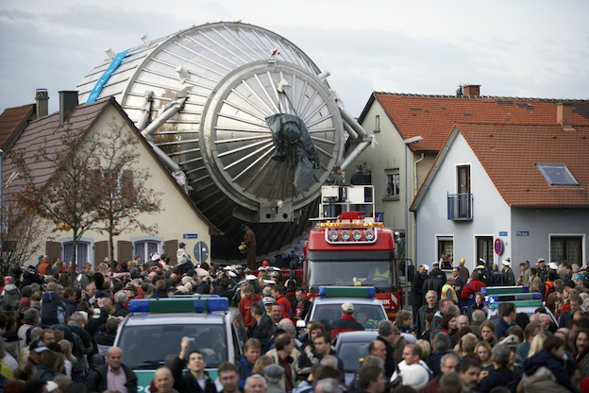
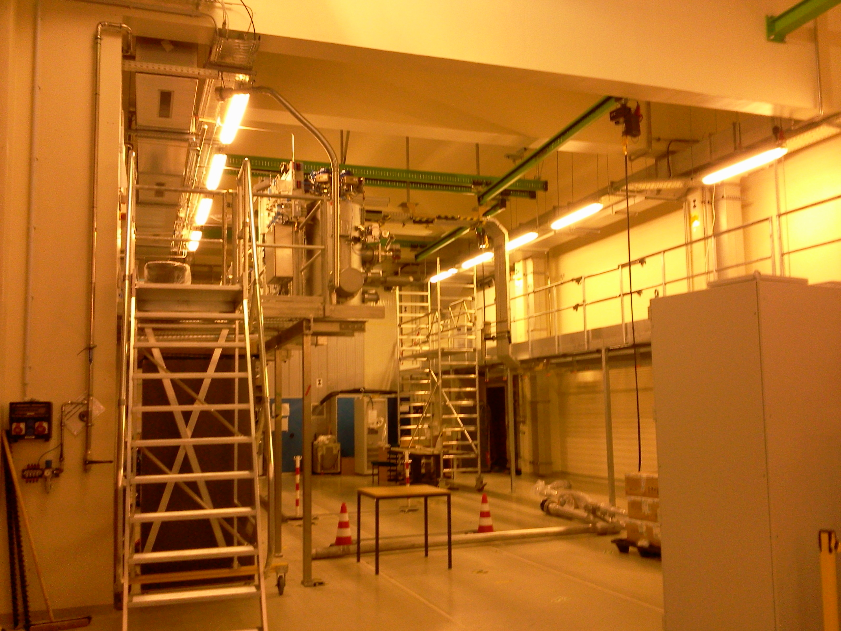
Virtual visits to large-scale physics experiments
Educational requirements
illustrate the dimensions of the real setup
all buildings and components explorable
recognize virtual components in reality
illustration of measurement principle
(using animations, not: physics simulations)
Interactive elements and game mechanics
Implementation requirements
look-and-feel of commercial adventure games
affordable game design (time and money)
use CAD drawings to construct the game geometry
open source software (Blender, www.blender.org)
Schematic drawing of
experiment setup: size?
Spectrometer transport:
this is large!
Under construction …

Slide 3
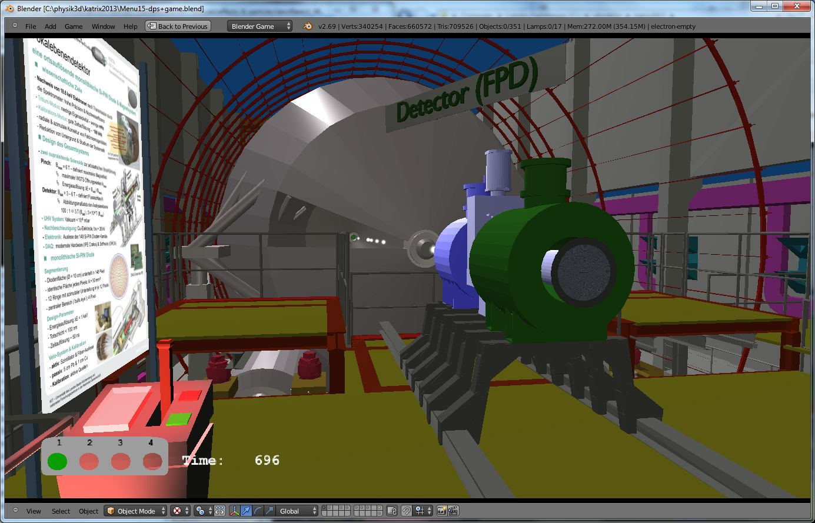
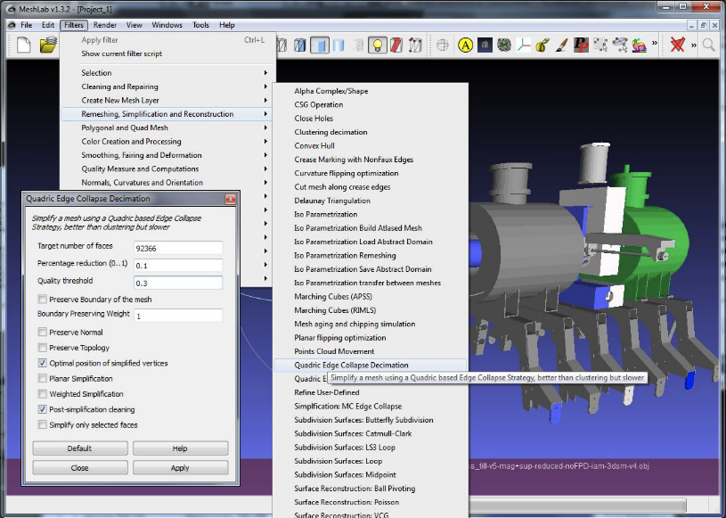
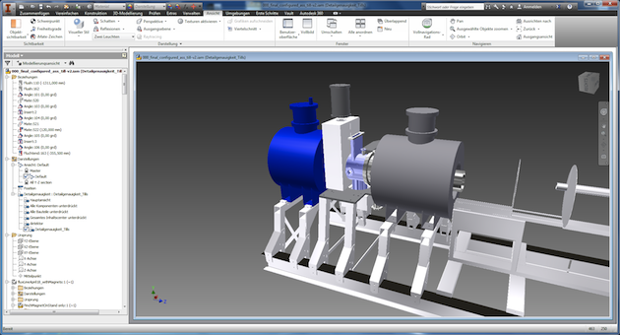
From CAD drawings to the game geometry
Workflow
Inventor (AutoDesk ™)
MeshLab
Blender 3D modeling
Blender
10.000 polygons
and finishing
MeshLab
100.000 polygons
AutoDesk Inventor
1.000.000 polygons →
100.000 polygons
Fast game geometry
construction!

Slide 4
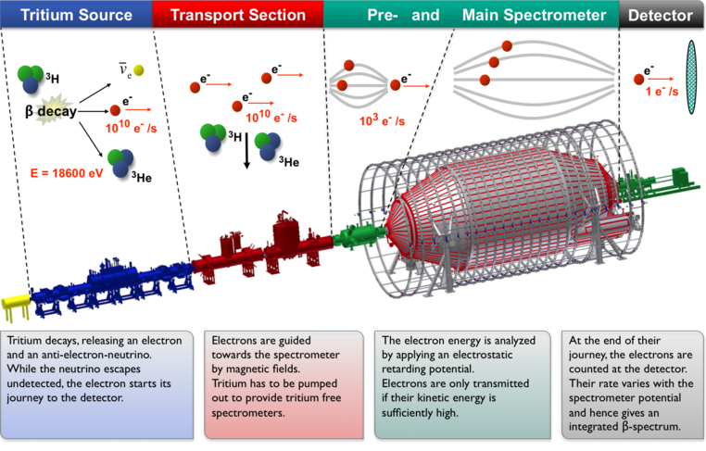
The KATRIN experiment goal: direct measurement of the neutrino mass
more info:
katrin.kit.edu
Neutrino
Electron
Tritium area (radioactive)
70 m

Slide 5
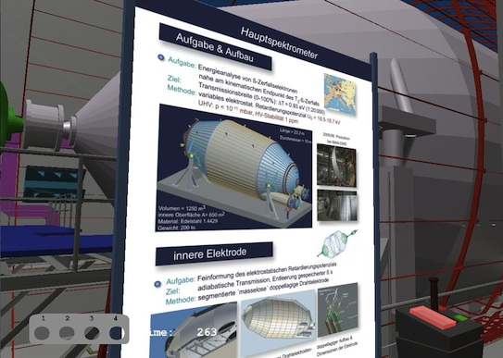
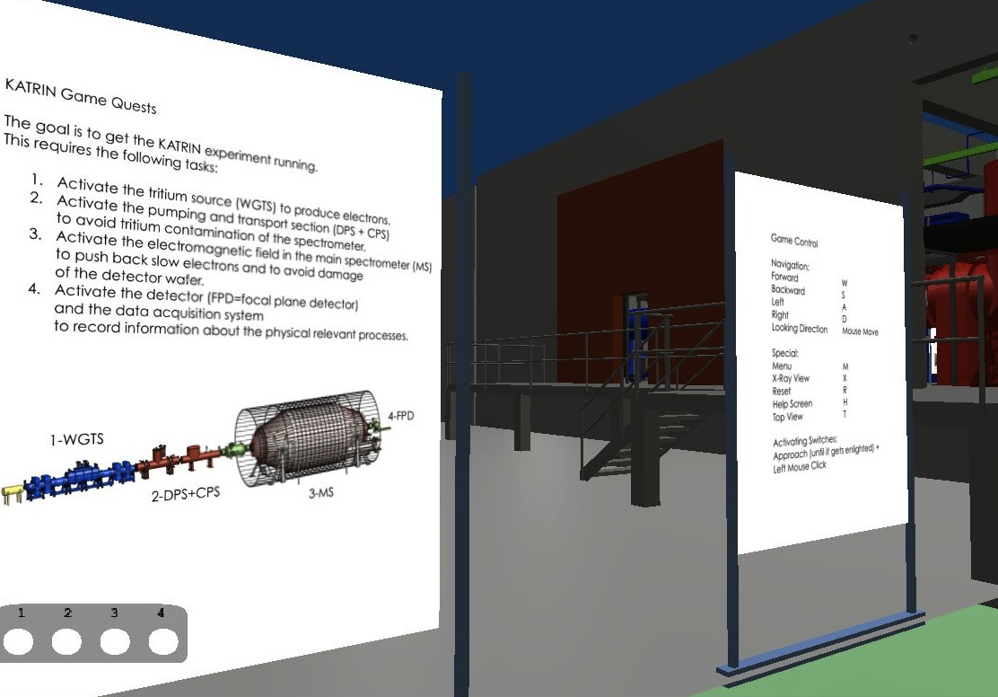
KATRIN educational game: features
Game navigation: standard WASD control scheme
Virtual posters: copy of real posters and game instructions
Virtual posters: info points (physics and technics) and game instructions

Slide 6
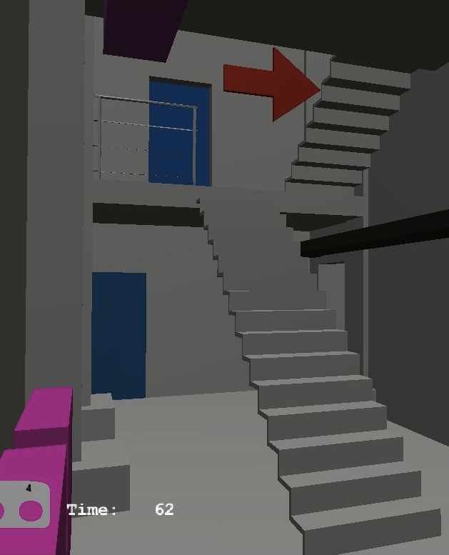
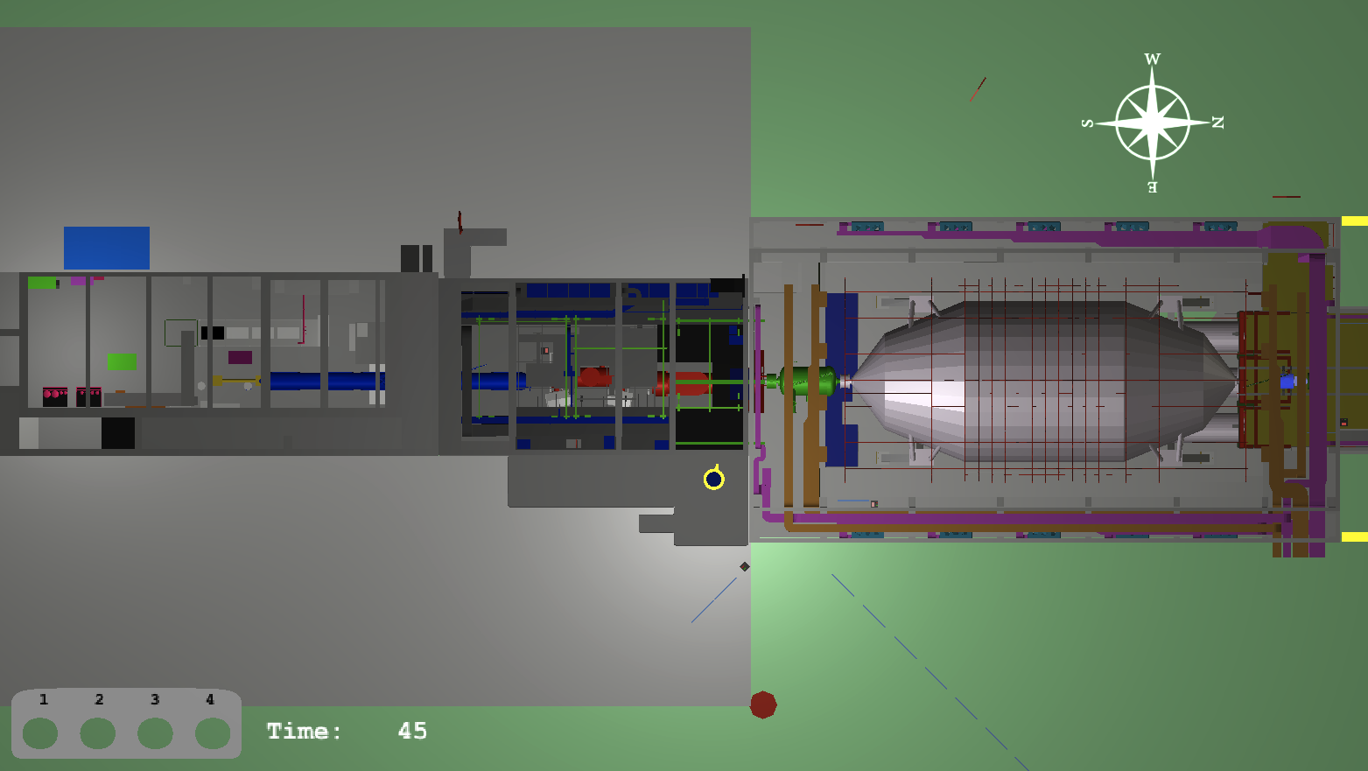
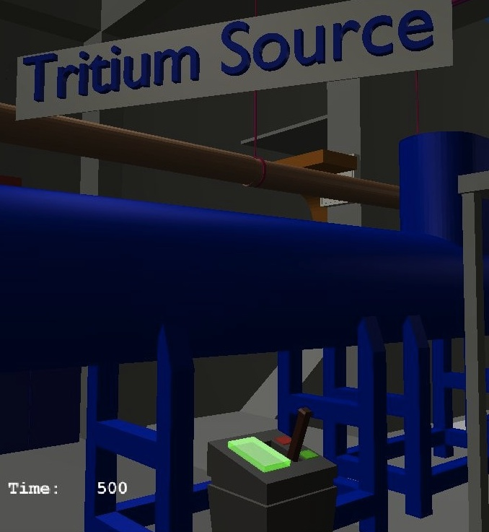
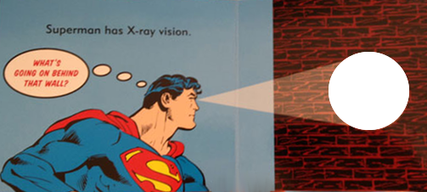
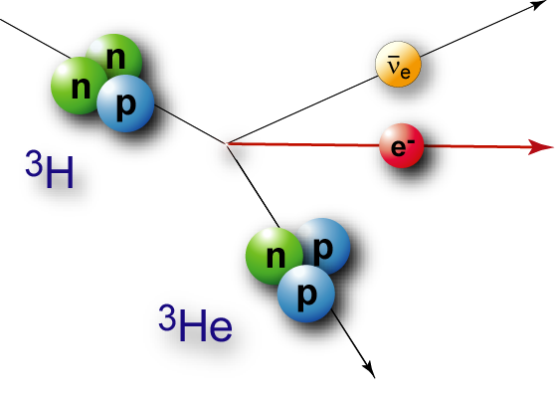
KATRIN educational game: features
virtual tour marked with red arrows
map view to keep orientation
user interaction (switches) → animations
X-Ray view to see interior of components
Map View
Arrows mark virtual tour
Player position
Switch

Slide 7
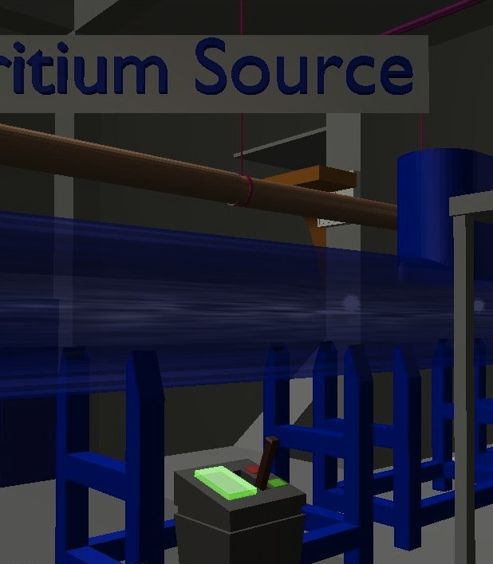
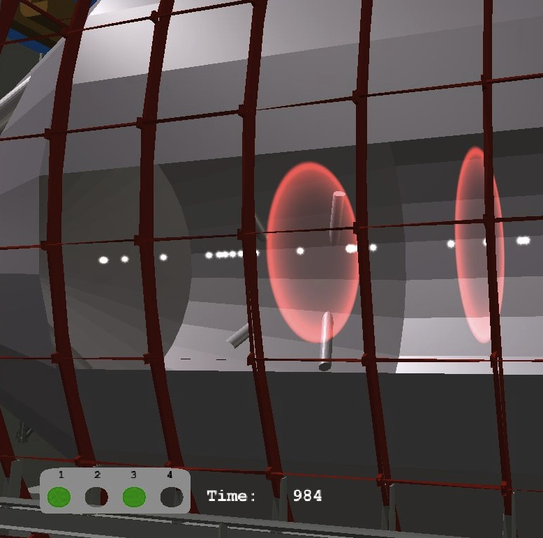
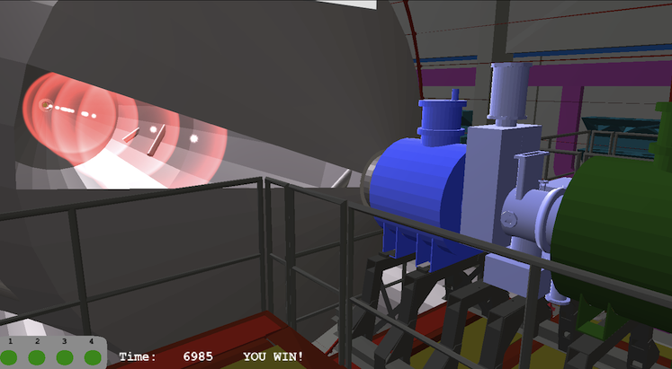
Animations illustrate the measurement principle
Tritium source: Tritium gas flow and electron production
Main spectrometer
  visualization of force on electrons induced by retarding static E-field
  retardation and acceleration of electrons
Detector:
  move detector carriage towards main spectrometer
  dock to main spectrometer
Game puzzle: activate all switches in the correct order!

Slide 8
Animations – Video:
Tritium Source + Transport section
Tritium Source + Transport section
Main Spectrometer + Detector
PDF-Version!
Videos are not included in this version!

Slide 9
Animations illustrate the measurement principle
Tritium source: Tritium gas flow and electron production
Main spectrometer
  visualization of force on electrons induced by retarding static E-field
  retardation and acceleration of electrons
Detector:
  move detector carriage towards main spectrometer
  dock to main spectrometer
Game puzzle: activate all switches in the correct order!

Slide 10
Animations – Video:
Main Spectrometer + Detector
Tritium Source + Transport section
Main Spectrometer + Detector
PDF-Version!
Videos are not included in this version!

Slide 11
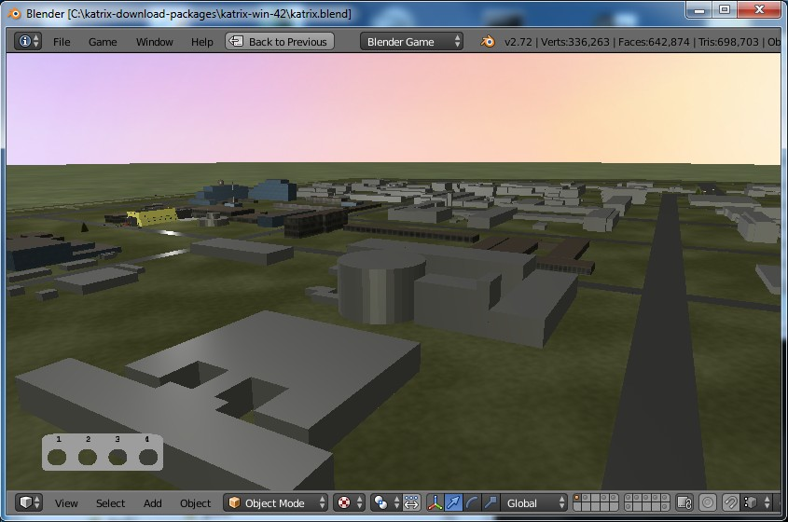
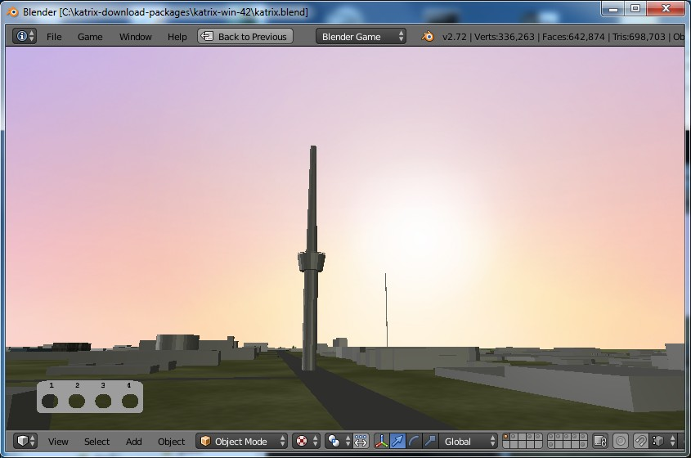
KIT campus site with ‘easter egg’
KIT campus: may help visitors to find KATRIN
Possible extension: show other experiments
Easter egg = beam up on tower: satisfy play instinct

Slide 12

KIT campus site with ‘easter egg’
KIT campus: may help visitors to find KATRIN
Possible extension: show other experiments
Easter egg = beam up on tower: satisfy play instinct
PDF-Version!
Videos are not included in this version!

Slide 13
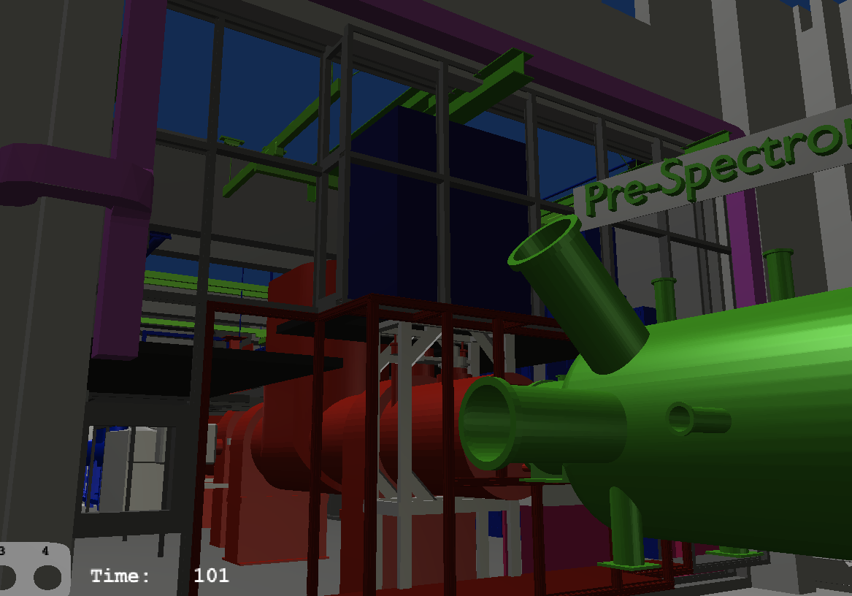
Use cases of the educational game
visit final assembly of the experiment: follow red arrows
  possible, even if not yet assembled in reality!
visit closed/restricted areas
visualize invisible (and dangerous) processes
get a visual impression of the measurement
principle and the interplay of the main experiment
components: solve the game puzzle
for physics students: learn details and background
about KATRIN:
  follow the virtual tour (red arrows)
  read the posters about physics
  solve the game puzzle
training for experiment operators
from distant countries
(PhD/Diploma students)
Under construction …
Same view in game

Slide 14
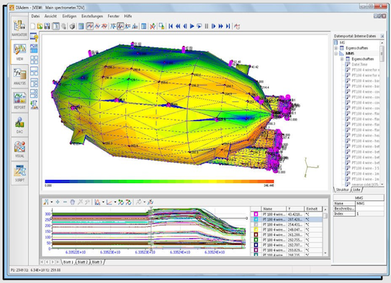
Outlook
Sound
Physics simulation visualization
Slow control data visualization for operators
better interaction and tour planning for teachers
Nowadays we have great tools to build computer games: we have powerful 3D graphic cards and great software – even open source!
Use gamification as visualization tool!
Visualization is the fundamental of all knowledge.
(freely adapted from Johann Heinrich Pestalozzi, 1746 – 1827)
The game is the way that children get to know the world in which they live (and which they are called upon to change). (Maxim Gorky, 1868 – 1936)
Slow Control Data with Diadem

Slide 15
Backup Slides
Neutrino Physics
WASD game control scheme
Tested Hardware
Blender
Learning Pyramid

Slide 16
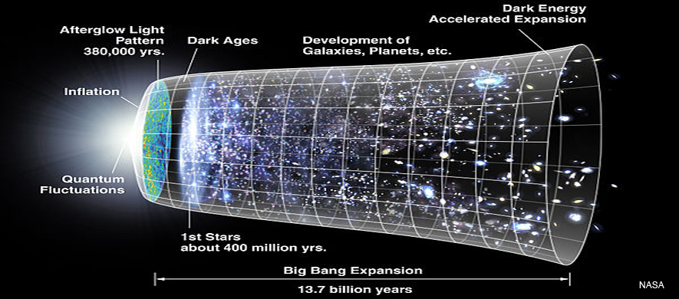
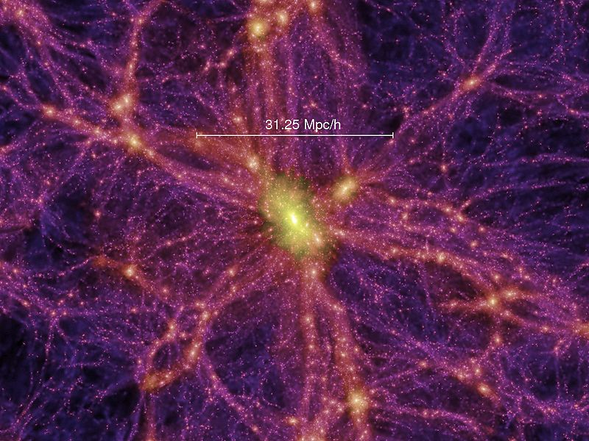
Physics and measurement principle
more info:
katrin.kit.edu
Neutrino Physics
observation of neutrino oszillations → neutrinos have mass
most important open issue in neutrino physics:
What is the absolute mass scale of neutrinos?
most abundant particle with mass in the universe
→ considerable influence on the development of the universe
recent experiments: neutrino mass smaller than 2 eV/c2
(electron: 511000 eV/c2 , KATRIN sensivity: 0.2 eV/c2)

Slide 17
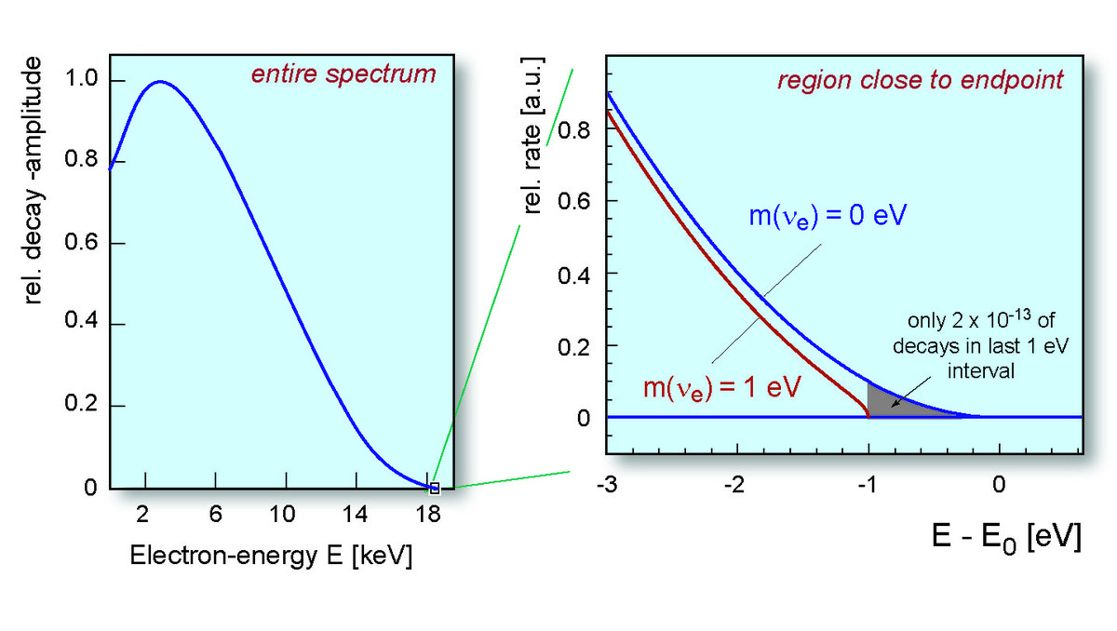
Physics and measurement principle
Measurement principle: Tritium decay
released energy E0=18600 eV, shared between kinetic energy of electron and neutrino and the rest mass of the neutrino m(νe)
the neutrino vanishes → measure energy E of electrons to get information about the neutrino mass m(νe)
the maximum possible electron energy E is E0- m(νe)
Tritium
Neutrino
decay
Electron
Helium
Tritium Decay
Electron Energy Spectrum

Slide 18
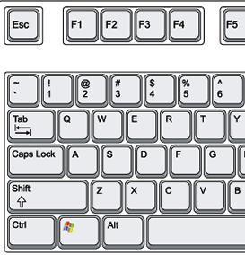


KATRIN educational game: features
navigation: WASD control scheme
Virtual posters:
  game instructions (H key)
  copy of real posters about KATRIN
virtual tour marked with red arrows
top view / map view to keep orientation
zoom
Combination of
keyboard and mouse:
Walking: WASD-keys
Viewing direction:
Mouse move
Viewing
direction
up
left
right
Walking
W: forward
down
A: left
D: right
originates from
T-shaped arrow
key block
S: backward

Slide 19
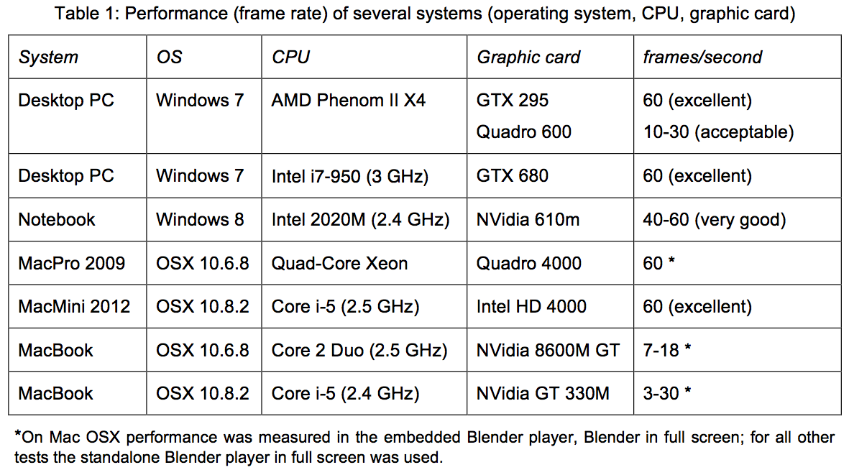
Tested CPU, Graphic Cards, OS
Backup Slides

Slide 20
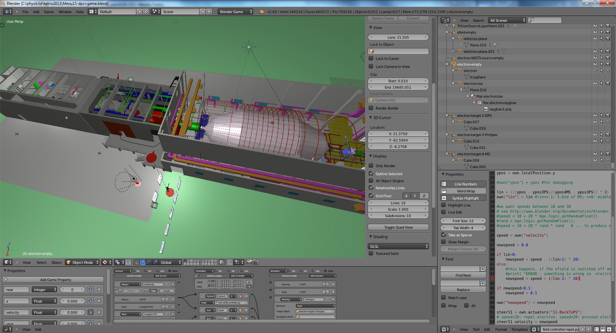
Blender 2.69 (www.blender.org)

Slide 21
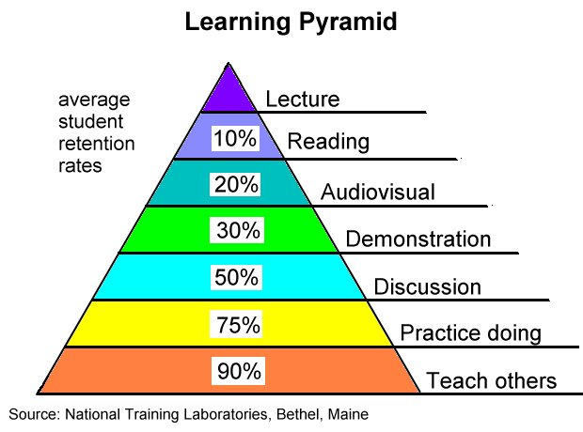

Motivation
Physics Education:
excursions important for sensual and visual experience beyond theoretical
and scientific lessons
→ supports sustainable comprehension
Public Relations:
great public interest in large-scale research facilities
→ provide information and access to experiment sites
Problem:
accessibility of the experiment
traveling time and costs
Proposed Solution: virtual reality (VR) visits
VR application prototype has been constructed:
the KATRIN educational game
(after 2 weeks)
Game

