Slide 1
The PENTAQUARK
is it magic?
R. Landua
July 2015
1 - Reminder: quarks, colour, J/𝜓
2 - Bound states of quarks - simple and complex states
3 - Why to search for a pentaquark?
4 - Production of b quarks in LHCb
5 - The decay of a Λb
6 - Some of the observations
7 - The analysis and interpretation

Slide 2
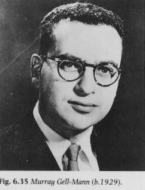
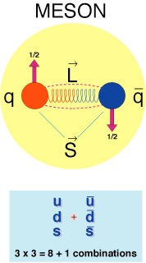
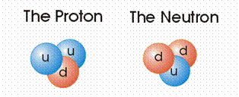
1963
REMINDER FROM LECTURES
SU(3) - Classification scheme based on ‘quarks’
1) 3 types of “quarks” : up, down, strange
u
d
s
2) Carry electric charges: +2/3, -1/3, -1/3
+2/3 e
-1/3 e
-1/3 e
3) Appear in combinations:
  Meson = quark+antiquark
  Baryon = quark(1) + quark(2) + quark(3)
Gell-Mann, 1963
(G. Zweig, 1963, CERN)

Slide 3
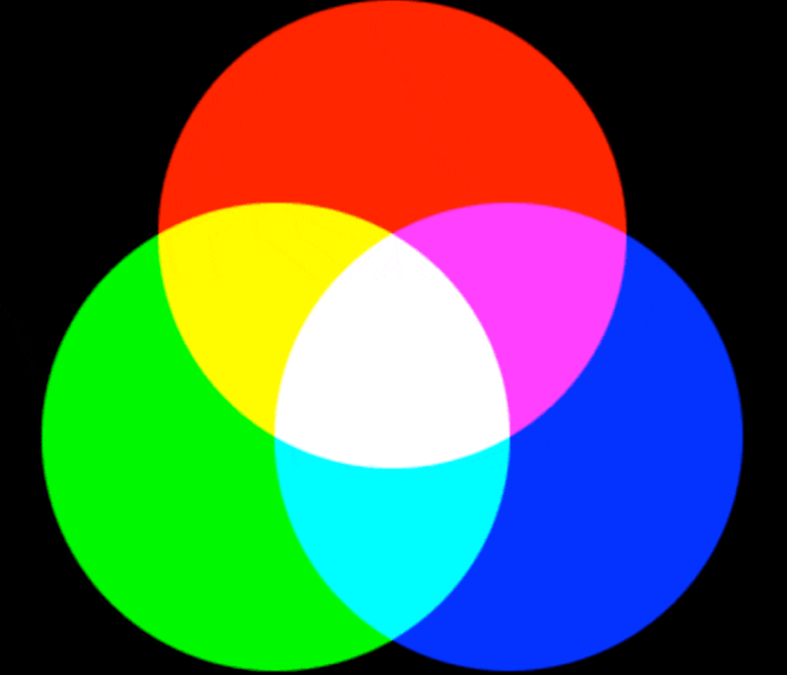
Quantum Chromo Dynamics
this has nothing to do
with our visible colours,
just an analogy
Theory constructed in analogy to QED
QCD: 3 different charges (“colour charge”) [red, green, blue]*
‘Strong force’ between quarks is transmitted by (8) gluons
Dogma of QCD: Only colour-neutral bound states are allowed
MESONS = Quark-Antiquark
BARYONS = 3-Quark states

Slide 4
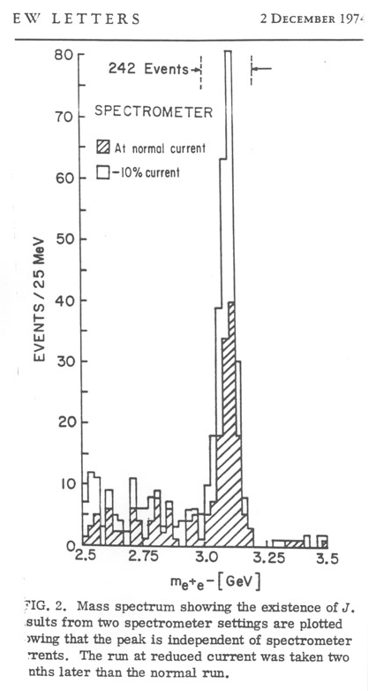
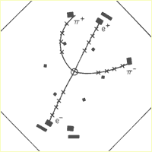
1974
Discovery of the ‘charm’ quark in 1974
NOVEMBER REVOLUTION (11 November 1974)
'Psi' am SLAC (Burt Richter)
'J' at Brookhaven (Sam Ting)
Compromise: J/Psi
“Extremely” long lifetime (~10⁻²⁰ sec)
Decay only possible through electroweak interaction

Slide 5

2 - Bound states of quarks - simple and complex states
QCD: only ‘white’ states can exist
“50 shades of white”
MESON
+
= white
Colour
Anti-Colour
SIMPLEST STATES
BARYON
= white
+
+
Blue
Green
Red

Slide 6
2 - Bound states of quarks - simple and complex states
More complex bound states also allowed:
+
Four quark state
= white
+
Colour
Anti-Colour
COMPLEX BOUND STATES
Five quark state
Colour
Anti-Colour
“Pentaquark”
= white
Blue
Green
Red

Slide 7
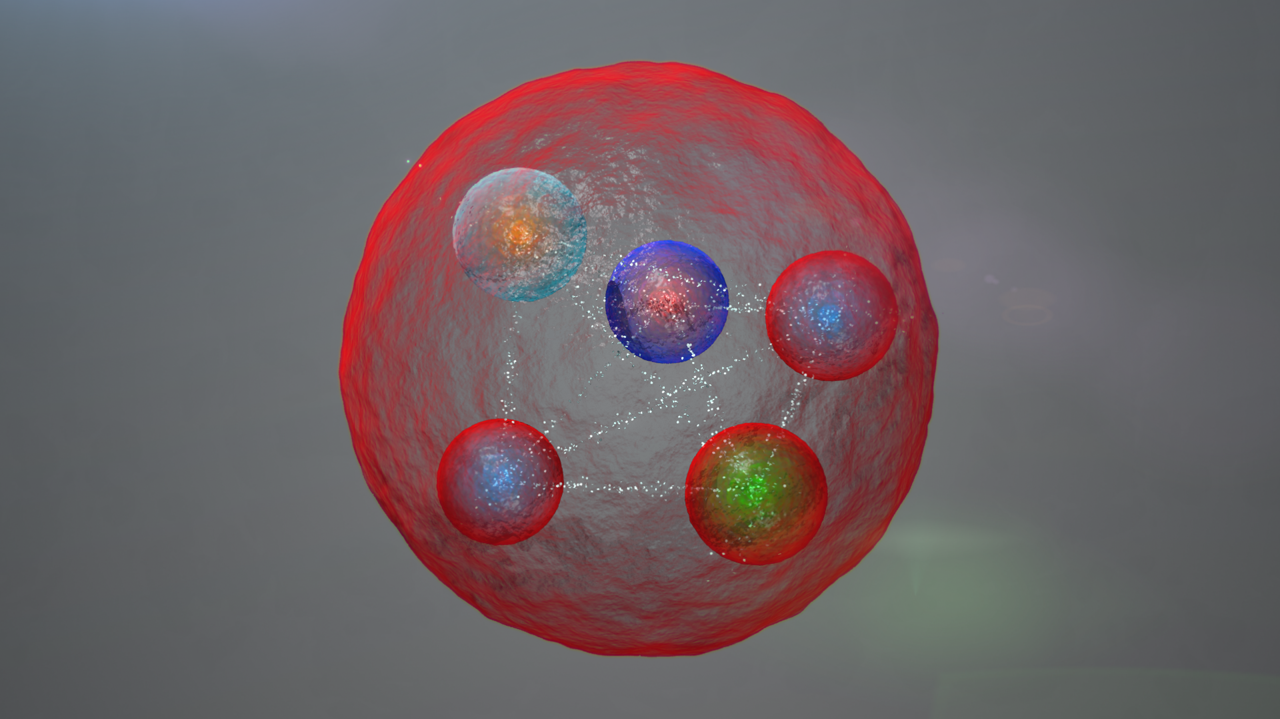
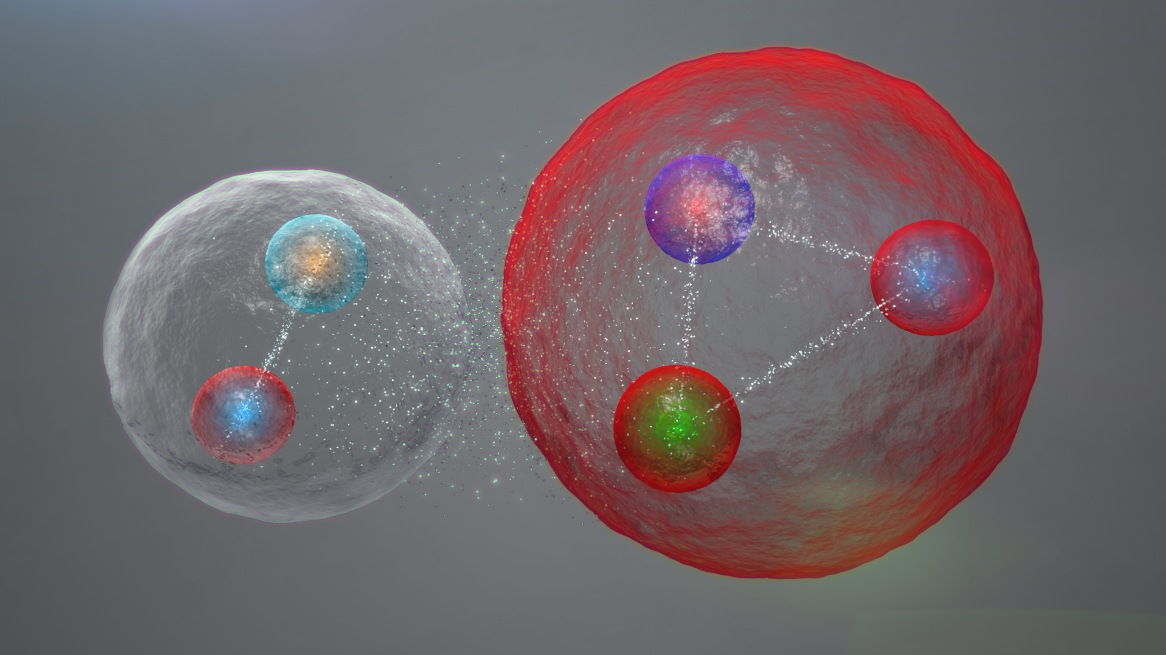
3 - Why to search for a pentaquark?
Better understanding of QCD at low energy
This … or this ?

Slide 8

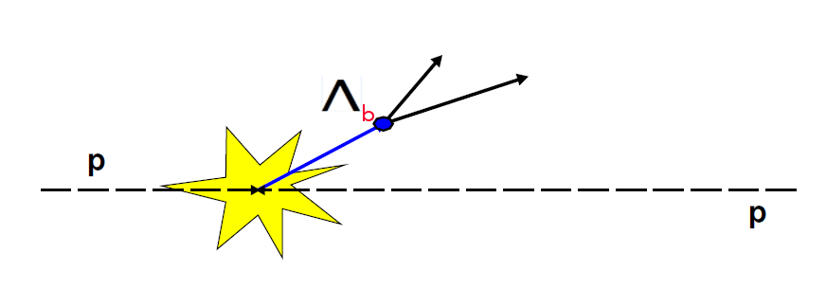

4 - Production of b quarks in LHCb
J/𝜓
p
K⁻
Secondary vertex
Lifetime Λb : 1.4 · 10⁻¹² sec ~ 435 µm
Mass Λb : 5619.5 MeV

Slide 9
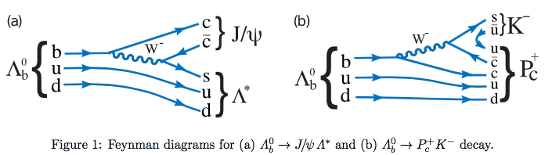
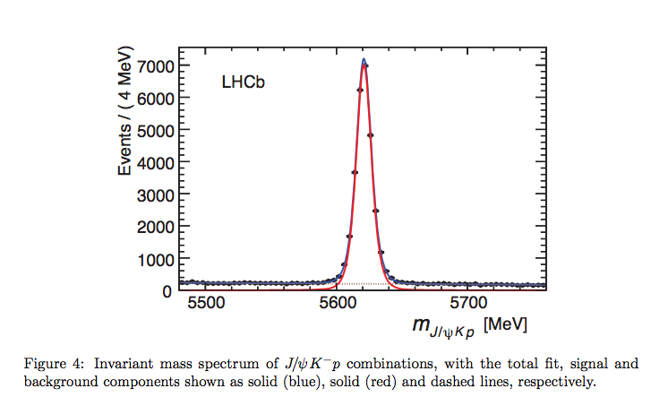
5 - The decay of a Λb
Mass Λb : 5619.5 MeV

Slide 10
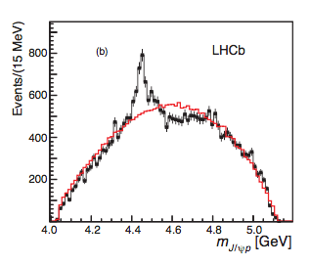
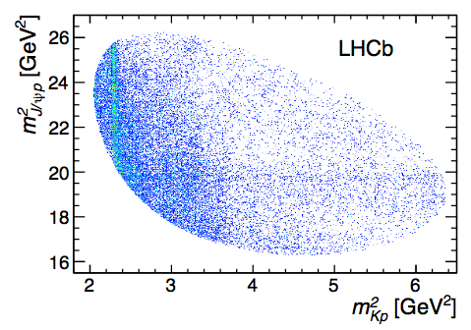
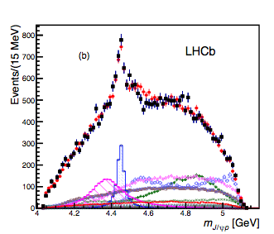
6 - Some of the observations
M = 4380 MeV, Width = 205 MeV
M = 4450 MeV, Width =40 MeV
Two Penta-Quark states

Slide 11
7 - Analysis and interpretation
Complex partial wave analysis based on “Dalitz plot”
Best fit results: Spin 3/2 (broad state), Spin 5/2 (narrow state)
J/𝜓
p
J/𝜓
p
More studies are necessary to find out more about these states.

