Slide 1

Abha Phoboo, Konrad Jende, High School Teacher Programme 2015
WG2: Educational games

Slide 2
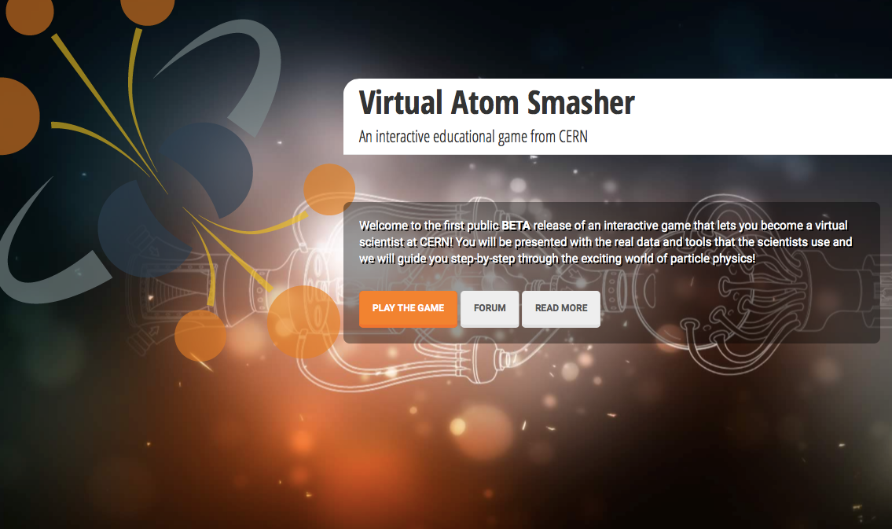
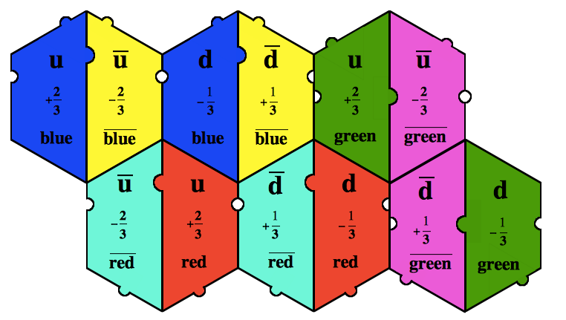
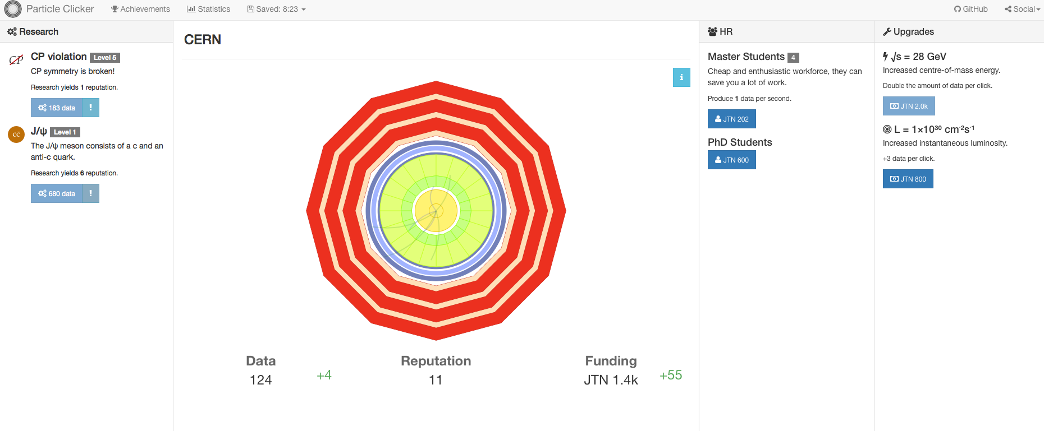
Have fun!
Online Computer Games
Dice games
Card games
Puzzle games

Slide 3
Specific Task for the group
Have Fun!
Find out, which games are efficient when learning particle physics.

Slide 4
Working group leaders, 1st meeting
Abha Eli Phoboo: abha.eli@cern.ch
Konrad: konrad.jende@cern.ch
1st meeting: 8 July 2015 4:00pm at 61/1-009 (Salle C)

Slide 5

Merci
Konrad Jende - konrad.jende@cern.ch
33/R-010 +41 75 411 0246

