Slide 1
HCAL Analysis
Yalcin Guler
Serdal Damarseckin, Emine Gurpinar
Shuichi Kunori, Isa Dumanoglu,
Bayram Tali, Merve Ince, Hasan Huseyin Isik, Samet Lezki

Slide 2
Introduction
The code is checked.
2012D minimum bias data is analysed
We have updated all plots
  Calculate a vector sum of PT of PMTs hits in iphi=39, 41, 43, 45, 47

Slide 3
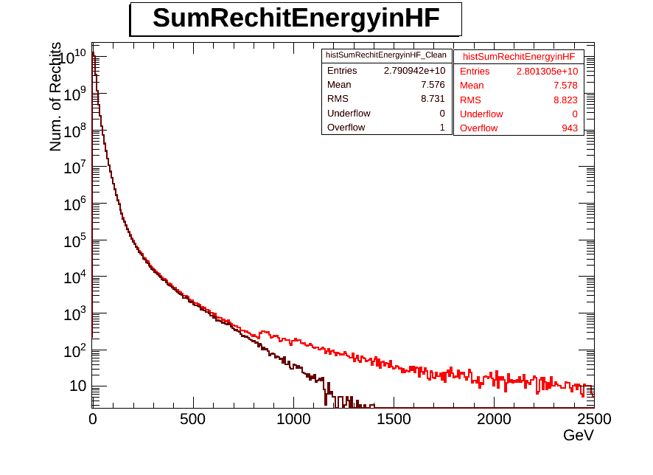
Individual Recohit Energy in HF before and after filter

Slide 4
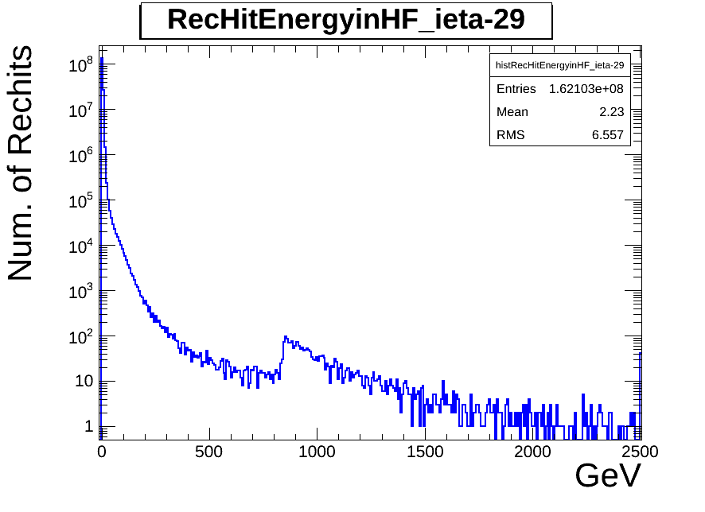
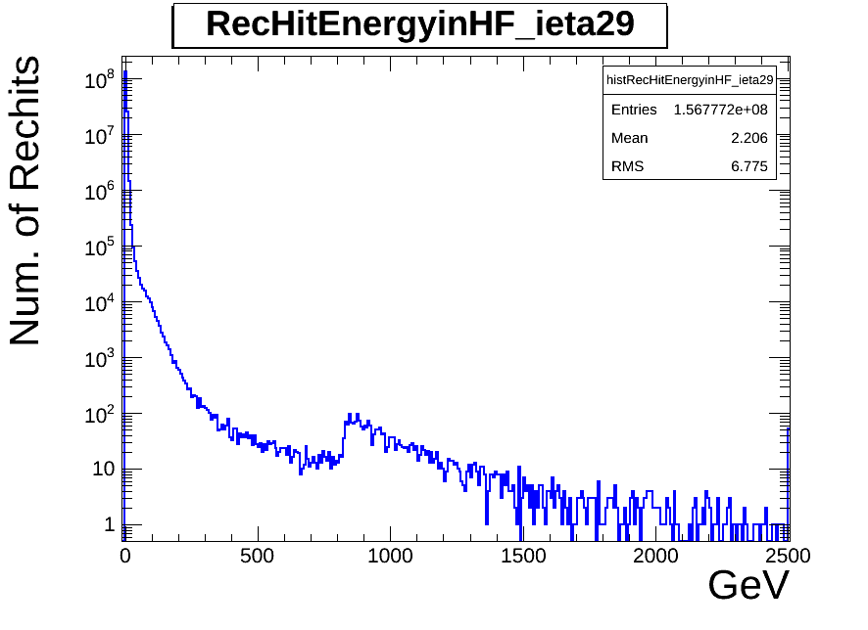
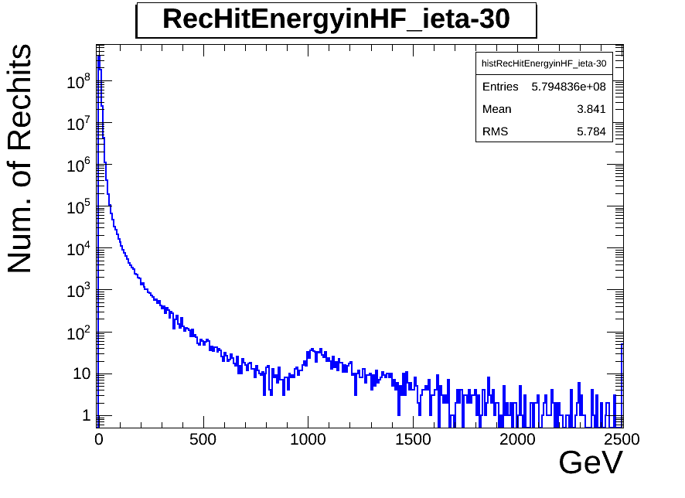
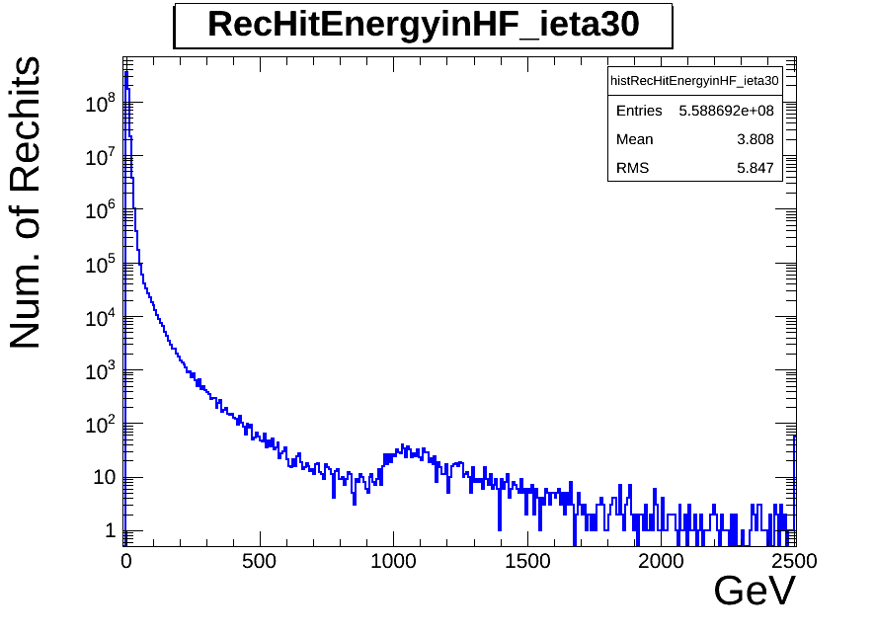
Individual Recohit Energy ieta=-29, 29, -30, 30

Slide 5
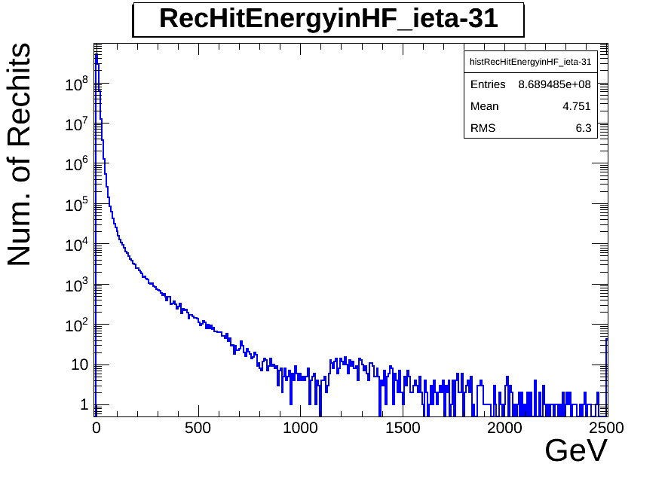
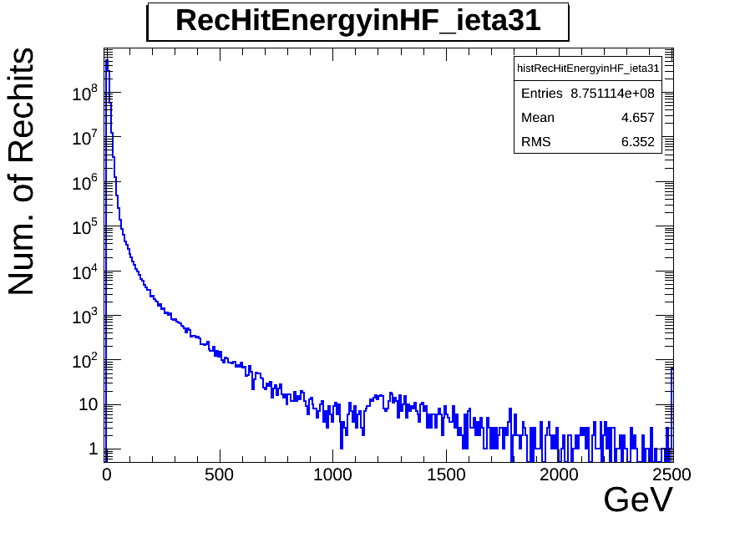
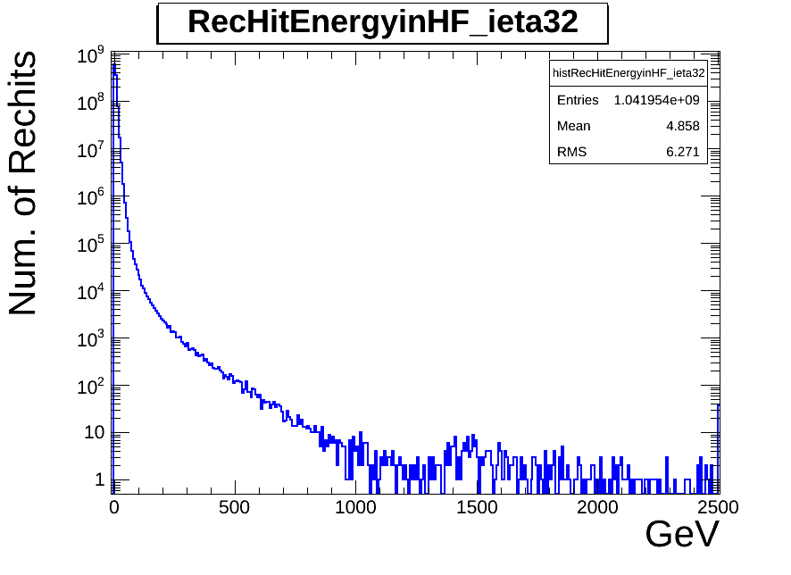
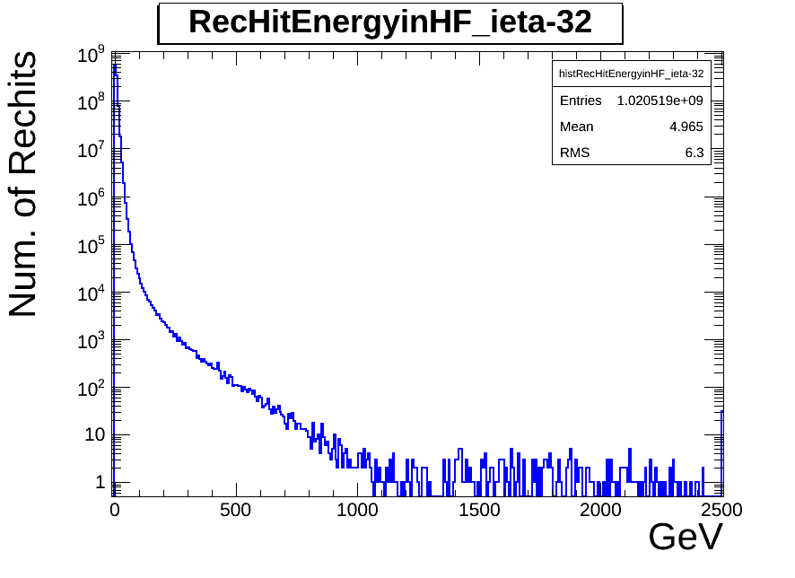
Individual Recohit Energy ieta=-31, 31, -32, 32

Slide 6
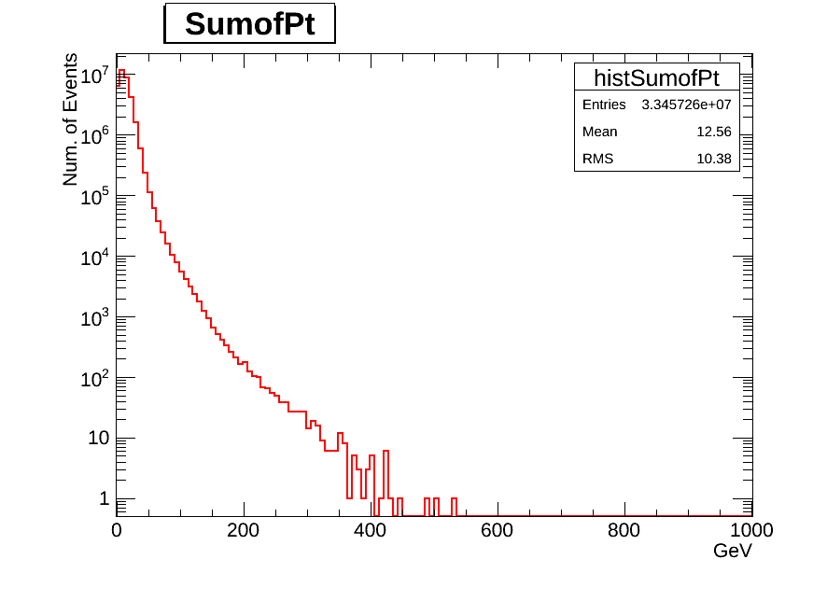
Pt distribution

Slide 7
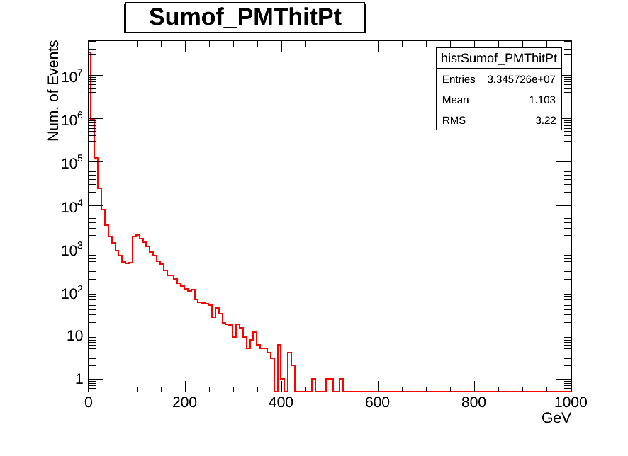
Pt distribution of PMT hits

Slide 8
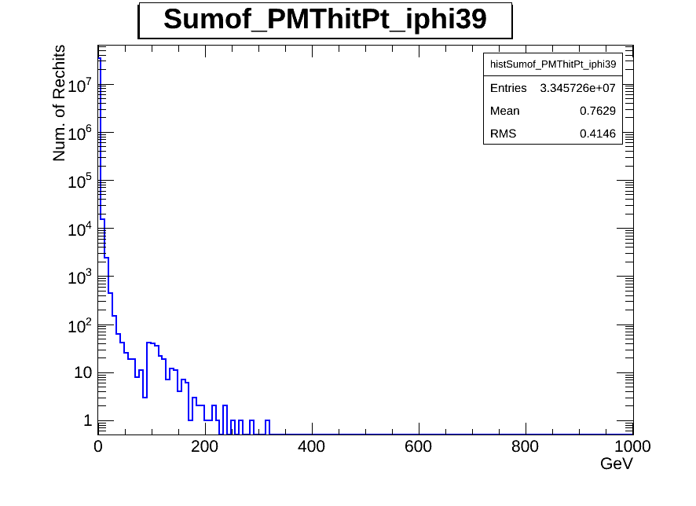
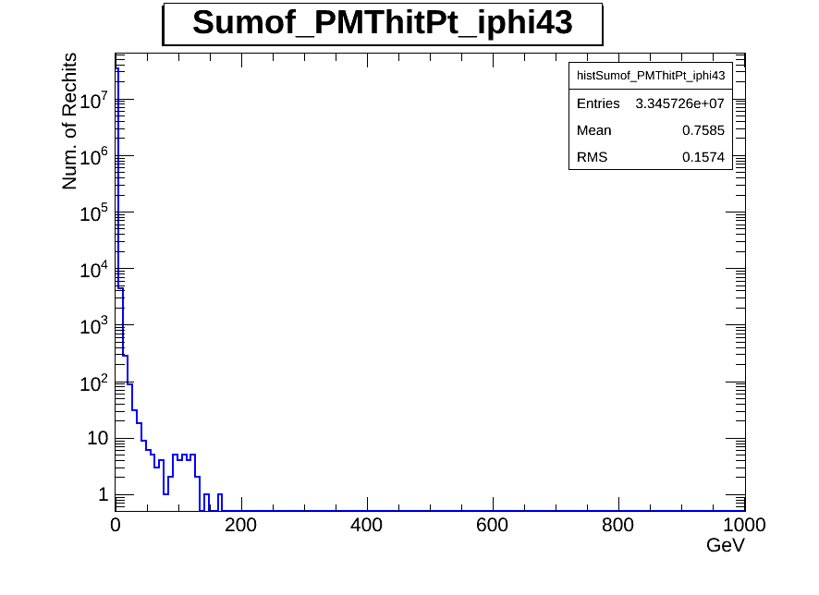
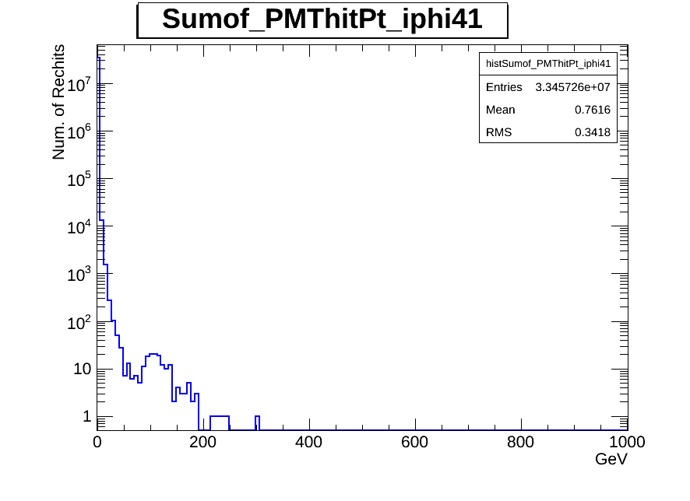
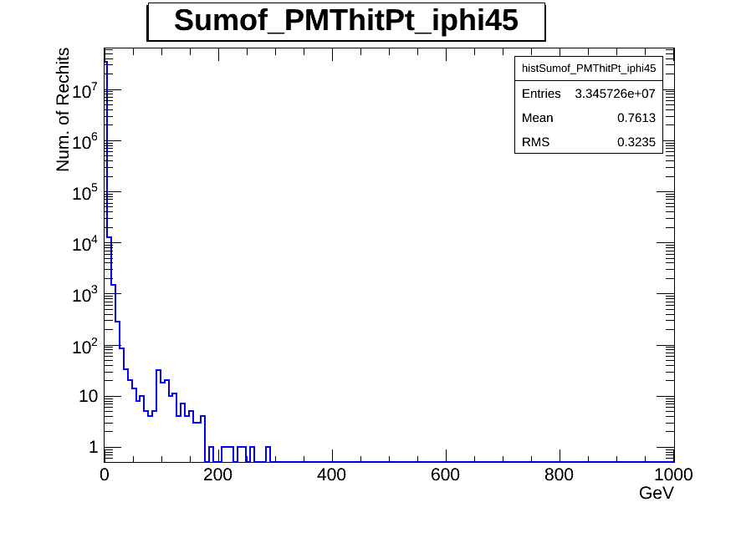
Pt distribution of PMT hits iphi=39, 43, 41, 45
İphi=39
Old PMTs
İphi=43
New PMTs
İphi=41
Old PMTs
İphi=45
Old PMTs

Slide 9
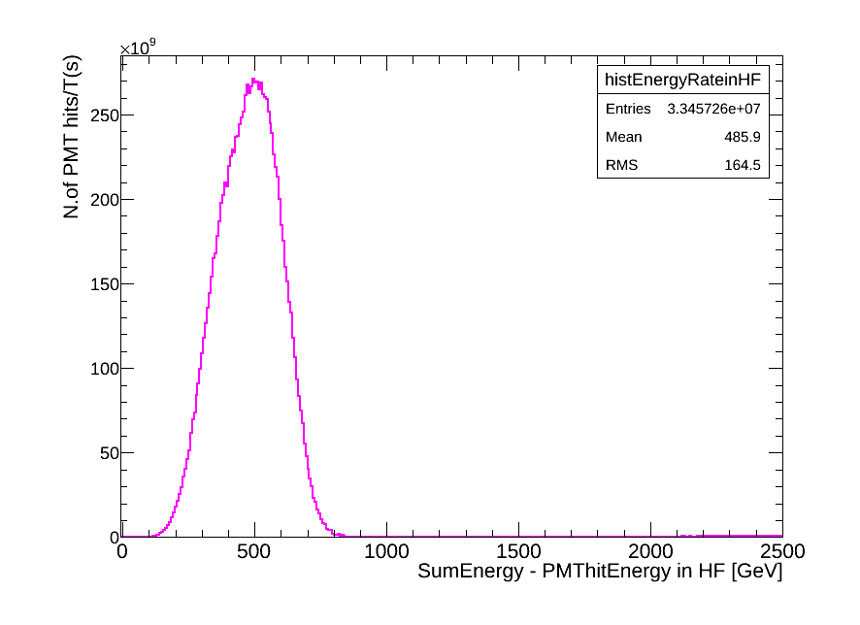
Clean Energy vs Rate
T [sec] =integratedLumi/L(average)
Rate = N/T * 1.5E6 * 36 [Hz]
N: noise events
ZeroBias trigger used a pre scaling factor
9973(L1)x150(HLT) = 1.5E6, according to RunSummary

Slide 10
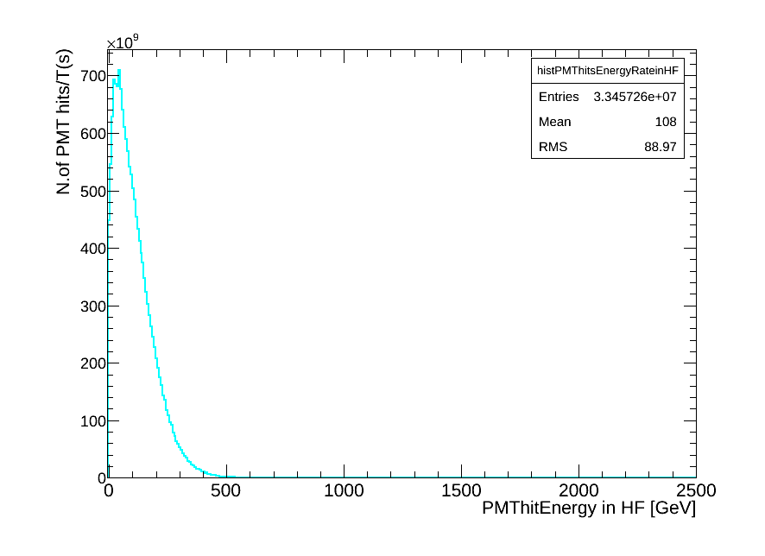
PMThits Energy vs Rate
T [sec] =integratedLumi/L(average)
Rate = N/T * 1.5E6 * 36 [Hz]
N: noise events
ZeroBias trigger used a pre scaling factor
9973(L1)x150(HLT) = 1.5E6, according to RunSummary

Slide 11
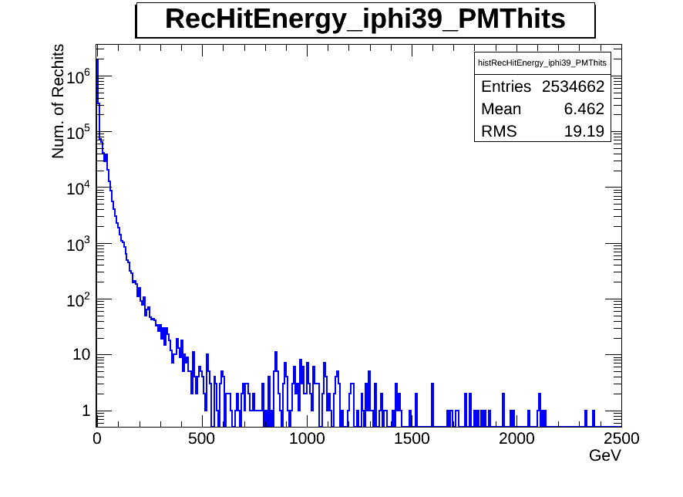
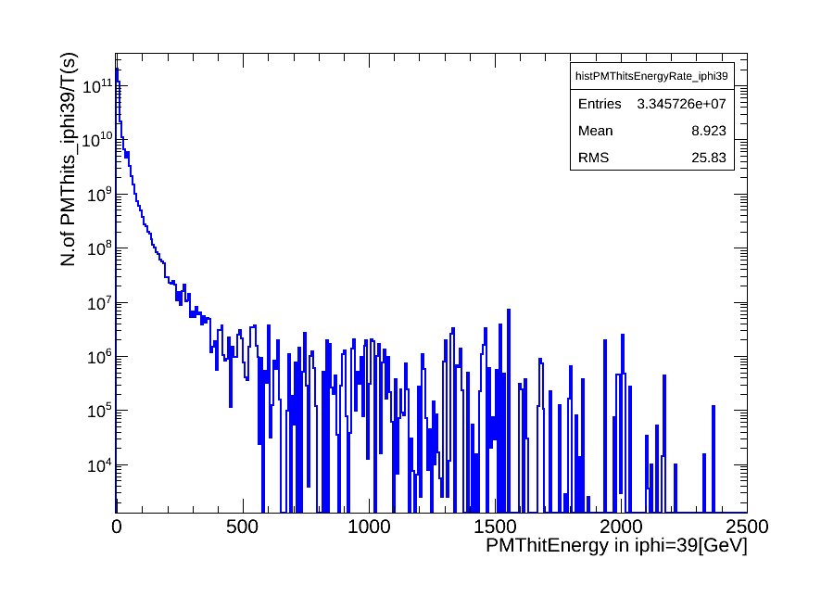
PMThits Energy and PMThits Energy in iphi=39 vs Rate
Old PMTs

Slide 12
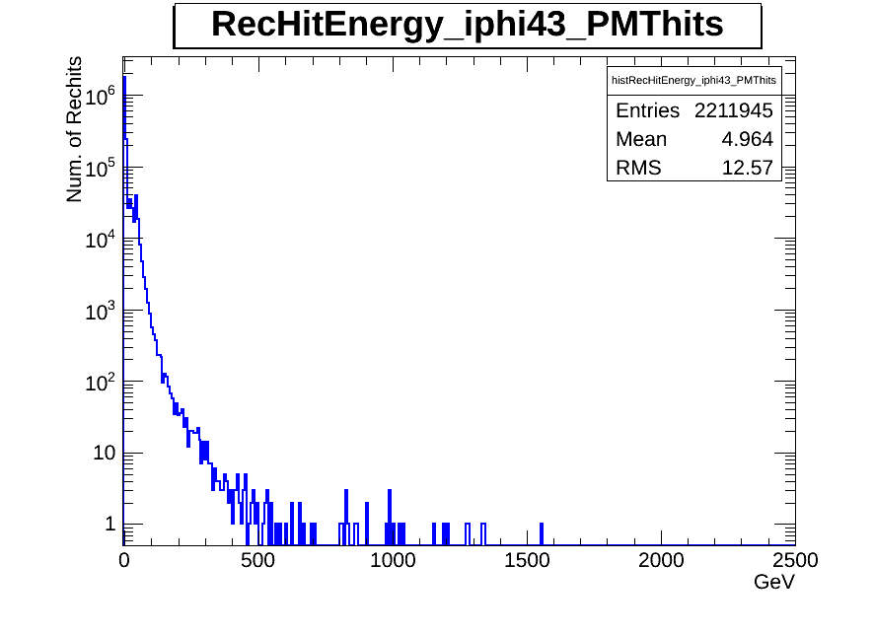
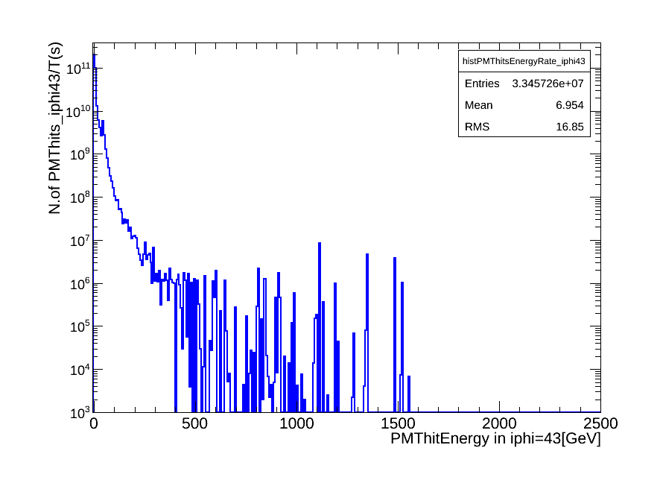
PMThits Energy and PMThits Energy in iphi=43 vs Rate
New PMTs

Slide 13
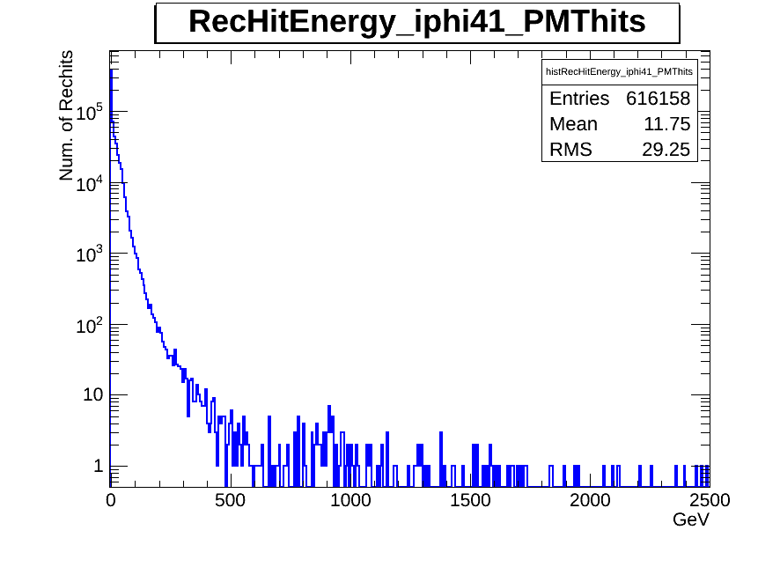
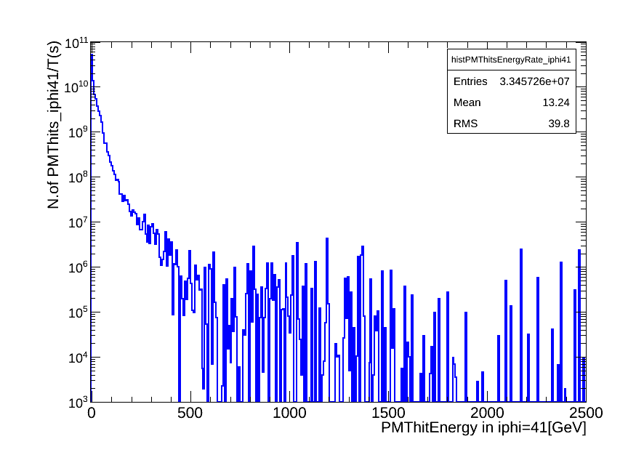
PMThits Energy and PMThits Energy in iphi=41 vs Rate
Old PMTs

Slide 14
Summary
We have presented updated results for all HF and also new PMTs using all 2012D minimumbias data set.
Sum of Energy and vector sum of Pt are shown.
/afs/cern.ch/work/y/yalcin/public/Hcal/CMSSW_7_1_7/src/HcalAnalyzer/HcalRecHitAnalyzers/plugins/HcalRecHitAnalyzers.cc
/afs/cern.ch/work/y/yalcin/public/Hcal/CMSSW_7_1_7/src/HcalAnalyzer/HcalRecHitAnalyzers/test/Results/

Slide 15
Back up

Slide 16
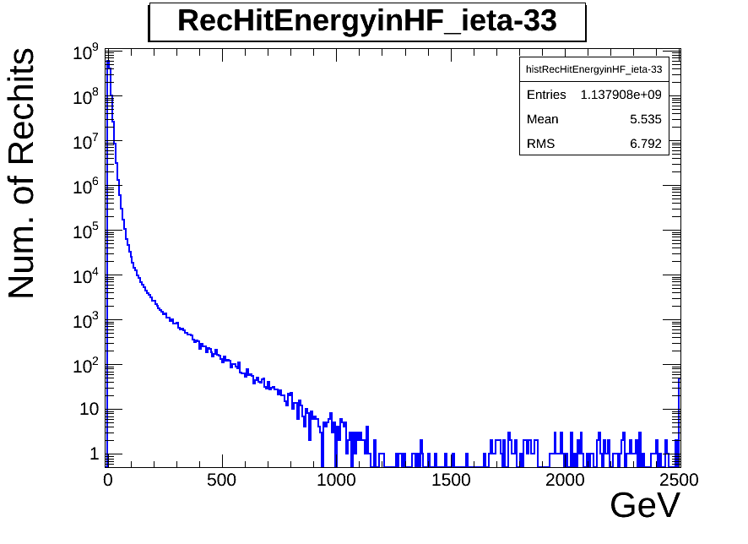
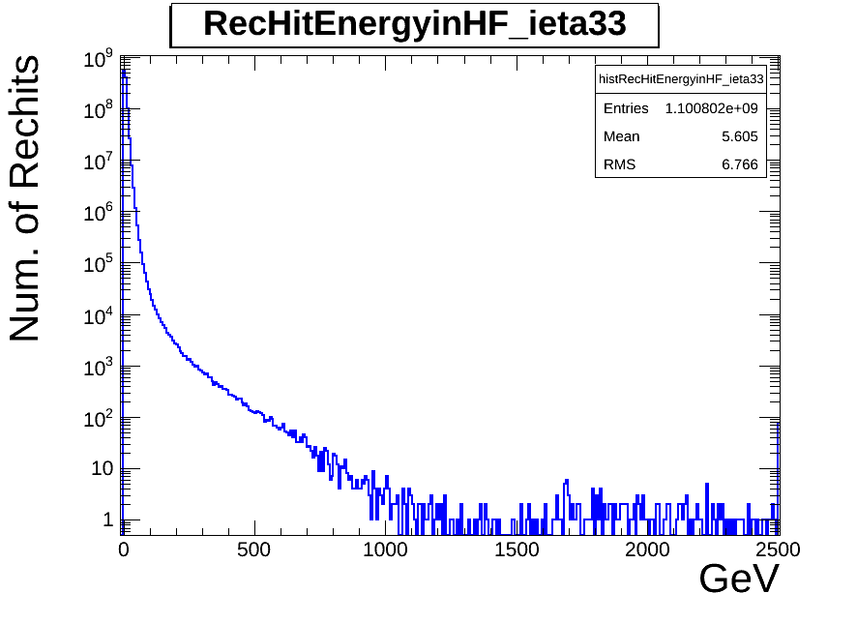
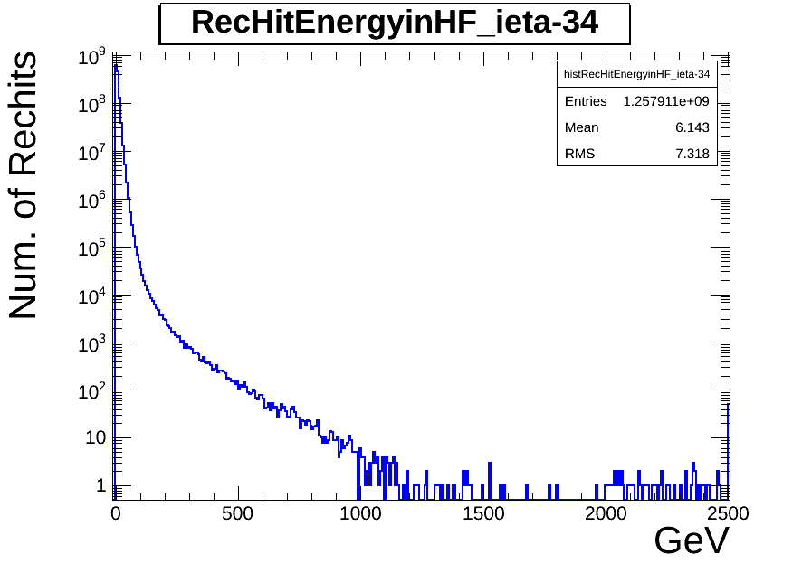
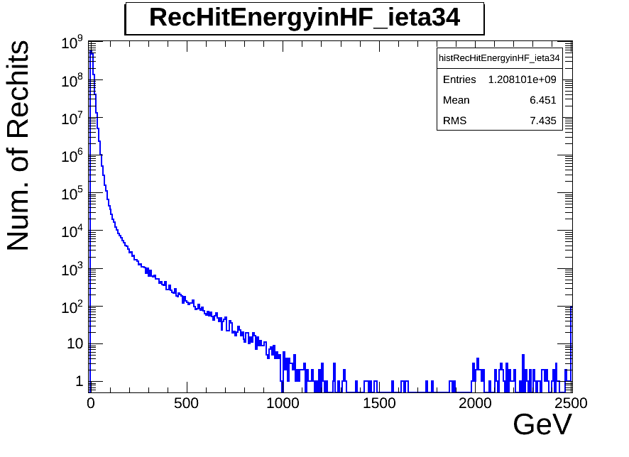

Slide 17
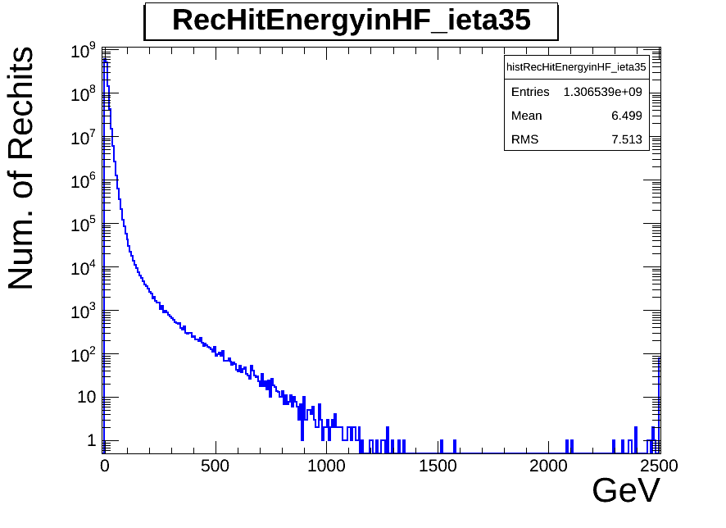
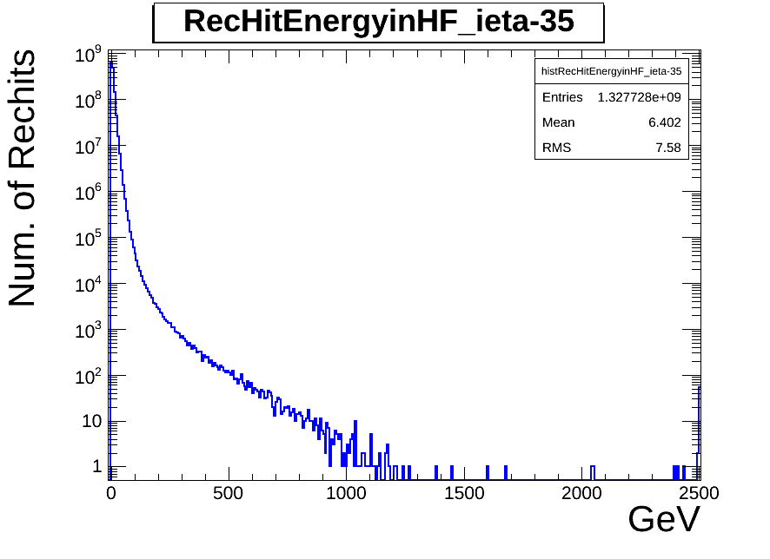
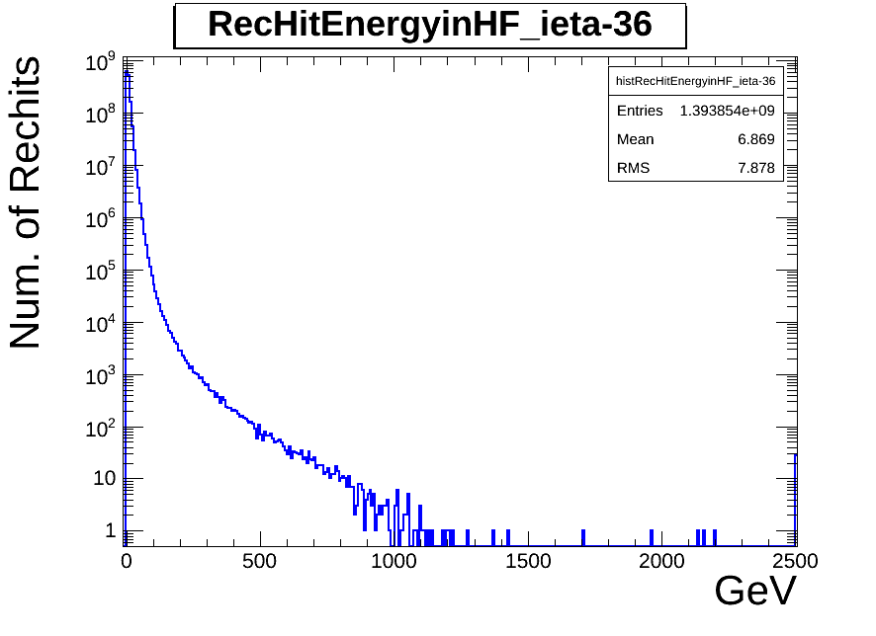
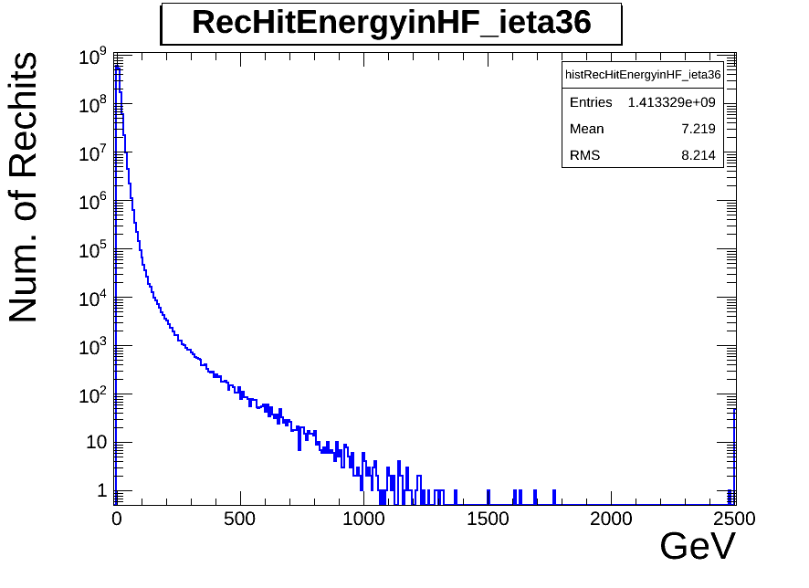

Slide 18
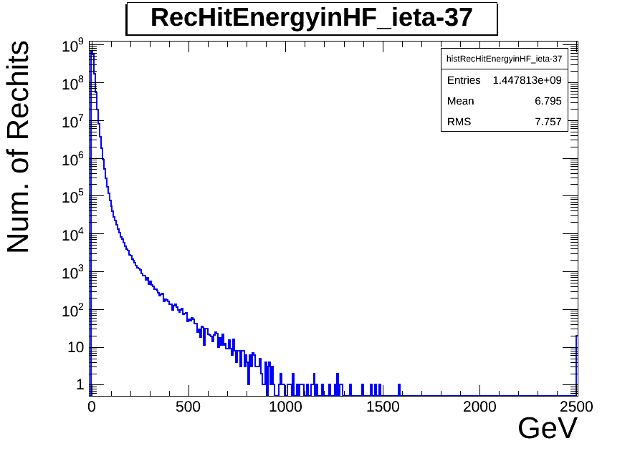
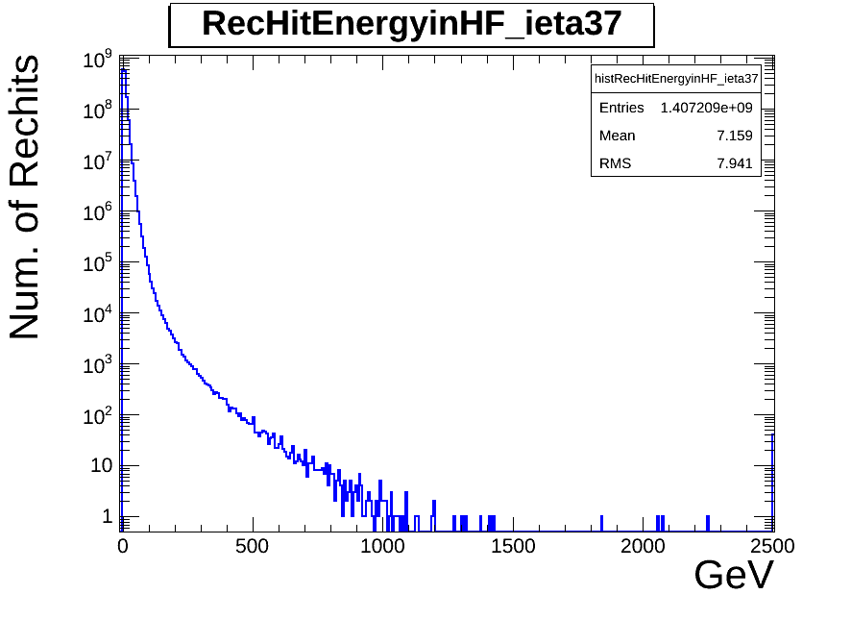
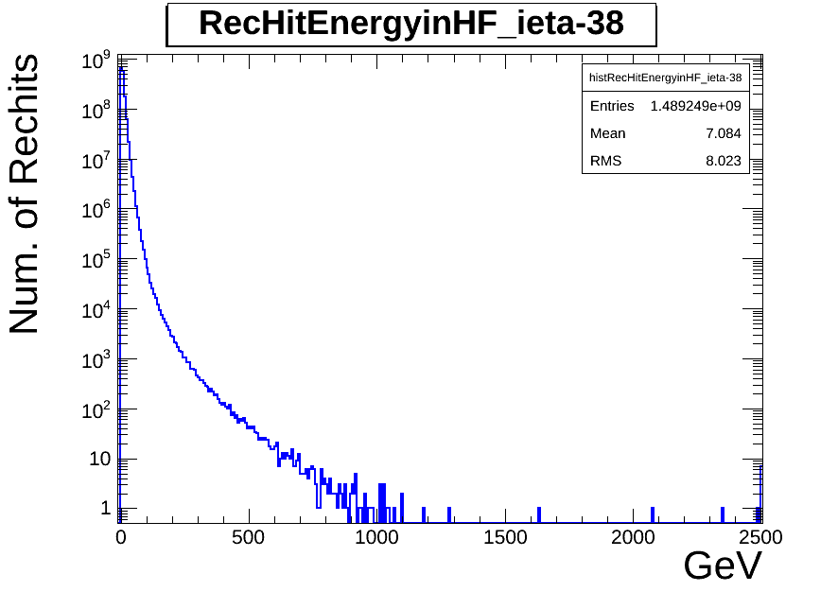
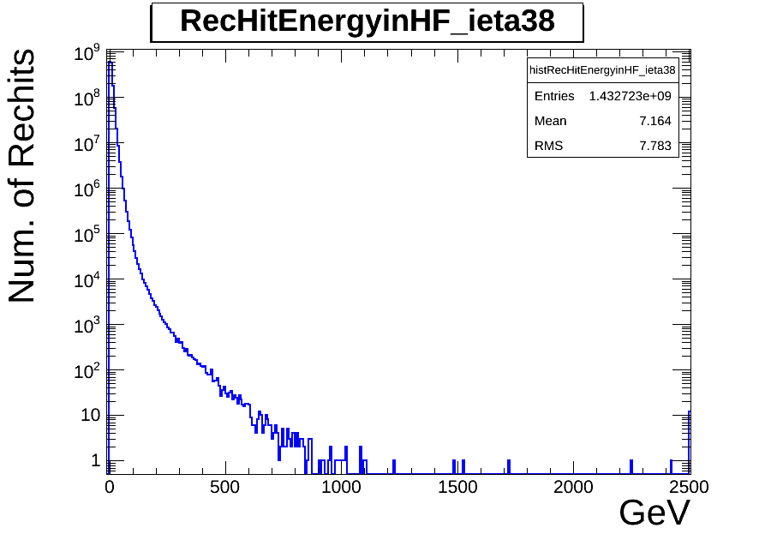

Slide 19
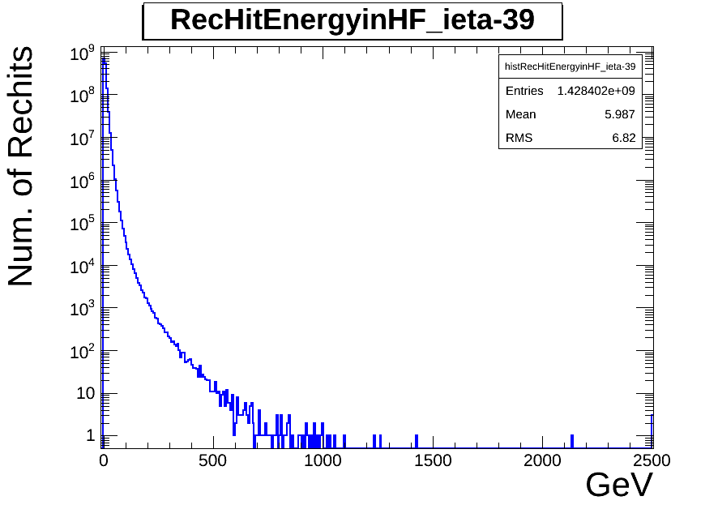
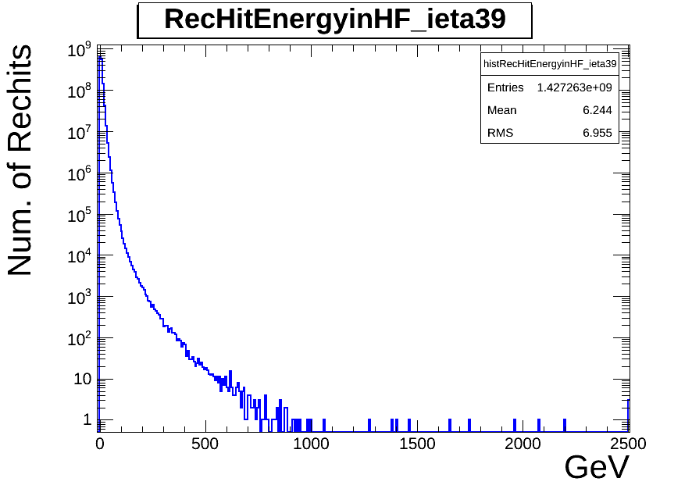
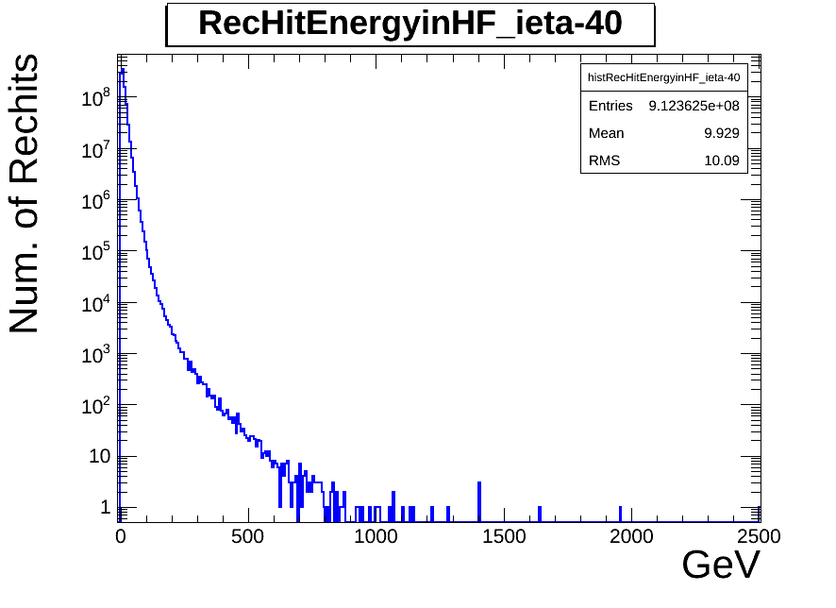
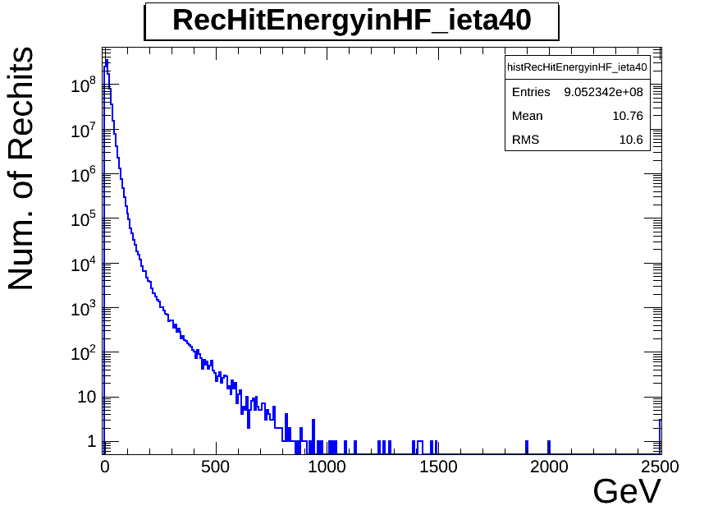

Slide 20
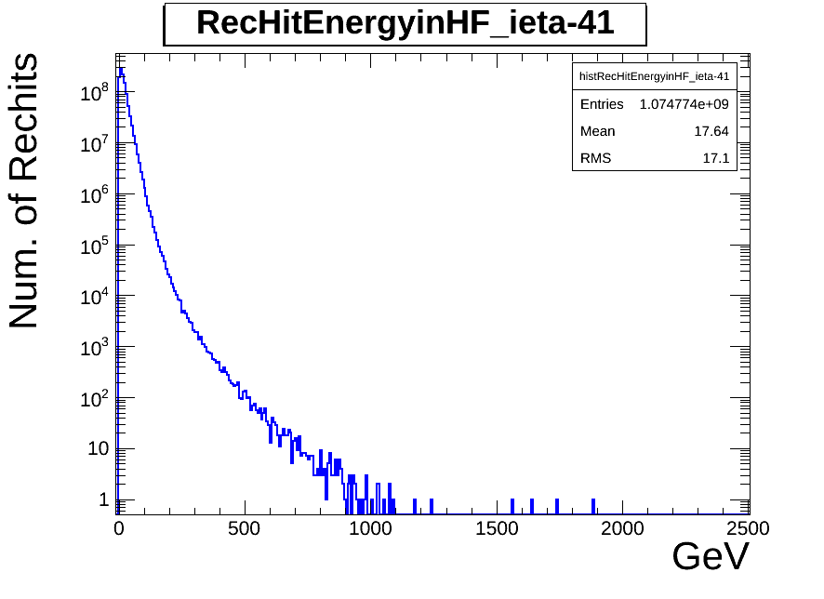
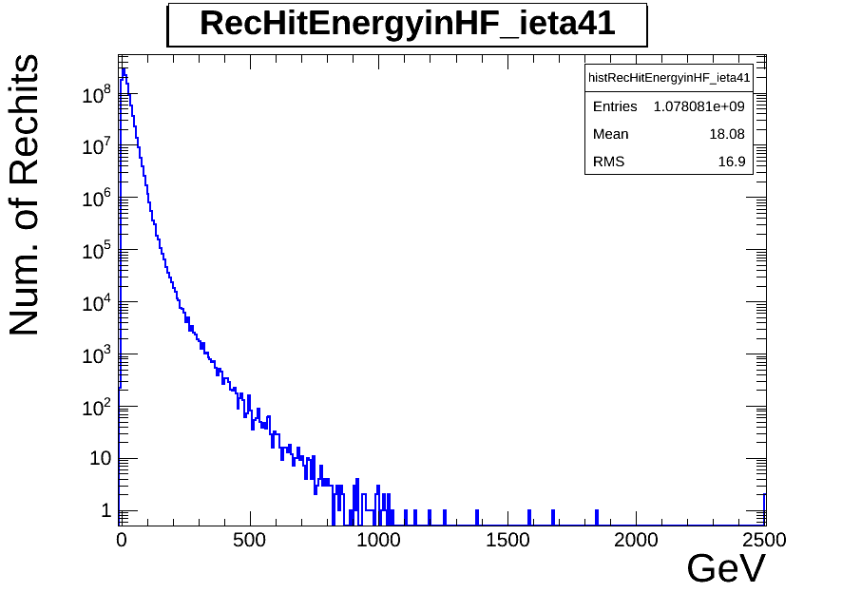

Slide 21
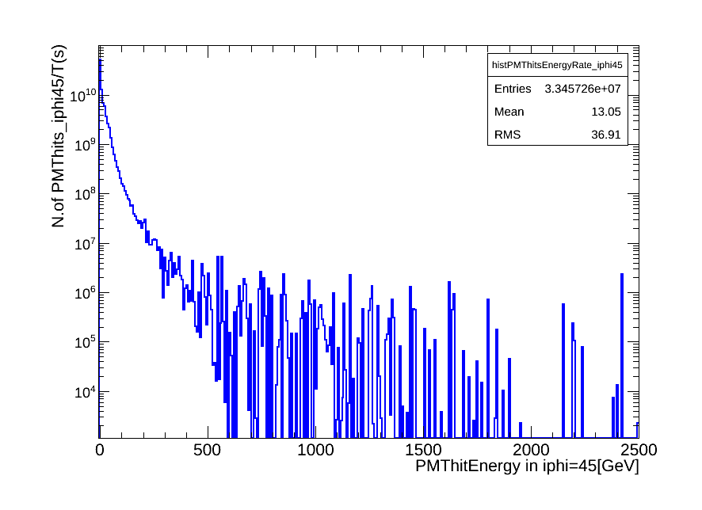
PMThits Energy in iphi=45 vs Rate

Slide 22
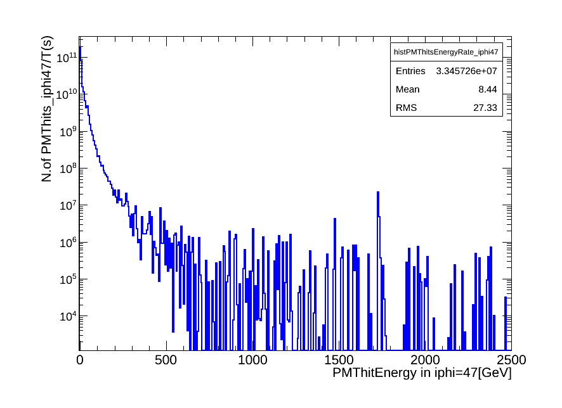
PMThits Energy in iphi=47 vs Rate

Slide 23
https://cmswbm.web.cern.ch/cmswbm/cmsdb/servlet/RunSummary
If you go to above link and submit a run number you will get some info. about the run.
(example from R208684)
L(initial) = 7E33 cm-2 sec-1
L(ending) = 5E33 cm-2 sec-1
L(average) = 6E33 cm-2 sec-1
Integrated lumi
integraedLumi [cm-2] = L(average) [cm-2 sec-1] * T [sec]
where T [sec] is the total time of active data taking.
If integrated luminosity is 6 [fb-1] from the database,
intrgaratedLumi = 6 [fb-1]
Since 1 [fb] = 1.0E-15 * 1.0E-24 = 1.0E-39 [cm-2]
integratedLumi = 6.0E+39 [cm-2]
then
itegratedLumi = 6.0E+39 [cm-2] = L(average) [cm-2 sec-1] * T [sec]
= 6E33 * T
gives
T [sec] =integratedLumi/L(average)
= 6E+39/6E33
= 1.0E6 [sec]
1000,000 seconds is about 12 days. If we take data only half of day
on average, this corresponds to 24 days of data taking.
This looks about right.
Now, let’s calculate the event rate in Hz.
If we get N noise events in x [fb-1] of data, the average trigger rate is
Rate = N/T. [Hz]

