Slide 1
HCAL Analysis
Yalcin Guler
Serdal Damarseckin, Emine Gurpinar
Shuichi Kunori, Isa Dumanoglu,
Bayram Tali, Merve Ince, Hasan Huseyin Isik, Samet Lezki

Slide 2
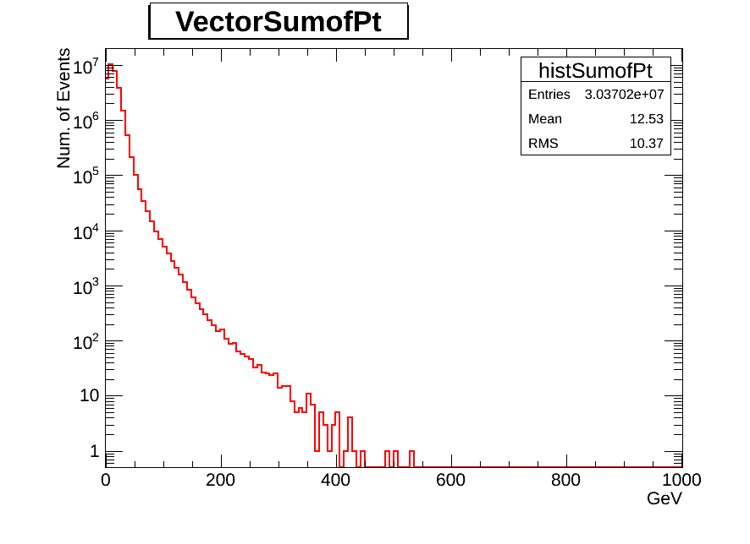
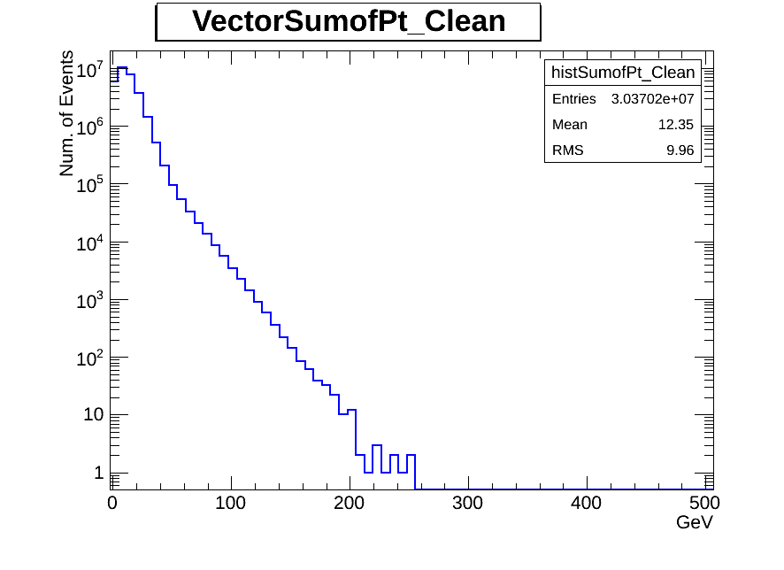
Pt distribution
Before Filter
After Filter

Slide 3
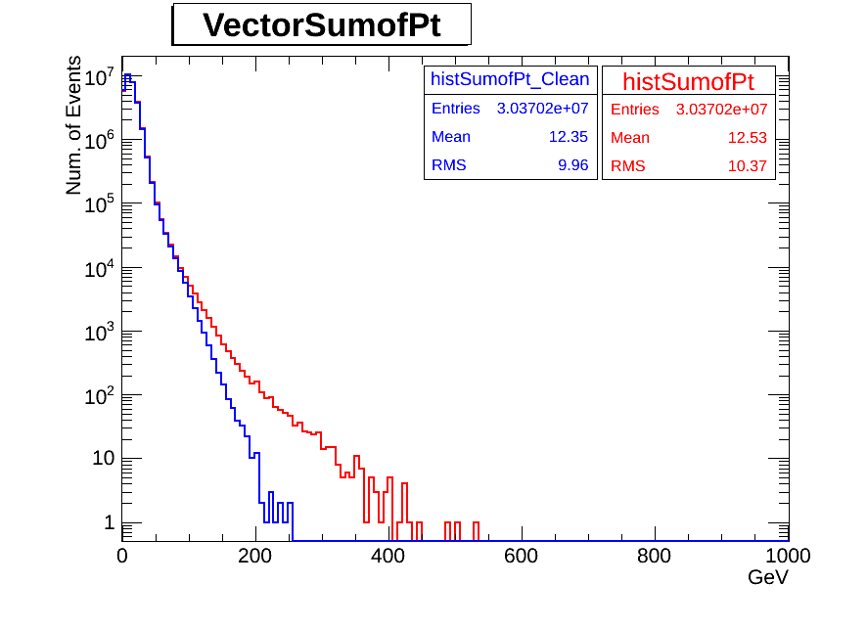
Pt distribution superimpose

