Slide 1
HCAL Analysis
Yalcin Guler
Serdal Damarseckin, Emine Gurpinar
Shuichi Kunori, Isa Dumanoglu,
Bayram Tali, Merve Ince, Hasan Huseyin Isik, Samet Lezki

Slide 2
Introduction
2012D minimum bias data is analysed
We applied below HLT trigger
HLT_Physics_v5 (pre-scale 8000)
HLT_ZeroBias_v7 (pre-scale 150)
HLT_Random_v2
HLT_PixelTracks_Multiplicity70_v3
HLT_PixelTracks_Multiplicity80_v12
HLT_PixelTracks_Multiplicity90_v3
HLT_ZeroBiasPixel_DoubleTrack_v2
JetHT-Run2012D-v1-RAW
We have updated all plots
  Plotted iphi=39, 41, 43, 45, 47 as a vector sum of Pt

Slide 3
HLT_Physics_v5

Slide 4
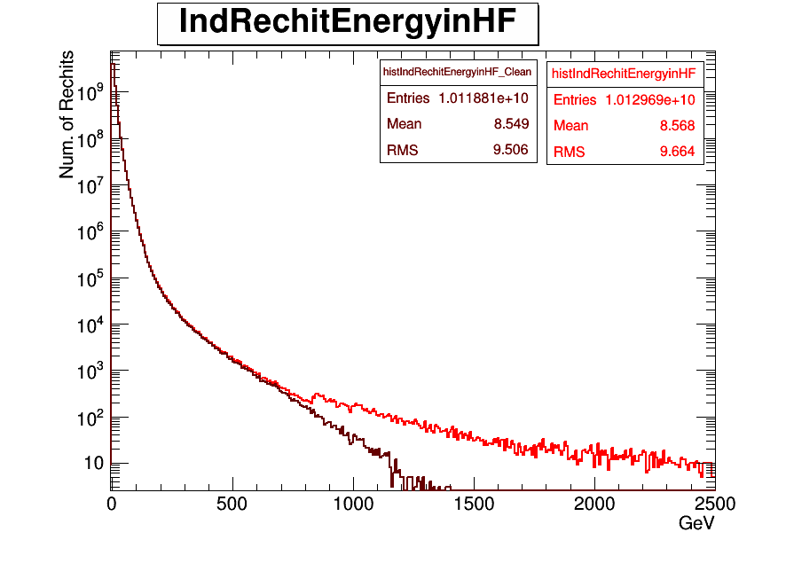
Individual Recohit Energy in HF before and after filter

Slide 5
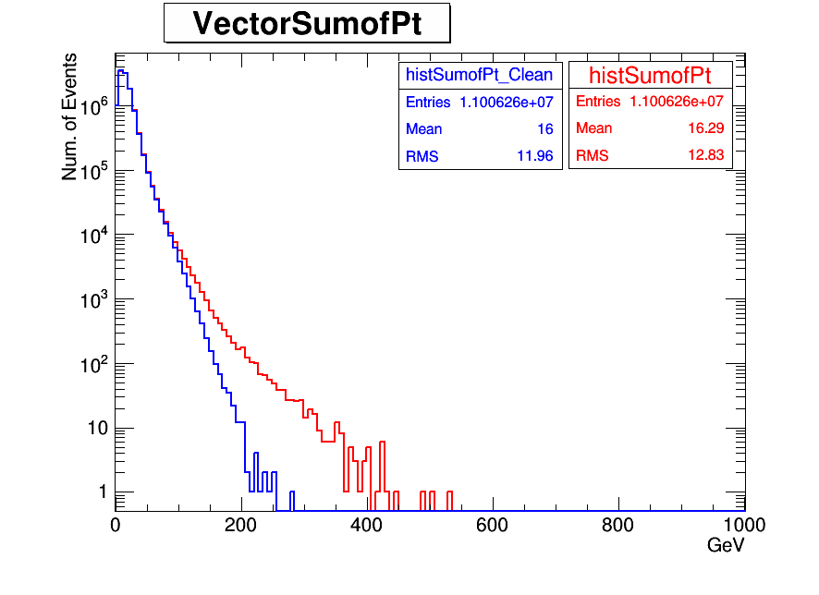
Pt distribution in HF

Slide 6
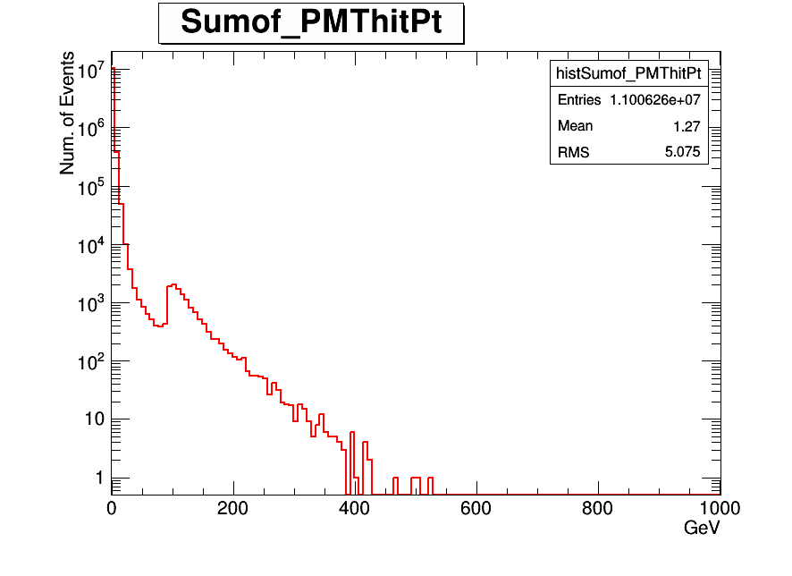
Pt distribution of PMThits

Slide 7
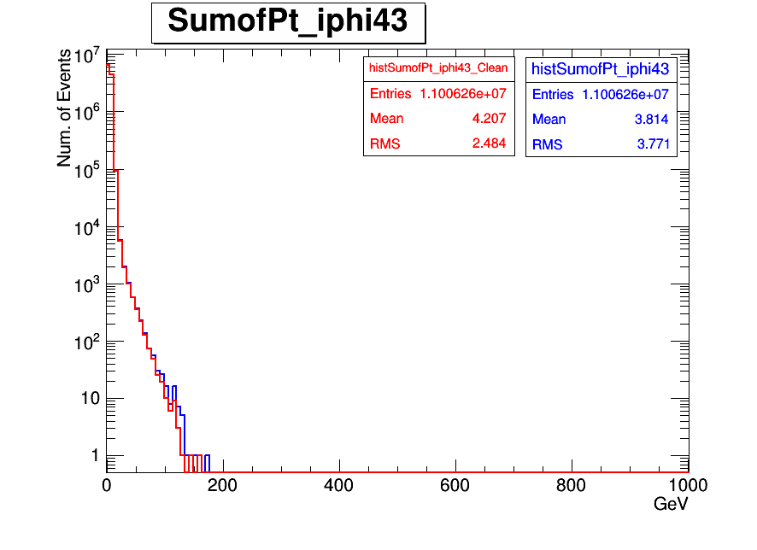
Pt distribution iphi43(New PMTs)
Vector sum of Pt iphi43

Slide 8
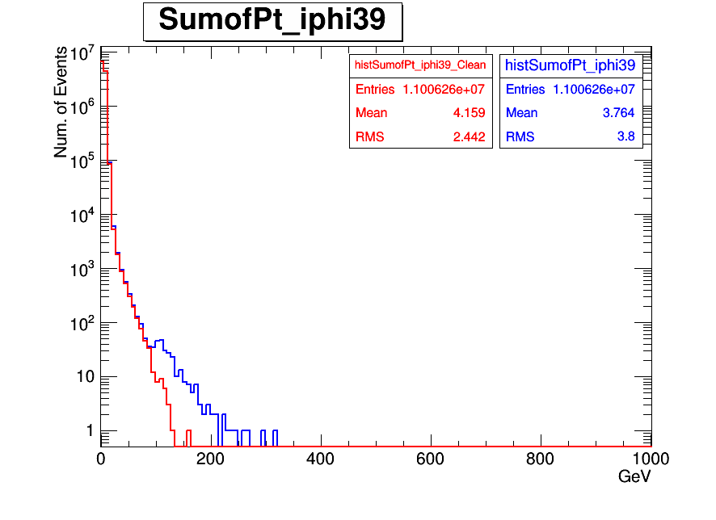
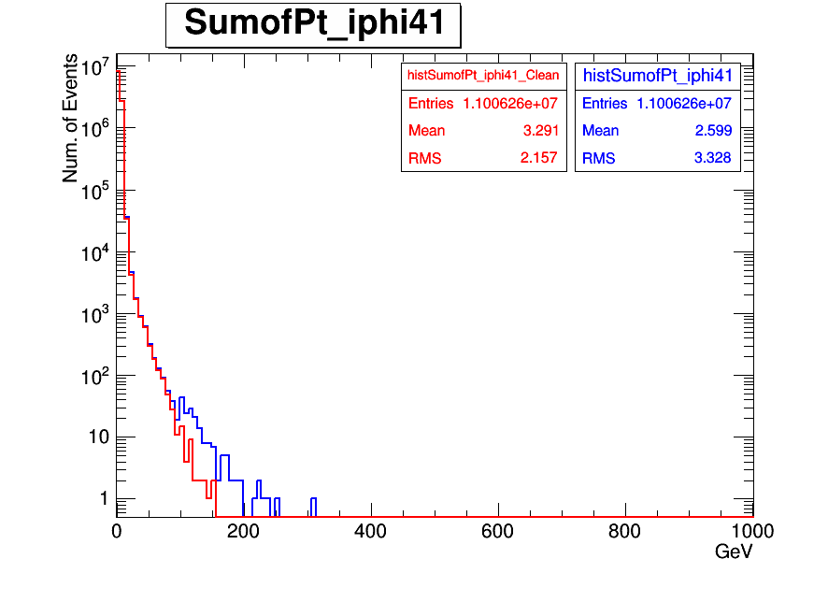
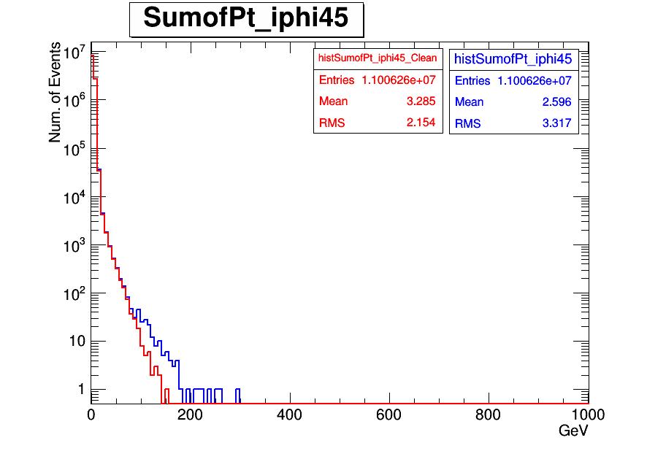
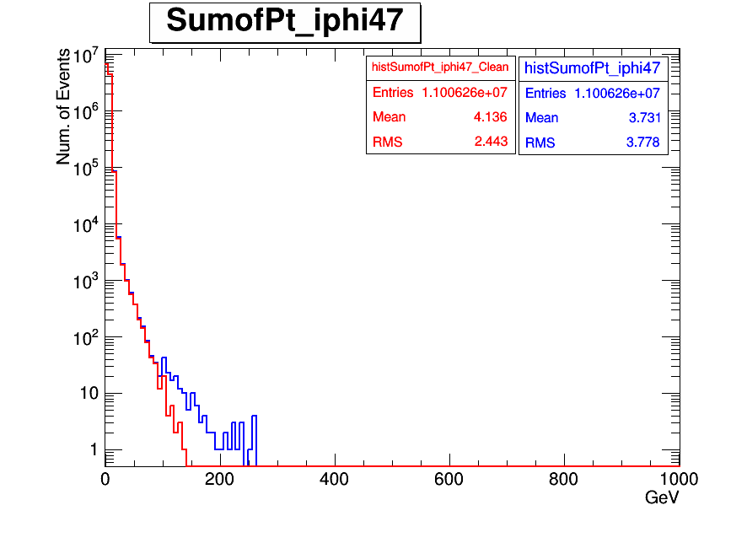
Pt distribution iphi=39,41,45,47 (old PMTS)
Vector Sum of Pt iphi39
Vector Sum of Pt iphi41
Vector Sum of Pt iphi45
Vector Sum of Pt iphi47

Slide 9
HLT_ZeroBias_v7

Slide 10
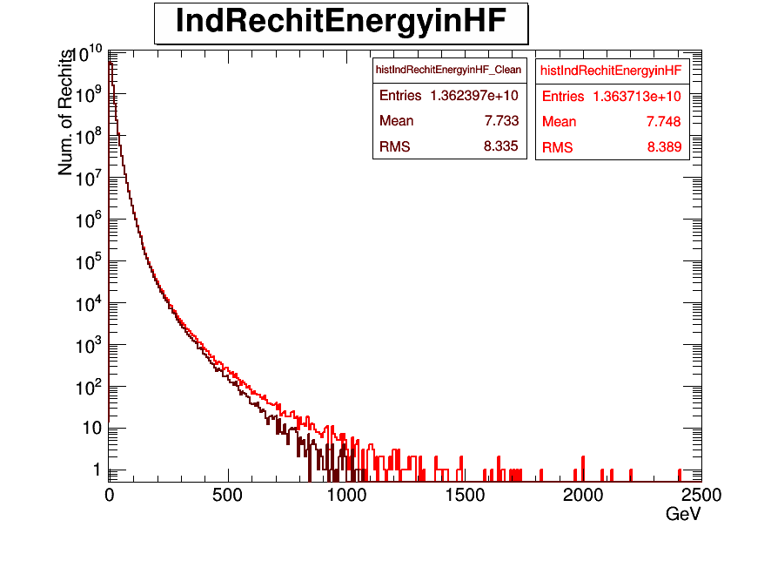
Individual Recohit Energy in HF before and after filter

Slide 11
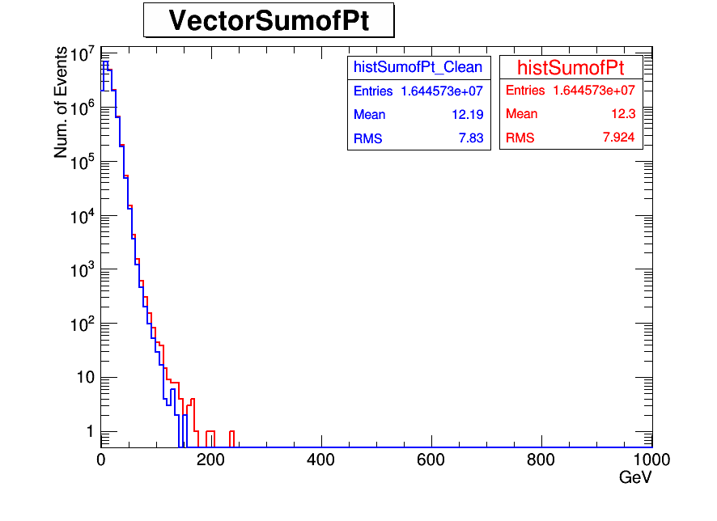
Pt distribution in HF

Slide 12
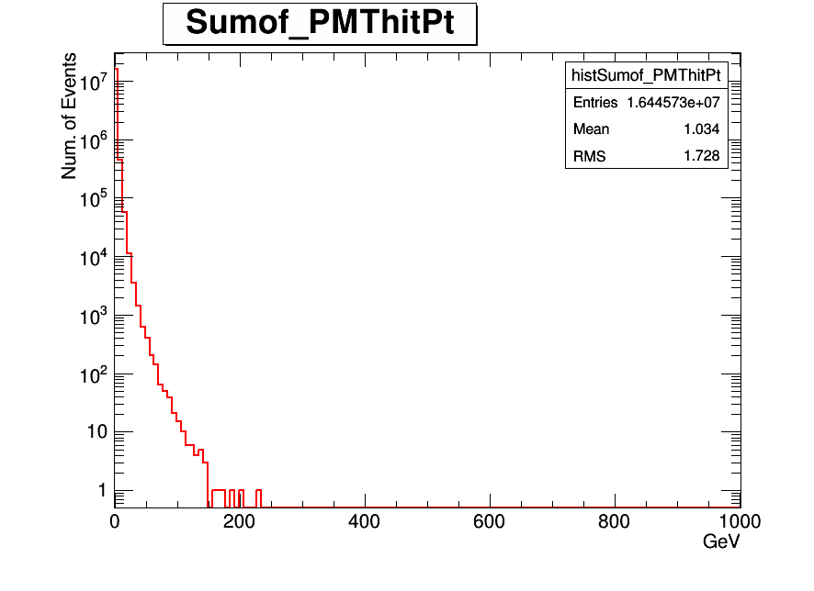
Pt distribution of PMThits

Slide 13
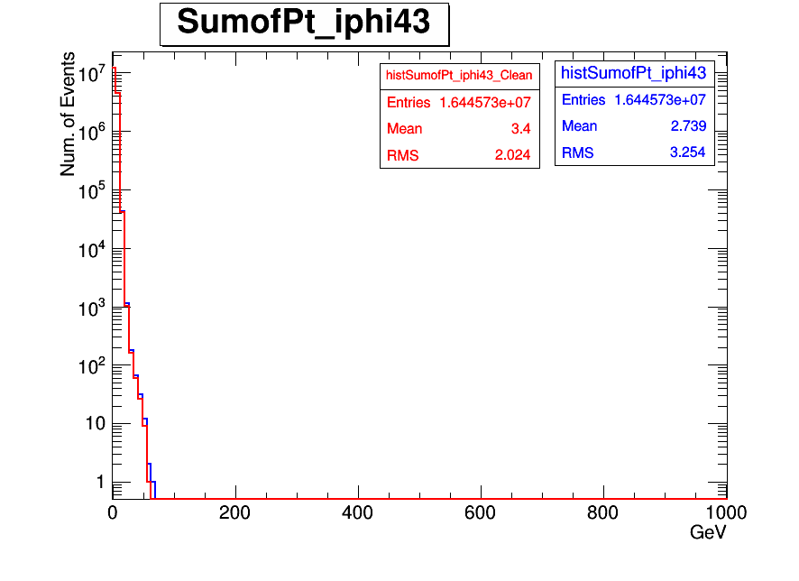
Pt distribution iphi43(New PMTs)
Vector sum of Pt iphi43

Slide 14
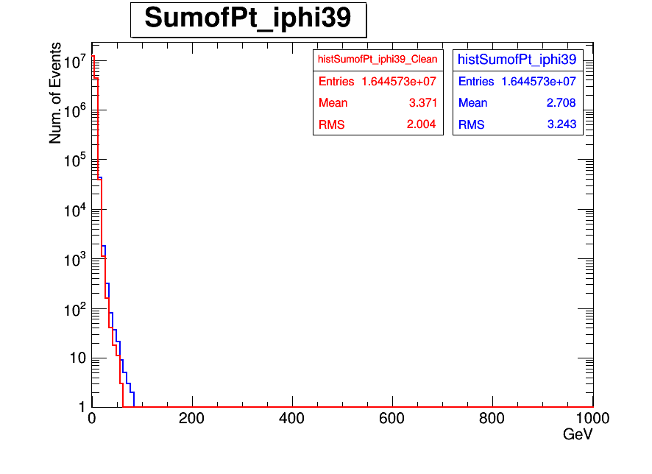
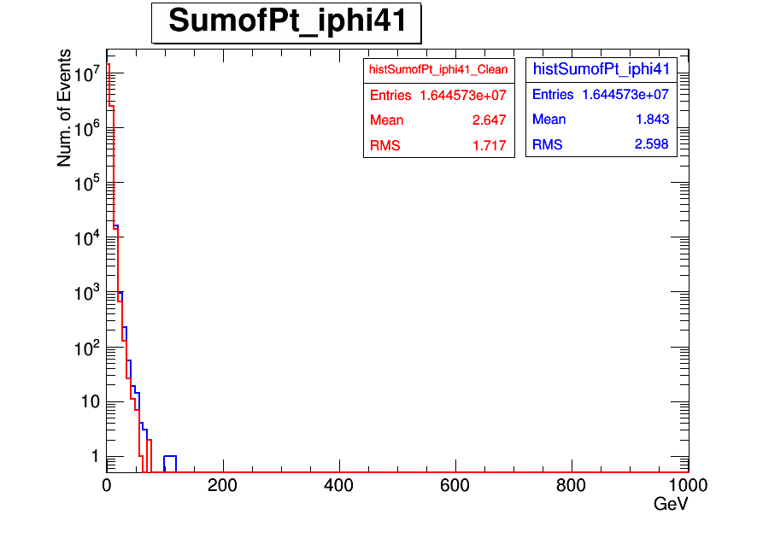
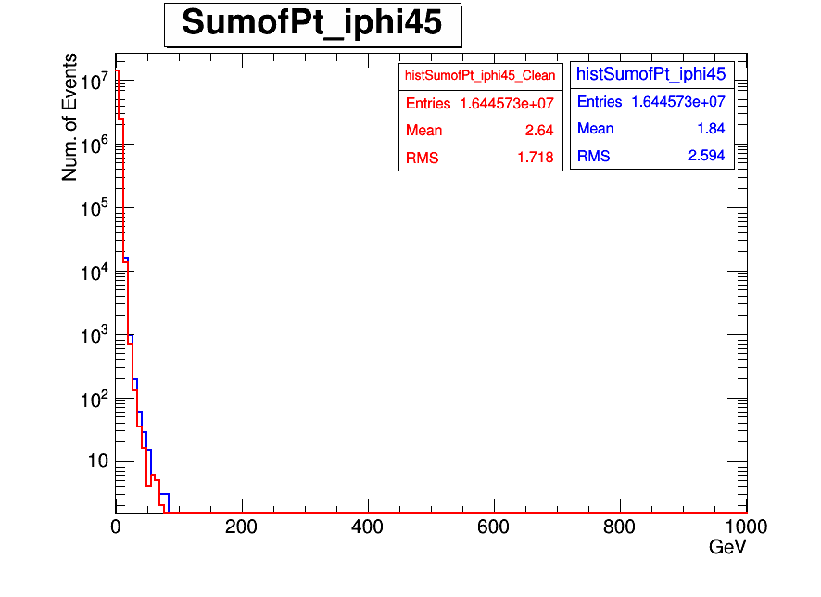
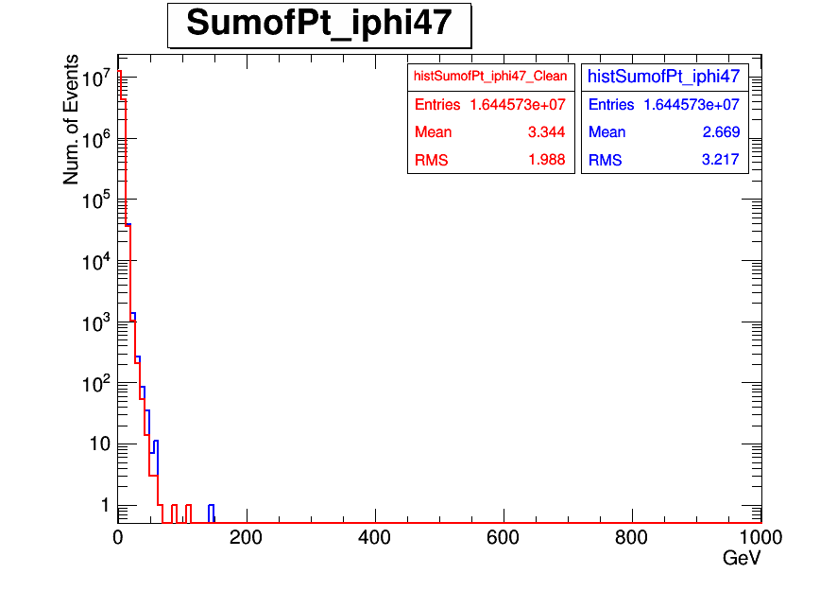
Pt distribution iphi=39,41,45,47 (old PMTS)

Slide 15
HLT_Random_v2

Slide 16
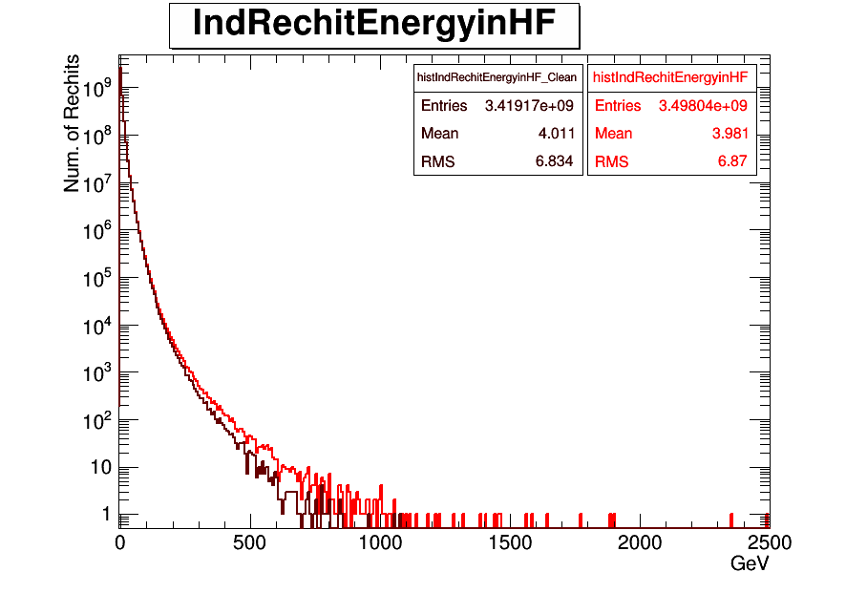
Individual Recohit Energy in HF before and after filter

Slide 17
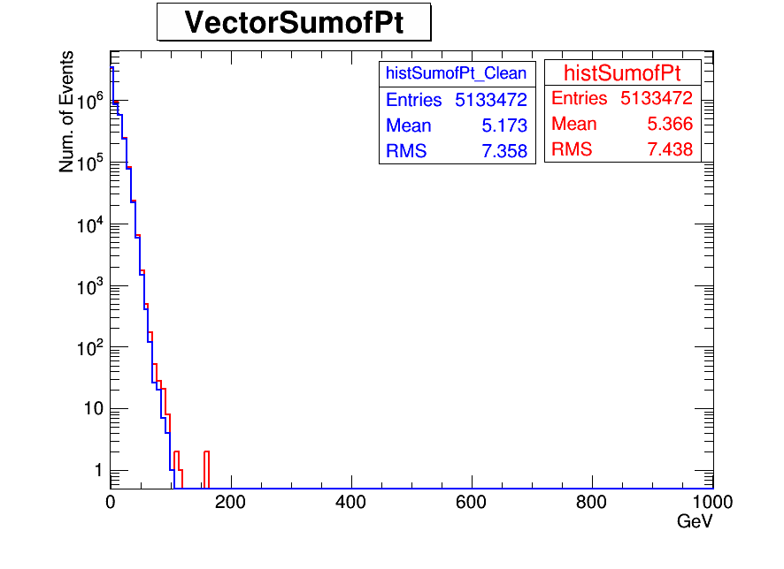
Pt distribution in HF

Slide 18
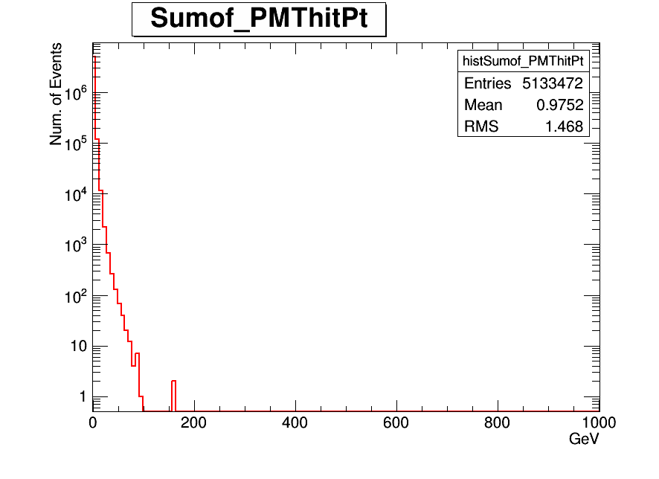
Pt distribution of PMThits in HF

Slide 19
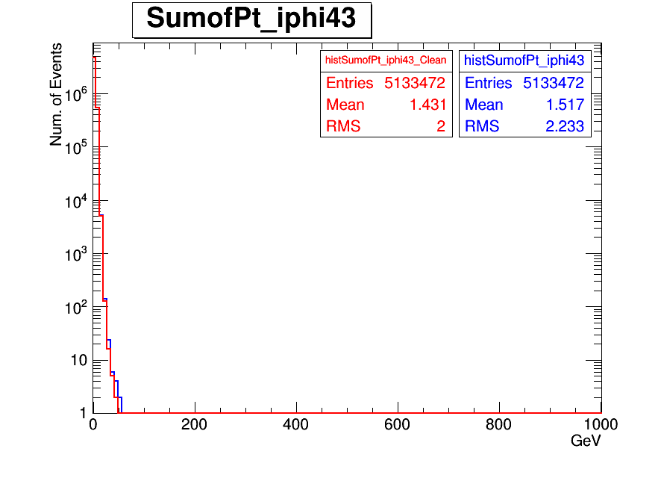
Pt distribution iphi43(New PMTs)

Slide 20
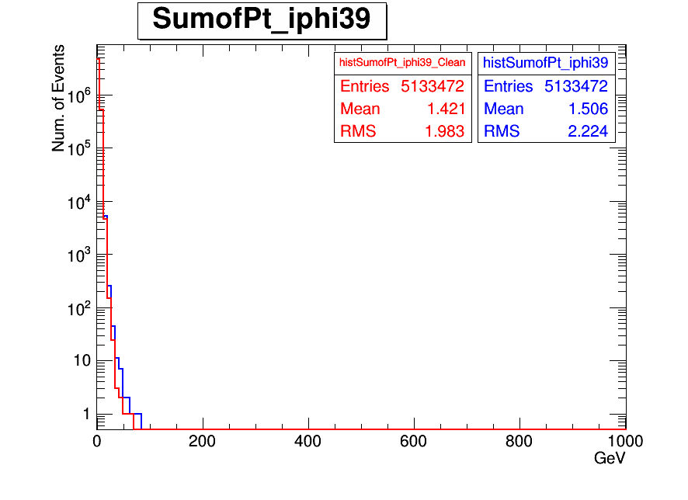
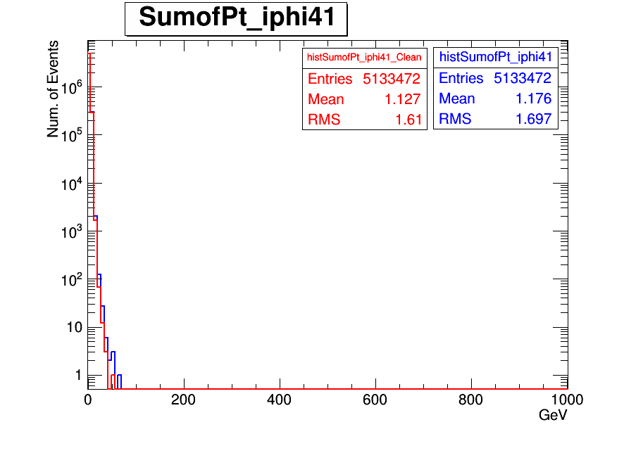
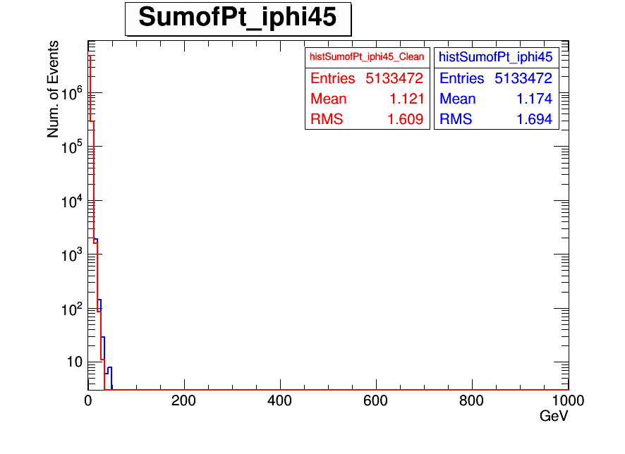
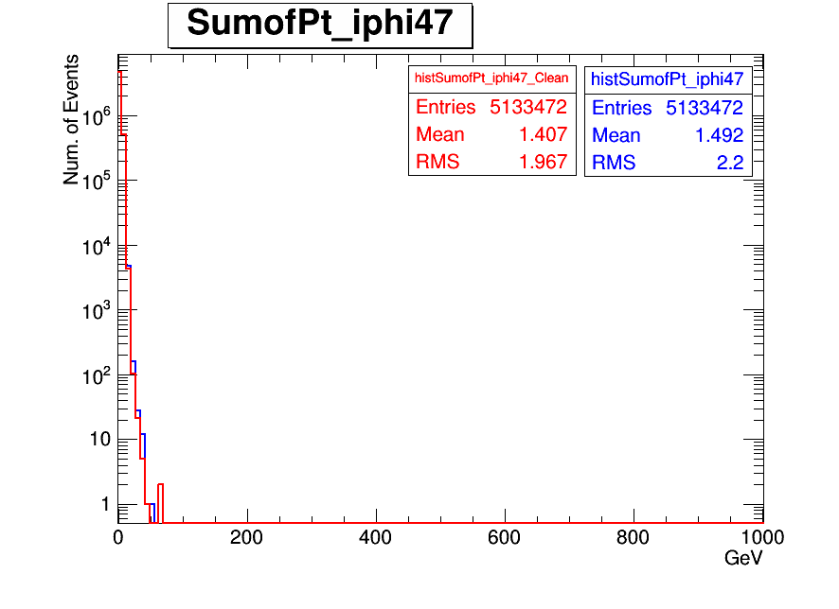
Pt distribution iphi=39,41,45,47 (old PMTS)

Slide 21
JetHT-Run2012D-v1-RAW

Slide 22
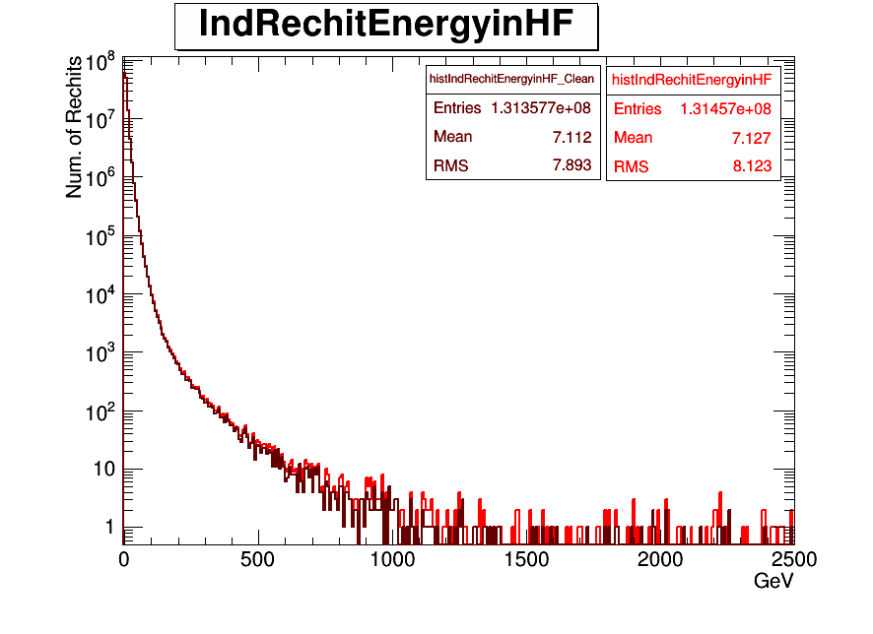
Individual Recohit Energy in HF before and after filter

Slide 23
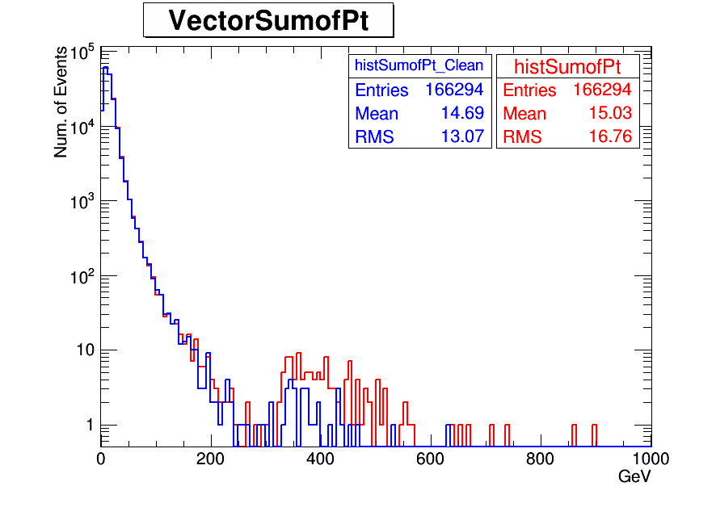
Pt distribution in HF

Slide 24
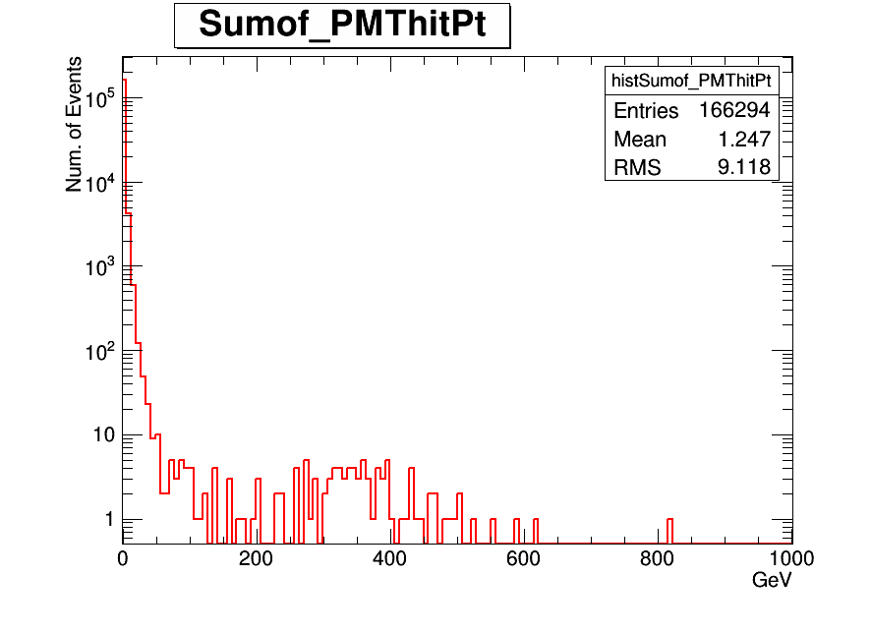
Pt distribution of PMThits in HF

Slide 25
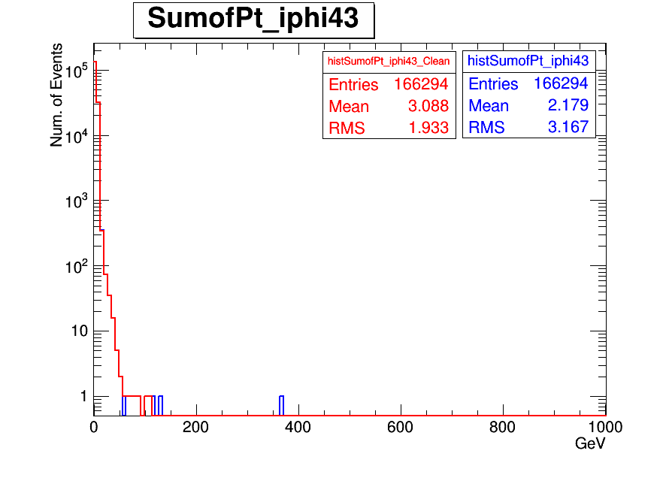
Pt distribution iphi43(New PMTs)

Slide 26
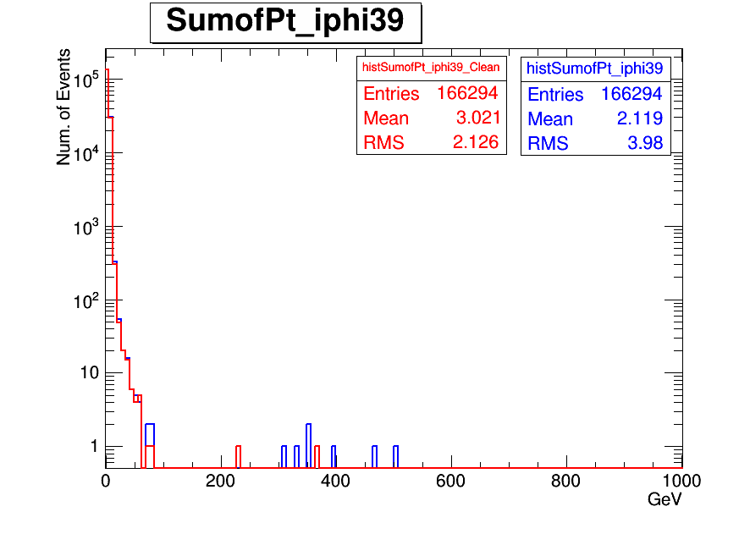
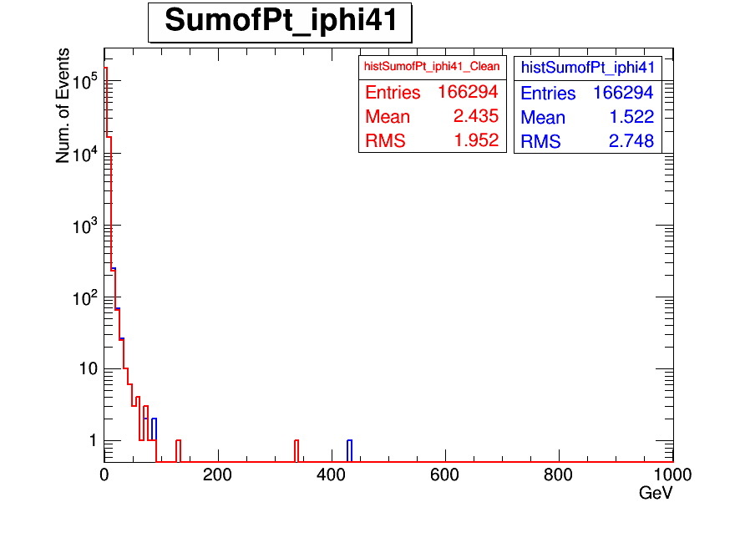
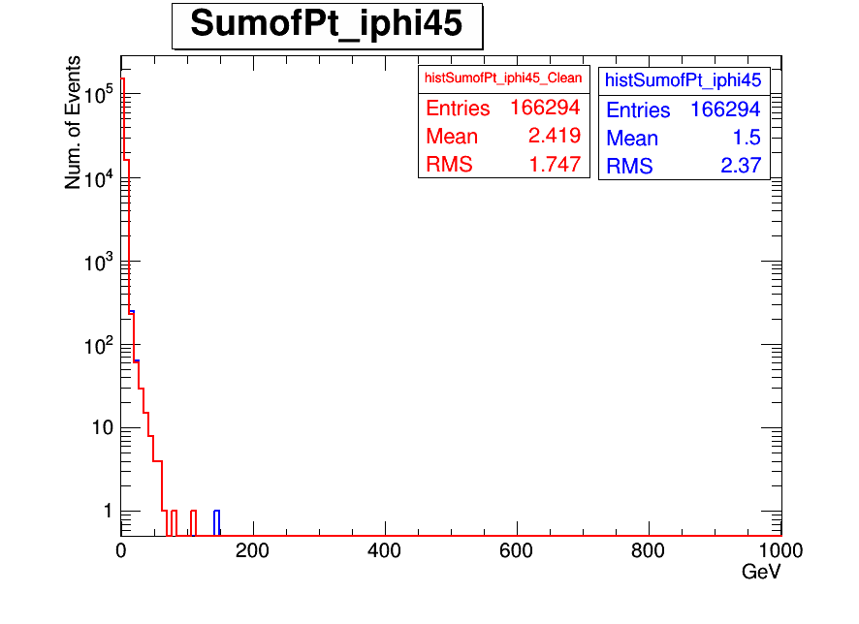
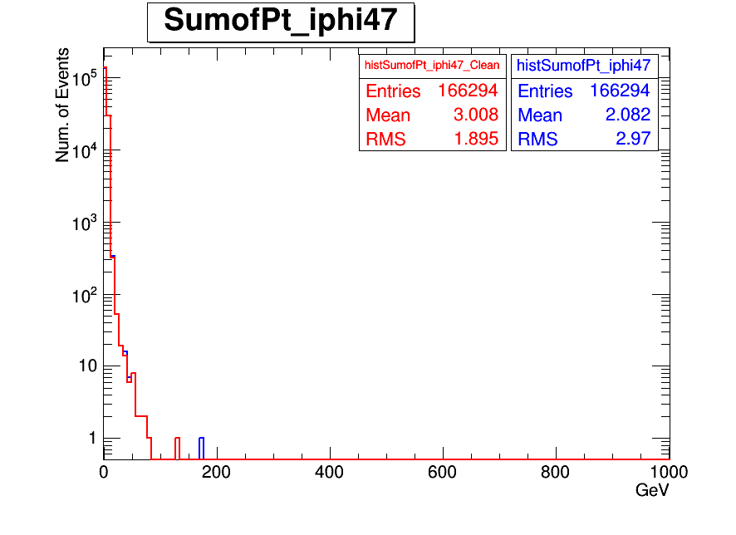
Pt distribution iphi=39,41,45,47 (old PMTS)

Slide 27
Summary
We have checked some trigger using 2012D minimumbias data set.
HLT_Physics_v5 (pre-scale 8000)
HLT_ZeroBias_v7 (pre-scale 150)
HLT_Random_v2
HLT_PixelTracks_Multiplicity70_v3
HLT_PixelTracks_Multiplicity80_v12
HLT_PixelTracks_Multiplicity90_v3
HLT_ZeroBiasPixel_DoubleTrack_v2
We also wanted to analyzed to RAW data but we didn’t reach all of them. We just get in the CERN site. We need more events.

Slide 28
Back up

Slide 29
HLT_Physics_v5

Slide 30
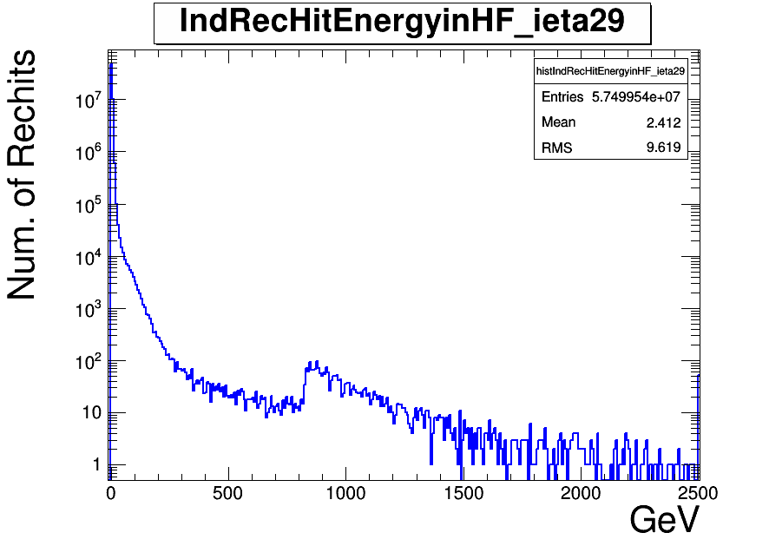

Slide 31
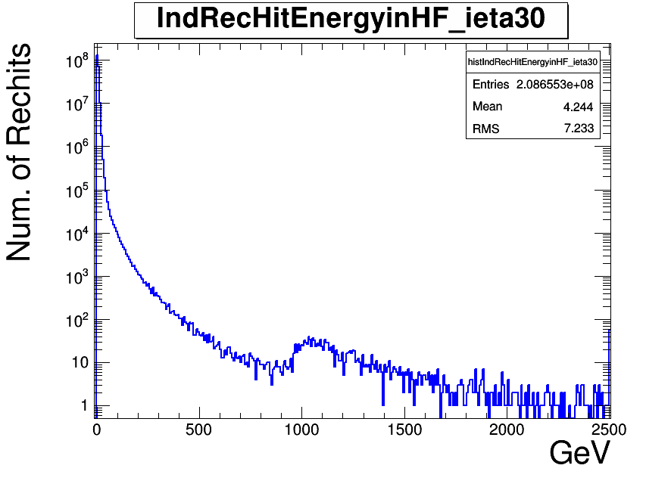

Slide 32
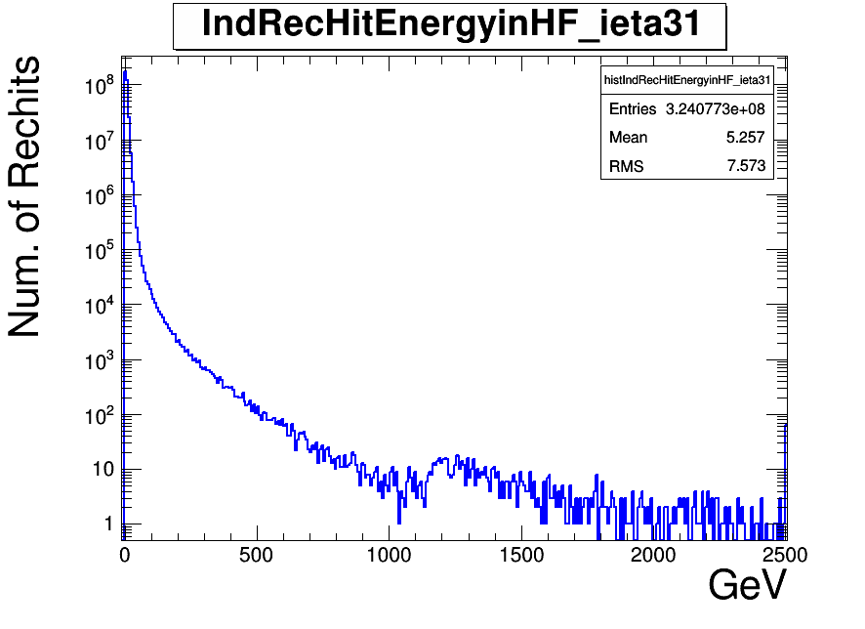

Slide 33
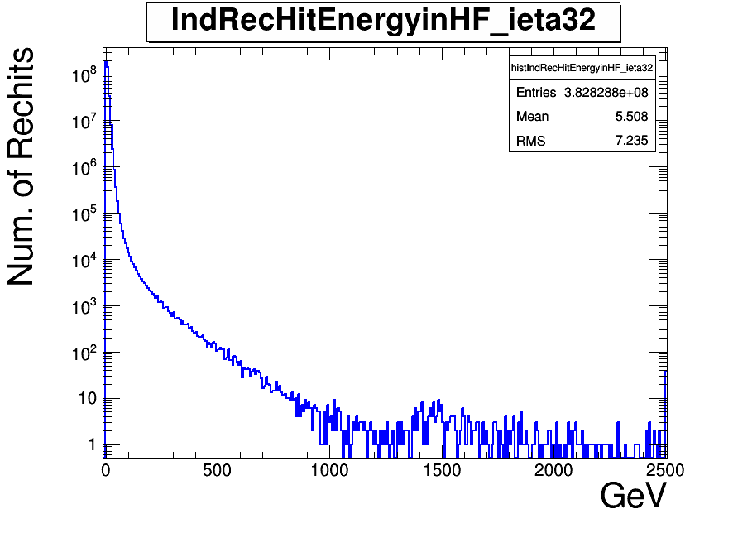

Slide 34
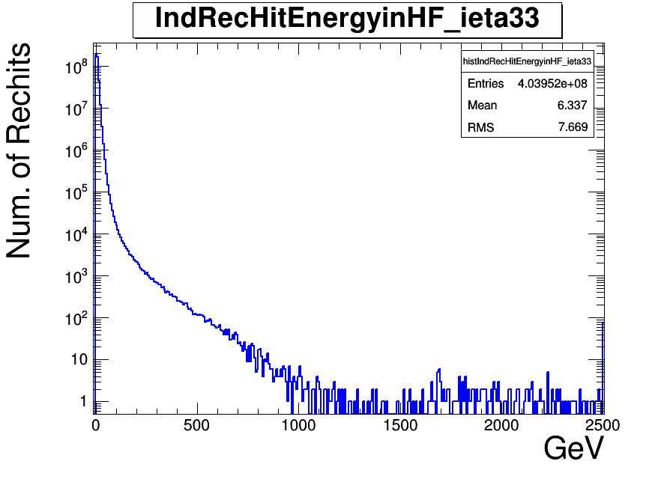

Slide 35
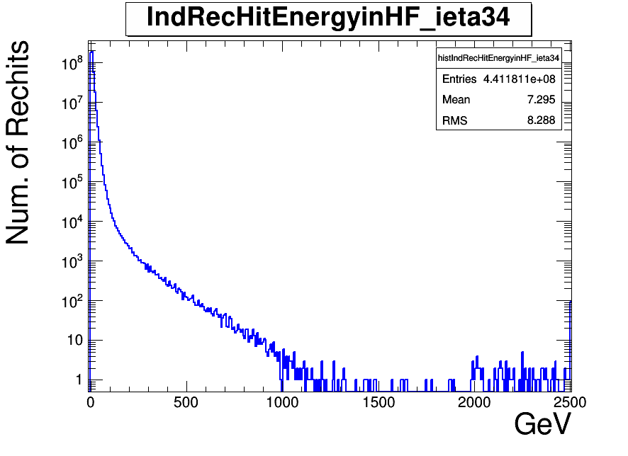

Slide 36
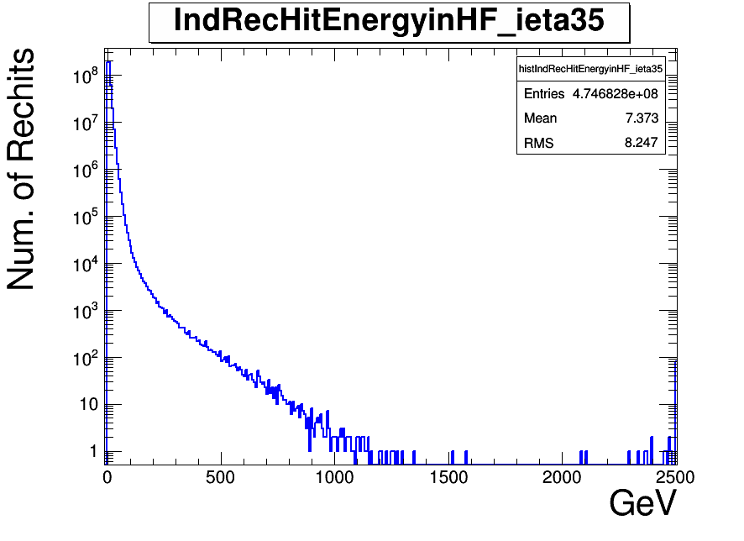

Slide 37
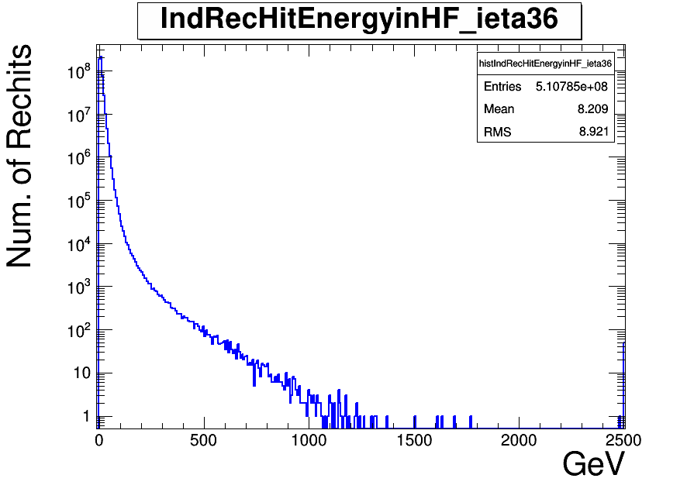

Slide 38
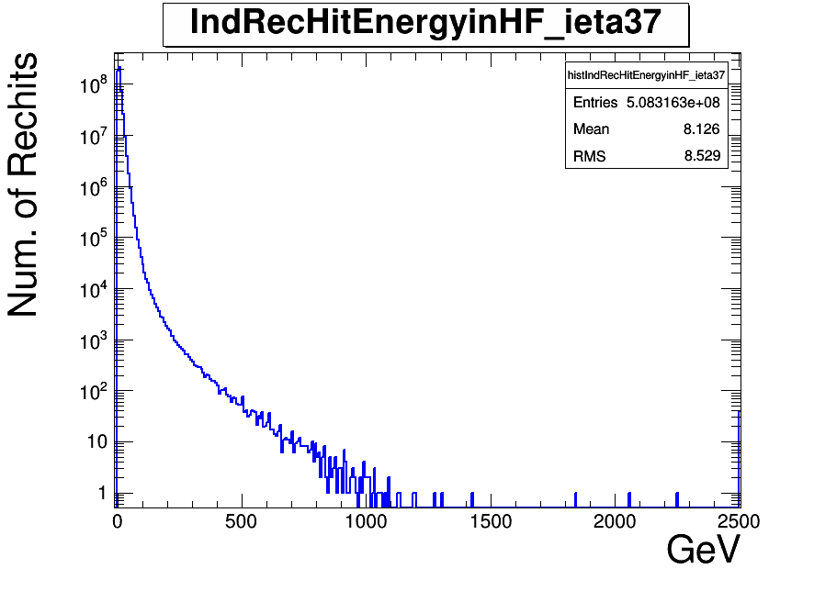

Slide 39
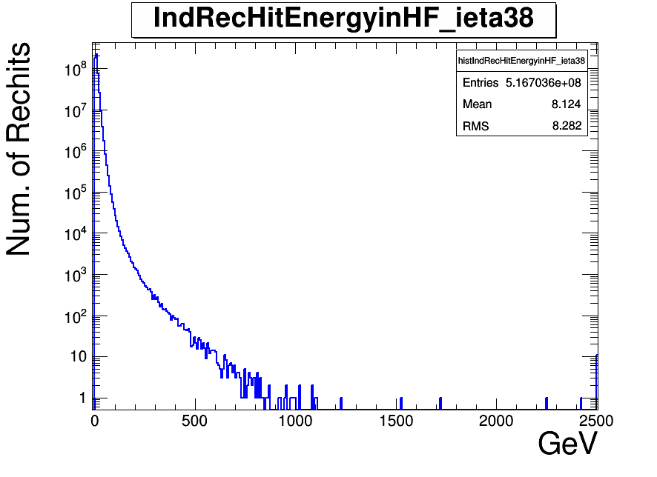

Slide 40
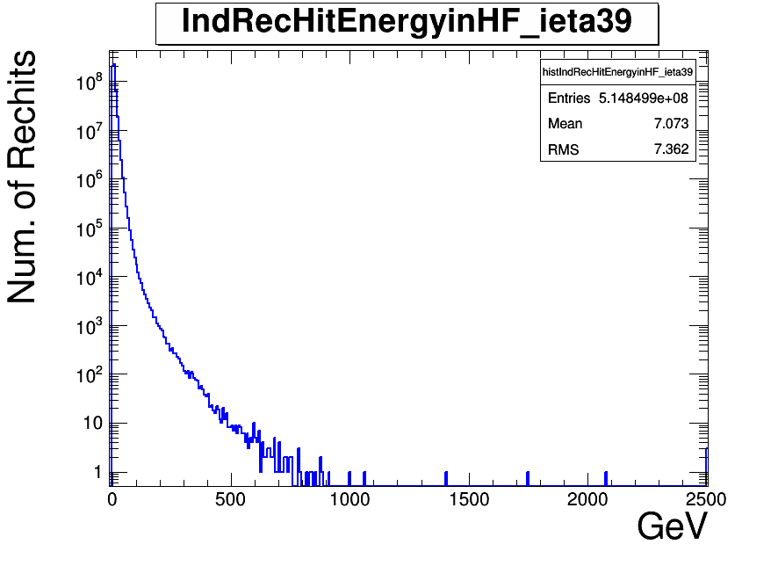

Slide 41
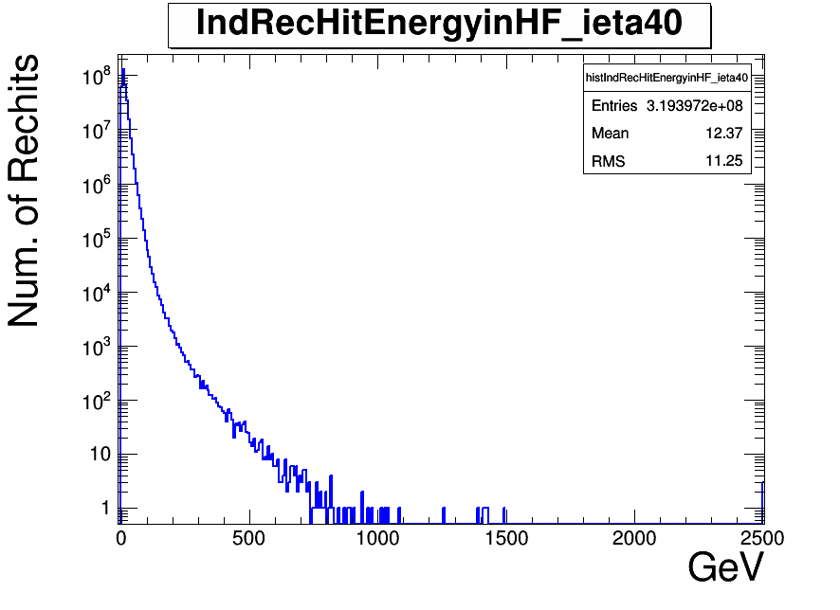

Slide 42
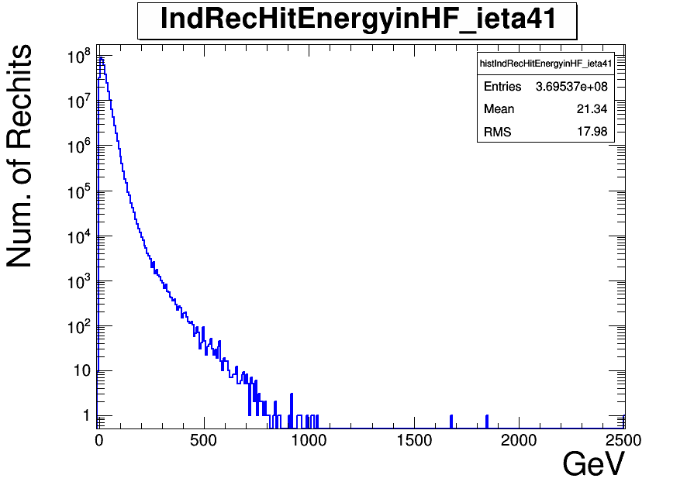

Slide 43
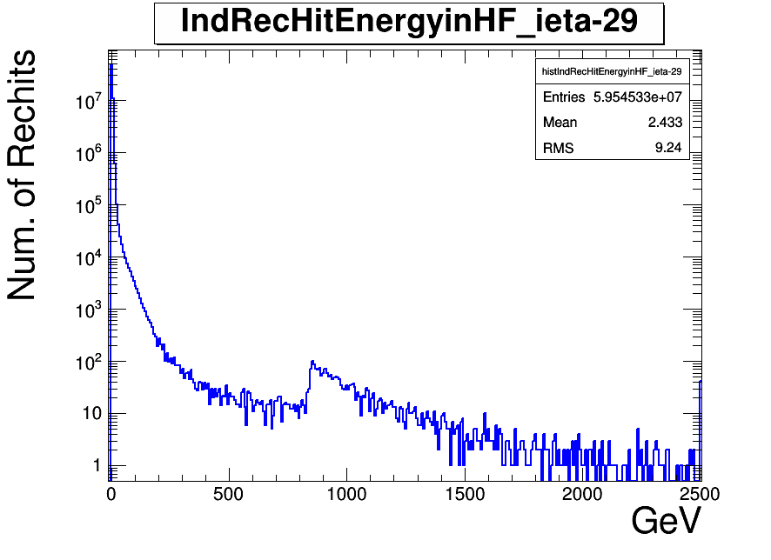

Slide 44
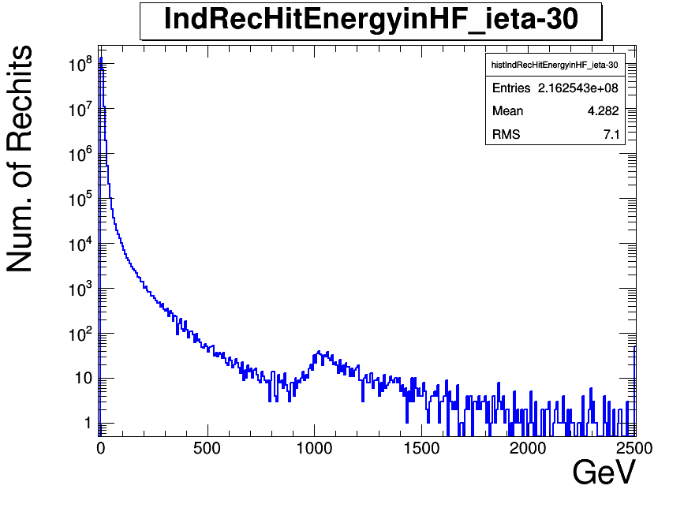

Slide 45
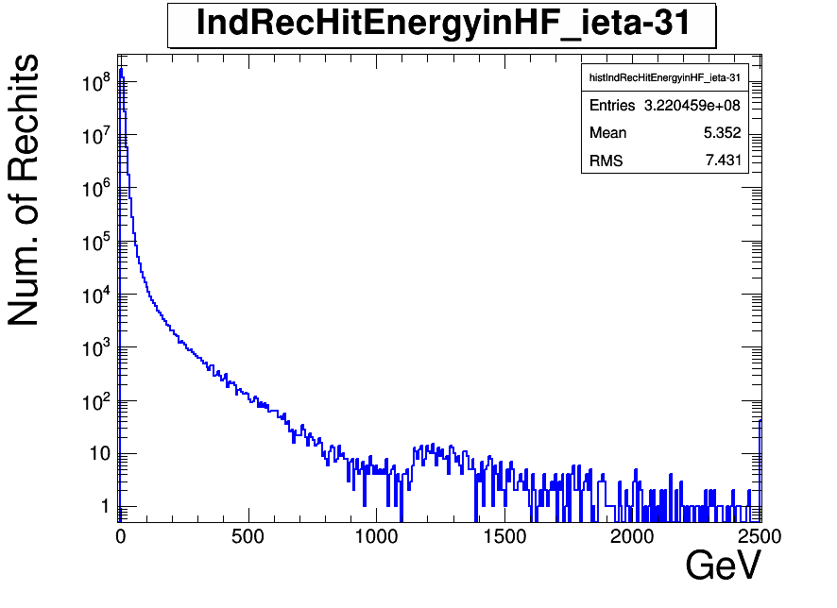

Slide 46
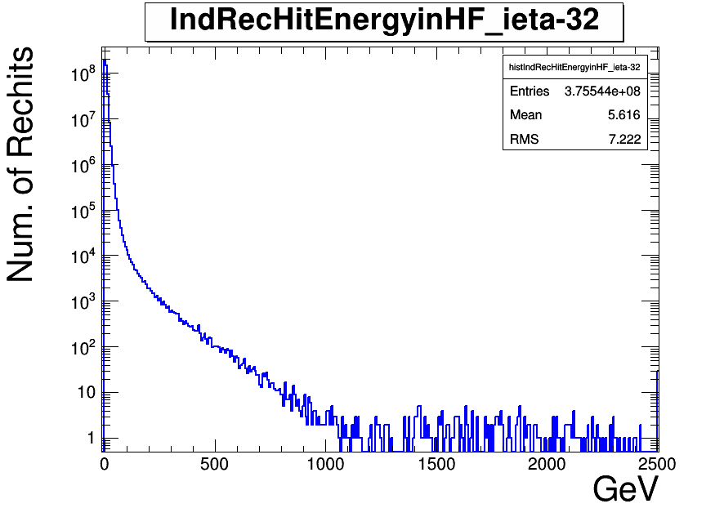

Slide 47
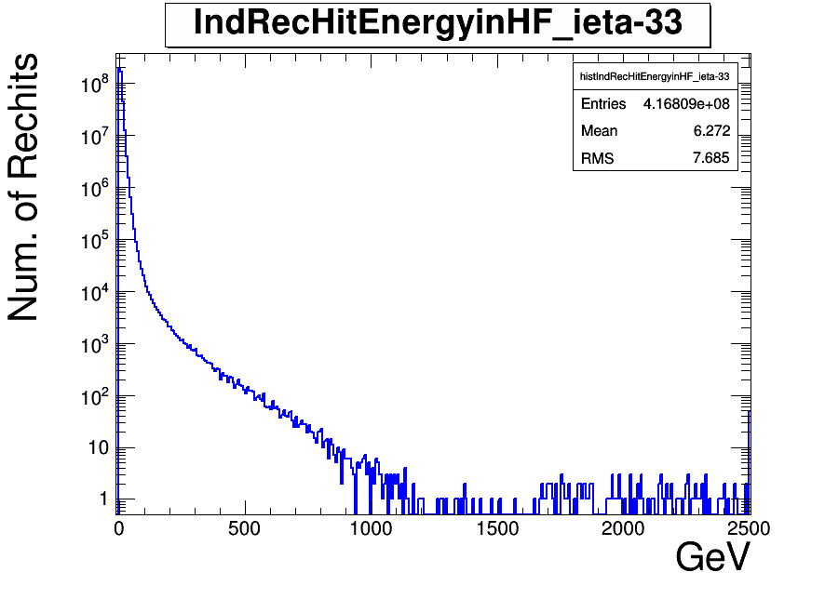

Slide 48


Slide 49


Slide 50


Slide 51


Slide 52


Slide 53


Slide 54


Slide 55


Slide 56


Slide 58


Slide 59


Slide 60


Slide 62


Slide 63


Slide 65


Slide 66


Slide 68


Slide 69


Slide 71


Slide 72


Slide 74


Slide 77


Slide 78


Slide 79


Slide 80


Slide 81


Slide 82


Slide 83


Slide 84


Slide 85


Slide 86


Slide 87


Slide 88


Slide 89


Slide 90


Slide 91


Slide 92


Slide 93


Slide 94


Slide 95


Slide 96


Slide 97


Slide 98
HLT_ZeroBias_v7

Slide 99


Slide 100


Slide 101


Slide 102


Slide 103


Slide 104


Slide 105


Slide 106


Slide 107


Slide 108


Slide 109


Slide 110


Slide 111


Slide 112


Slide 113


Slide 114


Slide 115


Slide 116


Slide 117


Slide 118


Slide 119


Slide 120


Slide 121


Slide 122


Slide 123


Slide 124


Slide 125


Slide 127


Slide 128


Slide 129


Slide 131


Slide 132


Slide 134


Slide 135


Slide 137


Slide 138


Slide 140


Slide 141


Slide 143


Slide 146


Slide 147


Slide 148


Slide 149


Slide 150


Slide 151


Slide 152


Slide 153


Slide 154


Slide 155


Slide 156


Slide 157


Slide 158


Slide 159


Slide 160


Slide 161


Slide 162


Slide 163


Slide 164


Slide 165


Slide 166


Slide 167
HLT_Random_v2

Slide 168


Slide 169


Slide 170


Slide 171


Slide 172


Slide 173


Slide 174


Slide 175


Slide 176


Slide 177


Slide 178


Slide 179


Slide 180


Slide 181


Slide 182


Slide 183


Slide 184


Slide 185


Slide 186


Slide 187


Slide 188


Slide 189


Slide 190


Slide 191


Slide 192


Slide 193


Slide 194


Slide 196


Slide 197


Slide 198


Slide 200


Slide 201


Slide 203


Slide 204


Slide 206


Slide 207


Slide 209


Slide 210


Slide 212


Slide 215


Slide 216


Slide 217


Slide 218


Slide 219


Slide 220


Slide 221


Slide 222


Slide 223


Slide 224


Slide 225


Slide 226


Slide 227


Slide 228


Slide 229


Slide 230


Slide 231


Slide 232


Slide 233


Slide 234


Slide 235


Slide 236
JetHT-Run2012D-v1-RAW

Slide 237


Slide 238


Slide 239


Slide 240


Slide 241


Slide 242


Slide 243


Slide 244


Slide 245


Slide 246


Slide 247


Slide 248


Slide 249


Slide 250


Slide 251


Slide 252


Slide 253


Slide 254


Slide 255


Slide 256


Slide 257


Slide 258


Slide 259


Slide 260


Slide 261


Slide 262


Slide 263


Slide 265


Slide 266


Slide 267


Slide 269


Slide 270


Slide 272


Slide 273


Slide 275


Slide 276


Slide 278


Slide 279


Slide 281


Slide 284


Slide 285


Slide 286


Slide 287


Slide 288


Slide 289


Slide 290


Slide 291


Slide 292


Slide 293


Slide 294


Slide 295


Slide 296


Slide 297


Slide 298


Slide 299


Slide 300


Slide 301


Slide 302


Slide 303


Slide 304


