Slide 1
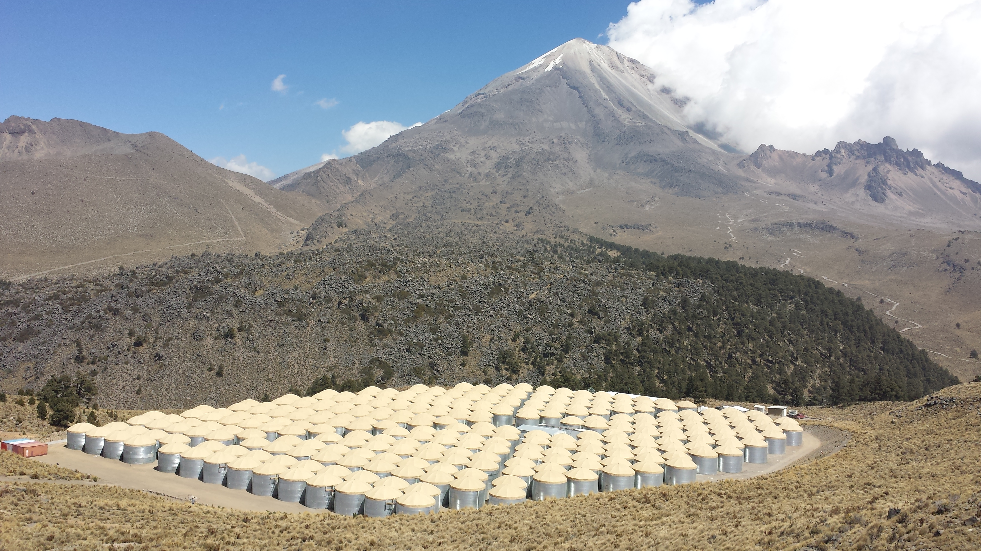
The HAWC
Gamma Ray Observatory
Andrés Sandoval
Instituto de Física
UNAM Mexico
Vienna EPS-HEP 2015 23 July 2015

Slide 2
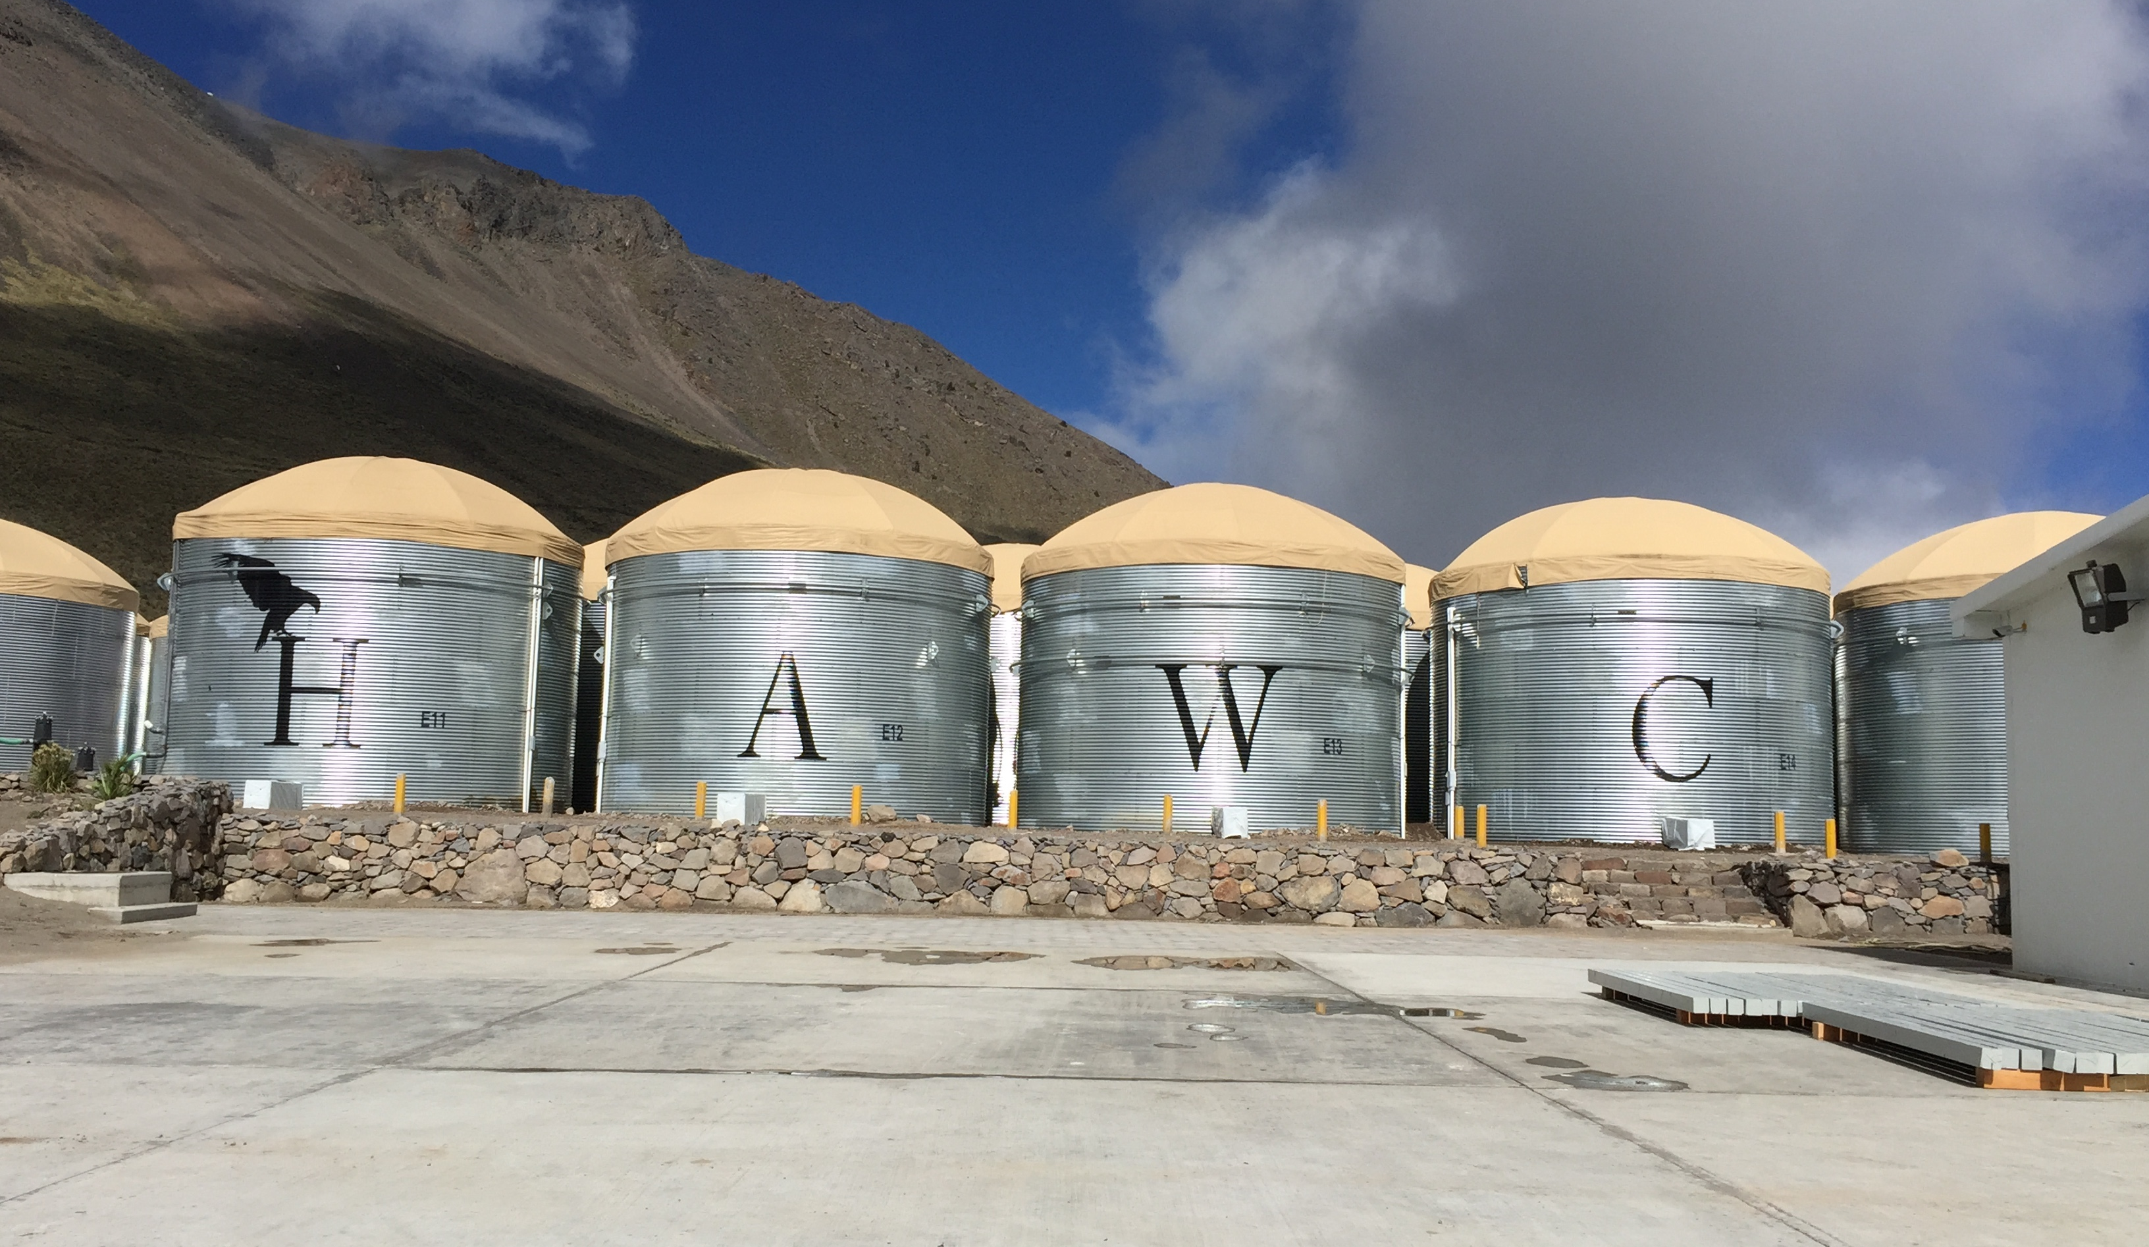
High Altitude Water Cherenkov
detector for gammas and cosmic rays in the 100 GeV to 100 TeV energy range
situated on the slopes of Volcan Sierra Negra, central Mexico
at 4,100 masl and ( 19º N, 97º W)

Slide 3


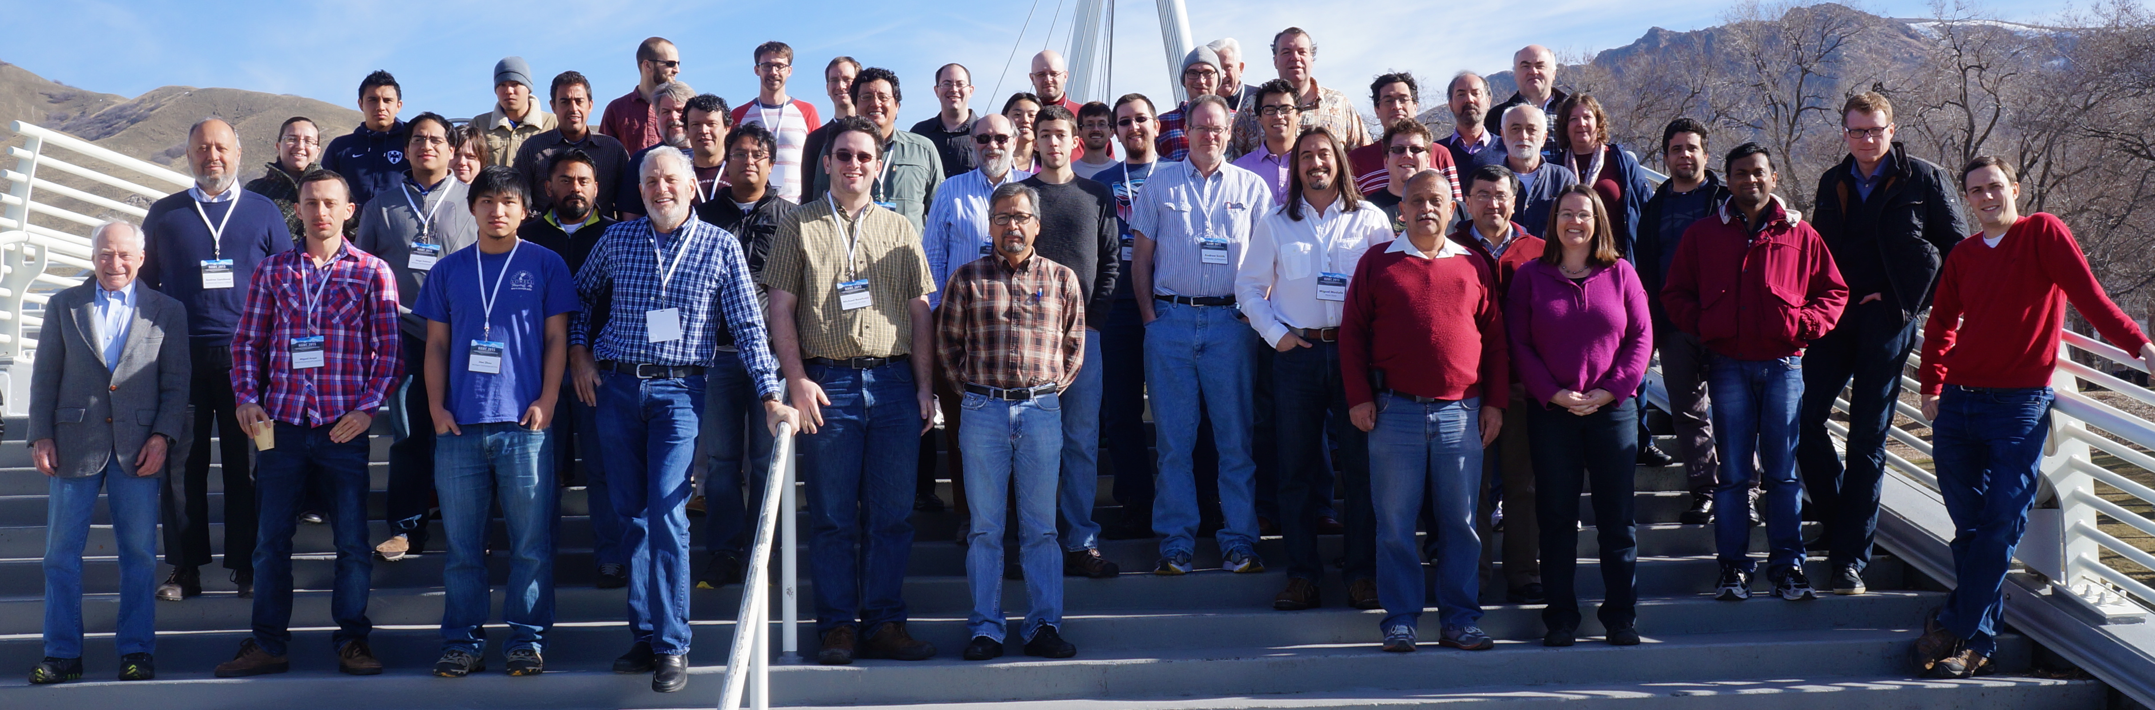
HAWC Collaboration
USA:
Pennsylvania State University
University of Maryland
Los Alamos National Laboratory
University of Wisconsin
University of Utah
Univ. of California, Irvine
University of New Hampshire
University of New Mexico
Michigan Technological University
NASA/Goddard Space Flight Center
Georgia Institute of Technology
Colorado State University
Michigan State University
University of Rochester
University of California Santa Cruz
Mexico:
Instituto Nacional de Astrofísica, Óptica y Electrónica (INAOE)
Universidad Nacional Autónoma de México (UNAM)
Instituto de Física
Instituto de Astronomía
Instituto de Geofísica
Instituto de Ciencias Nucleares
Universidad Politécnica de Pachuca
Benemérita Universidad Autónoma de Puebla
Universidad Autónoma de Chiapas
Universidad Autónoma del Estado de Hidalgo
Universidad de Guadalajara
Universidad Michoacana de San Nicolás de Hidalgo
Centro de Investigación y de Estudios Avanzados
Instituto Politécnico Nacional
Centro de Investigación en Computación - IPN

Slide 4
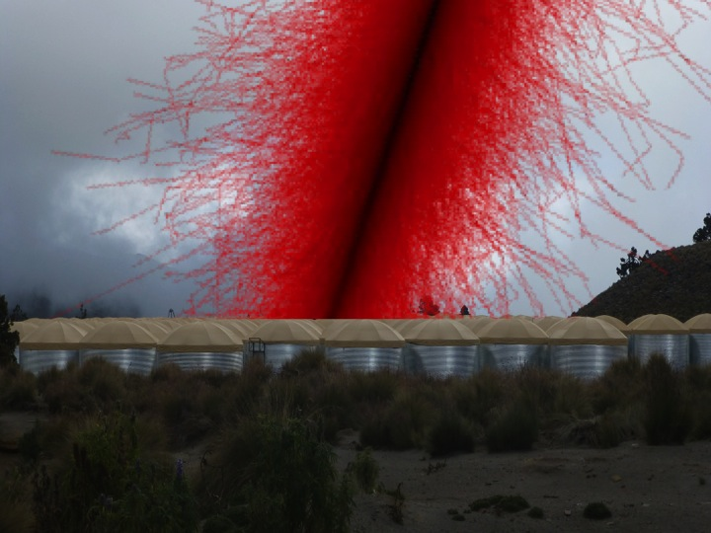
Detects continuously airshower particles
with 300 Water Cherenkov Detectors
over a large aperture
day and night

Slide 5
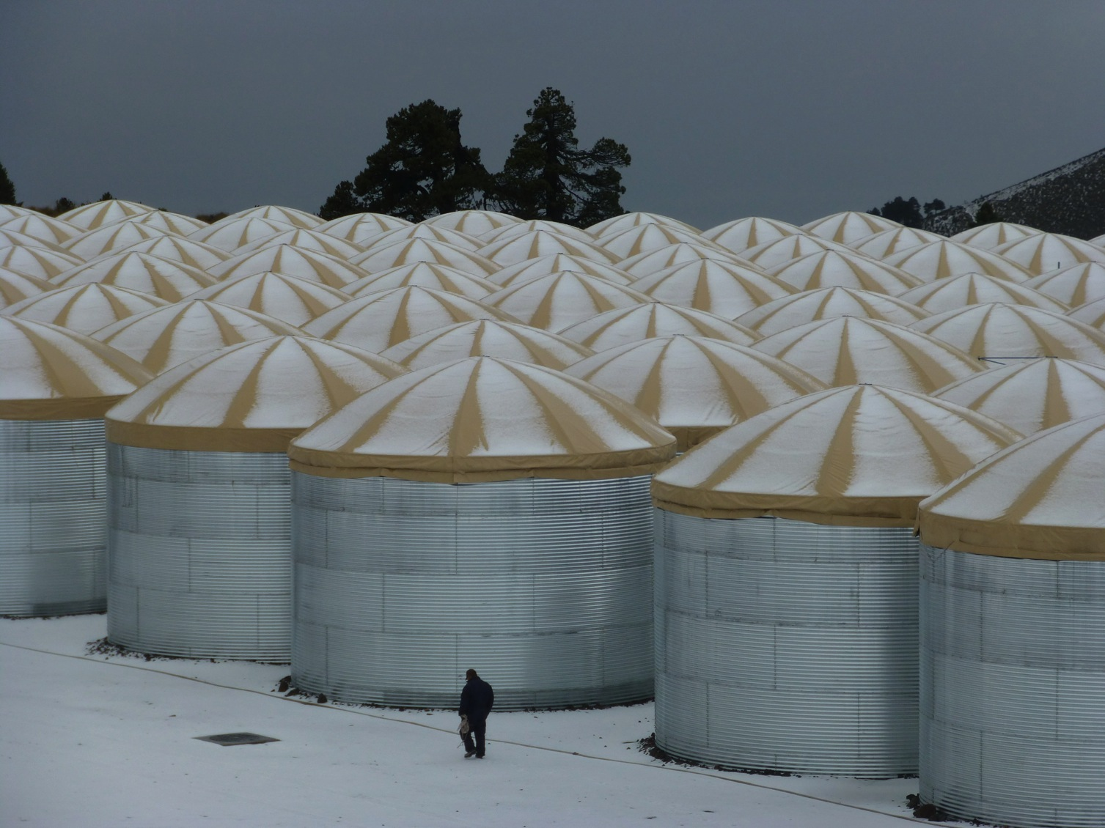
surveying every day 2/3 of the sky

Slide 6
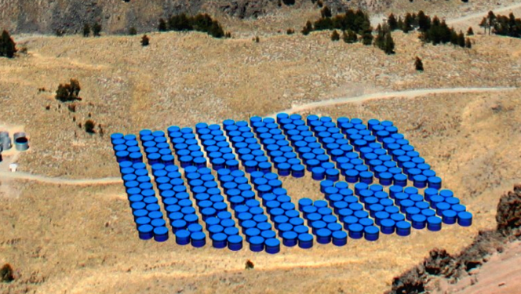
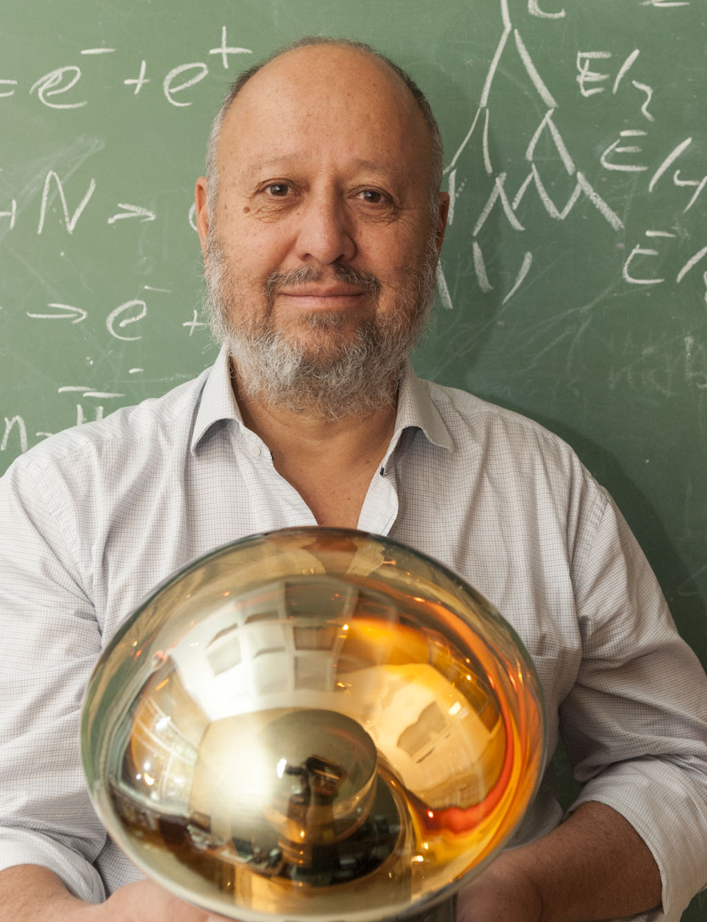
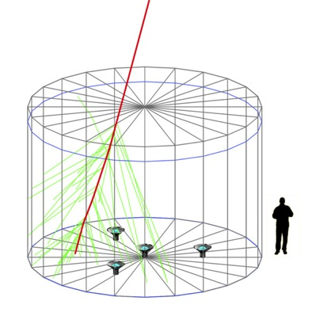
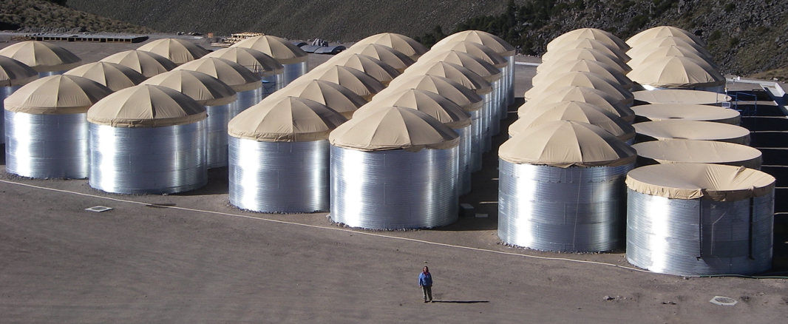
HAWC Design
300 close packed water tanks (7.3m dia x 4.5 m deep of 200,000 liters) each with 4 upward facing photomultiplier tubes at the bottom
180 meters
140 meters

Slide 7
Components of the Water Cherenkov Detectors (WCD)

Slide 8
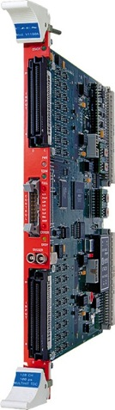
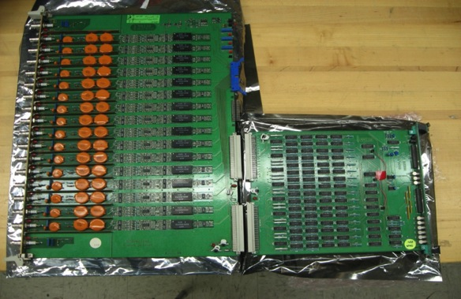
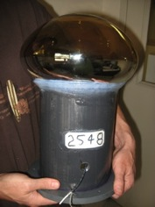

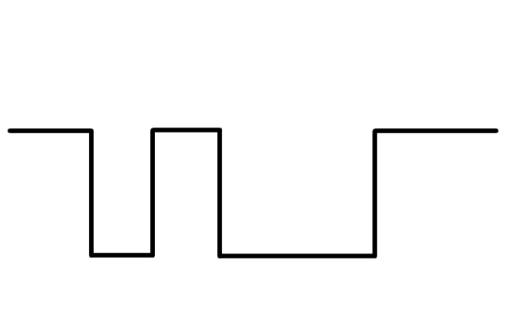
Front End Electronics
ToT (Time over Threshold)
Photo-multiplier Tube
Custom Front-End Electronics
Pick-off circuits and discriminators.
CAEN Vx1190
Time-to-Digital
Converters
Digitizing the times with 100 ps least count
20 – 40 kHz signal rate per PMT (8”, 10”)

Slide 9
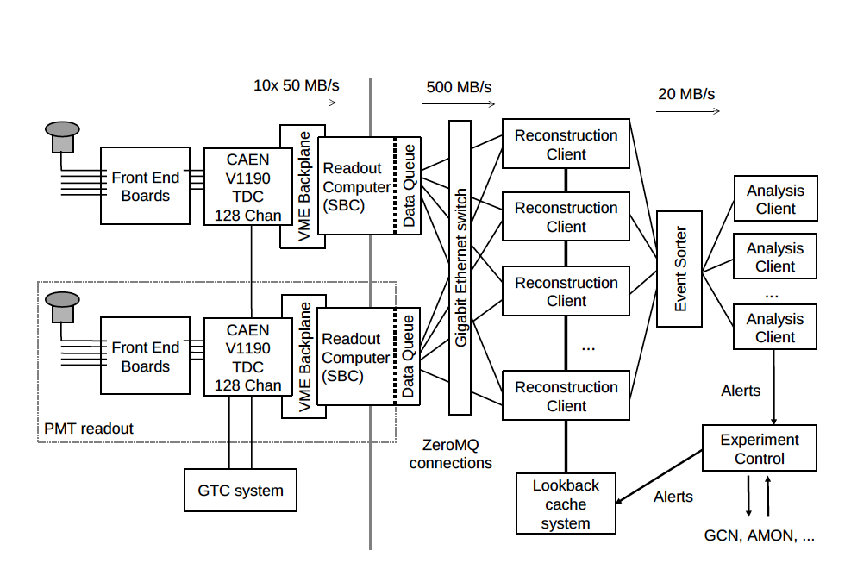
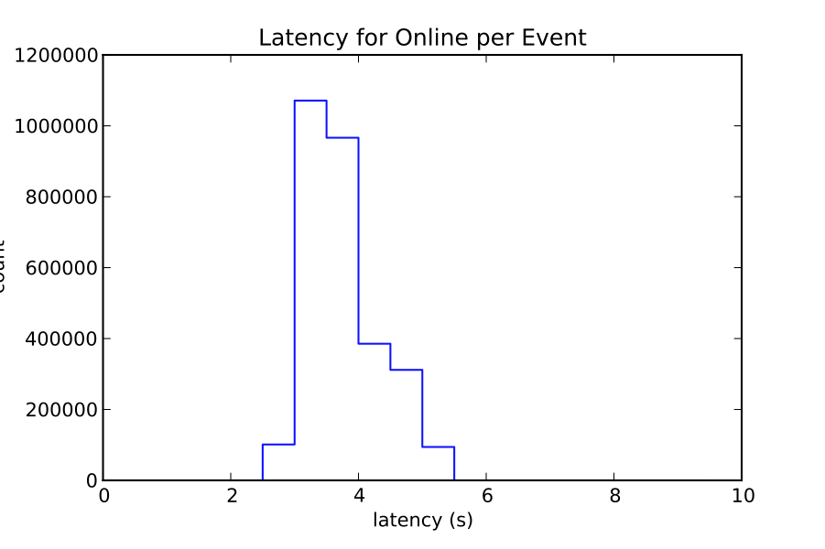
HAWC data acquisition and online analysis
On line transient analysis
4s latency
to generate
alarms and save ROI
24 h raw data
buffer
2 TB

Slide 10
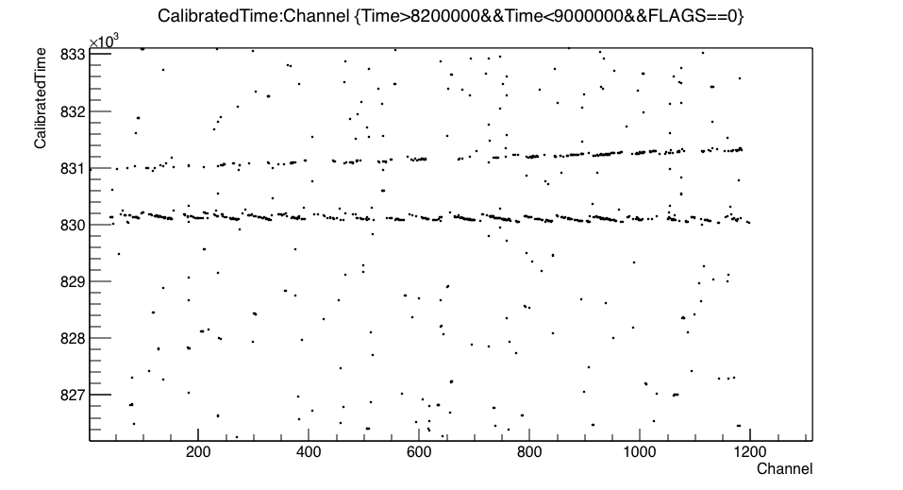
Raw Data
1200 PMTs – 6 µs

Slide 11
Event reconstruction
Shower core position
Center of Gravity, NKG lateral distribution, others.
Shower direction
Time of arrival of each signal. Shower front curvature.
Direction of primary is the perpendicular to the shower front
Shower energy
Event size, PMT charge, etc.
150 m

Slide 12
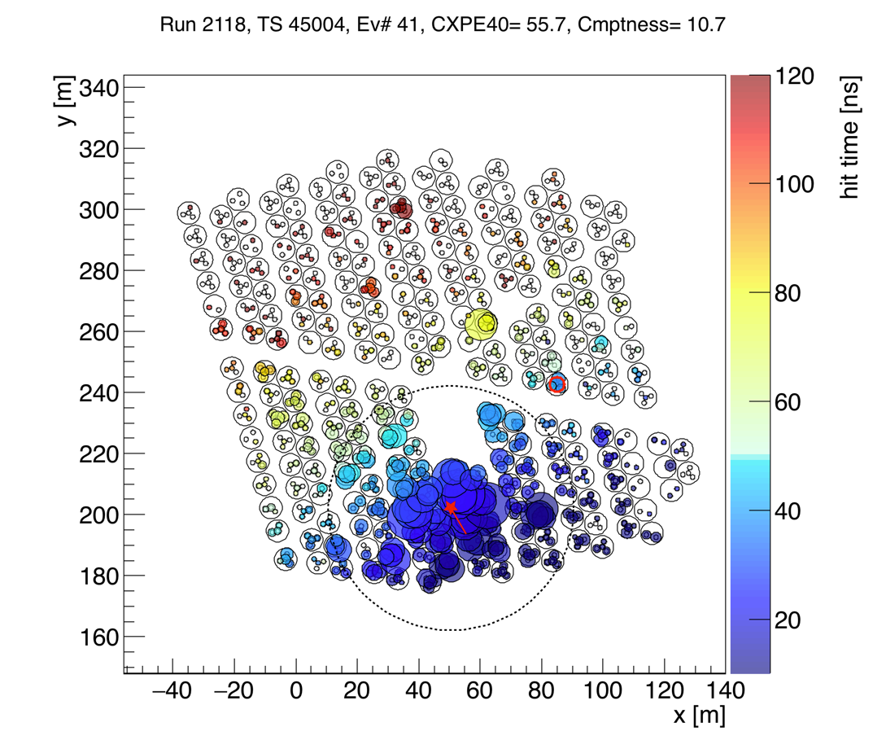
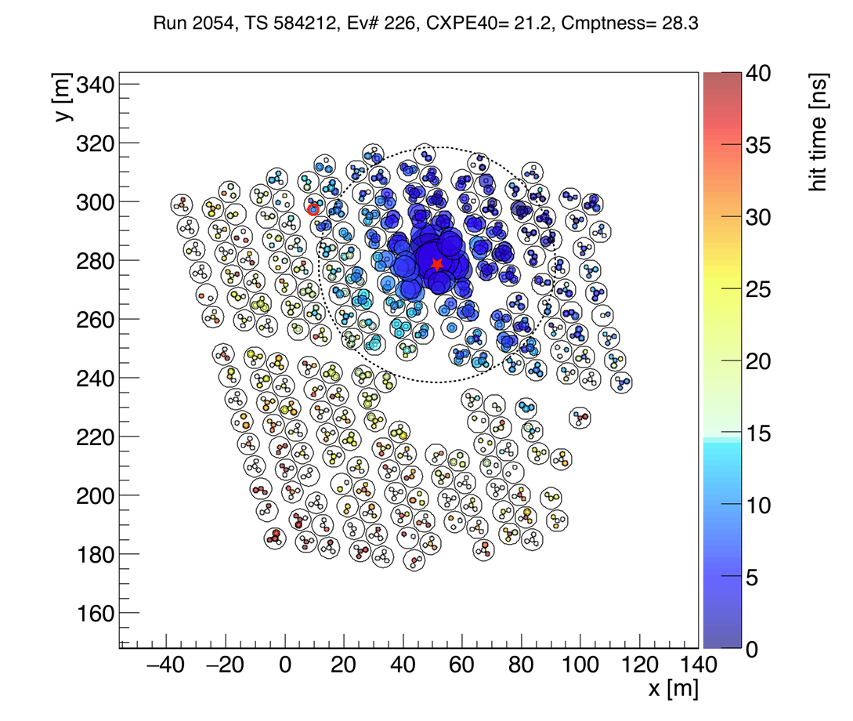
HAWC-250 gamma/hadron
Hadron Shower (off source)
Likely Gamma Shower (on Crab)

Slide 13
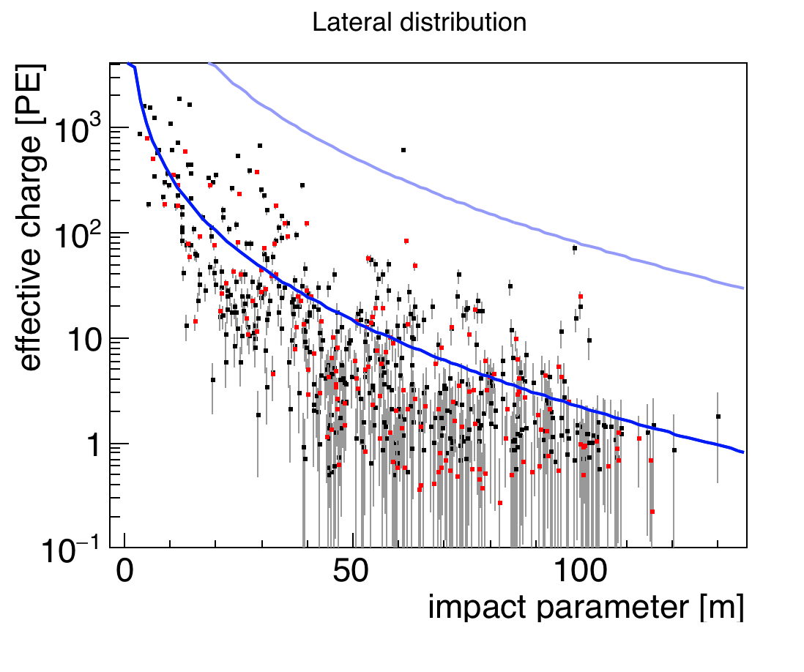
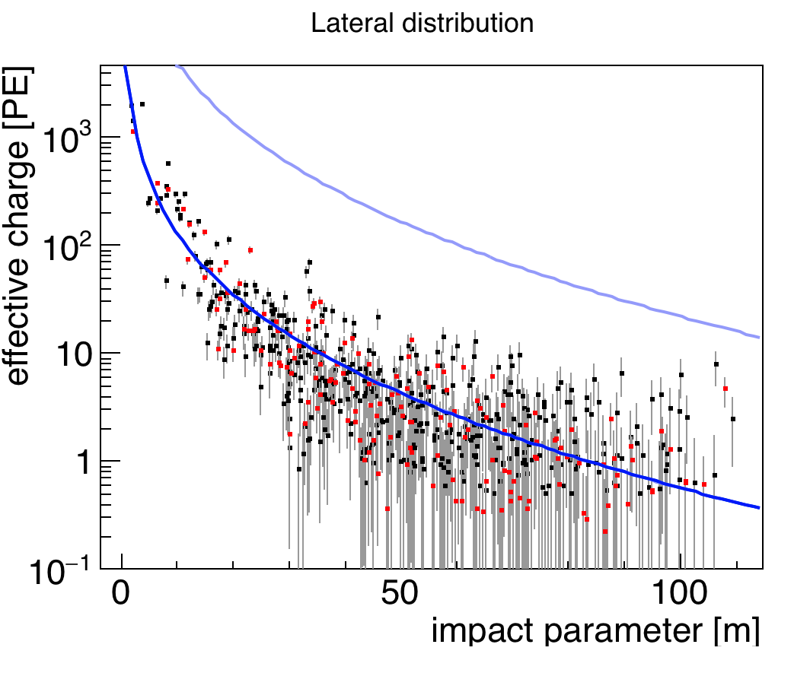
HAWC-250 gamma/hadron
Hadron Shower (off source)
Likely Gamma Shower (on Crab)
radial distance from shower core [m]
radial distance from shower core [m]
NKG (Nishimura-Kamata-Greisen) fits to lateral distribution function of an EM shower.
Kamata, Nishimura Prog. Theo. Phys. (1958)
Greisen Ann. Rev. Nucl. Sci. (1960)

Slide 14

HAWC Cost and Funding
$15 million USD shared equally between 3 funding agencies and managed by 4 PIs
CONACYT, Mexico
    Andres Sandoval UNAM
    Alberto Carramiñana INAOE
NSF, US
    Jordan Goodman, Univ. Maryland
DoE, US
    Brenda Dingus, Los Alamos National Lab

Slide 15
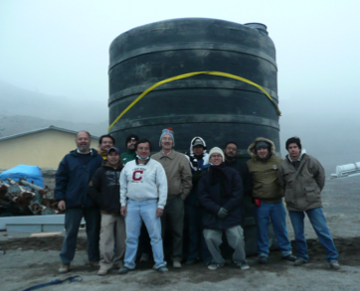
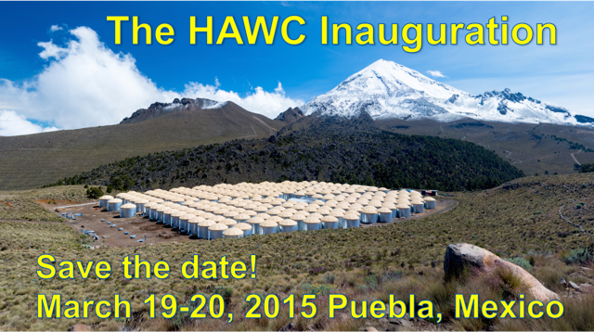
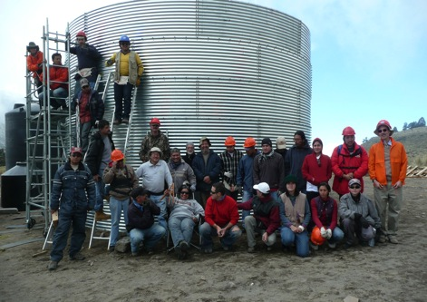
Time Line
Site selected in 2007 at the ICRC meeting in Merida
2008 – 2010 construction of prototypes and writing of proposals
February 2011 project funded
2011 site preparation and procuring of components
2012 – 2014 construction of the 300 WCD
1 August 2013 start of continuous operations HAWC-100
HAWC inauguration 19-20 March 2015

Slide 16
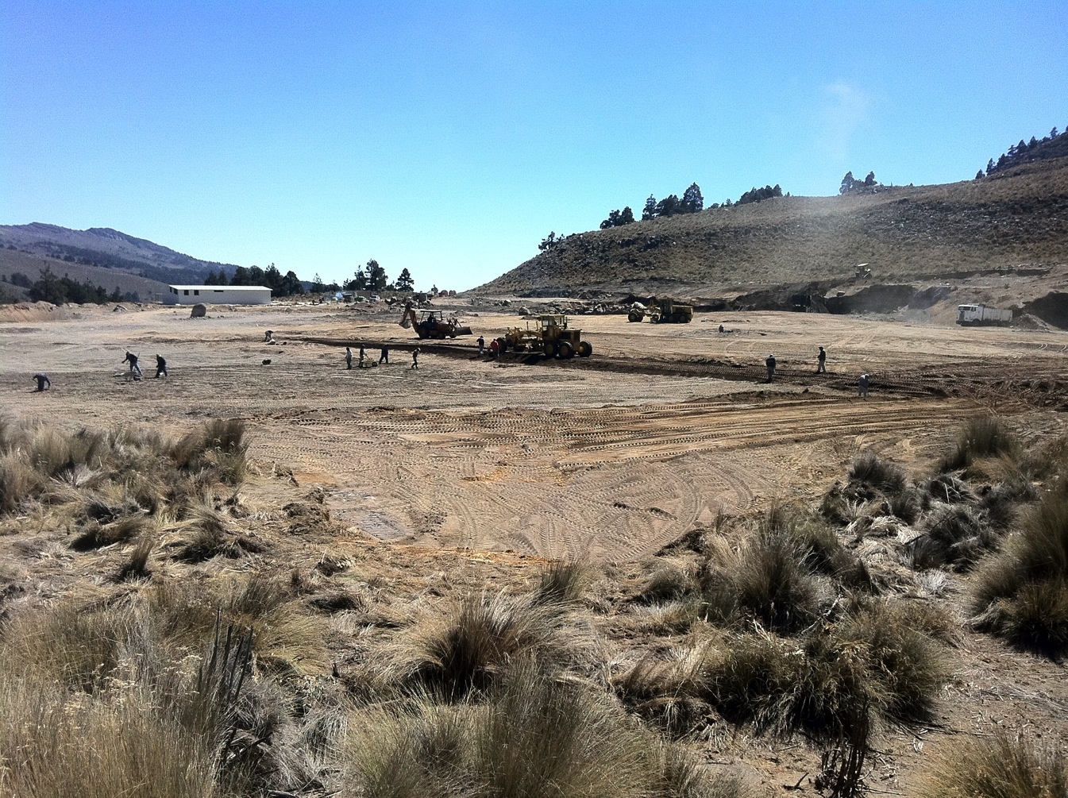
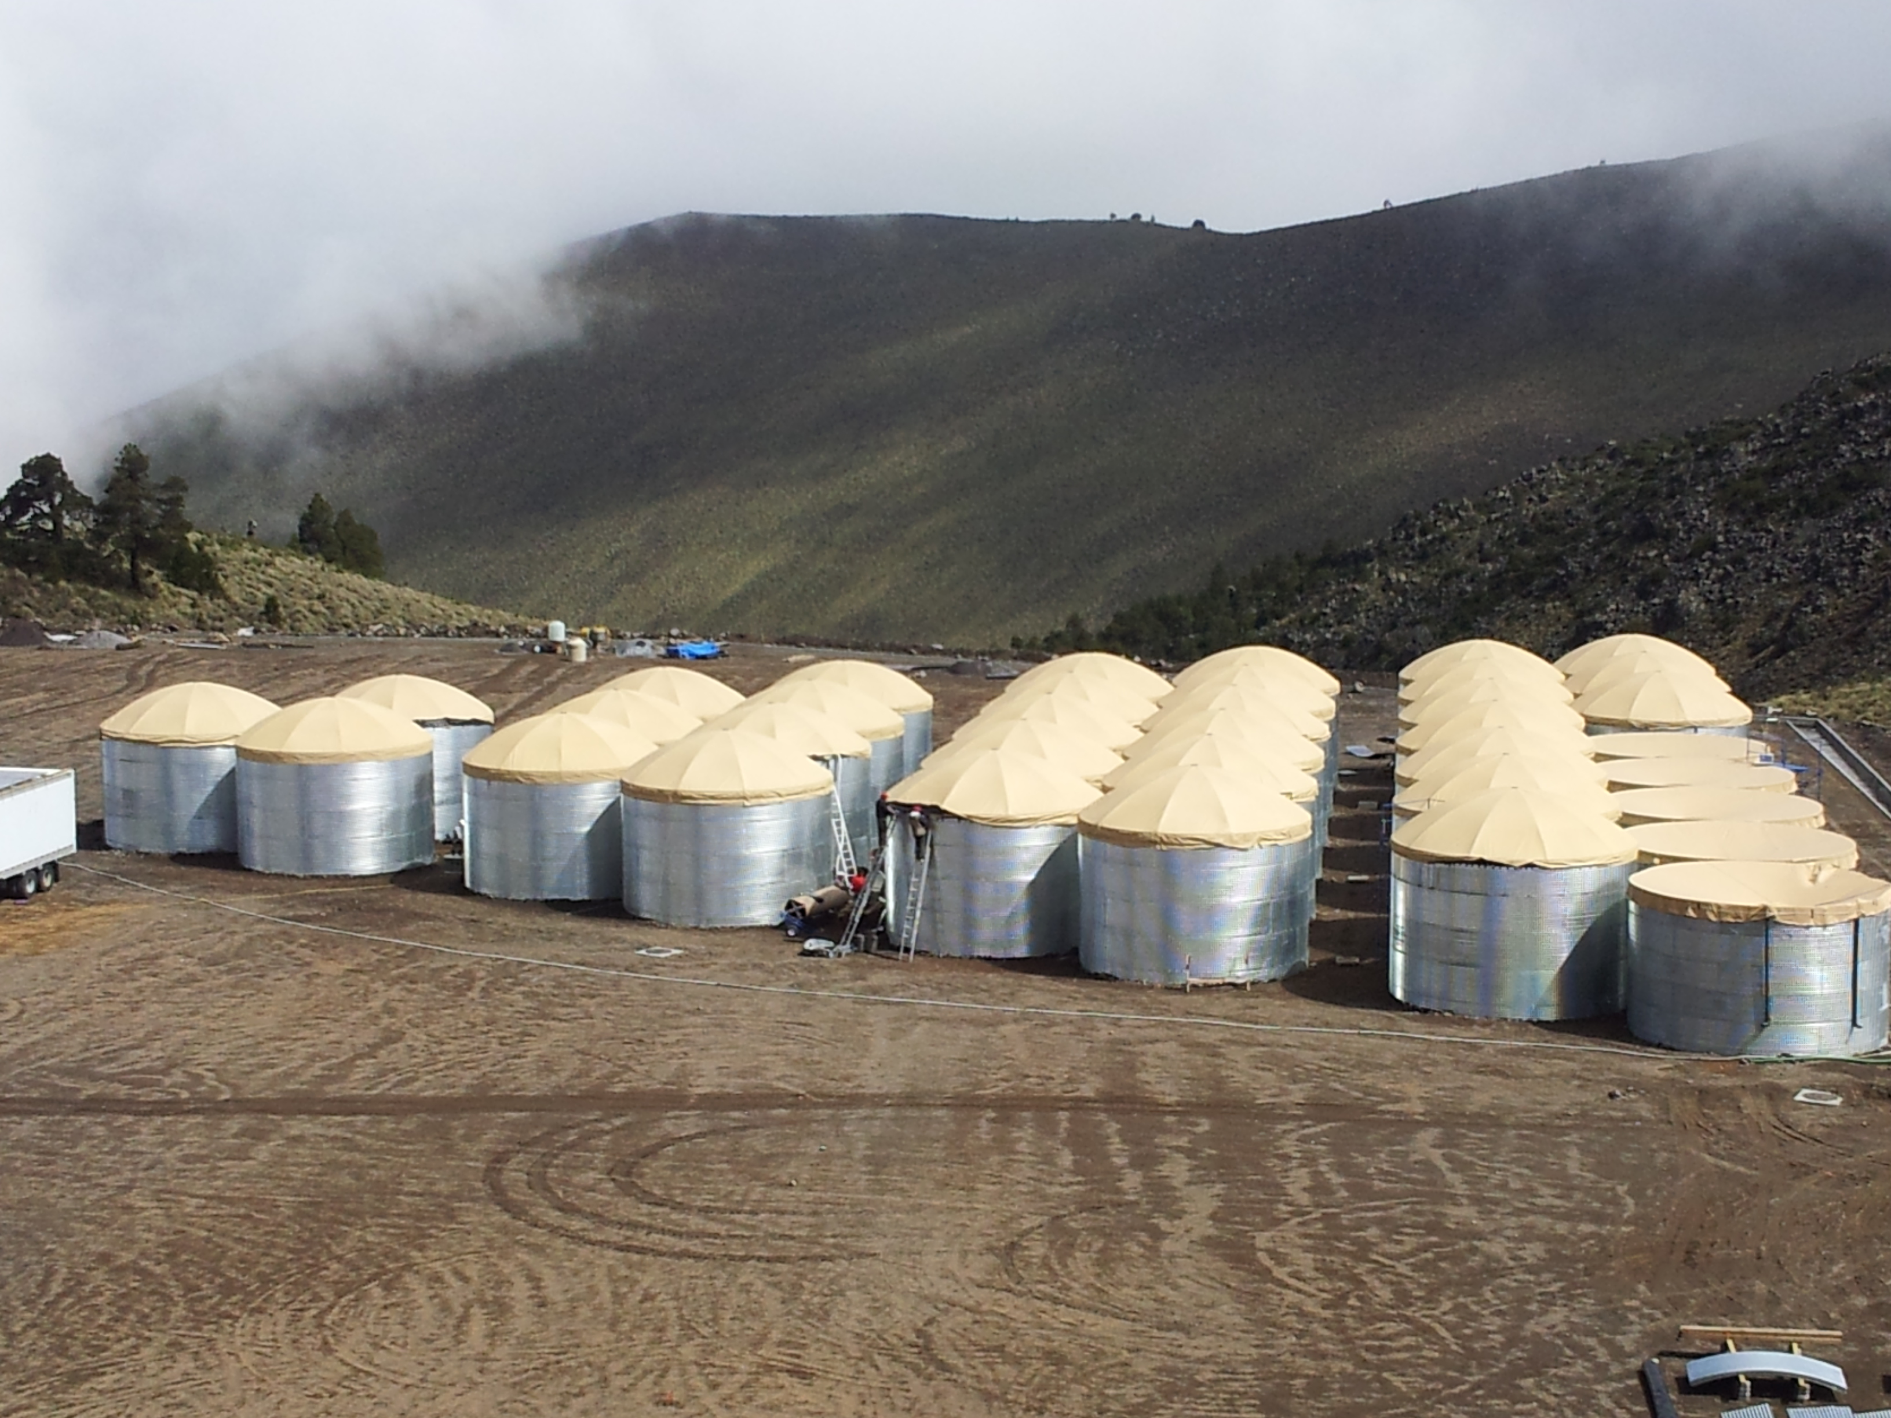
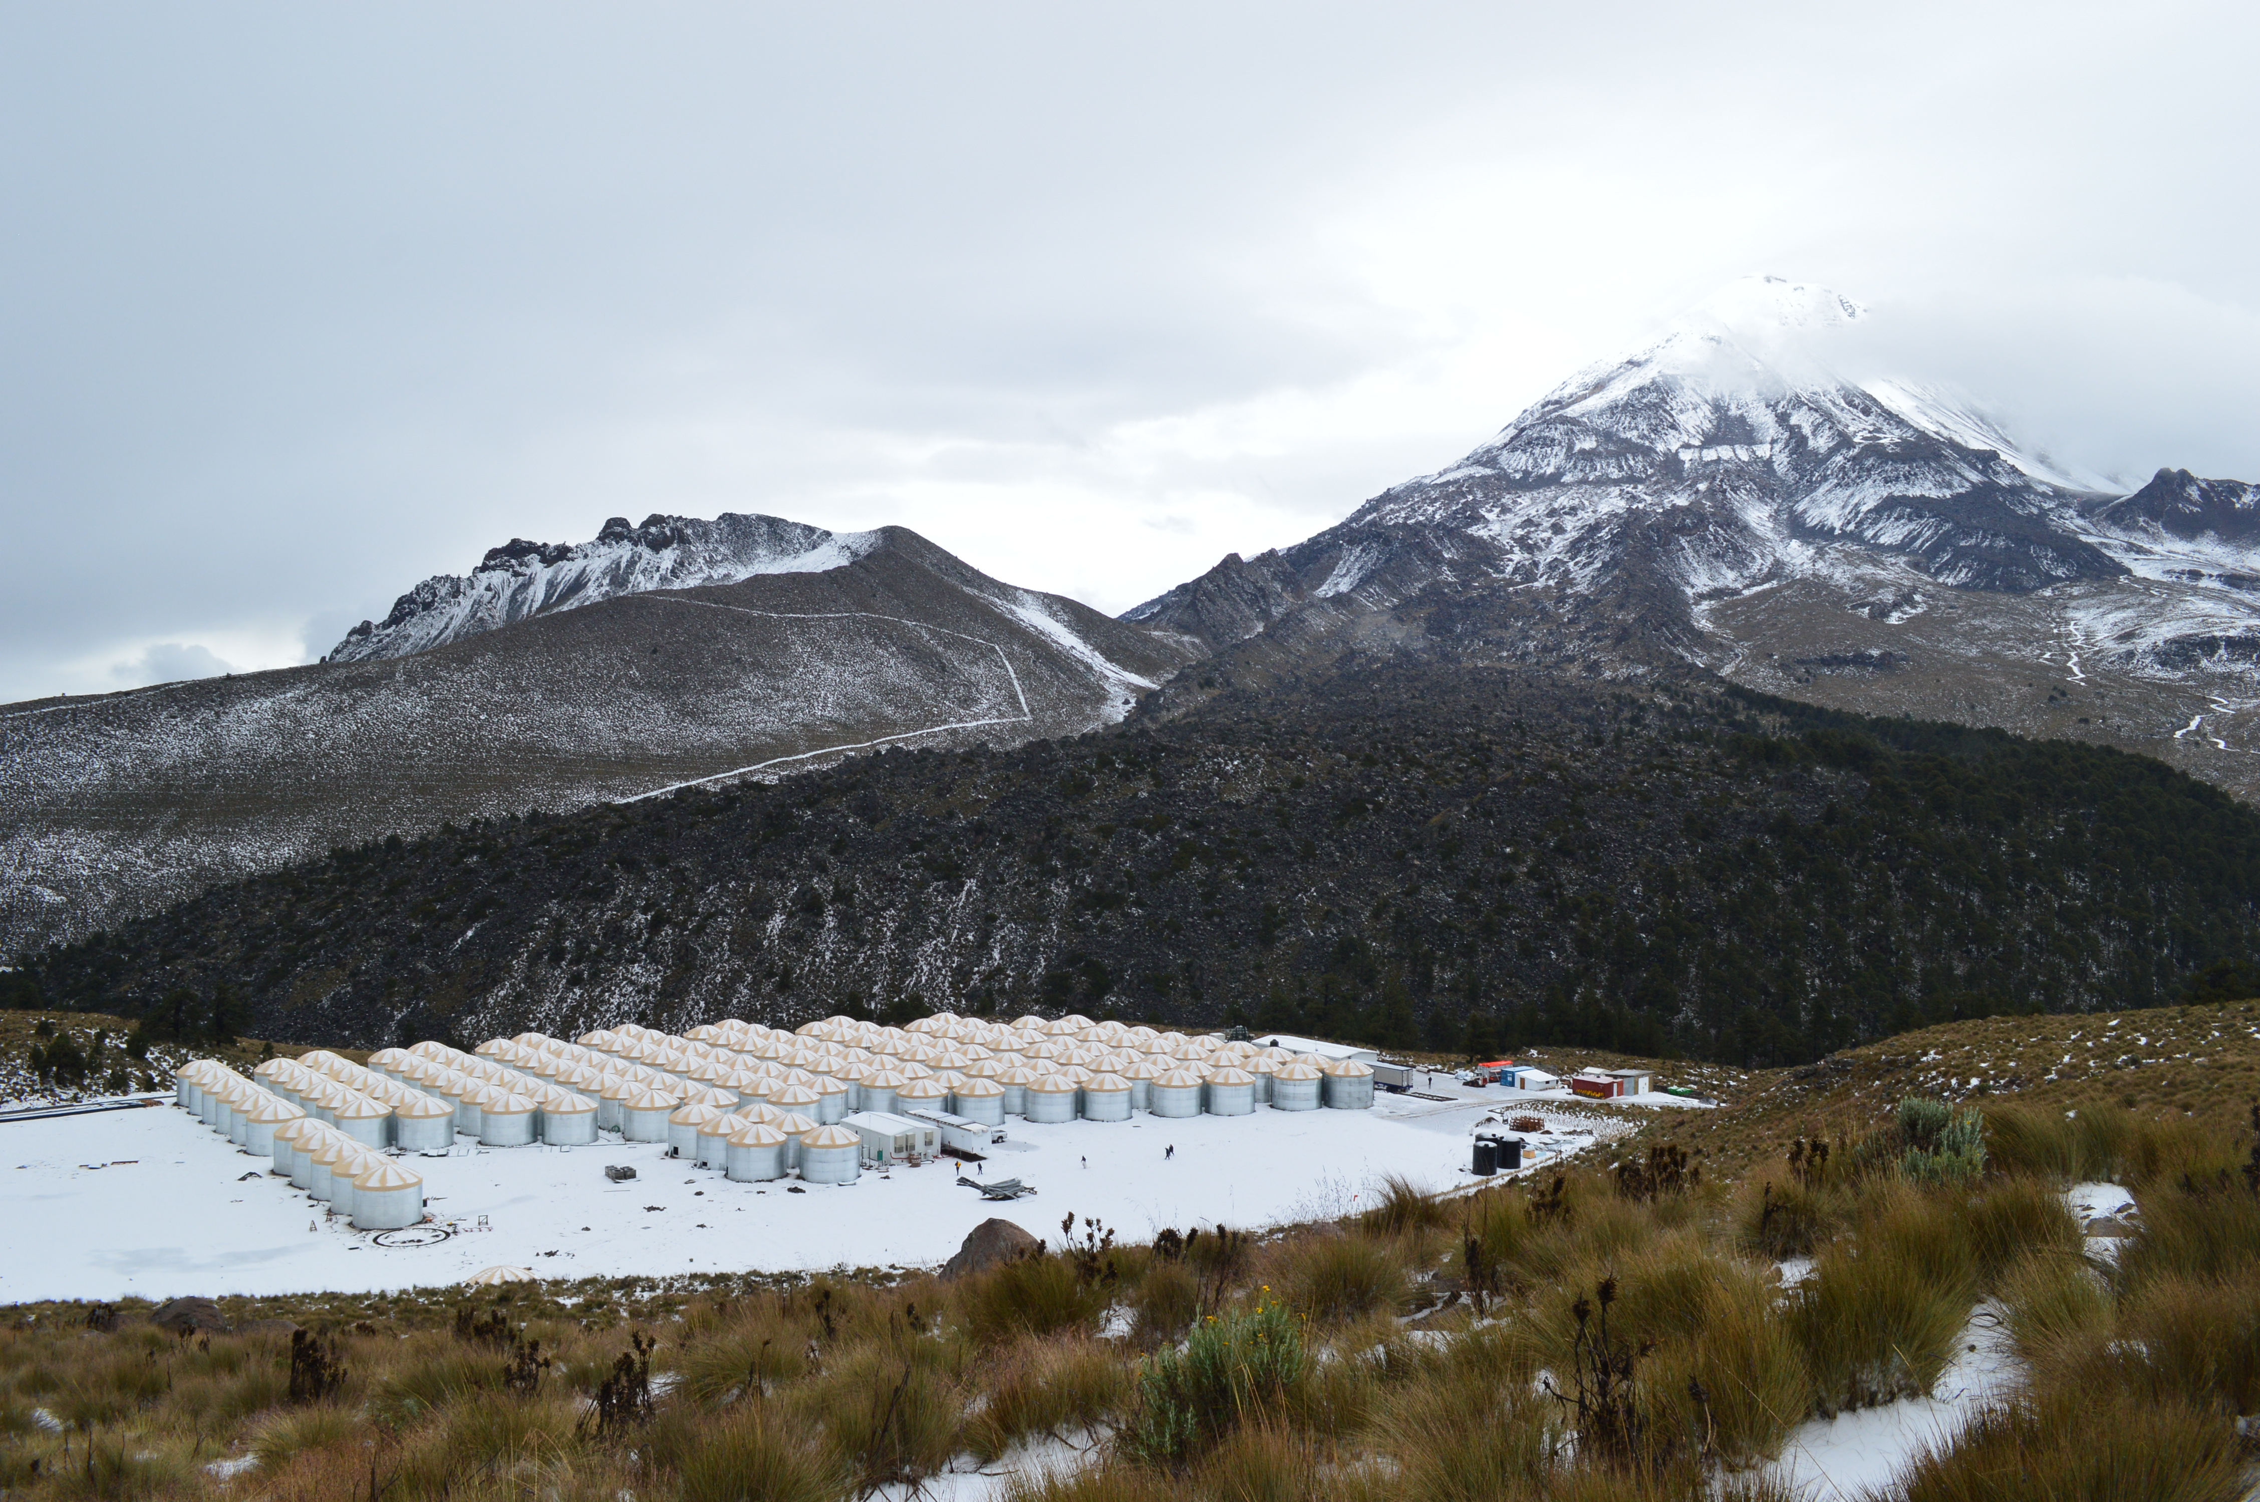
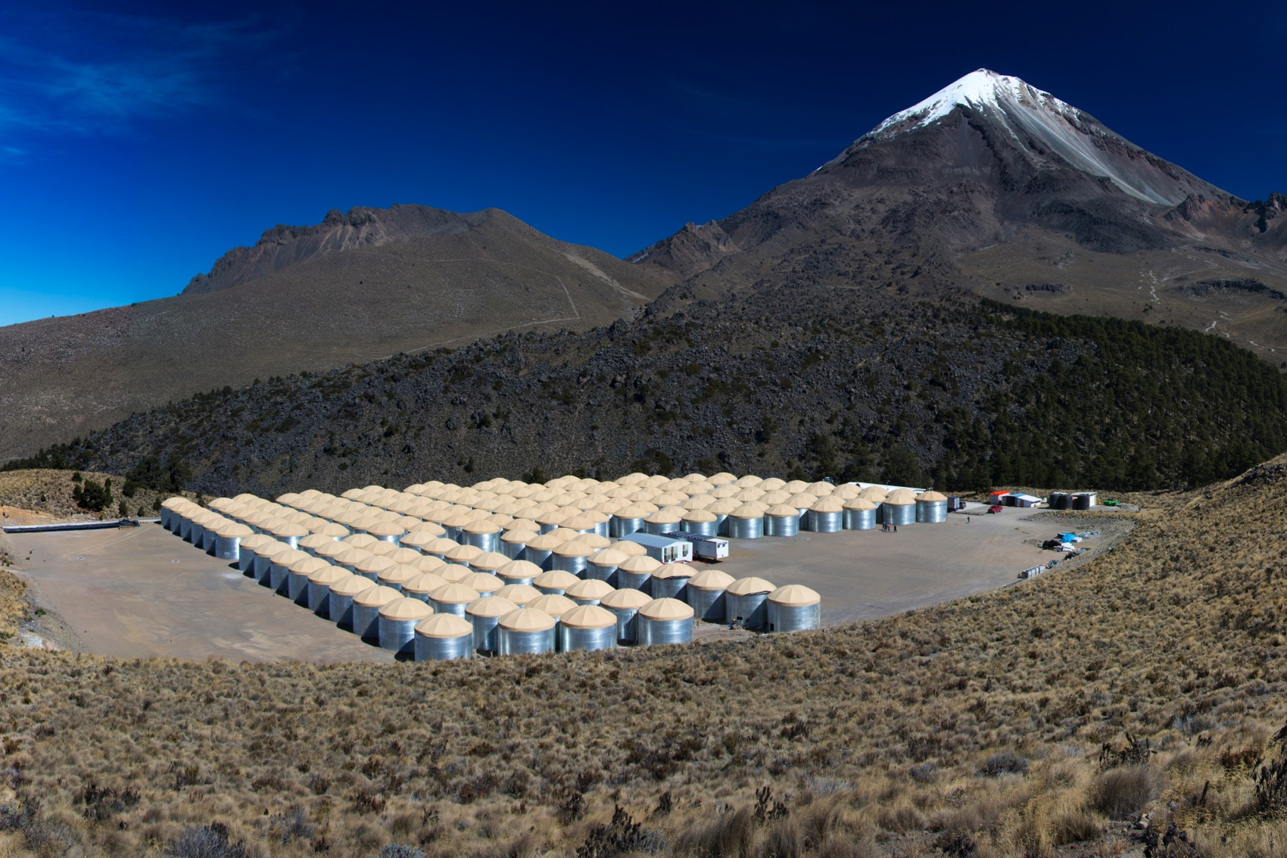
October 2011
August 2012
October 2013
January 2014

Slide 17
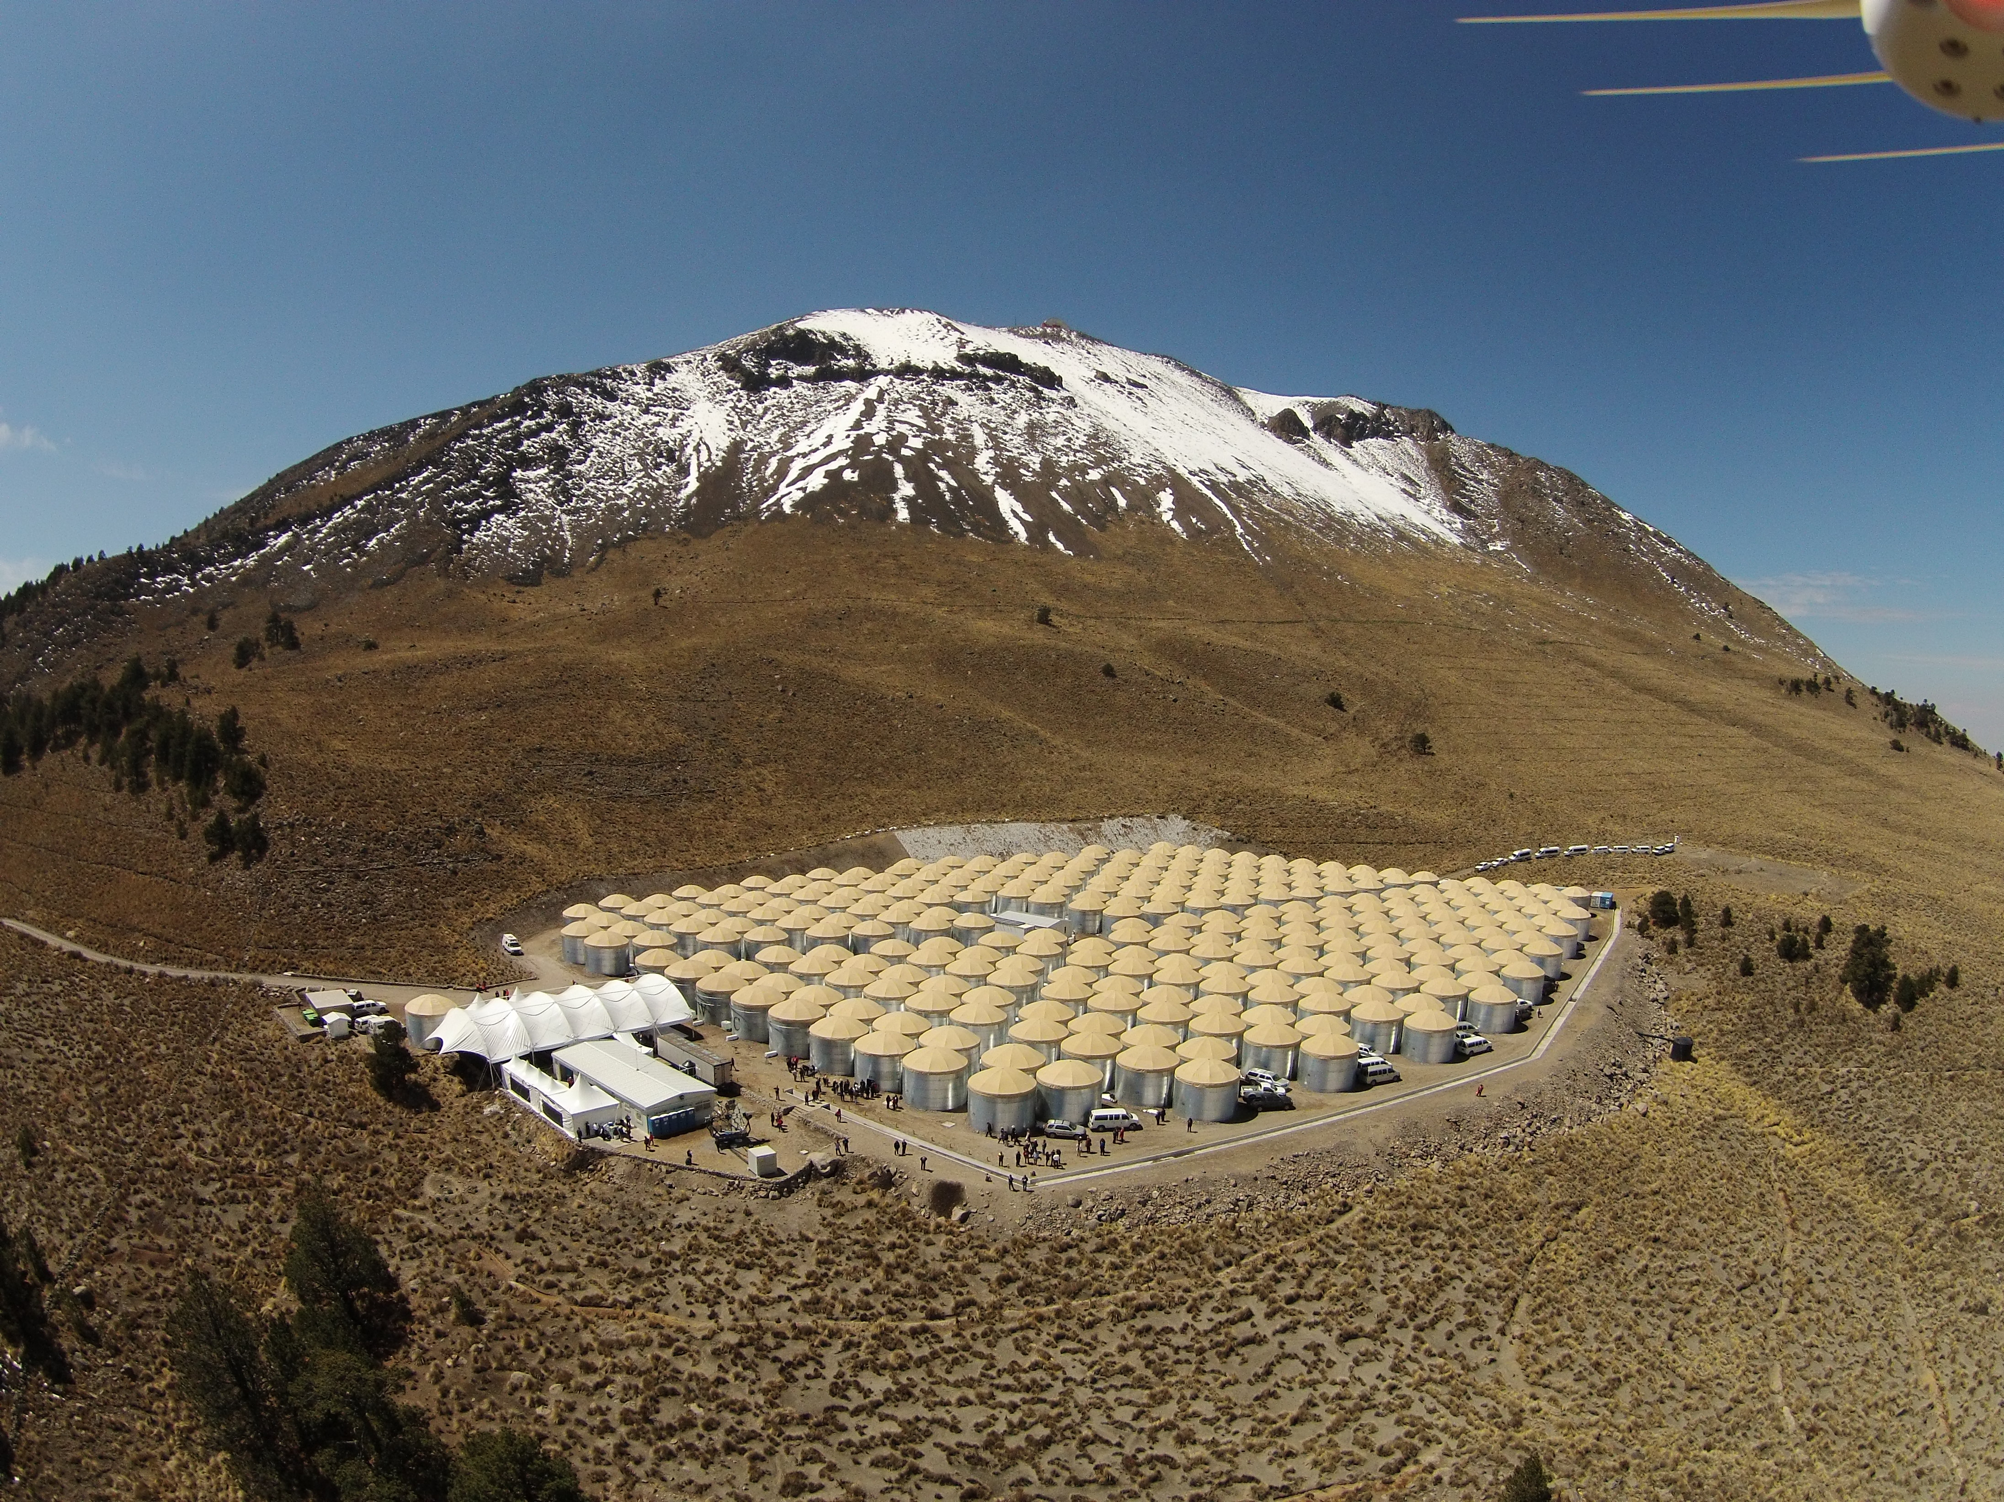
`
HAWC Inauguration
March 20 2015

Slide 18
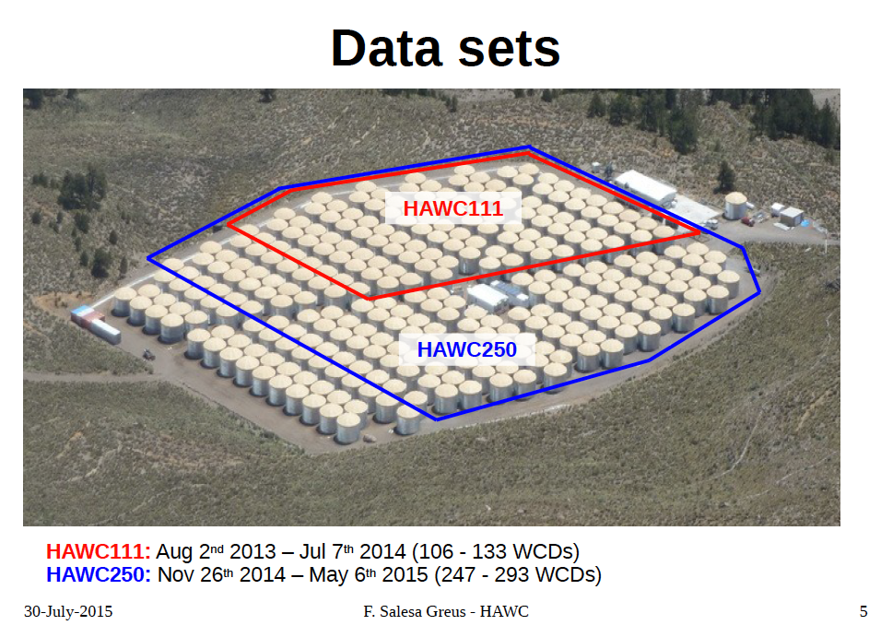

Slide 19
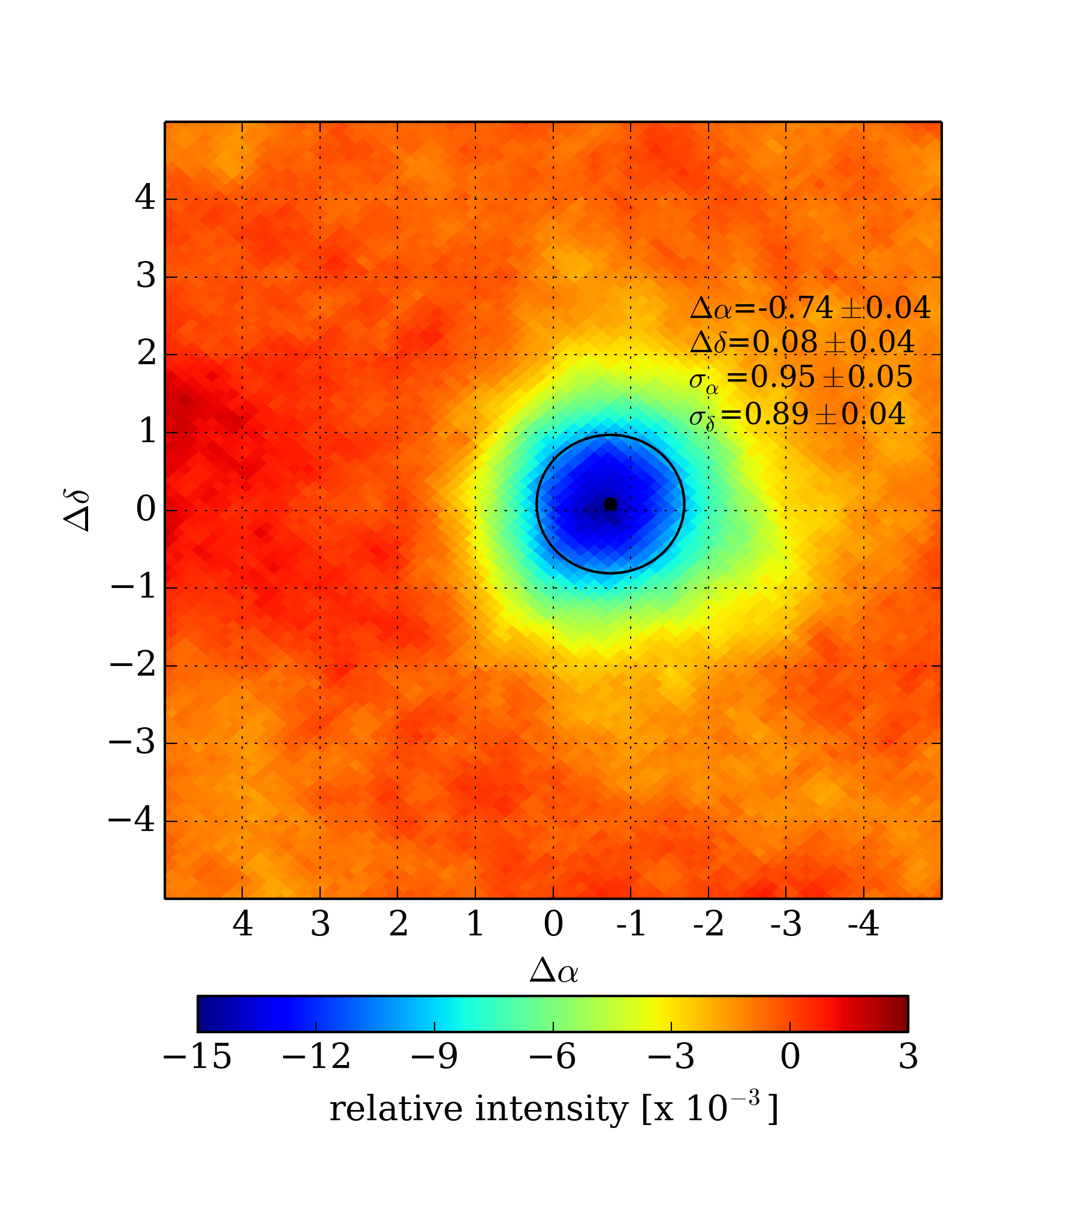
Cosmic Ray Moon Shadow
HAWC-250
52 full sidereal days
32 billion events
2 TeV median energy
Center displacement
  Δα = - 0.74º ± 0.04º
  Δδ = 0.08º ± 0.04º
  agrees with deflection of CR due to the Earth B field
  Δα = 1.6º Z/E [TeV]

Slide 20
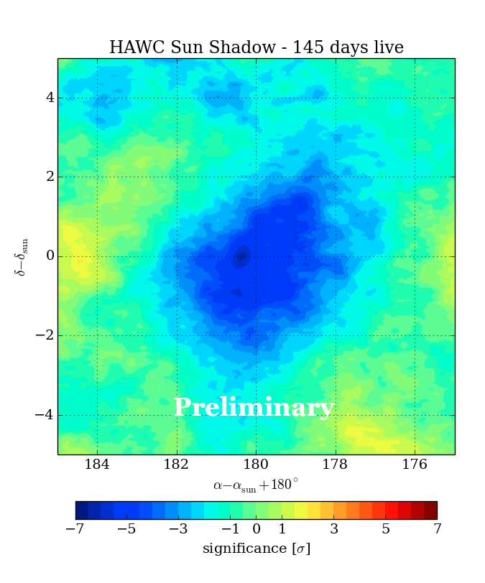
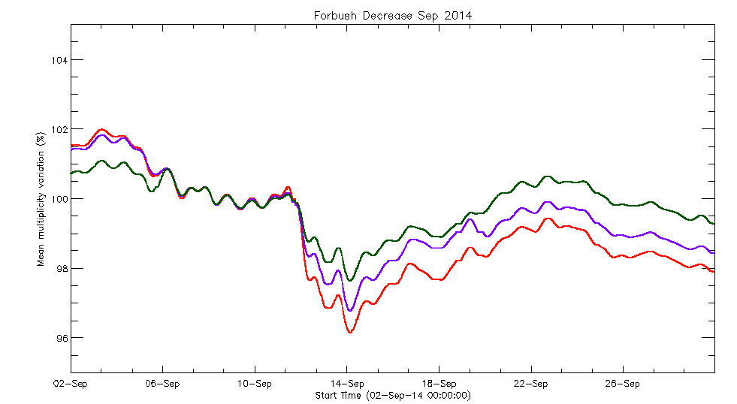
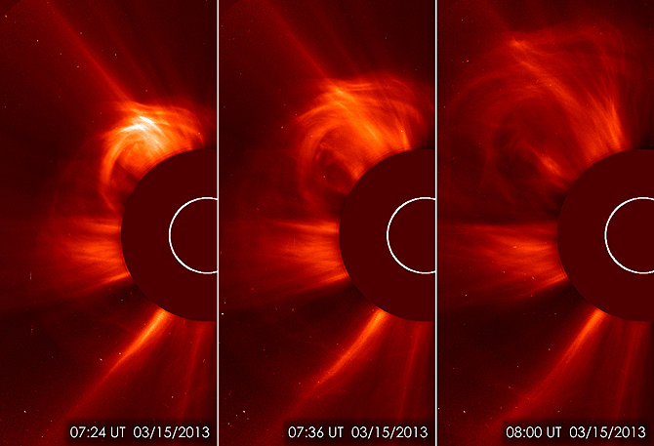
Sun Shadow and Forbush Decreases
CME in Earth direction modify the geomagnetic environment
blurry due to solar magnetic fields
drop in the
single PMT
count rate

Slide 21
HAWC-111
CR Anisotropy

Slide 22
L = 1-3

Slide 23
HAWC-111
CR Anisotropy
Detailed studies will be made over the next few years
already did a combined fit with IceCube CR data

Slide 24
The HAWC γ-ray Sky

Slide 25
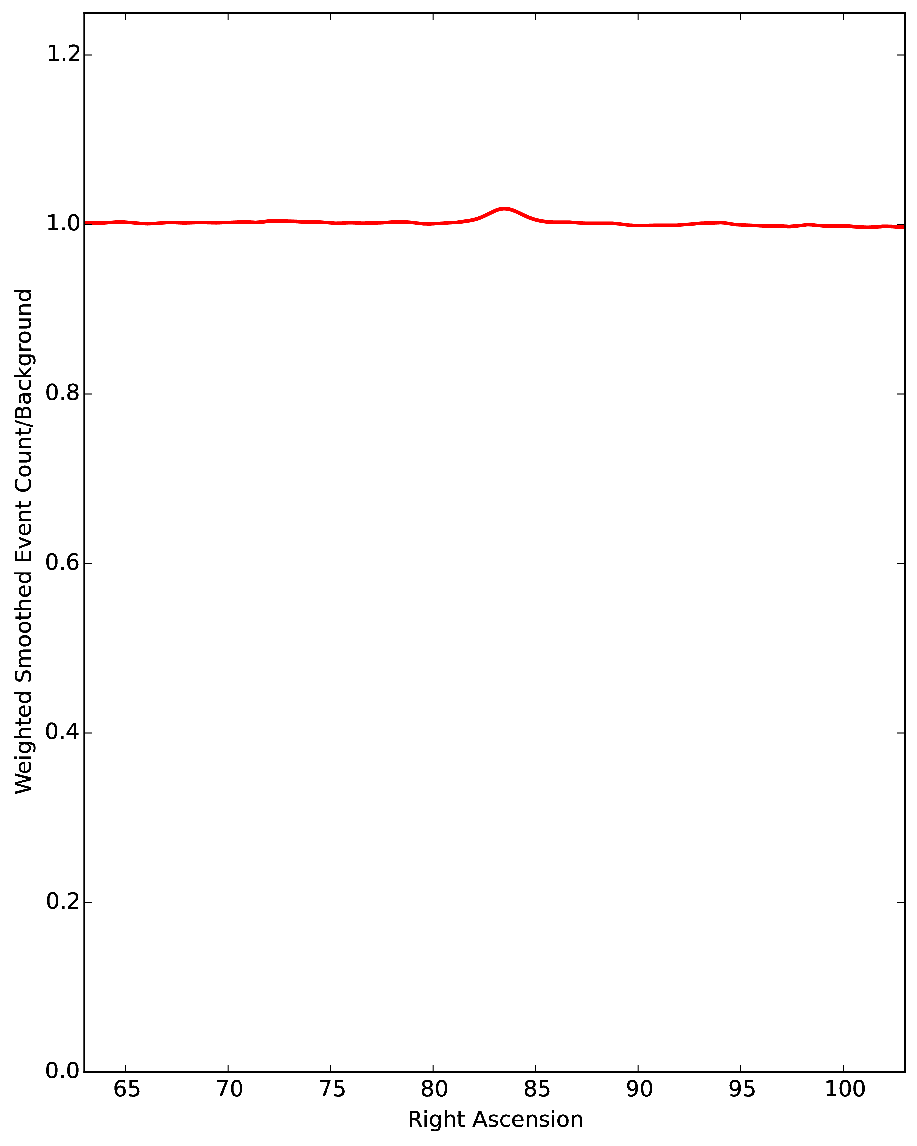
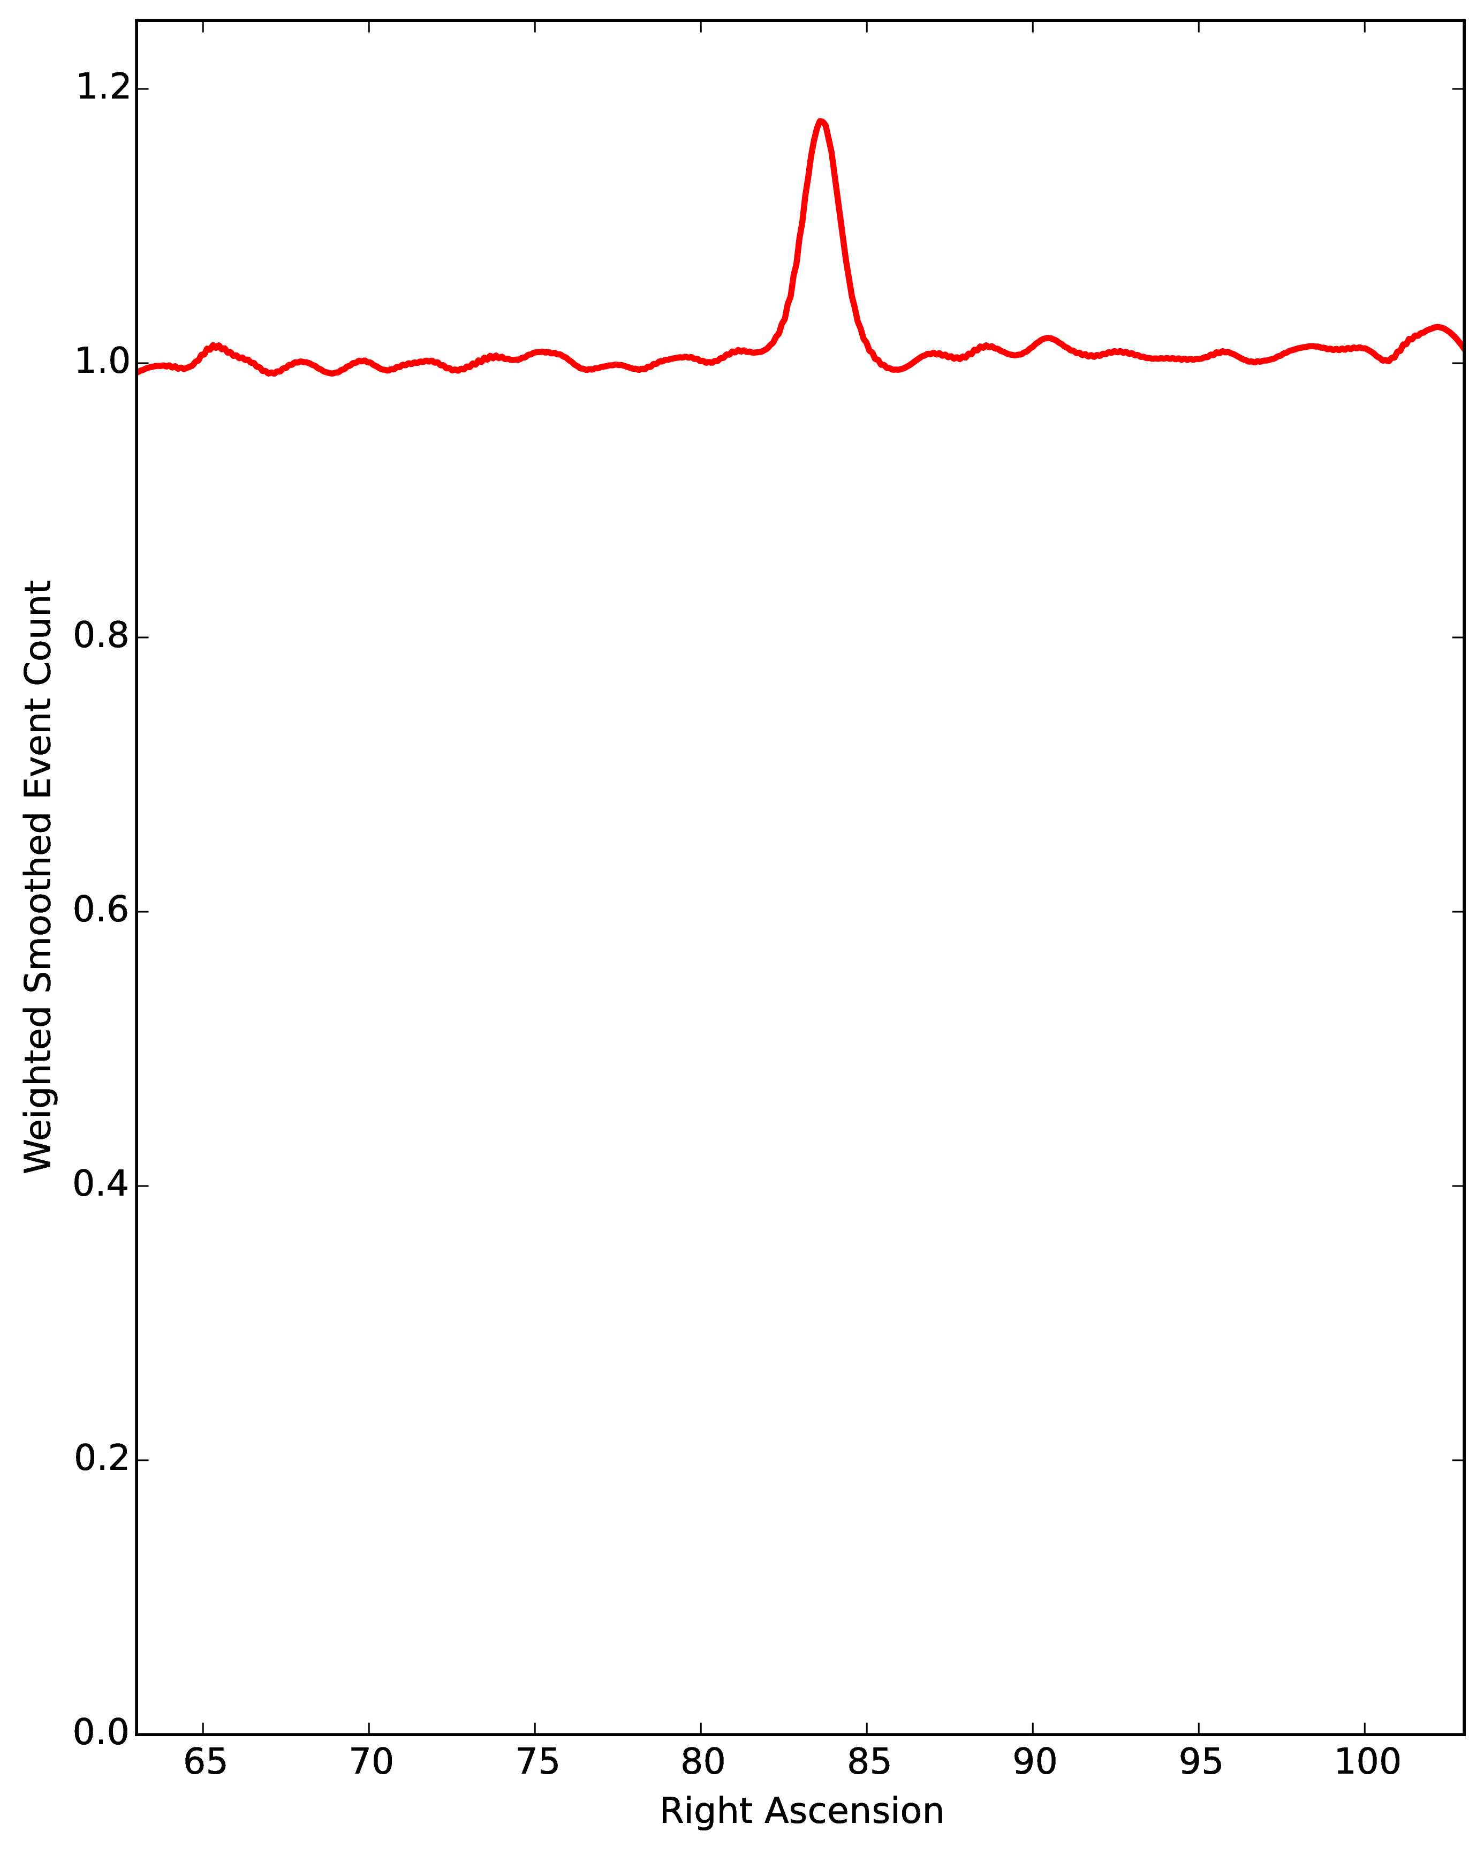
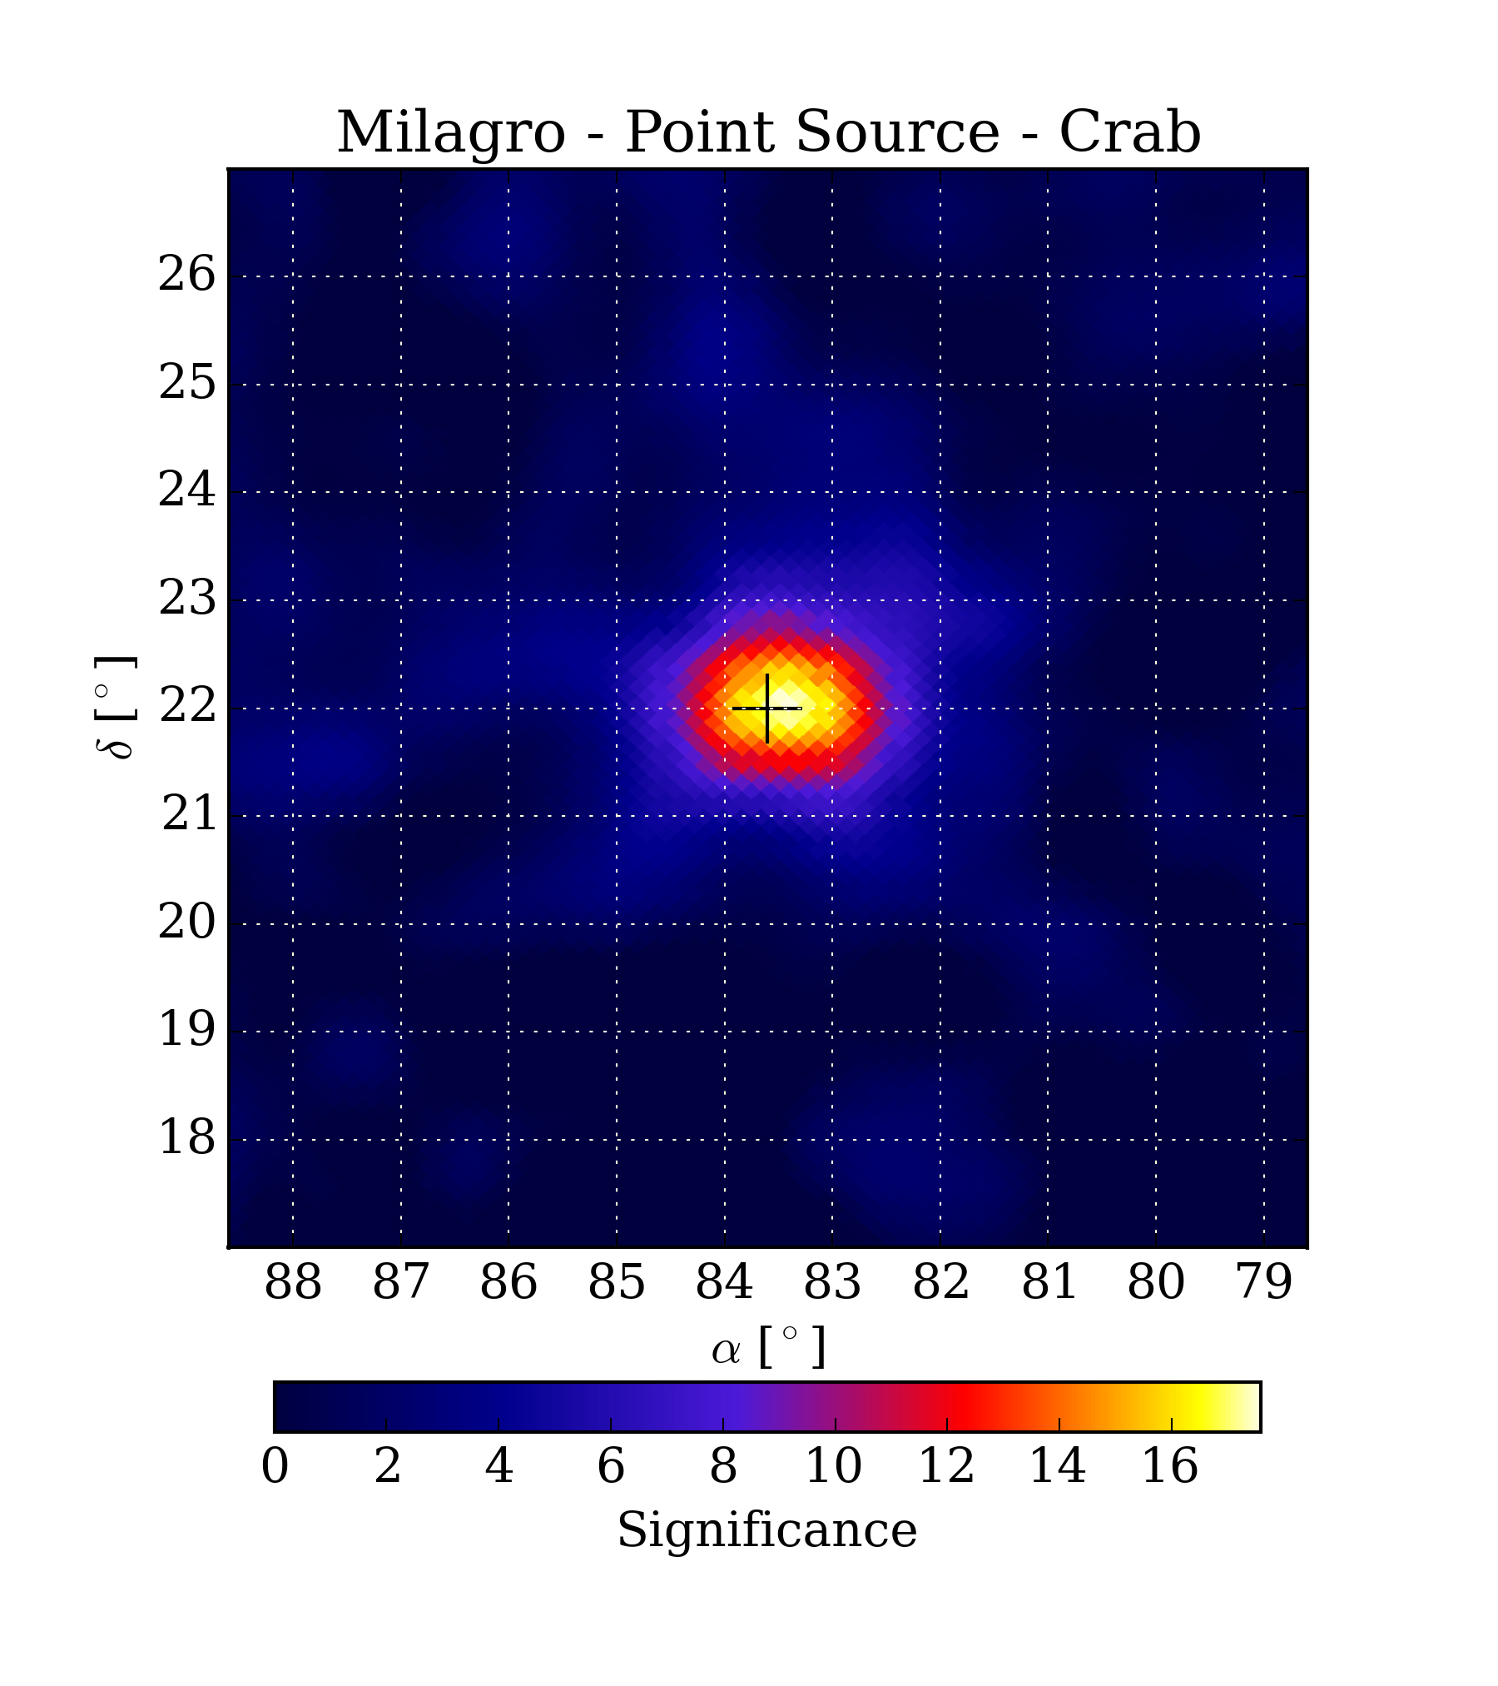
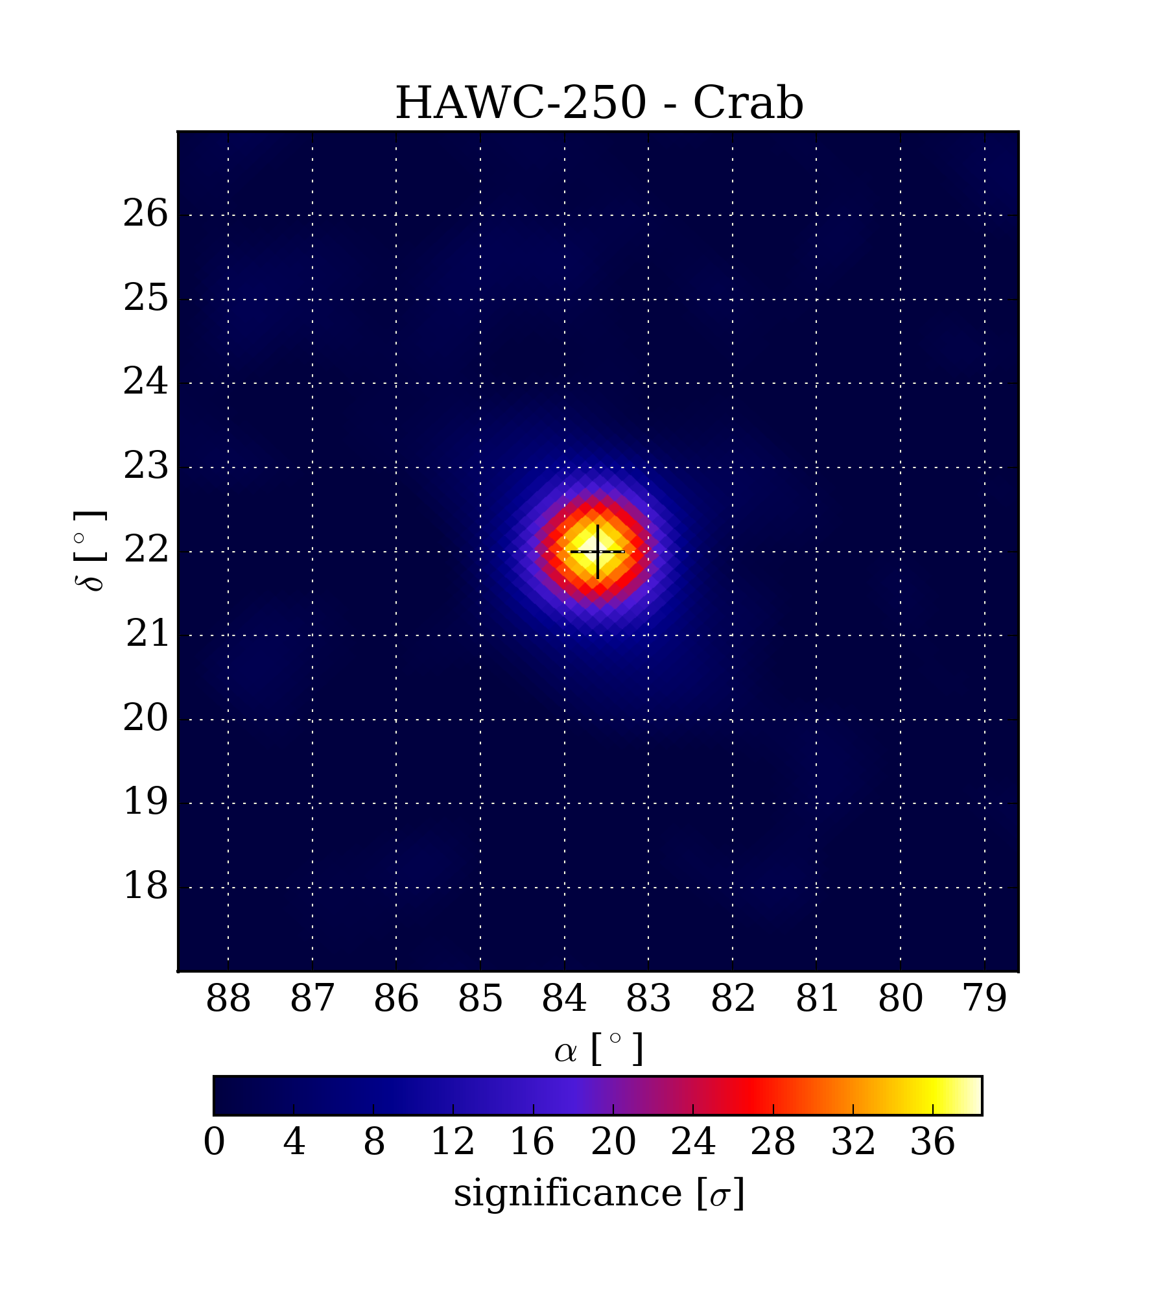
Crab Nebula
Milagro
HAWC
17σ - 8 years
38σ - 150 days

Slide 26
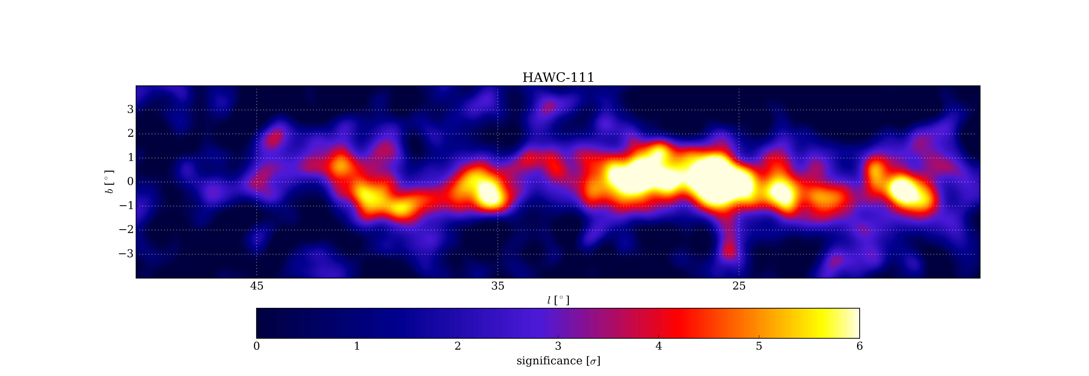
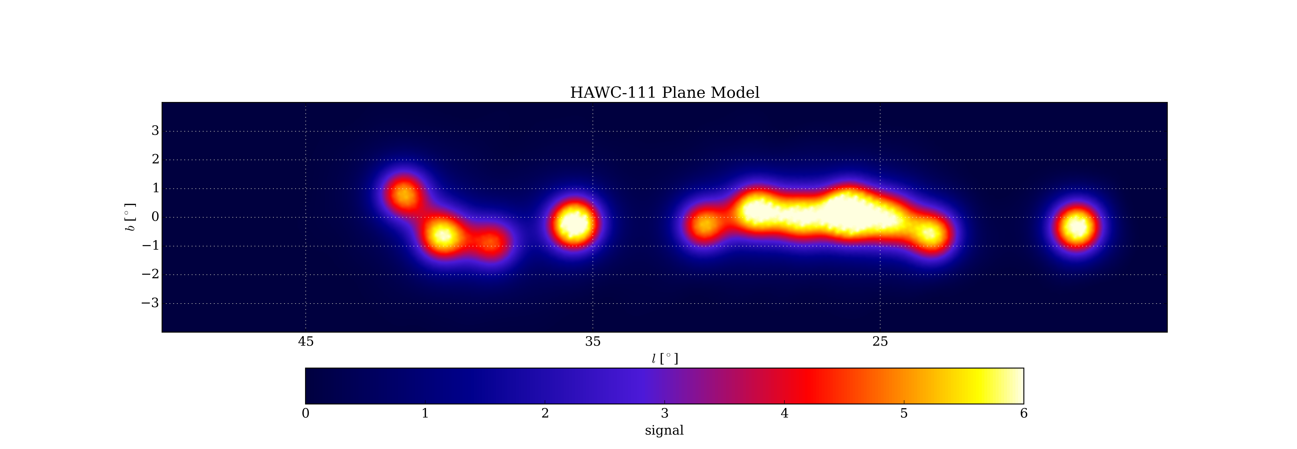
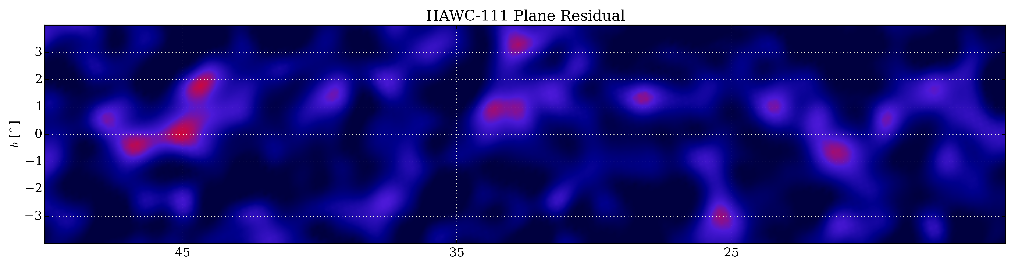
HAWC-111 Galactic Plane Analysis : 11 sources
HAWC-111 Data
Fit an Additional Source
ΔTS > 15 ?
HAWC-111 Model — 11 Sources
Residual
Yes
No
Finished Model

Slide 27
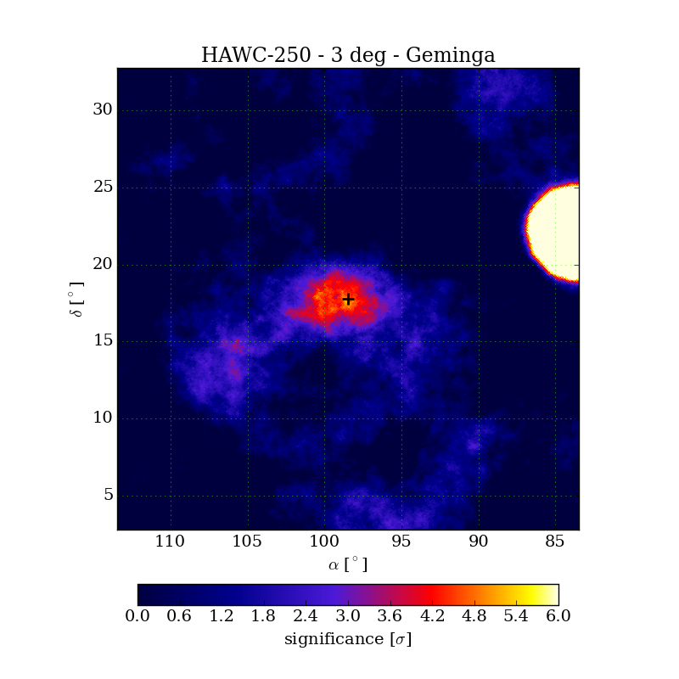
Detection of extended sources
HAWC 250
3 Deg Tophat Smoothing
Crab
Geminga

Slide 28
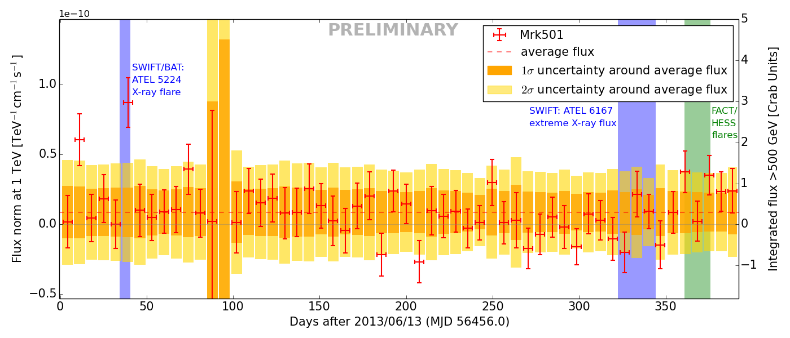
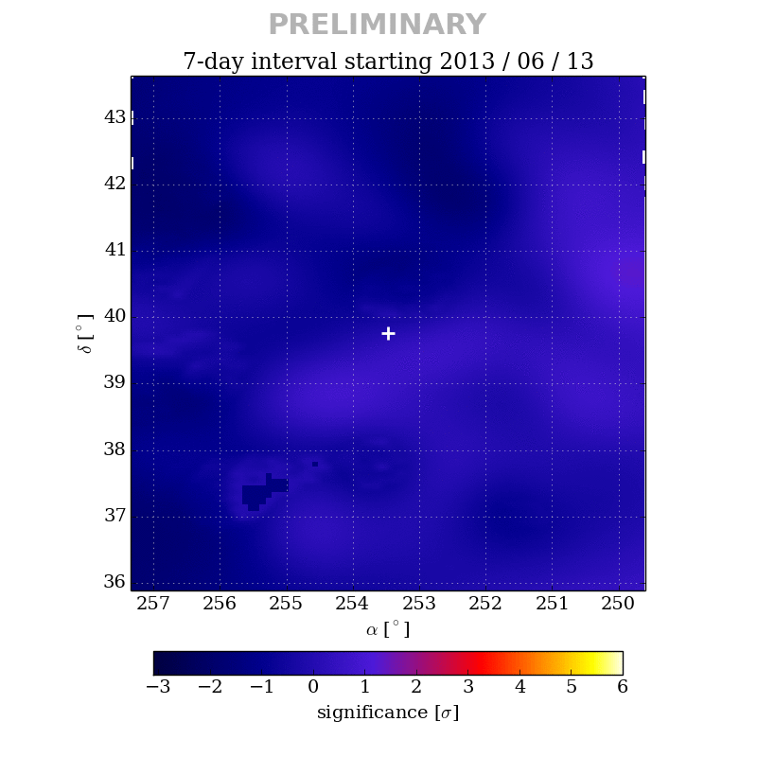
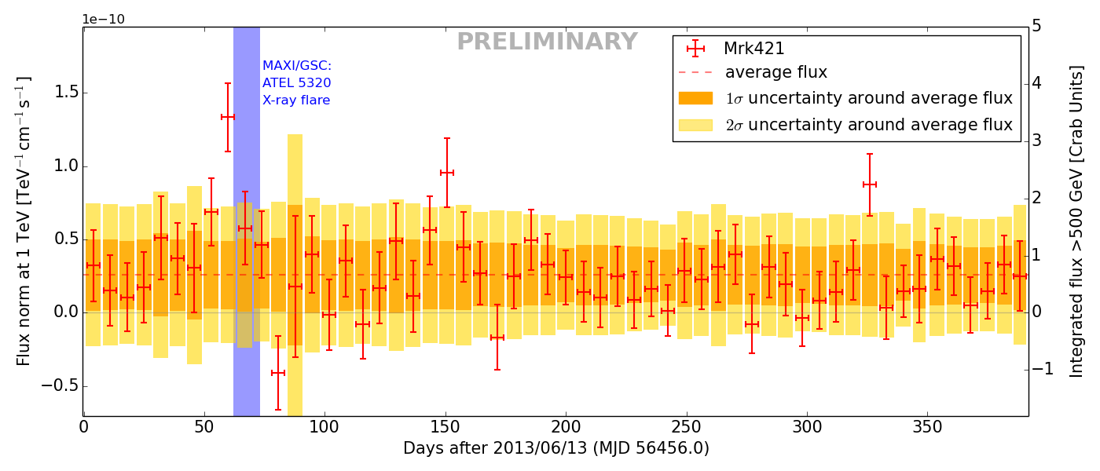
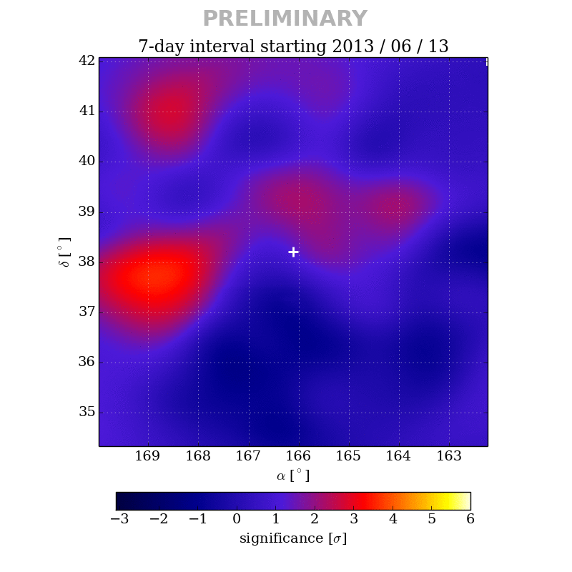
Blazar light curves and flares
HAWC-111
Markarian 501
Markarian 421

Slide 29
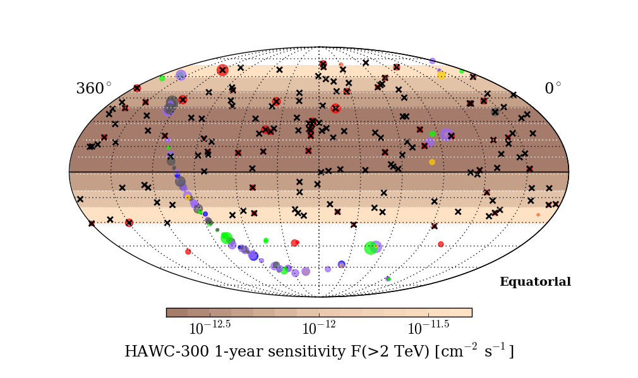
HAWC Online Monitoring
Presently monitoring daily 170 sources: all VHE Blazars and 1FHL blazars with z<1

Slide 30
Dark Matter indirect detection

Slide 31
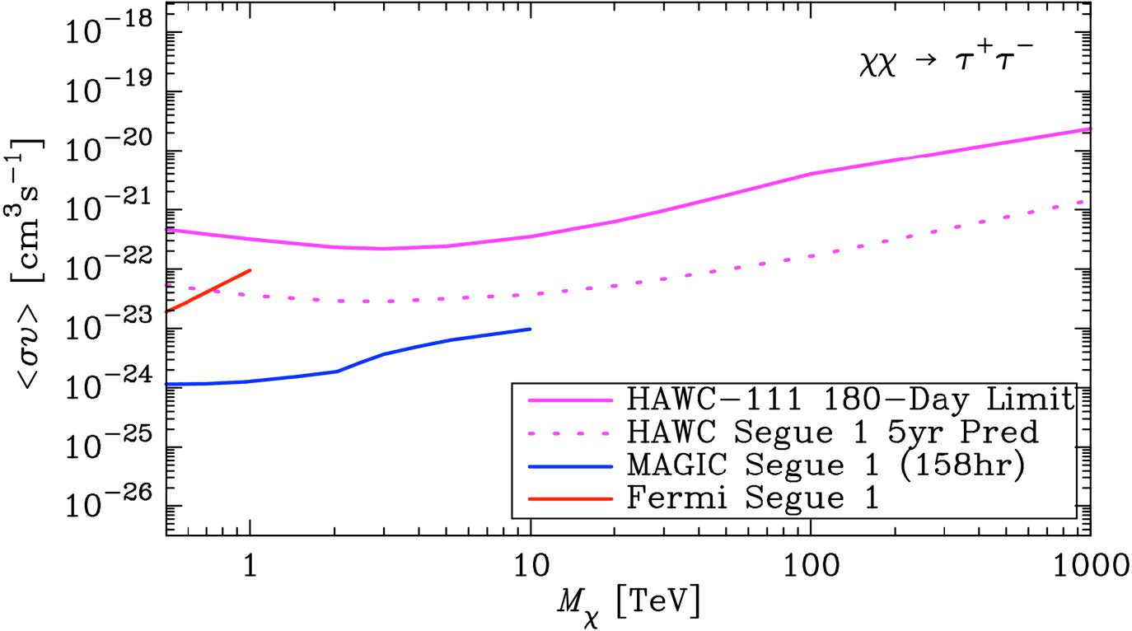
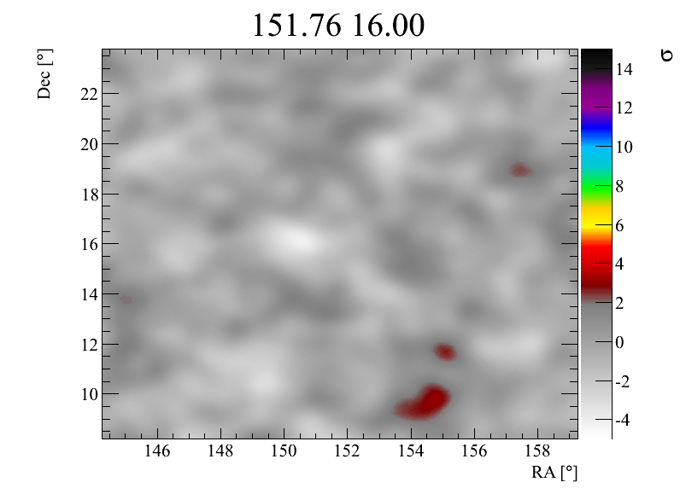
HAWC-111 DM limit for Segue-1

Slide 32
HAWC 5 year DM limit for the best 5 dwarf spheroidal galaxies

Slide 33
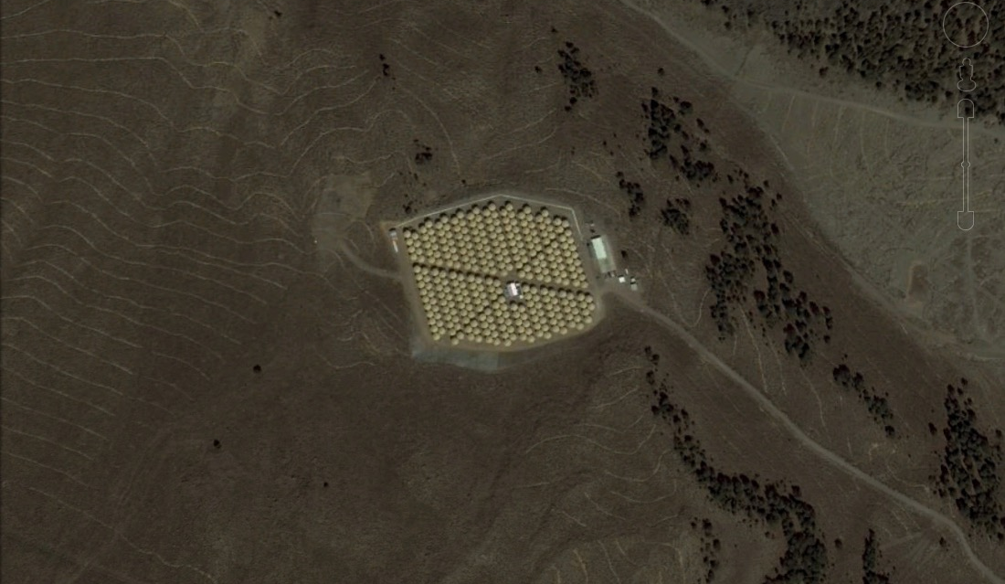
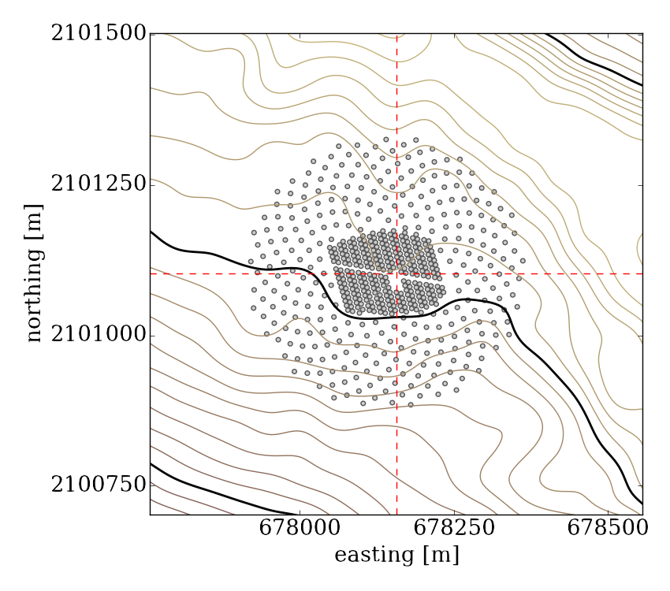
HAWC upgrade with a sparse outrigger array

Slide 34
FUNDED
Mesure the
shower core
position when
the shower falls
outside of the
main array.
Factor of 3-4
gain in
reconstruction
efficiency for
Εγ > 10 TeV

Slide 35

HAWC is working and
in full operation

