Slide 1





First Run 2 Results from CMS
Exploring the Unknown
Kerstin Borras
DESY, RWTH Aachen University, CERN

Slide 2
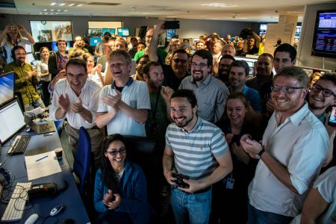
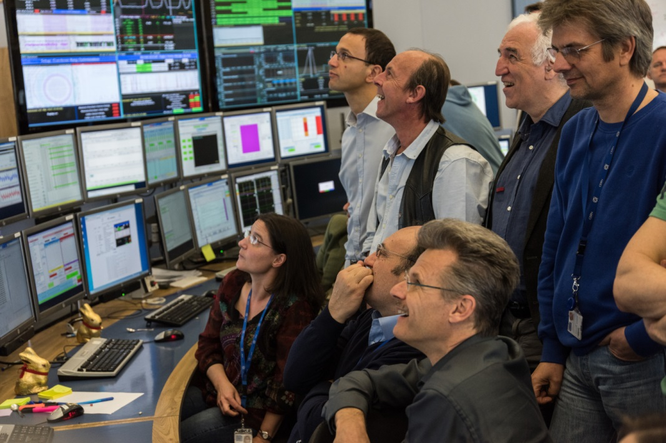
Congratulations and
many thanks
to the LHC Team

Slide 3
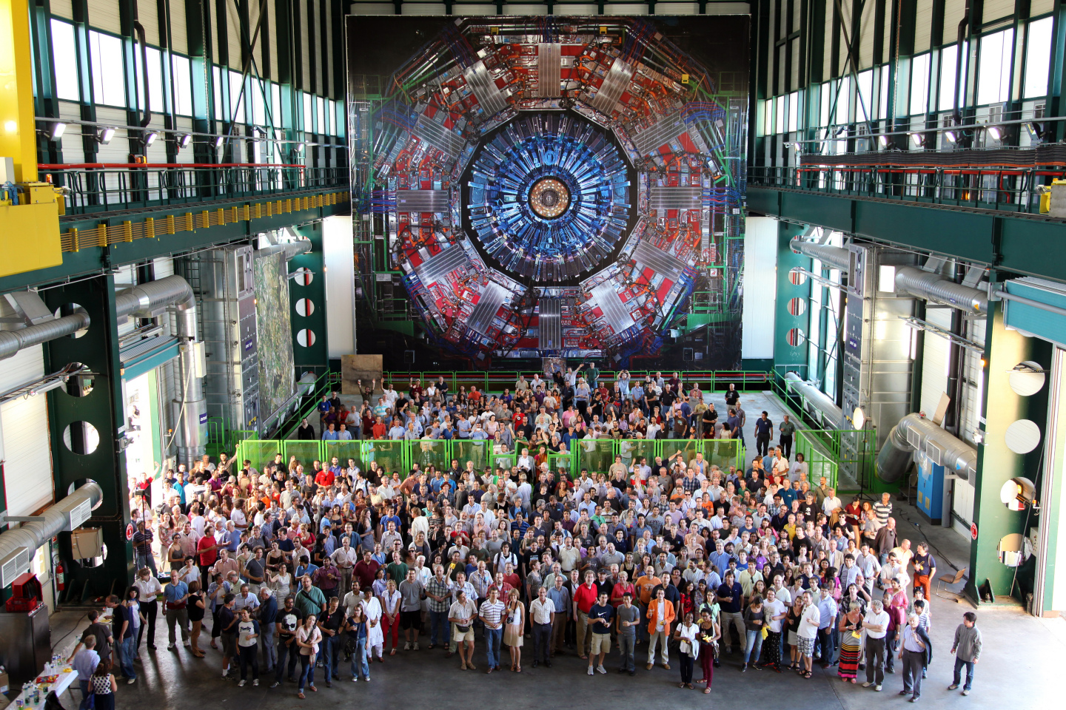
The CMS Collaboration
  Many: 5000 members, 1900 physicists,
  1800 students,
  950 eng./ techn.
  Global: 200 institutes from 43 countries
  One Goal:
  Unveil what our universe is made of !

Slide 4
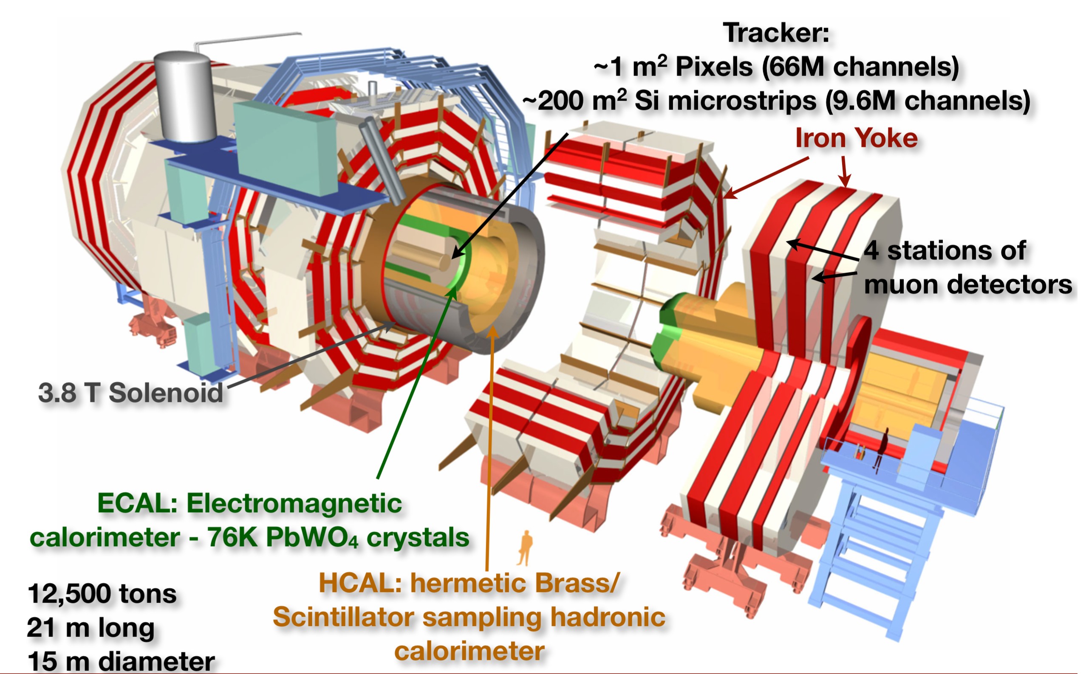
CMS after Long Shutdown 1
Tracker / Pixel:
Cold Operation
Channel Recovery
DAQ and HLT: New computers
Improved Trigger
New Beampipe
4th Muon Station
New Detectors for Luminosity
14,000 tons
21 m long
15 m diameter
HCAL
New Photosensors
Notes:
CMS: Long Shutdown 1
The biggest priority was to mitigate the effects of radiation on the performance of the Tracker, by equipping it to operate at low temperatures (down to -20°C). This required changes to the cooling plant, and extensive work on the environment control of detector and cooling distribution to prevent condensation or icing. The central beam-pipe was replaced by a narrower one in preparation for the installation in 2016-‘17 of a new Pixel Tracker that will better measure the momenta and points of origin of charged particles. A fourth measuring station was added to each muon endcap, in order to maintain discrimination between low-momentum muons and background as the LHC beam intensities increase. Complementary to this was the installation at each end of the detector of a 125-tonne composite shielding wall to reduce neutron backgrounds. A luminosity-measuring device, the Pixel Luminosity Telescope, was installed on either side of the collision point around the beam-pipe. Other major activities included replacing photo-detectors in the hadron calorimeter with better-performing designs, moving the muon readout to more accessible locations for maintenance, installation of the first stage of a new hardware triggering system and consolidation of the solenoid’s magnet cryogenic system and of the power distribution. The software and computing systems underwent a significant overhaul during the shutdown to reduce the time needed to produce analysis datasets.

Slide 5
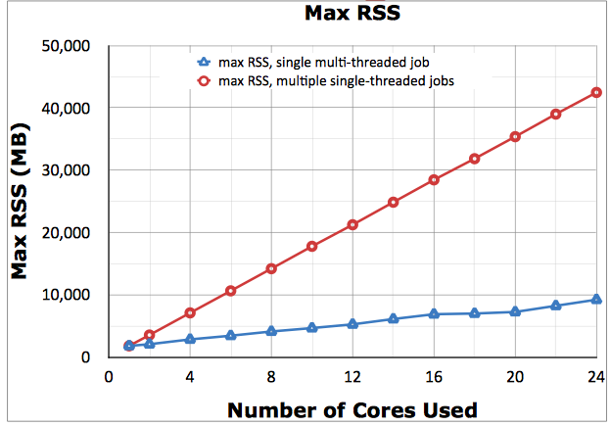
DAQ & Computing & Offline
New DAQ2 concept realized for the online part
Replaced all 500 DAQ Computers, and 1/2 of the High Level Trigger
(HLT) CPUs → increase budget to 0.3s/event from 0.2s/event
HLT Farm now also used for production and other offline tasks
Move to multi-threading with
multi-core queues at CERN and
Tier-1 centers
New, more flexible and efficient
workflow and data management
systems
Improvements in Distributed Analysis
Faster event reconstruction
New miniAOD data format for many physics object improvements:
  compact high level data objects (30-50 kb/event) → gain factor ~10
  covering needs of mainstream analyses → avoid duplications
Multi-threading now standard
Memory [MB]

Slide 6
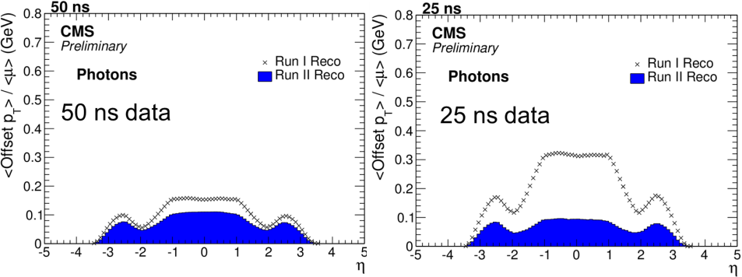
Reconstruction Algorithms
  Significant effort on algorithm improvements with emphasis on pile-up mitigation
    Improvement on track reconstruction
    Out of time PU mitigation in the calorimeters
    Pulse fit in ECAL/HCAL to extract the in-time energy per cell
    Revisiting of Particle Flow event reconstruction
  Improvements evaluated on 8 TeV data
Photon Reconstruction

Slide 7
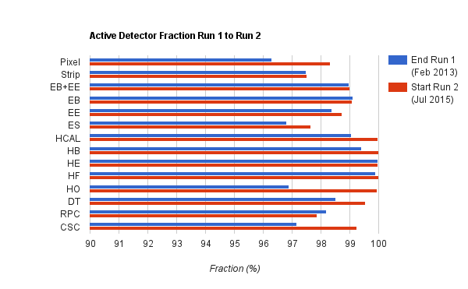
Detector Commissioning
  All sub-detectors ready for data-taking
  Active channel fraction higher than Run 1
A marvelous piece of work from our colleagues working tireless on technical items → they deserve our acknowledgement in recommendation letters and even more so in the ranking for open positions.
See also “Guidelines for scientific evaluations” released by ECFA
https://cds.cern.ch/record/2014643/files/ecfa-291_ECFA-HEP-evaluation.pdf

Slide 8
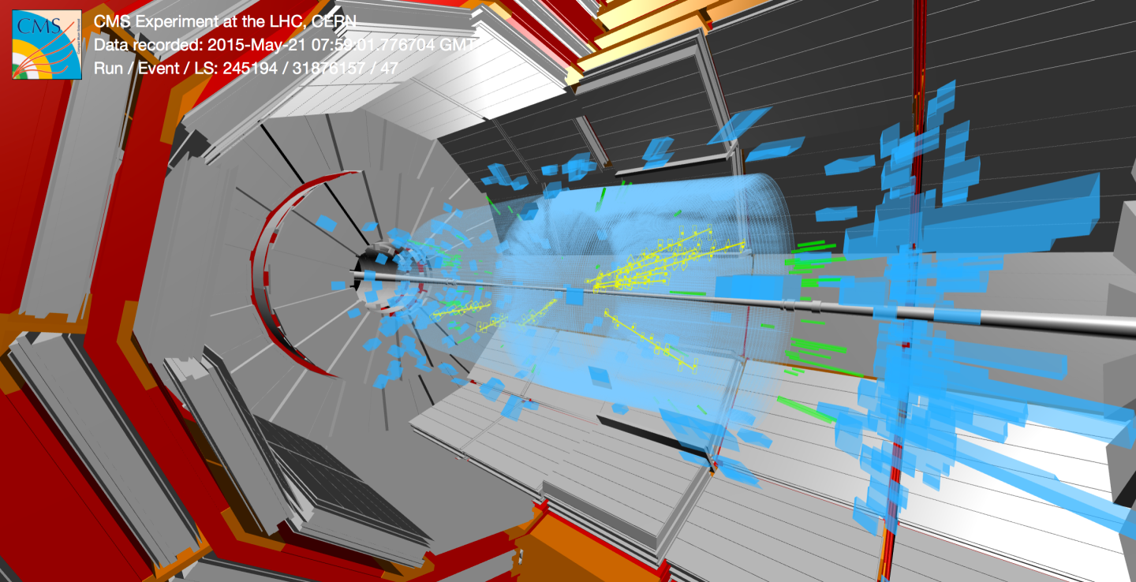
First Physics Collisions @ 13 TeV !

Slide 9
Magnet Cryogenics
The restart of the CMS magnet after LS1 was
more complicated than anticipated due to
problems with the cryogenic system in providing
liquid Helium.
Inefficiencies of the oil separation system of
the compressors for the warm Helium required
several interventions and delayed the start of
routine operation of the cryogenic system.
Currently the magnet can be operated, but the continuous up-time is still limited by the performance of the cryogenic system requiring more frequent maintenance than usual.
A comprehensive program to re-establish its nominal performance is underway. These recovery activities for the cryogenic system will be synchronized with the accelerator schedule in order to run for adequately long periods.
A consolidation and repair program is being organized for the next short technical stops and the long TS at the end of the year.

Slide 10
First LHC Physics Paper @ 13 TeV !
  The first CMS paper based on 13 TeV LHC data
    Pseudorapidity distribution of charged hadrons in proton-proton collisions at √s = 13 TeV
  has been submitted to PLB.
  The post on arXiv is http://arxiv.org/abs/1507.05915
  It is the first paper from LHC
  exploring the novel territory !

Slide 11
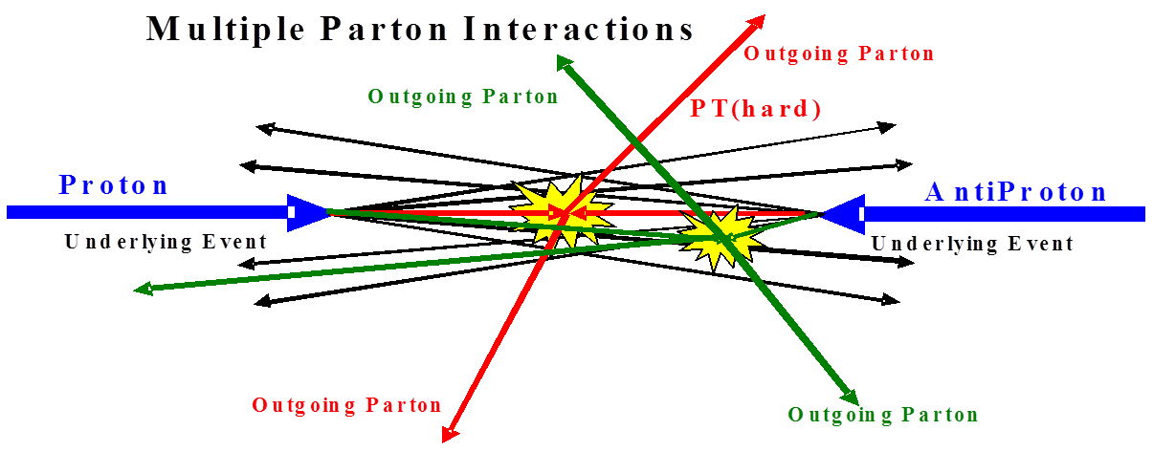
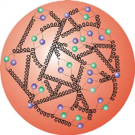
First Goal: Tune MC Models
Rick Field
In addition to the single hard interaction with large p_{T}:
(soft) interactions with low p_{T} → Underlying Event remnant-remnant interactions and parton showers … → additional energy offset
more hard interactions → Multi – Parton Interactions (evidence from CDF 1997: need >50% double parton interaction for γ + 3 jet)
→ important for jet analyses (additional UE energy ) or pile-up modelling or pp→W+H+X with W→l+ν and H→bb (MI: pp → W+X_{W} + bb+X_{b} without any Higgs!)
Good tune of the MC Genertors is important to model Underlying Event, Pile-Up and Multi – Parton Interactions → crucial for all precision measurements !

Slide 12

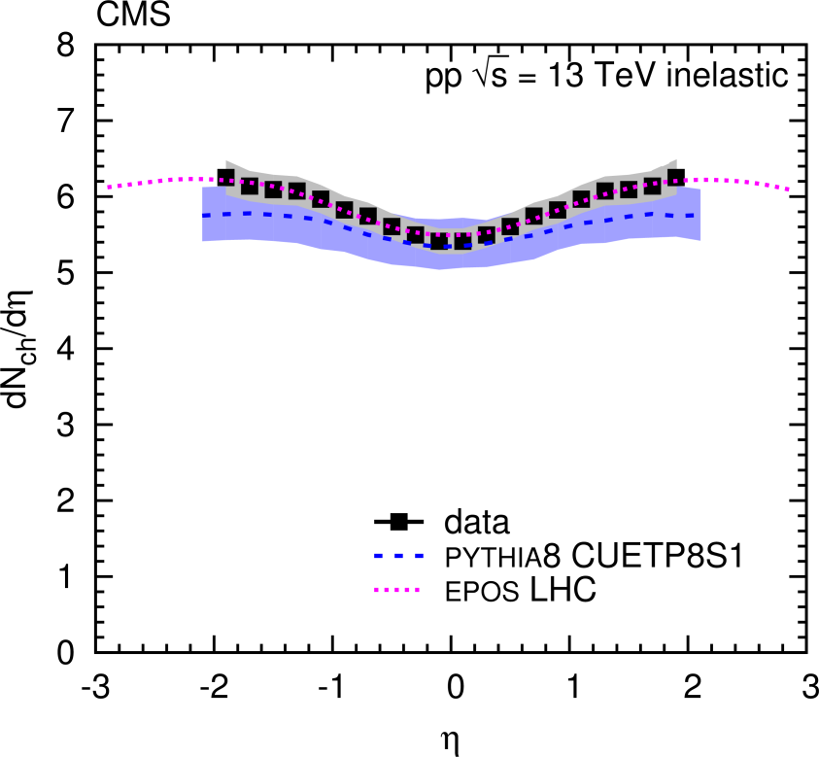
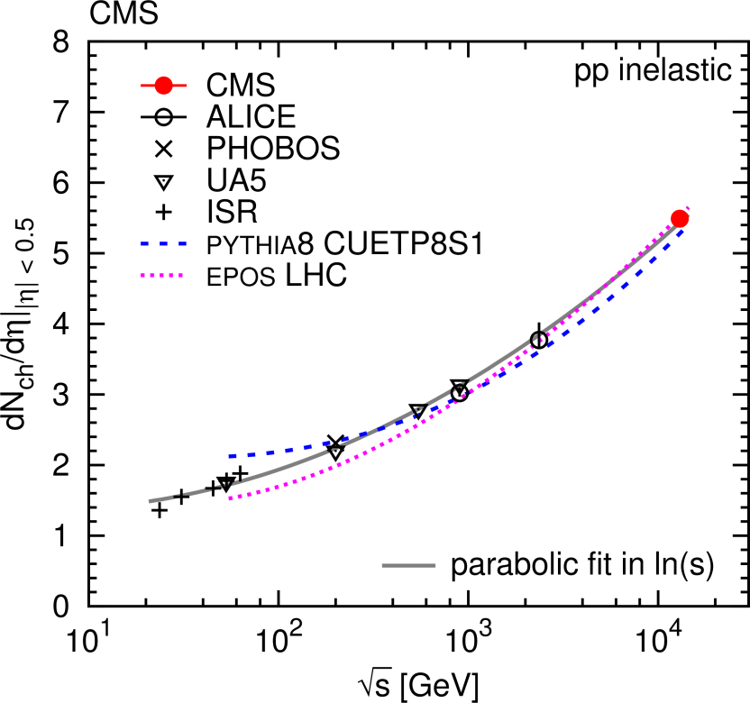
Charged Hadron Multiplicity @ 13 TeV
dn_{ch}/dη|_{|η| < 0.5}
= 5.49±0.01 (stat)±0.17 (syst)
B=0
  First measurement of inelastic dN_{ch}/dη at 13 TeV pp collisons.
  Mid-rapidity: EPOS LHC and PYTHIA8 CUETP8M1 consistent with data.
  Rapidity dependence better described by EPOS LHC

Slide 13
First Scan with Magnet On
CMS back in business
Analyzed up to ~40 pb-1 with magnet and
all detectors on.
Re-Discovery of Standard Model Physics
  Resonances
  Z → ee, μμ, ττ
  Top
Commencing Searches
  highest di-­lepton and (lepton+MET) mass events
  boosted top signatures
  first di-jet spectrum
All released Run 2 results can be found here:
https://twiki.cern.ch/twiki/bin/view/CMSPublic/PublicPlotsEPS2015

Slide 14
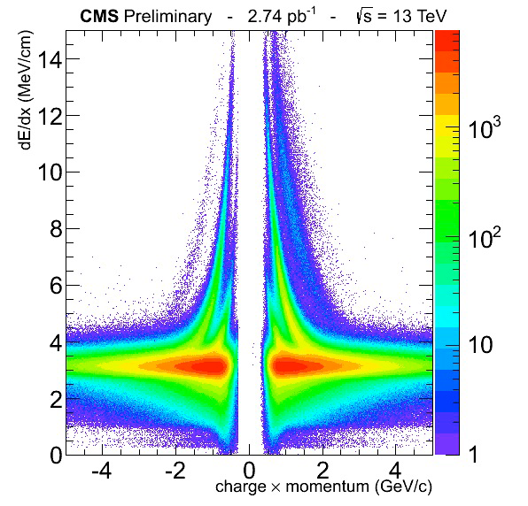

Tracker Performance
From right to the left Deuteron,
Proton and Kaon bands clearly visible.
Particles shown depending on their charge → observe an expected asymmetry in the production of particles/antiparticles for pp collisions.
PDG: 497.614 ± 0.006 MeV
Invariant mass of the pion pairs fitted with a double gaussian and a first order polynomial for the background.

Slide 15
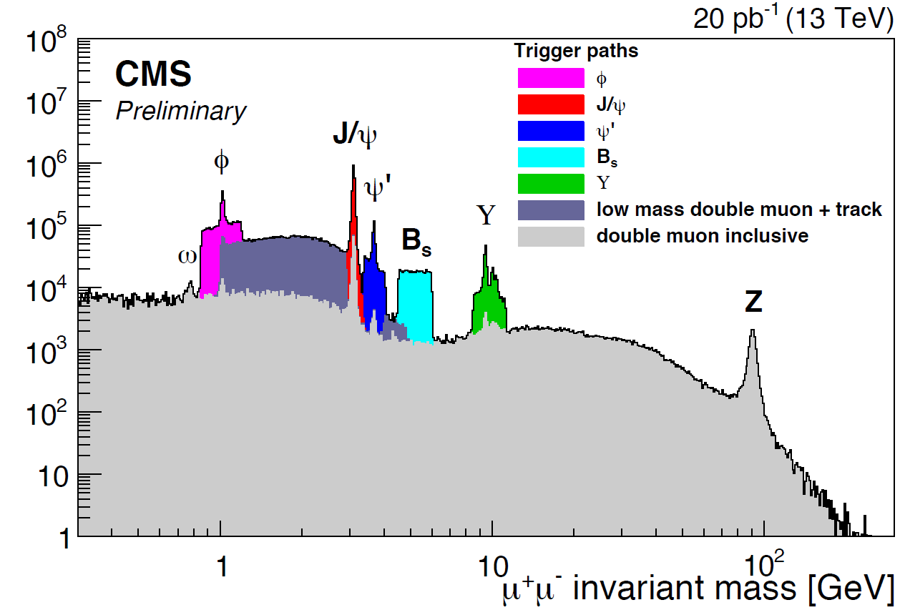
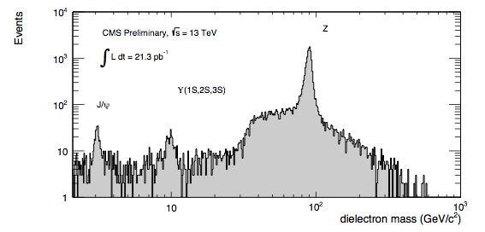
Scan for Resonances
Di-muon mass spectrum:
special triggers
in certain mass regions
and with different p_{T} cuts
Di-electron mass spectrum:
p_{T} > 10, |η|<2.5,
cut-based Electron ID

Slide 16
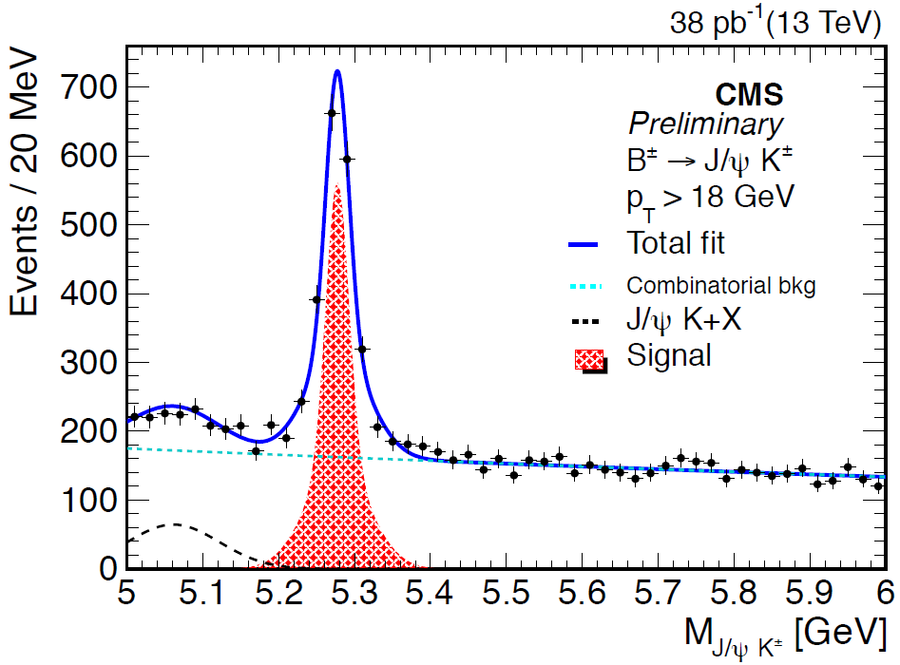
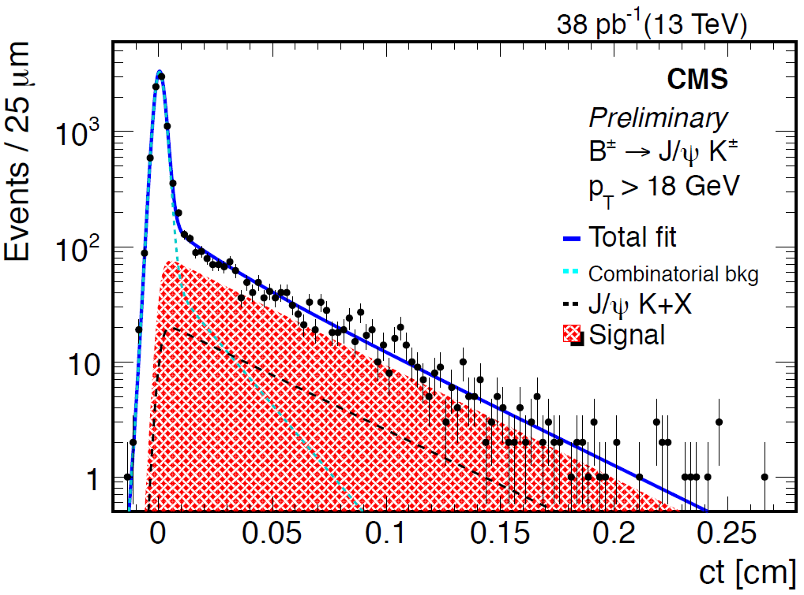
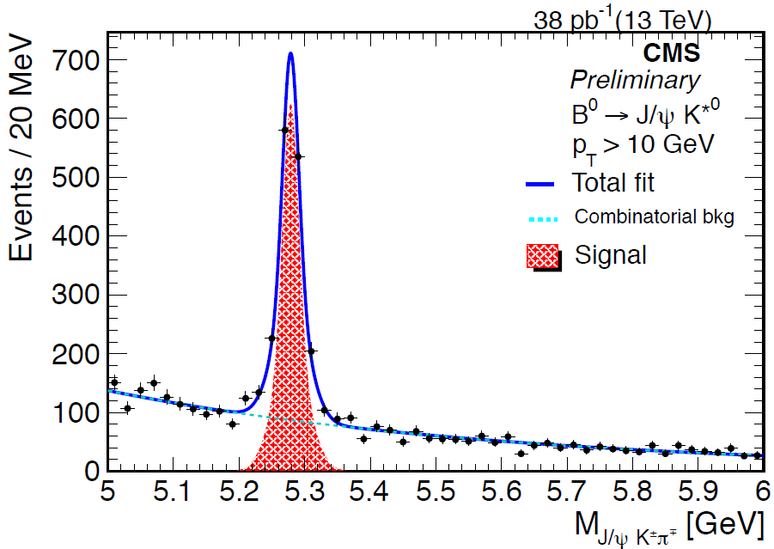
Resonances
B± → J/ψ K ±
  Inclusive J/ψ trigger with pT >16 GeV
Mass: 5.277 ± 0.001(stat.) GeV
PDG: 5279.26 ± 0.17 MeV
B⁰s → J/ψ φ
with displaced J/ψ and track trigger
Mass: 5.369 ± 0.001(stat.) GeV
PDG: 5366.7 ± 0.4 MeV

Slide 17
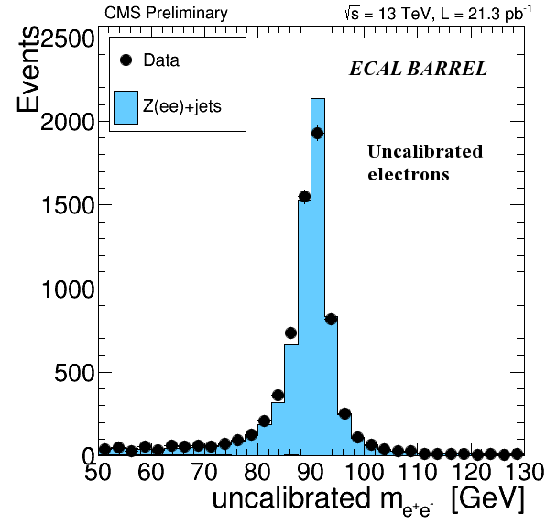
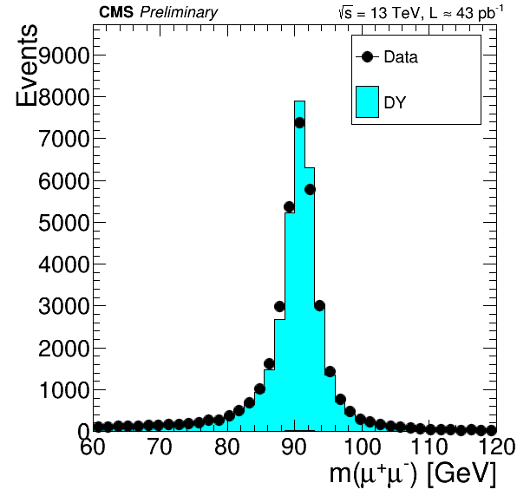
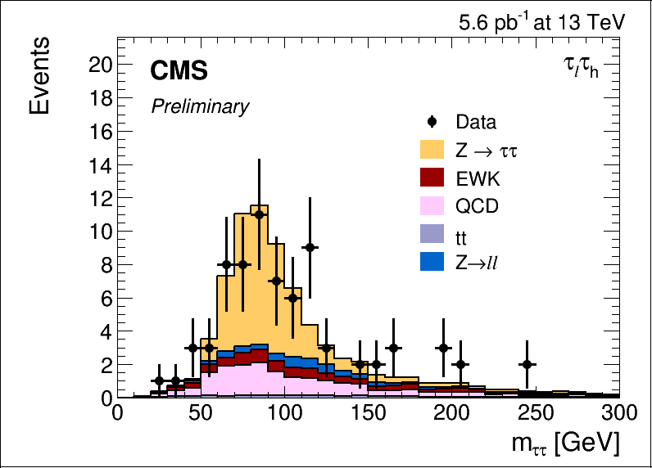
Detector & Algorithm Performance
  Z → ττ
  Z → ee
  Z → μμ
  Z – Boson as standard physics candle

Slide 18
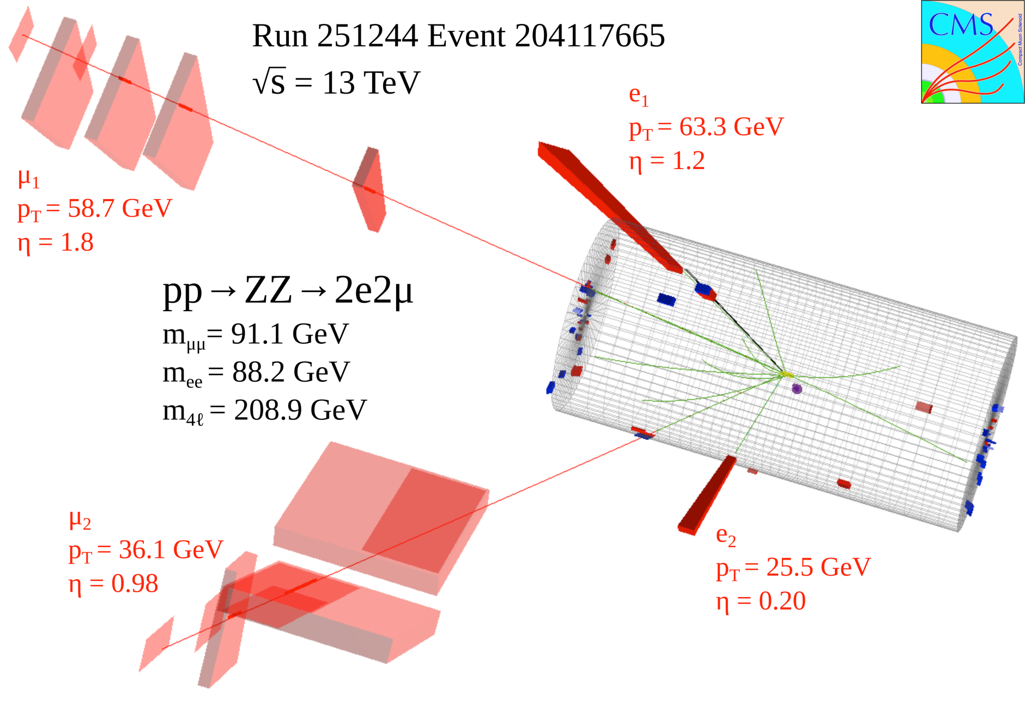
Spectacular ZZ in 4l decay

Slide 19
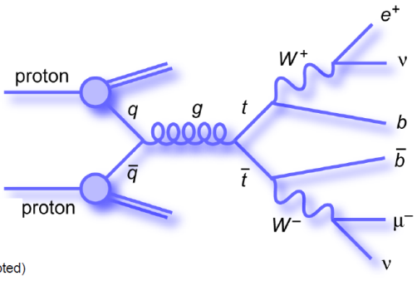
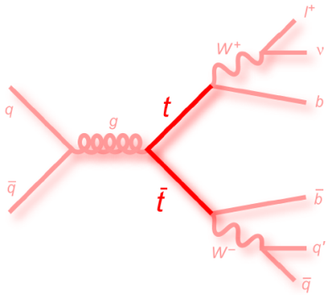
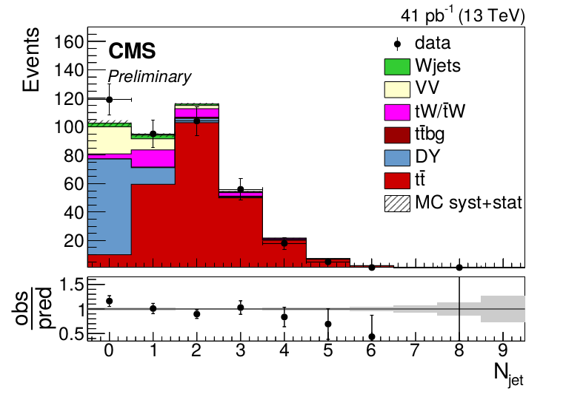
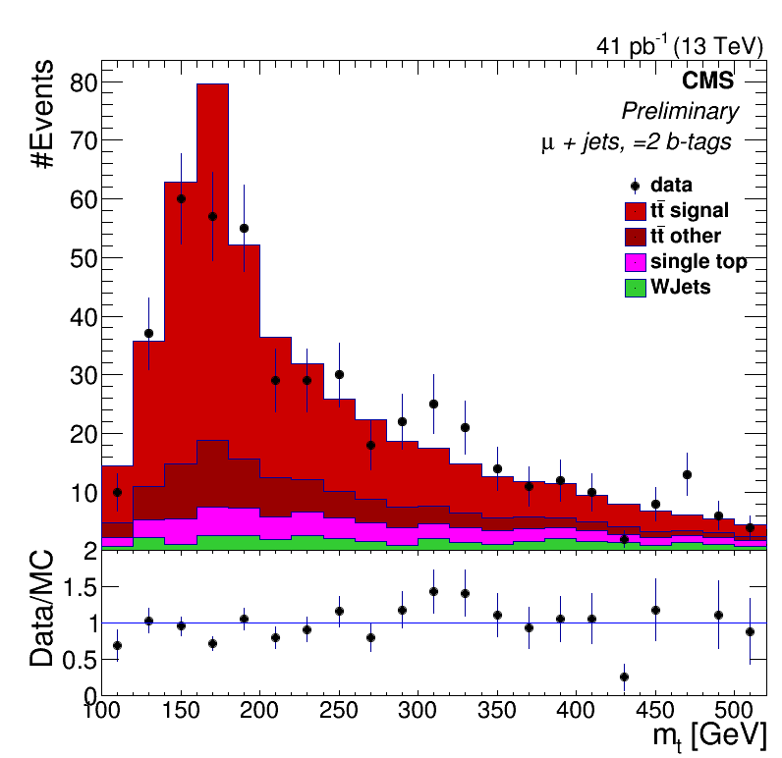
Top Re-Discovery
Top pair to di-leptons
Top pair to lepton+jets
Reconstructed hadronic top quark candidate mass for events containing 1 isolated muon (p_{T}>30 GeV, |𝜂|<2.4, passing medium identification), four jets (p_{T}>30 GeV, |𝜂|<2.5), out of which 2 pass the tight b-tagging threshold.
  Number of hadronic jets for events containing one isolated muon and one isolated electron forming an invariant mass greater than 50 GeV.

Slide 20
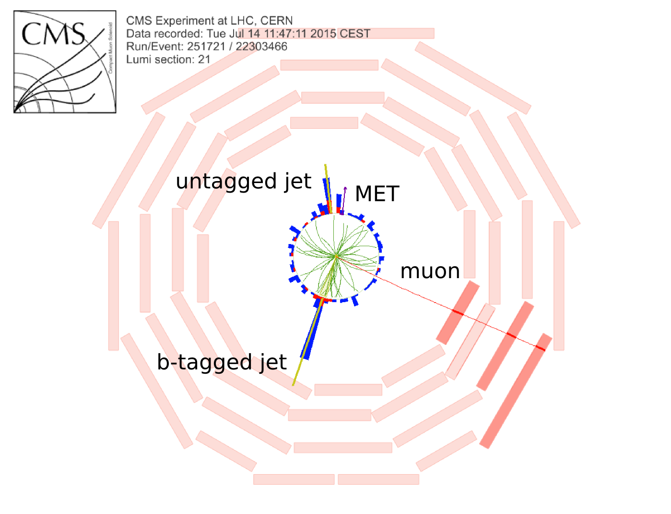
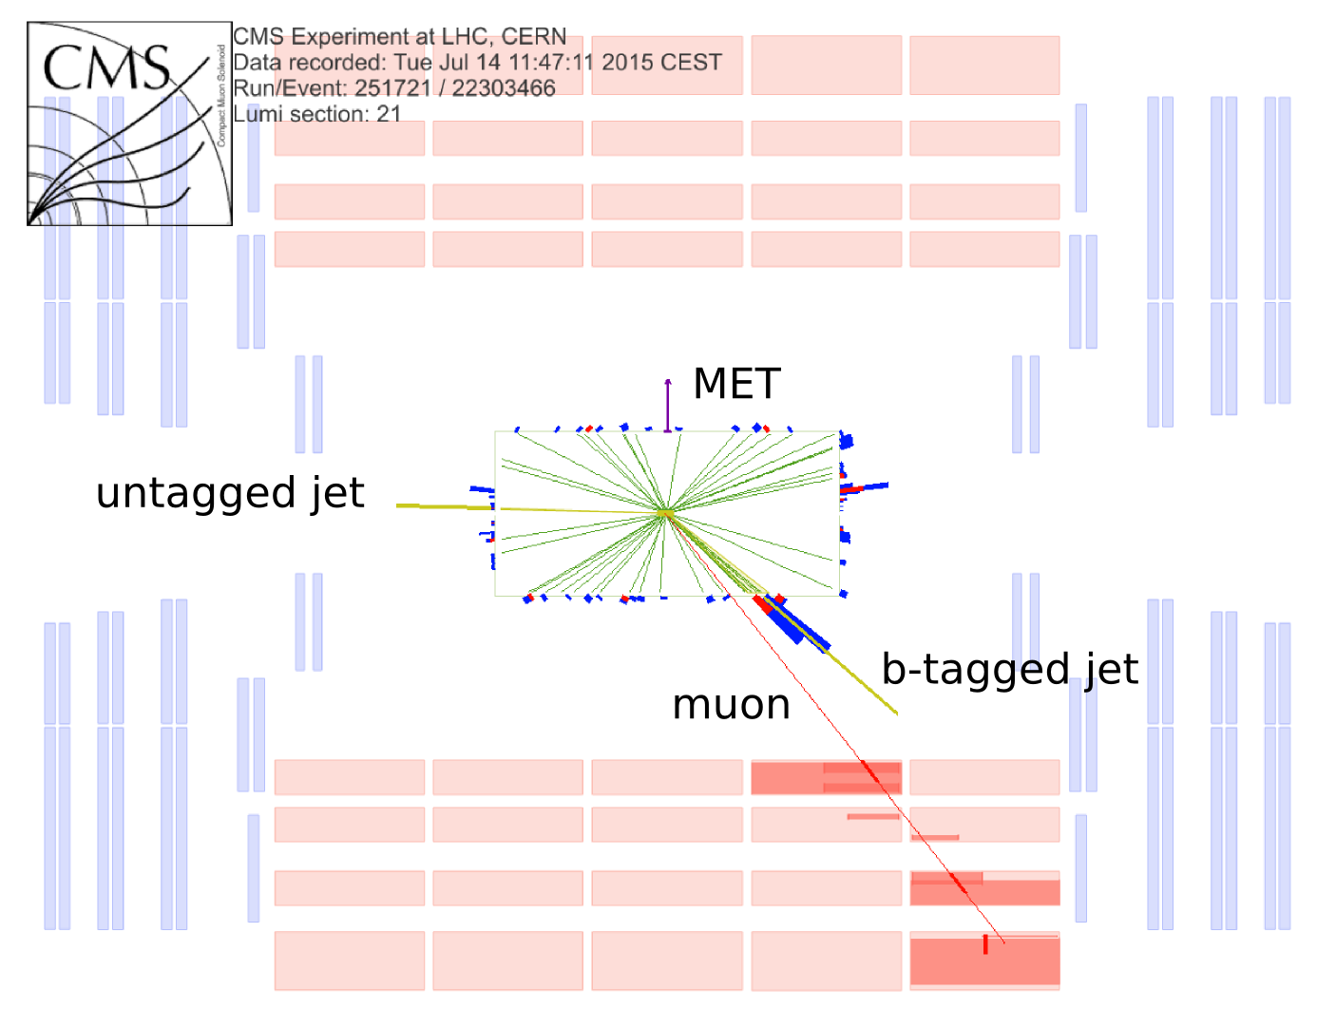
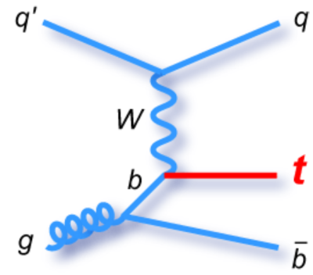
Towards Single Top (t-channel)
  One isolated muon
  MET: 27 GeV
  Mass : 177 GeV
  Two hadronic jets:
    b-tagged jet from top decay
    un-tagged jet

Slide 21
Searches Commenced
LHC at 13TeV is a resonance factory at a new energy scale, for example:
  Di-­jets and multi-jet mass spectra
  Di-­lepton (ee, μμ, ττ) mass spectra
  Di-­photon mass spectrum
  Lepton + MET final state
  Boosted Topologies
First look at the Run 2 data with preliminary initial results:
  Events with highest mass in di-­lepton and lepton+MET final state
  Event with boosted top signature
  Di-­jet invariant mass spectrum

Slide 22
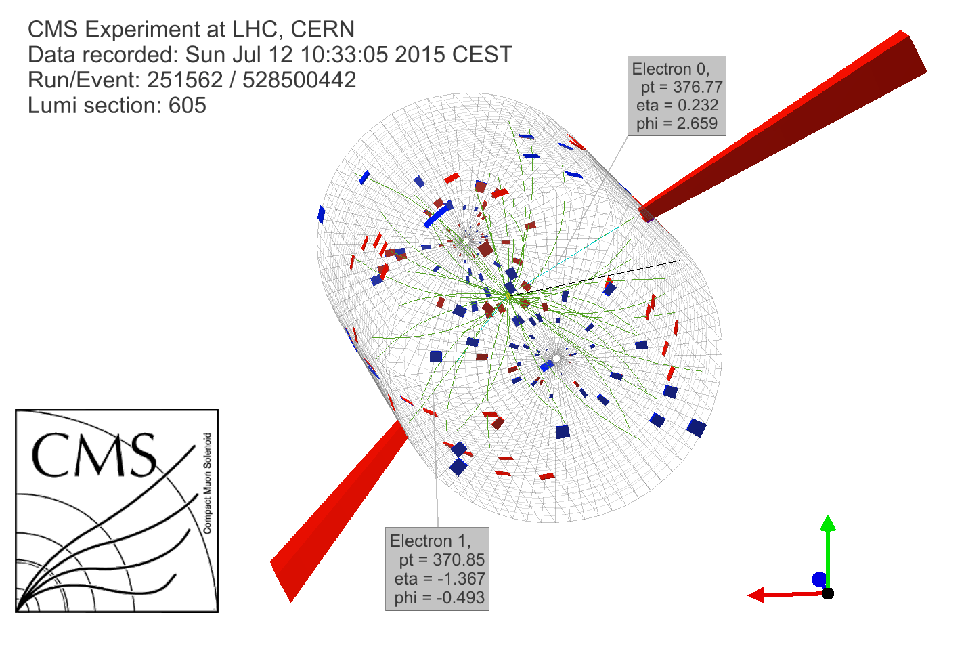
TeV Electron - Positron Candidate
Kinematic Quantities:
  Electron 1:
    p_{T} = 377 GeV,
    η = 0.232,
    φ = 2.66 rad
  Electron 2:
    p_{T} = 371 GeV,
    η = -1.37,
    φ = -0.493 rad
  MET : 9.2 GeV
  Mass (ee) : 999 GeV

Slide 23
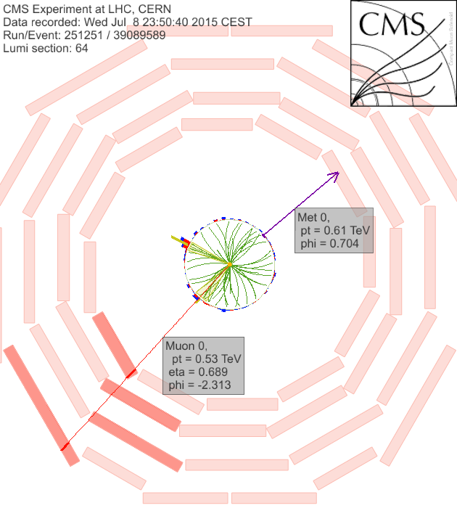
Single muon + missing E_{T} @ m_{T} = 1.1 TeV
Kinematic Quantities:
  Muon:
  p_{T}= 0.53 TeV
  η = 0.69
  φ = -2.3
  MET: 0.62 TeV
  Δφ (μ-MET) = 3.0
  m_{T} = 1.1 TeV
1 event expected with m_{T} > 700 GeV for the luminosity analyzed

Slide 24
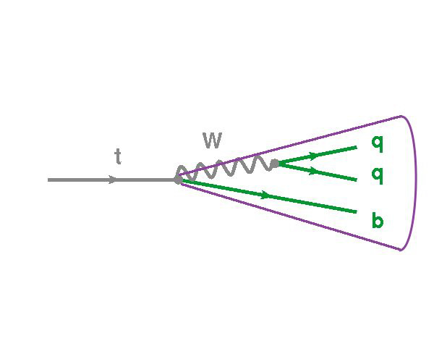
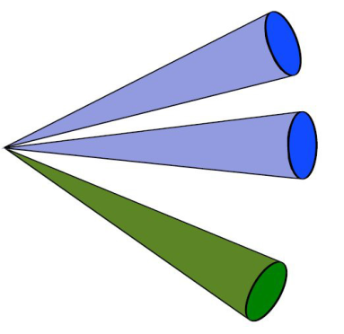
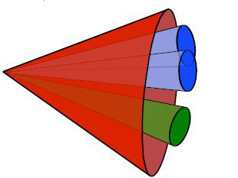
Boosted Top Candidate
  Search for Heavy Masses:
    For example: vector-like quarks, Z’, ….
    boosted decay products
    merged jets
    ➔ challenging hadronic final states
    Accessing for example with substructures
    (or clean signatures with photons)
  Non-boosted top:
  ➔b and W decays in different jets
  q1
  W q2
  b
  Boosted top:
  ➔ b and W decays in same jet
  top

Slide 25
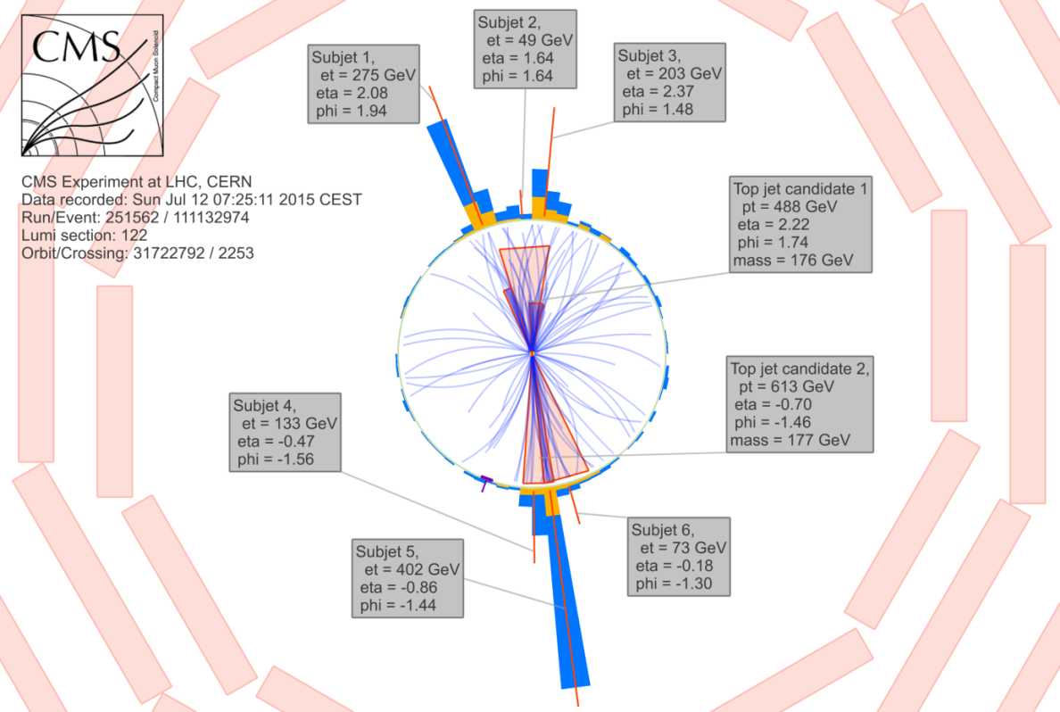
Boosted Top Candidate
  Top – jet 1:
    m =177 GeV, p_{T} =613 GeV
  Di-top jet Mass: 2491 GeV
  Top – jet 2:
    m =176 GeV , p_{T} = 488 GeV

Slide 26
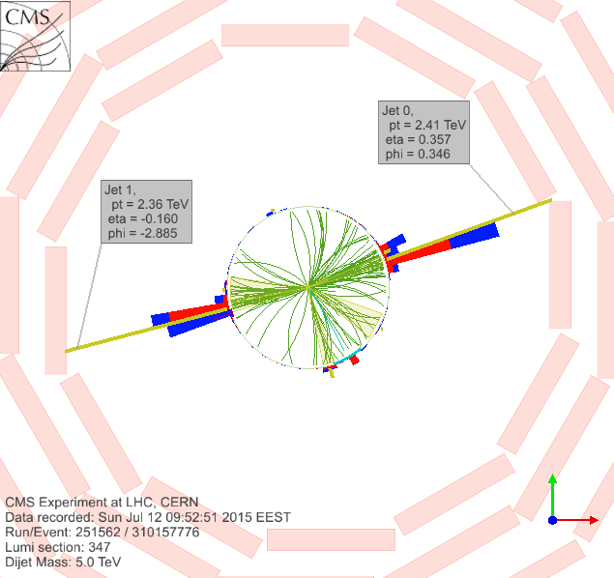
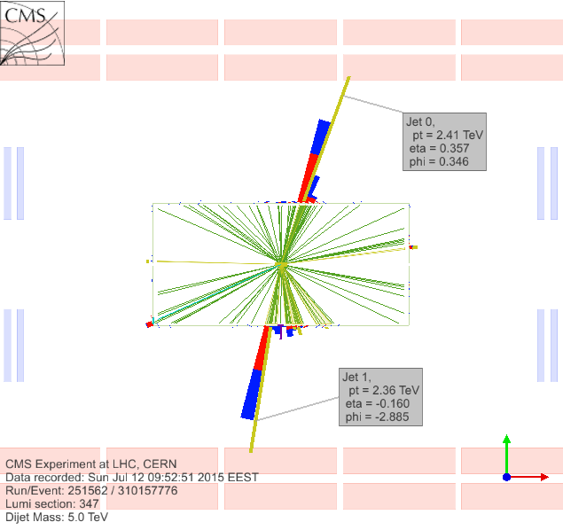
Di-Jet Event with Mjj = 5 TeV

Slide 27
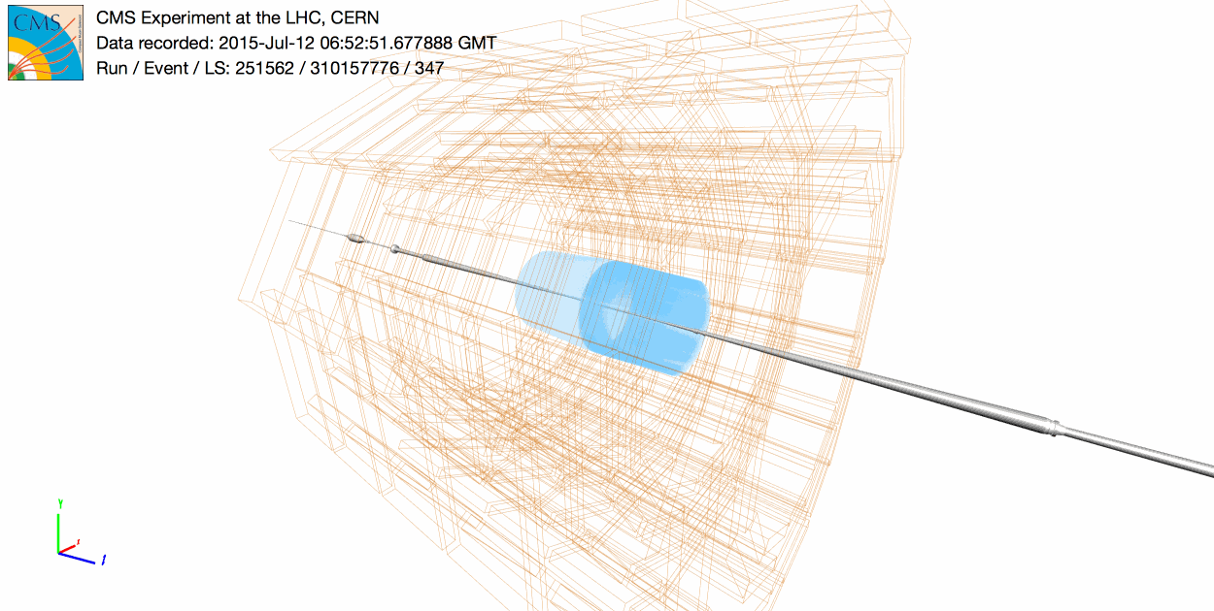
Di-Jet Event with Mjj ~ 5 TeV

Slide 28
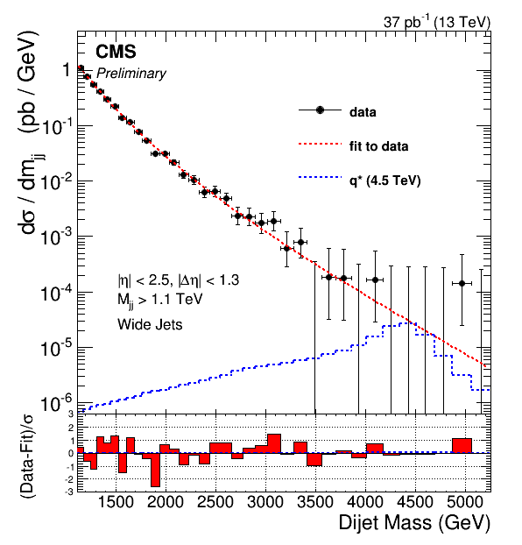
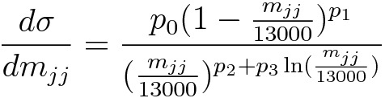
Di-Jet Mass Spectrum
  Luminosity 37 pb-1
  The dijet mass distribution is fitted using 4-parameter function:
  Superimposed for illustration q* → qg signal with resonance mass M=4.5 TeV (blue dashed).
  With 37 pb-1 expect to exceed the sensitivity of
  8 TeV analyses only for narrow resonances with masses >≈ 5 TeV

Slide 29
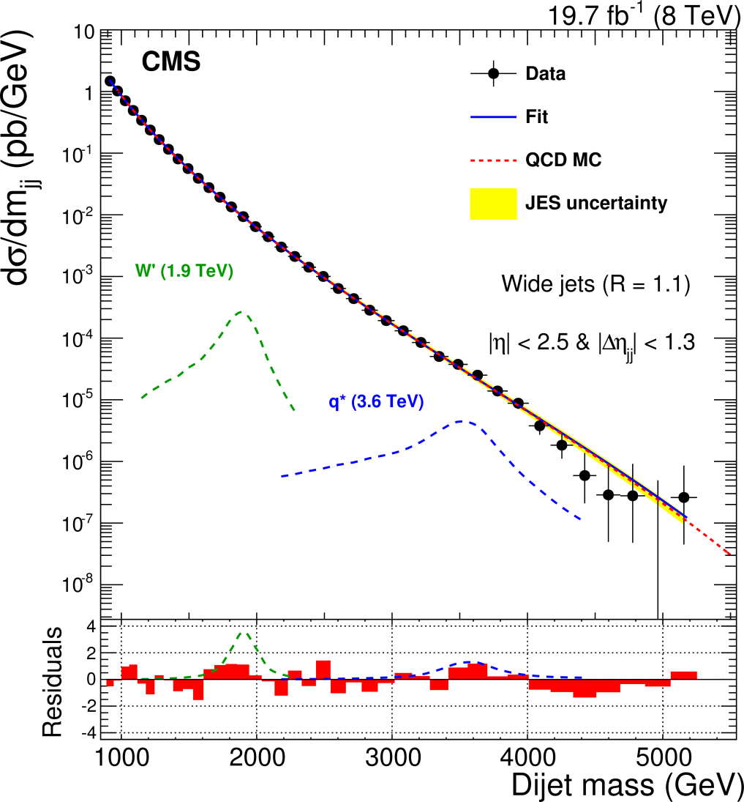
Di-Jet Mass Spectra 13 TeV ↔ 8 TeV
13 TeV
8 TeV
  13 TeV: 37 pb-1, Mjj = 5 TeV, 8 TeV:19.7 fb-1, Mjj = 5.15 TeV
  Close to Run 1 limit ➔ interesting times ahead of us ☺

Slide 30
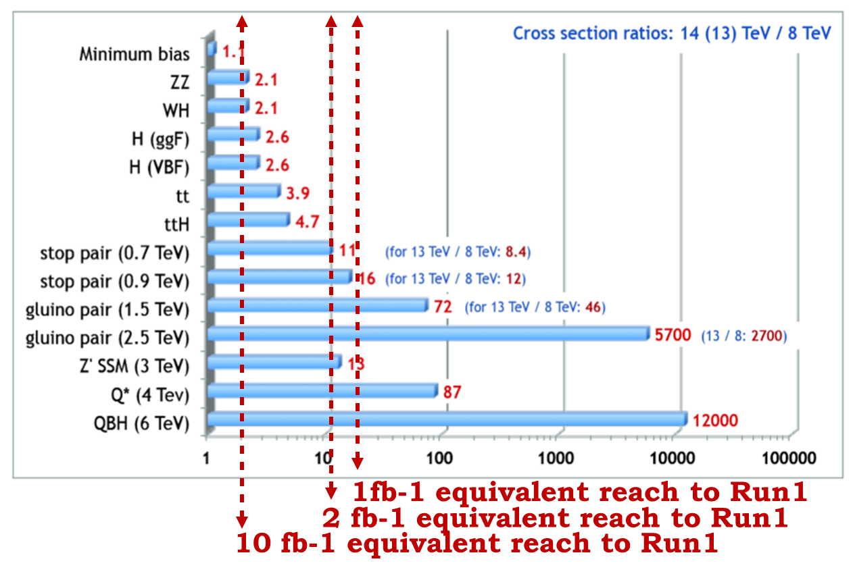
A Glance at Run 2 Expectations
A different way to look at the Stirling plot:
How much luminosity @ 13TeV is needed to equal the 8 TeV discovery potential (a really rough guestimate)

Slide 31
Summary
CMS mastered successfully all novel installations, consolidations and developments in Long Shutdown 1
Data taking at world-record energy has commenced,
several obstacles overcome
First LHC physics paper at novel collision energy accomplished: charged hadron multiplicity
→ tuned MCs describe data well
Full suite of performance checks done
Standard Model re-discovered, spectacular ZZ → 4l seen
Searches commenced: interesting events seen,
di-jet events @ √s = 13 TeV even with very low luminosity already at a similar level as the √s = 8 TeV results
CMS returned to precision and discovery mode
Thanks to my colleagues for making it happen for this conference ☺

Slide 32
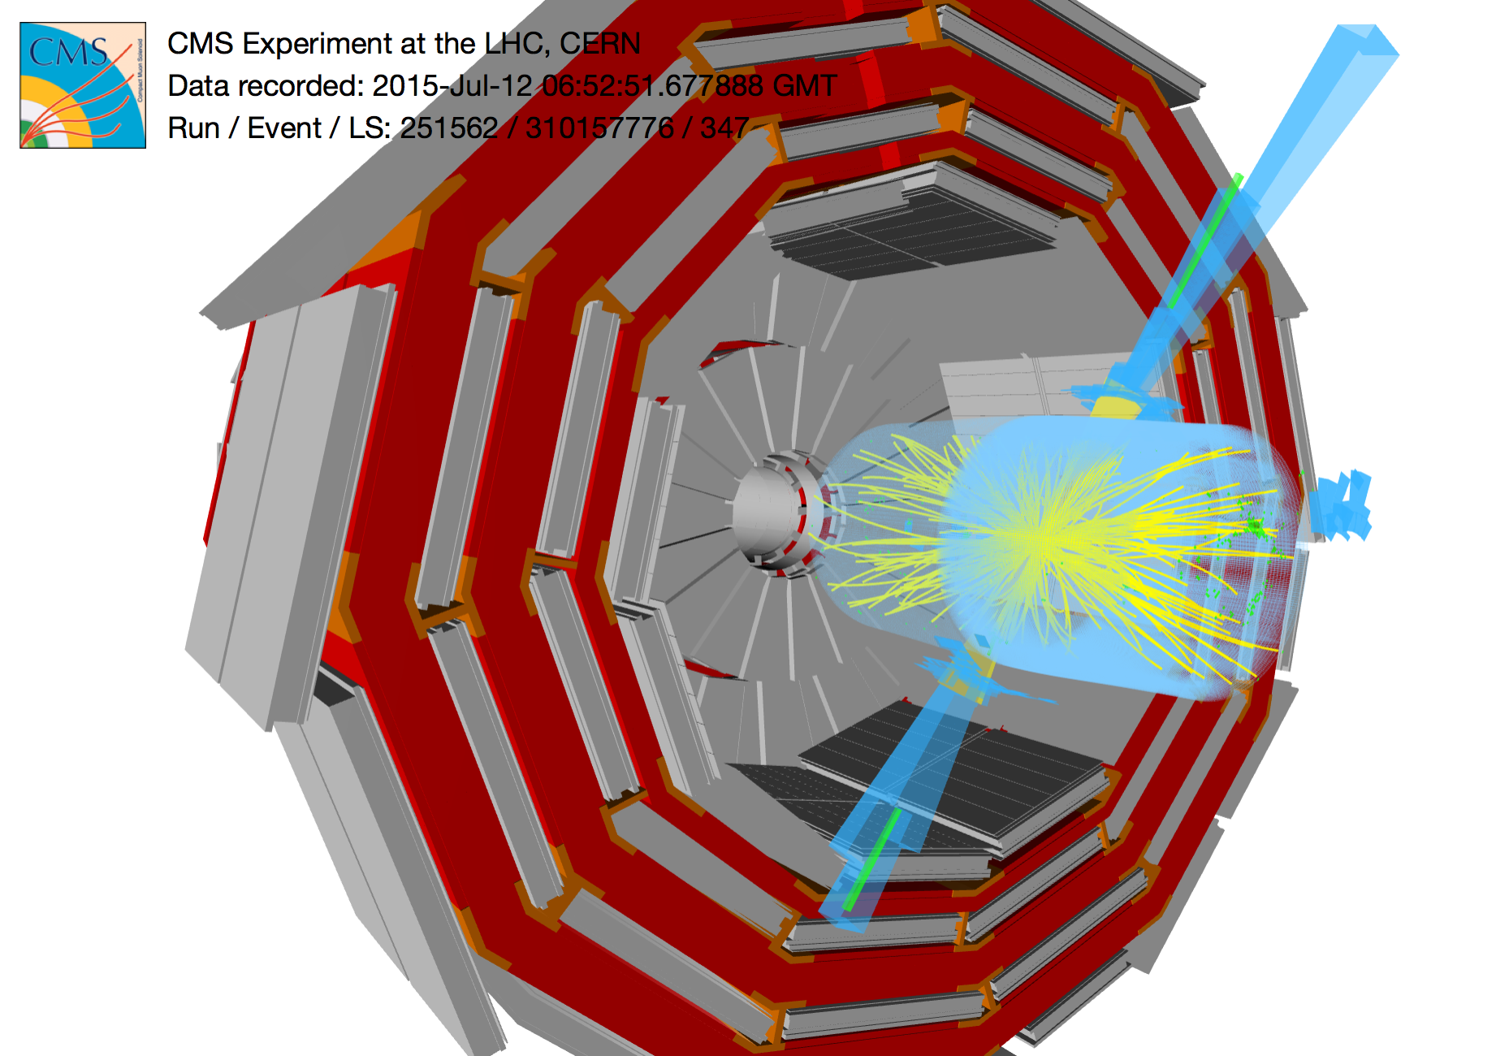
Our Future has just started
Let‘s see, what Nature has in stock for us !

Slide 33


Slide 34
BackUp

Slide 35
Luminosities
Total delivered: 106/pb
Total recorded: 83.5/pb
Total recorded @ 3.8T: 61.8/pb
Results @ EPS presented up to 43/pb

Slide 36
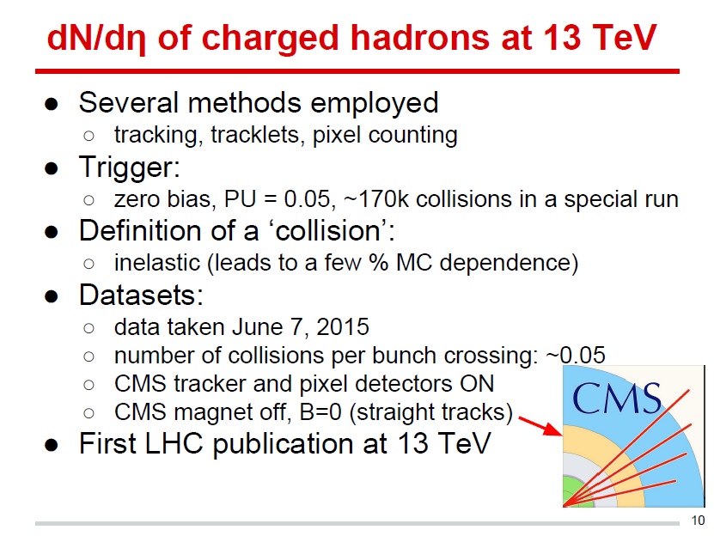

Slide 37
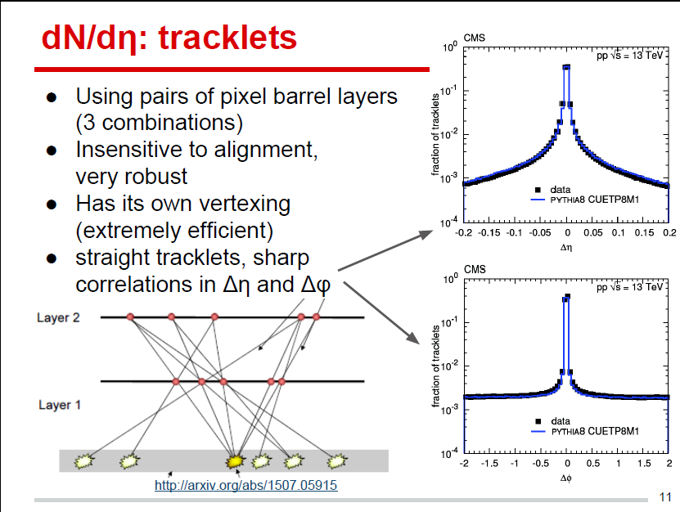

Slide 38
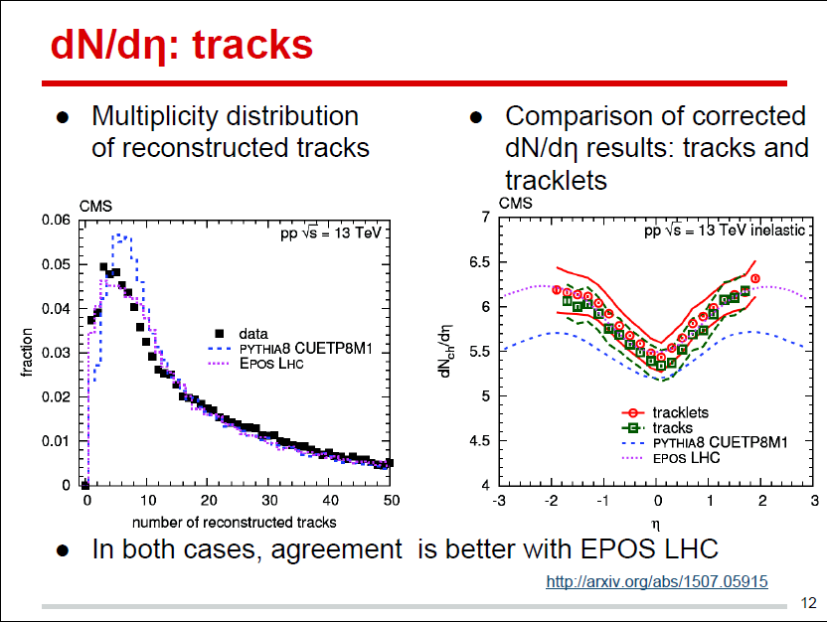

Slide 39
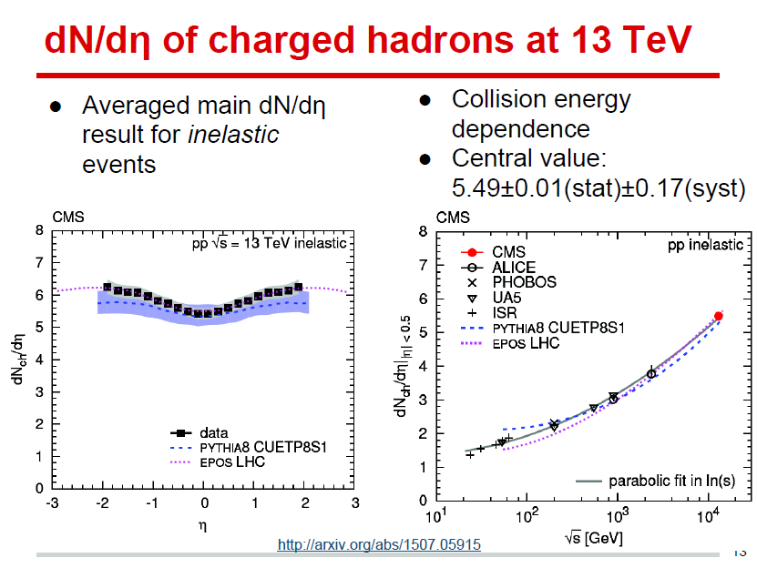

Slide 40
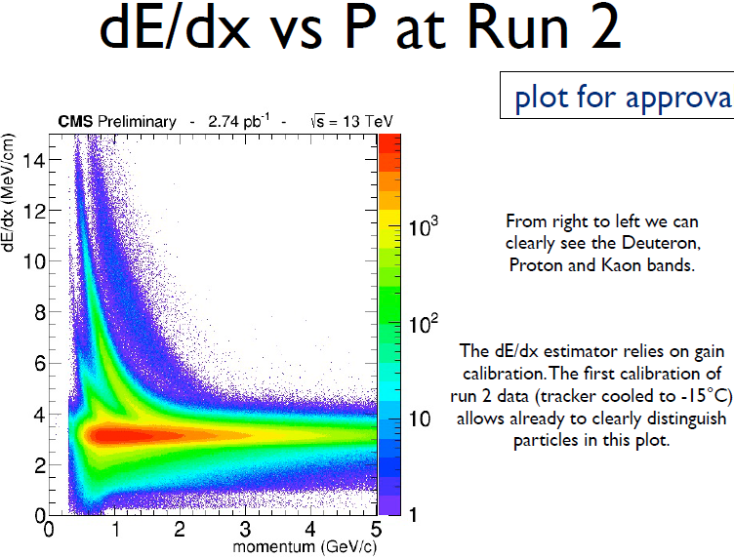
Tracker Performance

Slide 41
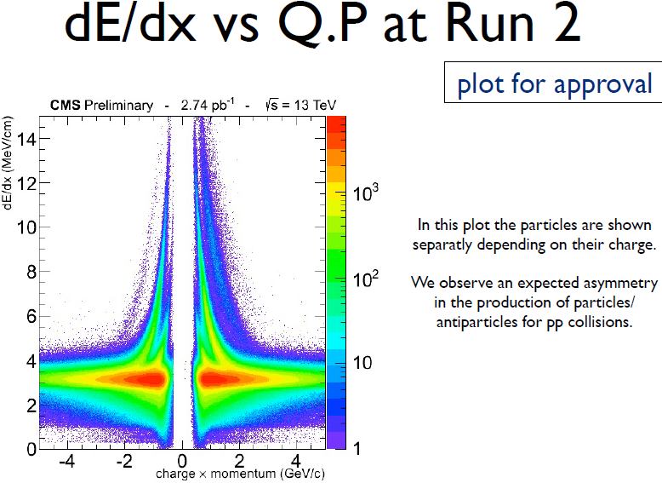
Tracker Performance

Slide 42
Reconstruction of K⁰_{S} and Λ⁰ in 13 TeV data
Invariant mass of the pion pairs fitted with a double gaussian and a first order polynomial for the background
Invariant mass of the proton-pion pairs fitted with a double gaussian and a first order polynomial for the background
Tracks selected with p_{T}>350 MeV. Selection requires displaced vertex wrt the primary vertex by 10σ and cosθ>0.9998

Slide 43
Dimuon invariant mass spectrum
Dimuon mass distribution collected with various dimuon triggers
  The light gray continuous distribution represents events collected with inclusive dimuon triggers with high p_{T} thresholds
  The dark gray band is collected by a trigger with low-mass non-resonant dimuon plus a track
  The other colored spectra are acquired using specialized triggers which require a pair of muons with opposite charge, a vertex-fit probability greater than 0.5%, and specific dimuon invariant mass and p_{T} regions:
    Magenta: dimuon mass within (0.85, 1.2) GeV, dimuon p_{T} > 0 GeV, dimuon |y| < 1.25
    Red: dimuon mass within (2.95, 3.3) GeV, dimuon p_{T} > 16 GeV; or dimuon mass within (2.95, 3.3) GeV, dimuon p_{T} > 10 GeV, dimuon |y| < 1.25
    Blue: dimuon mass within (3.4, 4) GeV, dimuon p_{T} > 13 GeV; or dimuon mass within (3.4, 4) GeV, dimuon p_{T} > 8 GeV, dimuon |y| < 1.25
    Cyan: dimuon mass within (4.5, 6) GeV, the leading muon p_{T} > 4 GeV and the sub-leading muon p_{T} > 3 GeV
    Green: dimuon mass within (8.5, 11) GeV, dimuon p_{T} > 13 GeV; or dimuon mass within (8.5, 11) GeV, dimuon p_{T} > 8 GeV, dimuon |y| < 1.25

Slide 44
Dimuon invariant mass spectrum

Slide 45
Electron Commissioning
SingleElectron PD:
  ~42/pb, with run selection based on [1], see backup
RunII 50ns DY-M50 Monte Carlo
Tag selection
  Pass POG tight ID , pT > 30 and |η| < 2.1
  Matched to HLT_Ele27_eta2p1_WPLoose_Gsf in data
Probe is reco electron with pT > 10 and |η| < 2.5
  Z window: 80 < mll < 100
  POG medium ID required for kinematic plots
  Relative isolation cut (0.1) for track and cluster plots
  POG Veto ID track and cluster cuts for isolation plots
Pile-up re-weighting applied
[1] https://twiki.cern.ch/twiki/bin/view/CMS/CollisionsJuly2015

Slide 46
Di-Electron Spectrum
Dielectron mass spectrum for electrons in the DoubleEG dataset with pT > 10 and |η|<2.5 which pass the cut-based Electron ID Veto working point.

Slide 47
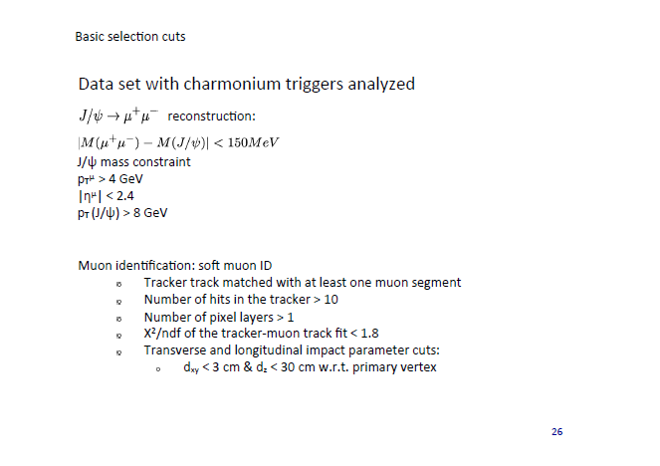

Slide 48


Slide 49


Slide 50

PDG is 5366.7 ± 0.4 MeV

Slide 51

Reconstruction of Z→ee in 2015 data
Invariant mass of di-electron pairs for both electrons in the barrel (left) and in the endcap (right). The calibrations applied in the data are the Run I ones extrapolated using the laser measurements. Simulation not tuned and assumes a calibration that will be achieved by the end of 50ns run. Data and simulation normalized to the same area

Slide 52
Muons in 13 TeV Collisions
Data and MC
Data
  Collision data at 13 TeV and 50 ns bunch spacing
  Prompt reconstruction, certified only on the basis of DCS detector status
  DoubleMuon dataset
  Integrated luminosity ~ 43 pb^{–1}
Monte Carlo
  Samples of Drell–Yan, W + jets, top-top, single-top, dibosons generated with MadGraph_aMC@NLO
  Detector alignment and calibration conditions as expected after about
  1 fb^{–1} of integrated luminosity
  Overall normalization of simulated distributions scaled to the data yield
  No event re-weighting is applied to match the pileup distribution in data

Slide 53
Muons in 13 TeV Collisions
Selection
Trigger
  double-muon trigger with p_{T} thresholds of 17 and 8 GeV on higher- and lower-p_{T} muon, loose tracker-based isolation on each muon
Offline selection
  at least two opposite-sign muons passing the Loose ID
  p_{T} > 20 and 10 GeV, |η| < 2.4
  both muons passing a loose isolation requirement:
  Σ p_{T}(tracks) + max(0, Σ E_{T}(ECAL) + Σ E_{T}(ECAL) – k · ρ) < 0.2 · p_{T}(muon)
  (where ρ is the average energy density in the event)
  di-muon invariant mass between 60 and 120 GeV
  if more than one muon pair satisfies the requirements above, the pair with invariant mass closest to the nominal Z boson mass is selected

Slide 54

Muons in 13 TeV Collisions
Invariant Mass
linear scale
logarithmic scale

Slide 55

Reconstruction of Z → ττ in 13 TeV data
Visible mass distribution (left) and fully reconstructed mass using the SVFit algorithm (right) for lepton (e,μ) and hadronically decaying taus in 13 TeV data.The simulation is normalized to the total integrated luminosity for all contributions except from the QCD background that is estimated by same sign data
Selection
  Muons: p_{T}>18 GeV, η<2.1
  Electrons: p_{T}>20 GeV η<2.1
  Taus: p_{T}>20, η<2.3
  Event: lepton,tau have opposite sign , M_{T}(μ,τ)<40 GeV

Slide 56

Distribution of the number of hadronic jets with p_{T}>30 GeV, |𝜂|<2.4 (left) and jets passing the tight threshold on the b-tagging discriminant (right) for events containing one isolated muon (p_{T}> 20 GeV, |𝜂|<2.4, passing tight identification criteria) and one isolated electron (p_{T}> 20 GeV, |𝜂|<2.4, excluding barrel-endcap gap, passing medium identification criteria) with opposite charge, forming an invariant mass greater than 50 GeV.

Slide 57
Reconstructed hadronic top quark candidate mass for events containing 1 isolated muon (p_{T}>30 GeV, |𝜂|<2.4, passing medium identification), four jets (p_{T}>30 GeV, |𝜂|<2.5), out of which 2 pass the tight b-tagging threshold. Leptonically decaying W boson is reconstructed using the lepton momentum and missing energy. The longitudinal component of the neutrino momentum is determined using the W boson mass constraint, with a 2-fold ambiguity. Then, the jet pair giving the best W boson mass is selected among the jets failing the b-tagging selection and assigned to the hadronic top quark. Finally, the b-tagged jet assignment and the neutrino solution that give the closest leptonic top mass to the world average are retained.

Slide 58
3. Towards single top
(t-channel production)

Slide 59
Event display of a single top quark t-channel candidate in x-y (left) and r-z (right) views. This event has one isolated muon, transverse missing energy of 27 GeV, and two hadronic jets. One of the jets passes the tight threshold on the Combined Secondary Vertex b-tagging discriminant and is interpreted as originating from the b quarks from top quark decay. The other jet has a pseudorapidity of -4.3 and in the signal ansatz it is interpreted as originating from a light quark recoiling against the top quark. The mass of the reconstructed top quark is 177 GeV.

Slide 60


Event display of a single top quark t-channel candidate in x-y (left) and r-z (right) views. This event has one isolated muon, transverse missing energy of 27 GeV, and two hadronic jets. One of the jets passes the tight threshold on the Combined Secondary Vertex b-tagging discriminant and is interpreted as originating from the b quarks from top quark decay. The other jet has a pseudorapidity of -4.3 and in the signal ansatz it is interpreted as originating from a light quark recoiling against the top quark. The mass of the reconstructed top quark is 177 GeV. (Zoom-in of the previous figures.)

Slide 61

Top-antitop candidate event display
CMS Collaboration
61

Slide 62
Details
DCS-only lumi selection
Selected with: 2xCMSTopTagged jets, pT>300GeV, m(ttbar)>2TeV, deltaPhi(topjets)>2.1
Plotted: (apart from the usual) CMSTopJet subjets in yellow
Coordinates: 251562:122:111132974
Kinematics:
m(topjet1)=177 GeV, pt(topjet1)=613 GeV,
m(topjet2)=176 GeV, pT(topjet2)=488 GeV,
ditopjet mass = 2491 GeV,
1 btagged subjet (CSVIVFv2 medium OP)

Slide 63


Slide 64


Slide 65


Slide 66
Event Display information
Run: 251251, LumiSection:64, Event Number: 39089589
Event: Single high p_{T} muon (red line) detected in the barrel muon chambers with a large imbalance in the transverse momentum (Missing ET) (arrow).
Kinematic quantities:
Muon: p_{T}= 0.53 TeV
η = 0.69
φ = -2.3
MET : 0.62 TeV
Δφ (μ-MET) = 3.0
m_{T} = 1.1 TeV

Slide 67
Single muon + missing E_{T} @ m_{T} = 1.1 TeV
1 event expected with m_{T} > 700 GeV for the luminosity analyzed
W prime candidate

Slide 68
Details
DCS-only lumi selection
selected with two events passing the high energy electron ID tuned for 50ns data taking (HEEP ID V6.0)
event details:
  run: 251562
  luminosity section: 605
  event number: 528500442
kinematics:
  ele1 : pt = 377 GeV, η = 0.232, φ = 2.66 rad
  ele2 : pt = 371 GeV, η = -1.37, φ = -0.493 rad
  mass(ee) : 999 GeV
  missing transverse energy : 9.2 GeV
Z prime candidate

Slide 70


Slide 71


Dijet resonance search
Many extensions of the standard model predict the existence of new massive particles (X) that couple to quarks or antiquarks (q) and gluons (g). These new particles could produce resonant bumps in the dijet invariant mass distribution associated with strong interaction processes.
q, g
q, g
X
q, g
q, g
A search for narrow resonances in dijet final states have been performed at CMS using 20 fb⁻¹ of pp collisions at = 8 TeV [1].
Phys.Rev. D91 (2015), 052009
In this document, the first results on the dijet resonance search using 37 pb⁻¹ of pp collisions at = 13 TeV are presented.
71
Notes:
71
71

Slide 72
Event reconstruction and selection
The Particle Flow (PF) candidates (charged/neutral hadrons, muons, electrons, photons) [2] are clustered into jets using the anti-kT algorithm with distance parameter of 0.4
  jet momenta are corrected using calibration constants derived from simulations;
  jets are required to have p_{T} > 30 GeV and |η| < 2.5; leading jet is required to have p_{T} > 60 GeV
  jet identification criteria are applied to the two jets in the event with the highest p_{T} (leading jets), in order to remove spurious events associated with calorimeter noise. The event is rejected if either of these two jets fails these criteria.
Geometrically close jets are combined into “wide jets”, which are used to measure the dijet mass spectrum (m_{jj})
  the two jets with largest p_{T} are used as seeds. The Lorentz vectors of all other jets are then added to the closest leading jet, if within
Dijet event selection using “wide jets”
Jet1: p_{T} > 60 GeV , |η| < 2.5 Jet2: p_{T} > 30 GeV , |η| < 2.5
|∆η_{jj}|<1.3
m_{jj} > 1.1 TeV
The background from t-channel multijet events is suppressed by requiring the pseudorapidity separation of the two wide jets (|Δη_{jj}|) to be less than 1.3. This requirement maximizes the search sensitivity for isotropic decays of dijet resonances in the presence of multijet background .
The high level trigger used for this search requires that the scalar sum of the PF jet p_{T}s in the event be larger than 800 GeV.
  Biases from the trigger requirements are avoided by requiring that the fully reconstructed events have m_{jj} >1.1 TeV. In this region the trigger selection is found to be fully efficient.
72
Notes:
72
72

Slide 73


Data quality checks
Basic jet and reconstructed event quantities are studied:
  jet kinematics (p_{T}, η, φ)
  particle flow composition of the jets
  quantities sensitive to detector noise (such as missing transverse energy in the event)
  rate of selected events above the m_{jj} threshold
  κinematics of dijet system (m_{jj}, |∆η_{jj}|, ∆φ_{jj})
Various cross-checks are performed
  data vs simulation comparison
  stability as a function of time
  stability as a function of number of pileup interactions
The studies show we are selecting good dijet events
  no signs of spurious events from detector noise in the data sample
  good stability of all reconstructed quantities vs pileup and time
73
Simulation is normalized to the same area of the data
Standard selection applied (no Δφ cut)
Notes:
73

Slide 74

Dijet mass spectrum
The dijet mass distribution is fitted using the following 4-parameter function. This function is the same used in previous versions of this analysis at 7 and 8 TeV
The variable size binning corresponds to the estimated dijet mass resolution
Black points are data
Red dashed line is the fit to data
For illustration, we superimpose a q* -> qg signal with resonance mass M=4.5 TeV (blue dashed).
We perform a maximum likelihood fit
To give a rough estimate of the goodness of fit we calculate the χ²
  χ² / ndof = 26.6 / 31
The fit to the data using a background parameterization is good and there is no evidence for a dijet resonance.
Above 3.5 TeV we expect ~4.6 background events (from fit to data) and ~0.8 events of signal from the considered q* model, and we observe 4 events in data.
With the current integrated luminosity of the 13 TeV data sample, using an estimate based on 13TeV / 8TeV parton luminosity ratios, we expect to exceed the sensitivity of the 8 TeV analyses only for narrow resonances with masses greater than about 5 TeV.
74
Notes:
74

Slide 75
Event Display of the highest dijet mass event in data
Rho-phi and x-z view of the highest dijet mass event (m_{jj}=5 TeV)
The labels show the the kinematic variables of the two wide jets
75
Notes:
75

Slide 76


Event Display of the highest dijet mass event in data
3-D and “lego” view of the highest dijet mass event (m_{jj}=5 TeV)
The labels show the the kinematic variables of the two wide jets
76
Notes:
76

Slide 77
References
[1] CMS Collaboration, “Search for resonances and quantum black holes using dijet mass spectra in proton-proton collisions at = 8 TeV”, Phys.Rev. D91 (2015), no. 5, 052009,doi:10.1103/PhysRevD.91.052009, arXiv:1501.04198.
[2] CMS Collaboration, “Particle-Flow Event Reconstruction in CMS and Performance for
Jets, Taus, and E T miss ”, CMS PAS PFT-09-001 (2009)
77
Notes:
77

Slide 78


@ 8 TeV

Slide 79

A glance at Run 2 expectations
1fb-1 equivalent reach to Run1
2 fb-1 equivalent reach to Run1
10 fb-1 equivalent reach to Run1

