Slide 1


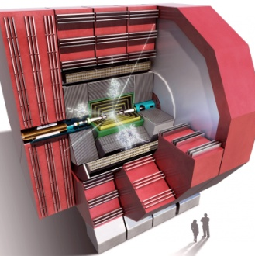
HCal Optimization: Updated results for HCal Barrel Studies + HCal Endcap Coverage Extension Study
Nikiforos Nikiforou
CERN/PH-LCD
CLICdp Optimization Meeting
CERN, 11th of December 2014

Slide 2
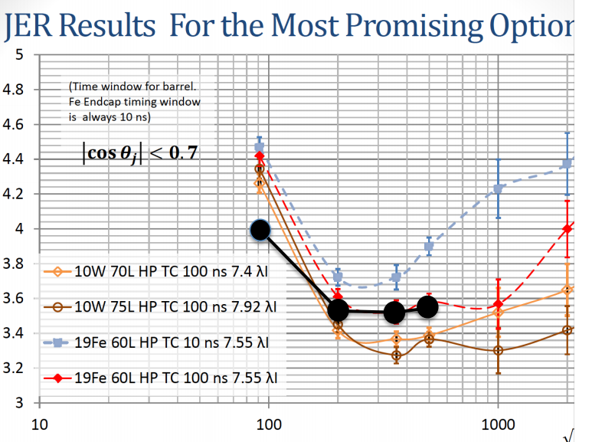
Introduction - Outline
In past meetings, people questioned the compatibility of the HCal Barrel Optimization results (W vs Fe) shown previously with other studies:
  JER results from Steve
  W/Z separation results in Pandora PFA performance paper Some updated results are shown today to alleviate those concerns
I will also show some early results of the studies for the extension of the HCal coverage
Steve at Cambridge has independently produced JER results for ILD models
Optimized calibration procedure, tweaked PFA
  Did not expect results to be directly comparable
  BUT: worrisome that he obtained 10 ns Steel performance comparable to my 100 ns steel results
Black points: Steve’s 10 ns Steel results overlaid by hand by Mark at Nov. 5th meeting

Slide 3
Differences with Steve’s setup
Steve and I discussed and compared configurations and found a couple obvious differences:
  MaxHCalHitHadronicEnergy (MHHHE) truncation: I wasn’t applying any (100000) Steve has 1 (GeV) -> Appears to drive the difference
  ECal Readout window: I had 10 ns, Steve has 20 ns (small effect)
Other differences (more Pandora tweaks, Non-linearity Corrections) appear to have a smaller effect
I added one new line (black line next slide) to the JER plot, showing the case of a Steel HCal with 10 ns readout window, recalibrated and events re-reconstructed with:
  MHHHE=1 GeV
  ECal Readout window of 20 ns
  (Rest same as original blue line: 19 mm Fe, 60L, 10 ns, NLC,…)

Slide 4
19Fe 60L 10 ns HCal with MHHHE=1 and 20 ns ECal
Performance of 10 ns Steel HCal is now comparable to the performance of 100 ns Steel with previous calibration at low energies

Slide 5
Conclusions on Tweaking?
Clearly the 1 GeV cut is not optimal for high jet energies
However this demonstrates that a lot can be accomplished by optimizing /configuring the software
It also shows that it is not easy or clear to directly compare between independent studies if the configuration is not the same
Perhaps more importantly, it shows that the performance of individual models under investigation should not be considered in absolute terms

Slide 6
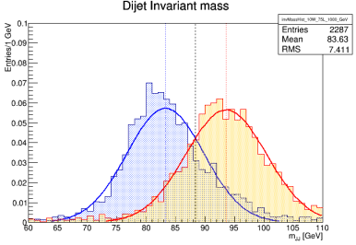
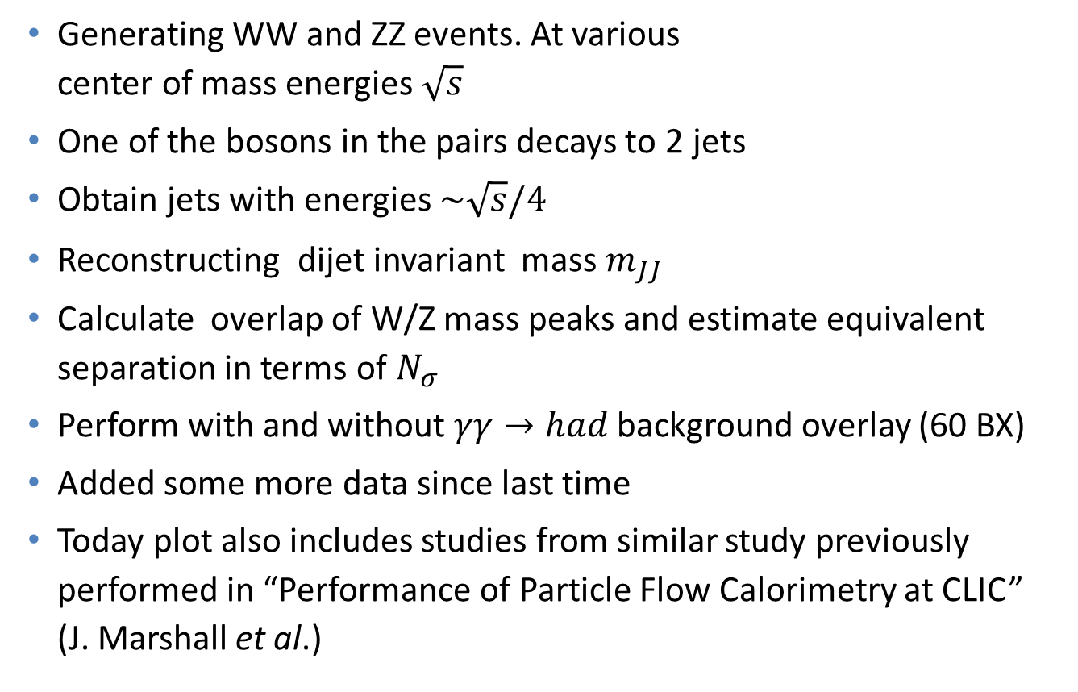
W/Z Separation Study -Reminders
Generating WW and ZZ events. At various center of mass energies $\sqrt{s}$
One of the bosons in the pairs decays to 2 jets
Obtain jets with energies $\sim \sqrt{s}/4$
Reconstructing dijet invariant mass $m_{JJ}$
Calculate overlap of W/Z mass peaks and estimate equivalent separation in terms of $N_{σ}$
Perform with and without $γγ→had$background overlay (60 BX)
Added some more data since last time
Today plot also includes studies from similar study previously performed in “Performance of Particle Flow Calorimetry at CLIC” (J. Marshall et al.)

Slide 7



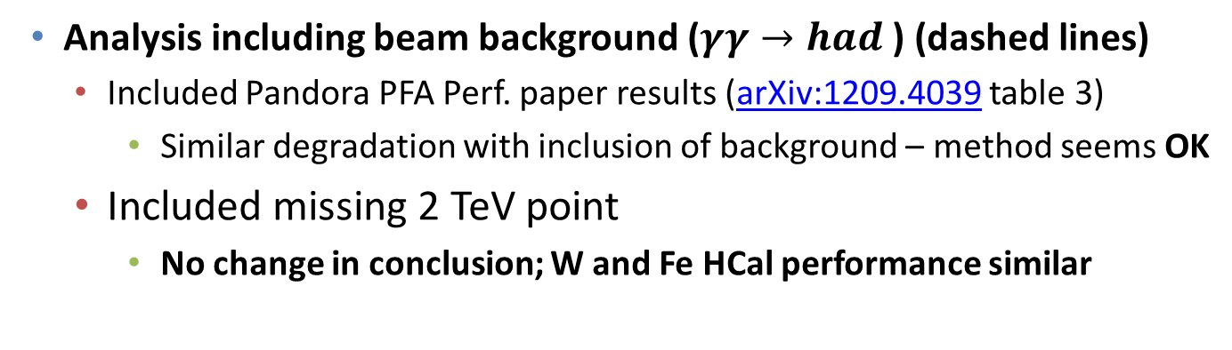
W/Z Separation Study – Updated
W models: 100 ns Barrel
Fe: model: 10 ns Barrel
Both: 10 ns Endcap
Overlap [%]
Separation [$N_{σ}$]
(equivalent separation for ideal gaussians with same σ)
$\sqrt{s}$ [GeV]
$\sqrt{s}$ [GeV]
Analysis including beam background ($γγ→had$) (dashed lines)
  Included Pandora PFA Perf. paper results (arXiv:1209.4039 table 3)
    Similar degradation with inclusion of background – method seems OK
  Included missing 2 TeV point
    No change in conclusion; W and Fe HCal performance similar

Slide 8
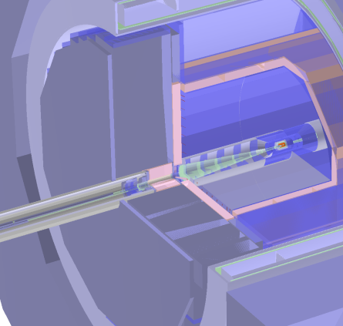
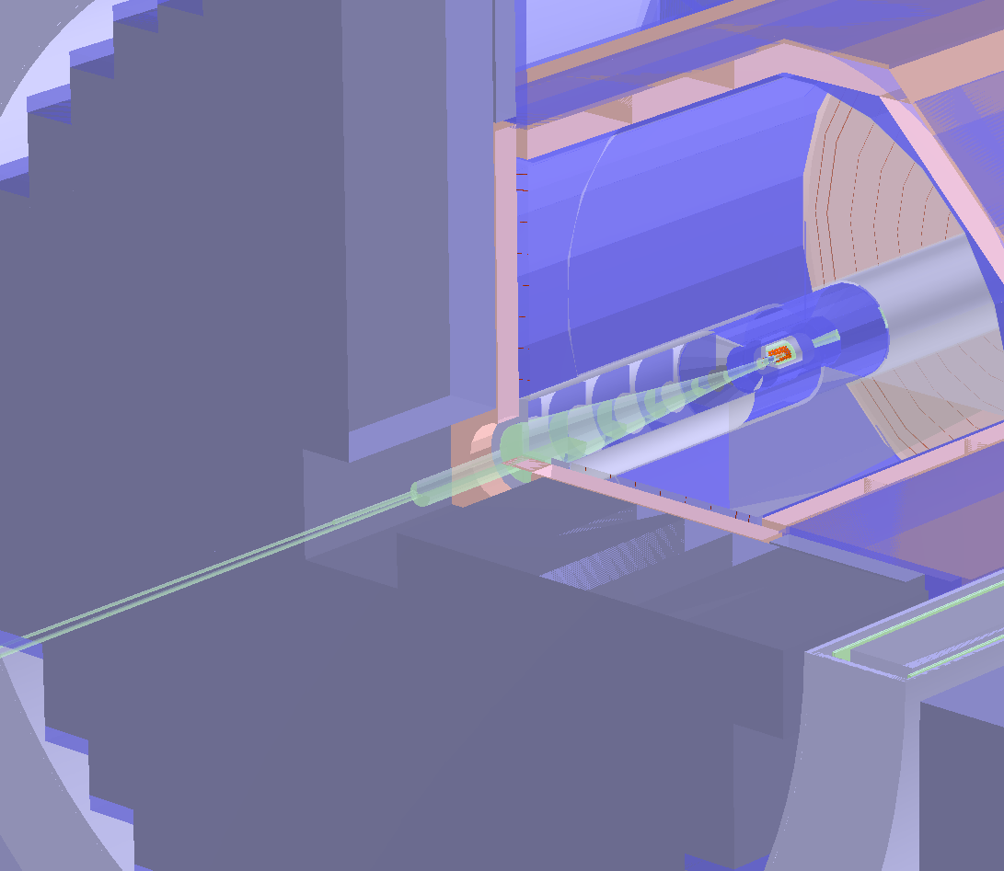

HCal Coverage Extension - Strategy
Study W/Z separation Vs. Coverage ($R_{in}$), with background overlay
Work with ILD_o1_v06 (adapted to CLICdp Radius, Nlayers, etc)
  Remove BeamCal08, LumiCalV, LHcal01 and maskX03
  Square hole with half side size of 360 mm remains (1 HBU unit?)
  In Gear File for reconstruction an inner HCal radius of 350 mm is assumed
  Need to extend coverage without messing up driver too much (next slide)

Slide 9
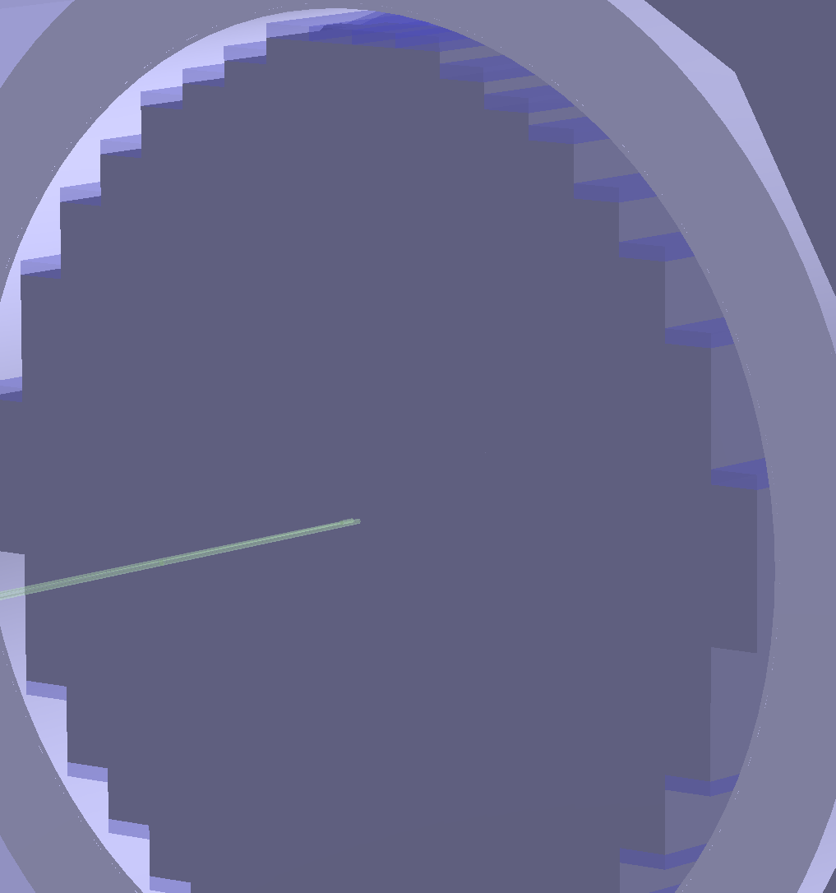
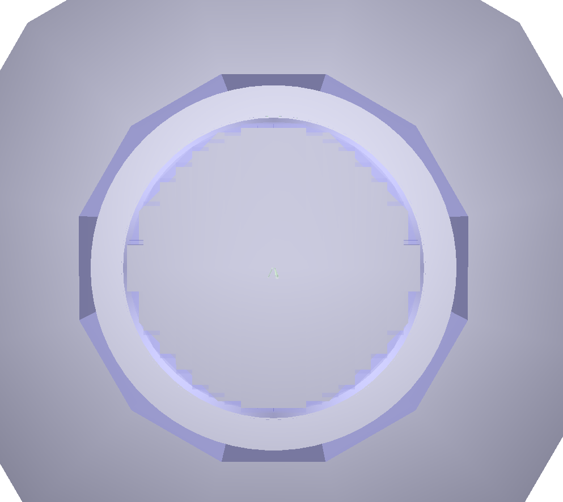
HCal Coverage Extension – Strategy II
HCal is built with narrow and long boxes of fixed width of one HBU
Chose to fully extend the two central pairs of boxes down to the beam pipe (ignore some overlap with the pipe)
Obtain fully hermetic detector
Generate and simulate WW and ZZ events for this model once (for each energy point)

Slide 10
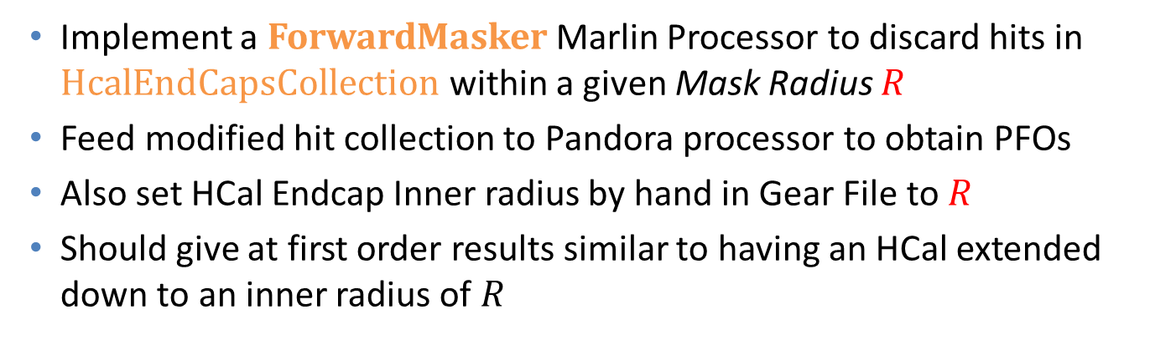

HCal Coverage Extension – Strategy III
Implement a ForwardMasker Marlin Processor to discard hits in HcalEndCapsCollection within a given Mask Radius $R$
Feed modified hit collection to Pandora processor to obtain PFOs
Also set HCal Endcap Inner radius by hand in Gear File to $R$
Should give at first order results similar to having an HCal extended down to an inner radius of $R$
Clearly this method ignores the LHCal contribution completely
  But anyway I haven’t at all been optimizing/paying any attention to the LHCal for these studies
We can study various radii from 0, 150 mm, 350 mm, … without having to simulate new events every time
$$R$$

Slide 11
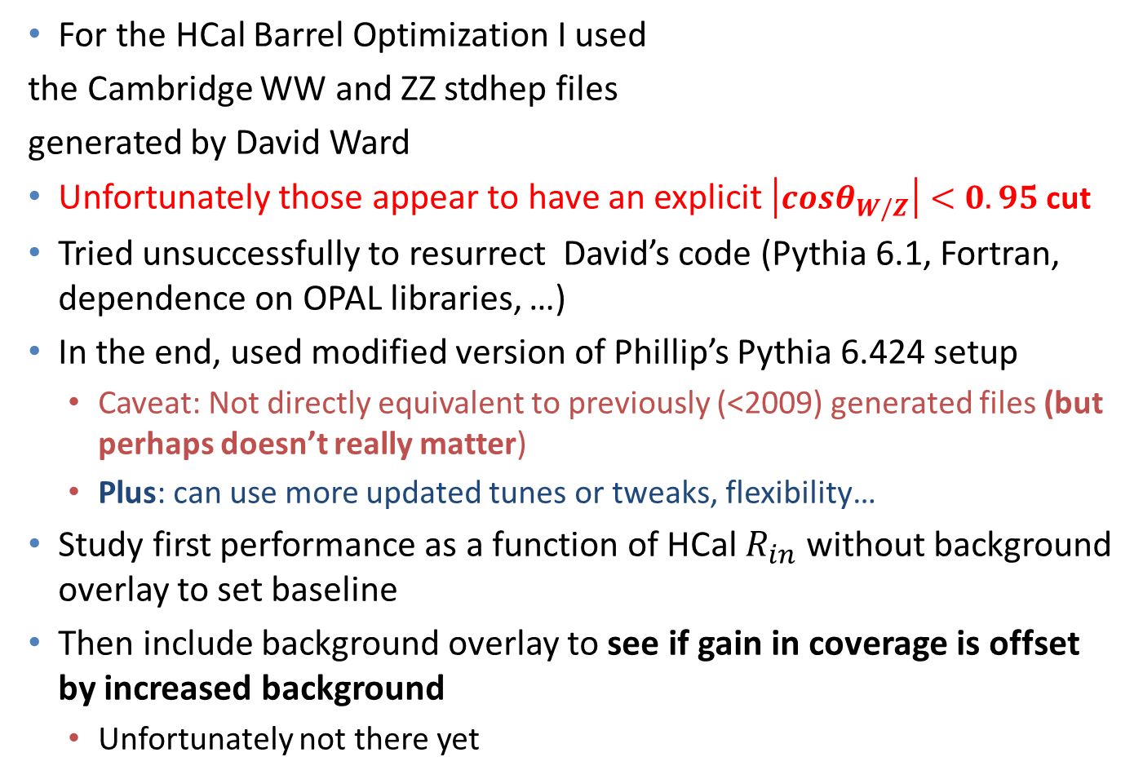
Generating WW/ZZ events
(Values for L=2.3 m)
cosθ | θ [rad] | θ [deg] | tanθ | R [mm]
0.85 | 0.55 | 32 | 0.62 | 1425
0.90 | 0.45 | 26 | 0.48 | 1114
0.95 | 0.32 | 18 | 0.33 | 756
For the HCal Barrel Optimization I used
the Cambridge WW and ZZ stdhep files
generated by David Ward
Unfortunately those appear to have an explicit $\left|cosθ_{W/Z}\right|<0.95$cut
Tried unsuccessfully to resurrect David’s code (Pythia 6.1, Fortran, dependence on OPAL libraries, …)
In the end, used modified version of Phillip’s Pythia 6.424 setup
  Caveat: Not directly equivalent to previously (<2009) generated files (but perhaps doesn’t really matter)
  Plus: can use more updated tunes or tweaks, flexibility…
Study first performance as a function of HCal $R_{in}$ without background overlay to set baseline
Then include background overlay to see if gain in coverage is offset by increased background
  Unfortunately not there yet

Slide 12

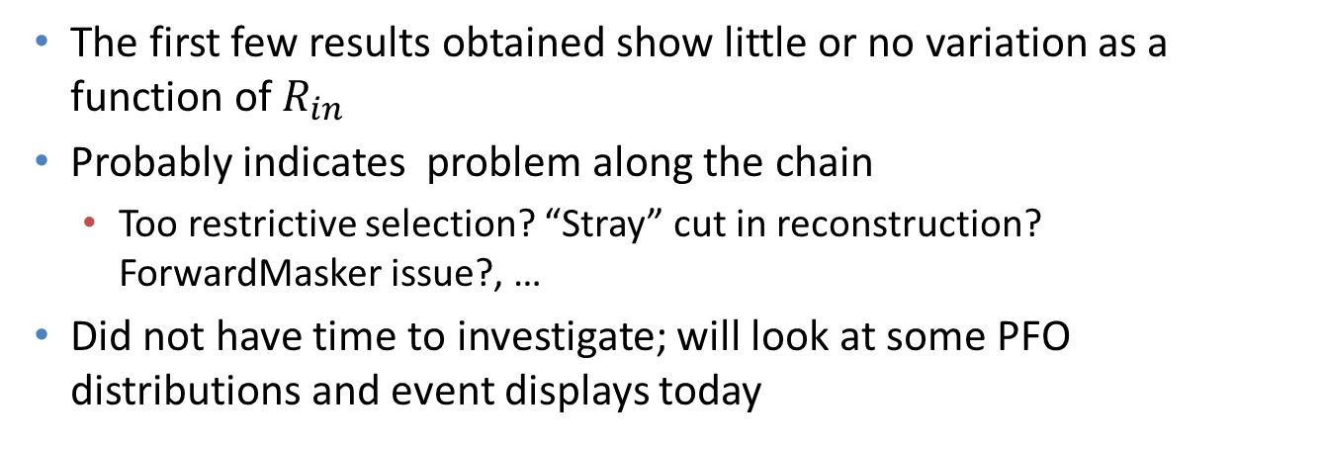
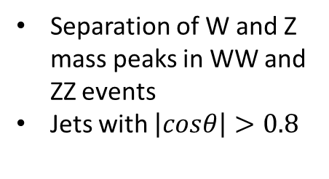

Very early results not very promising
Separation of W and Z mass peaks in WW and ZZ events
Jets with $\left|cosθ\right|>0.8$
The first few results obtained show little or no variation as a function of $R_{in}$
Probably indicates problem along the chain
  Too restrictive selection? “Stray” cut in reconstruction? ForwardMasker issue?, …
Did not have time to investigate; will look at some PFO distributions and event displays today

Slide 13
Conclusions
Tracked down the apparent discrepancy with Steve’s JER results
  Shows additional degree of freedom in optimization
W/Z mass separation method for HCal barrel appears compatible with previous results
Intend to use the same method for extension of the HCal coverage
However, the details of the implementation still need to be worked out

Slide 14
Bonus material – OLDER PLOTS

Slide 15
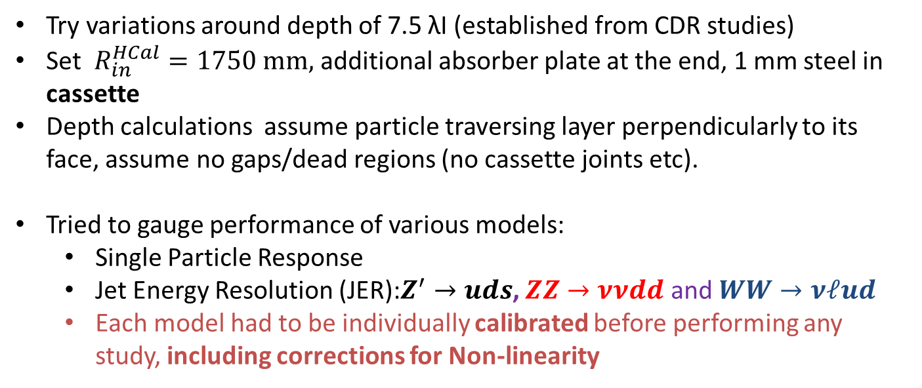
Various Model Options for the HCAL Barrel
Try variations around depth of 7.5 λΙ (established from CDR studies)
Set $R_{in}^{HCal}=1750 mm,$ additional absorber plate at the end, 1 mm steel in cassette
Depth calculations assume particle traversing layer perpendicularly to its face, assume no gaps/dead regions (no cassette joints etc).
Tried to gauge performance of various models:
  Single Particle Response
  Jet Energy Resolution (JER):$Z^{′}→uds$, $ZZ→ννdd$ and $WW→νℓud$
  Each model had to be individually calibrated before performing any study, including corrections for Non-linearity
Detector | # Layers | Abs Thick | Cass. Thick | Air | Total Depth | Total Thickness | Inner R | Outer Face Position | Outer Radius
 |  | mm | mm | mm | #λΙ | mm | mm | mm | mm
CLIC_ILD_CDR | 75 | 10 | 5* (*Scint) | 1.5 | 7.42 | 1237.5 | 2058 | 3295.5 | 3341.2
CLIC_SID_CDR |  |  |  |  |  | 1237.5 | 1447 | 2684.5 | 2721.7
W + cassette | 75 | 10 | 4.8 | 2.7 | 7.92 | 1322.5 | 1750 | 3072.5 | 3115.1
W + cassette | 70 | 10 | 4.8 | 2.7 | 7.40 | 1235 | 1750 | 2985 | 3026.4
Fe + cassette | 60 | 19 | 4.8 | 2.7 | 7.55 | 1609 | 1750 | 3359 | 3405.6
Fe + cassette | 70 | 16 | 4.8 | 2.7 | 7.93 | 1661 | 1750 | 3411 | 3458.3

Slide 16

JER Results For the Most Promising Options
$$\left|\cos{θ_{j}}\right|<0.7$$
Probably the performance for Tungsten shown here is close to its optimal
  Tungsten has been observed to be compensating
Steel on the contrary, may benefit from software compensation -> expect some improvement in JER
  May also explain observed gain from increased timing window (?)

Slide 17
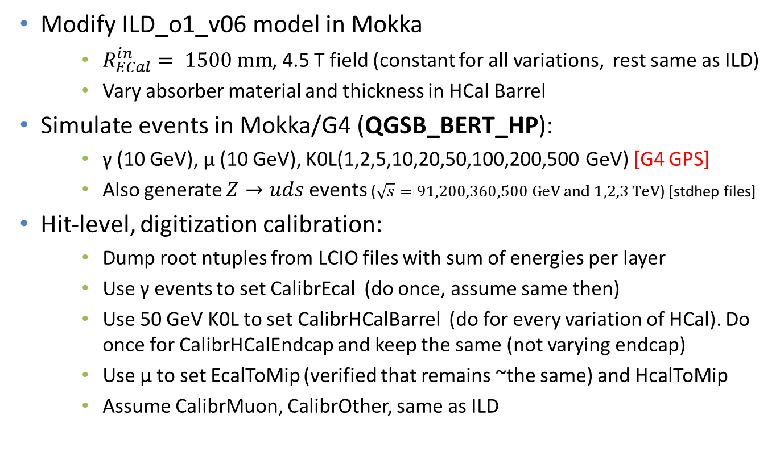
Outline of Calibration Procedure and JER study
Modify ILD_o1_v06 model in Mokka
    $R_{ECal}^{in}= 1500 mm$, 4.5 T field (constant for all variations, rest same as ILD)
    Vary absorber material and thickness in HCal Barrel
Simulate events in Mokka/G4 (QGSB_BERT_HP):
    γ (10 GeV), μ (10 GeV), K0L(1,2,5,10,20,50,100,200,500 GeV) [G4 GPS]
    Also generate $Z→uds$ events ($\sqrt{s}=91,200,360,500 GeV and 1,2,3 TeV$) [stdhep files]
Hit-level, digitization calibration:
    Dump root ntuples from LCIO files with sum of energies per layer
    Use γ events to set CalibrEcal (do once, assume same then)
    Use 50 GeV K0L to set CalibrHCalBarrel (do for every variation of HCal). Do once for CalibrHCalEndcap and keep the same (not varying endcap)
    Use μ to set EcalToMip (verified that remains ~the same) and HcalToMip
    Assume CalibrMuon, CalibrOther, same as ILD

Slide 18
Outline of Calibration Procedure - II
PandoraPFA calibration:
    Run PandoraPFA over the γ events to get ECALToEM , HCALToEM (actually set both to 1 for these studies)
    Run Calibration procedure over the Kaon events to obtain ECALToHAD, HCALToHAD at 50 GeV
    Obtain Non-Linearity Corrections (NLC) [Note Difference from Steve’s studies who does not use NLC]:
      Measure response for 1,2,5,10,20,50,100,200,500 GeV Kaons and calculate scaling factor (extrapolate in-between)
Recalibrate when changing Readout Window Timing Cut
Having these numbers, we can study the Jet Energy Resolution
Use AnalysePerformance (from PandoraAnalysis-v00-06)
Study the performance various models
  Also look at different Timing Cuts

Slide 19
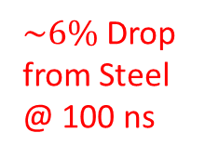

JER Results
$\sim 14\%$ Drop
$\sim 6\%$ Drop from Steel @ 100 ns

Slide 20
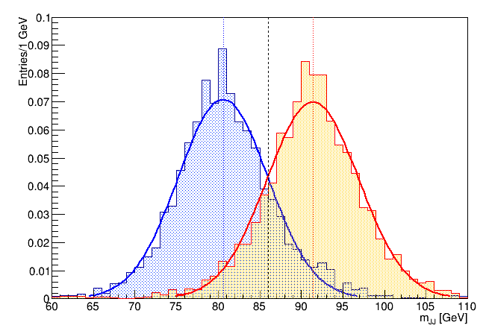
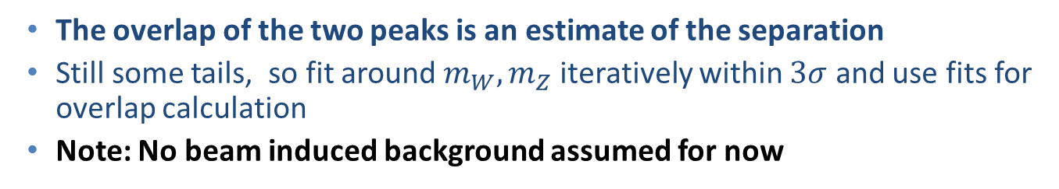

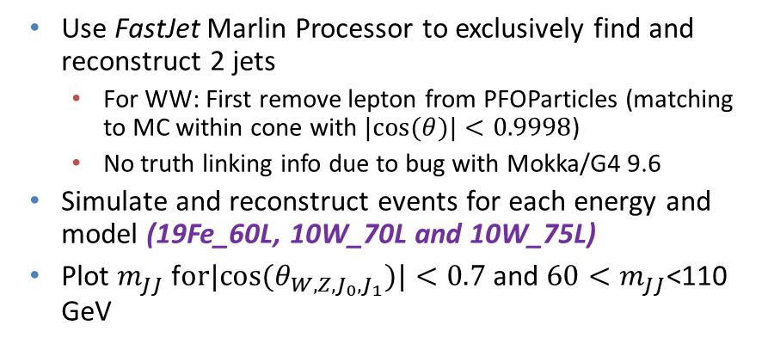
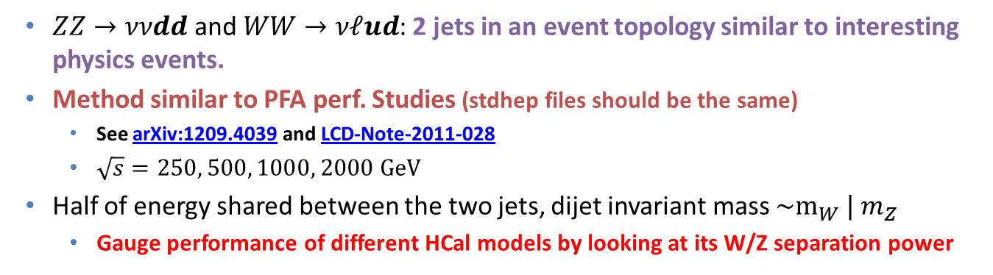
W/Z Separation Study
  $ZZ→ννdd$ and $WW→νℓud$: 2 jets in an event topology similar to interesting physics events.
  Method similar to PFA perf. Studies (stdhep files should be the same)
    See arXiv:1209.4039 and LCD-Note-2011-028
    $\sqrt{s}=250, 500, 1000, 2000 GeV$
  Half of energy shared between the two jets, dijet invariant mass $\sim m_{W} | m_{Z}$
    Gauge performance of different HCal models by looking at its W/Z separation power
Use FastJet Marlin Processor to exclusively find and reconstruct 2 jets
  For WW: First remove lepton from PFOParticles (matching to MC within cone with $|cos⁡(θ)|<0.9998$)
  No truth linking info due to bug with Mokka/G4 9.6
Simulate and reconstruct events for each energy and model (19Fe_60L, 10W_70L and 10W_75L)
Plot $m_{JJ}$ f$or|cos⁡(θ_{W,Z,J_{0},J_{1}})|<0.7$and $60<m_{JJ}$<110 GeV
Example for 19Fe_60L, $\sqrt{s}=1 TeV$
The overlap of the two peaks is an estimate of the separation
Still some tails, so fit around $m_{W},m_{Z}$ iteratively within $3σ$ and use fits for overlap calculation
Note: No beam induced background assumed for now

Slide 21
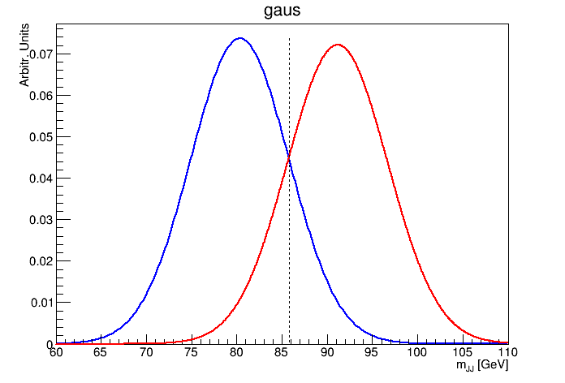
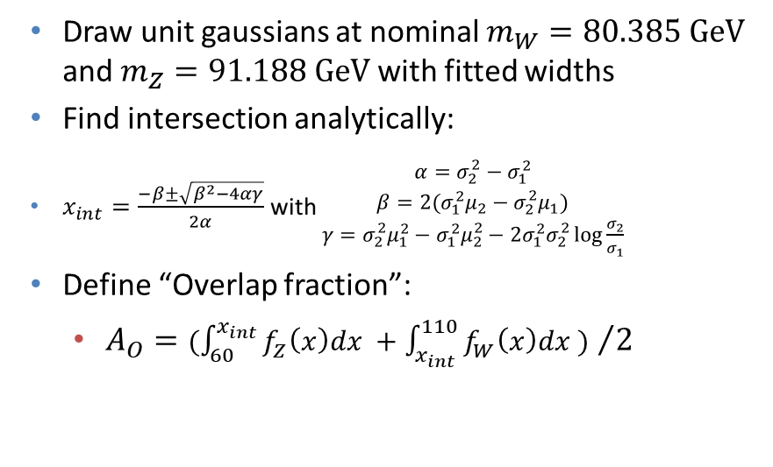
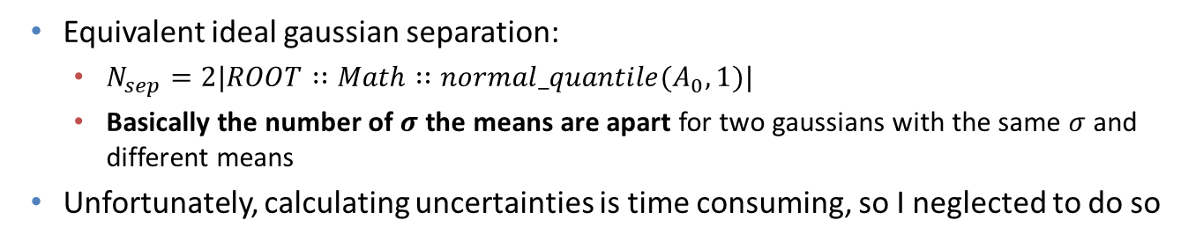
W/Z Separation Study – cont’d
Draw unit gaussians at nominal $m_{W}=80.385 GeV$ and $m_{Z}=91.188 GeV$ with fitted widths
Find intersection analytically:
$x_{int}=\frac{−β±\sqrt{β^{2}−4αγ}}{2α}$ with $\begin{matrix}α=σ_{2}^{2}−σ_{1}^{2} \\ β=2(σ_{1}^{2}μ_{2}−σ_{2}^{2}μ_{1}) \\ γ=σ_{2}^{2}μ_{1}^{2}−σ_{1}^{2}μ_{2}^{2}−2σ_{1}^{2}σ_{2}^{2}\log{\frac{σ_{2}}{σ_{1}}}\end{matrix}$
Define “Overlap fraction”:
  ${A_{O}=(\int_{60}^{x_{int}}{f_{Z}\left(x\right)dx }+\int_{x_{int}}^{110}{f_{W}\left(x\right)dx }) }/2$
Equivalent ideal gaussian separation:
  $N_{sep}=2|ROOT∷Math∷normal_quantile(A_{0},1)|$
  Basically the number of $σ$ the means are apart for two gaussians with the same $σ$ and different means
Unfortunately, calculating uncertainties is time consuming, so I neglected to do so
Energy | 19Fe_60L |  | 10W_70L |  | 10W_75L
[GeV] | Overlap [%] | Nsep [σ] | Overlap [%] | Nsep [σ] | Overlap [%] | Nsep [σ]
250 | 11.3 | 2.4 | 10.6 | 2.5 | 10.3 | 2.5
500 | 11.9 | 2.4 | 11.3 | 2.4 | 10.6 | 2.5
1000 | 16.2 | 2.0 | 14.9 | 2.1 | 14.2 | 2.1
2000 | 22.3 | 1.5 | 21.2 | 1.6 | 22.0 | 1.5

Slide 22
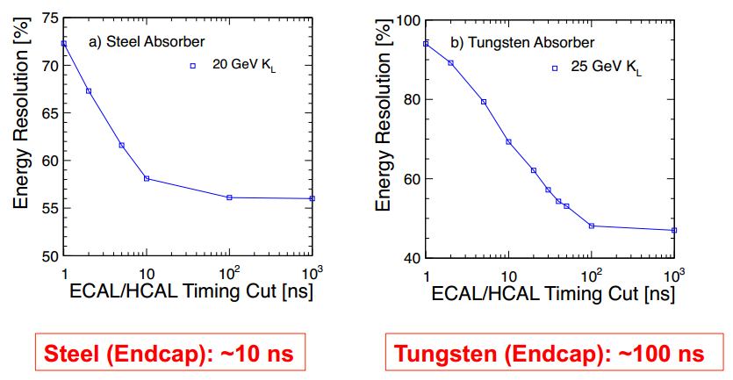
Reminder: Readout Windows
See talks by M. Thompson:
  http://indico.cern.ch/event/115459/contribution/14/material/slides/0.pdf (slides 3,4)
  https://agenda.linearcollider.org/getFile.py/access?contribId=13&sessionId=1&resId=0&materialId=slides&confId=5134 (slides 16,17…)
Further timing cuts (mainly for background/pileup suppression) are applied at the PFO level. NOT CONSIDERED IN THE STUDY PRESENTED TODAY
  We will apply cuts at the digitization level

Slide 23
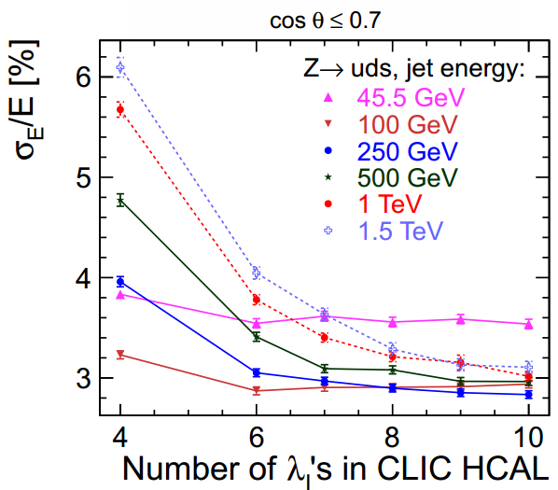
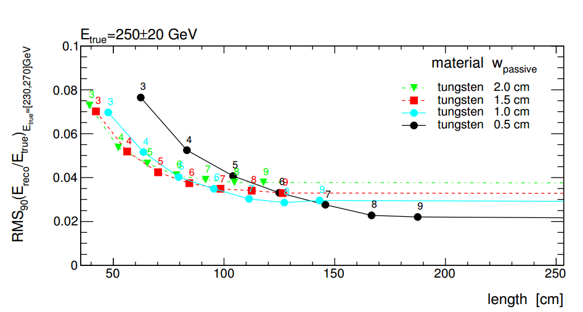
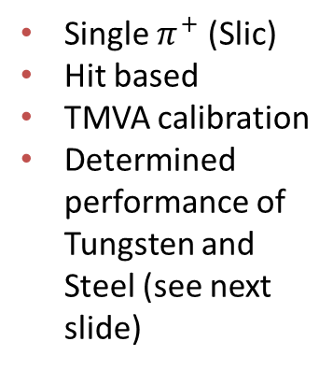
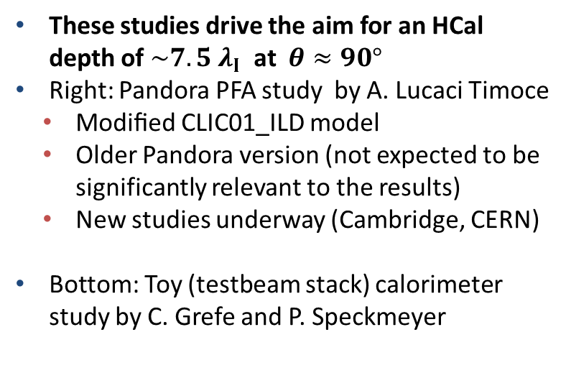

Plots from CDR
These studies drive the aim for an HCal depth of $\sim 7.5 λ_{Ι}$ at $θ≈90°$
Right: Pandora PFA study by A. Lucaci Timoce
  Modiﬁed CLIC01_ILD model
  Older Pandora version (not expected to be significantly relevant to the results)
  New studies underway (Cambridge, CERN)
Bottom: Toy (testbeam stack) calorimeter study by C. Grefe and P. Speckmeyer
CDR Fig. 6.2 and Refs. [3,4]
Single $π^{+}$ (Slic)
Hit based
TMVA calibration
Determined performance of Tungsten and Steel (see next slide)
Numbers indicate $\#λ_{Ι}$
CDR Fig. 6.1, see also Ref. [1]

Slide 24
Material Scan of W-HCAL (CLIC_SID_CDR)
Try to verify material budget in current detector geometry implementations
See whether we can squeeze some more the HCal outer radius
Scan using Slic/Geant4 (see backup)
Geometry Parameters:
(www.lcsim.org/detectors/clic_sid_cdr.html)
HCAL BARREL
Number Of Layers | 75
Number Of Sides | 12
Inner Radius | 1419 mm
Outer Radius | 2656.5 mm
Z Length | 3530 mm
Section Phi | 0.52 radians
Cell Size U | 30.0 mm
Cell Size V | 30.0 mm
Layers 0 - 74
10 mm | Tungsten
5 mm (sensor) | Polystyrene
1.5 mm | Air

Slide 25

CLIC_SID_CDR Material Scan in θ

Slide 26
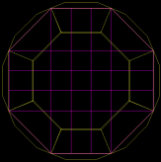
CLIC_ILD_CDR Material Scan in φ
Scan using Mokka/Geant4 (see backup)
Geometry Parameters:
(from CDR and http://www-flc.desy.de/ldcoptimization/tools/mokkamodels.php?model=CLIC_ILD_CDR)
HCAL BARREL | SHcalSc02
Number Of Layers | 75
Number Of Sides | (8) 16
Inner Radius | 2058 mm
Outer Radius | 3296 mm
Z Length | 4700 mm
Section Phi | 0.52 radians
Cell Size U | 30.0 mm
Cell Size V | 30.0 mm
Layers 0 - 74
10 mm | Tungsten
5 mm (sensor) | Polystyrene
1.5 mm | Air

Slide 27
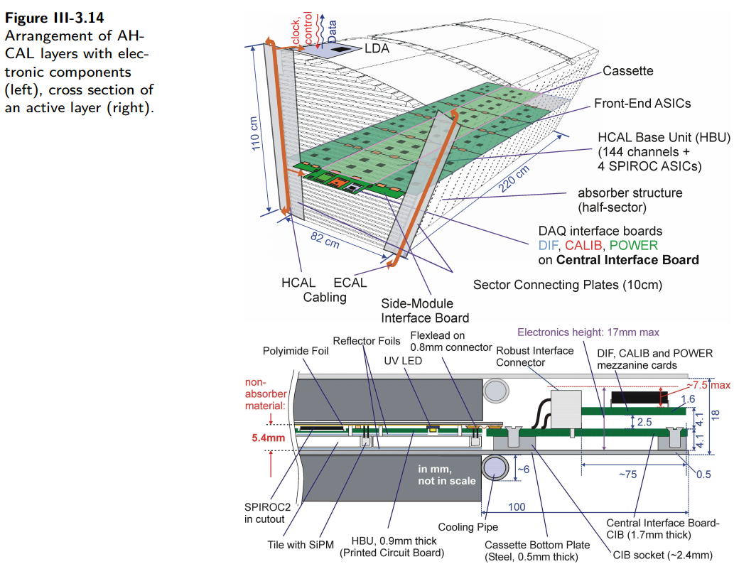
ILD AHCAL Assembly (from ILD TDR)
Active Element Cassette |  | ILD
Material | Thickness | Thickness
 | mm | mm
Steel | 2 | 0.5
PCB | 1.4 | 1
Cu (etching) | 0.1 | 0
Electronics (30%) | 1.5 | 1
Scintillator | 5 | 3
Sum (per layer) | 10 | 5.5
#λΙ (per layer) | 0.02 | 0.01
NB: ILD TDR also mentions “The active layers will contribute 4 mm of steel to each absorption layer”
Not shown in diagram?
16 mm (absorber layer) +
4 mm = 20 mm steel
+0.5 mm bottom plate?
Not clear what is done in code (comment says ignored)

