Slide 1
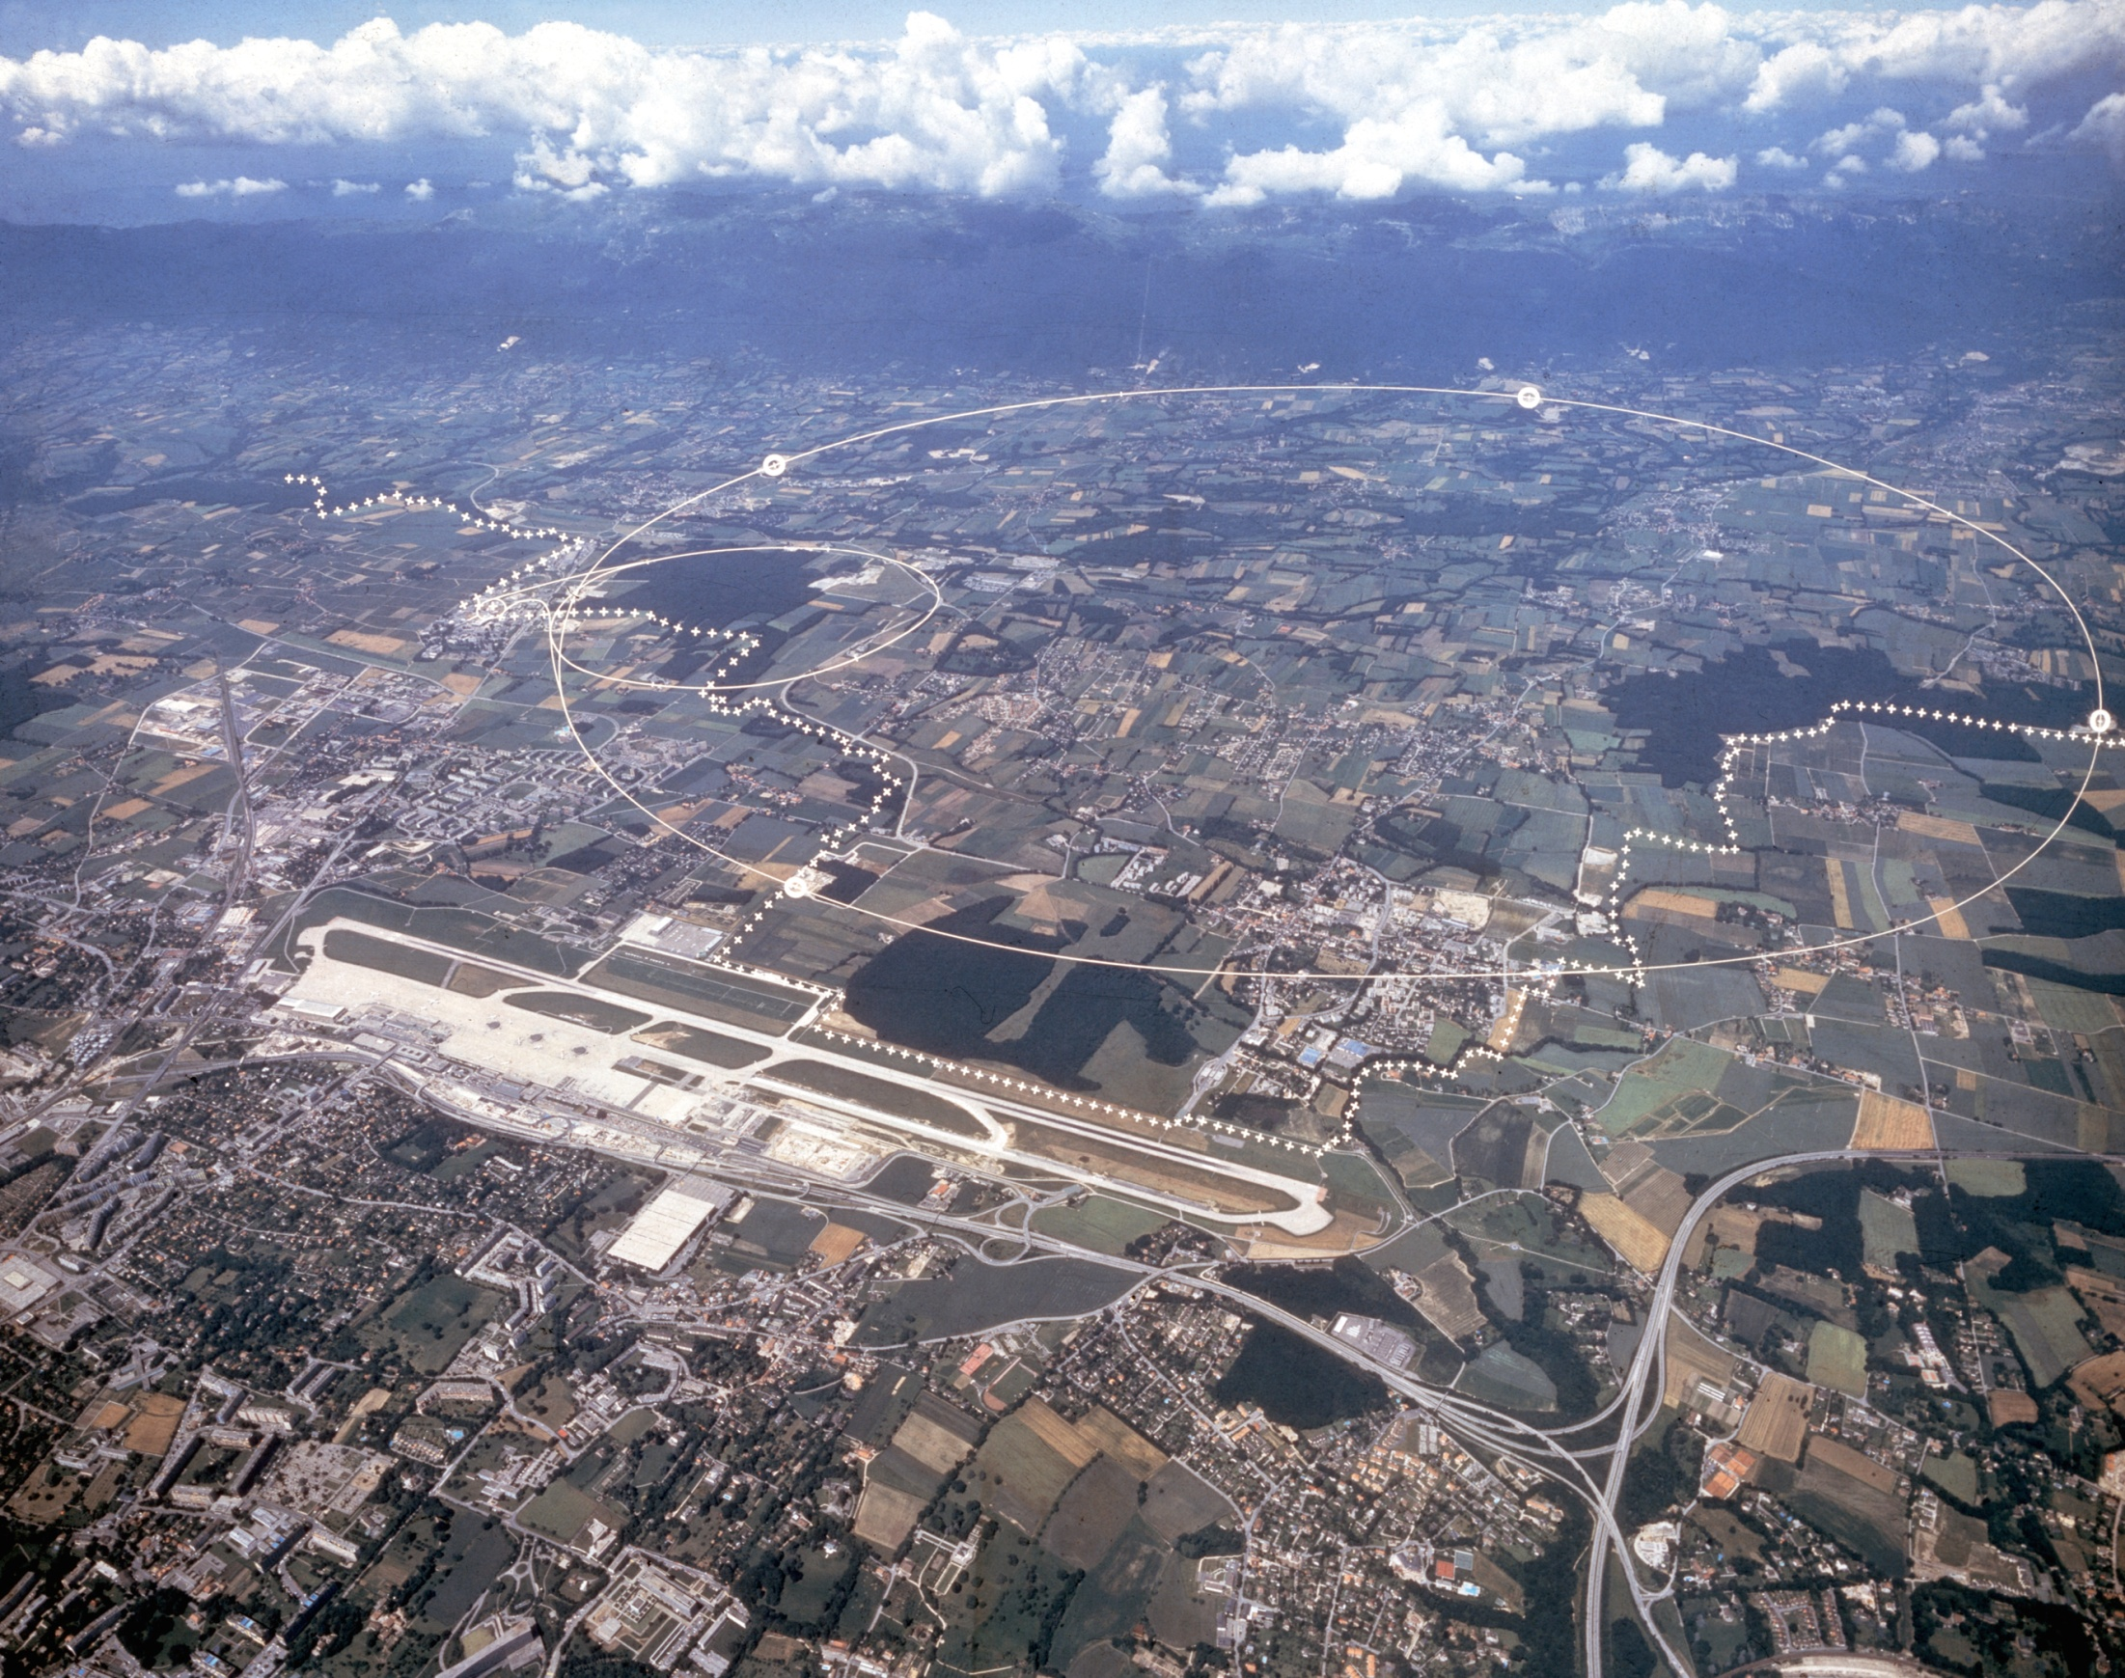




Potential for early SUSY discovery
at the LHC
Talk given at
Ulrich Landgraf University of Freiburg, Germany
Member of the ATLAS collaboration

Slide 2
OUTLINE
Why Supersymmetry?
SUSY models and SUSY events
LHC detectors
SUSY searches
  Inclusive SUSY searches
  Trilepton events
  Other searches
SUSY mass spectrum
Conclusions
The plots in this talk are the result of the work of many people. – Thanks to all of them!
LISHEP2009, Rio de Janeiro - 19 Jan. 2009
U. Landgraf – University of Freiburg
Slide 2

Slide 3
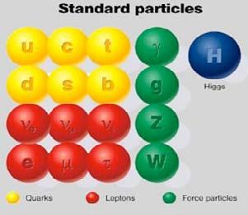
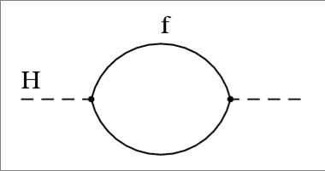
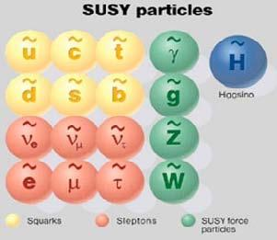
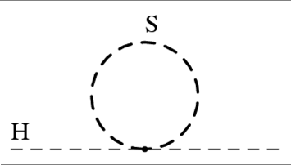
Why Supersymmetry?
Large fermion loop correction to Higgs mass…
Spin ½
Spin 1
SUPERSYMMETRY
but needs to be broken!
… is cancelled by boson loop correction:
Spin 1
Spin ½
LISHEP2009, Rio de Janeiro - 19 Jan. 2009
U. Landgraf – University of Freiburg
Slide 3

Slide 4
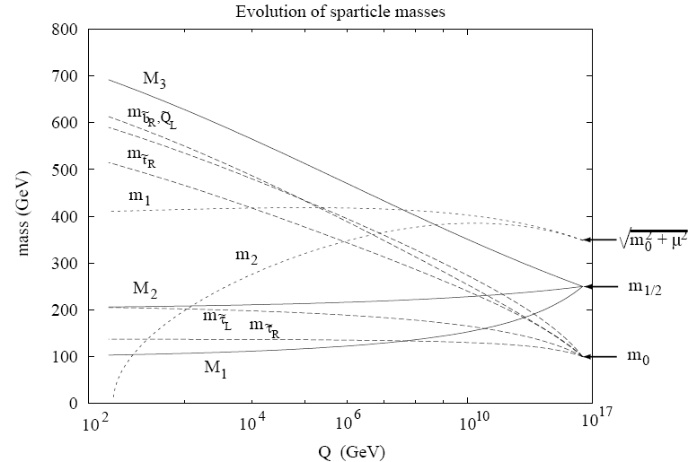
SUSY Breaking
Huge number of additional mass parameters even in MSSM (ca. 100)
→ parameters have to be constrained in specific models
No unique way of breaking SUSY → several models ( mSUGRA, GMSB, …)
Mixing of “pure” gauginos/higgsinos:
(ordered by mass)
in mSUGRA SUSY masses are derived from 5 theoretical mass parameters at GUT scale: m_{1/2,} m₀, A₀, tanβ, sign(μ)
I will consider only so called R-parity conserving models in my talk!
LISHEP2009, Rio de Janeiro - 19 Jan. 2009
U. Landgraf – University of Freiburg
Slide 4

Slide 5
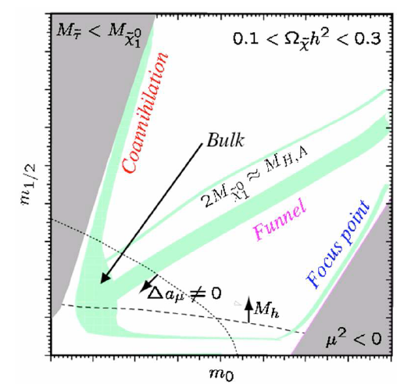
SUSY benchmark scenarios (ATLAS)
SU1:
  – Coannihilation region
  SU2:
  – Focus point
  SU3:
  – Bulk point
  SU4:
  – Just beyond Tevatron reach
  SU6:
  – Funnel regions
CMS uses somewhat different benchmark scenarios with additional points in the high mass region!
LISHEP2009, Rio de Janeiro - 19 Jan. 2009
U. Landgraf – University of Freiburg
Slide 5

Slide 6
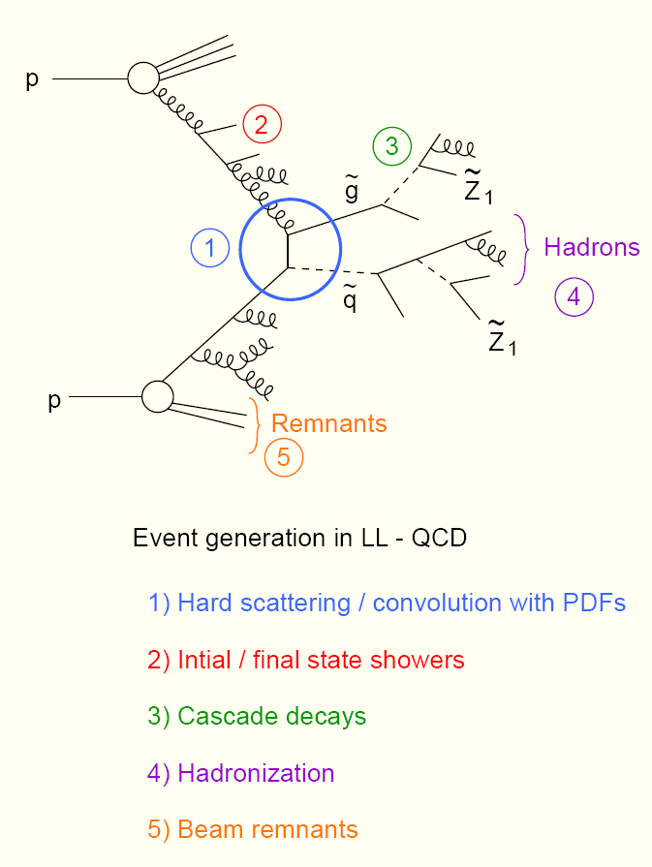
SUSY events
Dominant process:
(squark/gluino pair production)
SUSY decay cascades down to stable LSP
Neutralinos via
Signatures:
Missing energy
  from Lightest Supersymmetric Particles(LSPs)
  from neutrinos (e.g. from semileptonic b decays)
Hard jets (from quarks or gluons)
Additional hard leptons (0, 1, 2, …)
LISHEP2009, Rio de Janeiro - 19 Jan. 2009
U. Landgraf – University of Freiburg
Slide 6

Slide 7
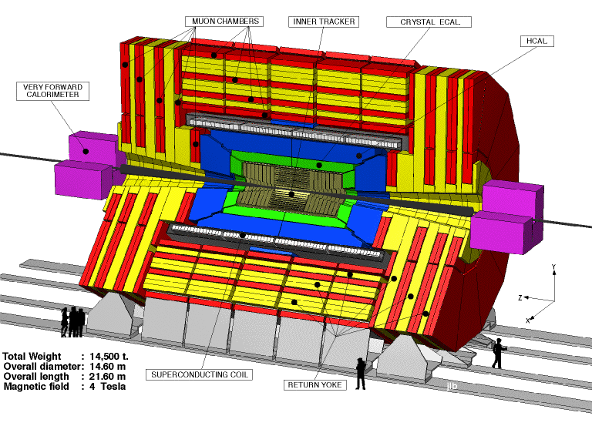

CMS (Compact Muon Solenoid)
Large 4T Solenoid
Muon Spectrometer
  Muon Chambers Integrated in Return Yoke
Calorimetry
  PbWO₄ Crystal: Excellent Resolution
Inner Tracking
  Pixels: 100μm (r-φ) x 150μm (z)
  Δp/p (1 GeV) = 0.007,0.02 (η≈0,2.5)
  Δp/p (100 GeV) = 0.015,0.07
CMS
ATLAS (A Toiroidal LHC ApparatuS)
Muon Spectrometer (3 Large Toroids)
  High BL² for Standalone Measurements
Calorimetry
  Lateral & Longitudinal Segmentation
Inner Tracking (Small” 2T Solenoid)
  Pixels: 50μm (r-φ) x 400μm (z)
  Δp/p (1 GeV)= 0.013,0.02 (η≈0,2.5)
  Δp/p (100 GeV) = 0.038,0.11
  TRT for e/π identification
ATLAS
LISHEP2009, Rio de Janeiro - 19 Jan. 2009
U. Landgraf – University of Freiburg
Slide 7

Slide 8
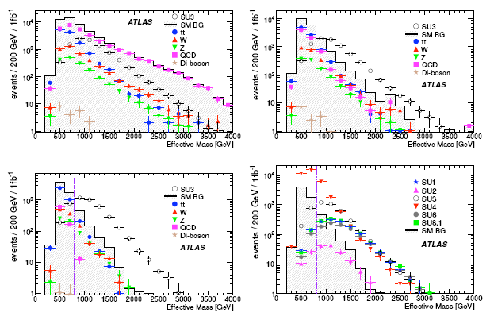
Inclusive Analysis (no leptons)
SUSY shape looks like background → Tune your cuts:
Lum.: 1 fb⁻¹
1): 4 jets+
2): 1) +
3): 2) +
+more
: Effective mass with
Cuts do not work for all models!
: Transverse Sphericity;
LISHEP2009, Rio de Janeiro - 19 Jan. 2009
U. Landgraf – University of Freiburg
Slide 8

Slide 9
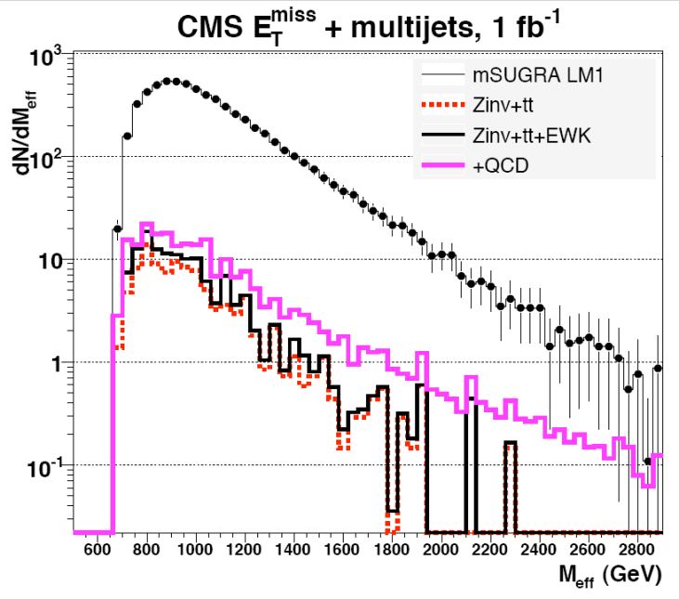
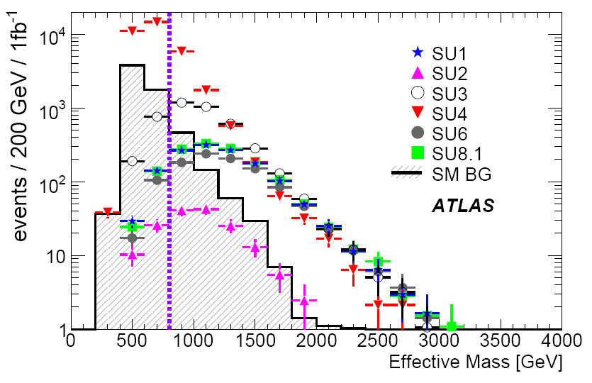
Inclusive Analysis: Comparison
ATLAS: 1 fb⁻¹
ATLAS has looked at several different benchmark points without optimizing the cuts for each point separately
CMS has demonstrated the analysis potential in detail for one particular benchmark point (LM1 ≈ SU4)
Difficult for 1st year: • requires that detector is fully understood
• QCD background has big theoretical(!) uncertainty –
→ it’s better to derive this background from data!
LISHEP2009, Rio de Janeiro - 19 Jan. 2009
U. Landgraf – University of Freiburg
Slide 9

Slide 10
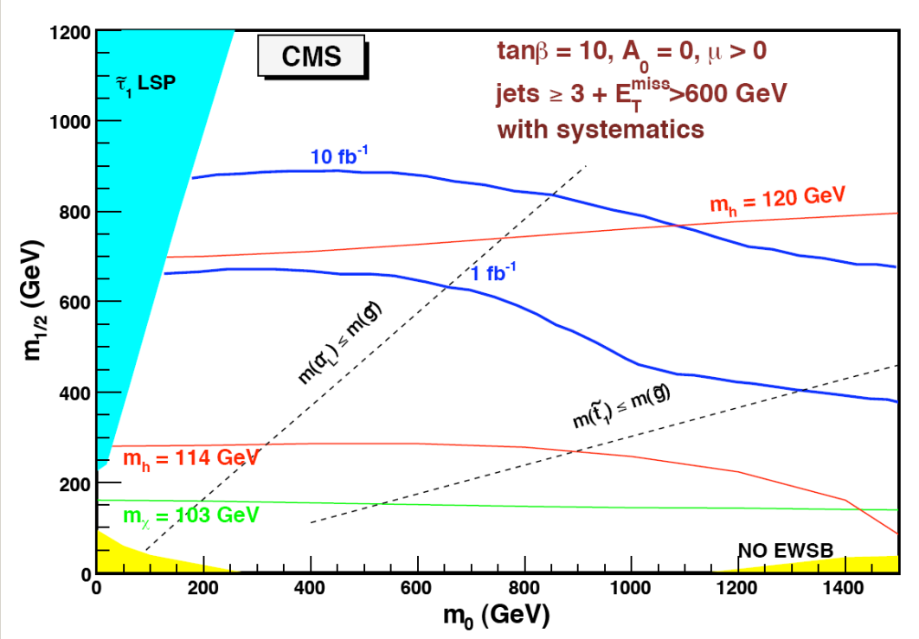
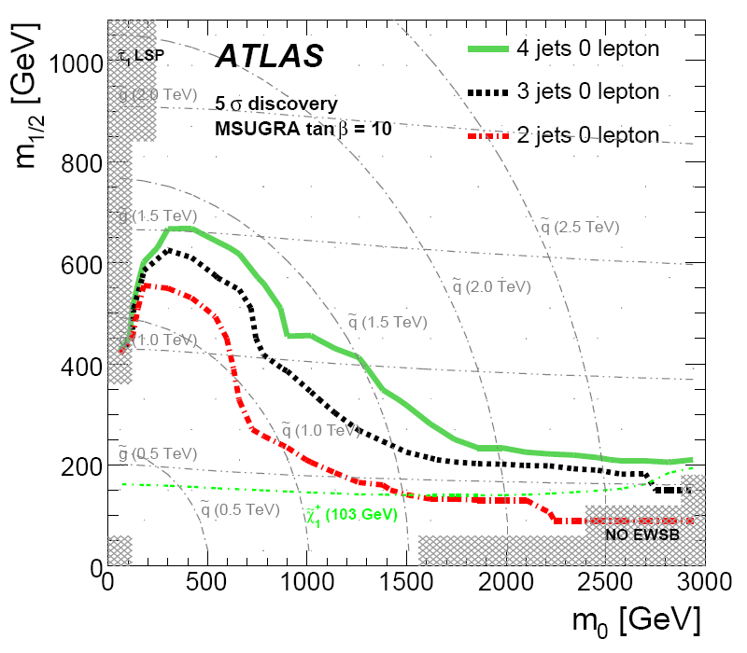
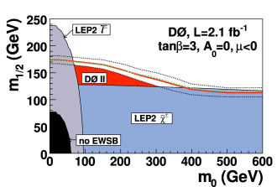
Inclusive Analysis – discovery reach
5σ discovery
for 1 fb⁻¹
With 1 fb⁻¹ at 14 TeV can be reached
2009 running at 10 TeV: around 0.6 TeV, if(!) we get 1 fb⁻¹
These plots depend also on tanβ, but not too much!
Other SUSY breaking models: similar discovery potential
LISHEP2009, Rio de Janeiro - 19 Jan. 2009
U. Landgraf – University of Freiburg
Slide 10

Slide 11
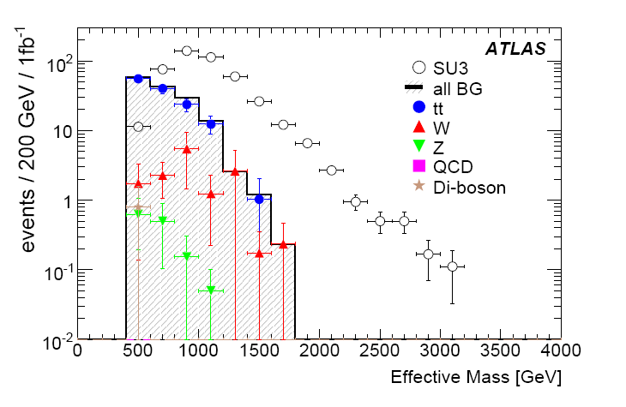
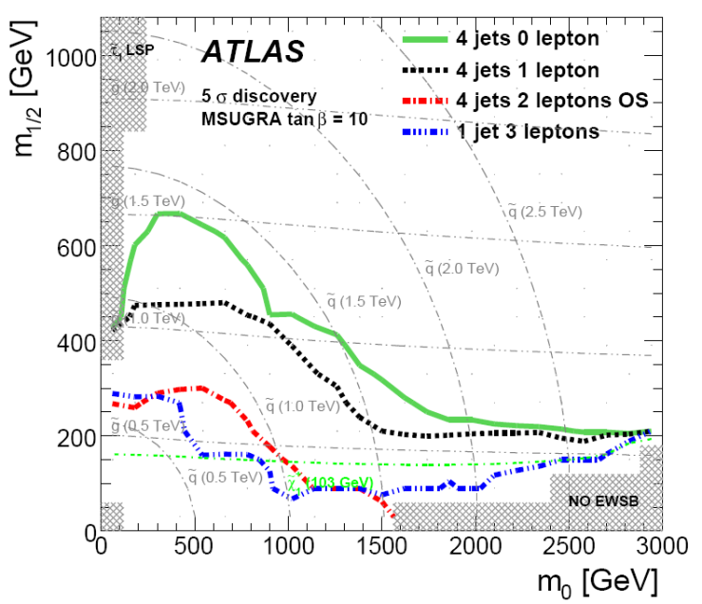
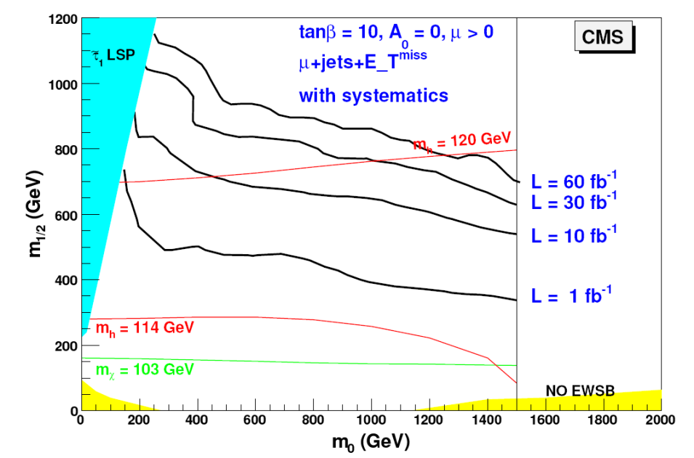
Inclusive Analysis with leptons
Additional requirement: ≥ 1 isolated lepton ( ≥ 1μ for CMS); e.g. from
Effective mass now
Less events, but cleaner signal
QCD background negligible!
Discovery
reach:
(1 fb⁻¹)
5σ discovery
for
LISHEP2009, Rio de Janeiro - 19 Jan. 2009
U. Landgraf – University of Freiburg
Slide 11

Slide 12
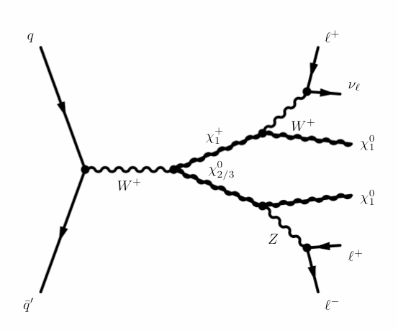
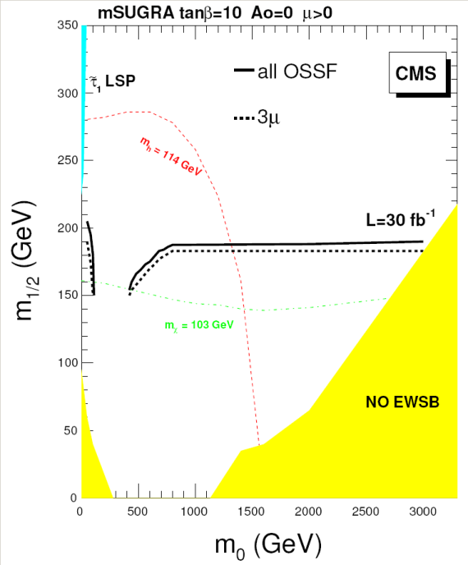
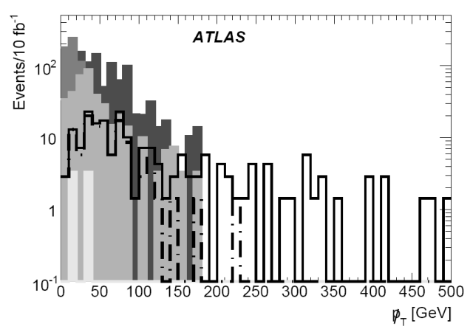
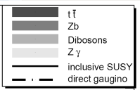
Trilepton analysis (heavy squarks)
If squarks are heavy (>1TeV), production cross sections are small
→ mainly gauginos are (pair-)produced
Event selection:
Require 3 isolated leptons; two OSSF from decay
Cut M_{OSSF} around real Z peak (remove background
from ZW and Zb events)
ATLAS: Require
CMS: Use neural network
5σ discovery
for
ATLAS Event selection | Luminosity for 5σ discovery
 | SU2 | SU3
Inclusive SUSY | 7.1 fb⁻¹ | 0.8 fb⁻¹
Direct gaugino only | 22.4 fb⁻¹ | 92.9 fb⁻¹
LISHEP2009, Rio de Janeiro - 19 Jan. 2009
U. Landgraf – University of Freiburg
Slide 12

Slide 13
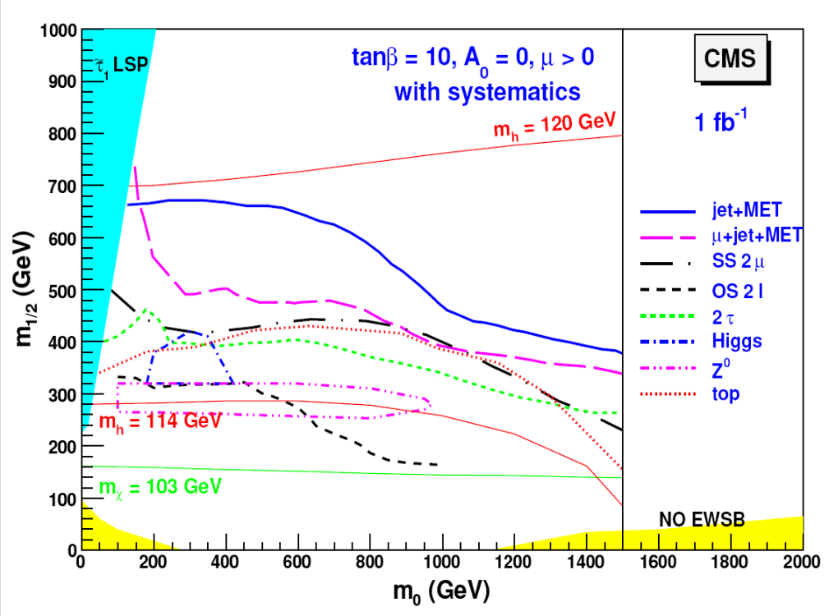
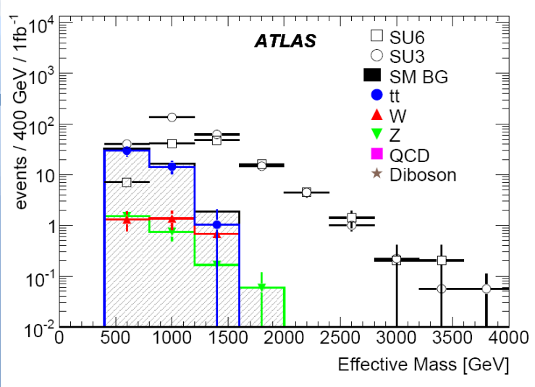
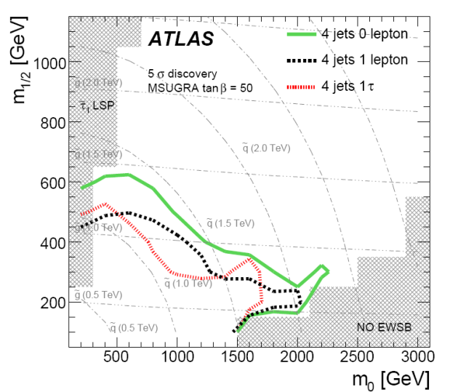
Other searches
CMS
ATLAS
Reach for different analysis channels
Study of inclusive analysis + ≥ 1 reconstructed τ
(tan β = 50)
5σ discovery
for
(tan β = 6)
(1 fb⁻¹)
ATLAS:
τ channel about as good as
1-lepton channel!
CMS: SS dimuons promising:
significance of discovery
>14σ for all low mass models
LISHEP2009, Rio de Janeiro - 19 Jan. 2009
U. Landgraf – University of Freiburg
Slide 13

Slide 14
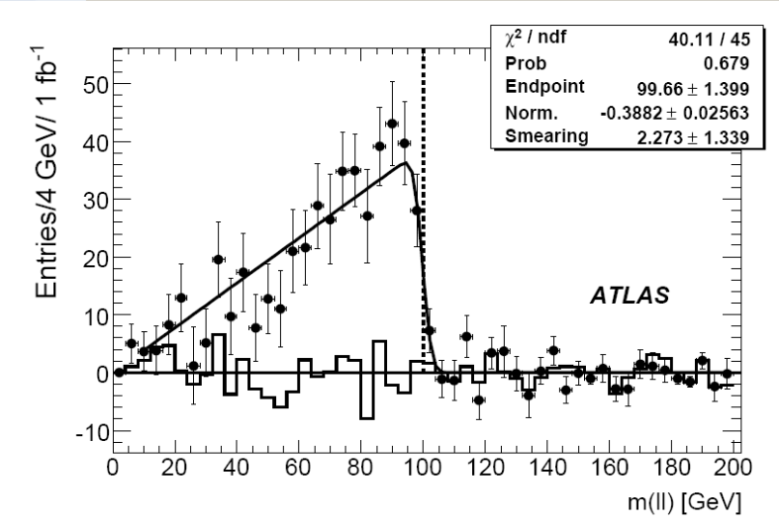
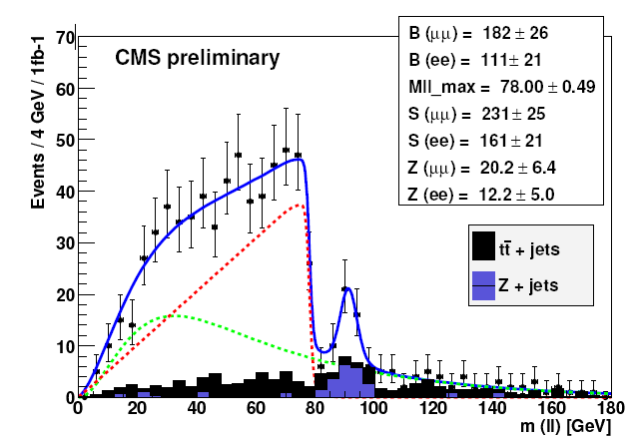
SUSY mass spectrum
Consider
Plot
Extract edge at
More complicated plots → can be obtained separately
(but with larger errors)
1 fb⁻¹
SF background fit
Signal fit
1 fb⁻¹
ATLAS: SS and Z⁰ background subtracted
CMS: SS and Z⁰ background fitted
ATLAS result for SU3: 99.3±1.3±0.3 GeV
Theory: 97.9 GeV
CMS result for LM1: 78.00 ± 0.49 GeV
Theory: 78.15 GeV
LISHEP2009, Rio de Janeiro - 19 Jan. 2009
U. Landgraf – University of Freiburg
Slide 14

Slide 15
Conclusions
Two powerful experiments: ATLAS and CMS
with similar discovery potential
  At 14 TeV and 1 fb⁻¹ SUSY can be detected
  for squark and gluino masses up to 1 TeV
  At 10 TeV masses of about 600 GeV can be found
  Inclusive channels requiring only jets and missing energy
  have best discovery potential
  For early discoveries inclusive events with 1 lepton
  are more promising
  If SUSY is realized in the low mass region,
  also mass parameters can be determined
LISHEP2009, Rio de Janeiro - 19 Jan. 2009
U. Landgraf – University of Freiburg
Slide 15

Slide 16
Backup slides
LISHEP2009, Rio de Janeiro - 19 Jan. 2009
U. Landgraf – University of Freiburg
Slide 16

Slide 17
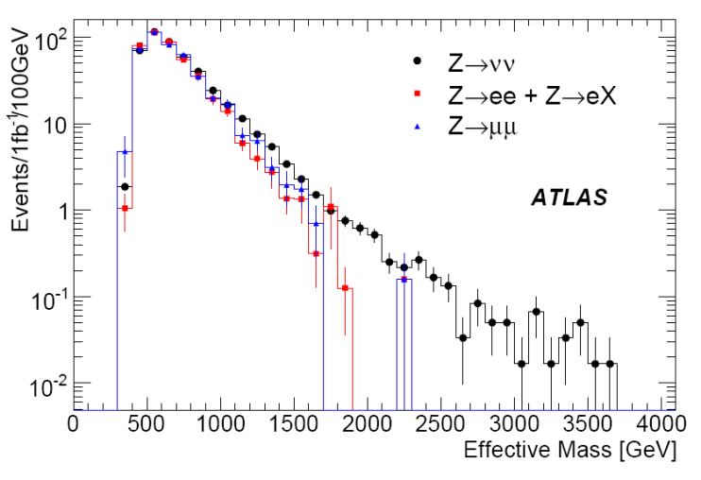
Background determination from data
Example 1: Background from Z decays
- Events with have contribution from the process
- The decay has similar kinematics as or
- The relative rates for the different Z decays are known exactly
Recipe:
- Take measured events that contain or
- Delete the electrons or muons
- Weight these events with
Correct for finite acceptance of
(Acceptance not to see is 100 %!)
LISHEP2009, Rio de Janeiro - 19 Jan. 2009
U. Landgraf – University of Freiburg
Slide 17

Slide 18
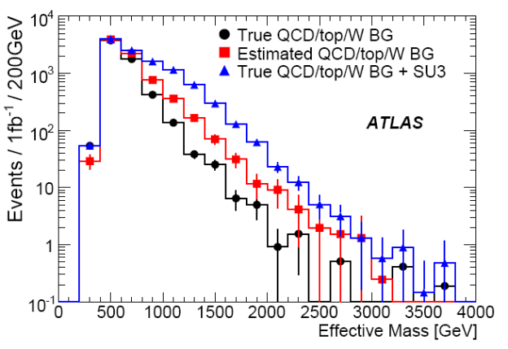
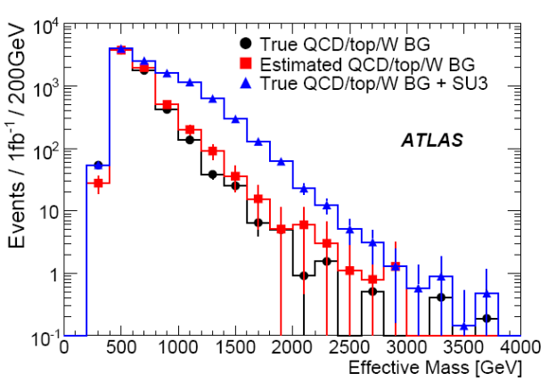
Background determination from data
Example 2: Background from top/W decays in distribution
Recipe:
Define (with cuts that do not depend on !) :
signal region (the region of your cuts)
with high SUSY and low background content
control region (the complement)
with high background and low SUSY content
no correction
Find the distribution of
in the control region
This should be the distribution of background events (almost, since some SUSY events are still in)
Renormalize this and use
it as background
But this overestimates the background,
i.e. underestimates SUSY!
Make an Ansatz for the SUSY events
as function of the cut variables and
subtract from control region
Get the new background and iterate
corrected
LISHEP2009, Rio de Janeiro - 19 Jan. 2009
U. Landgraf – University of Freiburg
Slide 18

Slide 19
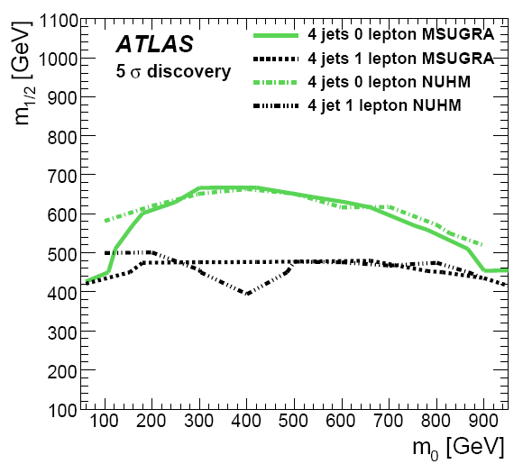
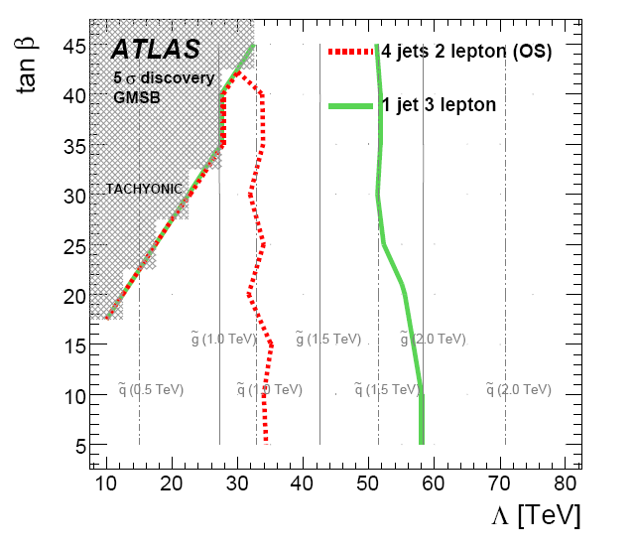
Other SUSY models
Non-Universal Higgs Model
(NUHM)
Gauge-Mediated Symmetry Breaking
(GMSB)
Discovery potential of LHC for other models is rather similar to mSUGRA,
i.e. squark and gluino masses ≤ 1TeV are reachable with 1fb⁻¹@14TeV
Similar studies have also been performed by CMS!
LISHEP2009, Rio de Janeiro - 19 Jan. 2009
U. Landgraf – University of Freiburg
Slide 19

