Slide 1

Photonuclear Reactions with MeV γ-rays from LCB
Norbert Pietralla, TU Darmstadt
Outline
Photonuclear Reactions
Nuclear Resonance Fluorescence
Some Previous Achievements
Intensity Frontier → „Discovery Frontier“
  „Availability Frontier“ (photonuclear reactions on rare isotopes)
  „Sensitivity Frontier“ (weak channels: strong physics)
  „Precision Frontier“ (high count rates, new methods)
Conclusion
γ

Slide 2
Photonuclear Reactions
γ
What happens?

Slide 3
Nuclear Physics with MeV-range photon beams
Pure EM-interaction
(nuclear-)model independent
“small“ cross sections, intense beams
Minimum projectile mass
min. angular momentum transfer, spin-selective: low-spin modes [E1,M1,E2,(E3?)]
Polarisation
„Parity Physics“, channel selectivity
Narrow Bandwidth (at ELI-NP and CERN-ERL)
Explore specific excitation energy „Selective Manipulation of Nuclear States“: Nuclear Photonics
γ

Slide 4
Photonuclear Reactions
Separation
threshold
~ 8 MeV
Absorption
γ
γ´
γ´
β
^{A´}Y
β
gs
^{A}X
Nuclear Resonance Fluorescence (NRF)
Photoactivation
Photodesintegration
Photofission
(-activation)

Slide 5
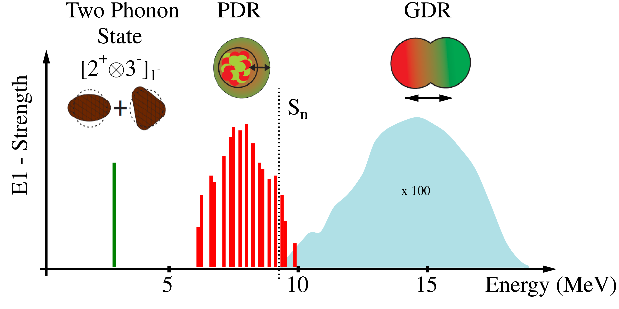
Electromagnetic dipole-response
γ
E1 strength distribution

Slide 9
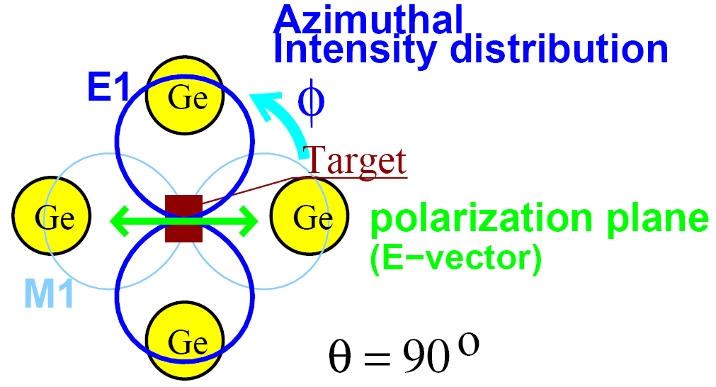
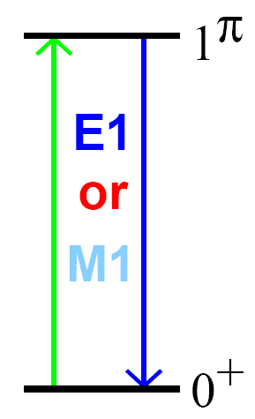
Parity Measurements with Linearly
Polarized Photon Beams
Azimuthal asymmetry → parity quantum no.

Slide 10
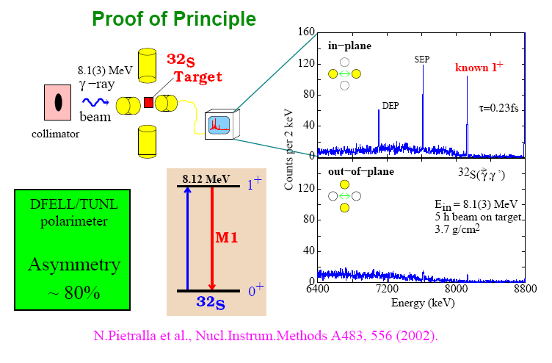
CERN - ERL
1,000 x more flux
10 x higher energy resolution
great discovery potential
N. Pietralla et al., Phys. Rev. Lett. 88, 012502 (2002).

Slide 11
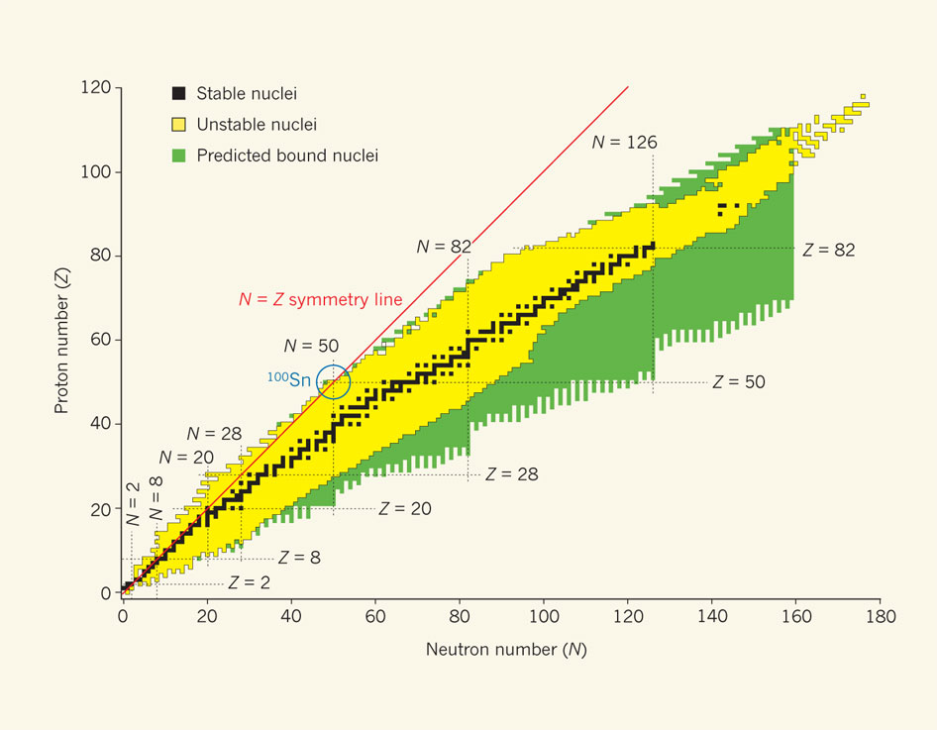
Physics with Photon Beams
Nuclear Structure Physics
    Nuclear single particle structure
    Collective nuclear structures
    Photofission
Particle-Physics Metrology
    Neutrino detectors
    Nuclear matrix elements for ββ-decay
Nuclear Astrophysics
    Capture / desintegration reactions
    Nuclear synthesis
Applications
    Radiotomography
    Nuclear Photonics

Slide 12

ELI – Nuclear Physics, Bucharest, Design

Slide 13
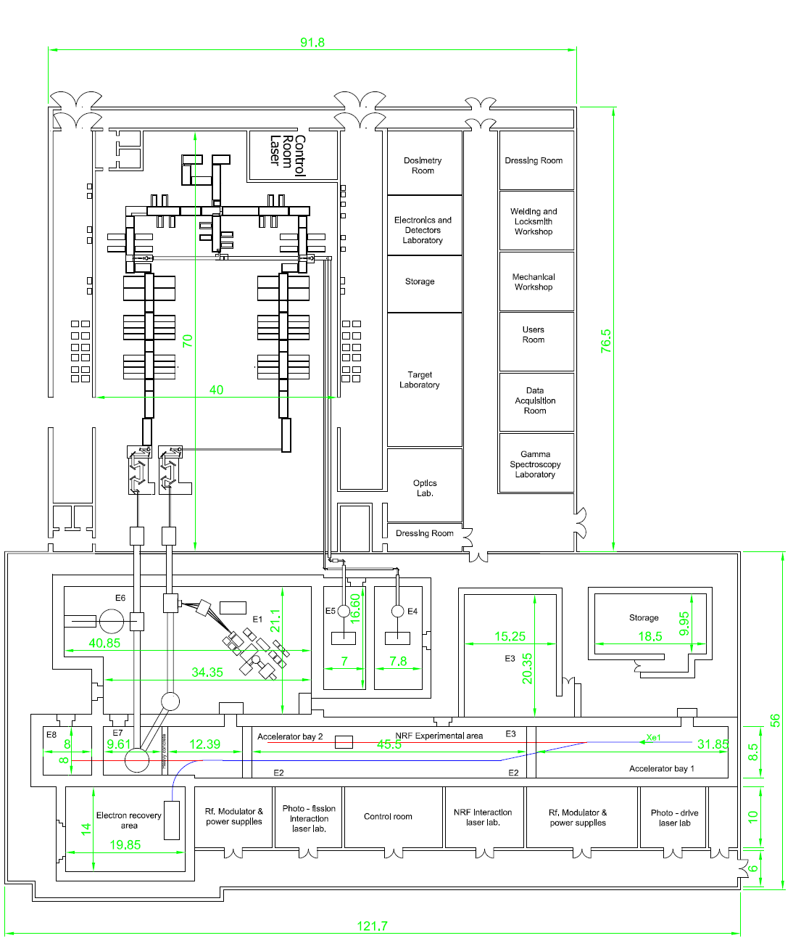
ELI – Nuclear Physics, Floor Plan
Equipment
2 10-Petawatt-Laser (low-rep., Thales)
700 MeV Electron linac (warm)
external high-rep. high intens. laser
highest-brillant gamma beams from Lasercompton-backscattering 0.5 MeV < E_{γ} < 20 MeV, 10⁴ /eV s
minimale Bandbreite 0.5% - 0.1%
→ Photonuclear Reactions

Slide 14
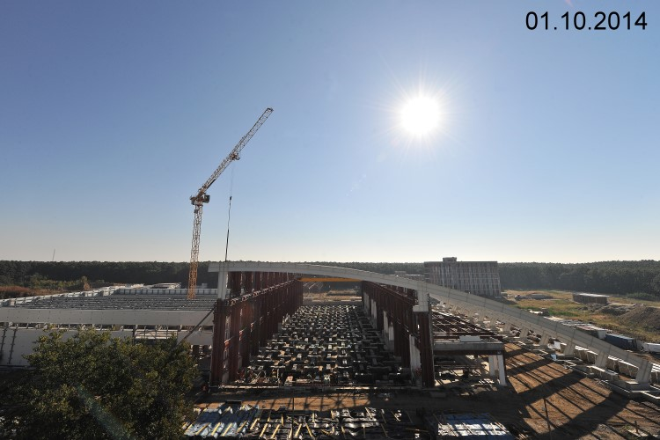

ELI – NP, Progress
Civil Conctruction finished: end of 2015

Slide 15
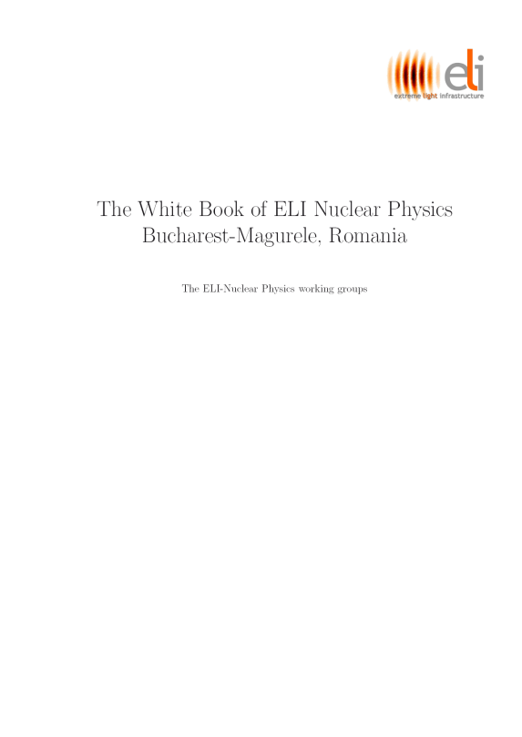
International Scientific Advisory Board Implementation Phase ELI-NP
Faiçal AZAIEZ - Institut de Physique Nucléaire d'Orsay, France
Christopher BARTY - Lawrence Livermore National Laboratory, USA
Paul BOLTON - Kansai Photon Science Institute, JAEA, Japan
Angela BRACCO - Istituto Nazionale di Fisica Nucleare, Milano, Italy
Richard CASTEN - Yale University, New Haven, Connecticut, USA
John COLLIER - STFC Rutherford Appleton Laboratory, Oxfordshire, United Kingdom
Sandro DI SILVESTRI - Politecnico di Milano, Italy
Umberto DOSSELI - Istituto Nazionale di Fisica Nucleare, Laboratori Nazionali di Frascati, Italy
Muhsin HARAKEH - KVI, University of Groningen, Groningen, The Netherlands (Vice-chairman)
Calvin HOWELL - Triangle Universities Nuclear Laboratory, Durham, USA
Ken LEDINGHAM - The University of Strathclyde, Scotland, United Kingdom
Patrick MORA - École Polytechnique - Saclay, Palaiseau, France
Gerard MOUROU - École Polytechnique - Saclay, Palaiseau, France
Chang Hee NAM - Gwangju Institute of Science and Technology, Korea
Norbert PIETRALLA - Technische Universität Darmstadt, Germany
Carlo RIZUTTO - Elettra-Sincrotorne Trieste, Italy
Guenther ROSNER - Facility for Antiproton and Ion Research, FAIR, Darmstadt, Germany
Hartmut RUHL - Ludwig Maximilian University of Munich, Germany
Christoph SCHEIDENBERGER - GSI Darmstadt, Justus-Liebig-University, Giessen, Germany
Toshiki TAJIMA - University of California at Irvine, USA (Chairman)
Michael WIESCHER - University of Notre Dame, Indiana, USA
strong international
user community

Slide 16
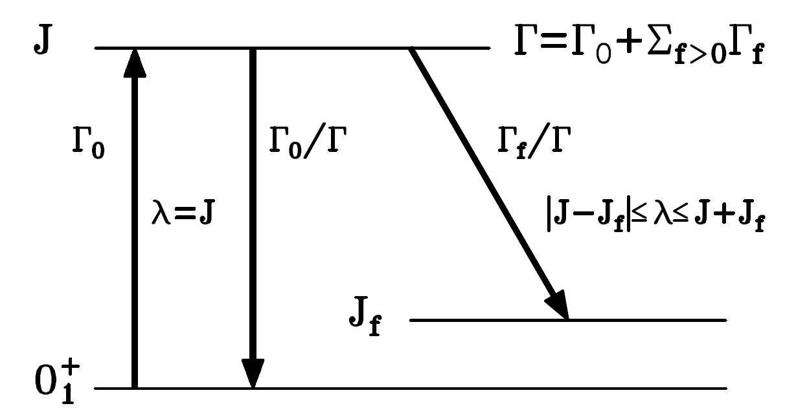
Nuclear Resonance Fluorescence
Observables
Excitation Energy E_{r}
Spin J
Parity π
Decay Energies E_{γ}
Level Width Γ (eV)
Lifetime τ (ps – as)
Decay Branching Γ_{i}/Γ₀
Partial Widths Γ_{i}
Multipole Mixing δ
Decay Strengths B(πλ)
Separation
threshold

Slide 17
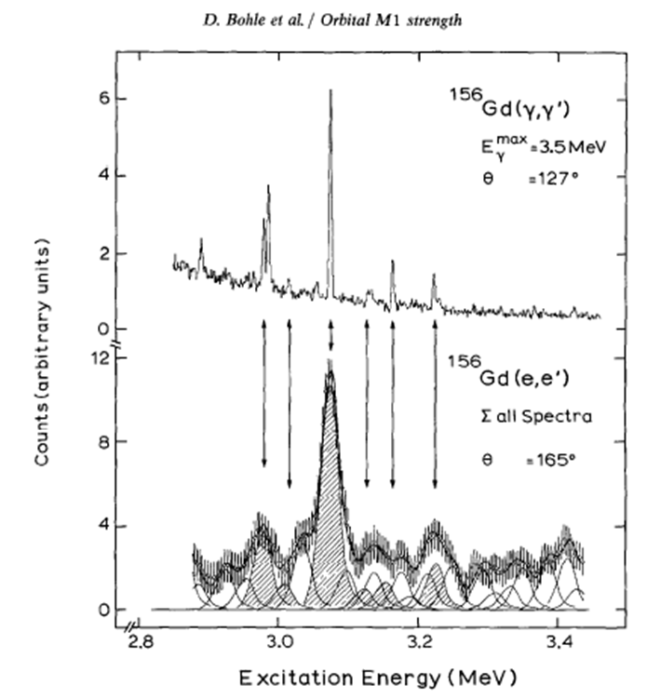

Some Historic Physics Highlights from NRF (personal selection)
Nuclear Scissors Mode
A.Richter, Darmstadt, 1983
Scissors mode
Classically: current loop
→ magnetic excitation: M1
First example of mixed-symmetry state
Discovery in electron scattering
Systematics: photon scattering

Slide 18
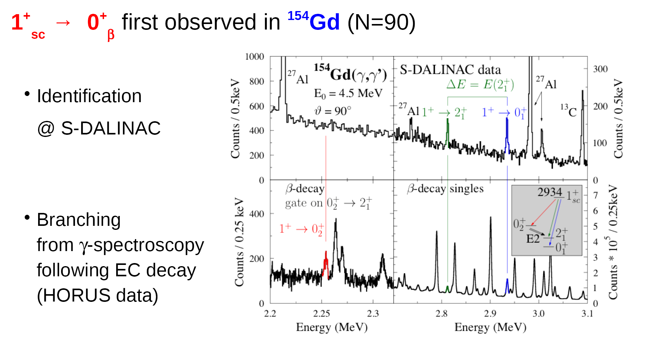
Scissors Mode: Decay to intrinsic excitations
Supplies new constraint to 0νββ - decay matrix element
with Zilges-group
J.Beller, N.P. et al., Phys. Rev. Lett. 111, 172501 (2013).

Slide 19
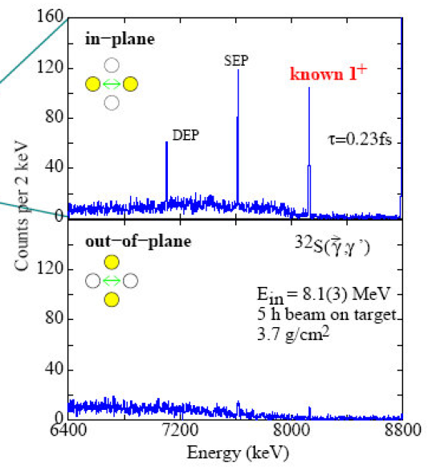
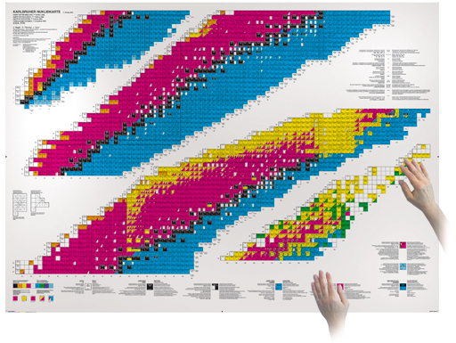
1. Availability Frontier
Current NRF measurements require gramm-size targets (~ 10²²⁻²¹ nuclei)
Required by
    cross sections (~ eV b)
    detection efficiency (~ 10%),
    available luminosity (number of target nuclei times γ-ray flux)
    resonably long beam times (order of days)
Rare p-process nuclei (¹⁰⁶Cd,¹³⁰Ba,¹⁵⁶Dy,¹⁷⁴Hf) ~ 0.1% ab., enriched material at ~$1,000/mg
Long-lived radioactive isotopes(¹⁰Be,¹⁸²Hf,²⁵⁰Cm) T_{1/2} > ~10,000 yrs.
51 more nuclides would become accessible to photonuclear studies
A variety of scientific questions could be answered.

Slide 20
Some Examples for Science Cases on Rare or Long-lived Radioactive Isotopes
¹⁰Be: What dominates the low-energy E1 strength in light nuclei, 1s – 1p particle-hole transitions or cluster structure? (lifetimes of 1⁻/2⁺ doublet at 6 MeV, 2nd/3rd excited state)
⁵³Mn: What is the fragmentation of the π(f_{7/2} – f_{5/2}) spin-flip strength across the Z=28 shell?
¹²⁶Sn: How does the fine-structure of the PDR evolve with neutron excess?
¹⁵⁶Dy: Test of the predicted decay branch of 0νββ-decay at N=90 from M1 decay branching of the 1⁺ scissors mode
²⁴⁸Cm₁₅₂: What are the fission resonances at the N=152 shell?
²⁵⁰Cm: First access to dipole strength above N=152 shell

Slide 21
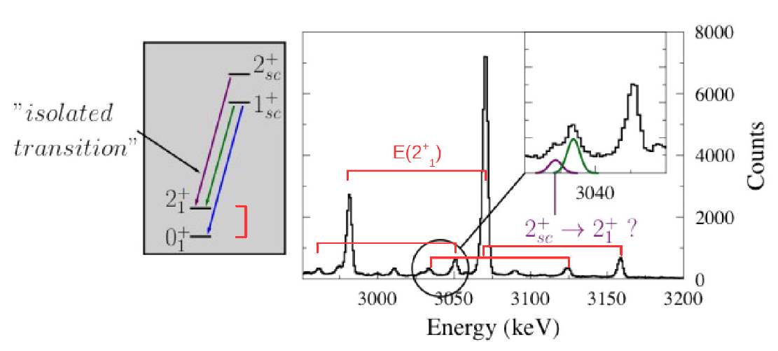
2. Sensitivity Frontier
Search for weak signals sensitive to the physics under study
One example: Rotational Moment of Inertia of the Scissors Mode
Other examples:
    decay branchings into sensitive channels
    search for predicted pygmy quadrupole resonance (PQR)
    measurement of decay E2/M1 multipole mixing ratios
    measurement of parity-mixing matrix element in ²⁰Ne
    to be continued…
¹⁵⁶Gd @ HIγS
Data: J.Beller, TU Darmstadt

Slide 22
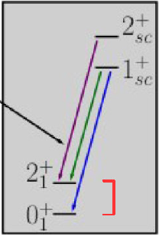
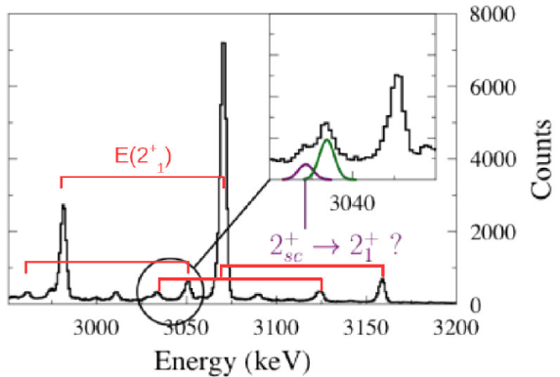
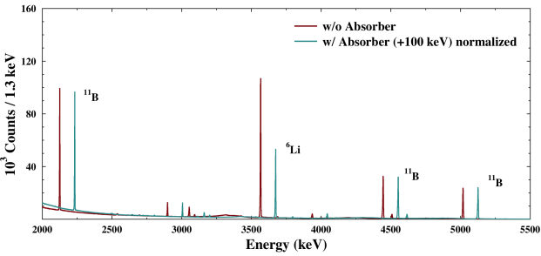
„Discovery Frontier“ for NRF at HIγS-2 / ELI-NP
High-Intensity Frontier = „Discovery Frontier“ (scientific opportunities)
  „Availability Frontier“ (NRF on rare isotopes, access to broader „nuclear gene pool“)
  „Sensitivity Frontier“ (weak channels: strong physics)
  „Precision Frontier“ (high count rates, new methods)

Slide 23
Thank you very much !
at 10⁵ – 10⁷ γ / (eV s) at CERN - ERL
γ

Slide 25
Photofission

Slide 27
Traditionally Bremsstrahlung: Kneissl,Pietralla,Zilges, J.Phys.G 32, R217 (2006).

Slide 28

NRF Basic Facts
Widths of particle-bound states: Γ ≤ 10 eV
Single-spin level density: ρ_{J} ≤ 10⁴ MeV⁻¹
→ isolated resonances
QM:
Decay law:
Typical lifetime limit: τ ≥ 100 as
Total width:
Transition rates:

Slide 29
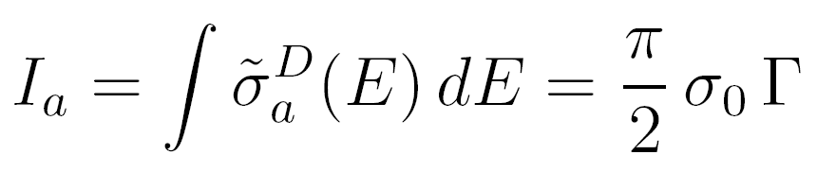
NRF cross section
Breit-Wigner absorption resonance curve for isolated resonance
[from Fourier transform: Ψ(t) → Ψ(E) ]
∼ Γ₀/Γ
On resonance cross sect.s are very large: σ₀ ≅ 200 b (for Γ₀=Γ, 5 MeV)
However, resonances are very narrow
Thermal motion of target nuclei lead to Gaussian Doppler-broadening of resonance (typical Doppler width Δ ≈ few eV >> Γ ≈ 10s of meV)
Energy-integrated cross section: ∼ Γ₀

Slide 30

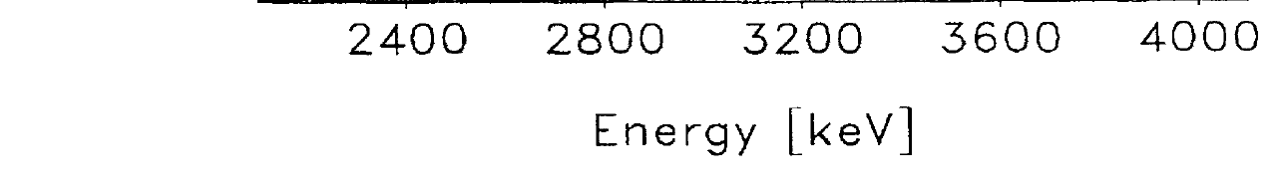
Scattering cross section
I_{sc,0} = I_{a} Γ₀/Γ ∼ Γ₀²/Γ
N. Pietralla et al., Phys. Rev. C, 51, 1021 (1995).

Slide 31
Angular Distribution, Spin Quantum Number J
Photon helicity 1, m = ±1 → non-isotropically alignment of photo-excited state (even oriented for circularly polarized beam)
Pronounced angular correlations when involving spin-0 states (ee-nuclei)
Angular distribution functions W(ϑ) from angular correlation theory
→ Spin quantum numbers J (easiest in even-even nuclei).
90º/127º – intensity ratios: 2.0 (J=2) vs 0.8 (J=1)

Slide 32
Observables in NRF
Observables
Excitation Energy E_{r}
Spin J
Parity π
Decay Energies E_{γ}
Level Width Γ (eV)
Lifetime τ (ps – as)
Decay Branching Γ_{i}/Γ₀
Partial Widths Γ_{i}
Multipole Mixing δ
Decay Strengths B(πλ)
Separation
threshold

Slide 33
S-DALINAC at TU Darmstadt
i
2
1
Source
Electron Source
Thanks to
State of Hesse
TU Darmstadt
DFG
130 MeV Electron LINAC
Photon Experiments
1
10 MeV Injector: Photon Scattering / Photofission
2
< 30 MeV Tagger: Photodesintegration / Photon Scattering

Slide 34
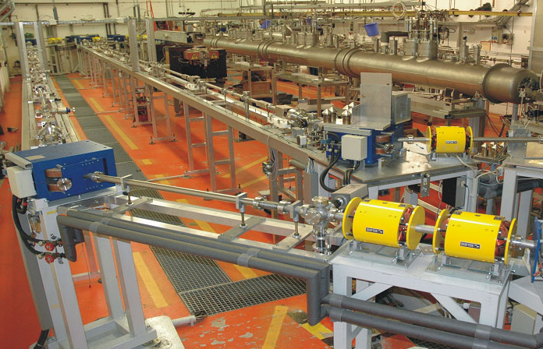
S-DALINAC at TU Darmstadt
Recirculating
superconducting LINAC
Niobium cavities,
LHe cooled @ 2 K,
3 GHz cw e-beams,
< 130 MeV, ≤ 60 μA

Slide 35
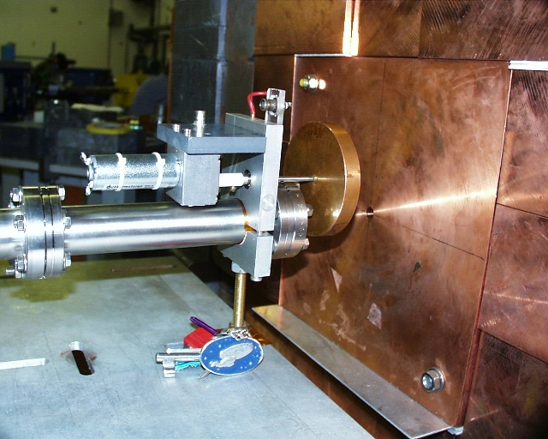

Bremsstrahlung-Site

Slide 36
Darmstadt Low-Energy Photon Scattering Site at S-DALINAC
K.Sonnabend et al., NIM A (2011).
Ge(HP)
γ-detectors
Cu
Cu
< 10 MeV
Target
e⁻
γ
Radiator target
Electrons
Bremsstrahlung
E_{γ} < 10 MeV
Intensity
Intensity
Energie
Energie

Slide 37
Some Historic Physics Highlights from NRF (personal selection)
Nuclear Scissors Mode
A.Richter, Darmstadt, 1983
Scissors mode
Classically: current loop
→ magnetic excitation: M1
First example of mixed-symmetry state
Discovery in electron scattering
Systematics: photon scattering

Slide 38
Systematics of scissors mode in rare earth‘s
Collectivity of the Scissors Mode
Richter,
Kneissl,
von Brentano
et al.
Stuttgart-Darmstadt-Köln
Measure of quadrupole
collectivity
1⁺
2⁺
M1
E2
N. Pietralla et al., PRC 58, 184 (1998)

Slide 39
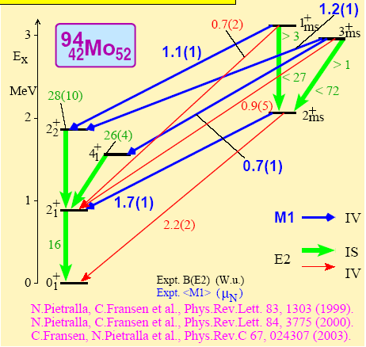
Nuclear Structures with Mixed pn-Symmetry
M1 as unique signature for mixed-symmetry states

Slide 40
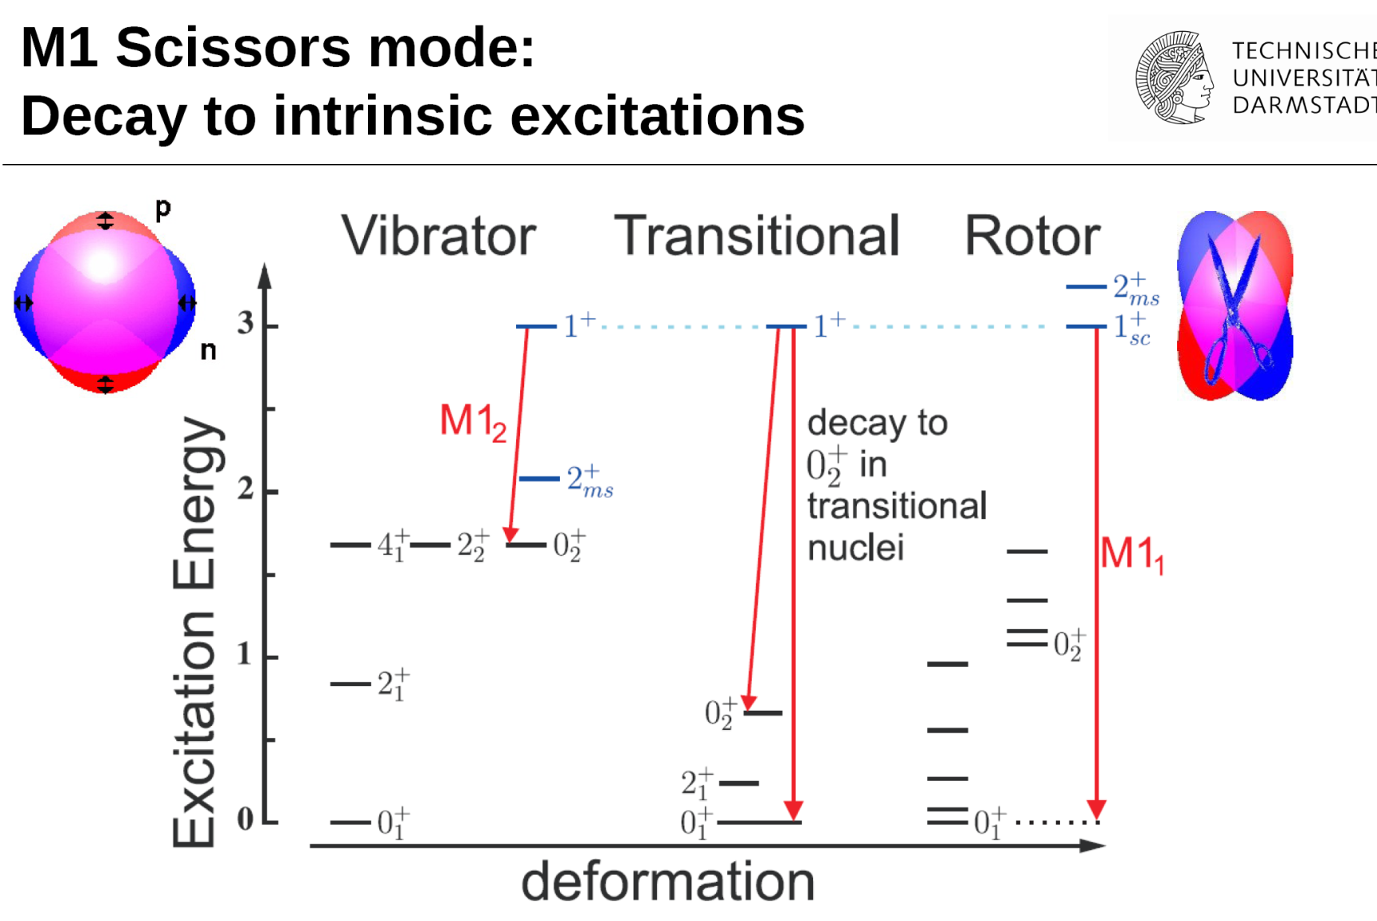
One example (NRF, of course…)

Slide 41
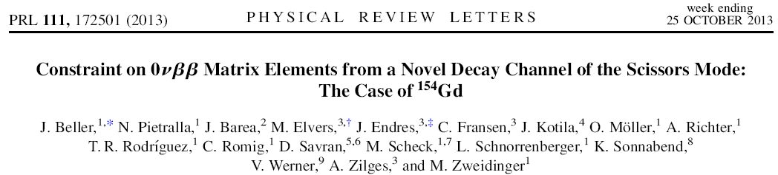
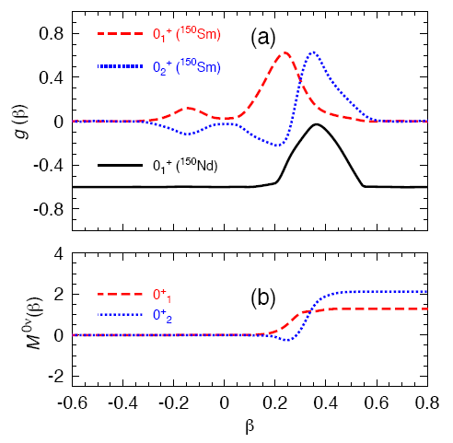
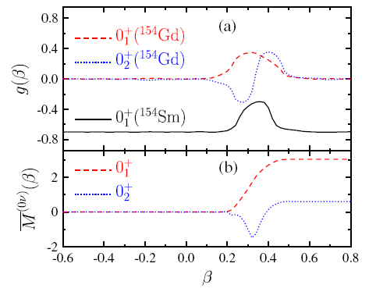
‚Application‘: Dipole strength and 0νββ-decays
¹⁵⁰Nd:
larger 0νββ-decay branch to 0⁺₂ state than to gs due to QSPT at N=90.

Slide 42
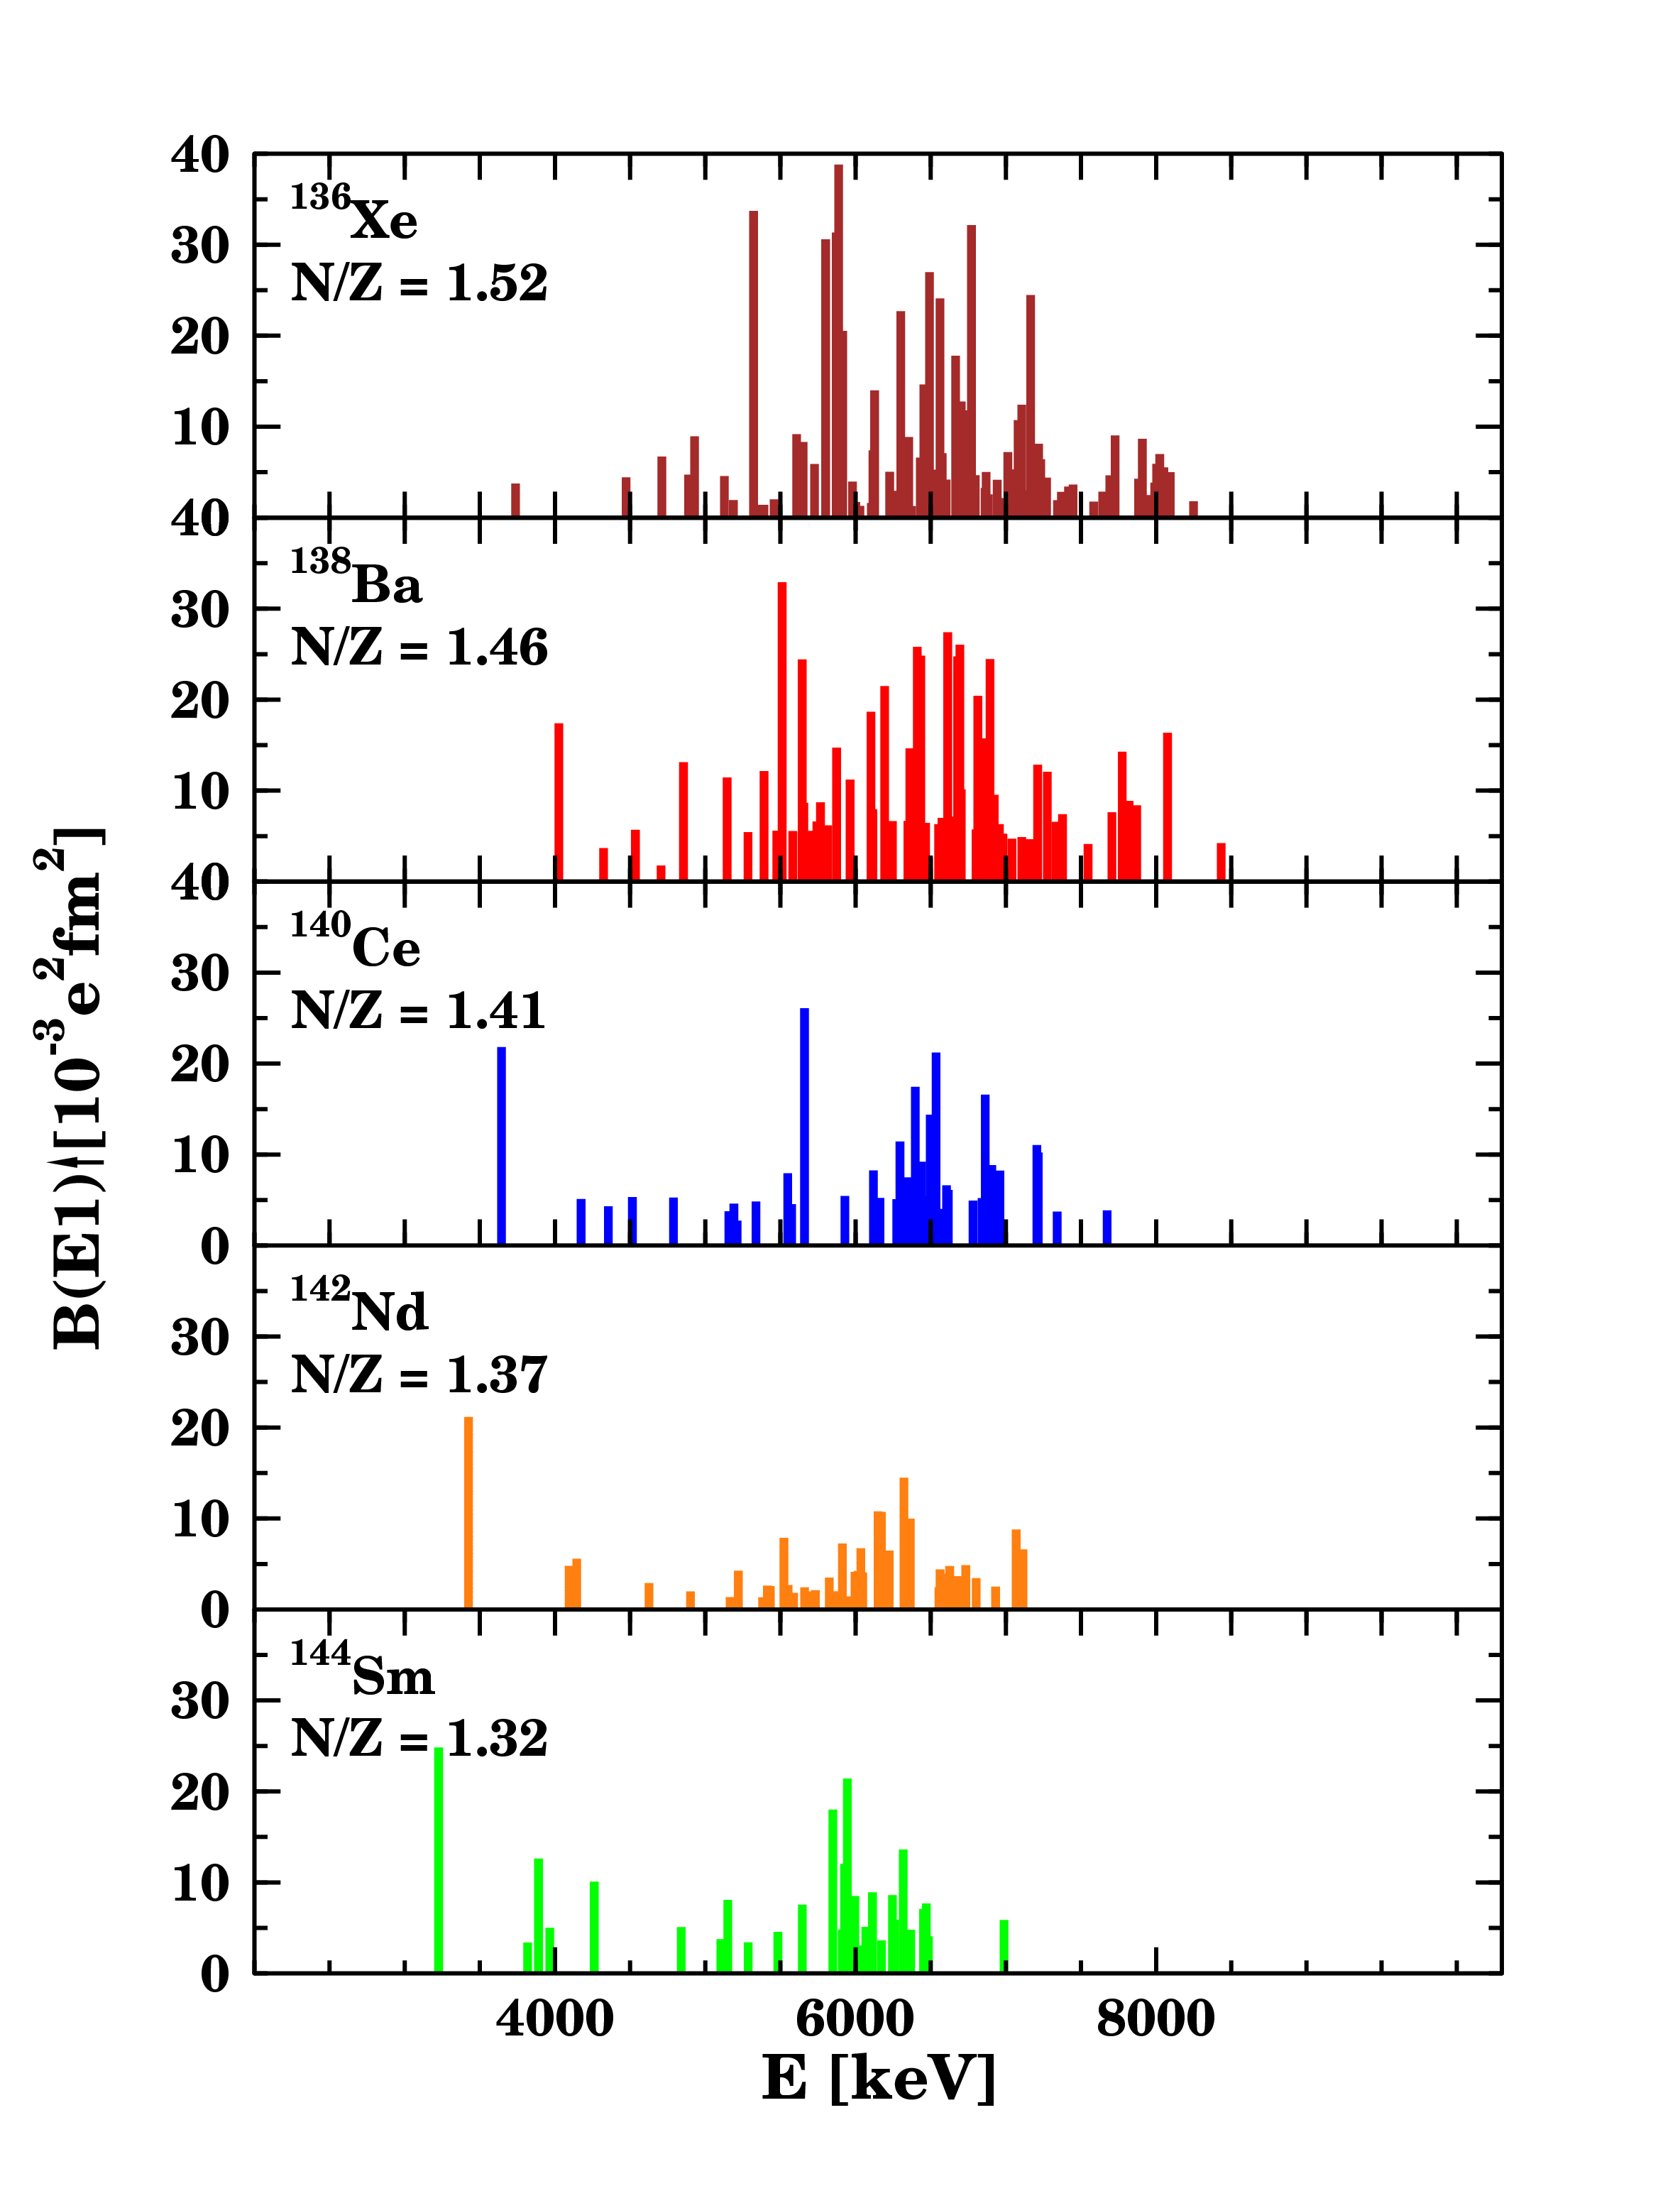

Pygmy Dipole Resonance
Concentration
around 5-7 MeV
Fragmented strength
Summed strength:
Scaling with N/Z ?
core
skin
R.-D. Herzberg et al., PLB 390, 49 (1997).
A. Zilges et al., PLB 542, 43 (2002).
D. Savran et al., PRC 84, 024326 (2011).
U. Kneissl et al., J.Phys.G 32, R217 (2006).

Slide 43
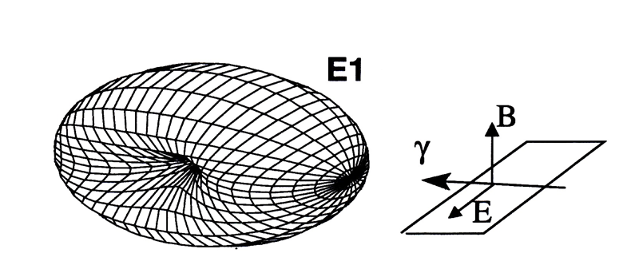


Parity quantum number π for J=1 states
N.Pietralla, H.R. Weller et al., NIM A 483 (2002) 556.
Elastic scattering distribution not isotropic about incident polarization plane.
No intensity along oscillating dipole vector
Azimuthal rotation by 90º for M1 and E1 distributions
Observable only for linearly polarized beam

Slide 44
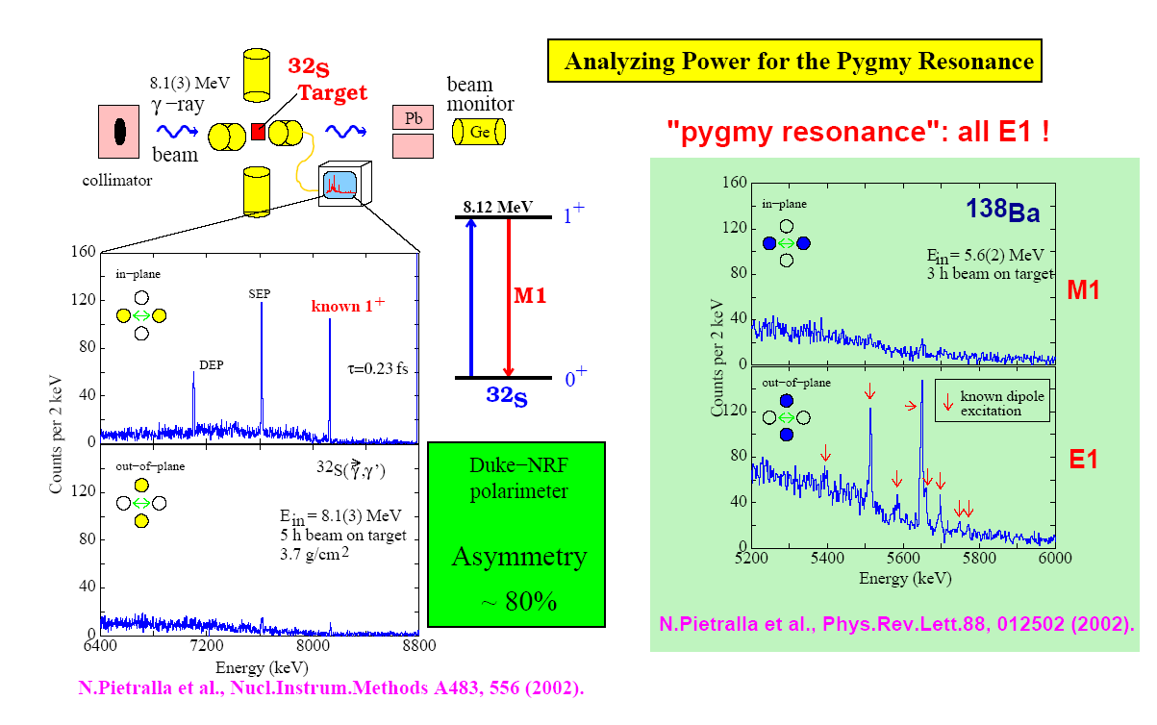
CERN - ERL
1,000 x more flux
10 x higher energy resolution
great discovery potential
established international community
(not only NRF!)

Slide 45
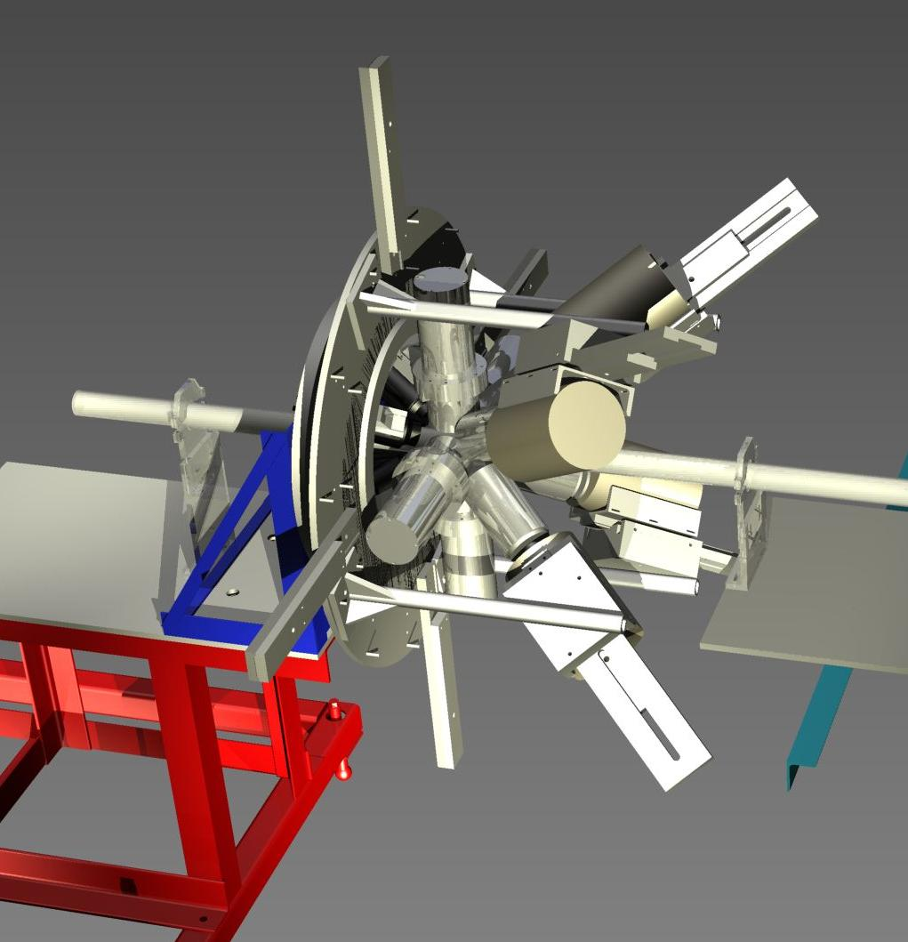
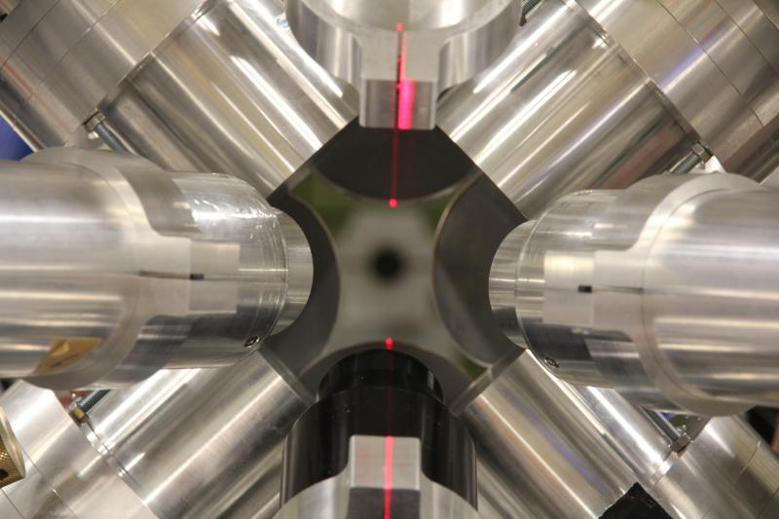

Advanced set-up: γ³ at HIγS
B. Löher et al., Nucl. Instruments Methods Phys. Res. Sect. A 723, 136–142 (2013).

Slide 46
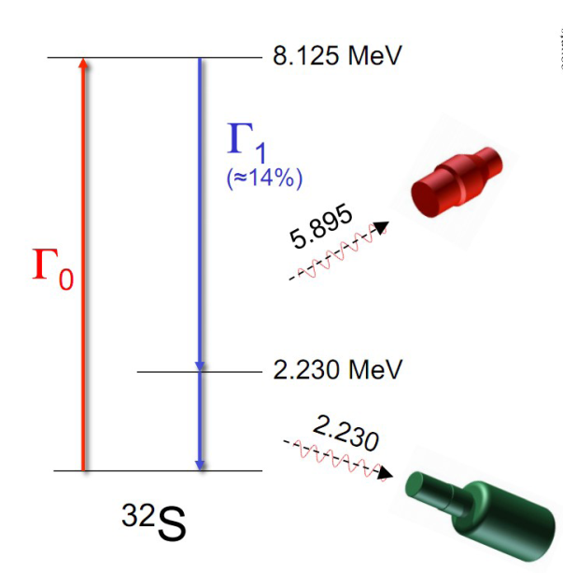
First γγ-coincidences in a γ-beam: γ³ @ HIγS
B. Löher et al., Nucl. Instruments Methods Phys. Res. Sect. A 723, 136–142 (2013).

Slide 47
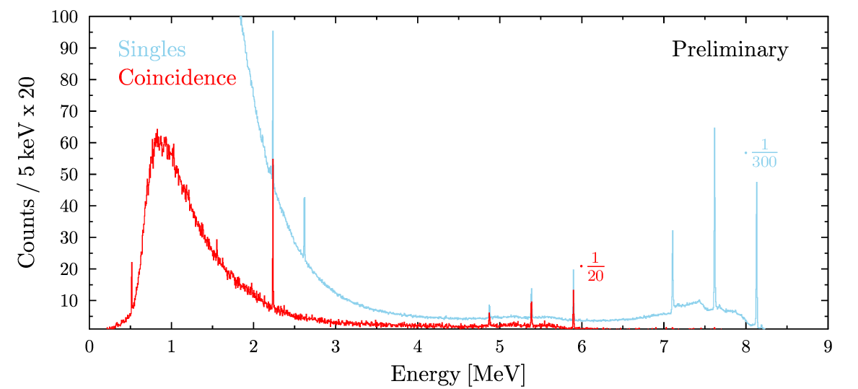
First γγ-coincidences in a γ-beam: γ³ @ HIγS
B. Löher et al., Nucl. Instruments Methods Phys. Res. Sect. A 723, 136–142 (2013).

Slide 48
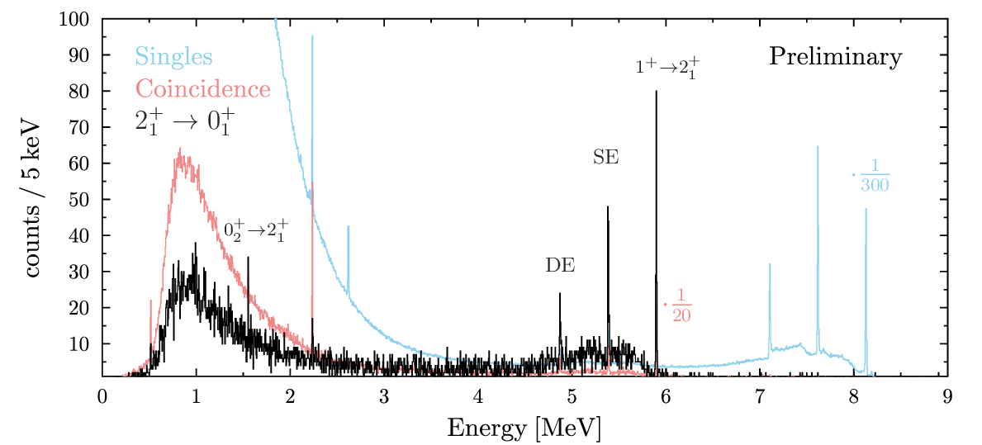
First γγ-coincidences in a γ-beam: γ³ @ HIγS
B. Löher et al., Nucl. Instruments Methods Phys. Res. Sect. A 723, 136–142 (2013).

Slide 49
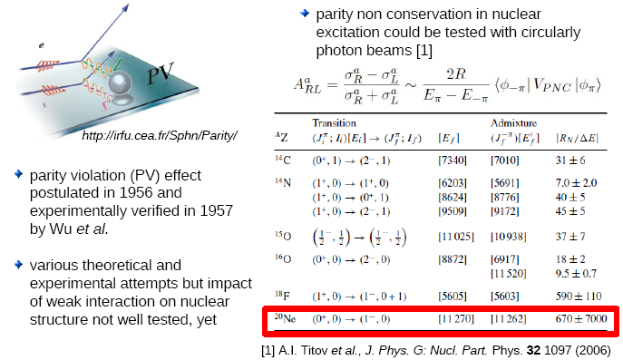
Parity Violation in Nuclear Structure?

Slide 50
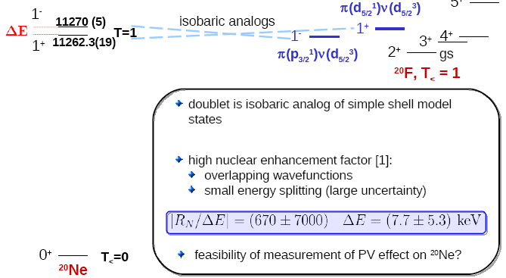
²⁰Ne Parity Doublet

Slide 51
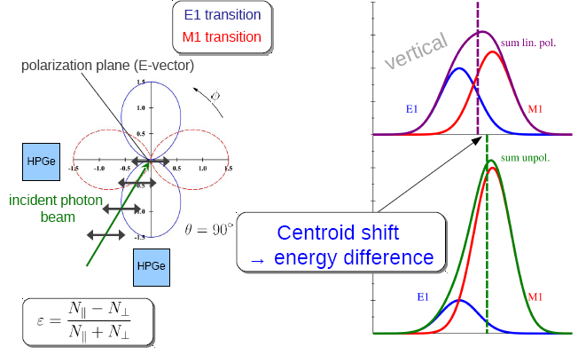
Energy Splitting of ²⁰Ne Parity Doublet

Slide 52
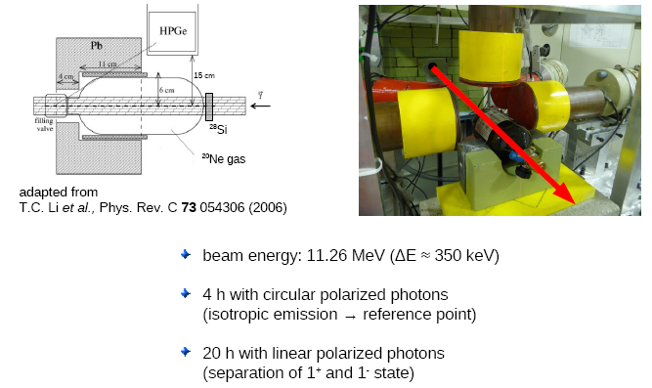
Experiment on ²⁰Ne at HIγS

Slide 53
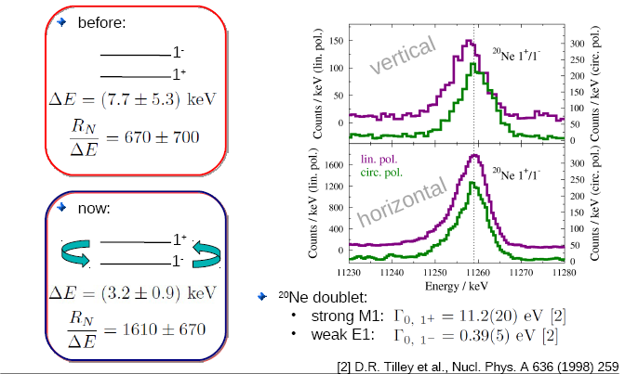
Energy Splitting of ²⁰Ne Parity Doublet
HIγS data
J.Beller
et al., TU
Darmstadt,
to be publ.
(2014)

Slide 54
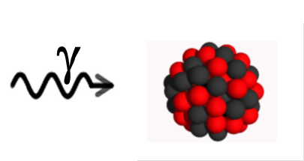
Scientific Opportunities at High-Intensity
Outline
Photonuclear Reactions
Nuclear Resonance Fluorescence
Some Previous Achievements
Intensity Frontier (instrumental challenge) → „Discovery Frontier“ (scientific opportunities)
  „Availability Frontier“ (NRF on rare isotopes)
  „Sensitivity Frontier“ (weak channels: strong physics)
  „Precision Frontier“ (high count rates, new methods)
Conclusion

Slide 55
3. Precision Frontier
High Intensity = High count rates → small statistical uncertainties
    address unresolved questions that cannot be answered today because of uncertainties
      e.g., scaling of scissors mode with deformation
      evolution of K-mixing in octupole-vibrational bands of deformed nuclei
      the „unknown unknown“…
N. Pietralla et al., PRC 58, 184 (1998)
1⁺
2⁺
High Intensity enables new approaches
    e.g. → Nuclear Self Absorption

Slide 56
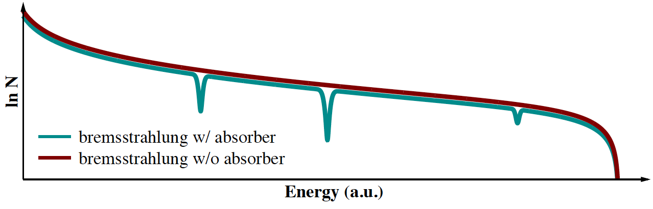







Absorption Processes
Absorption lines only a few eV wide!
atomic attenuation
  several processes
  contributes at each energy
  independent of
resonant absorption
  only at resonance energies
  depends on

Slide 57
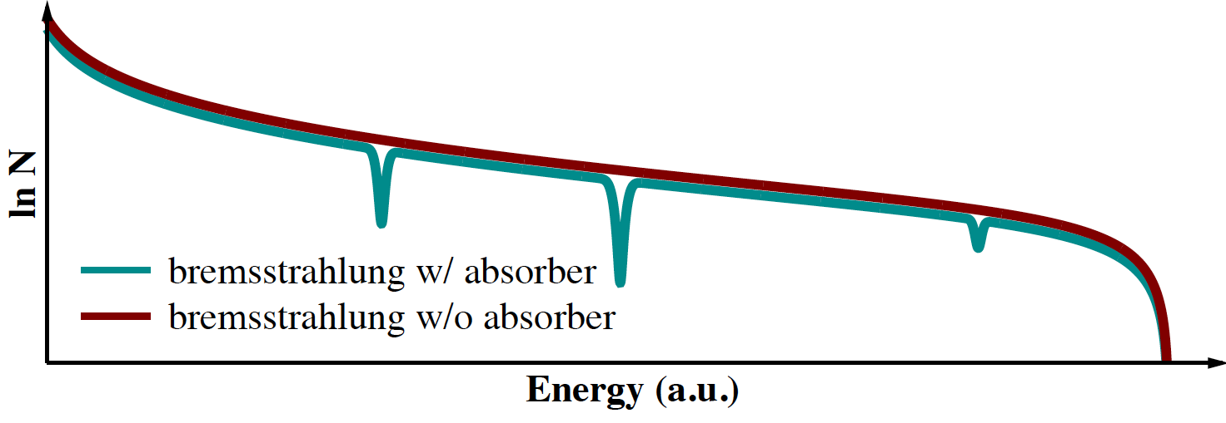
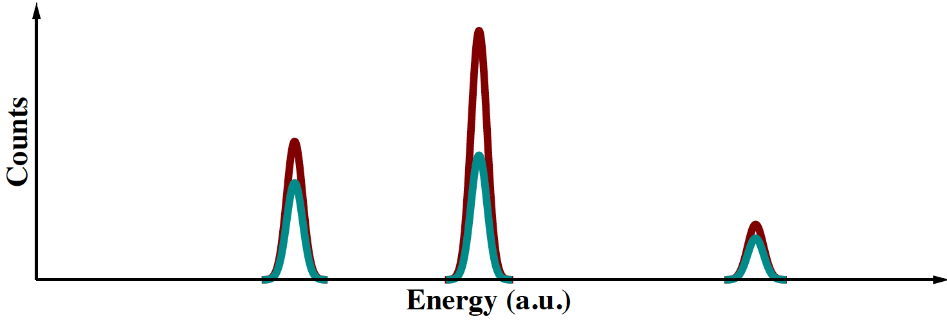
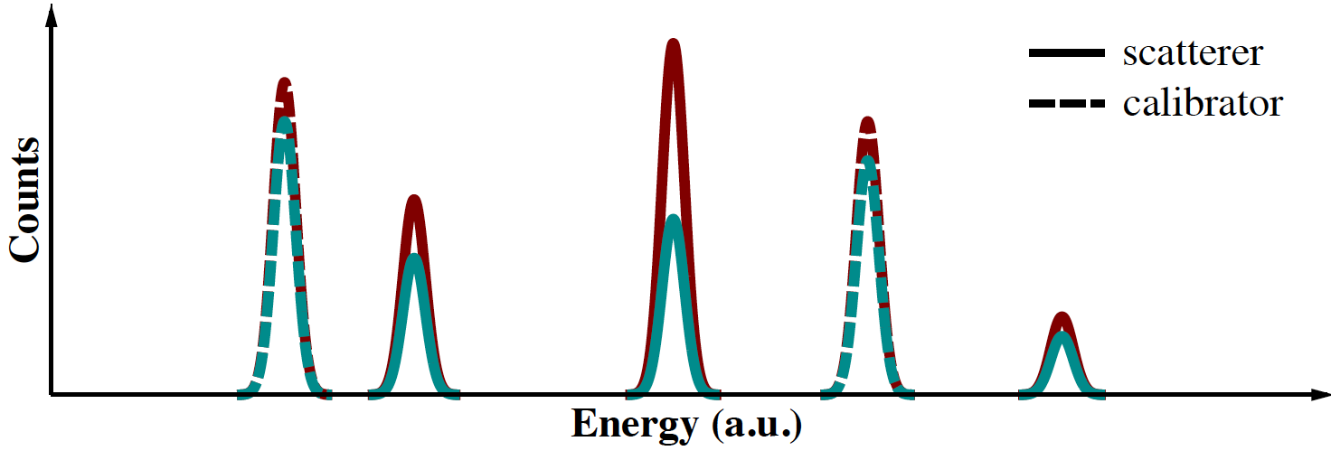
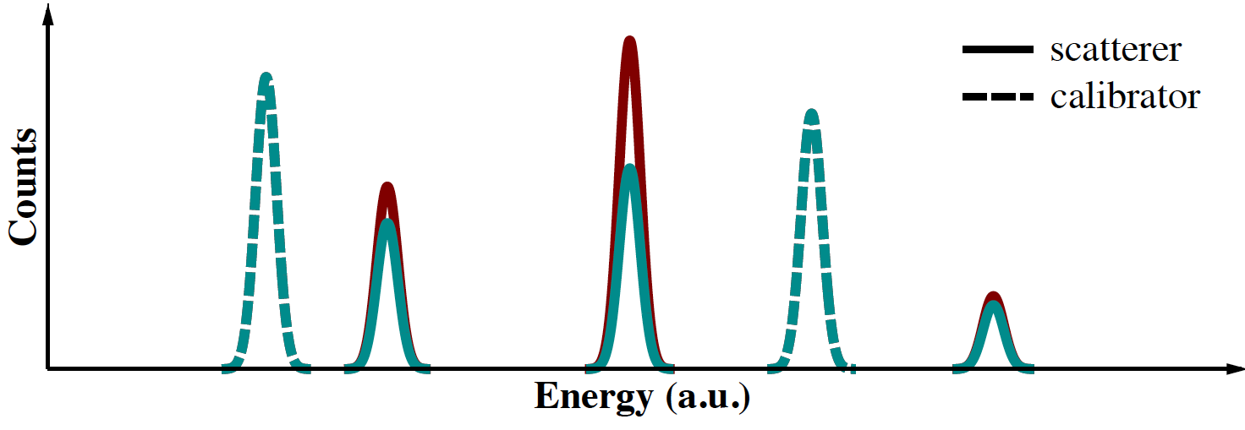
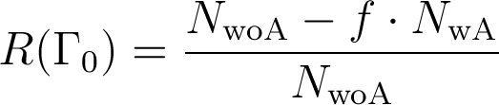
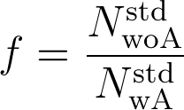
Principle of Measurement and Self Absorption¹
1 F. R. Metzger, Prog. in Nucl. Phys. 7 (1959) 53
Use scatterer made of absorber material as „high-resolution detector“.
scatterer
scatterer
calibration
target
calibration
target
Self Absorption:
Decrease of Scattered Photons because of Resonant Absorption

Slide 58
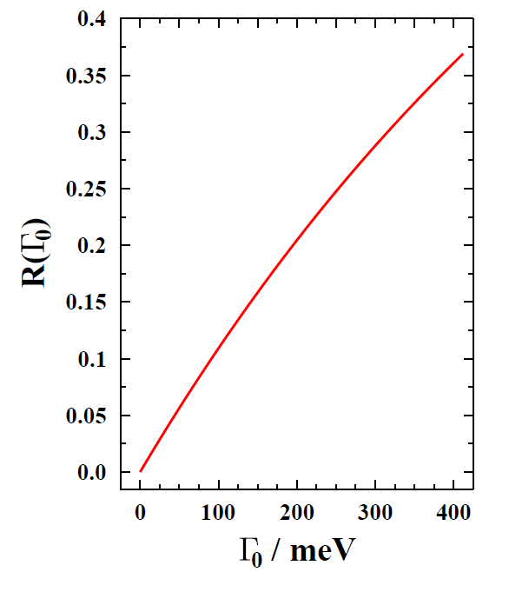
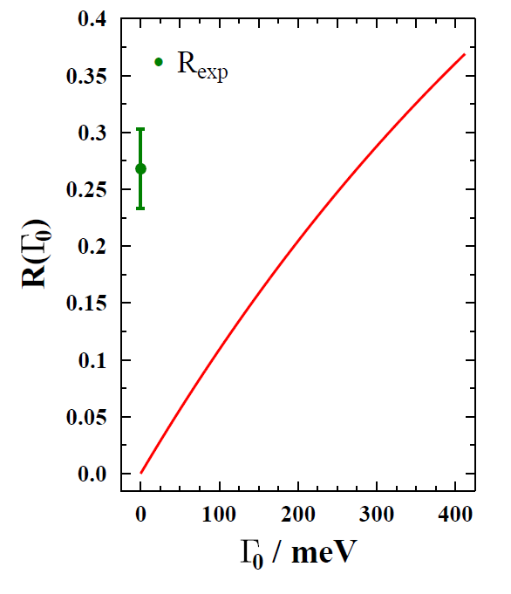
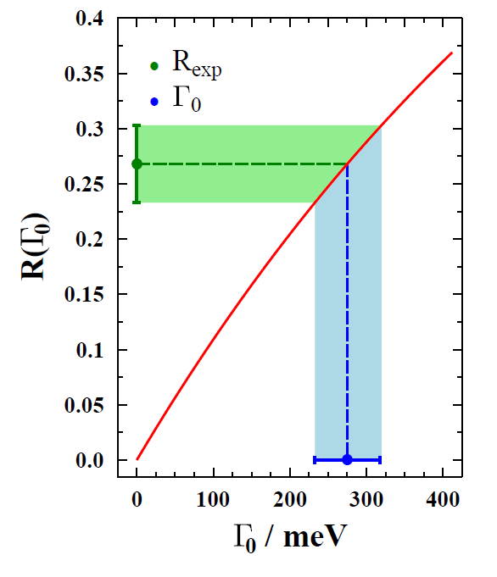



Determination of Ground-State Transition Width and Branching Ratio to the Ground State
calculate R as function of
self absorption R_{exp} determined experimentally
comparison of experiment and calculation gives ground-state transition width
NRF measurement gives
thus total transition width and branching
ratio to ground state can be determined

Slide 59

Application: ⁶Li as Benchmark for ab-initio Nuclear Structure Theory
Nuclear Quasideuteron-Configurations: A.F.Lisetskiy et al., Phys. Rev. C 60, 064310 (1999).

Slide 60


⁶Li as Benchmark for ab-initio Theory
3562
0⁺,T=1
parity forbidden
M1
2185
3⁺,T=0
1474
⁴He + ²H
1⁺,T=0
0⁺
T=0
1⁺
T=0
⁶Li
Exp.: Γ_{M1}=8.16(19) eV (from (e,e‘))
S. Pastore et al., PRC 87 (2013):
chiral currents contribute significantly to Γ_{M1}
GFMC with one-body EM current operator at leading order (impulse approximation): 6.90(2) eV
GFMC with additional two-body meson-exchange currents up to N³LO (χEFT): 8.41(3) eV
L. Cohen and R. Tobin, Nucl. Phys. 14(1959)
W.C. Barber et al., Phys. Rev. 120 (1960)
E.C. Booth and K.A. Wright, Nucl. Phys. 35 (1962)
W.C Barber et al., Phys. Rev. 41 (1963)
S.J. Skorka et al., Phys. Rev. 47 (1963)
W.L. Creten et al., Nucl. Phys. A120 (1968)
F. Eigenbrod, Z. Phys. 228 (1969)
V.K. Rasmussen and C.P. Swann, Phys. Rev. 183 (1969)
J.C. Bergstrom et al., Nucl. Phys. A251 (1975)

Slide 61


Self Absorption Measurement on ⁶Li
(Ch.Romig, TU Darmstadt, PhD thesis, 2014 in preparation)
scatterer: 5 g Li₂CO₃ (enriched to 95% in ⁶Li)
calibration target: 4.2 g ¹¹B (sandwiched)
absorber: 10 g Li₂CO₃ (enriched to 95% in ⁶Li)
endpoint energy: 7.1 MeV
7 days w/o absorber
8 days w/ absorber
S-DALINAC data
2013
R = 0.5178 ± 0.0015
(0.3% relative uncertainty)
Γ₀ ? Stay tuned…
Ch.Romig, TU Darmstadt, 2014
HIγS-2 will provide this precision for excitations that are 2 orders of magn. weaker !

