Slide 1

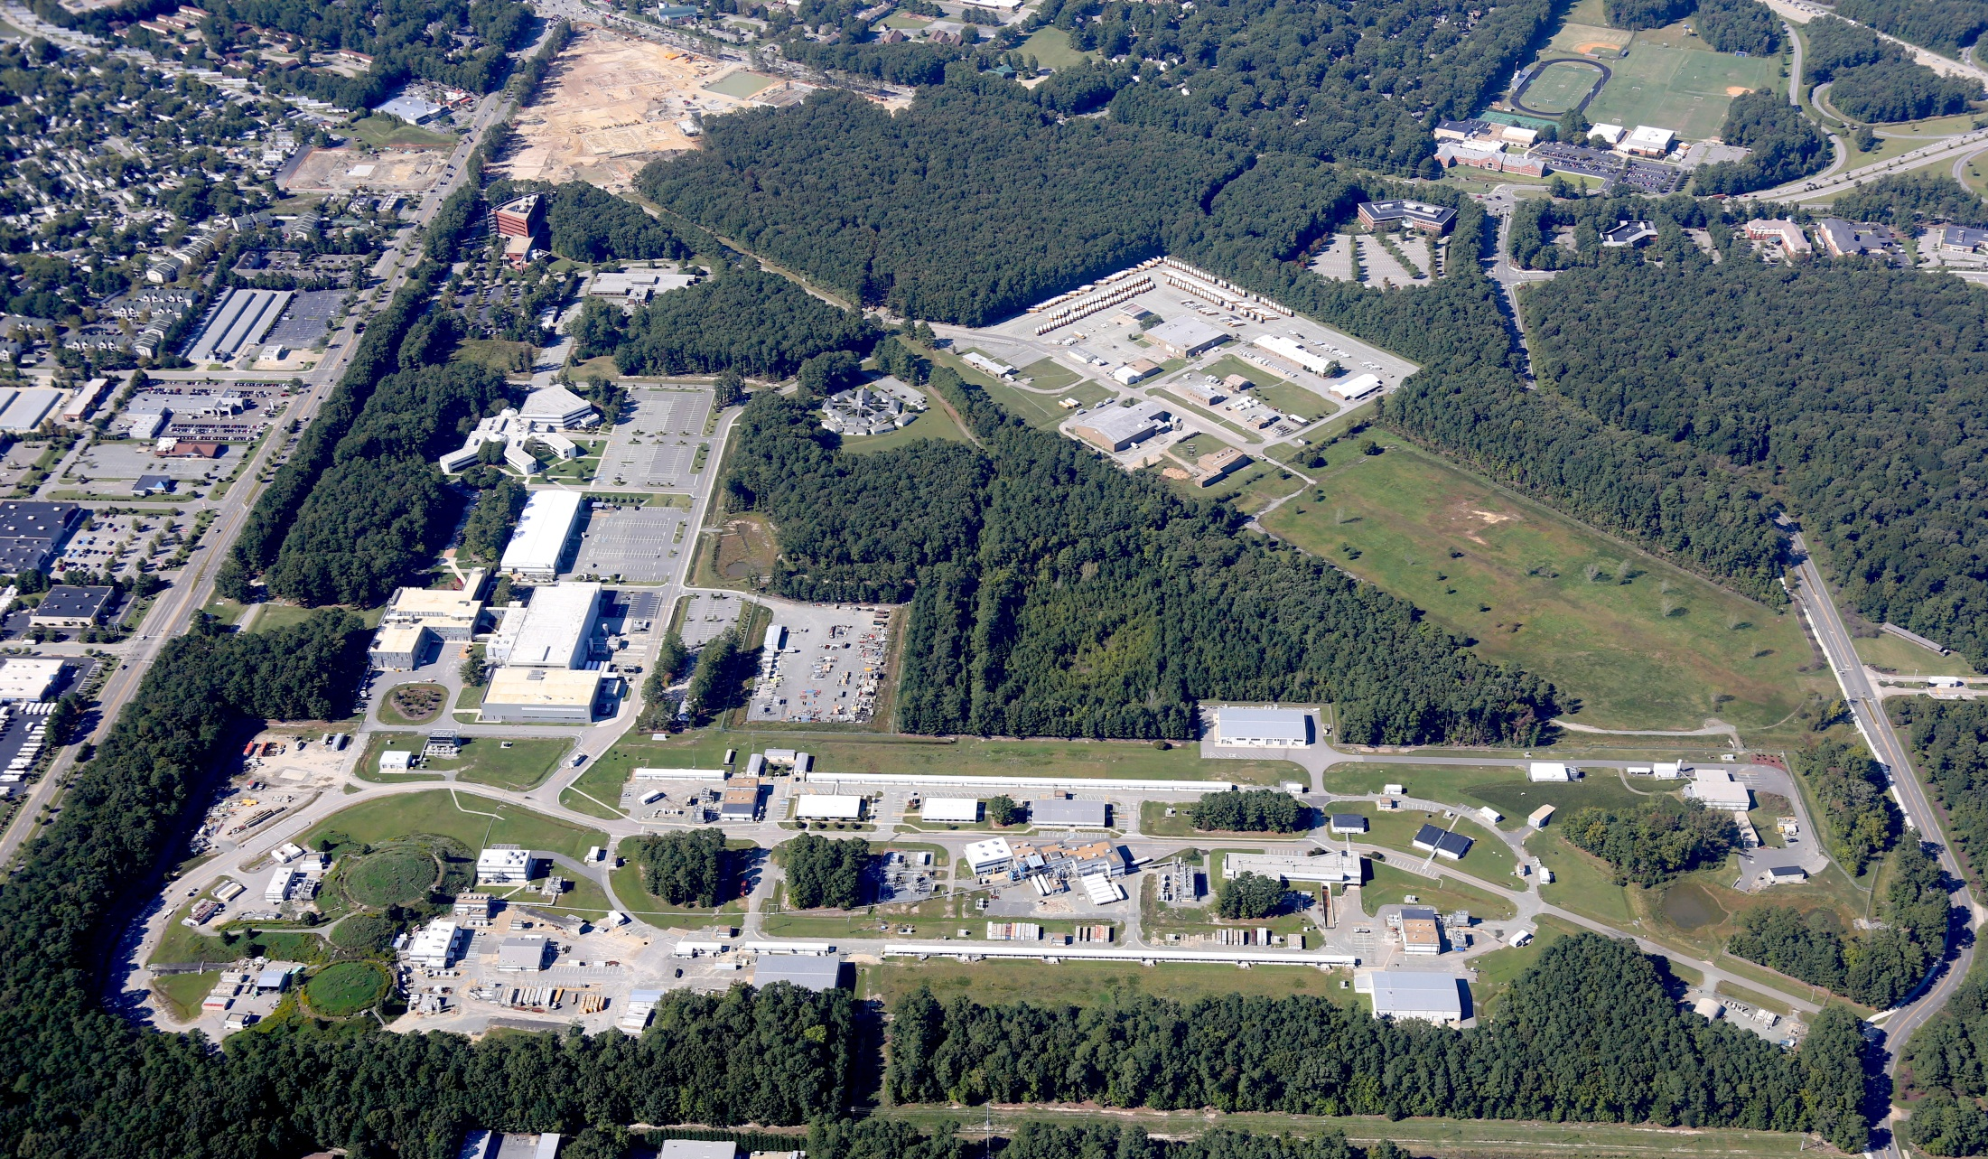
A compact, modular cryomodule concept suitable for a range of applications and for industrial production
Andrew Hutton for Bob Rimmer
LHeC Workshop, 24-26/6/2015

Slide 2
MEIC RF Systems
MEIC baseline design updated in Jan 2015
PEP-II warm RF adopted for electron ring
  Proven technology, looking for a new home
  Enough cavities and klystrons available
  476.3 MHz buckets can be filled from CEBAF linac with simple timing system
Ion ring frequency now 952.6 MHz
Crab cavity system now 952.6 MHz
Cooler source and ERL now 952.6 MHz
Ion injector chain not affected

Slide 3
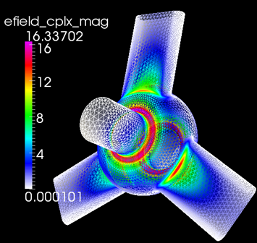
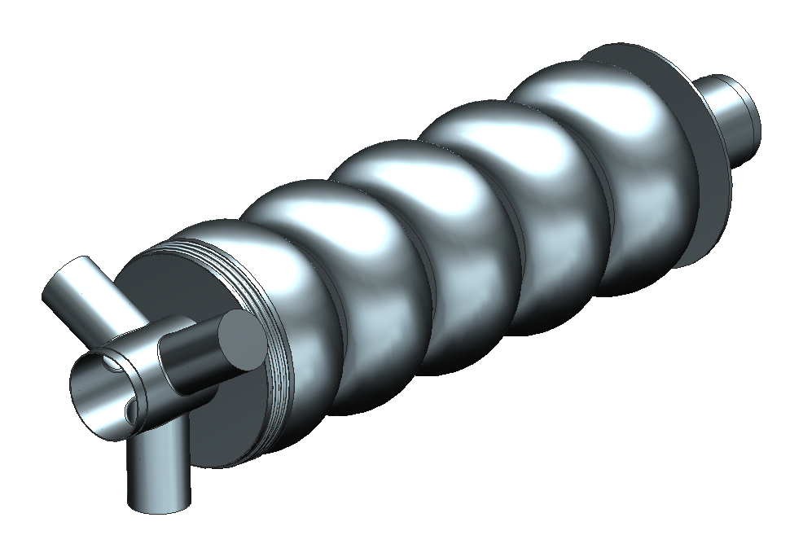
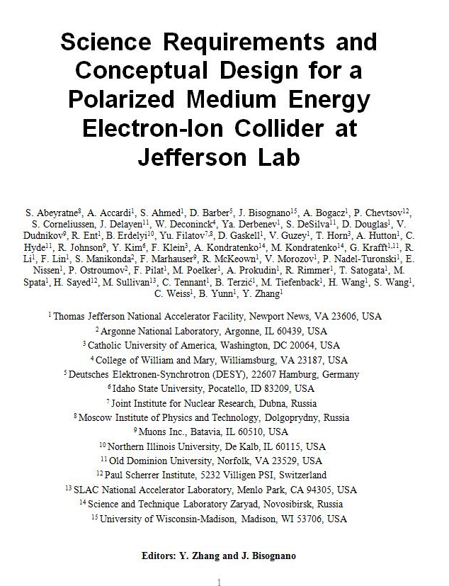
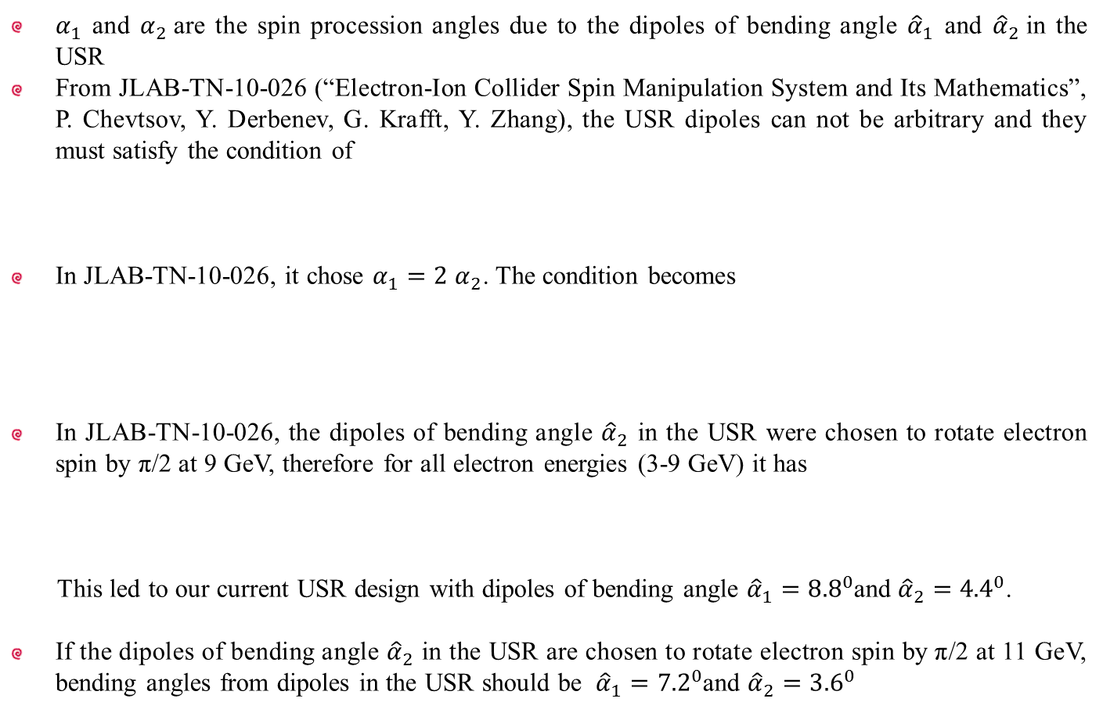
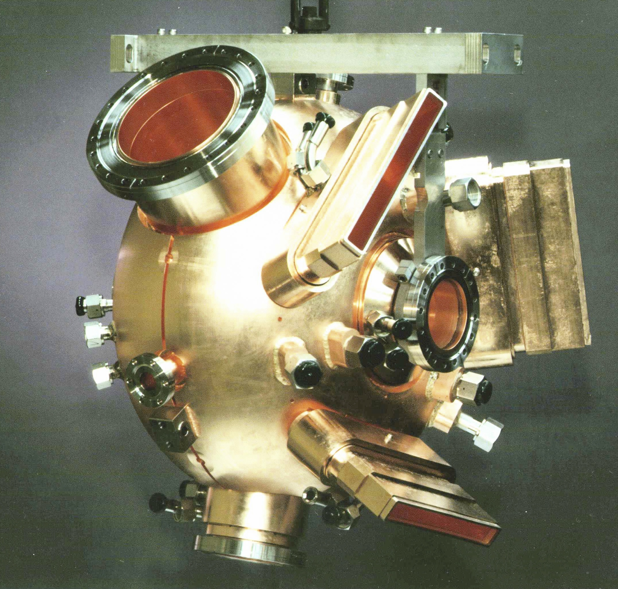
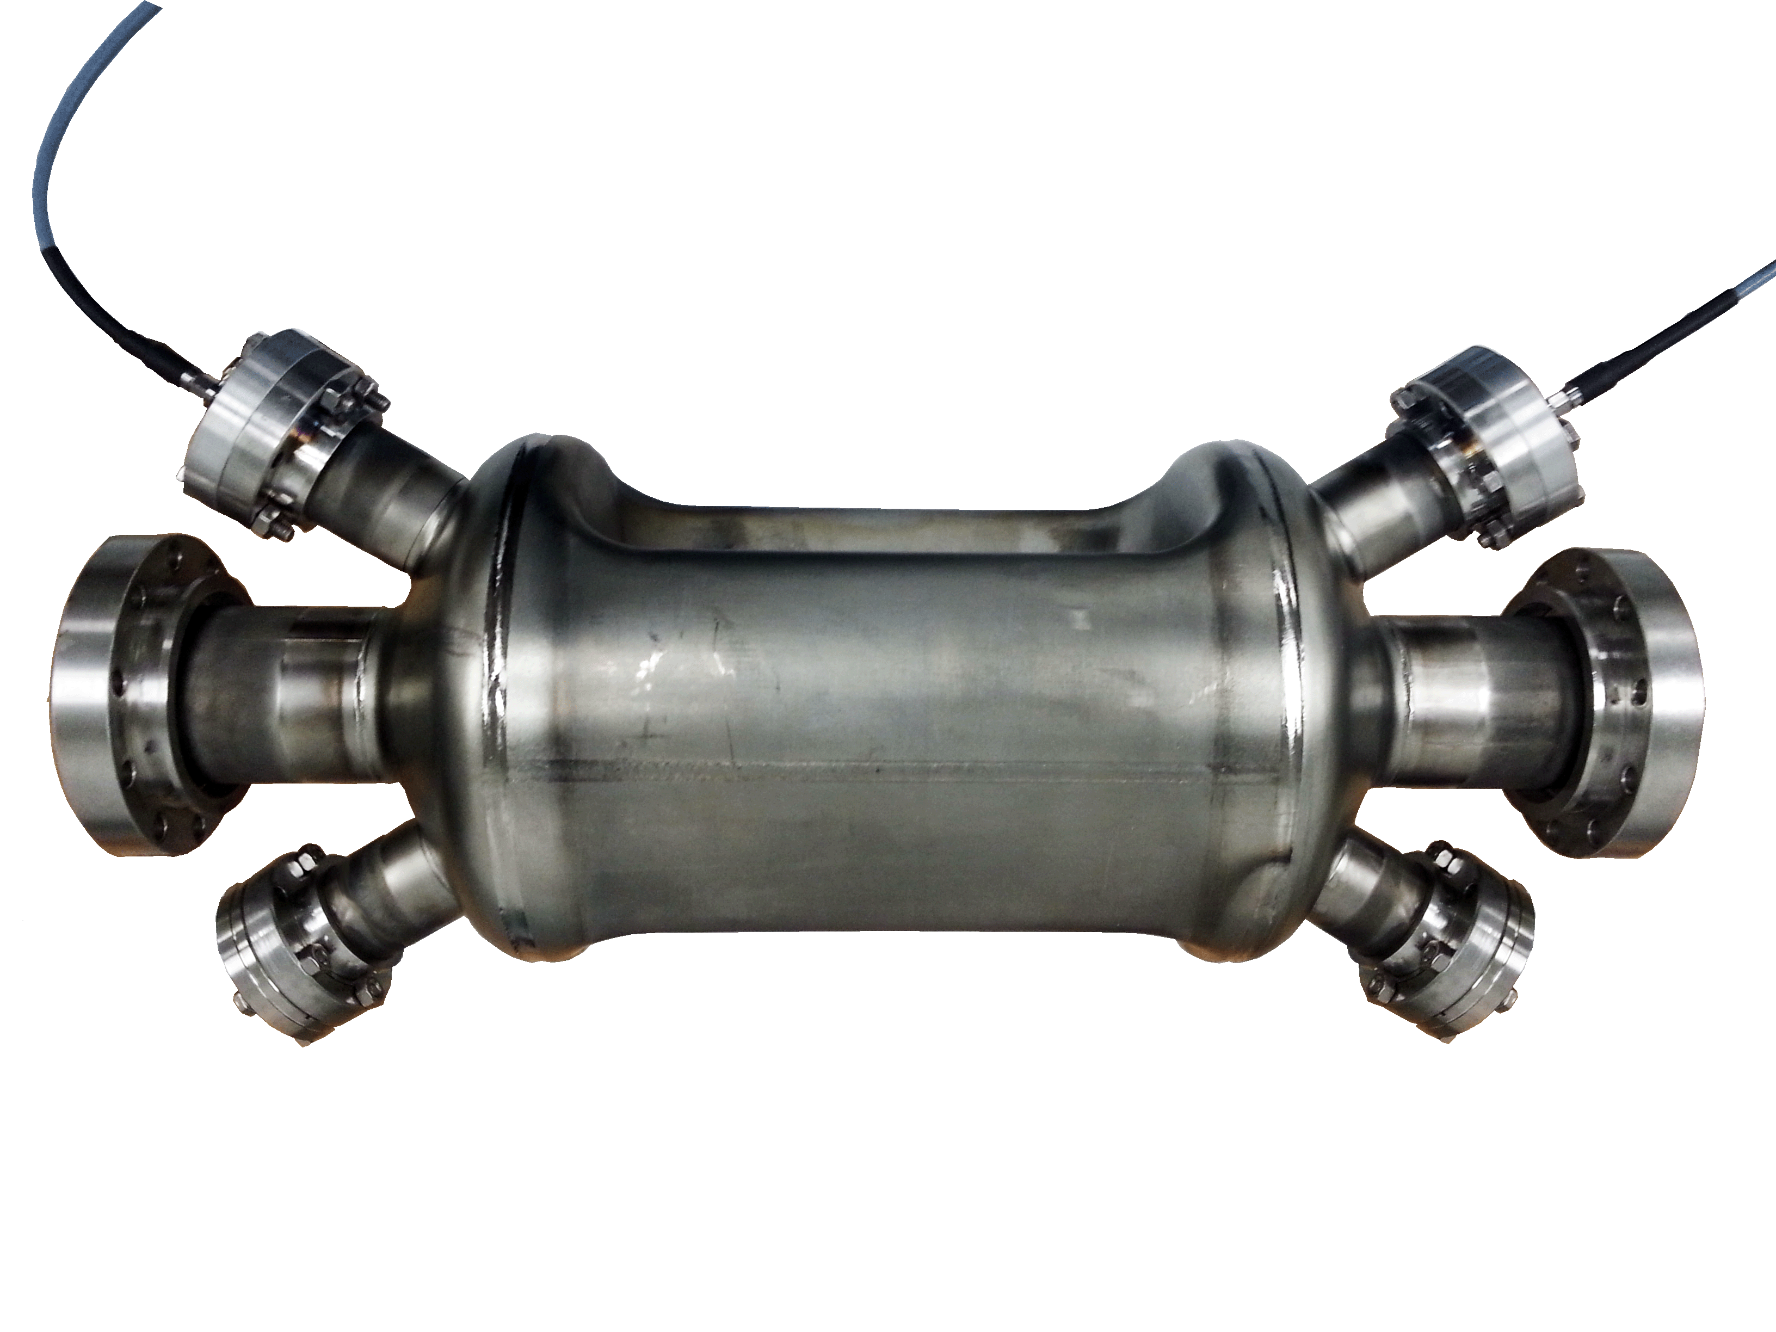
MEIC Conceptual Design
MEIC
Collider
Rings
i-SRF +
NCRF
Cooling
updated
Crab
IP
e-RF
e-RF
Crab
?
Future IP
Booster
SRF Linac
Stage I MEIC
  CEBAF as full-energy e⁻/e⁺ injector
  3-10 GeV e⁻/e⁺
  8-100 GeV protons
  <40 GeV/u ions
Stage II EIC
  up to 20 GeV e⁻/e⁺
  up to 250 GeV protons
  up to 100 GeV/u ions
Ion Source
Electron Injector
Hall D
12 GeV CEBAF
Halls A, B, C

Slide 4
High level RF parameters
 | electron ring NCRF |  |  |  | Proton SRF |  | Lead ion
Energy | 4 | 5 | 10 | GeV | 30 | 100 | 40 | GeV/u
Frequency | 476.3 | 476.3 | 476.3 | MHz | 952.6 | 952.6 | 952.6 | MHz
Current | 3.00 | 3.00 | 0.71 | A | 0.50 | 0.50 | 0.50 | A
SR power per ring | 1.08 | 2.65 | 10.00 | MW | - | - | - | MW
Energy Loss per Turn | 0.36 | 0.88 | 14.12 | MV | - | - | - | MV
Veff | 0.36 | 0.88 | 14.12 | MV | - | - | - | MV
Vpeak | 1.74 | 3.44 | 20.56 | MV | 4.94 | 18.95 | 17.93 | MV
Syn. Phase | 12.01 | 14.89 | 43.39 | degree | 0.0 | 0.0 | 0.0 | degree
Vgap | 0.43 | 0.34 | 0.79 | MV | 1.23 | 1.18 | 1.20 | MV
Gradient | 1.4 | 1.1 | 2.5 | MV/m | 7.8 | 7.522 | 7.591 | MV/m
Beam Power per Cavity | 271.2 | 264.8 | 384.6 |  | - | - | -
Forward Power | 455.5 | 497.8 | 492.0 | kW | 51.0 | 46.94 | 109.88 | kW
Cavity Power Loss | 27.0 | 16.9 | 89.3 | kW | 23.4 | 21.6 | 22.0 | W@4K
Reflected Power | 157.3 | 216.1 | 18.0 | kW | 50.9 | 46.9 | 109.9 | kW
Qext | 8.89E+03 | 8.89E+03 | 8.89E+03 |  | 7.07E+04 | 7.07E+04 | 3.08E+04
Minimum Cavity Number | 4 | 10 | 26* |  | 4 | 16 | 15
*Assumes 2 cavities per klystron.

Slide 5
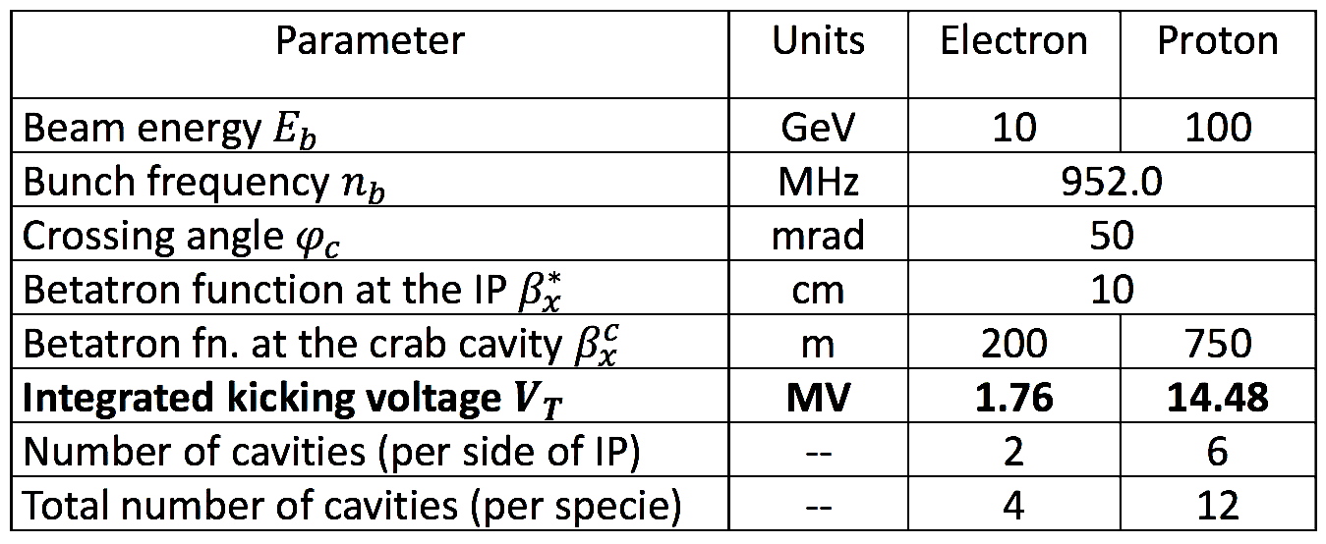
Crab cavity
Design by ODU (Alejandro Castilla, Ph.D project)
952.6 MHz “RF dipole” like LHC
Modest RF system (no beam loading)
Must have good HOM damping
Count for 1 IP in baseline
Assume cryostat cost/cavity same as ion storage ring

Slide 6
MEIC modular cryostat
Goals:
Take the best features of previous JLab designs
Modular approach to hold various different cavities
Design suitable for industrial production
Simple concepts, low parts count to reduce costs

Slide 7
Basic Decisions
Continuous (lower cryogenic losses) or discrete (cryostat easier to service)
Tuner motors inside cryostat (lower losses) or outside (easy repair)
Helium distribution at 2K (cryostat simpler) or 4K (lower cryogenic losses)
Fixed coupling (simpler) or variable (lower RF losses)

Slide 8
JLab SNS module experience is the starting point
• Ion Storage Ring cryomodules (4 x 4-seater)
• e-cooler Booster (1 x 4-seater)
• e-cooler Linac CM (1 x 4-seater 5-cell)
• Crab Cavity CMs (2 x 2-seater and 4 x 4-seater)
Updated modular design under development
MEIC SRF design basis
SNS high β module
A. McEwen

Slide 9
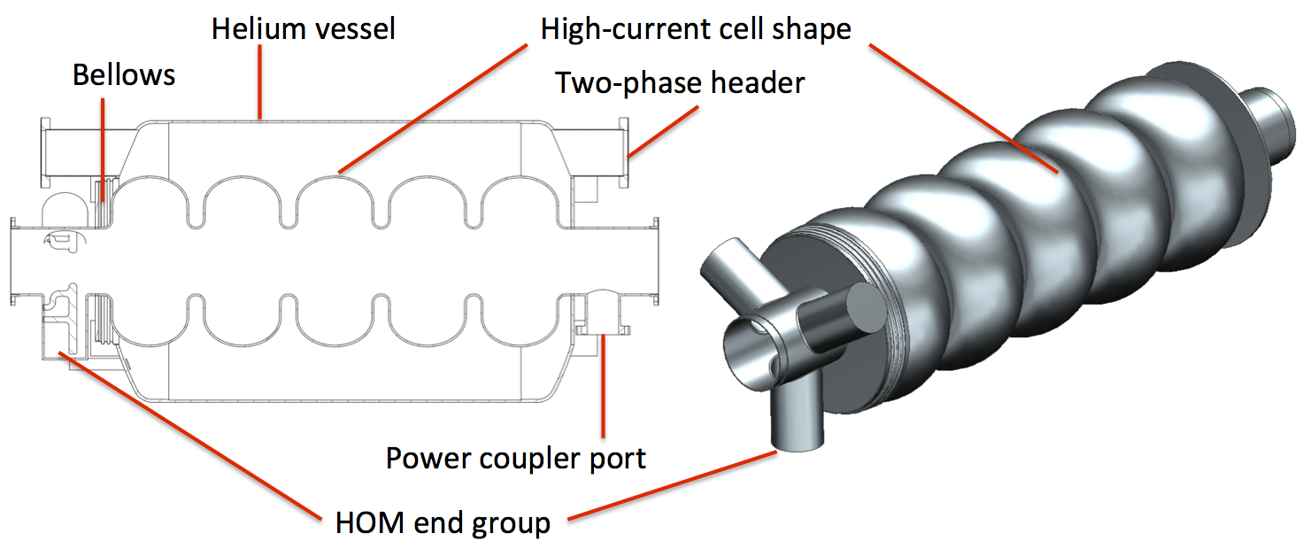
Cavity and helium vessel
Example: five-cell with symmetric HOM end group and coaxial FPC.
One helium vessel per cavity (SNS style).
End mount tuner (not shown).
The large helium vessel can accommodate alternative cavity shapes with few or no modifications.
Stainless steel He vessel and bellows.

Slide 10
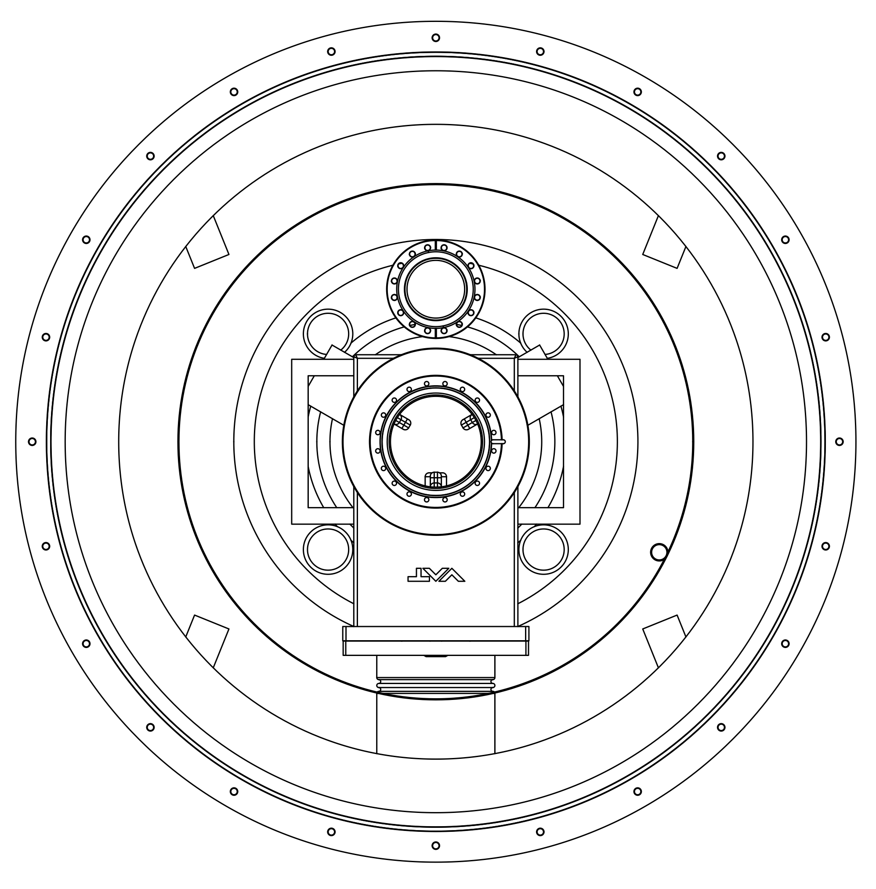
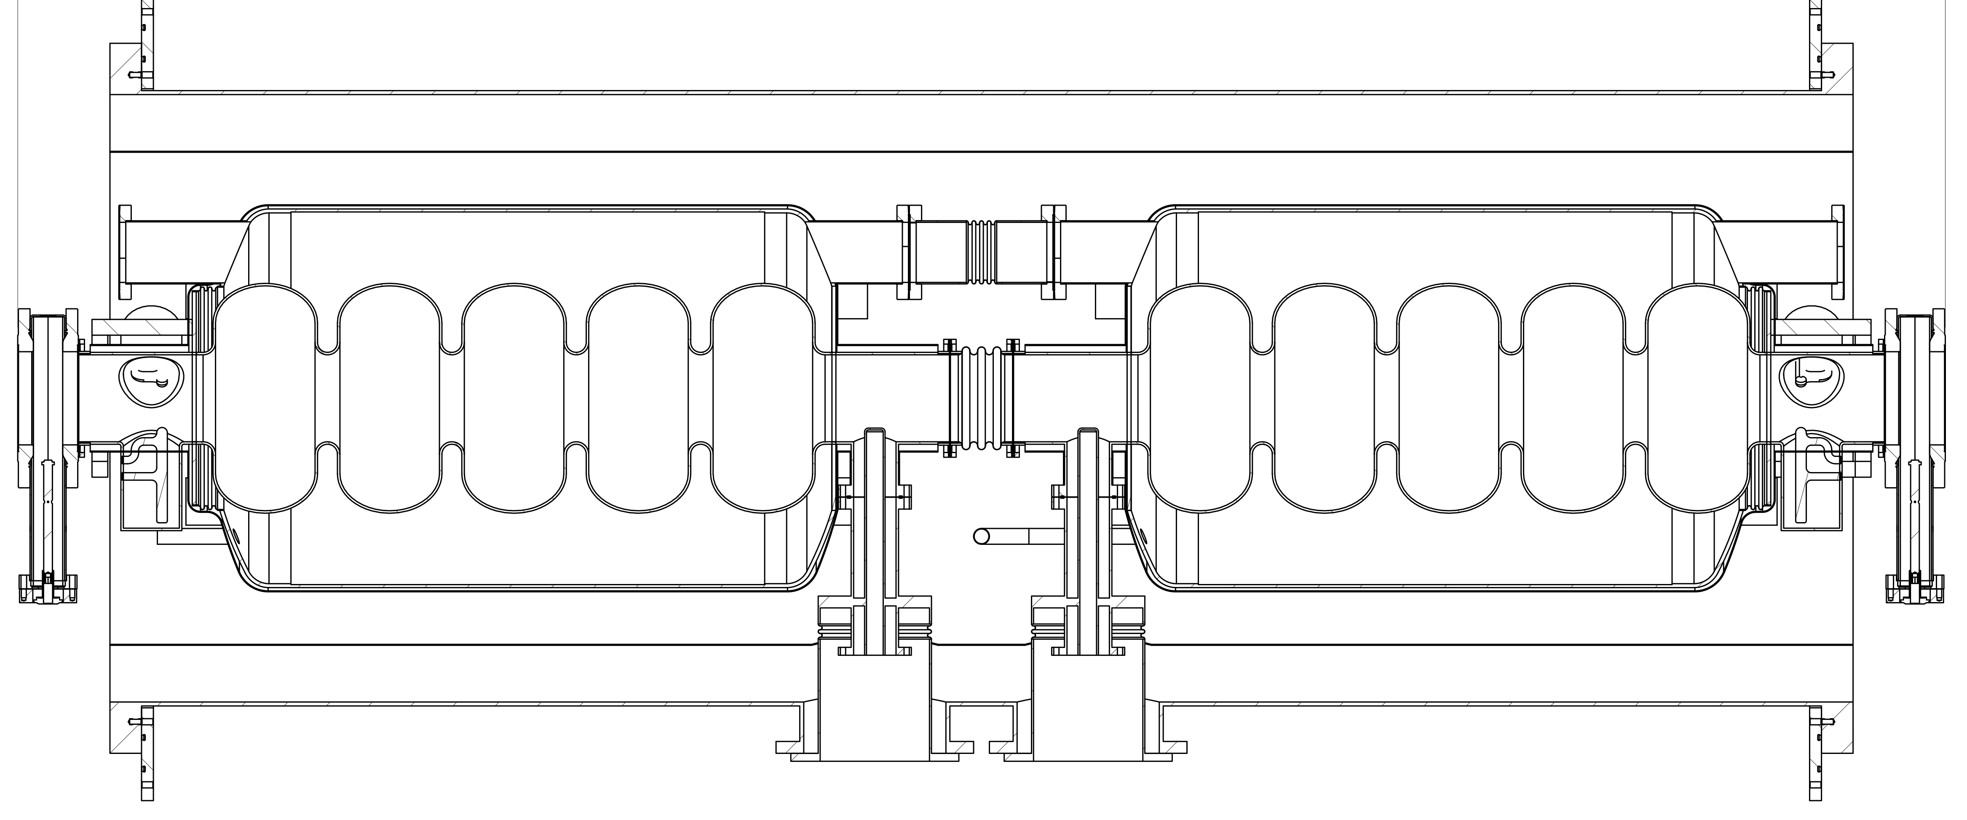
Cavity “pair”
Cavities assembled as hermetically sealed pairs
He vessels connected (no separate two-phase pipe)
Large He inventory, large free surface area
VTA tested as a unit
If good: straight to module
Minimal degradation from VTA to module
Pairs supported by rods from vacuum vessel (no space frame)

Slide 11
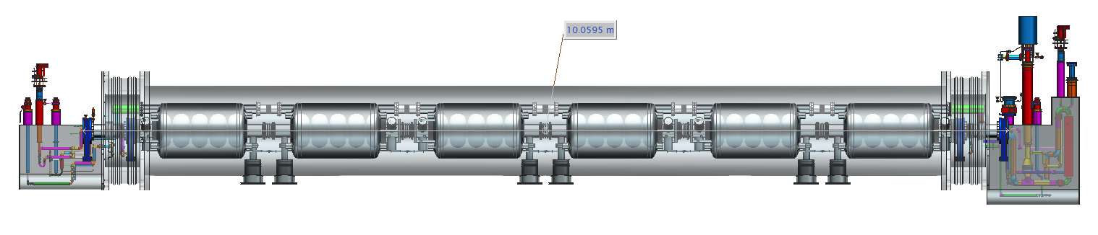
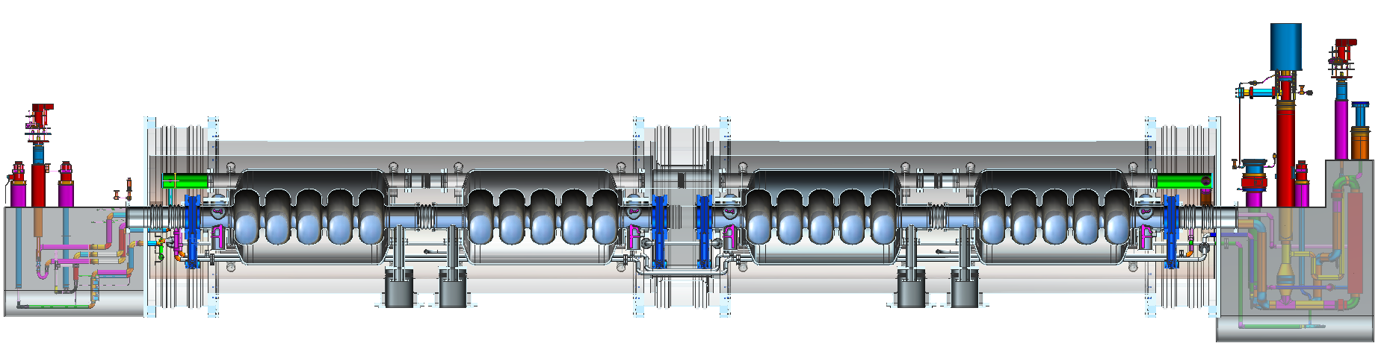
Modular cryostat
Modular cryostat containing “cavity pairs”
One piece or with bridging sections
Bridged version can be separated for repair or shipping
SNS type supply and return end cans shown

Slide 12
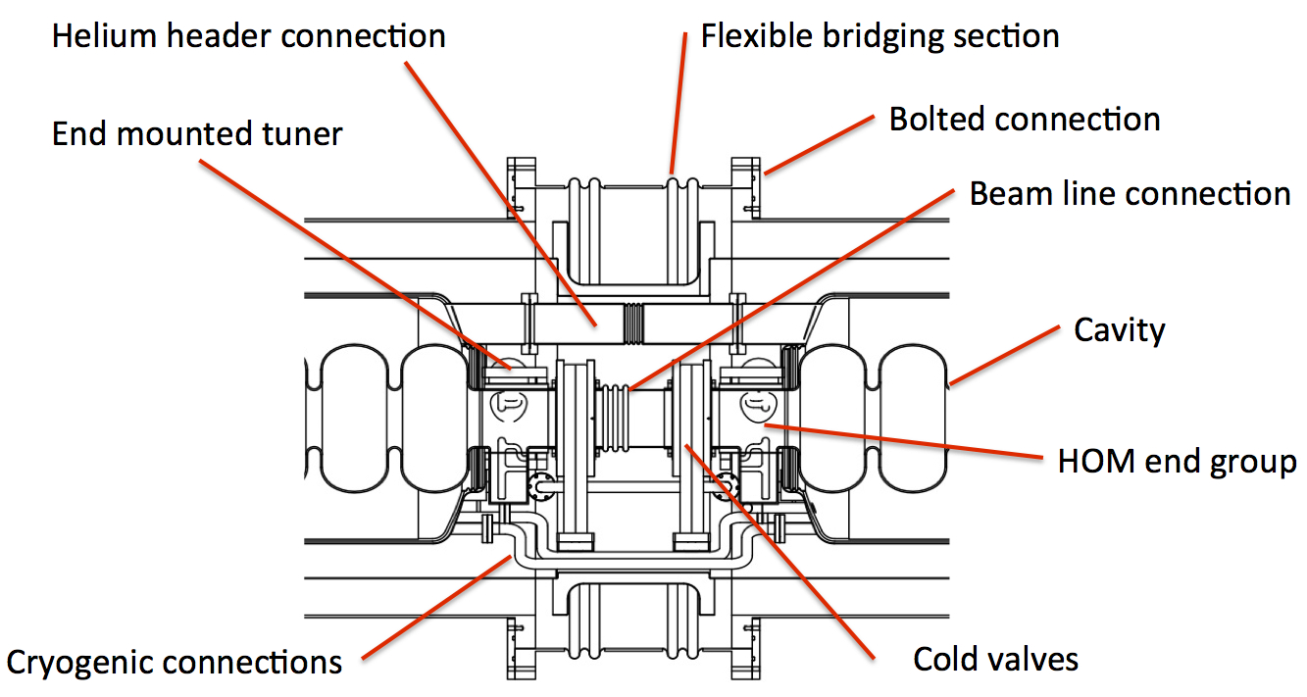
Close-up of bridging section
Bridging section showing cold valves, beamline bellows
Bolted vacuum vessel connection, helium circuit connections
Access to tuners, HOM cables etc.
Could also contain magnet, BPM or HOM load (e.g. XFEL)

Slide 13
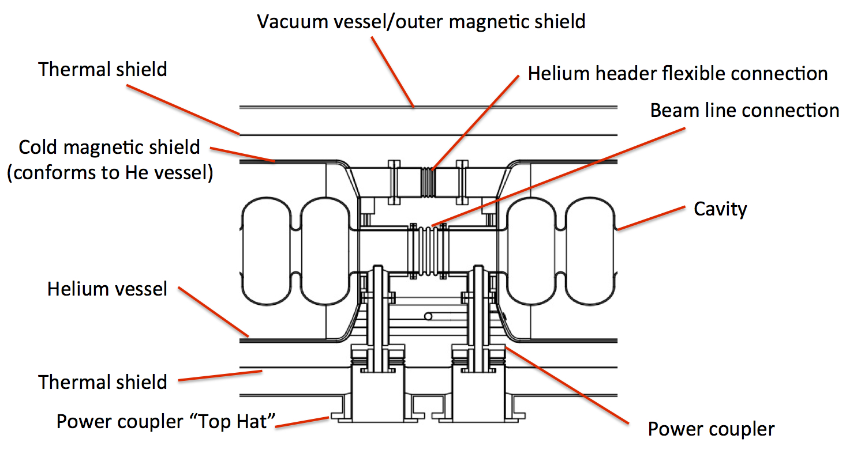
Coupler section
Close up of coupler section in the middle of each “pair”
Longitudinal fixed point is in the plane of the coupler
Bellows between cavities and helium vessels provide compliance for cool-down and alignment.

Slide 14
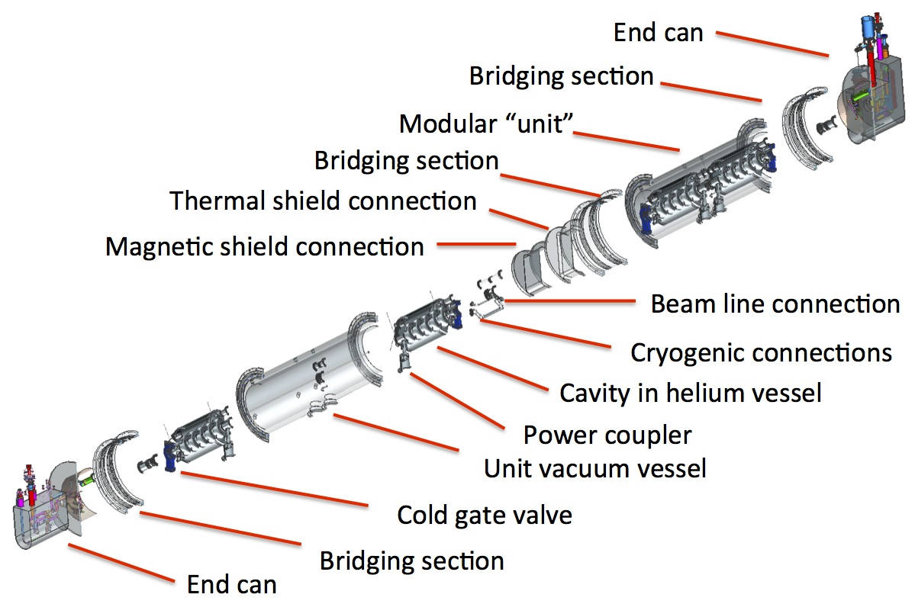
Exploded view showing details of modular construction

Slide 15
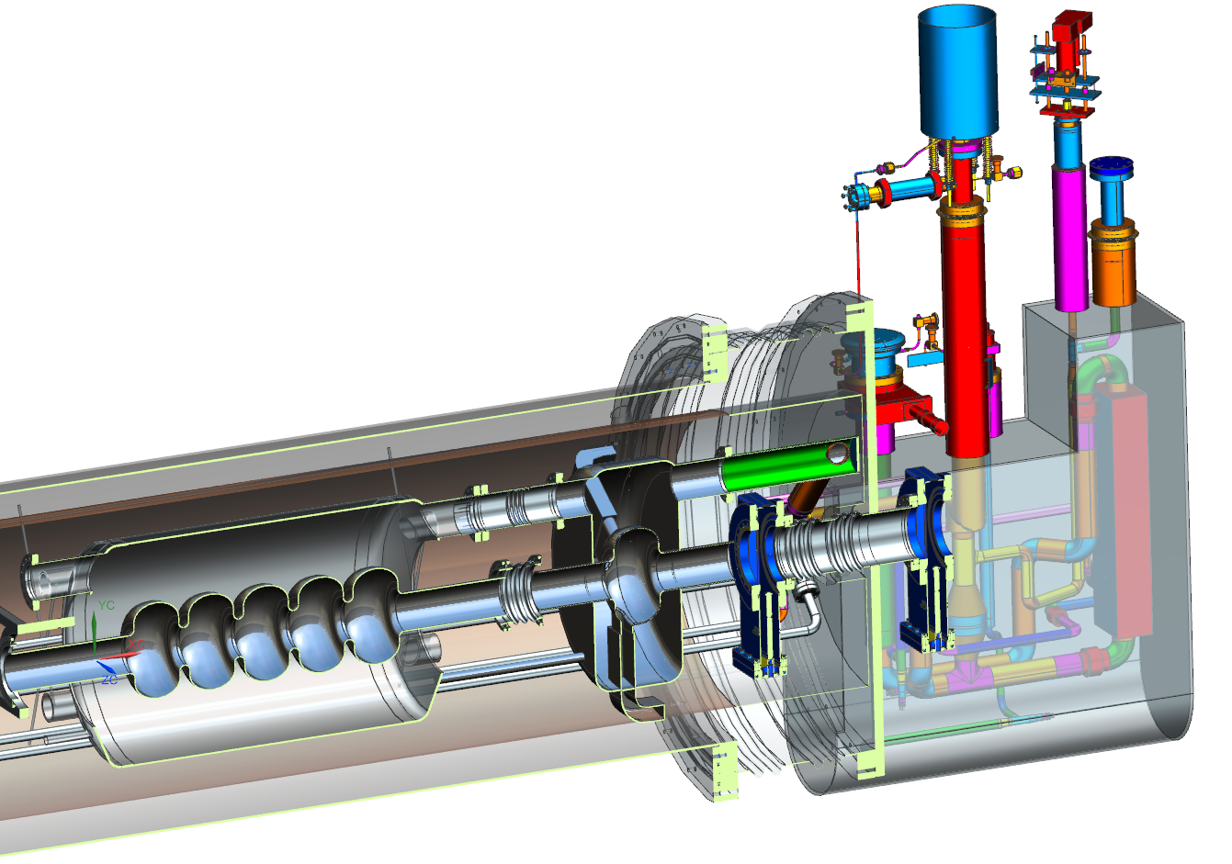
Examples: ion ring cavity
Single cell 952.6 MHz
On-cell HOM dampers
Individual He vessel

Slide 16
Example: Crab cavity
Crab cavity (RF dipole)

Slide 17
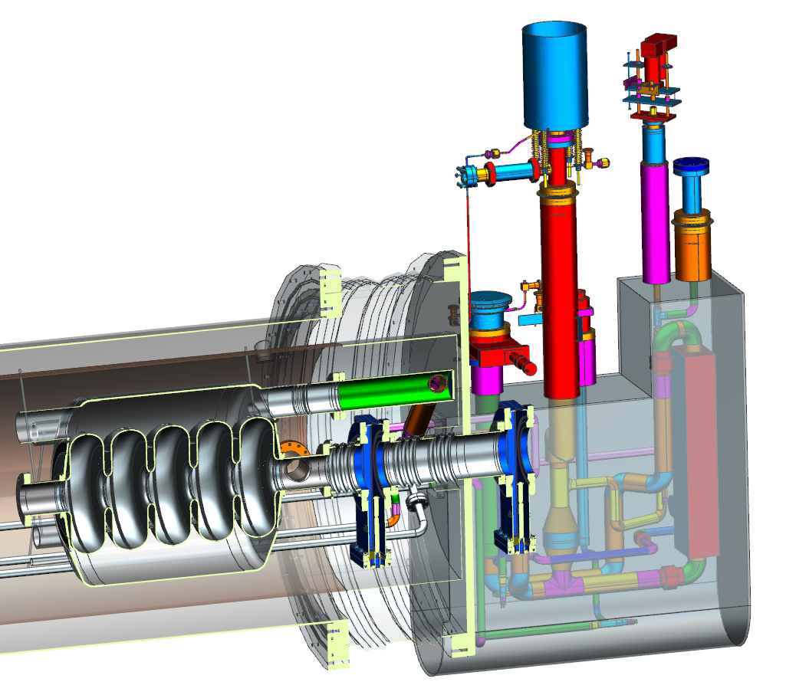
Example: 650 MHz low β cavity
PIP-II β=0.6 650 MHz cavity

Slide 18
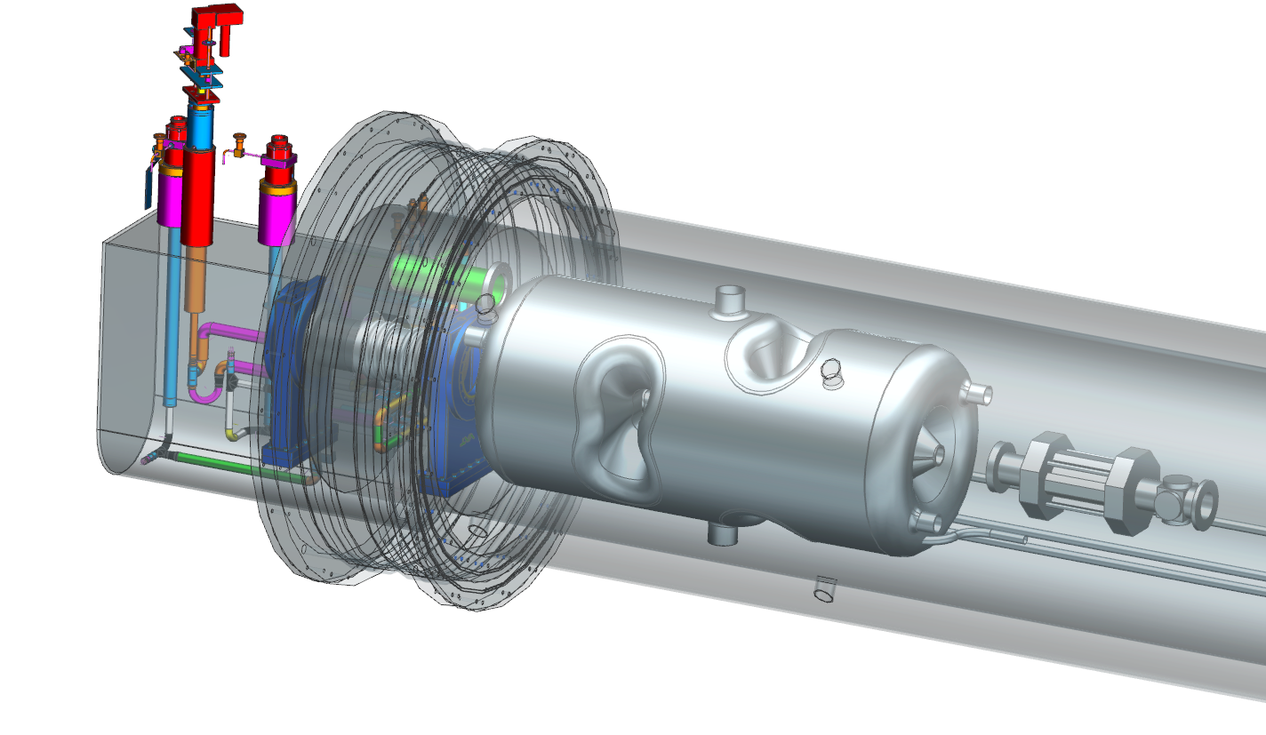
Example: 400 MHz β=1 spoke cavity
Double spoke β=1 cavity
LCLS-II magnet package

Slide 19
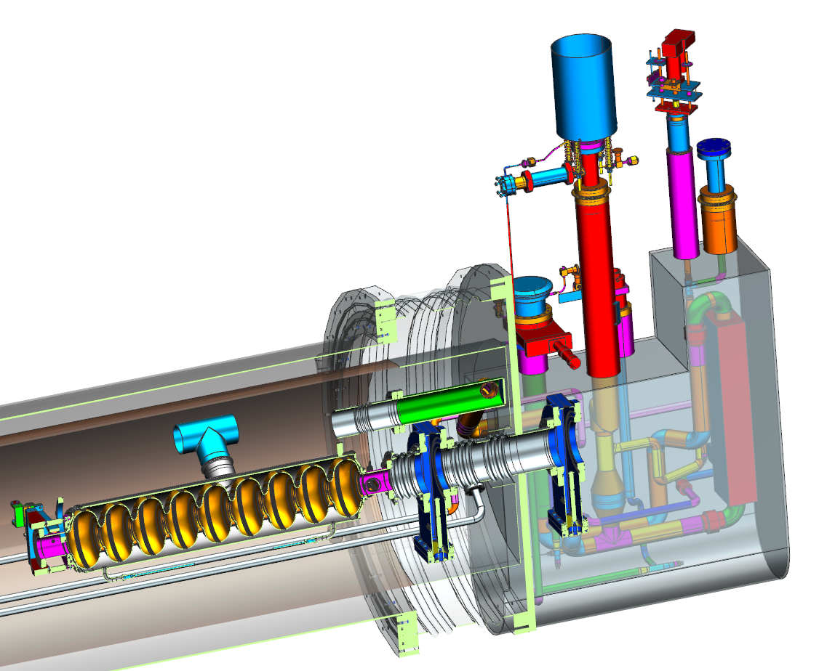
Example: 1.3 GHz LCLS-II production cavity
LCLS-II production cavity

Slide 20
Summary
This approach provides flexibility and modularity to accommodate a wide range of cavity types, frequencies and a variety of potential applications.
The simple, low-cost modular components allow for common tooling and assembly practices.
Well suited to industrial production.
Allows pre-qualified modular units to be shipped, combined at the point of use, or returned for repair.
This concept combines many of the best and proven features of previous JLab designs but goes beyond any existing module.

Slide 21
Collaboration CERN-JLab
Collaboration on Research and Development on
ERL Cavities and Cryomodules
1. Objective of the collaboration
  Following the MOU signed between CERN and JLAB on cooperation in superconducting RF accelerator technologies, this agreement, Appendix X, aims to develop a conceptual design and fabricate a prototype cavity suitable for LHeC. The aim of the prototype cavity is to validate the basic RF design in vertical test.
2. Organization of the Collaboration:
  JLAB: Robert Rimmer
  CERN: Karl-Martin Schirm

Slide 22
Collaboration CERN-JLab
3. Technical Scope of the Collaboration:
3.1. JLAB responsibilities for:
  Technical advice and recommendations for cavity design and cryomodule integration.
  Design and fabrication of cavity dies and tooling.
  Fabrication of one 5-cell cavity and one single cell cavity.
  Chemical processing and vertical testing of the cavities.
3.2. CERN responsibilities for:
  Interface and requirements document(s) providing necessary technical information for LHeC cavities.
  Technical materials including niobium sheet, flanges, brazed transitions etc. consistent with CERN regulations.
  Engineering support and analysis as needed to comply with CERN regulations.

Slide 23
Thanks!
And to JLab colleagues esp. Jim Henry for the 3D models

