Slide 1
Site considerations for ERL-TF
N. Catalan Lasheras
LHeC workshop 25.06.2015
Foot print from accelerator
Space requirements
Possible locations
Conclusions

Slide 2
Accelerator footprint
From A. Valloni

Slide 3
Passage and shielding
46 x 17 m
Shielding and passage ~4m on each direction
Assuming 50cm concrete shielding
Can be reinforced with heavier materials if space is a concern or for special areas
Minimum passage for interventions1.20 m

Slide 4
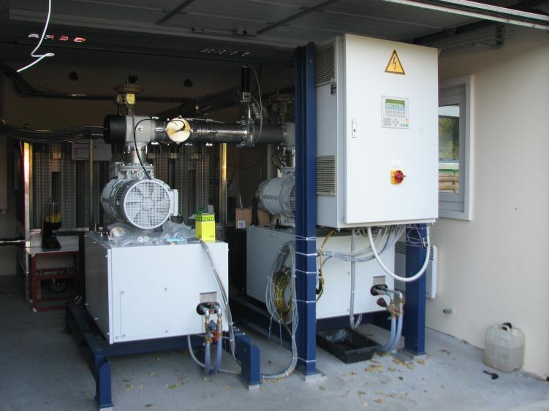
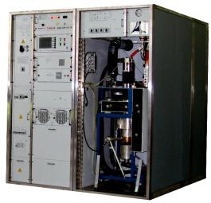
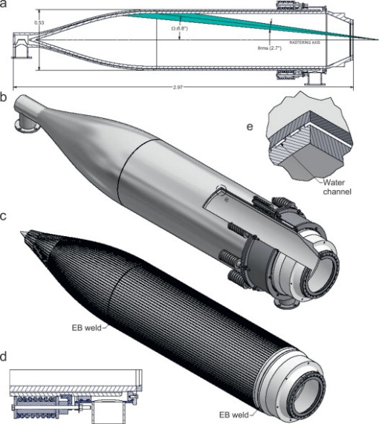
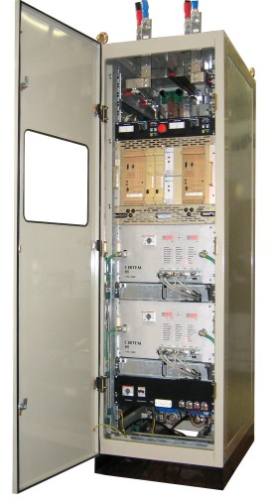
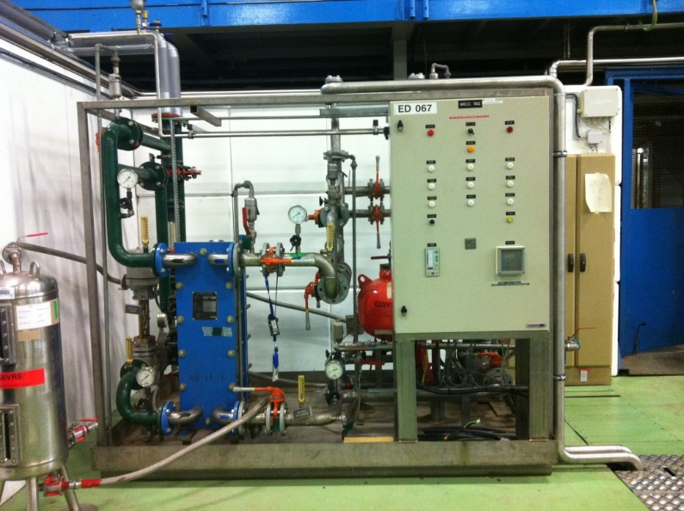
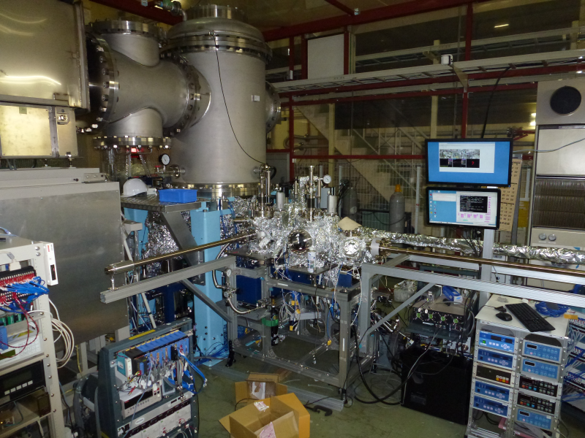
Other systems
Electron dump
RF power
Cryogenics
Power converters
Demineralized Water
e- source

Slide 5
How much more space?
(M. Tigner)
MESA (K. Auenbacher)
FFAG for eRHIC. (G. Hoffstaetter)

Slide 6
Total space needs
46x17m ~ 800m²
double the area of the accelerator itself to allocated all
services. 1500 m²
some services like RF power generation or power supplies may be placed on a different level than the accelerator itself,
We do not consider here the use of the interior part of the ring as the scape route would be compromised.
It may however be used to house a low energy dump which itself needs to be shielded and who will be on restricted access.
This is a significant size comparable to CFT3, AD or ISOLDE
How many buildings are there at CERN that can host a facility of that dimensions?

Slide 7
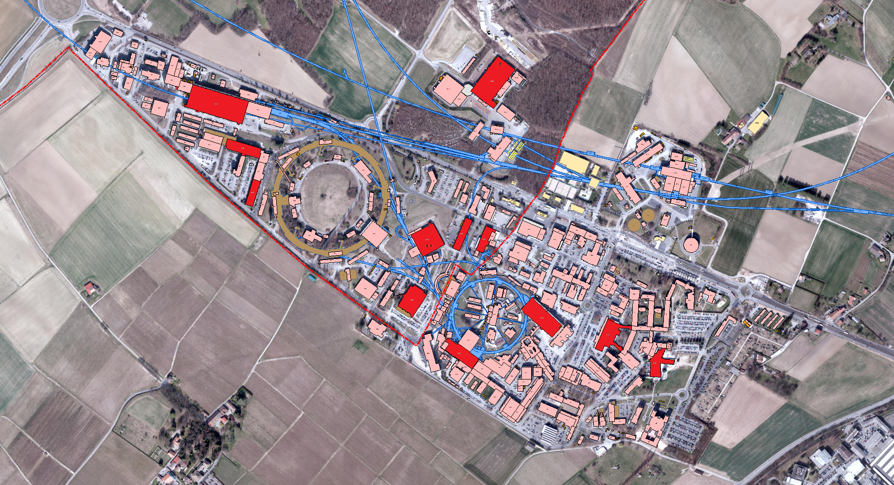
B. 180 Magnet recovery facility
B. 112 Brazing + LHC Klystrons
B. 378 TE/EPC testing
B. 193 AD + ELENA
B. 513 Computer Center
B. 3185 ATLAS shafts
B. 133 Recovery material
B. 170 ISOLDE
B. 150 LEAR
B. 157 EAST HALL
B. 100 Main Workshop
B. 510 Main building
B. 400 LINAC 4

Slide 8
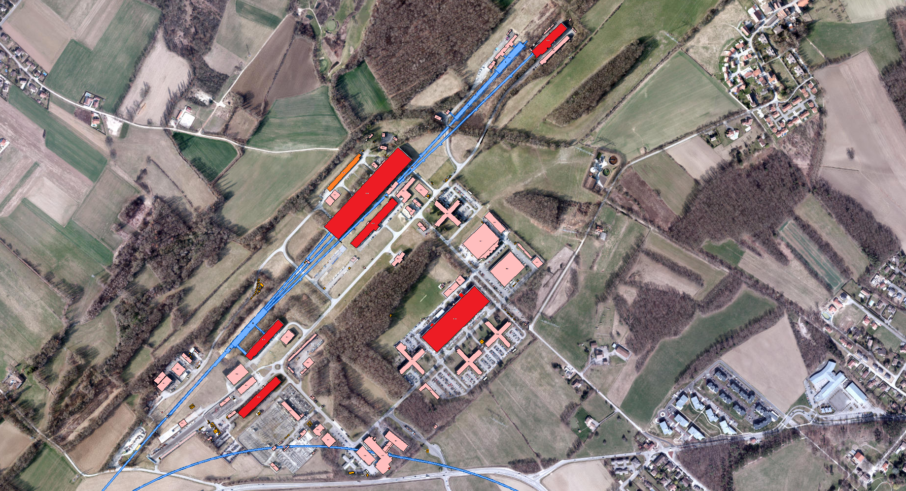
B. 889 SPS Access point
B. 897 Central Storage
B. 867 Radioactive facility
B. 888 COMPASS
B. 887 North Hall
B. 890 EN-CV for North Hall

Slide 9
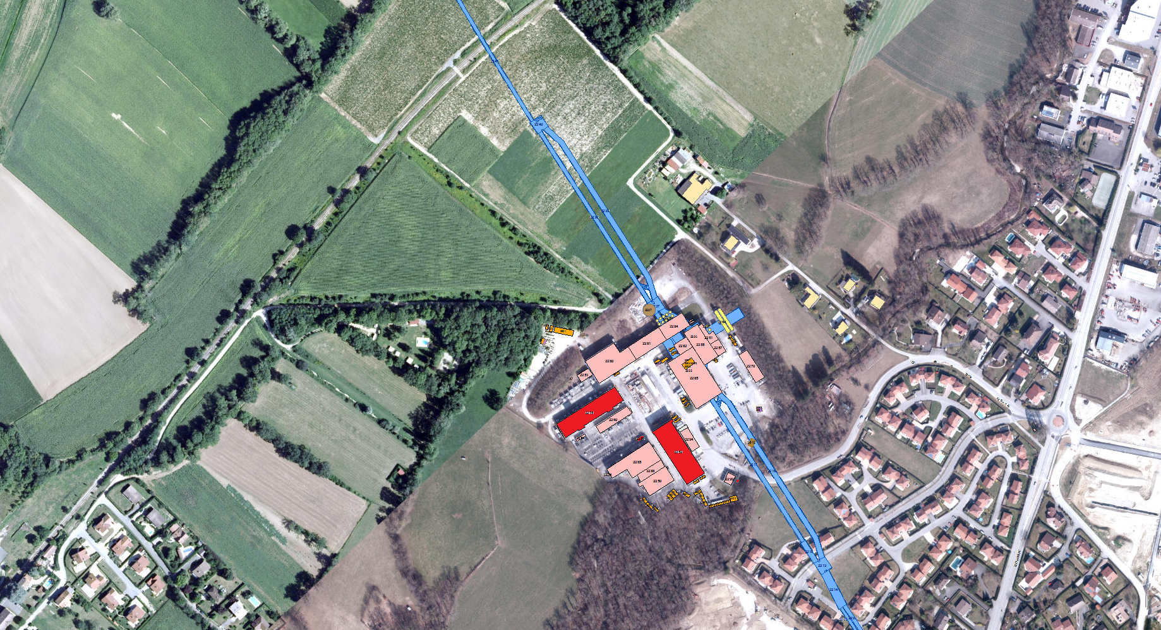
B. 2275 LEP converters and Klystrons
B. 2252 Alice Assembly hall
B. 2173 SM18
B. 2485 Shaft of point 4
B. 2685 Shaft of point 6
B. 3585 CMS Hall
… most SPS BAs

Slide 10
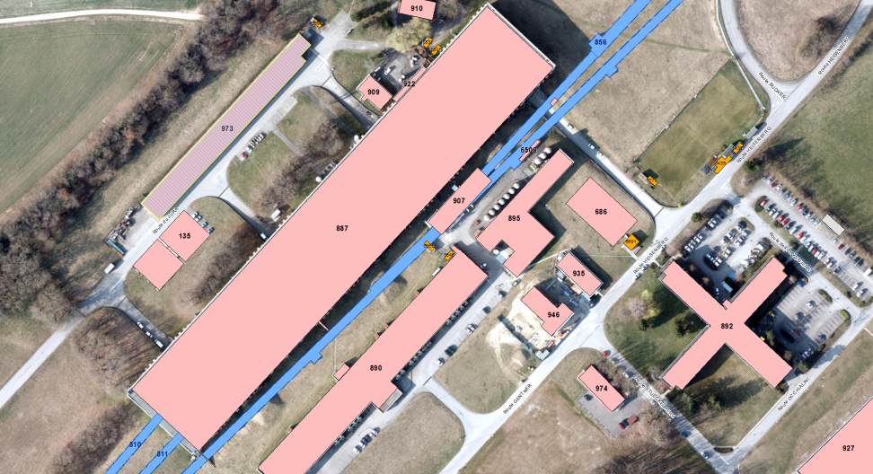
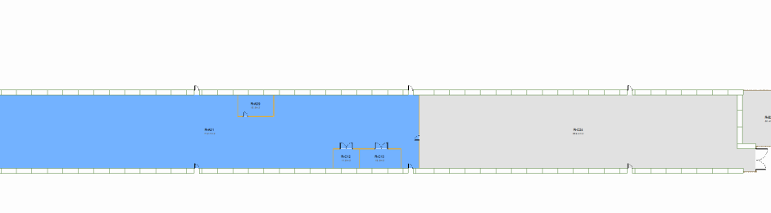
Building 973. Former QRL testing
Built for LHC- QRL testing. Currently used by EN mostly as storage
On the limit of the Prevessin site. Possible extension to be investigated
Some cryogenic infrastructure already available
Constructed from shielding blocks
No crane
Narrower than required
46x17
114 x 11

Slide 11
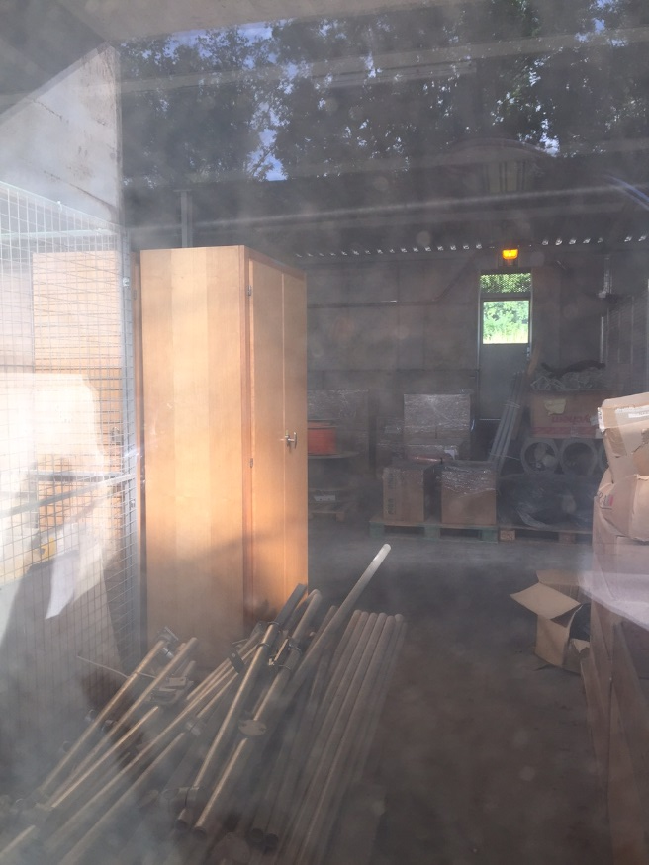
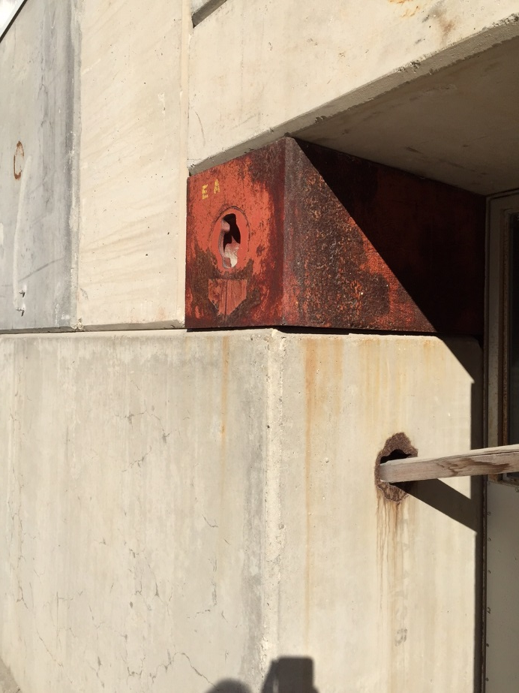
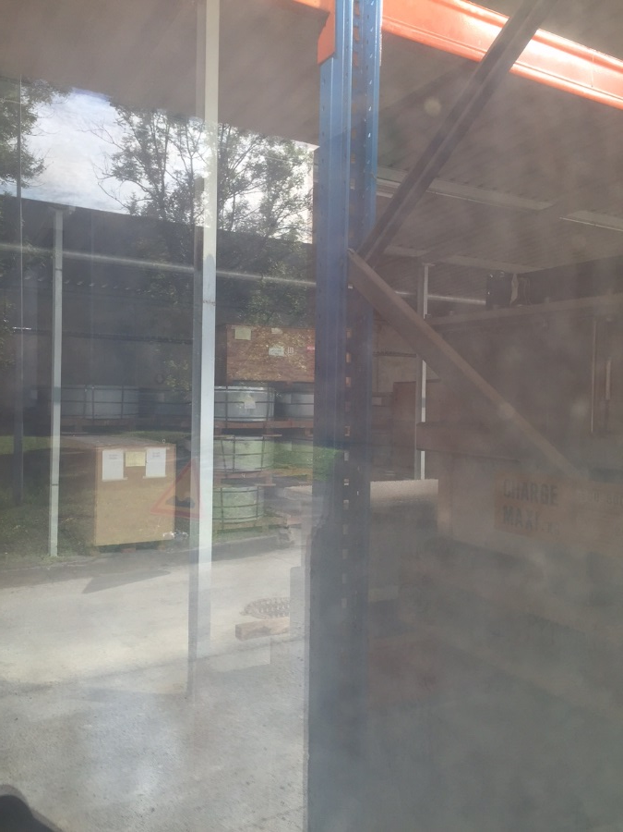
Building 973

Slide 12
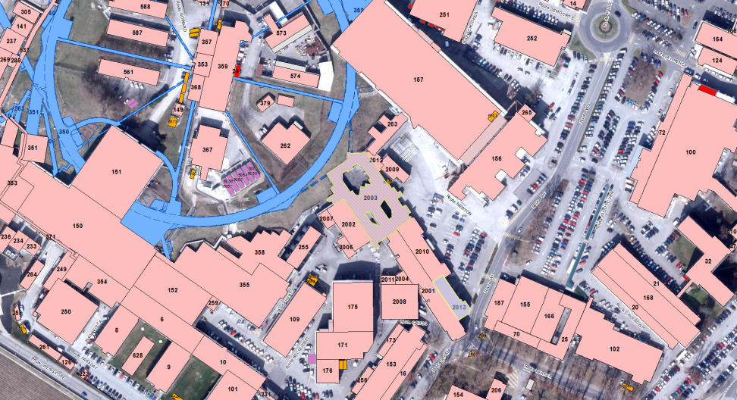
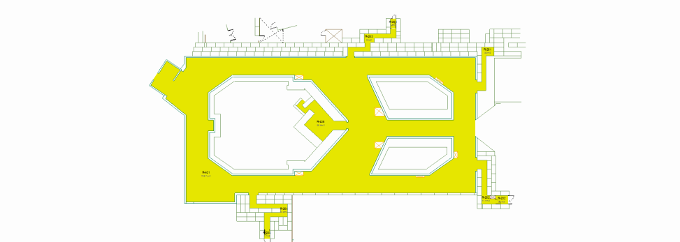
Building 2003 CTF3 combiner rings
Currently CTF3 to end operation in 2016
It is a beam facility: shielding, access, galleries, etc
Complicated topology. Expensive to clean out
Cryogenics?
46x17
60 x 25

Slide 13
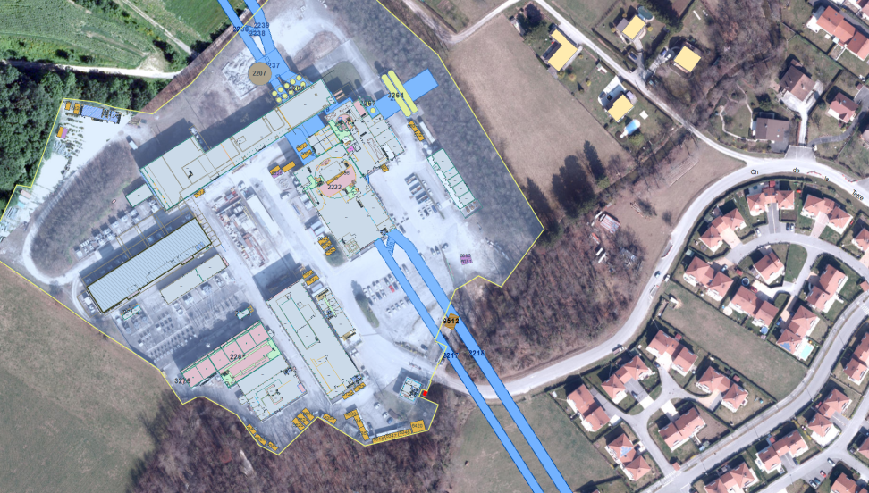
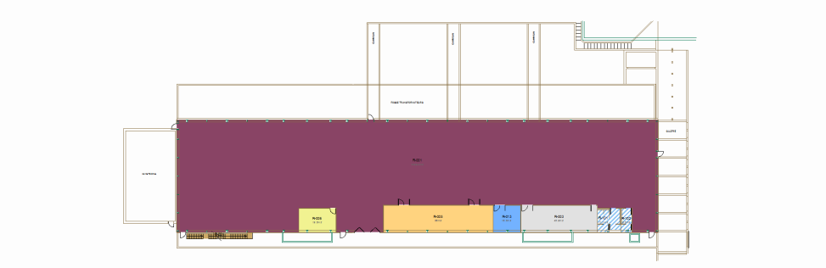
Building 2275. Point 2
LEP power converters and klystrons spares.
Power converters already in place.
Geographically good as injector for LHeC ERL
In use for LHC TI2 and Alice. Could we share the space?
46x17
71x16

Slide 14
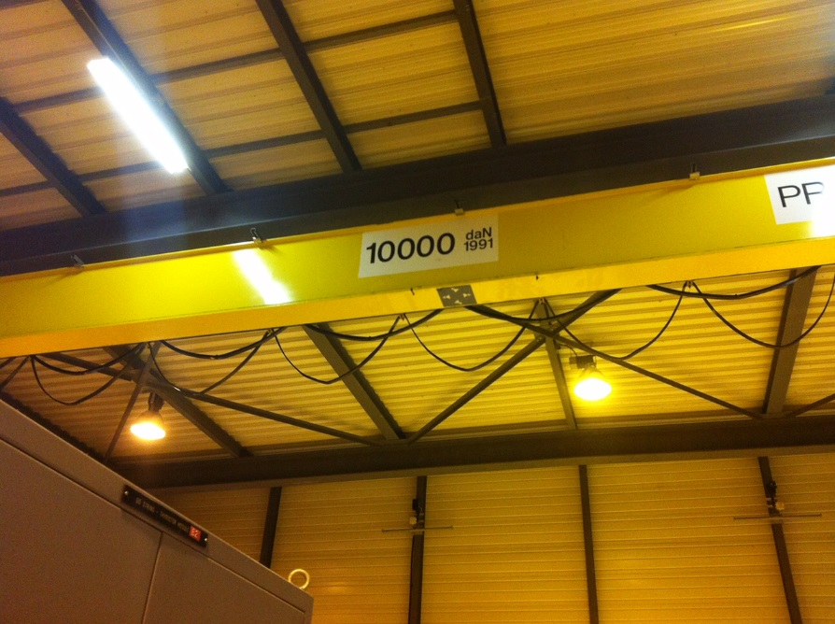
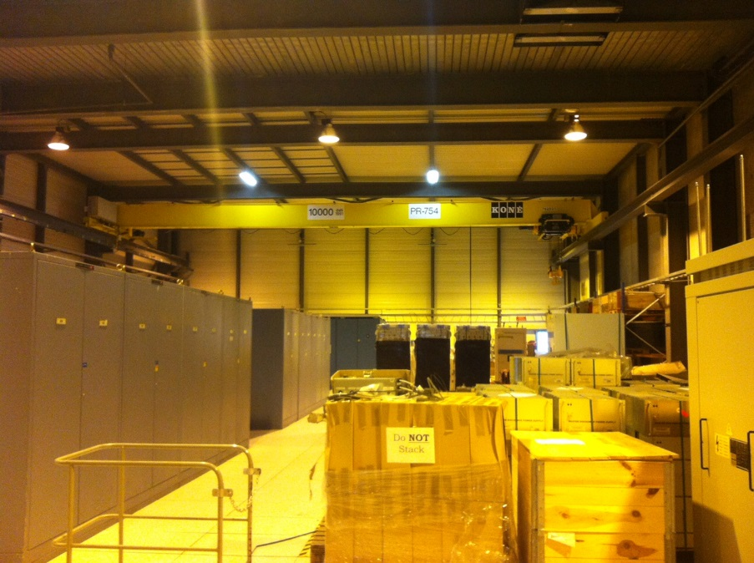
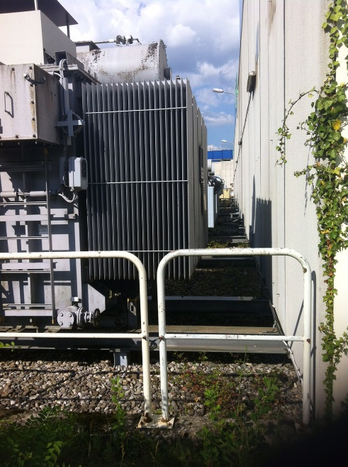
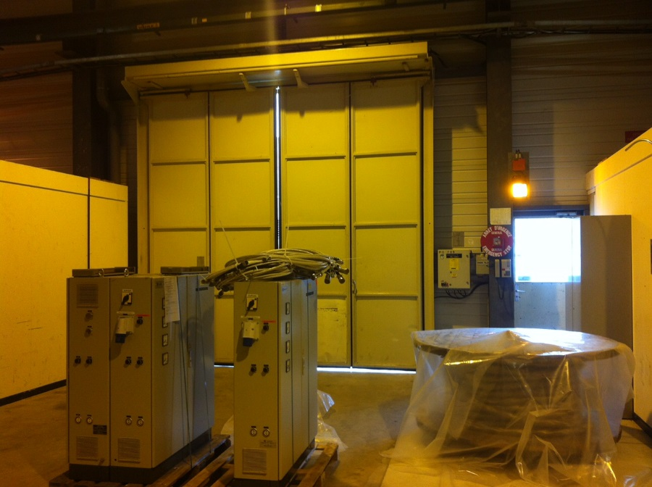
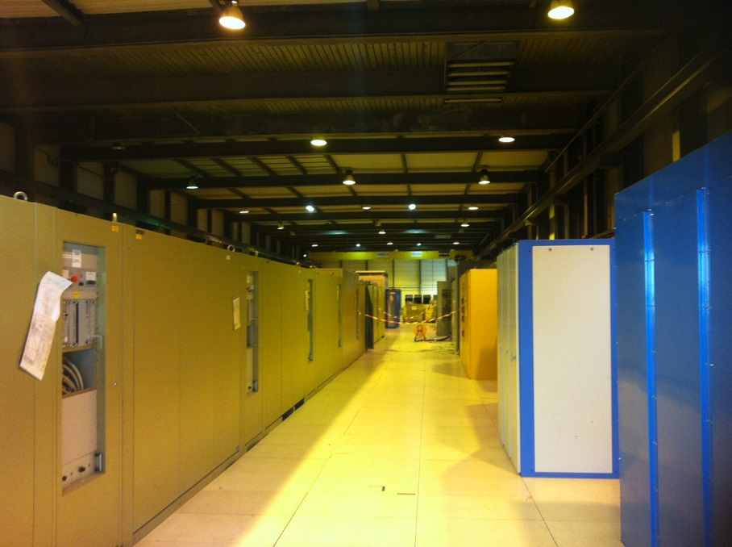
building 2275

Slide 15
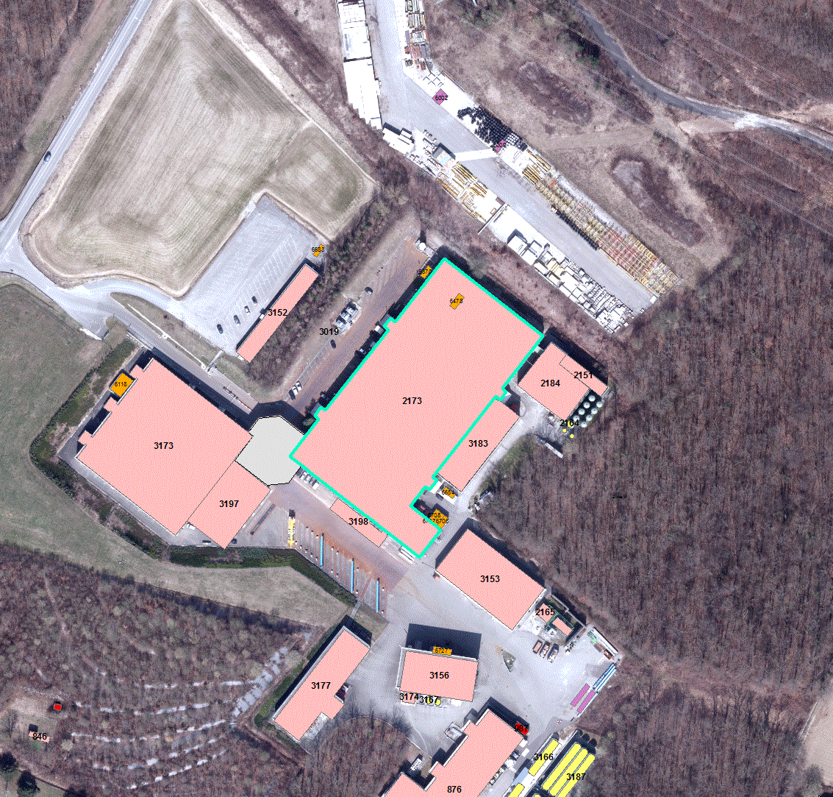
Around point 18
No space available in any of the buildings on the site but lots of empty space around it.
Why not build a new facility building in the north storage area?
Cryogenics water power and other services already available. May be upgraded
Accessibility for quench tests
Completely new construction
47x16

Slide 16
Conclusions
Lattice seems to be converging and with it the site dimensions
A small number of buildings in the CERN site could host the facility
Very dependent of the final implementation
Costs and time is very much site dependent
Maybe better/simpler is we assume a new building?
If you happen to have 1500m2 available, please contact us.

Slide 17
Thanks for your attention!

Slide 18
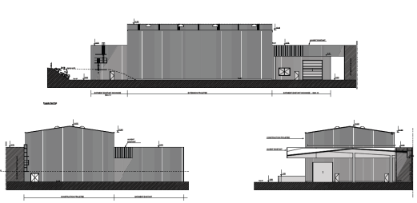
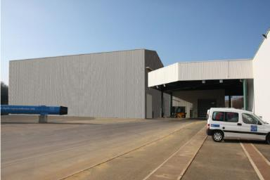
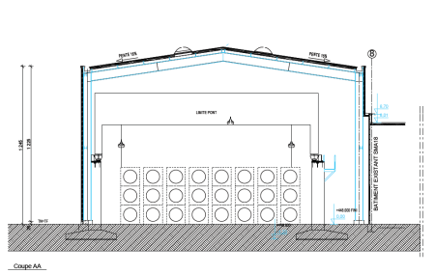
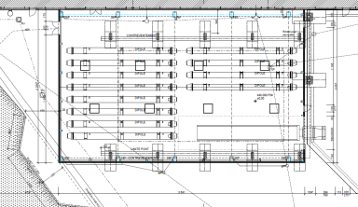
Extension of SMS18 (3197)

