Slide 1
Performance of nitrogen doped cavities
Anna Grassellino
SRF cavity test group leader, High Q program manager, TD
LHeC Workshop June 24-26, 2015 Geneva

Slide 2
Nitrogen Doping: a breakthrough in Q
Record after nitrogen doping – up to 4 times higher Q! Average values obtained on nine cell Q(2K, 16MV/m)~ 3.5e10
Typical Q obtained in VTS with 120C bake ~ 1.7e10 at 2K, 16 MV/m
Standard state-of-the art preparation
1.3 GHz
A. Grassellino et al, 2013 Supercond. Sci. Technol. 26 102001 (Rapid Communication)

Slide 3
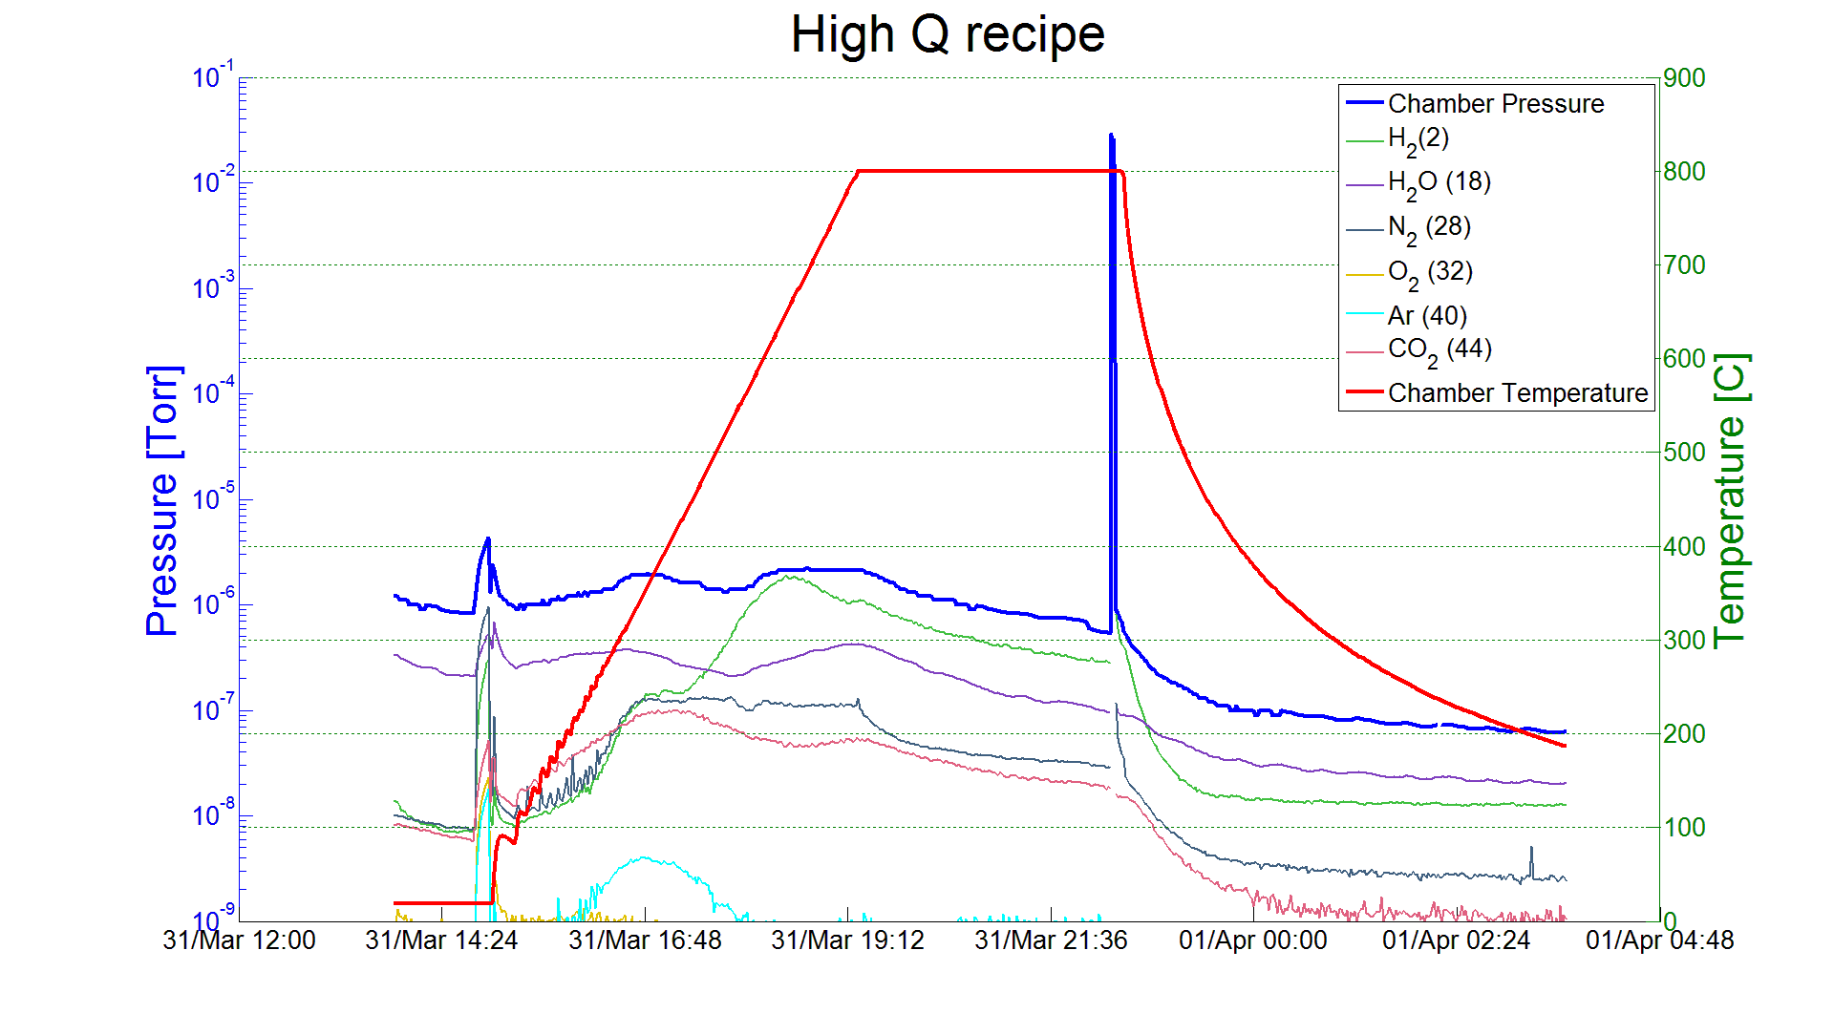
Doping Treatment: small variation from standard protocol, large difference in performance
Example from a doping process developed for LCLS-2:
Bulk EP
800 C anneal for 3 hours in vacuum
2 minutes @ 800C nitrogen diffusion
800 C for 6 minutes in vacuum
Vacuum cooling
5 microns EP
Ship to DESY
Cavity after Equator Welding
HOM Tuning
X
EP 140 um
120C bake
Short HPR
Leak Check
External 20 um BCP
Final Assembly
XFEL
Long HPR
Ethanol Rinse
VT Assembly
800C HT Bake
Helium Tank Welding Procedure
RF Tuning
Long HPR
EP 40 um
Ethanol Rinse
HPR
3

Slide 4
A bit of history about N doping
Discovered at FNAL in 2012 on single cells treated with nitrogen in high temperature furnace
During the first two years FNAL focused on understanding root of improvement and making process controllable and reproducible on single cells
Different doping recipes were designed based on simple diffusion models and implemented/tested; went from one step diffusion to two step diffusion to create flatter, deeper nitrogen concentration – this improved robustness and quench fields
In 2014 LCLS-2 decided to invest on this technology to go from wide demonstration on single cell to production ready nine cell; three partner labs working together FNAL-Cornell-Jlab
More than 100 N doped cavity tests with 16 nine cell qualified for the two LCLS-2 prototype cryomodules
Vendors RI and Zanon currently being qualified for N doping production process for LCLS-2
R&D continues for further understanding and improvements (quench, B sensitivity)

Slide 5
Origin of the Q improvement
Reverse field dependence of the BCS surface resistance component → lowest R_{BCS}
Lower than typical residual resistances (seems to zero all contributions but trapped flux)
Cause of MFQS
Origin of Q antislope
A.Grassellino et al, 2013 Supercond. Sci. Technol. 26 102001
A. Romanenko, A Grassellino, Appl. Phys. Lett. 102, 252603 (2013)

Slide 6
Physics – perceived BCS limit has been overcome
Anti-Q-slope emerges from the BCS surface resistance decreasing with field
This is what BCS theory predicted to be the lowest possible surface resistance
The increasing Q with field allows to run at higher gradient with lower cryo-cost
A. Grassellino et al, 2013 Supercond. Sci. Technol. 26 102001 (Rapid Communication)
A. Romanenko and A. Grassellino, Appl. Phys. Lett. 102, 252603 (2013)

Slide 7
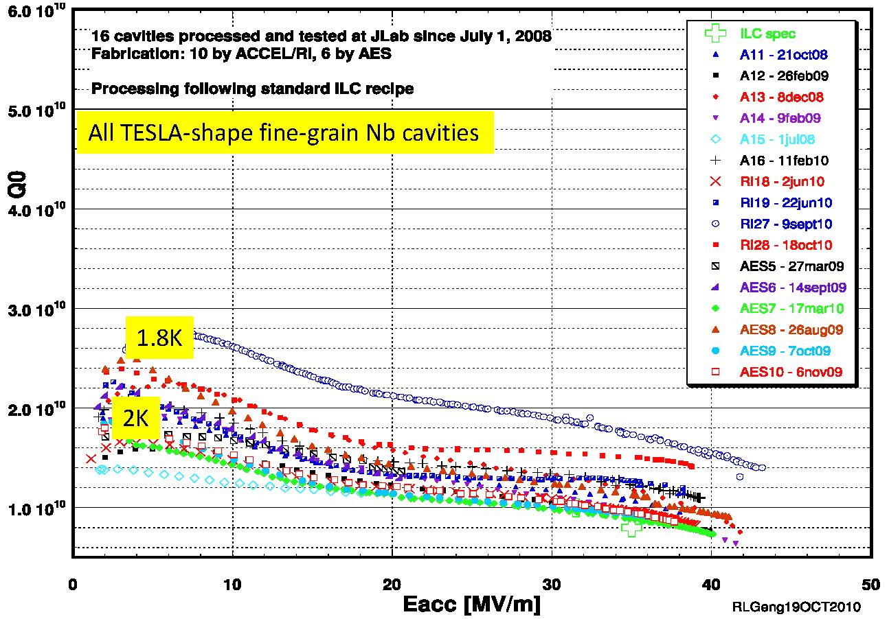
The importance of a high Q technology – the case of the CW machine LCLS-2
Example of 120C baked (standard ILC/XFEL technology)
Would possibly require > 2 full cryoplants
Example of N doped
Dressed cavity for LCLS-2
Below the one cryoplant threshold
LCLS-II one vs two 2K cryoplants threshold
One vs two 2K cryoplants threshold
Two vs three 2K cryoplants threshold
N doping technology allows significantly lower refrigeration costs (capital, operating)
Larger margin and possibility for an energy upgrade for same refrigeration cost

Slide 8
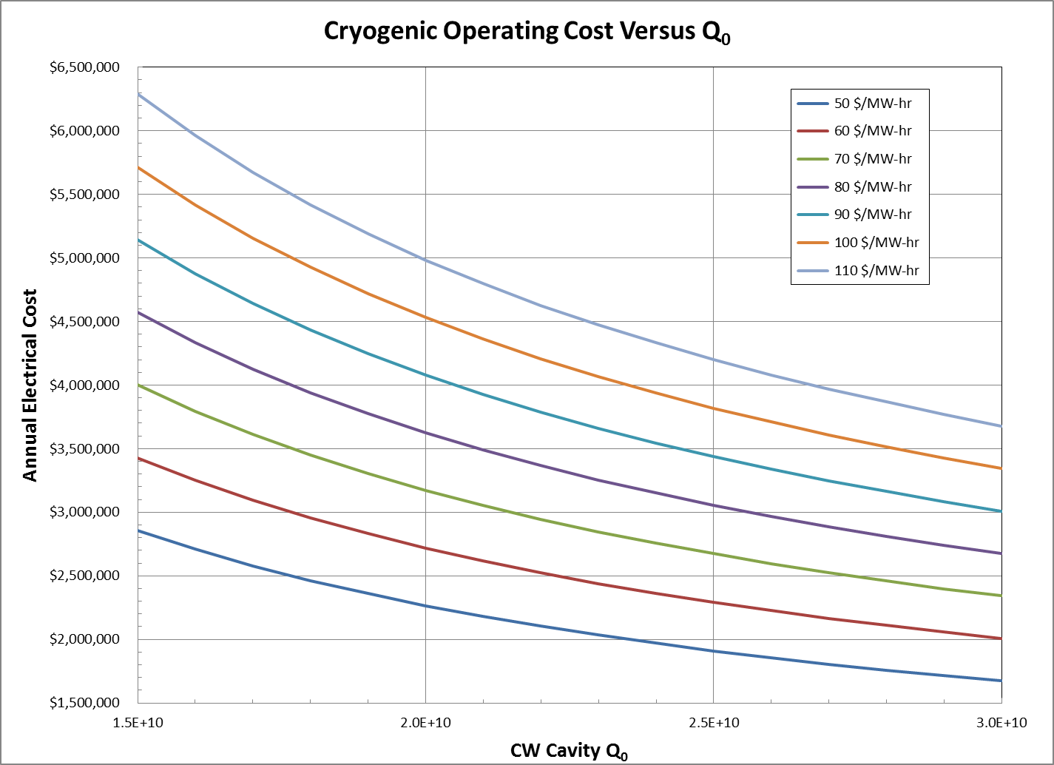
The importance of a high Q technology – the case of the CW machine LCLS-2
Higher Q ~ 3e10 compared to 1.7e10 will translate into ~1.5 millions saving per year in operating costs
Capital cost savings go in thresholds of several tens of millions (LCLS-2)

Slide 9
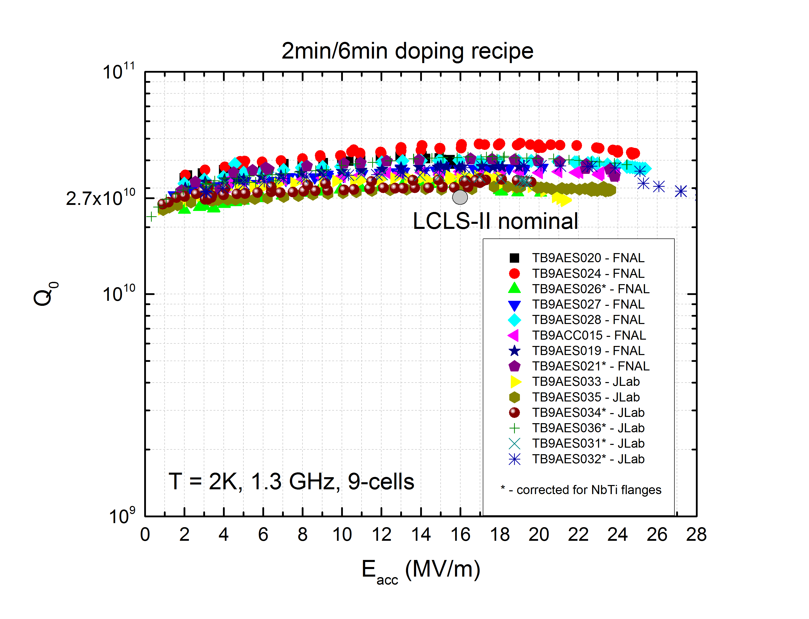
From single cell R&D to cryomodule ready technology: the two LCLS-II prototype cryomodules (FNAL and Jlab)
<Q>=3.6e10
<E_{max}>=22.2 MV/m
E_{max}median=22.8MV/m
It is the highest average Q ever demonstrated in vertical test for 1.3 GHz nine cells at 2K, 16 MV/m in the history of SRF
(larger than a factor of two the state of the art)

Slide 10
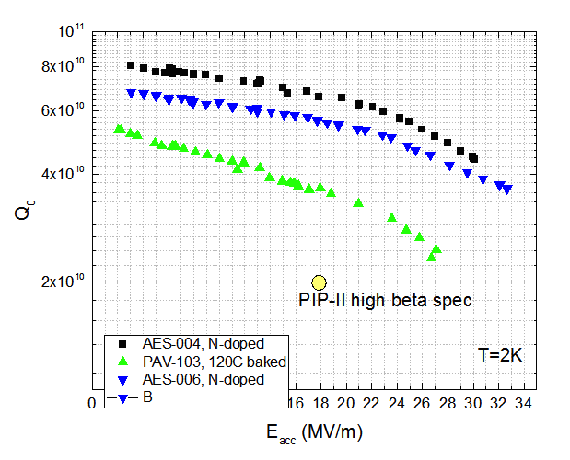
N doping applied to 650 MHz cavities at FNAL
Q~ 7e10 at 2K, 17 MV/m – record at this frequency!
Applying N doping to 650 MHz (beta=0.9) leads to double Q compared to 120C bake (standard surface treatment ILC/XFEL)
But from frequency scaling from 1.3GHz, with ideal recipe the projected Q value is ~1e11 at 17 MV/m, 2K! Need to optimize doping recipe at lower freq

Slide 11
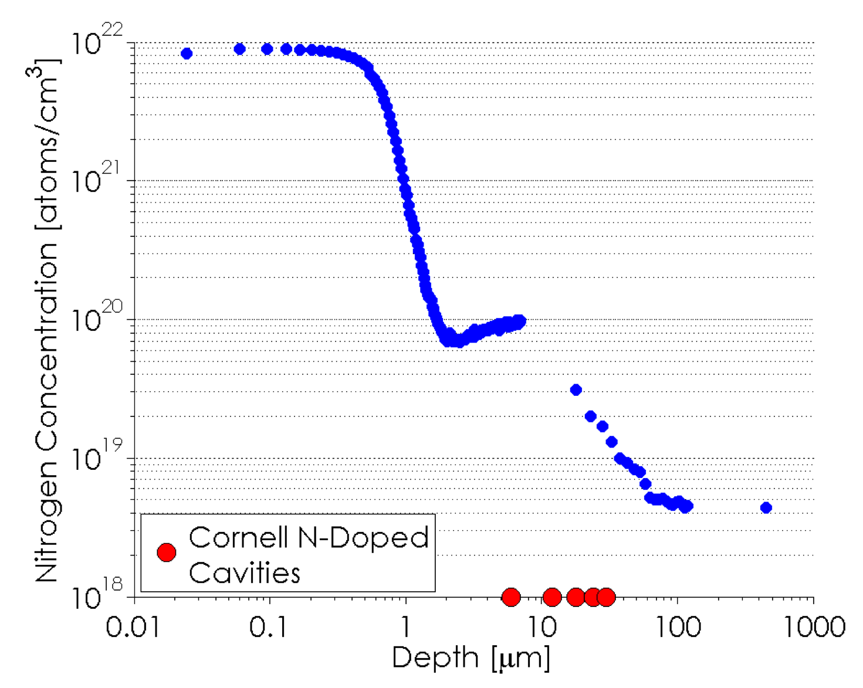
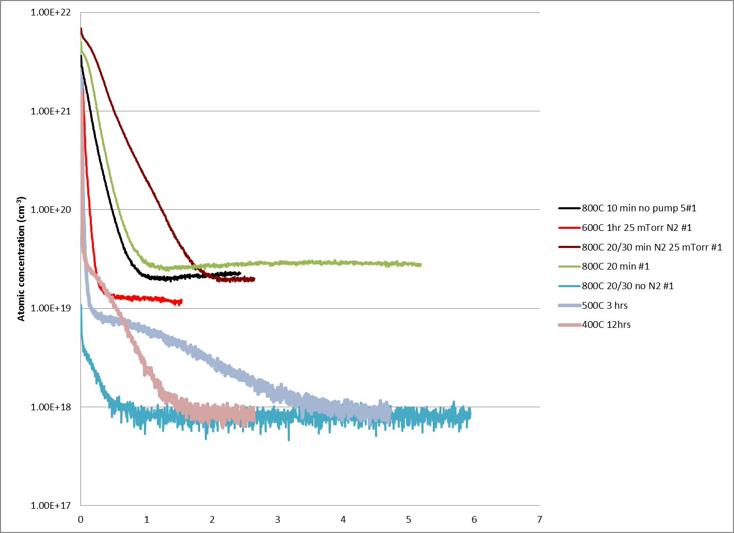
What does the N treatment do? N doping profiles via SIMS
Nitrides
Interstitial nitrogen in Nb
Doped
Non-doped
Depth (um)
A. Romanenko, talk at LINAC 2014, Geneva
And D. Gonnella et al, LINAC 2014, Geneva
C. Reece et al, WEPWI026
11

Slide 12
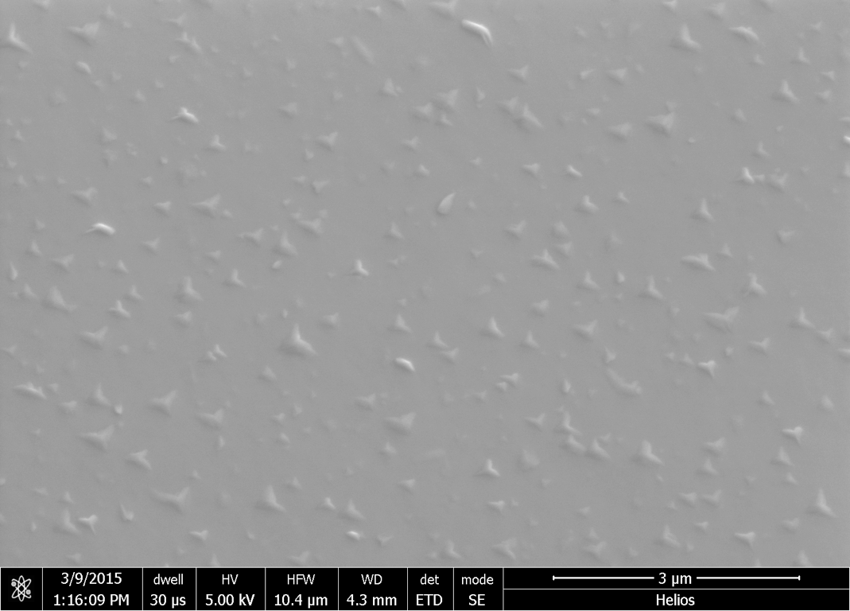
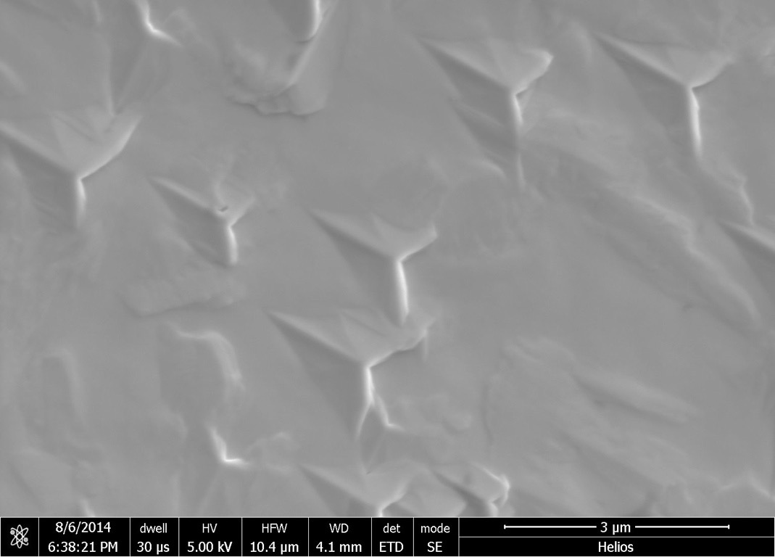
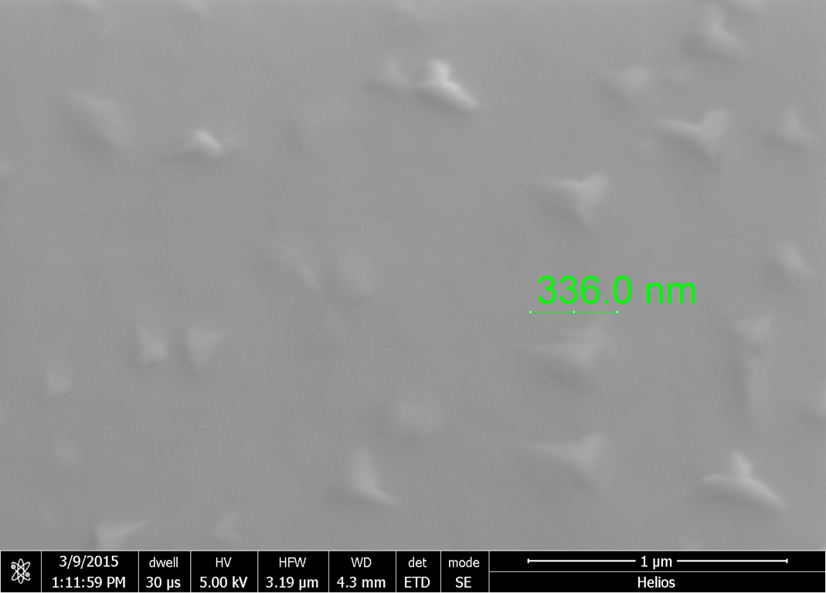
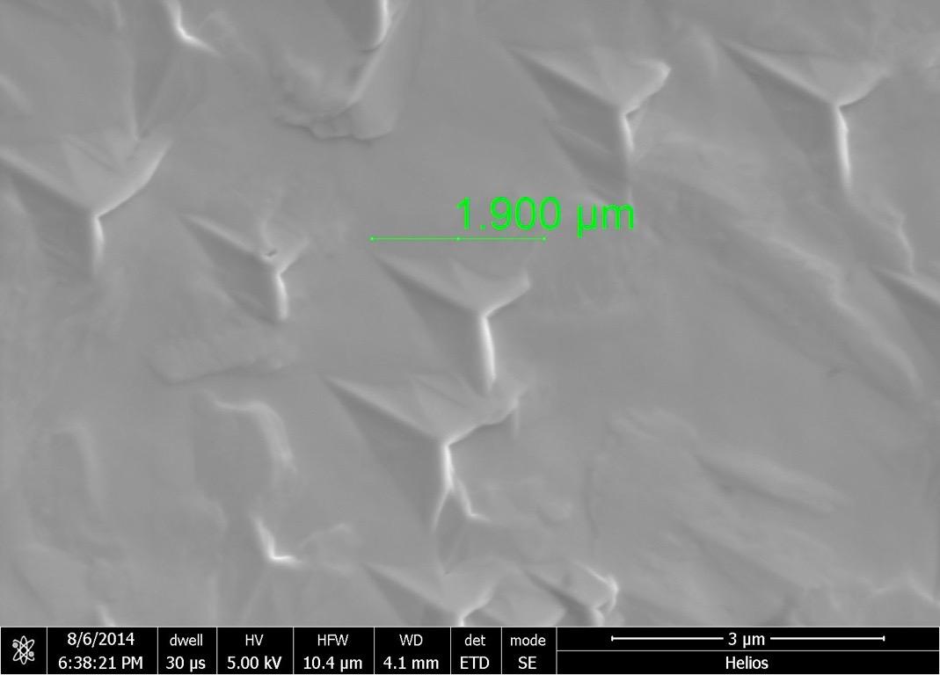
Surface Nitrides (post bake, pre-EP) – imaged by SEM
Flat Nb sample baked at 800C˚
for 2 min with N2 + 6 min annealing
Flat Nb sample baked at 800C˚ for
20 min with N2 + 30 min annealing
Bad (poorly SC) nitride phases that need to be removed via EP

Slide 13
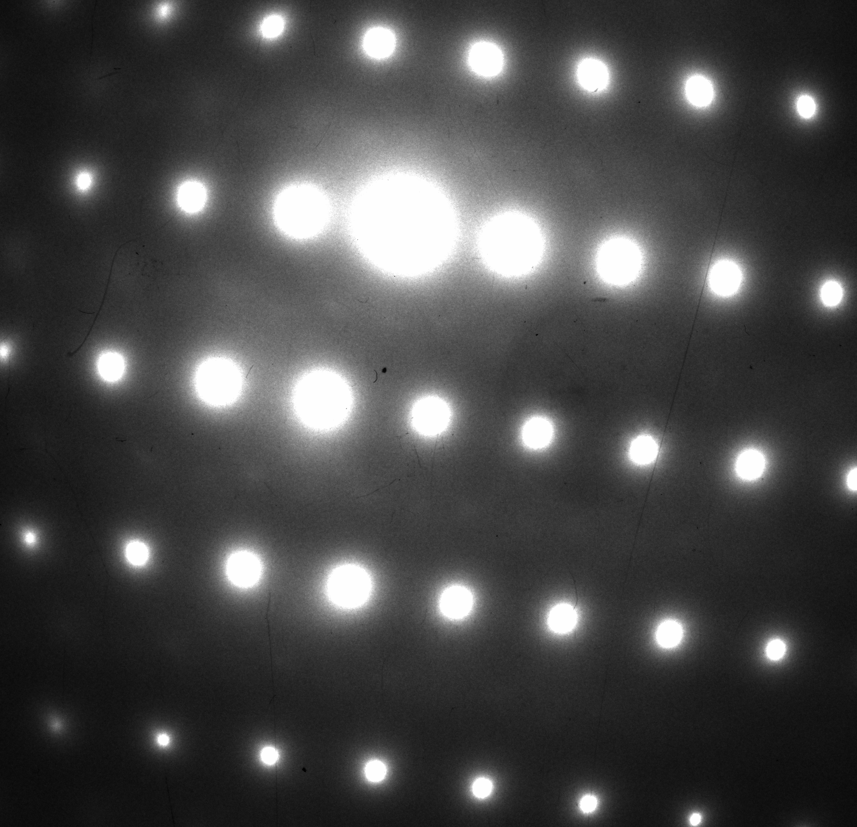
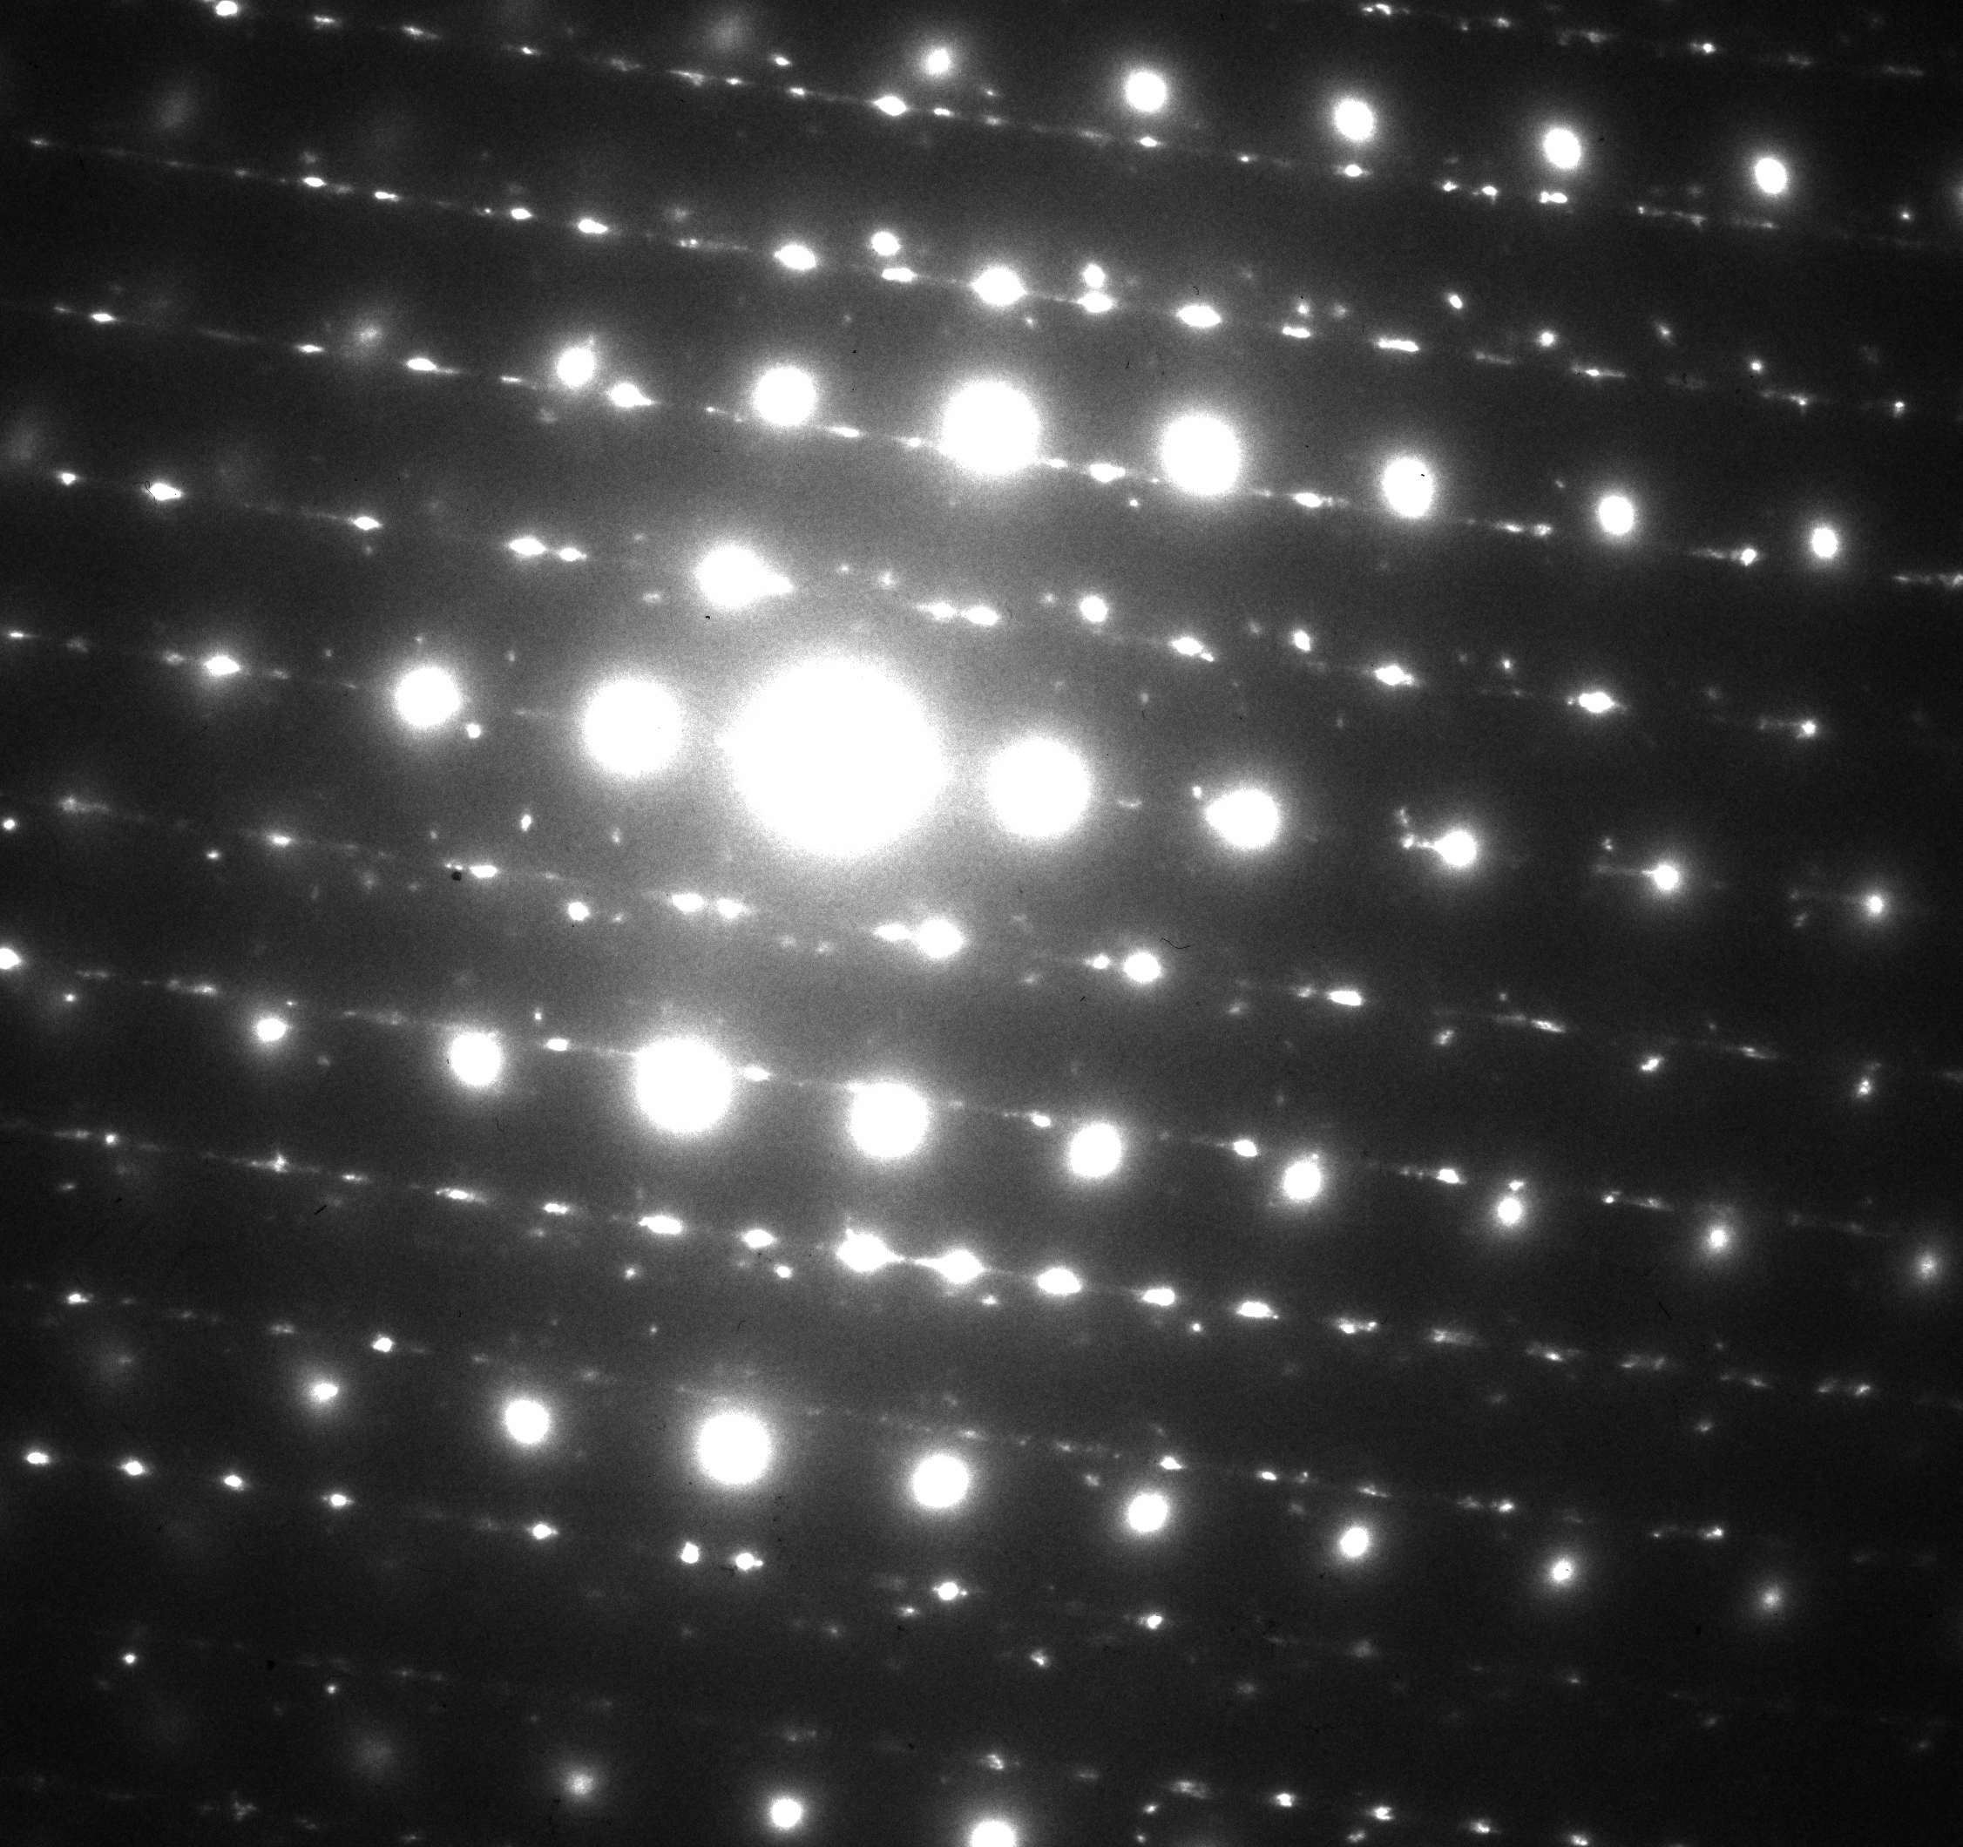
Room T TEM on post gas bake, pre-EP surface (2/6 recipe)
Pt layer
Nb [113]
a) μm-sized areas of “uniform” contrast in near-surface show only Nb reflections
Courtesy of Y. Trenhikina, FNAL
Nb [113]+Nb2N [210]+?
b) few Nb nitrides-features (Nb2N reflections) in Nb near-surface. Nitride “teeth” go ~0.2 μm deep
Pt layer
~0.2 μm

Slide 14
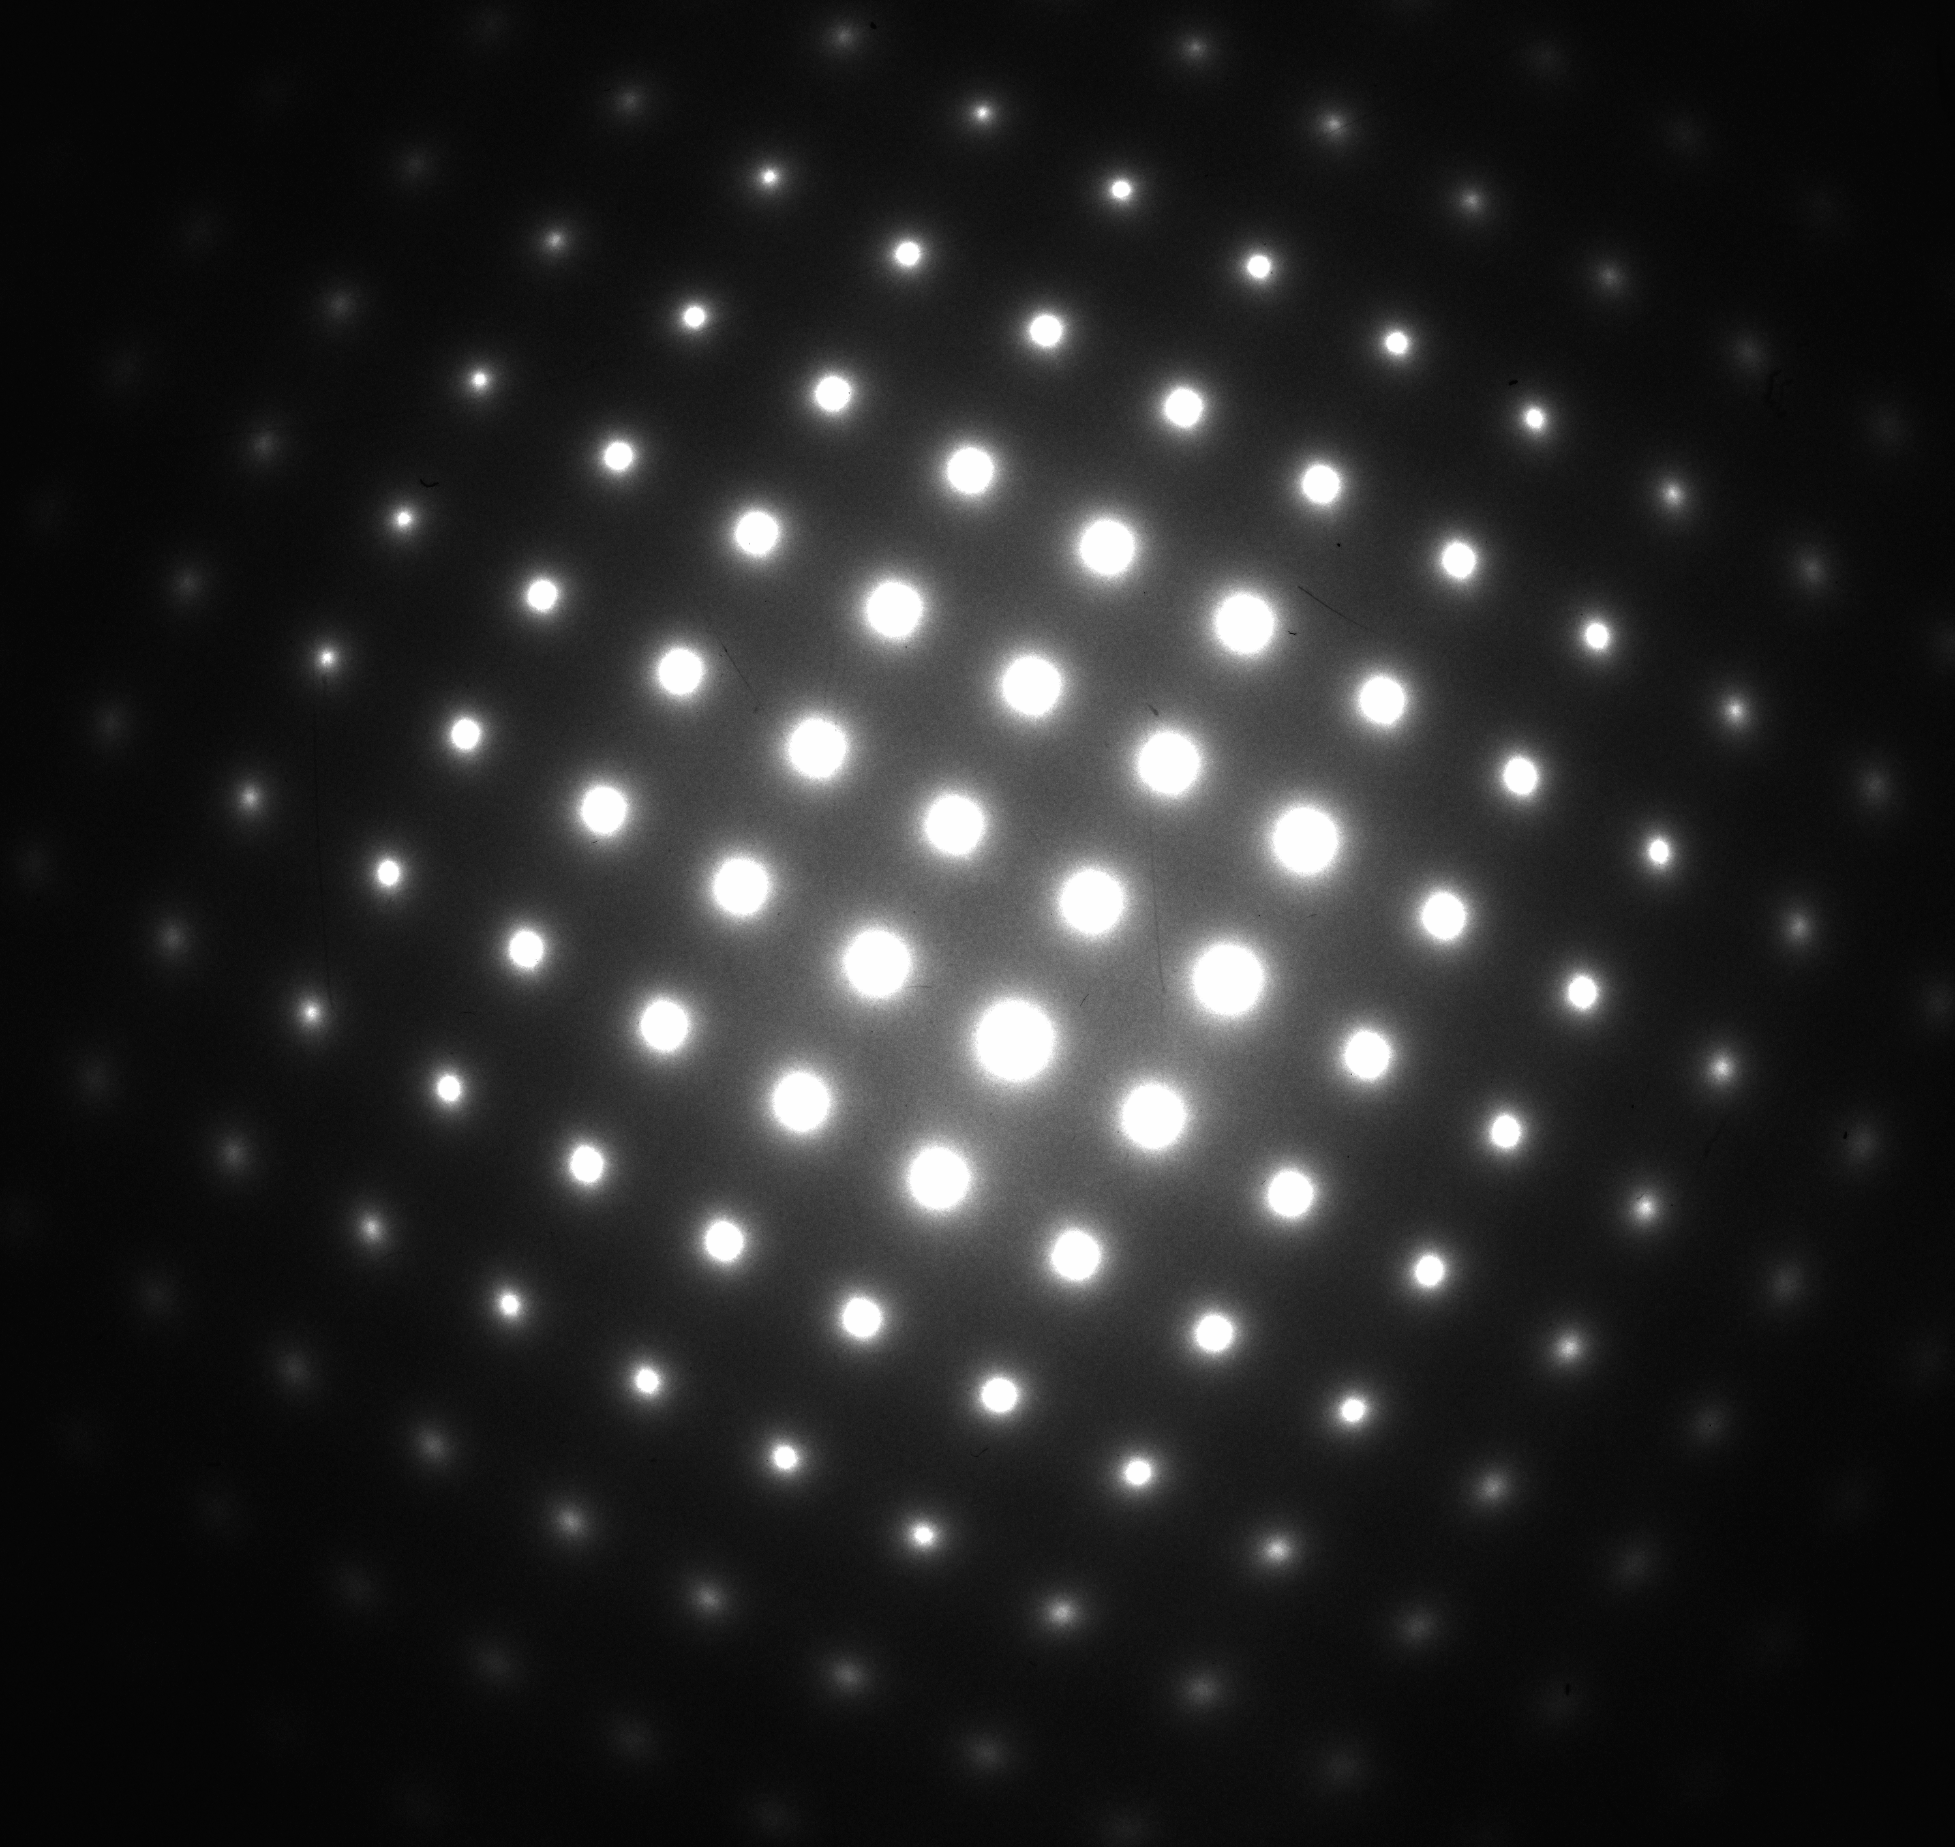
Room T TEM on N doped surface AFTER EP
Nb [100]
Preliminary: no visible Nb nitrides-teeth in near-surface show only Nb reflections
Confirms that root of improvement is from nitrogen as interstitial in the lattice

Slide 15
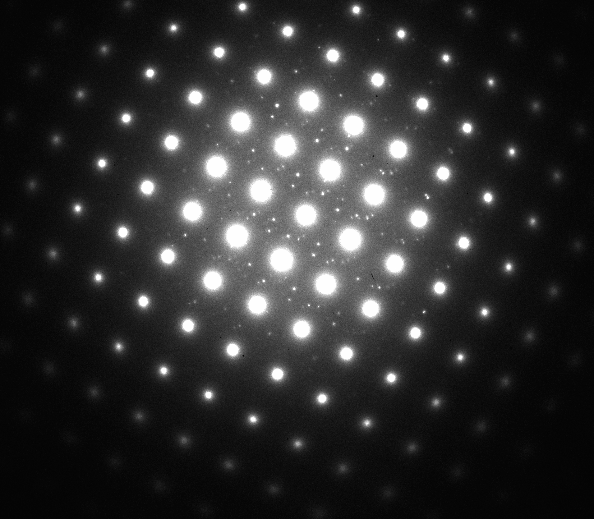
Cryogenic TEM on N doped surface AFTER EP
ROOM T
90K
Nb [100]
Preliminary: large near-surface area is affected by Nb nanohydride precipitation! But different than typical: closely spaced, very small/thin Nb hydrides.
Nanohydrides in standardly treated samples: Trenikhina et. al. J. of Appl. Phys., 117, 154507 (2015).

Slide 16
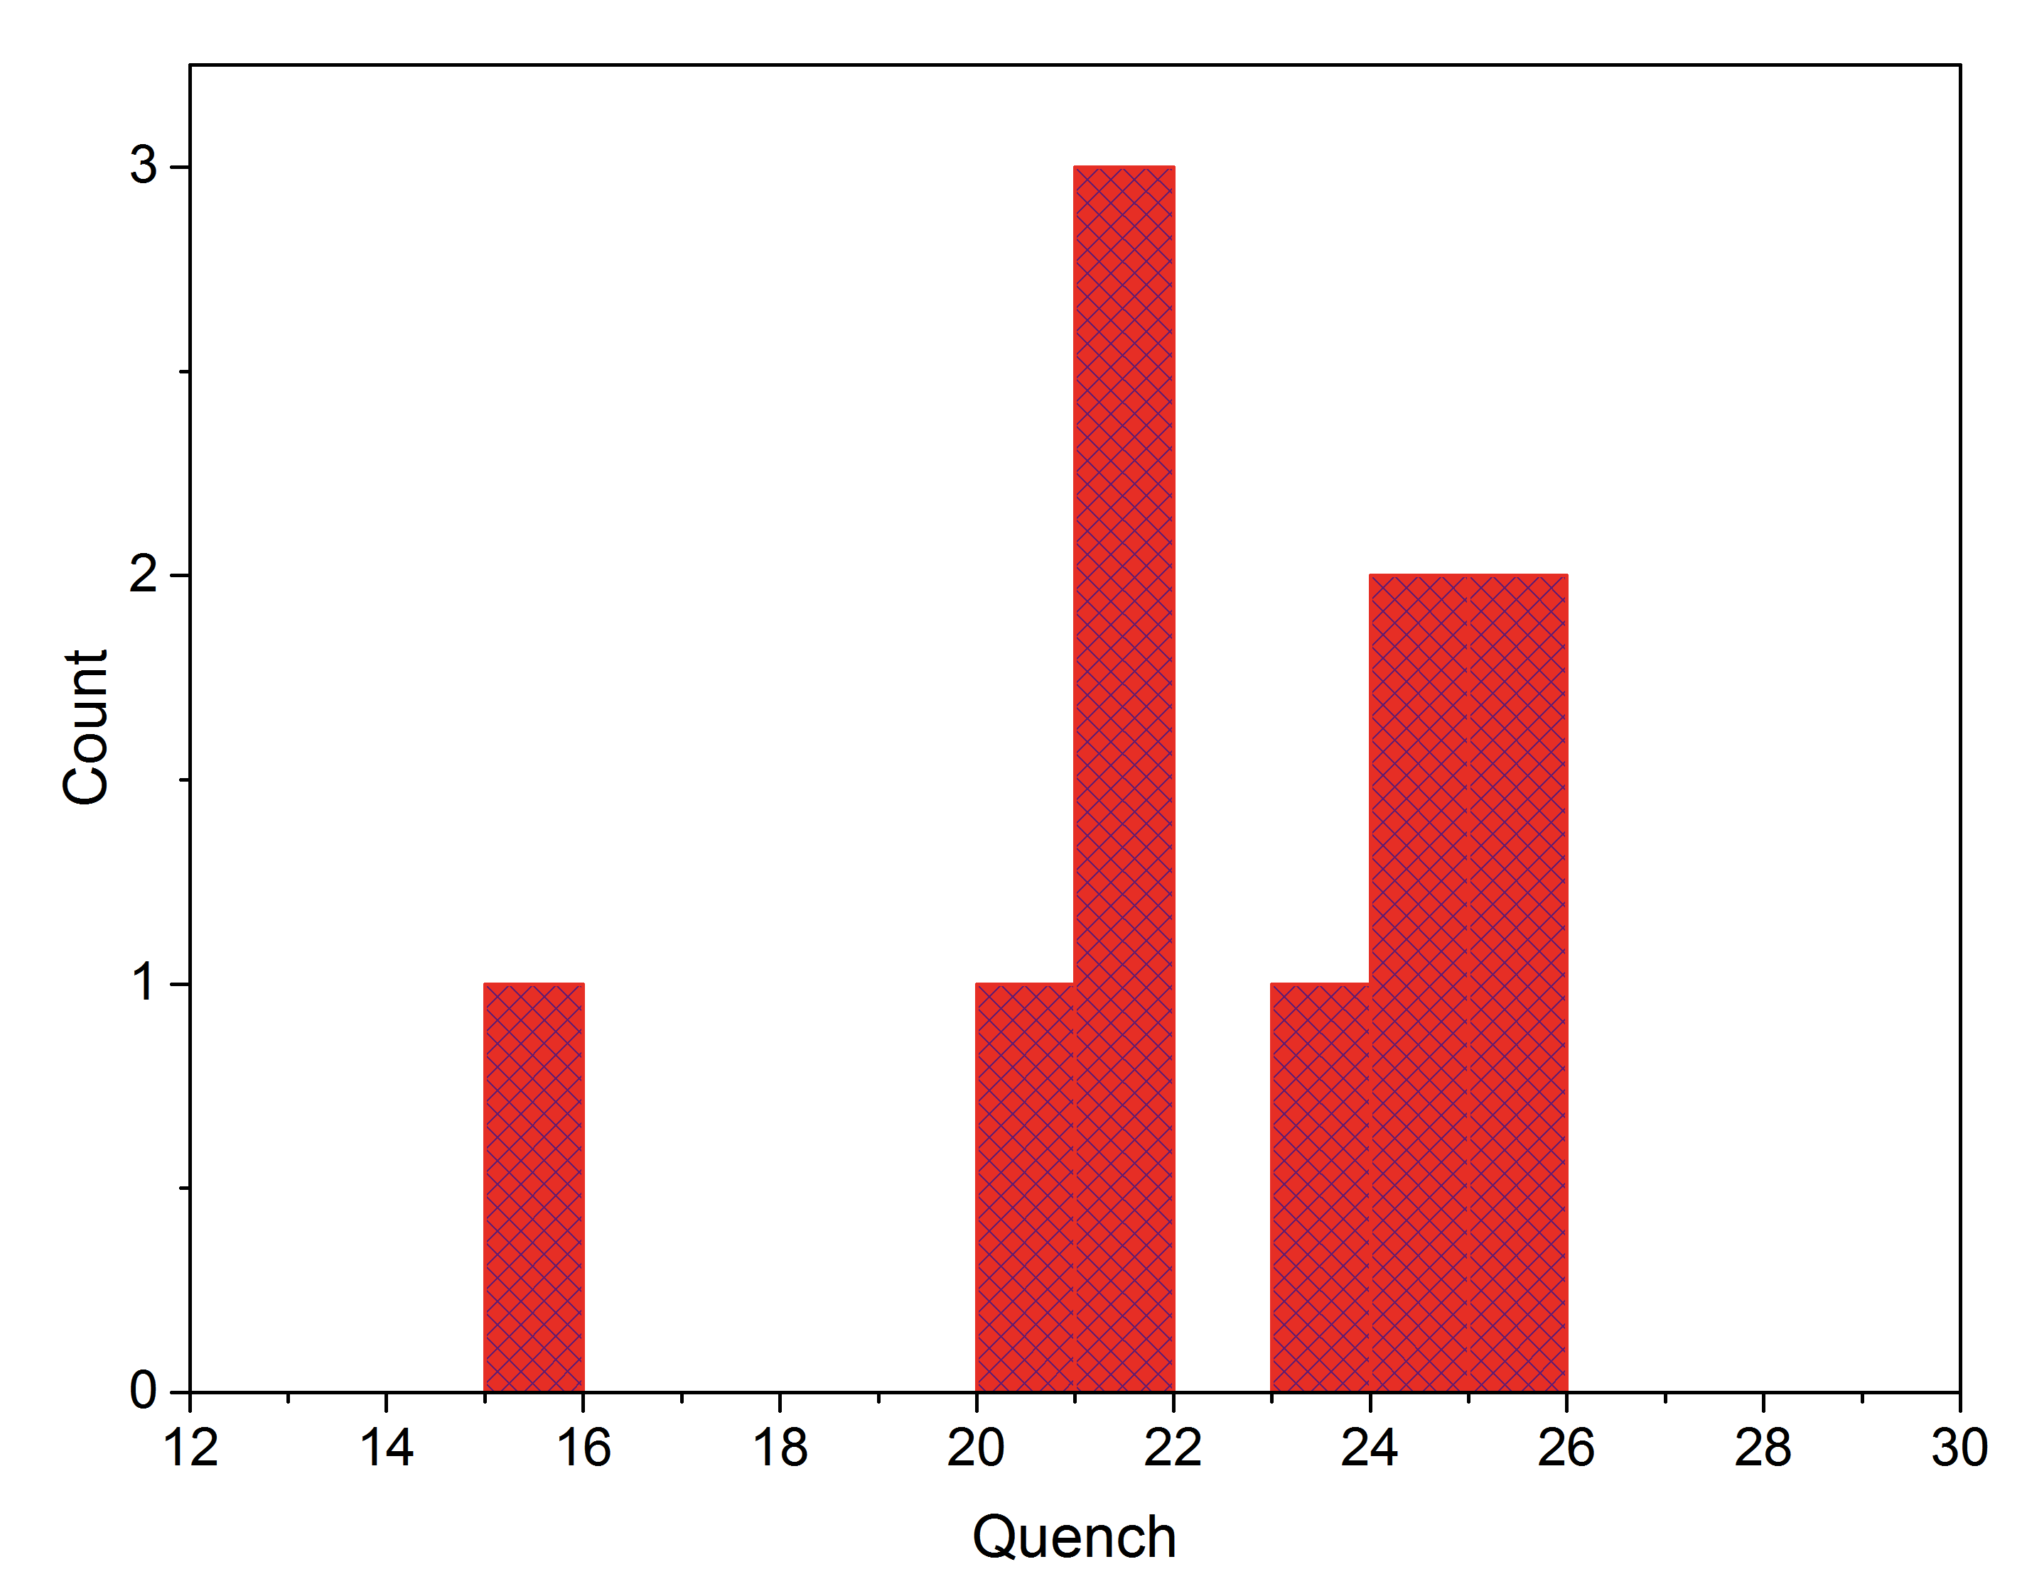
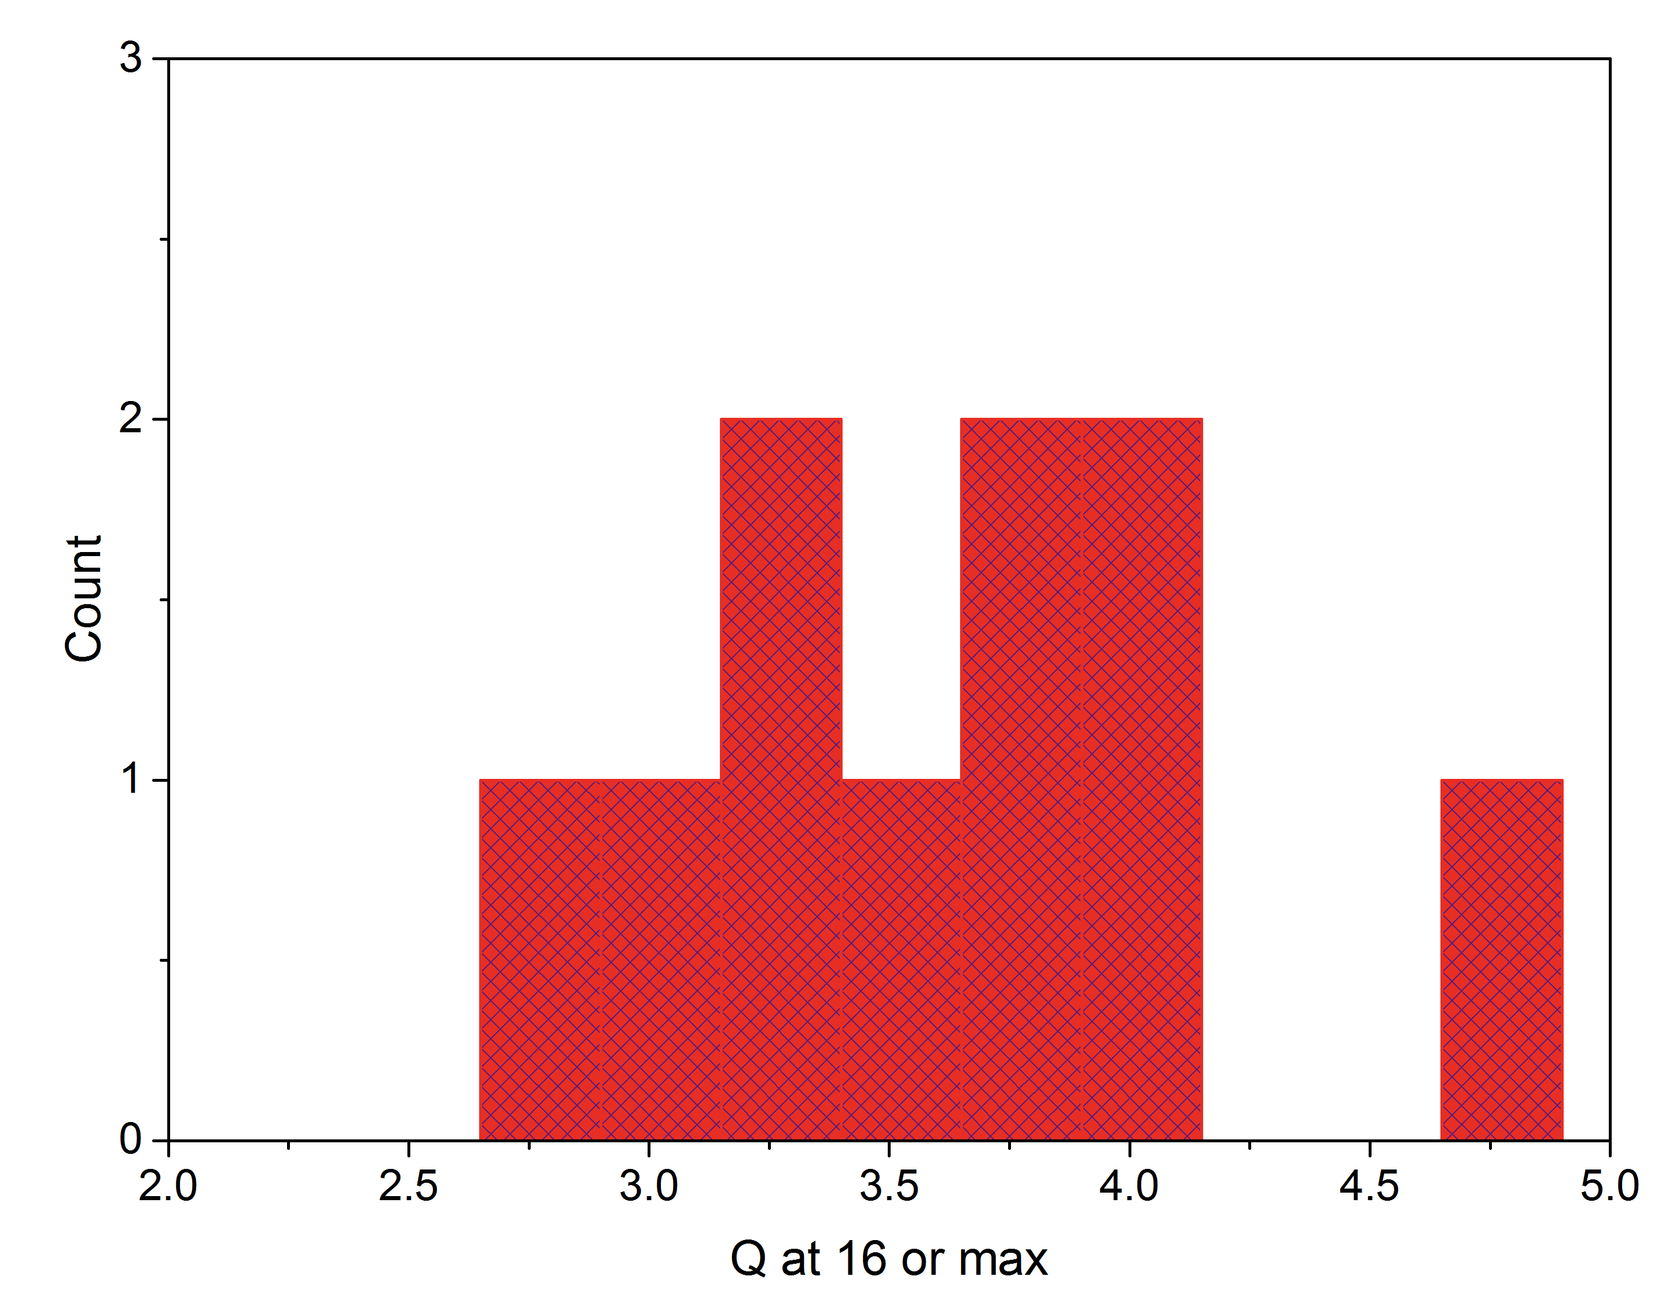
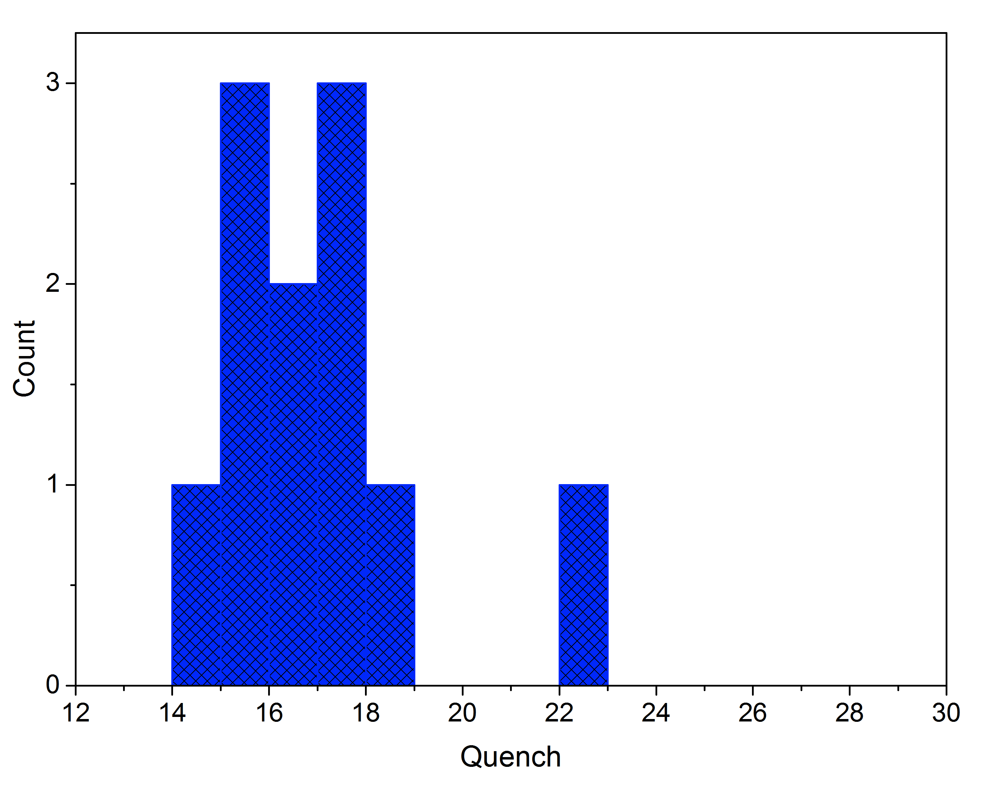
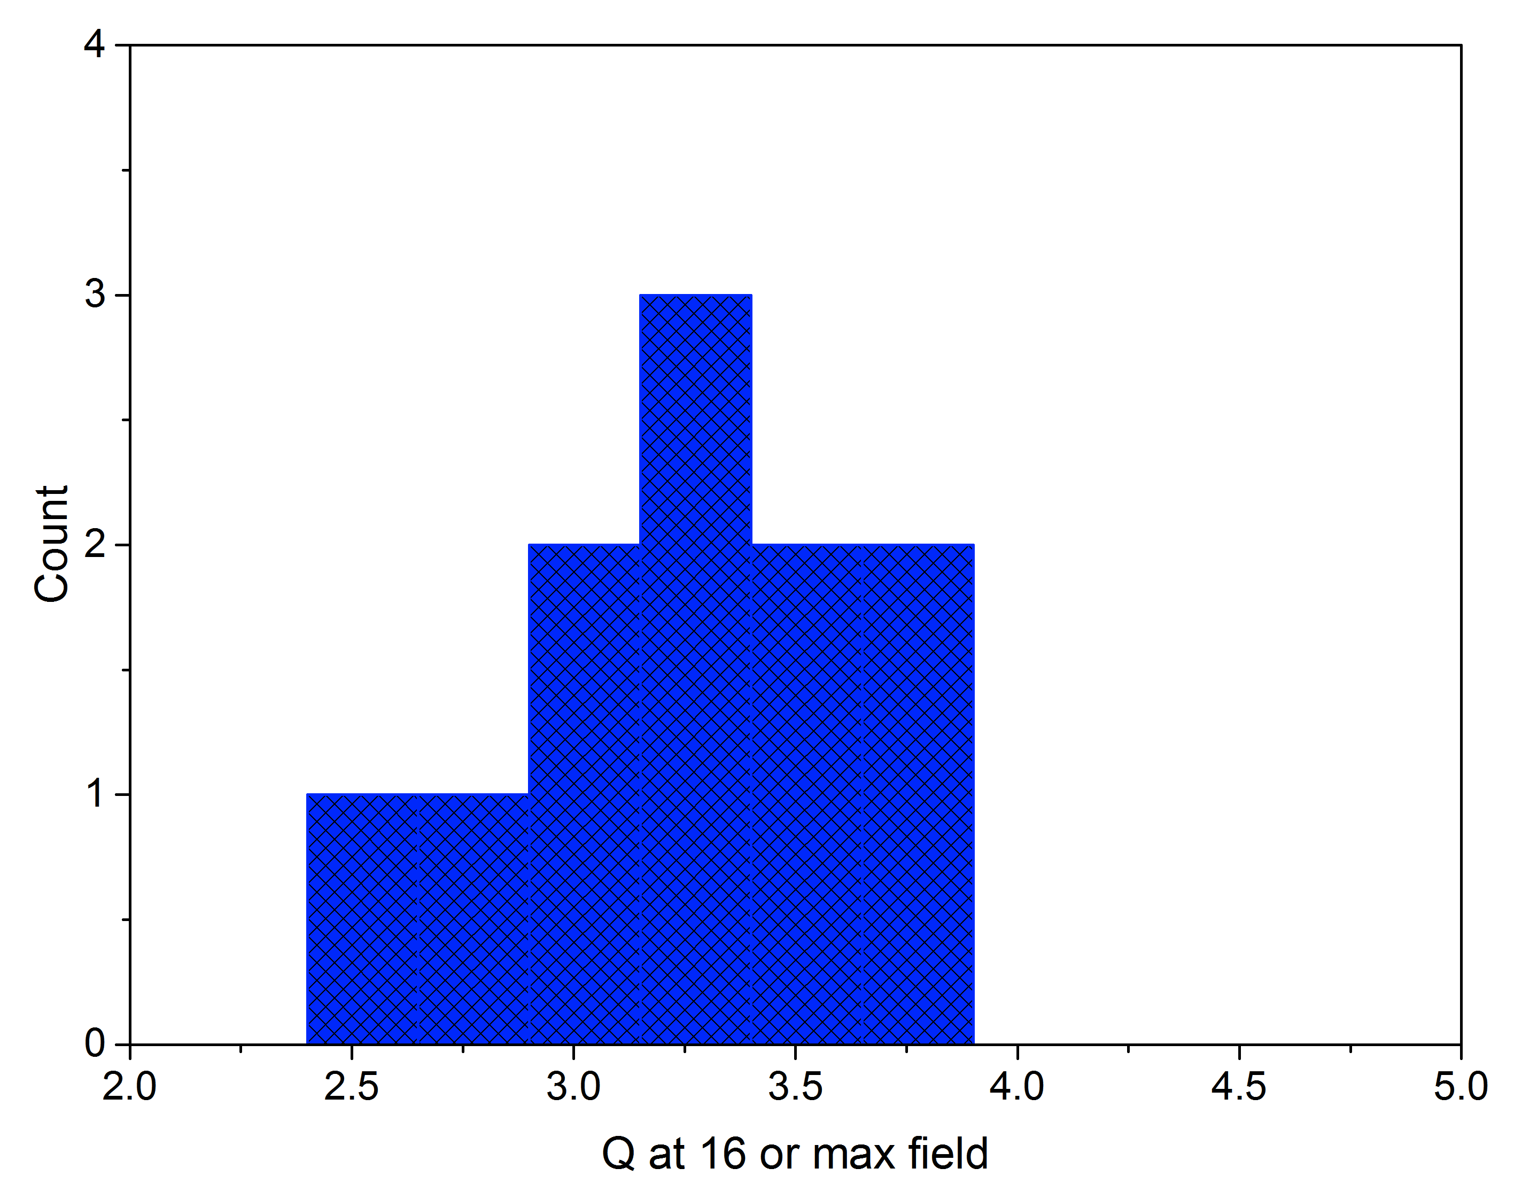
Open questions: nature of premature quench in N doped
16 MV/m
2.7e10
Heavier doping levels result in premature quench
Single cell N doped demonstrated up to 39 MV/m
Nine cells lower than single cell for same treatment
Recipe 2/6
“light doping”
<Q>=3.6e10
<E_{max}>=22.2 MV/m
E_{max}median=22.8MV/m
Recipe 20/30
“heavy doping”
<Q>=3.24e10
<E_{max}>=16.3 MV/m
E_{max}median=16.5MV/m
16

Slide 17
New insights on quench in
N doped cavities – magnetic peak field driven
Nitride teeth…residual nanonitrides post EP?
M. Martinello et al, WEPTY034, IPAC15
A. Vostrikov et al, WEPTY022, IPAC15

Slide 18
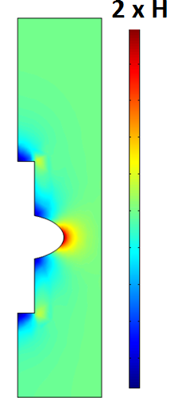
High Q discovery 2 – efficient flux expulsion
Full expulsion of the magnetic field should increase the field at equator ~2 times when going superconducting
It turns out the expulsion efficiency can be controlled by the cooldown procedure through Tc=9.2K (fast/slow, uniform or not)
Efficient flux expulsion
H
Poor flux expulsion
Fluxgate
magnetometers
Same Meissner behavior for EP, EP+120C, N doping, fine/single grain, cooling is what matters

Slide 19
Record Q up to the highest fields combining N doping and efficient flux expulsion
High thermal gradient provides depinning force allowing efficient magnetic field expulsion
Ultra-high Q₀ even in 190mG
A. Romanenko, A. Grassellino et al. J. Appl. Phys. 115, 184903 (2014)
A. Romanenko, A. Grassellino et al. Appl. Phys. Lett. 105, 234103 (2014)

Slide 20
It’s a matter of thermogradient along the cell (at the phase front) – and geometry of the problem has an effect, too…
Romanenko, A. Grassellino, A.Crawford, D. A. Sergatskov, Appl. Phys. Lett. 105, 234103 (2014)
M. Martinello et al, arXiv:1502.07291

Slide 21
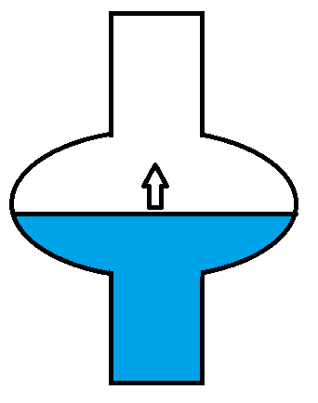
Details of superconductivity nucleation matter
Normal conducting
(T>Tc)
  Fast cooldown – well-defined superconducting/normal boundary is moving from bottom to the top => no energy barrier for flux to be expelled
Superconducting
(T<Tc)

Slide 22
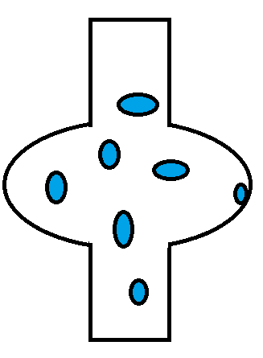

Details of superconductivity nucleation matter
  Slow uniform cooldown – superconductivity is nucleated at multiple spots which reach T<Tc
  Flux surrounded by superconducting areas has an energy barrier for escape=> more flux trapping is possible

Slide 23
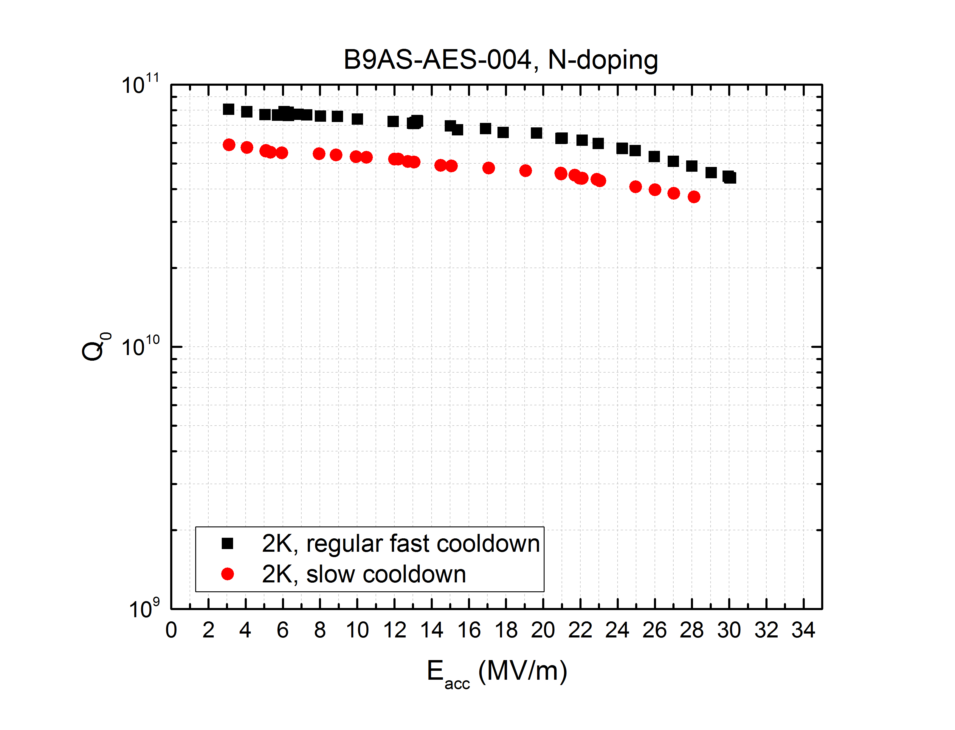
Results on 650MHz – cooling studies – fast vs slow cooling
Cooling details have been shown to play an important role in Q retention
Slow cooling through Tc shown to severely deteriorate Q for 1.3 GHz cavities
At 650 MHz we find a much weaker effect, likely due to smaller impact of trapped flux at lower frequency
Very promising for Q retention in cryomodule
T=2K
A. Romanenko, A. Grassellino, O. Melnychuk, D. A. Sergatskov, J. Appl. Phys. 115, 184903 (2014)
A. Romanenko, A. Grassellino, A.Crawford, D. A. Sergatskov, Appl. Phys. Lett. 105, 234103 (2014)

Slide 24
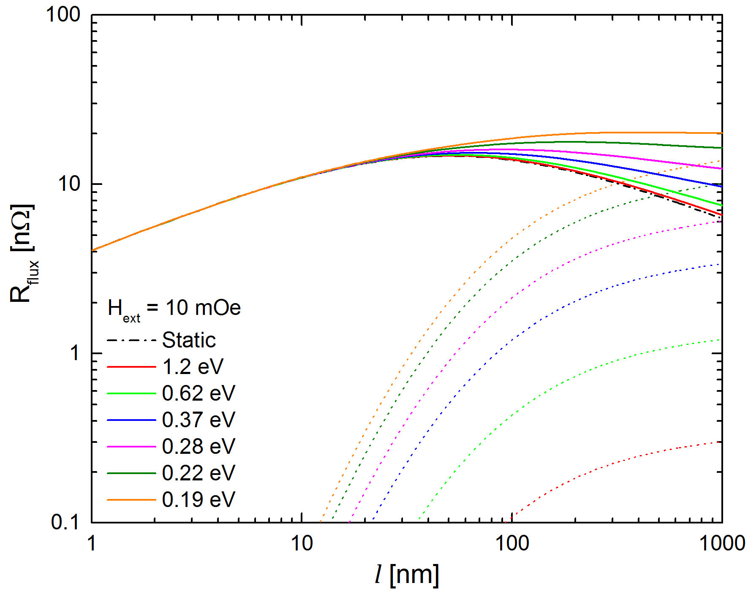
R&D on trapped flux dependence as a function of mfp
$$R_{f}\left({H_{ext},H}_{f}, l\right)=R_{dyn}\left({H_{ext},H}_{f}, l\right)+R_{st}\left(H_{ext},l\right)$$
Model by Mattia Checchin
Experiments ongoing! (M. Martinello and S. Posen)

Slide 25
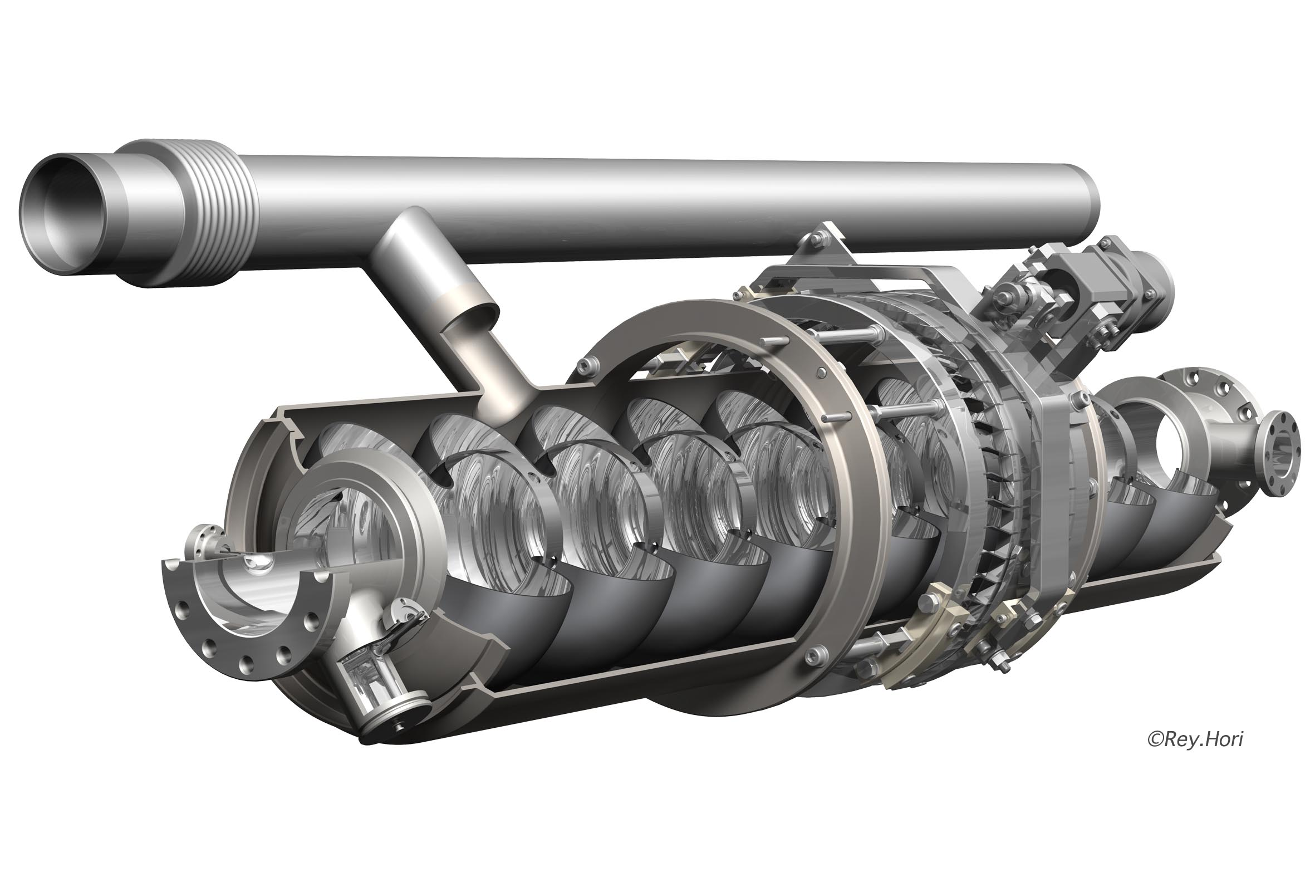
SRF cavity in its liquid helium filled tank: operating at 2 degrees above absolute zero (-456 deg F)
Cryogen fill pipe
Field Probe
Power Coupler Port
Tuner
Higher Order Mode extraction
Ports:
  Beam in /out
  Bring in power
  Monitor field
  Extract un-wanted frequencies

Slide 26
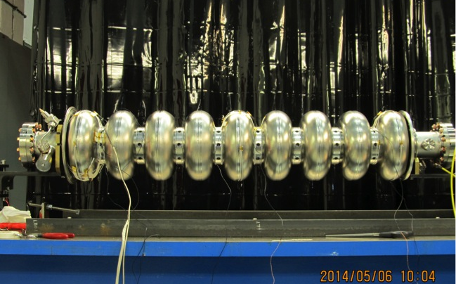
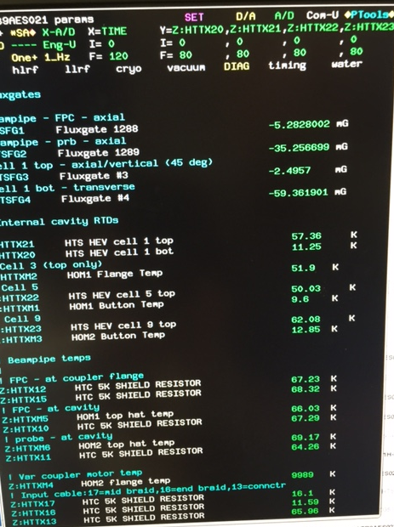
LCLS-2 cavities dressed with instrumentation inside vessel
D. Gonnella et al,
J. Appl. Phys. 117, 023908 (2015)

Slide 27
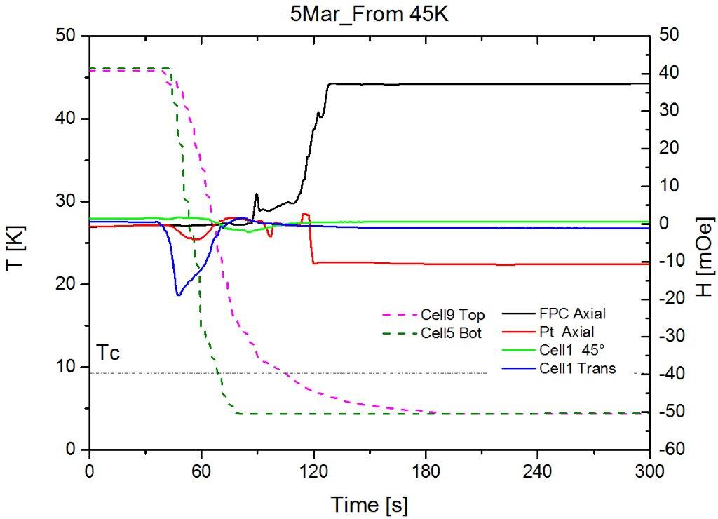
Sweeping the flux into the beampipes via fast cooling
Flux wave, travelling from cavity to beampipe
Flux all confined to beampipes, after efficient expulsion from cavity cells
Flux wave
Thermoelectric induced field, as first discussed in J. Vogt et al Phys.Rev.ST Accel.Beams 16 (2013) 10, 102002

Slide 28
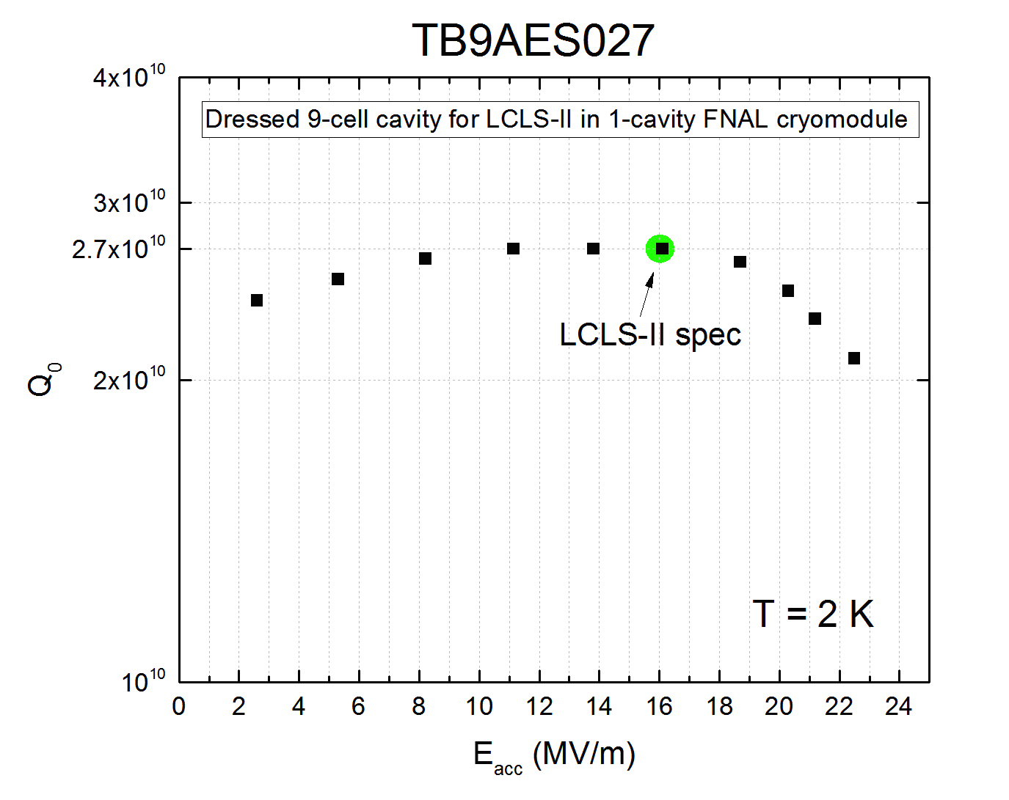

Slide 29
Horizontal dressed cavity tests at FNAL, Cornell, Jlab
Meeting final LCLS-2 specs in cryomodule environment!
State of the art ‘undoped’
Courtesy of D. Gonnella

Slide 30
Conclusions
Tremendous progress in the past two years in understanding of contributors to RF surface resistance
Record Q achieved from bare cavity tests all the way down to cryomodule environment, by implementing N doping and understanding of flux expulsion via efficient cooling through Tc
High Q at high gradient via doping is the frontier to be explored, exciting R&D ongoing
Flux trapping/detrapping and losses due to trapped flux for different surface processing is also a very interesting R&D path currently being pursued
Lower frequency N doping (~700 MHz) already doubled Q of standard treatment, and promises Q ~ 1e11 at 2K mid field – R&D ongoing

