Slide 1
Abstract:
The future Electron Ion Collider (EIC) LHeC will be able to collide electrons with protons/ions. Electron acceleration is based on a concept of Energy Recovery Linacs (ERL) with maximum energies of 60 GeV and almost completely recovering the energy during deceleration to the initial energy. We present: eRHIC, an ERL for LHeC (an example with almost double reduction in size of the linac, from 2 x 10 GeV to 2 x 5.345 GeV) from the present solution, using two Non-Scaling Fixed Field Alternating Gradient beam lines. This would reduce the three beam lines to two, and raise the luminosity for 34% from the electron current of 6.6 mA to 8.9 mA, for the synchrotron radiation limit of 15 MW.
ERL designs based on FFAG arcs
(eRHIC, LHeC, Cornell)
Dejan Trbojevic

Slide 2
OUTLINE
Electron Ion Colliders eRHIC and LHeC
SUMMARY:
Advantages come from multiple passes through the linac bring reduction in the linac size and of three beam circulating lines to two, reducing the synchrotron radiation – raising 42% the luminosity
NS-FFAG: Introduction to the concept
Lattice examples of the eRHIC and ERL LHeC

Slide 3
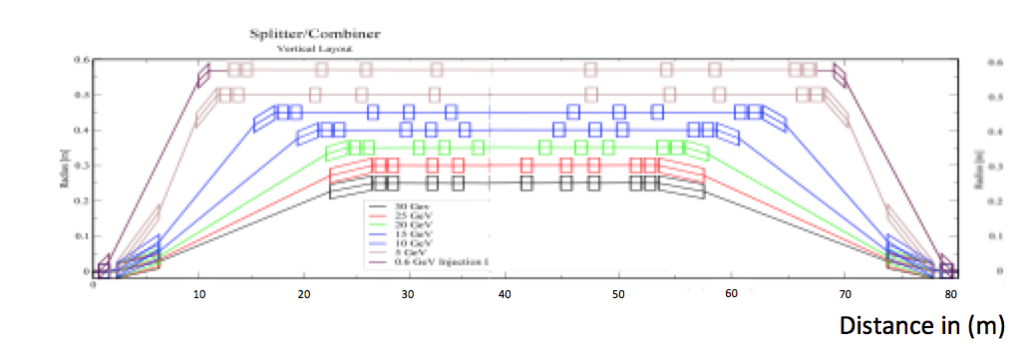
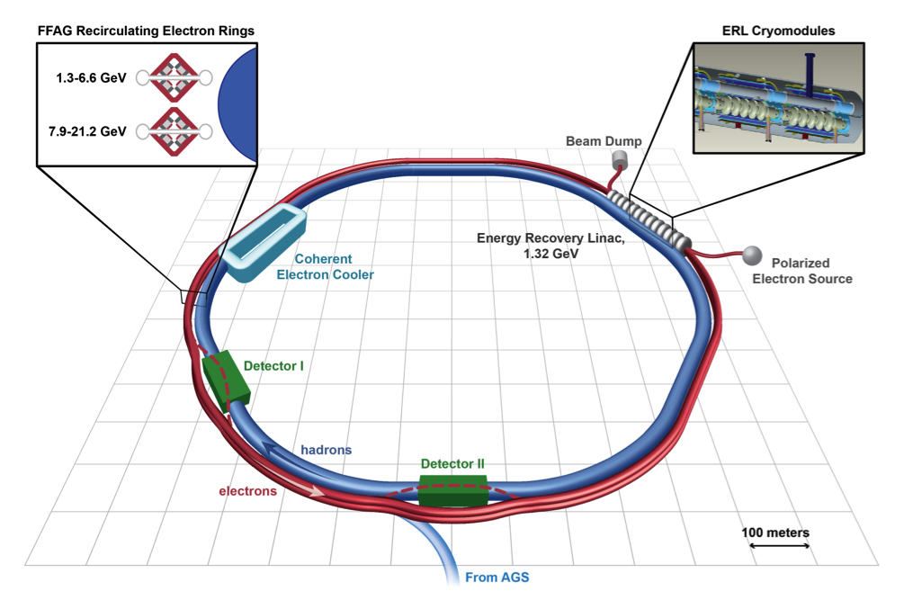
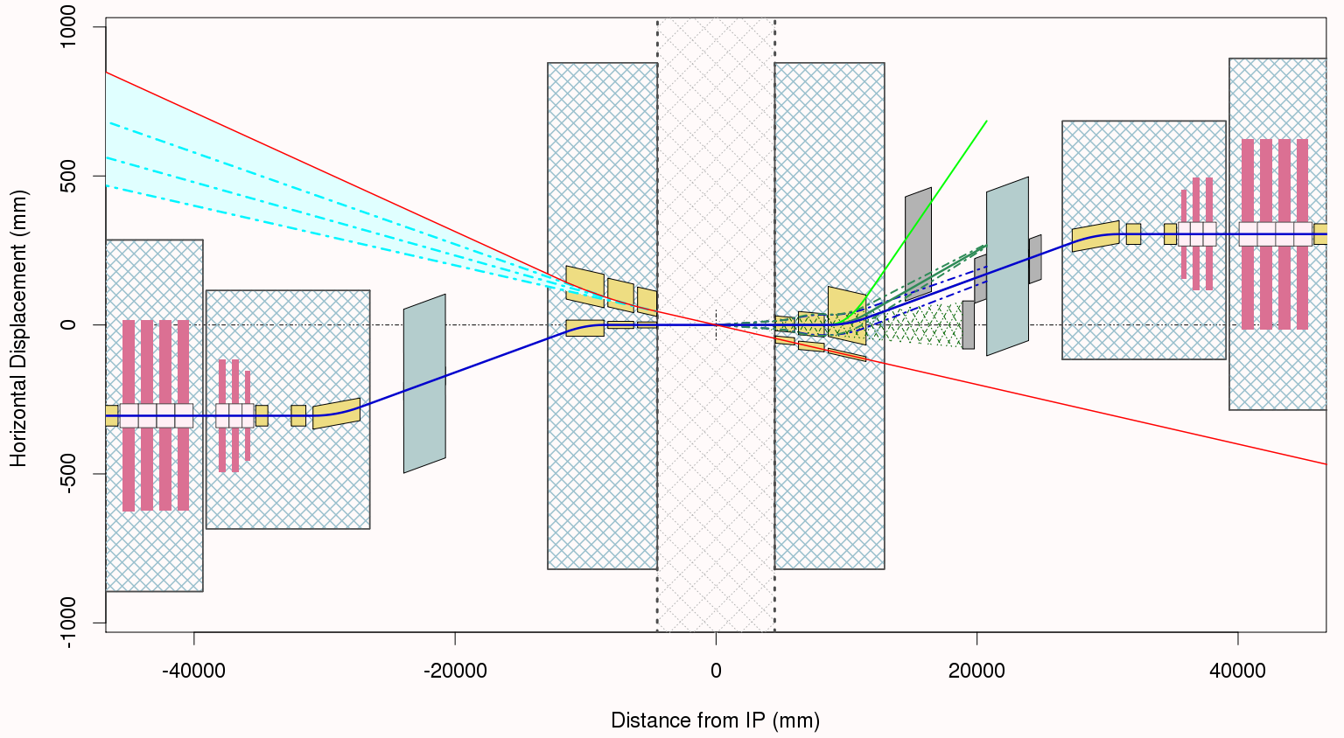
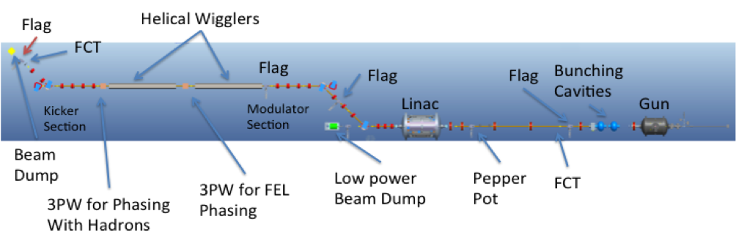
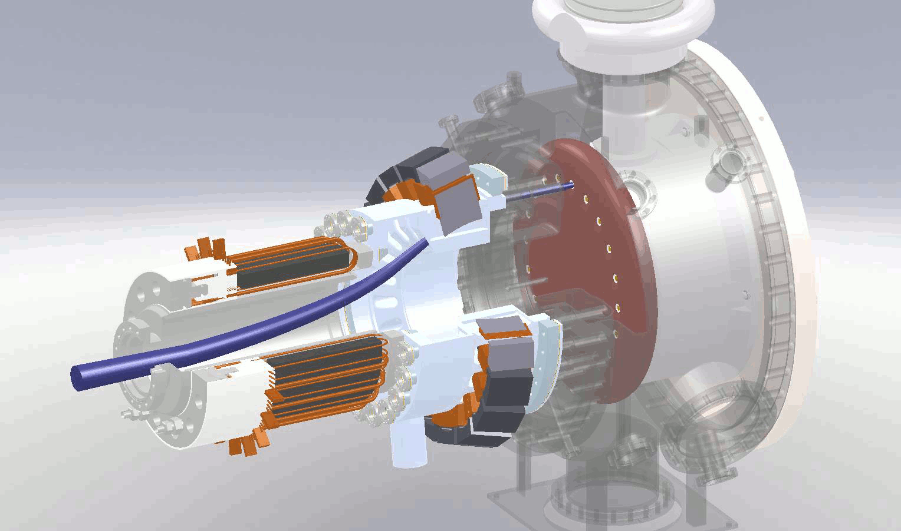
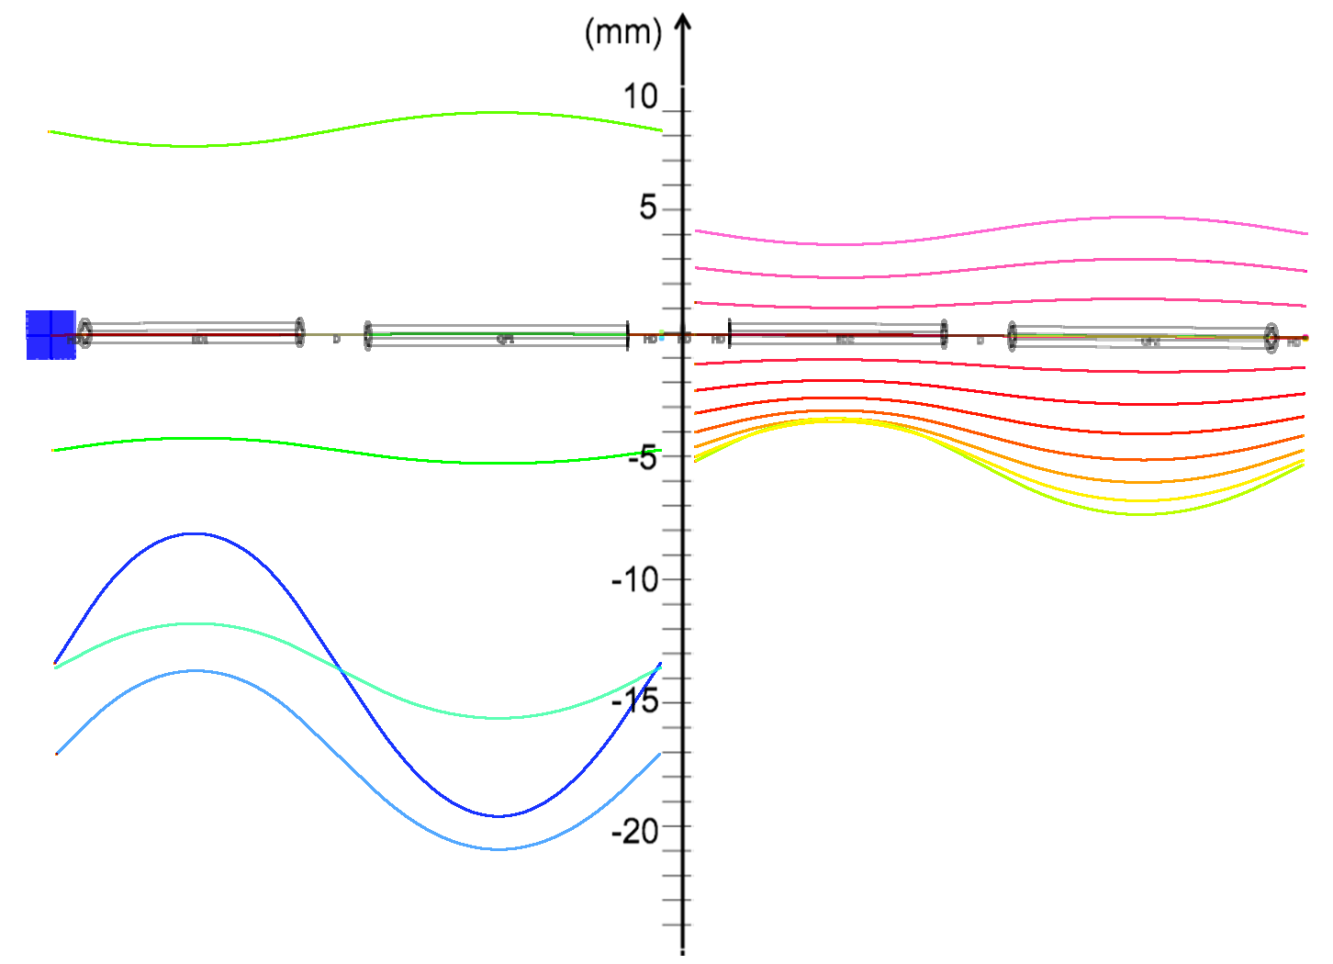
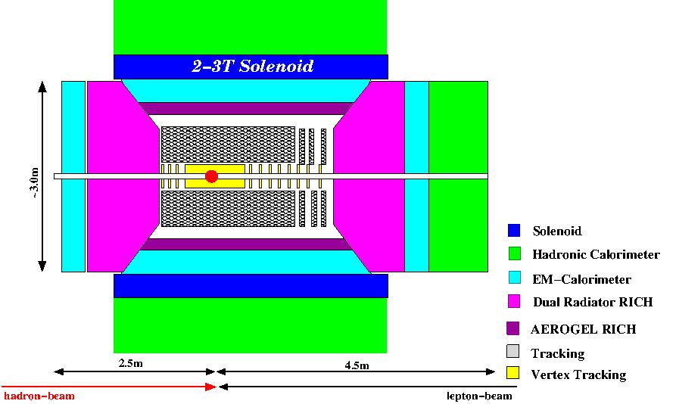
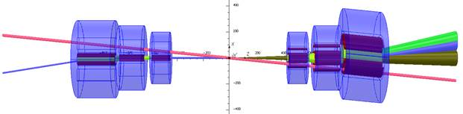
Layout of eRHIC with 21.2 GeV ERL
CeC PoP

Slide 4
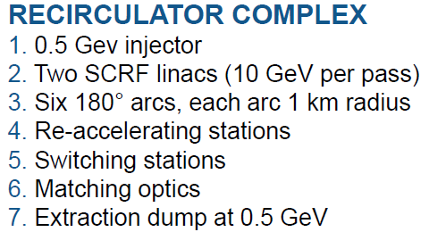
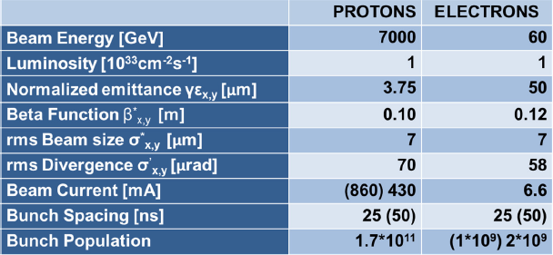
Linac-Ring Option − LHeC Recirculator
total circumference ~ 8.9 km
© F. Zimmermann
The baseline 60 GeV ERL option proposed can give an e-p luminosity of 10³³ cm⁻²s⁻¹ (extensions to 10³⁴ cm⁻²s⁻¹ and beyond are being considered)

Slide 5
NS-FFAG LHeC Recirculator with 12 GeV ER
LOW energy
NS-FFAG
Acceleration
12 GeV
24 GeV
36 GeV
LOW energy
NS-FFAG
Deceleration
36 GeV
24 GeV
12 GeV
Injector
10 MeV
dump
High energy
NS-FFAG
Acceleration
Linac
60 GeV
48 GeV
60 GeV
12 GeV/pass
IP
60 GeV
High energy
NS-FFAG
Deceleration
48 GeV
60 GeV
LHC

Slide 6
NS-FFAG LHeC Recirculator with 12 GeV ER
LOW energy
NS-FFAG
Acceleration
12 GeV
24 GeV
36 GeV
LOW energy
NS-FFAG
Deceleration
36 GeV
24 GeV
12 GeV
Injector
10 MeV
dump
High energy
NS-FFAG
Acceleration
Linac
12 GeV/pass
48 GeV
60 GeV
IP
60 GeV
High energy
NS-FFAG
Deceleration
60 GeV
48 GeV
LHC

Slide 7
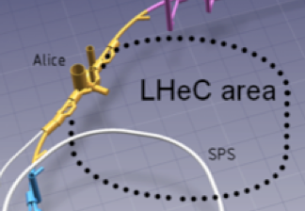
NS-FFAG LHeC Recirculator with ER
NS-FFAG
LOW energy
NS-FFAG
10.906 GeV
21.829 GeV
32.735 GeV
Injector
17 MeV
60 GeV
5.453 GeV/pass
IP
Linac 1
5.453 GeV/pass
Linac 2
Dump
17 MeV
LHC
NS-FFAG
High energy
NS-FFAG
54.55GeV
43.644 GeV

Slide 8
NS-FFAG LHeC Recirculator with ER
NS-FFAG
LOW energy
NS-FFAG
32.735 GeV
21.829 GeV
10.906 GeV
Injector
17 MeV
60 GeV
5.453 GeV/pass
IP
Linac 1
5.453 GeV/pass
Linac 2
Dump
17 MeV
LHC
NS-FFAG
High energy
NS-FFAG
43.644 GeV
54.550 GeV

Slide 9
OUTLINE: NS-FFAG for eRHIC and LHeC
WHAT IS Non-Scaling FFAG?
Orbits in NS-FFAG cells
Tune dependence on momentum
Path length dependence on energy
Straight section design
By pass design

Slide 10
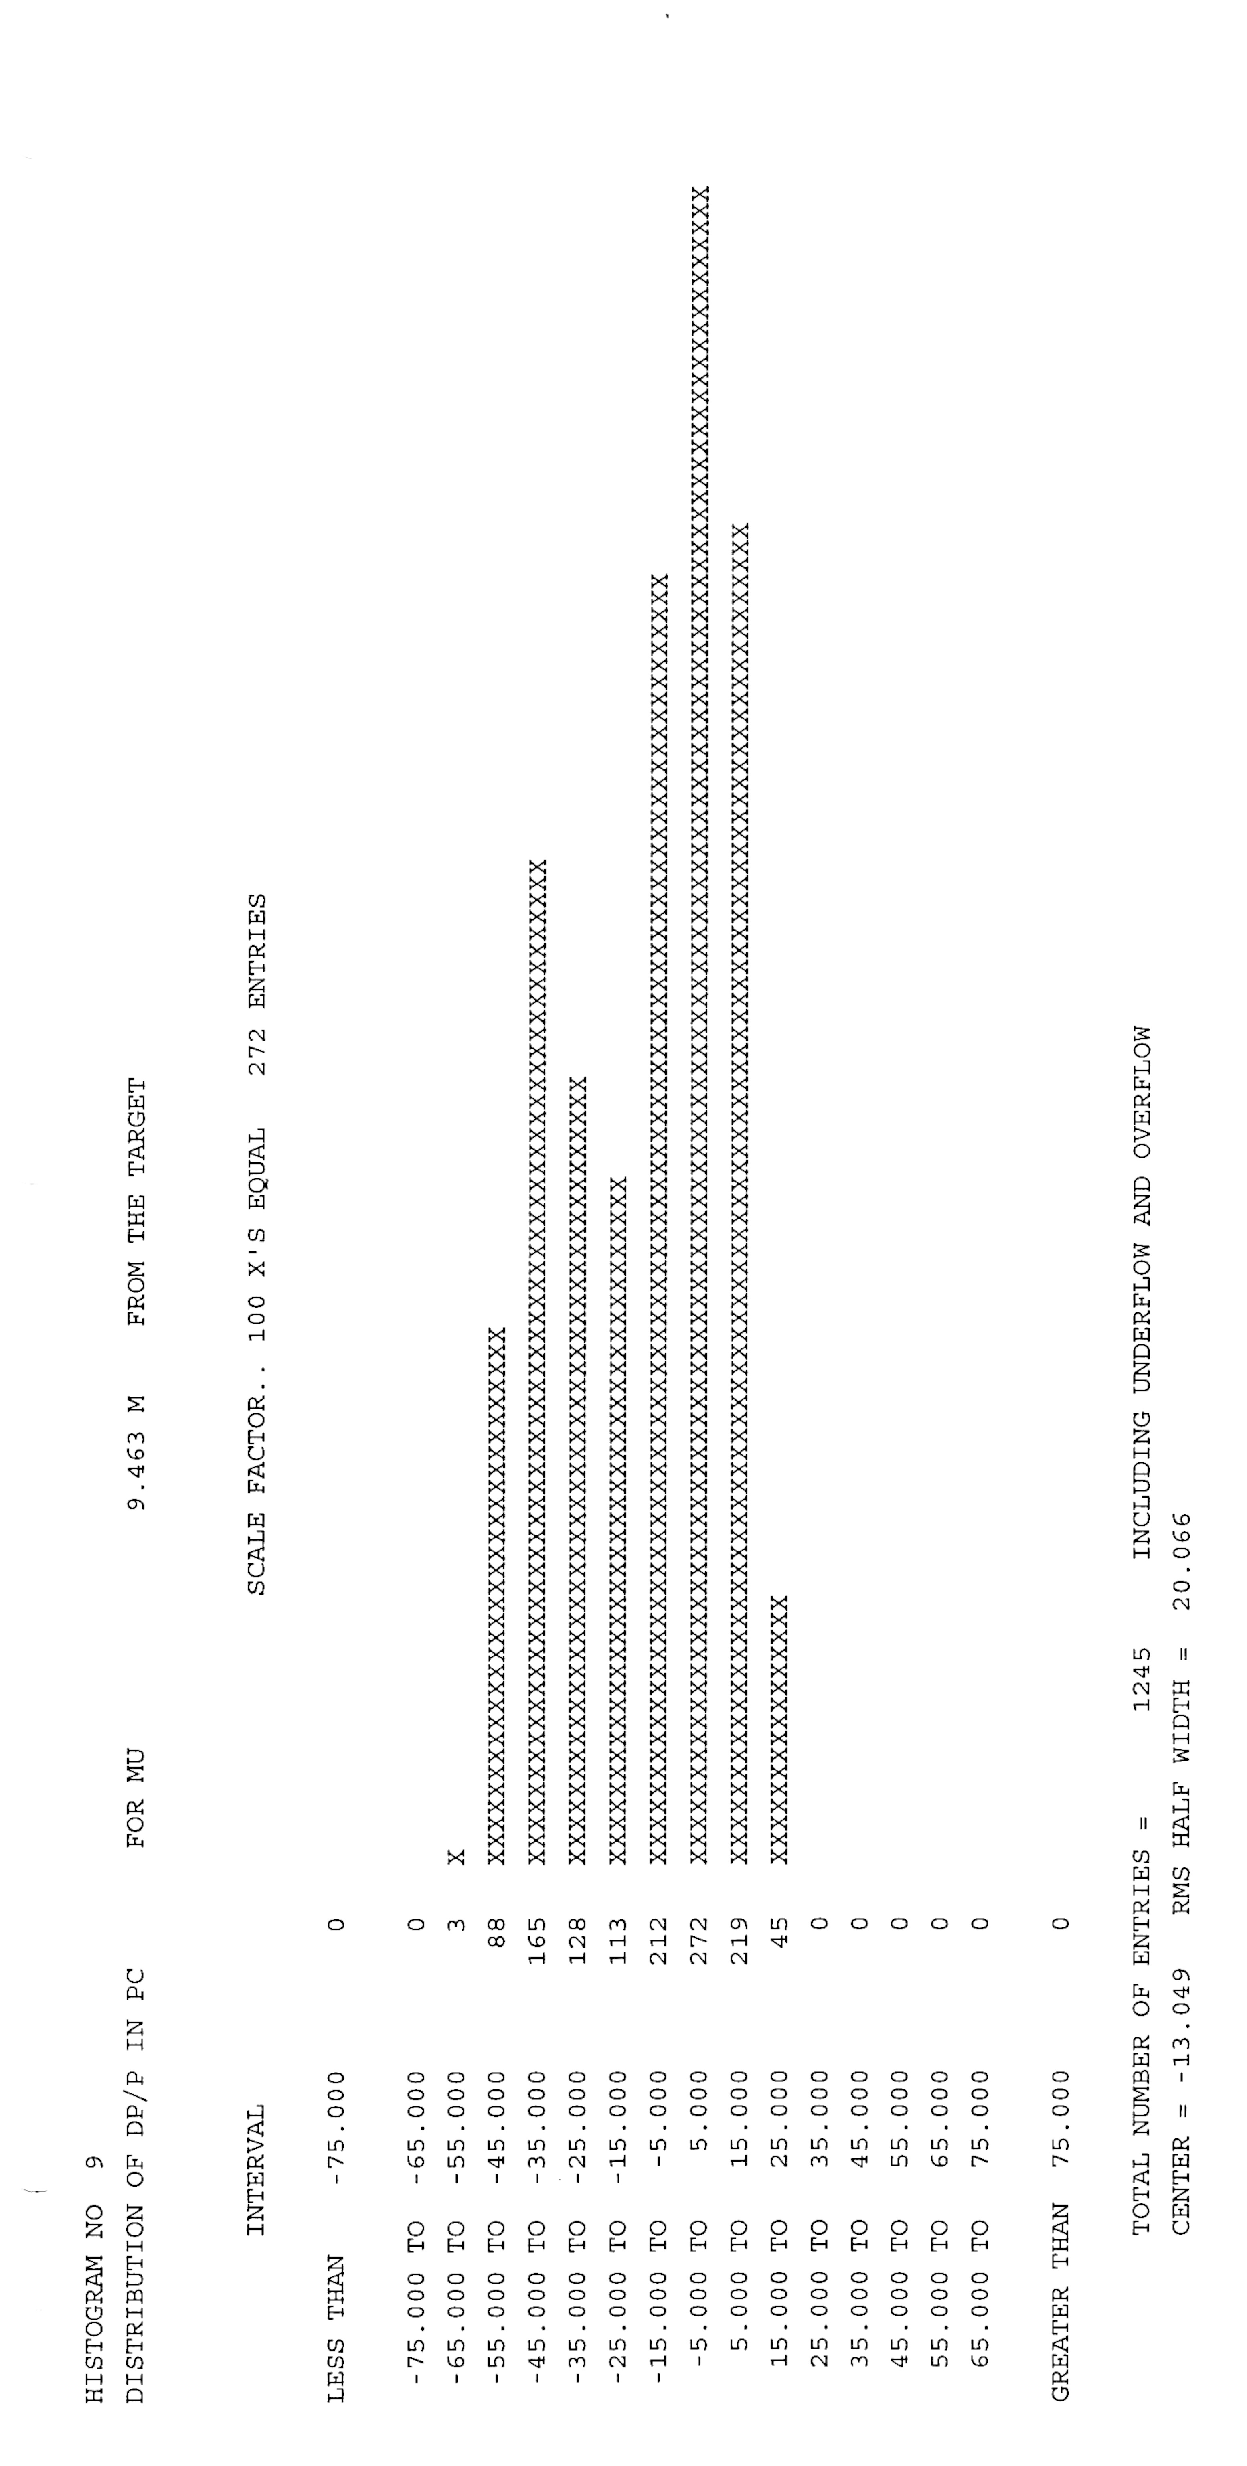
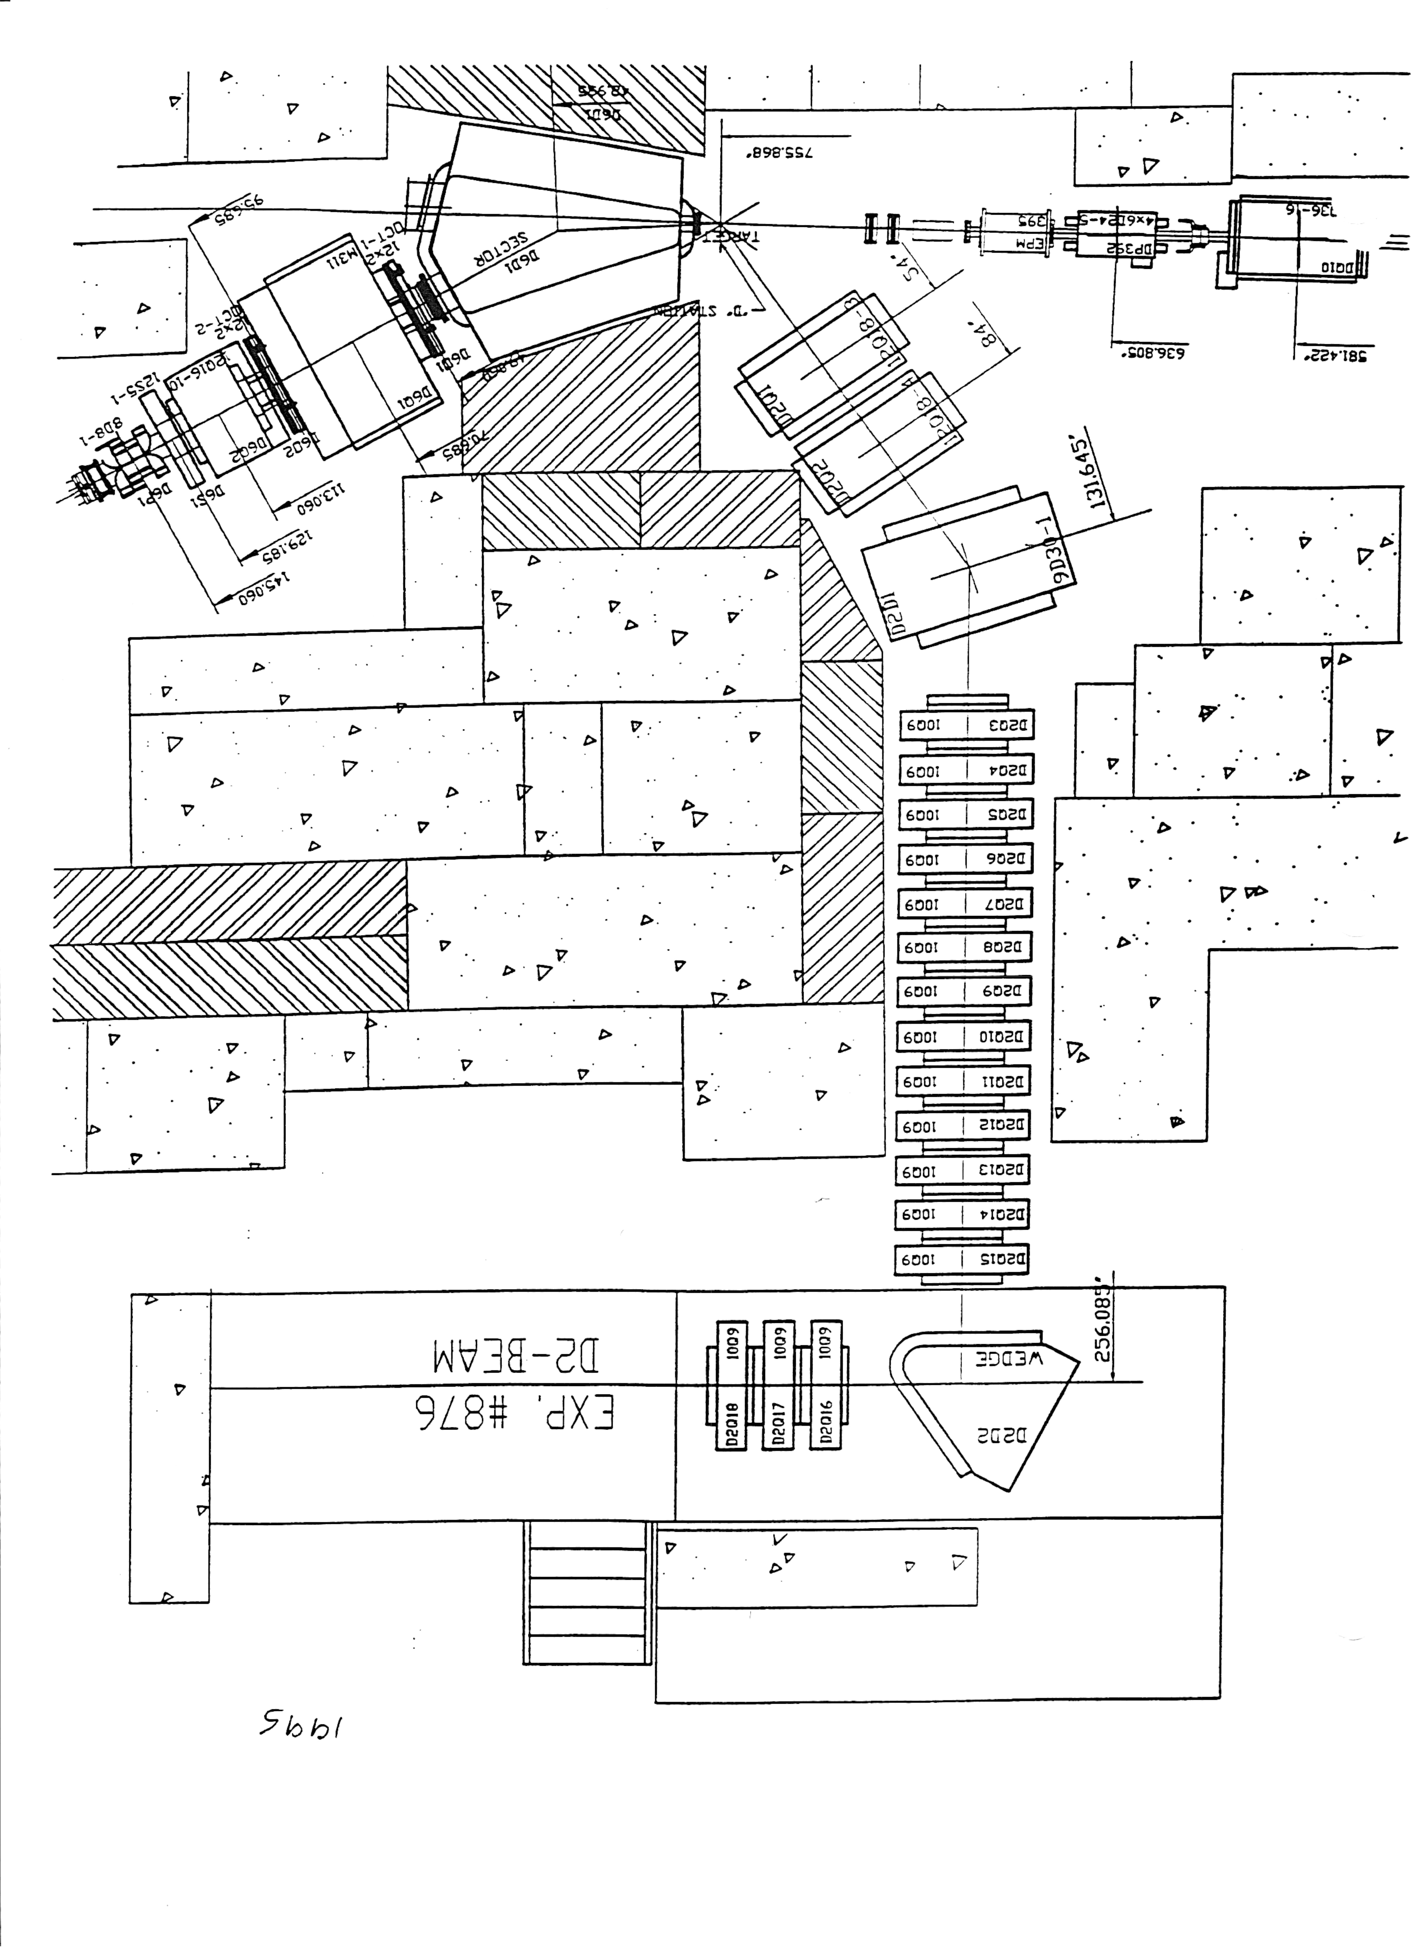
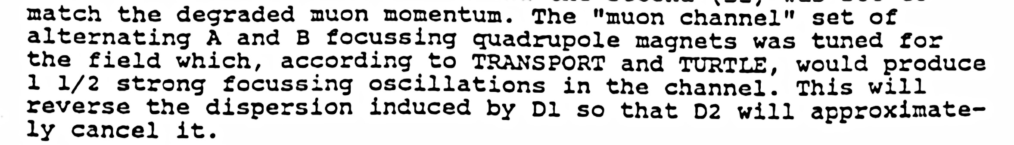
The AGS NS-FFAG, May 1983 D2-Muon Channel
Experiment 745
δp/p=-5,-5%
δp/p=-55,-45%
δp/p= -55, 25 %
δp/p=-15,-25%
NIM 179(1981) 95-103
TRIUMF Vancouver π-μ channel
D. Trbojevic, E.D. Courant, and A. A. Garren
Fall 1999,”FFAG Lattice Without Opposite Bends”,
HEMC’99 Workshop, δp/p= -30, 50 %

Slide 11
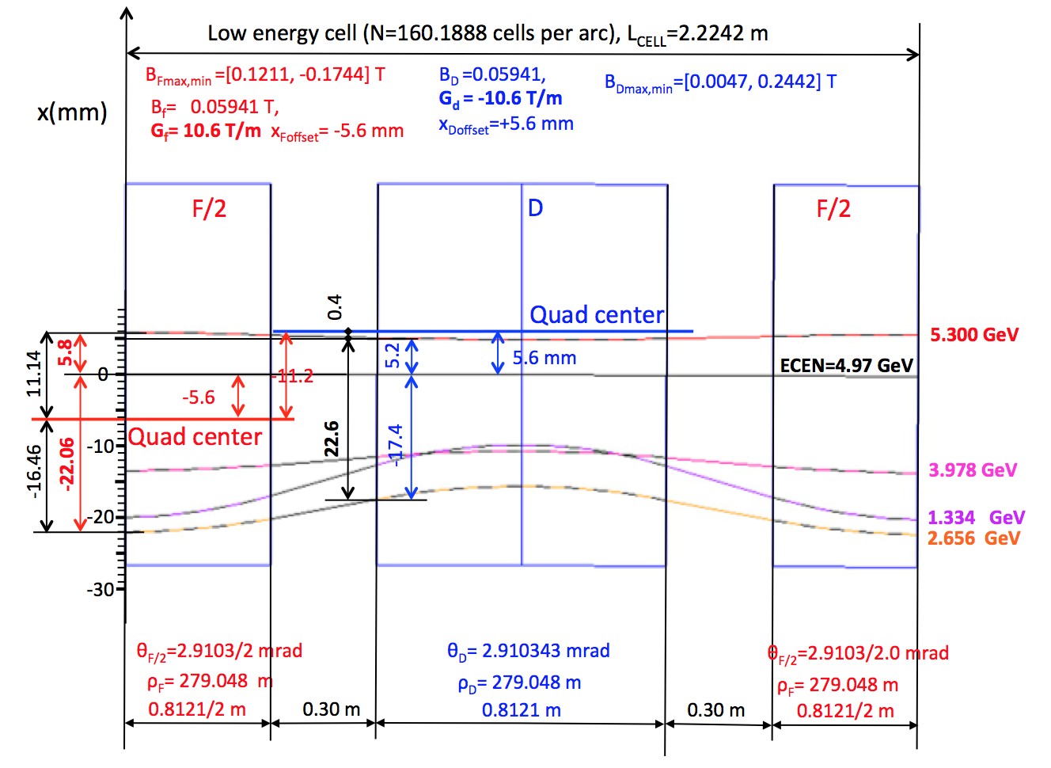
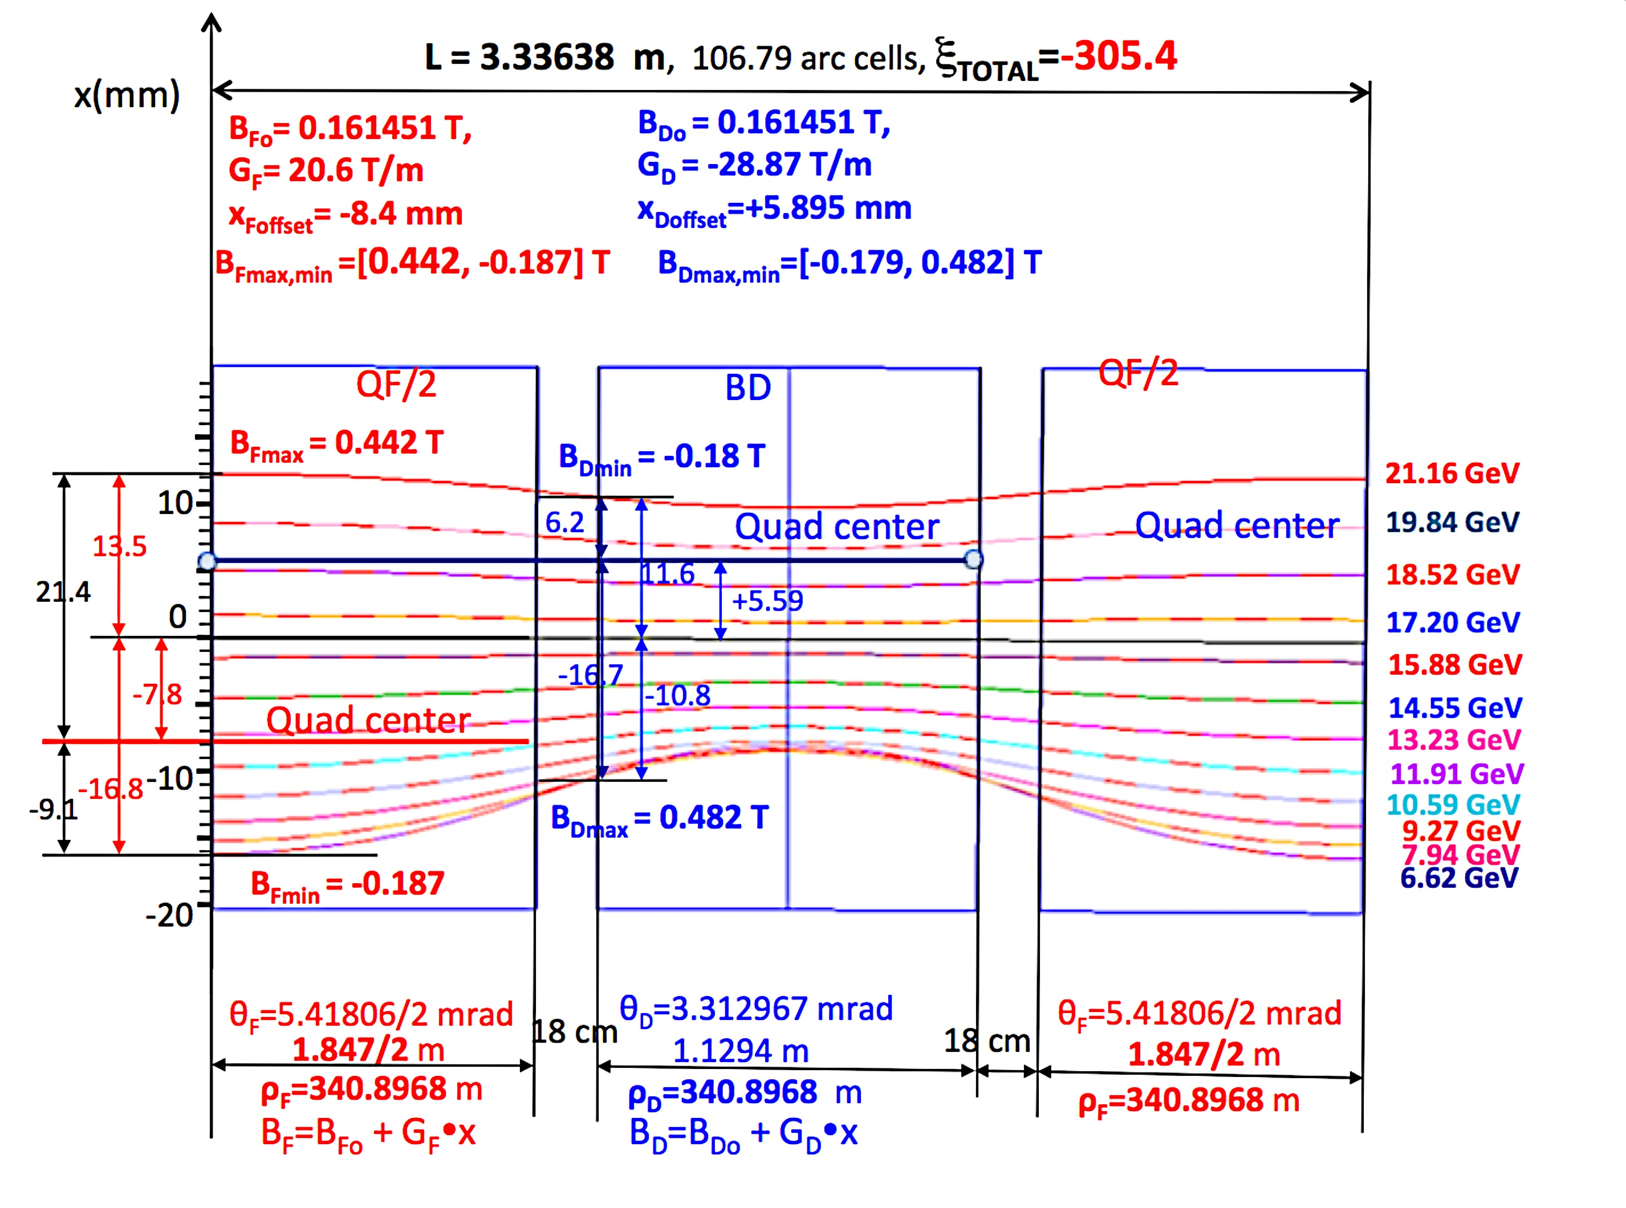
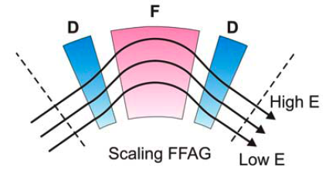
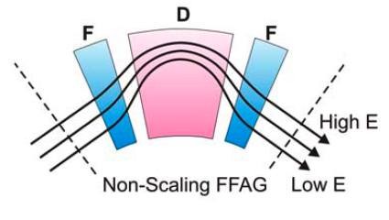
SCALING VS. NON-SCALING FFAG
Linear magnetic field:
B = B_{o}+ r G_{o}
Linear magnetic field:
B = B_{o}+ r G_{o}
0.03 meters
3 cm
0.9 meters
Δx = D_{x} ∗ δp/p
D magnet = reverse bend
Magnetically inefficient
VERY BAD for synchrotron radiation (10MW)
To reduce the orbit offsets to ±4 cm range,
for momentum range of δp/p ~ ± 50 %
the dispersion function D_{x} has to be of the order of:
D_{x} ~ 4 cm / 0.5 = 8 cm

Slide 12
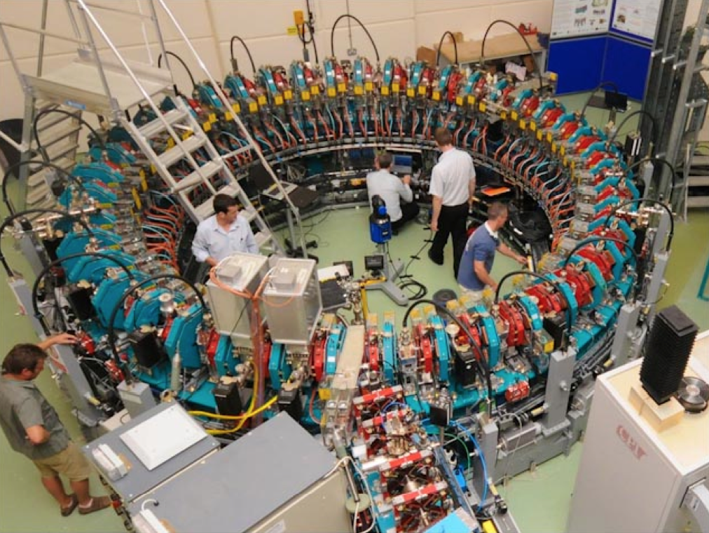
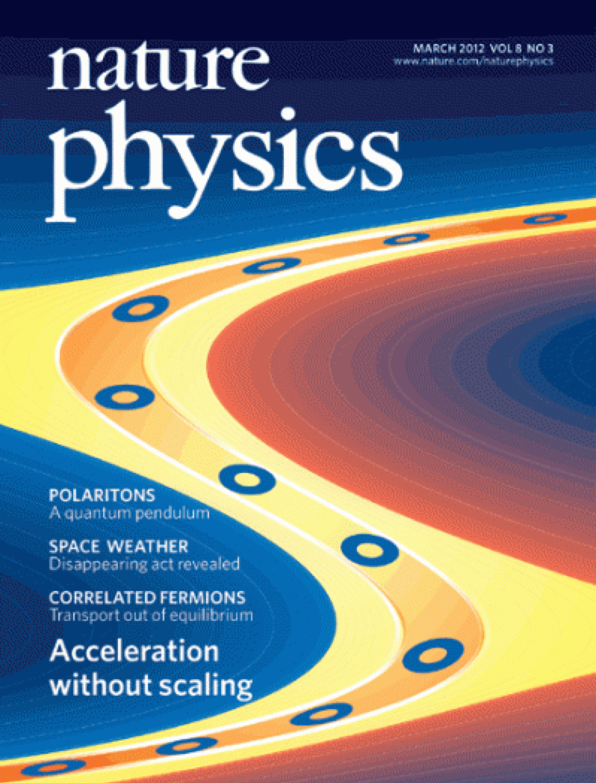
EMMA the first Non-Scaling FFAG
(Electron Model for Many Applications)
Daresbury Laboratory
LEARNING FROM PREVIOUS EXPERIENCE FROM WORKING NON-SCALING FFAG “EMMA”
(Being aware that EMMA is a much more difficult application of FFAG than eRHIC in many ways)
ELECTRON ENERGY RANGE IN EMMA WAS BUILT TO SIMULATE MUON ACCELERATION 10 – 20 GeV

Slide 13
Energy
#1 1.334 GeV
#2 2.565 GeV
#3 3.978 GeV
#4 5.300 GeV
NS-FFAG Layout of the eRHIC
6.622 – 15.876 GeV
Option #1 Energy
50 mA
Linac 1.322 GeV
#1 7.944 GeV
#2 9.266 GeV
#3 11.910 GeV
#4 13.232 GeV
#5 14.554 GeV
#6 15.876 GeV
Option #2 Energy
10 mA
Linac 1.322 GeV
#1 6.622 GeV
#2 7.944 GeV
#3 9.266 GeV
#4 10.588 GeV
#5 11.910 GeV
#6 13.232 GeV
#7 14.554 GeV
#8 15.876 GeV
#9 17.198 GeV
#10 18.520 GeV
#11 19.842 GeV
#12 21.164 GeV
1.322+0.012 GeV
Injector 0.012 GeV
Linac 1.322 GeV

Slide 14
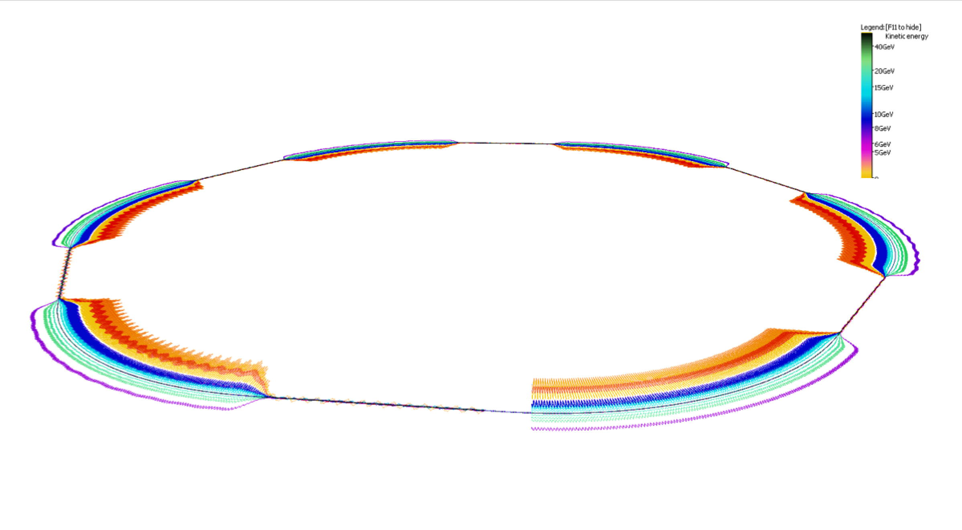
eRHIC FFAG Rings in Perspective
Orbits exaggerated transversely 5000x, shape of hexagonal RHIC is evident
© Stephen Brooks

Slide 15
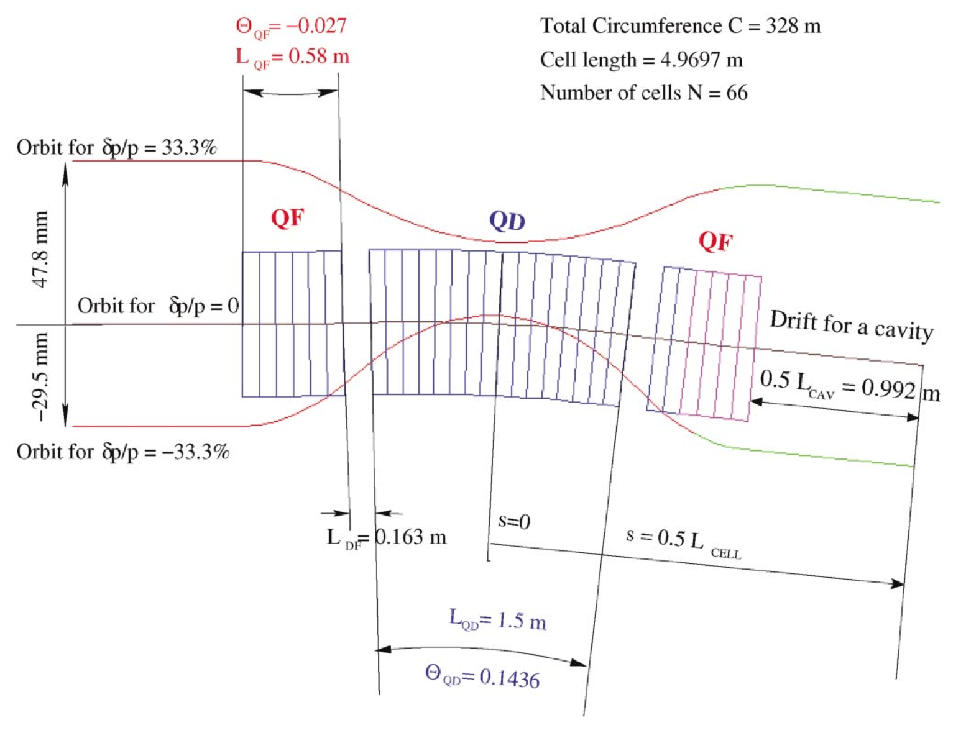
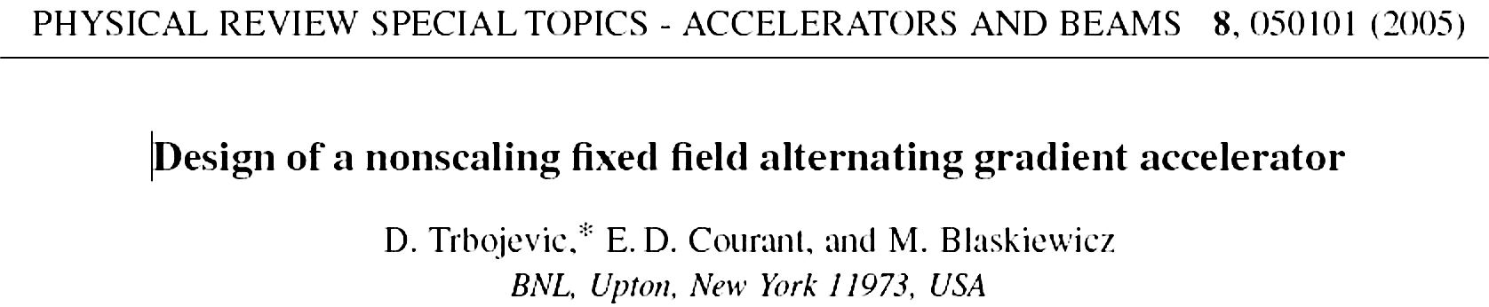
Non-scaling FFAG for Muon Acceleration
N=66
CELL LENGTH 5 m
QD
Extremely strong focusing with a small dispersion function
- Tunes vary
Orbit offsets are small
- Magnets are small
- Large energy acceptance
47.8 mm
QF
QF
DRIFT FOR A
CAVITY
-29.5 mm

Slide 16
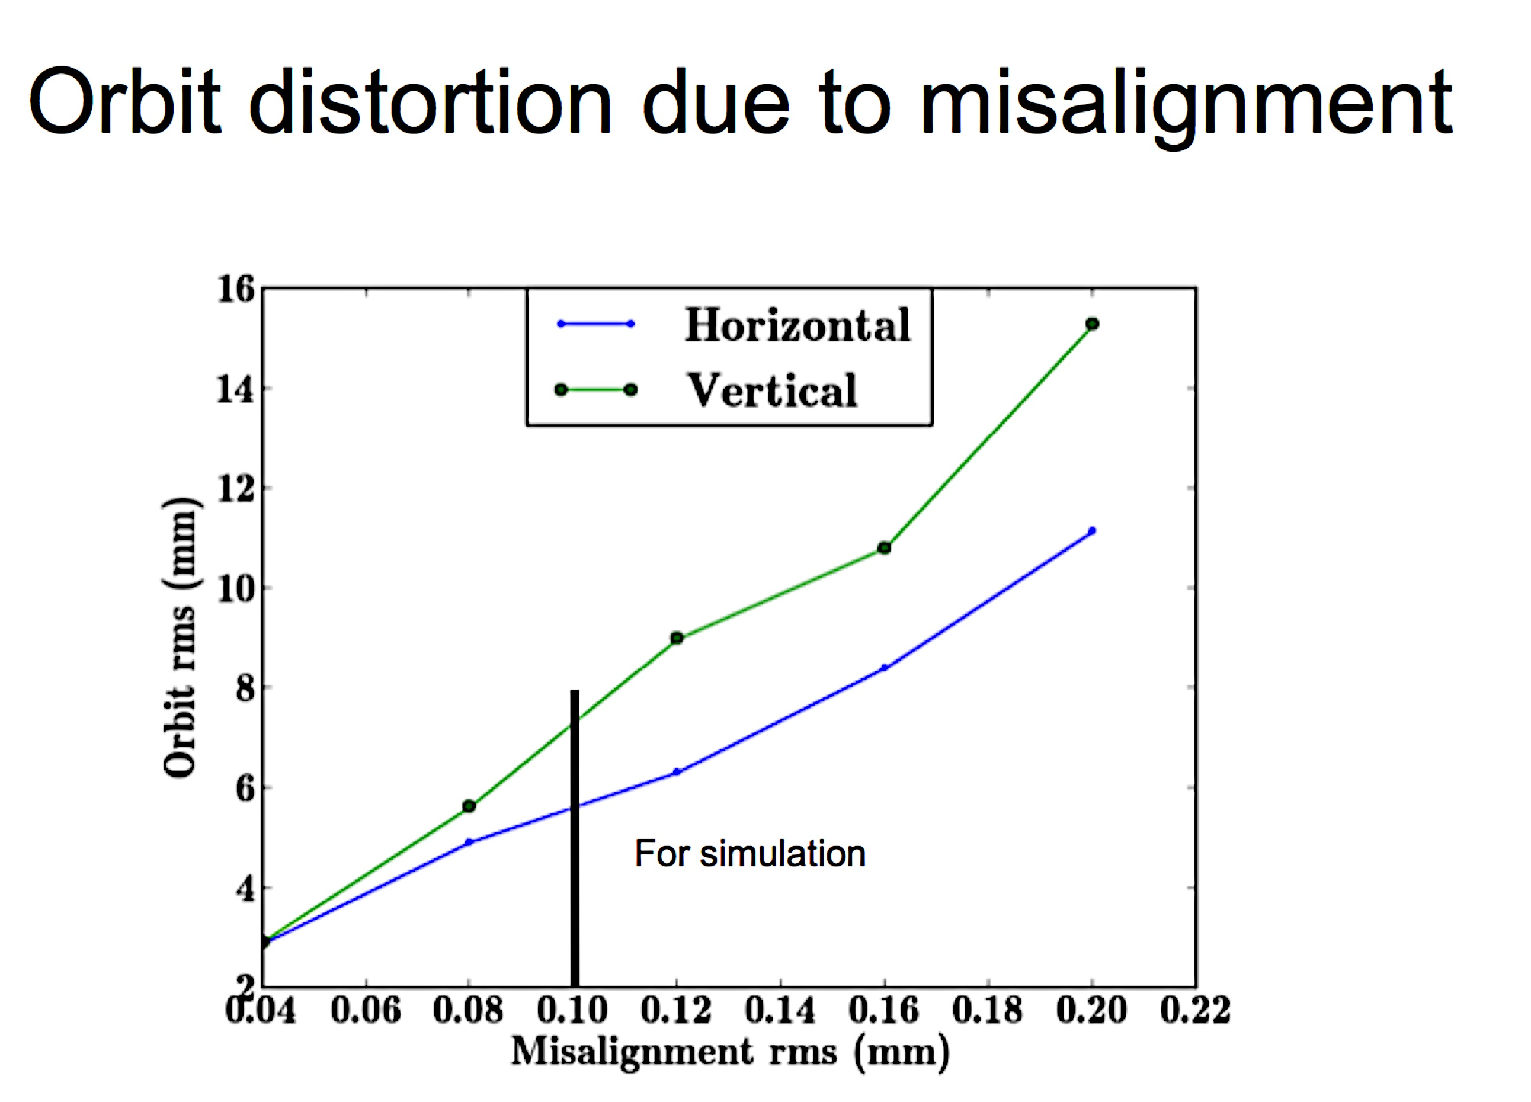
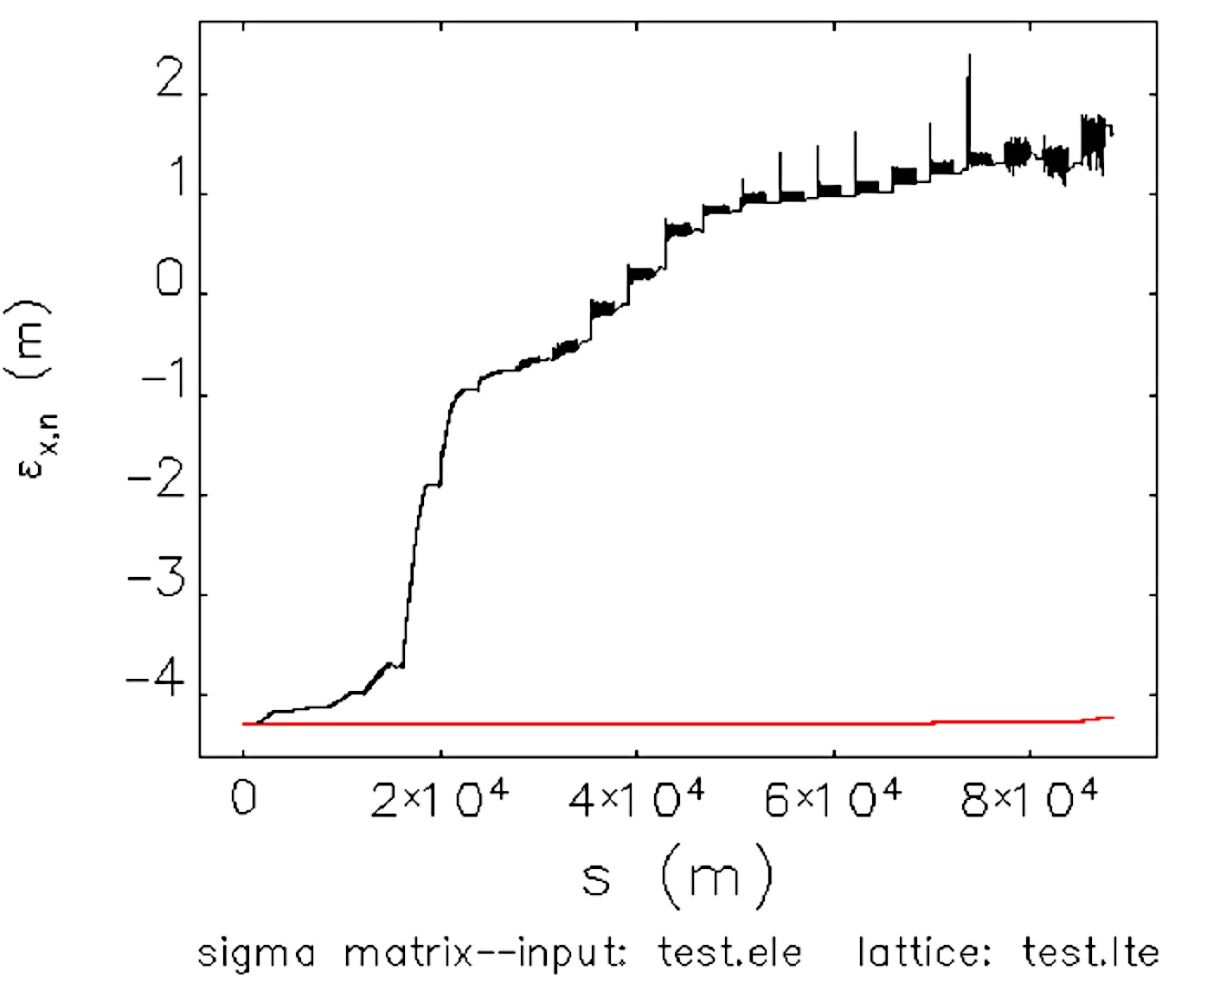
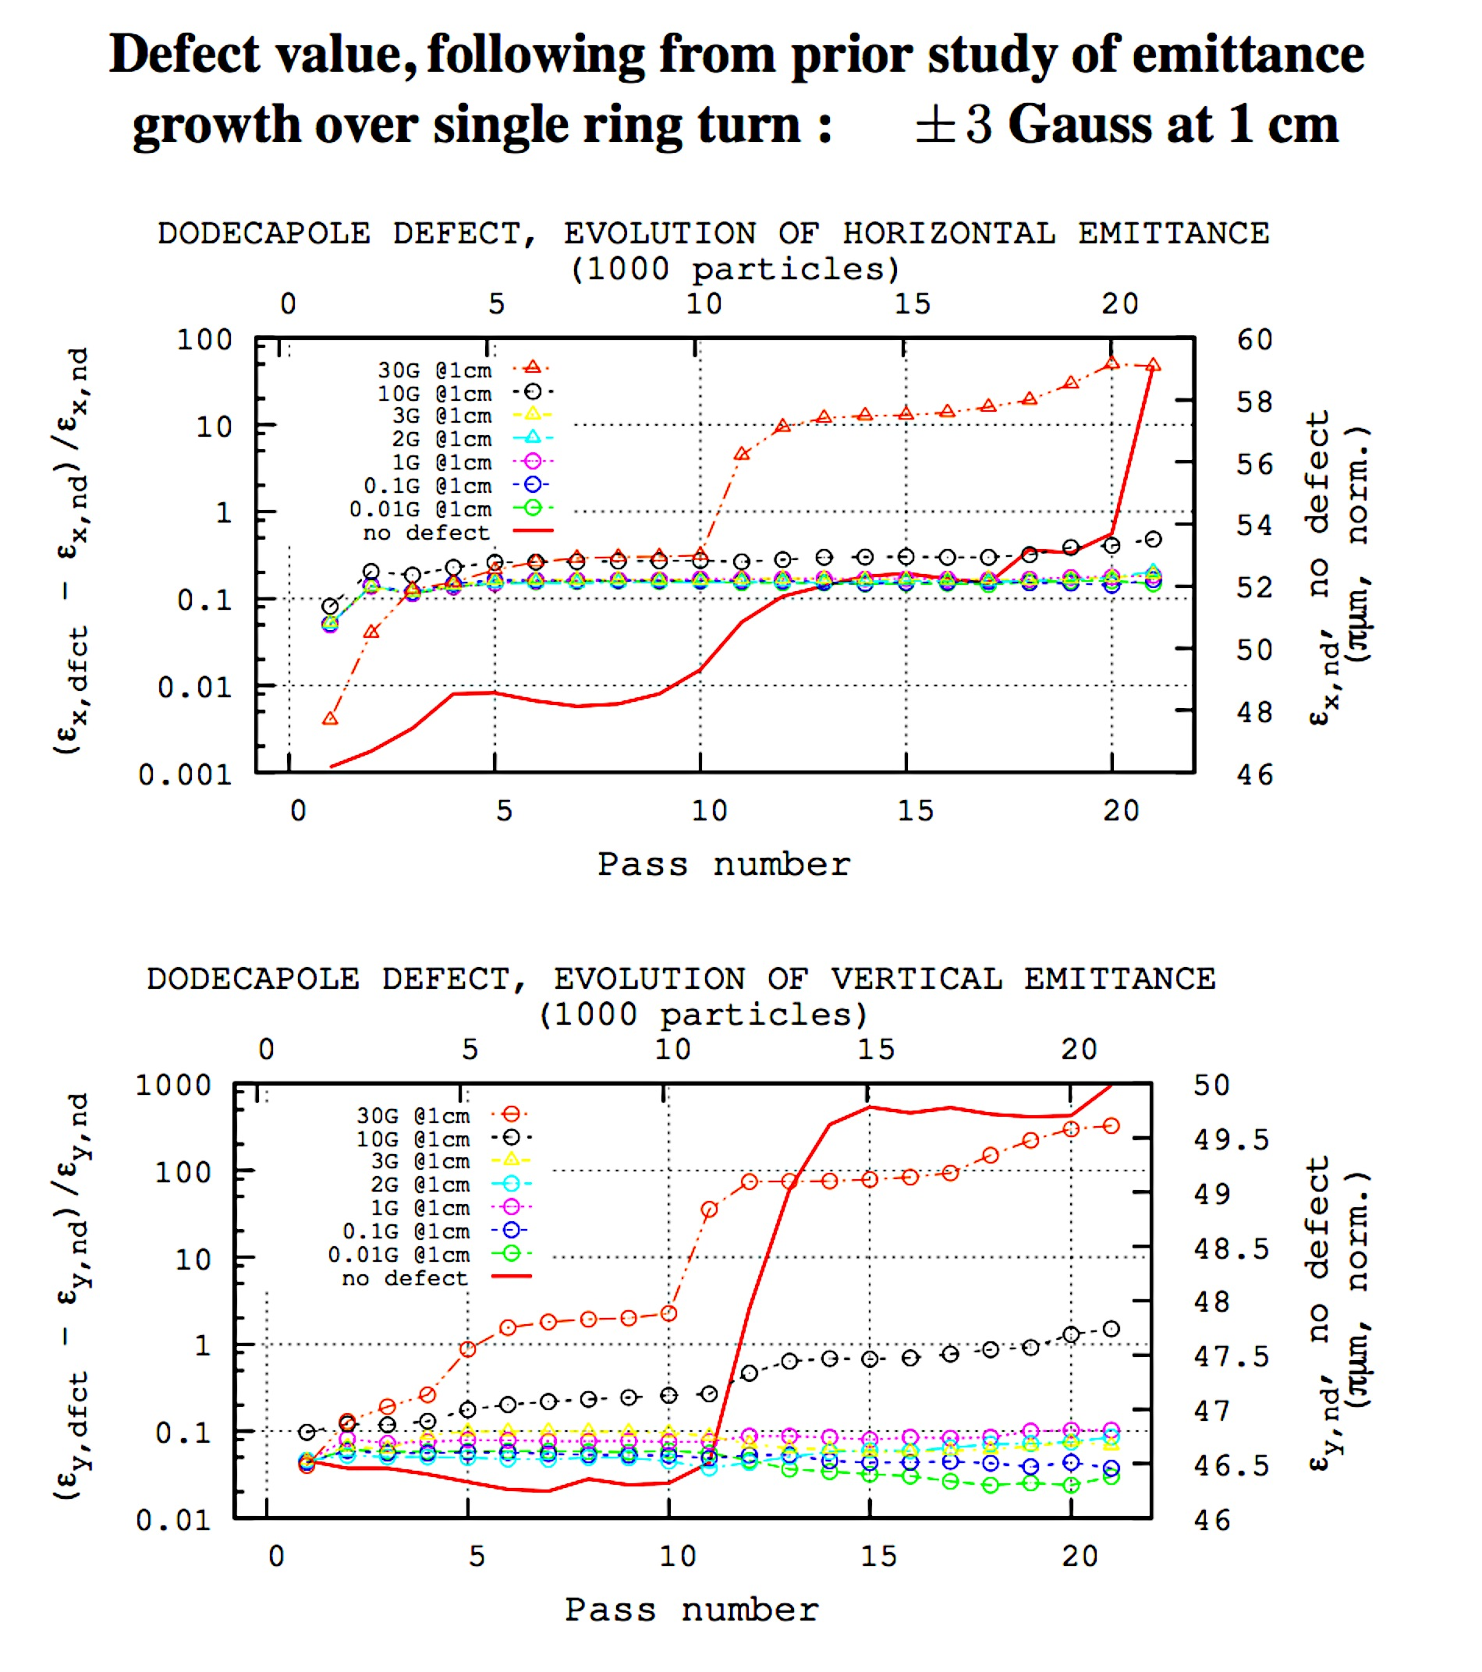
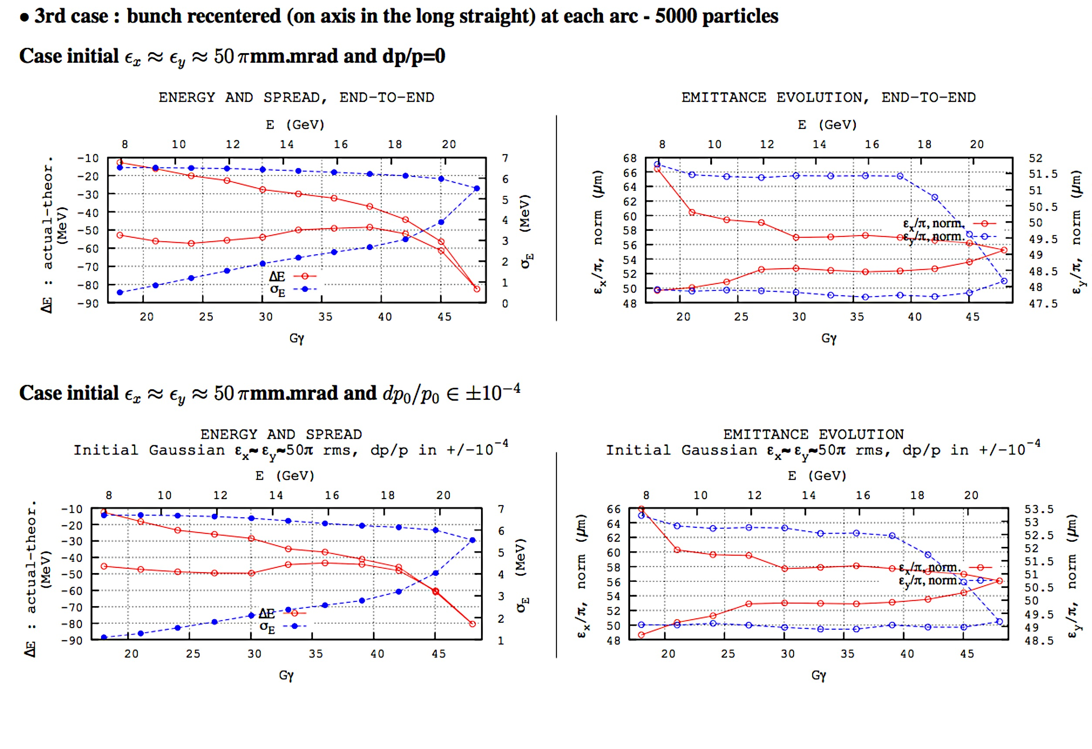
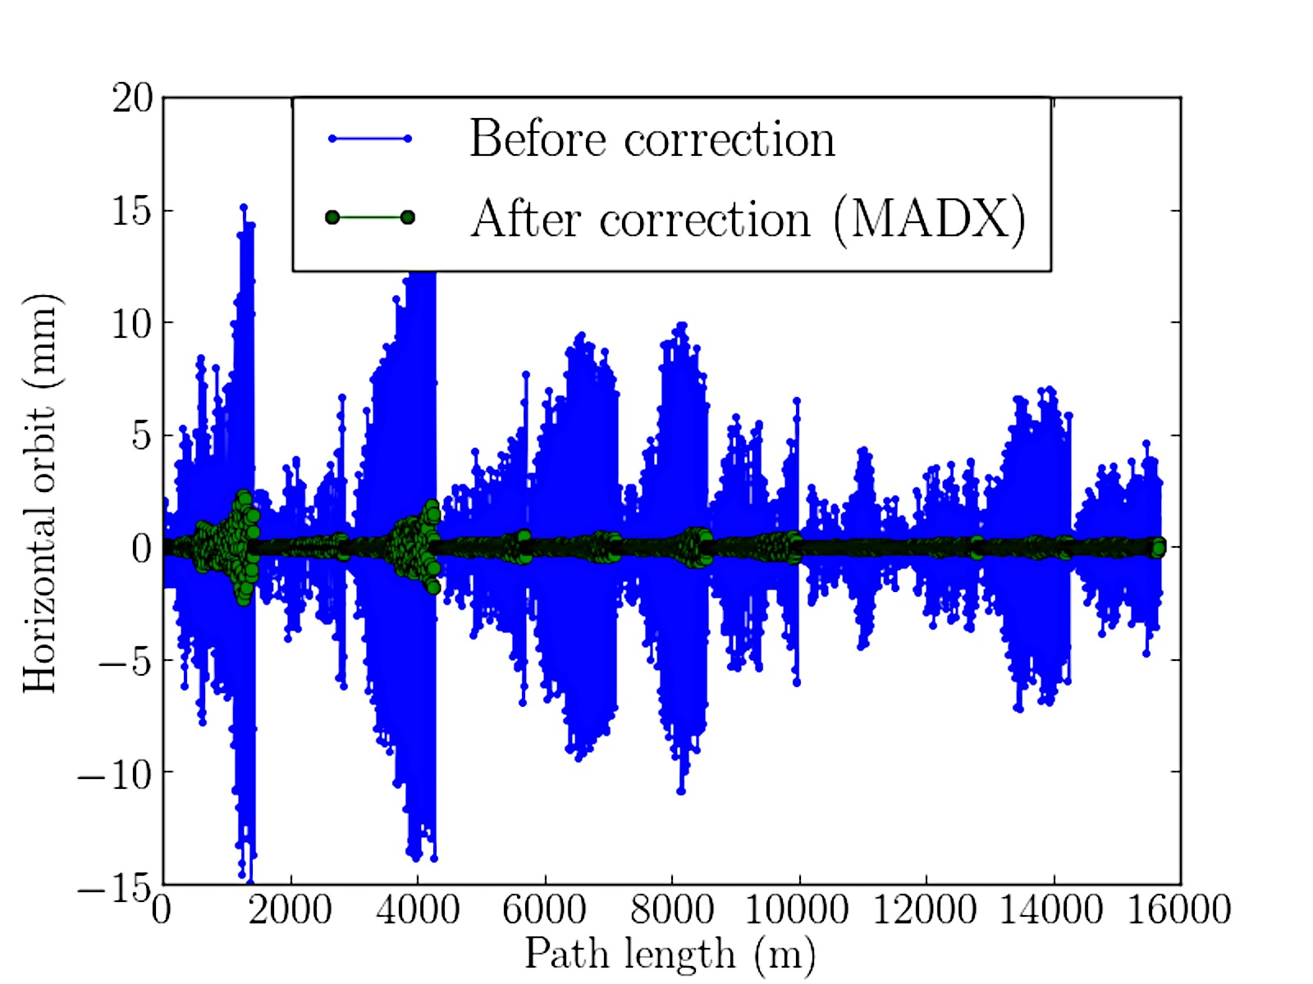
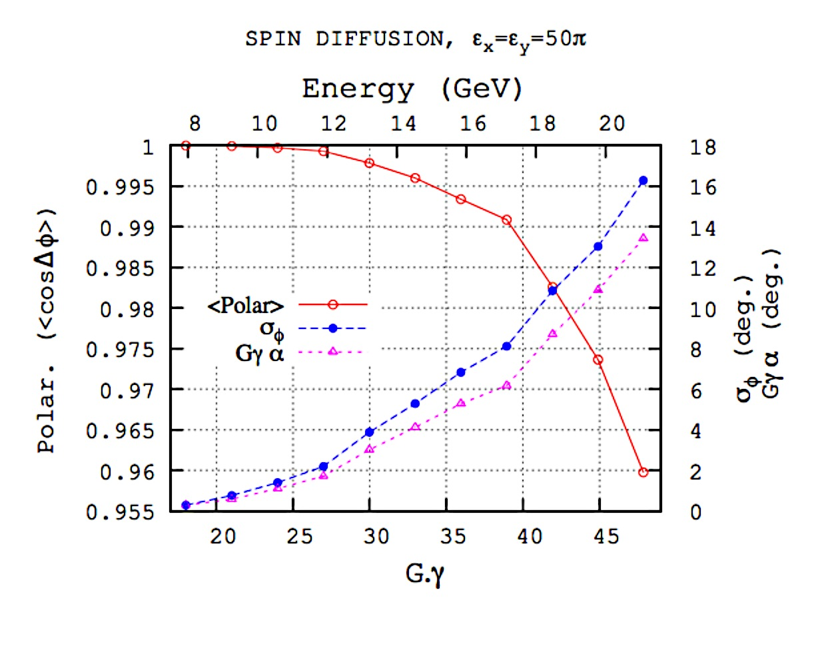
Studies in the eRHIC NS-FFAG lattice
5000 electrons
Chuyu Liu
François Méot
SPIN DIFFUSION
François Méot
ε_{o-rms}=50 π μm
δp/p=0
Yue Hao
Magnet misalignment, gradient errors, magnetic field variation due to temperature, reproducibility of the magnetic fields.
66
Chuyu Liu
30 G
0.01 G
48
Correcting misalignment errors
δp/p=±10⁻⁴
66
30 G
0.01 G
48
François Méot

Slide 17
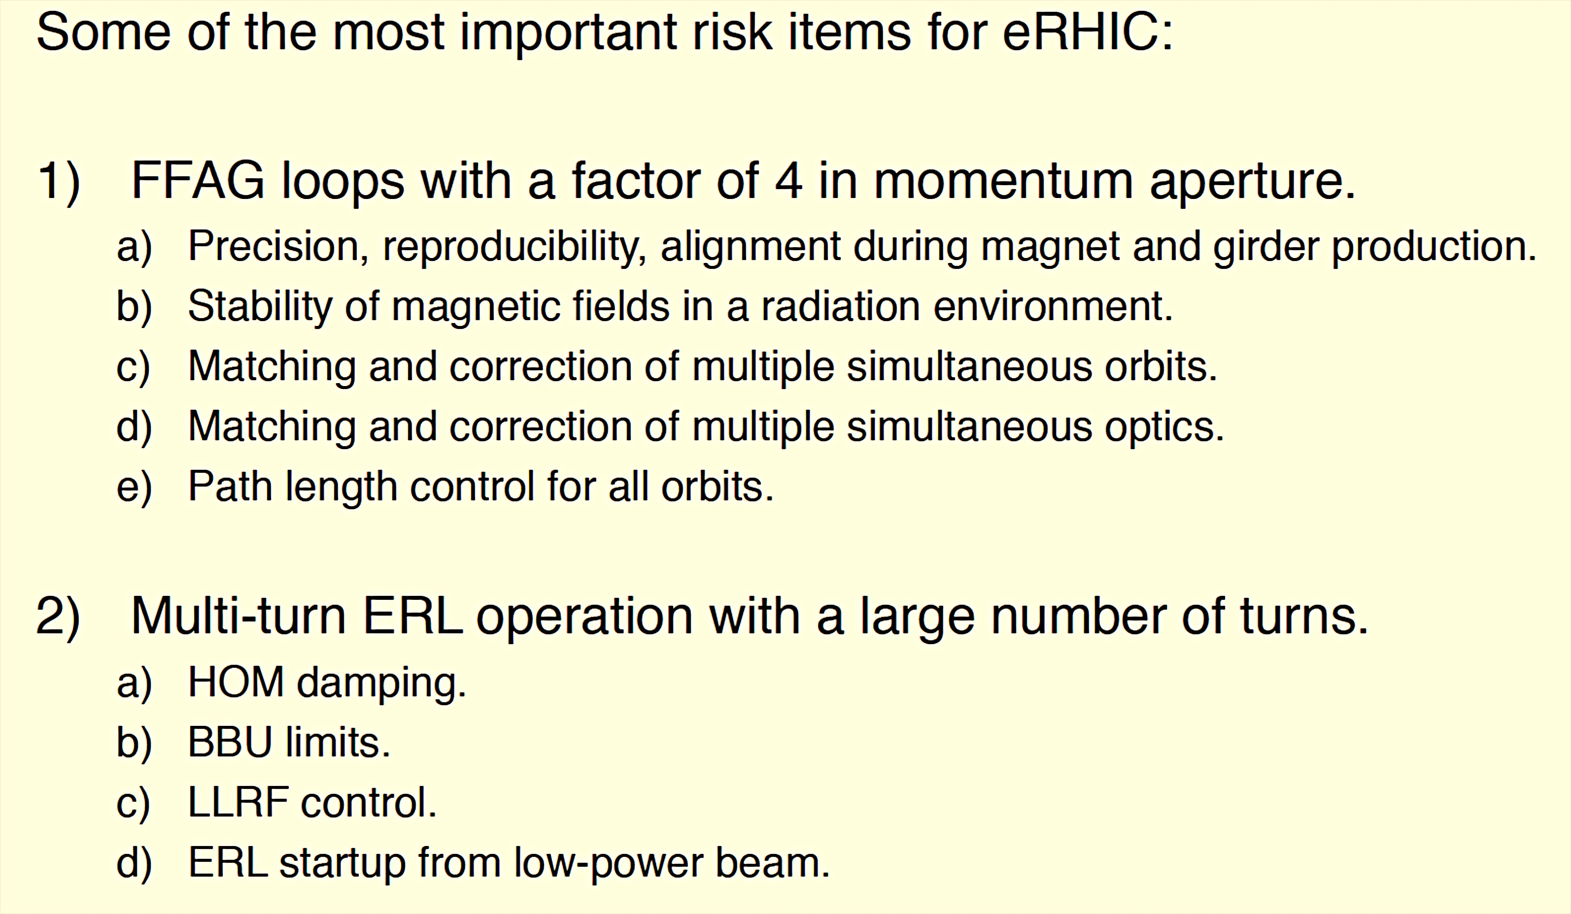
The prototype of eRHIC will be built at Cornell
Dejan Trbojevic, Workshop on the LHeC, June 24-26, 2015

Slide 18
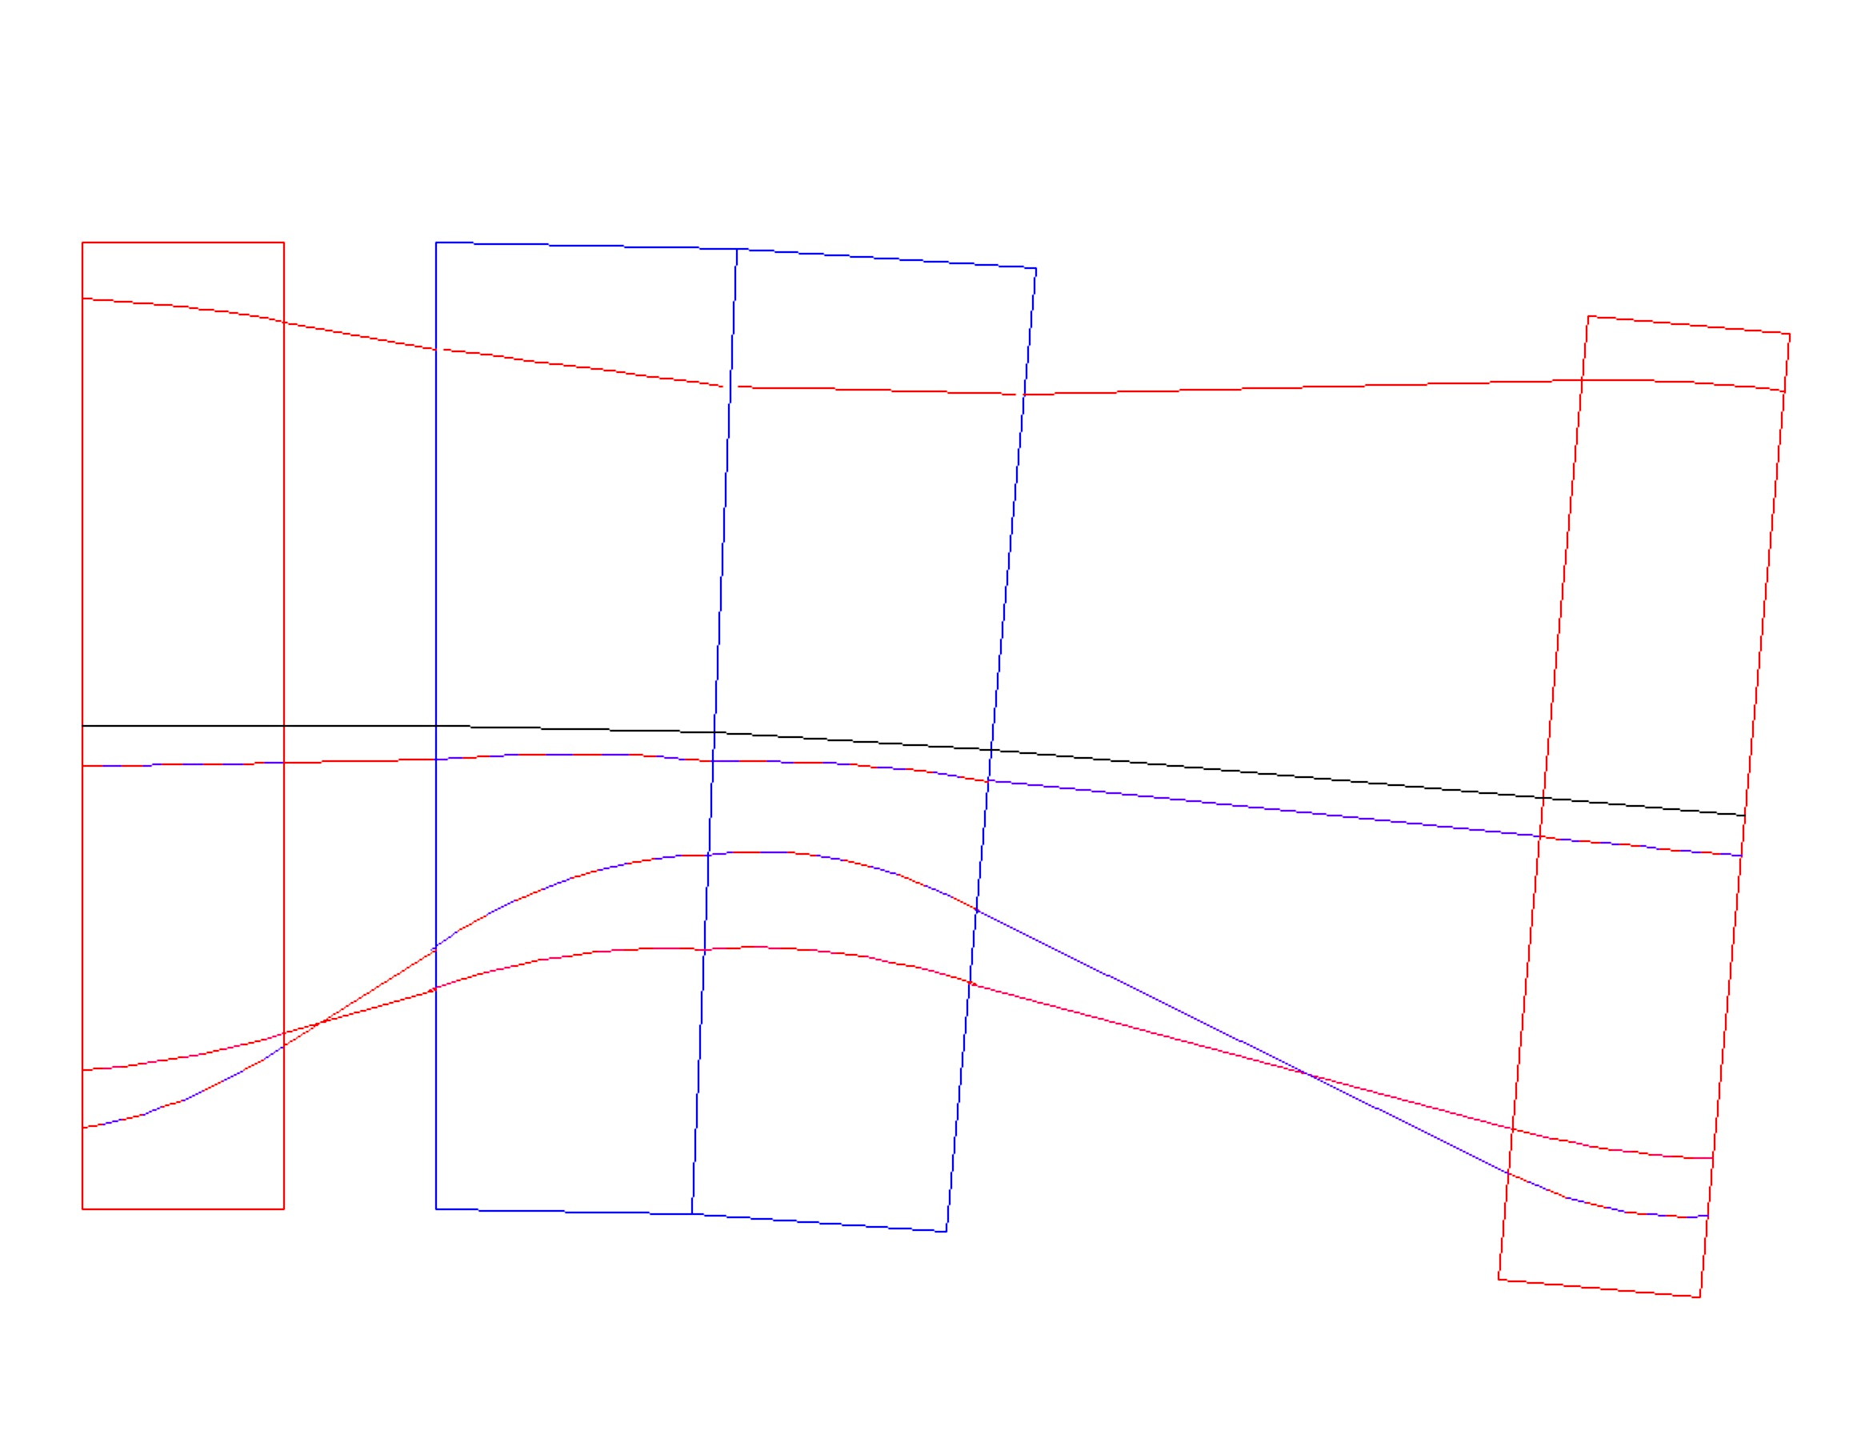
76 – 286 MeV NS-FFAG Cornell Lattice
100 cells : Orbits and magnets in the 10.5 m diameter
GF = 42.54 T/m
ByF =-0.104 T
GD = -27.493 T/m
ByD = 0.5044 T
BFmin = -0.104 + 42.54∗ (-13.364 mm) = -0.673 T
BDmin= 0.504+(-27.49*11.9 mm)=0.177 T
BFmax= -0.104 + 42.54 * (13.598 mm) = 0.4745 T
BDmax= 0.504+(-27.49*-8.98mm) =0.751 T
x (mm)
LINAC ENERGY 70 MeV
Injector 6 MeV
286 MeV
QF/2
13.598
11.2
11.9 mm
BD
QF/2
2.44
θF/2=-11.088/2 mrad
θD=73.93 mrad
ECEN=225 MeV
θF/2=-11.088/2 mrad
-8.98 mm
216MeV
-13.364
15.8
146 MeV
76 MeV
4.0 cm
3 cm
11 cm
10.99 cm
4.0 cm
BF= -0.104 + 42.54 ∗ x =0
x = 0.104/42.54 = 2.44 mm
32.99 cm
BD=0.504 + (-27.493) x = 0
x = + 18.331 mm
5/21/15
18

Slide 19
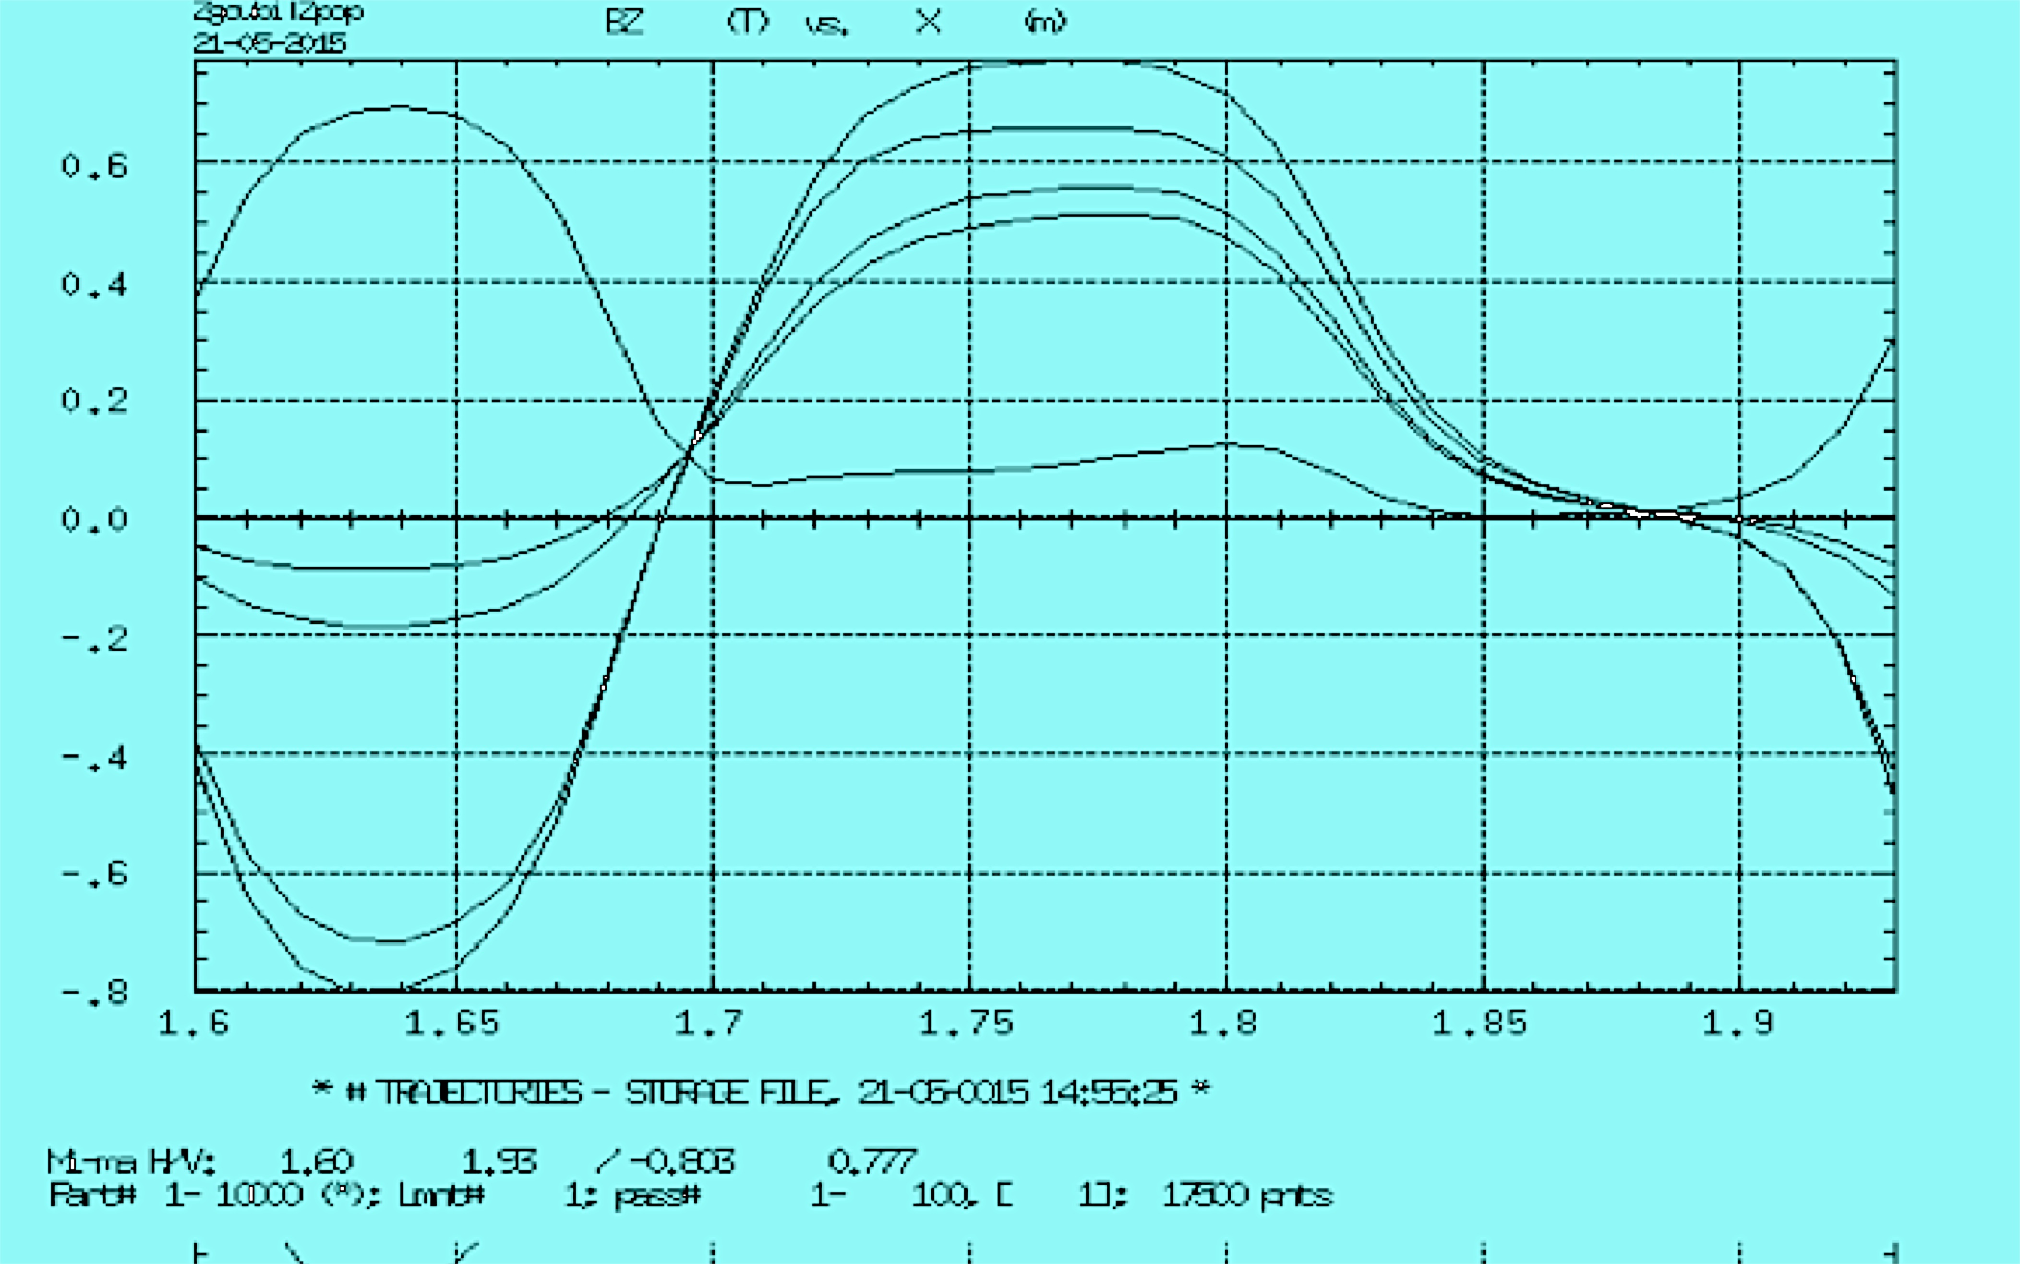
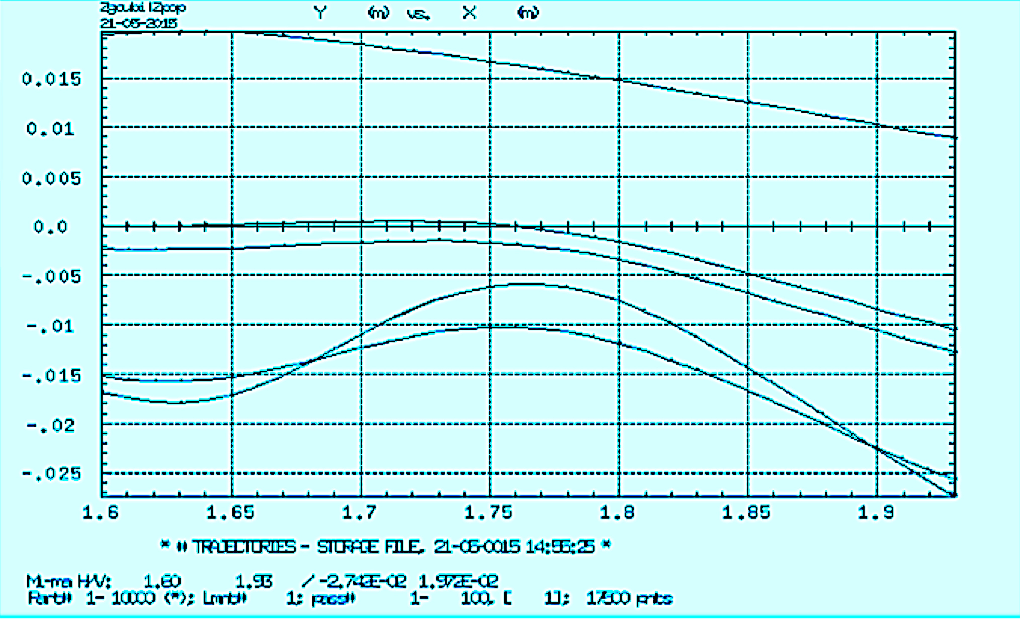
OPERA cell is QF-QD-drift. Axis is straight.
E = 76, 146, 216, 225 (reference) 286 MeV
FIELD
TRAJECTORIES
From Francois Meot and Nick Tsoupas

Slide 20
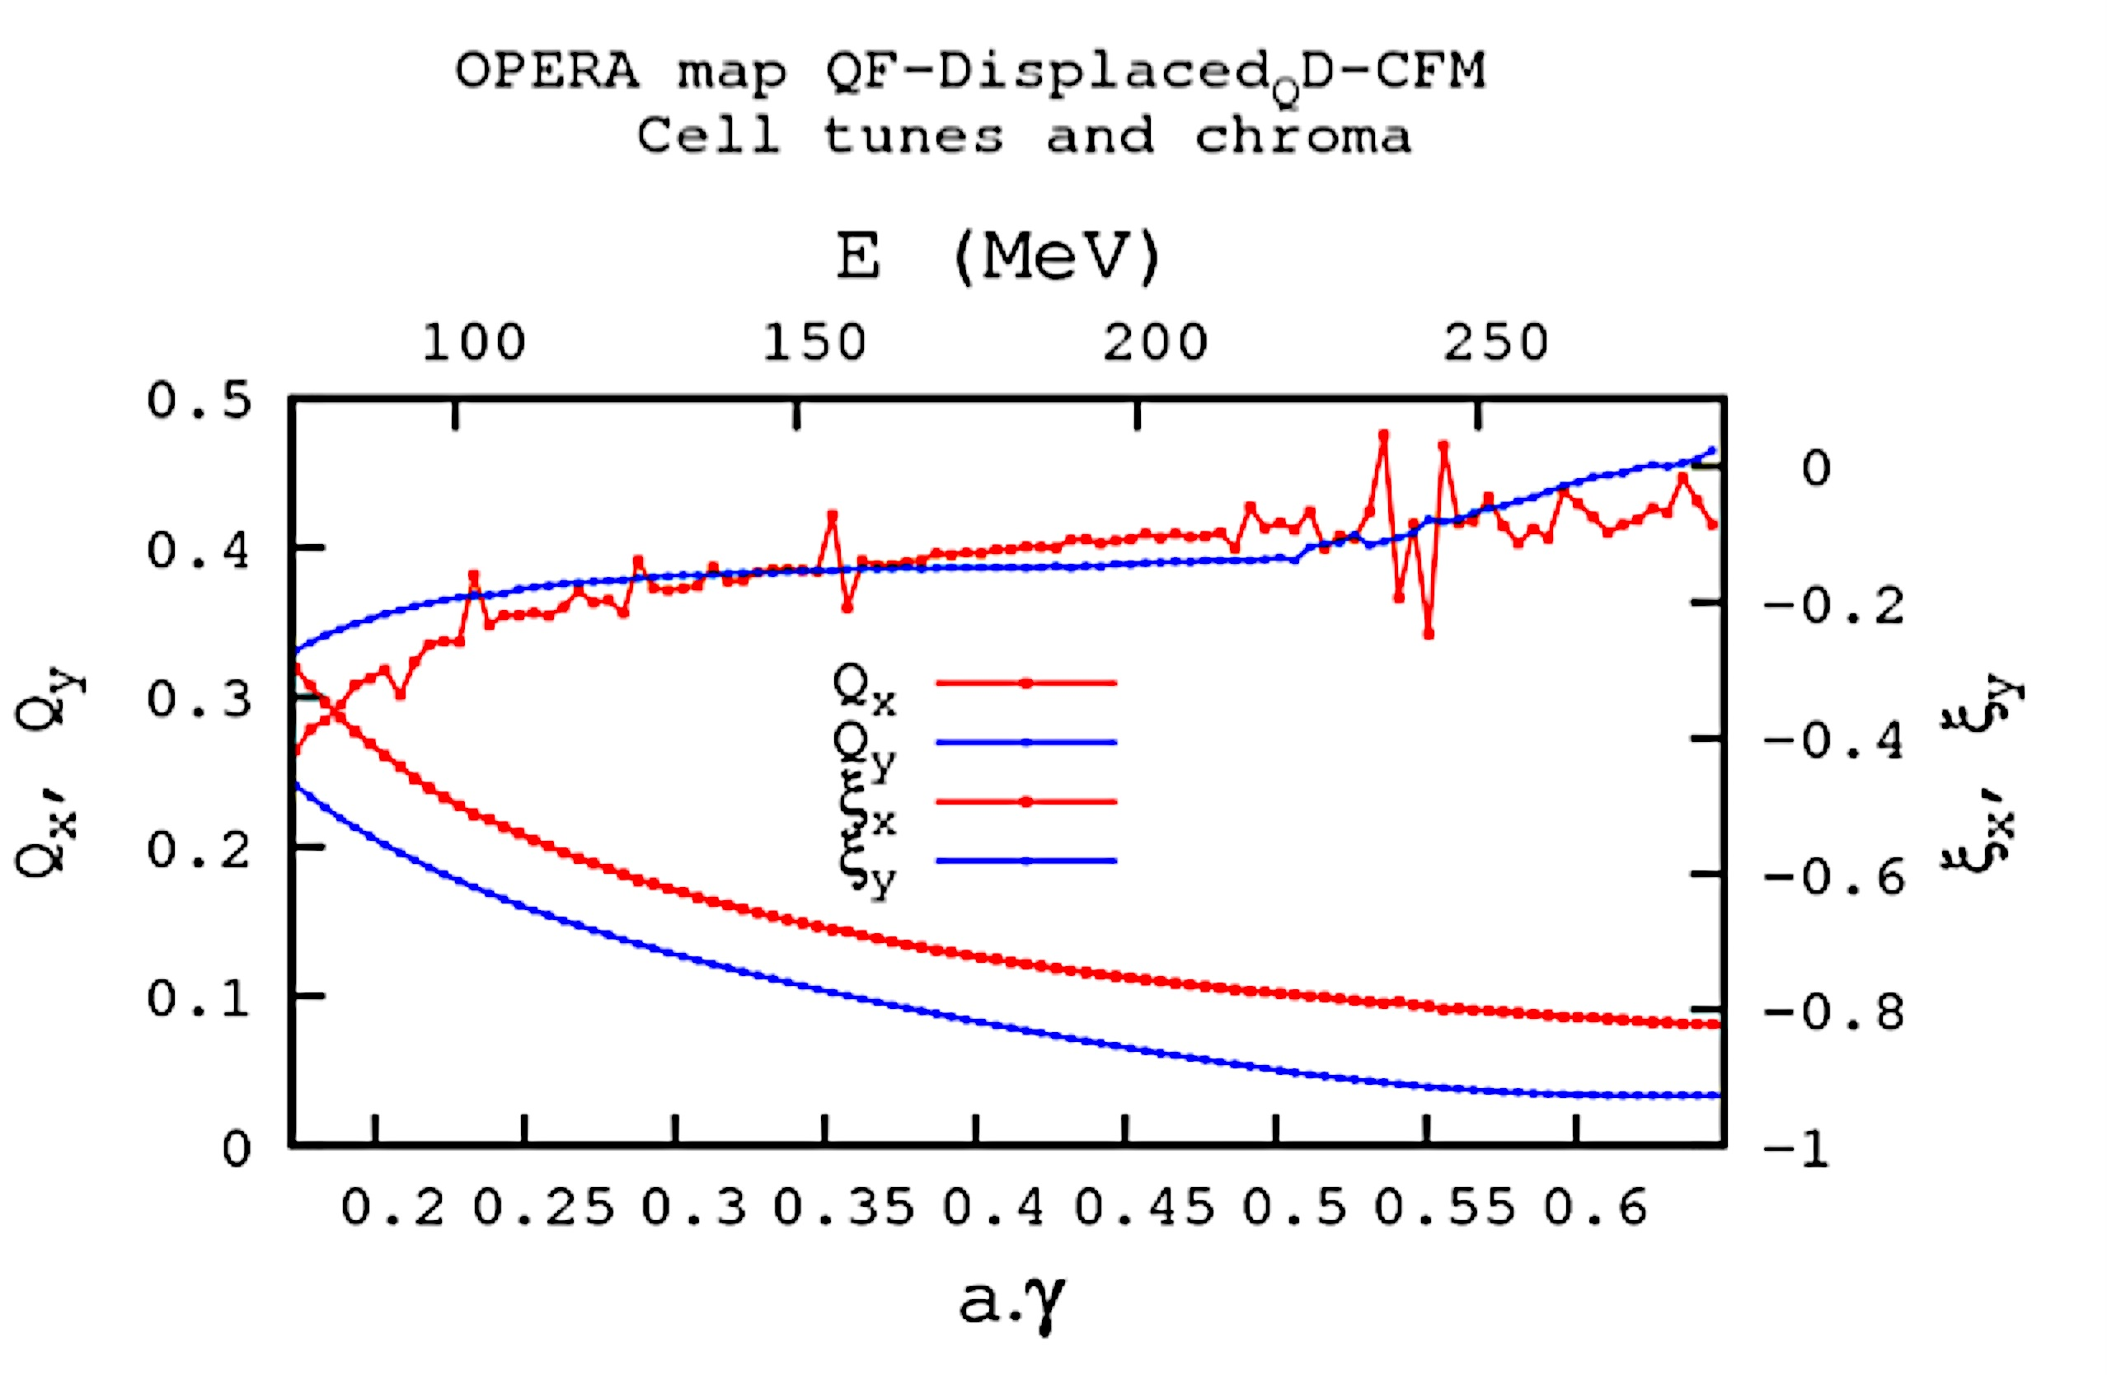
OPERA cell is QF-QD-drift. Axis is straight.
From Francois Meot and Nick Tsoupas

Slide 21
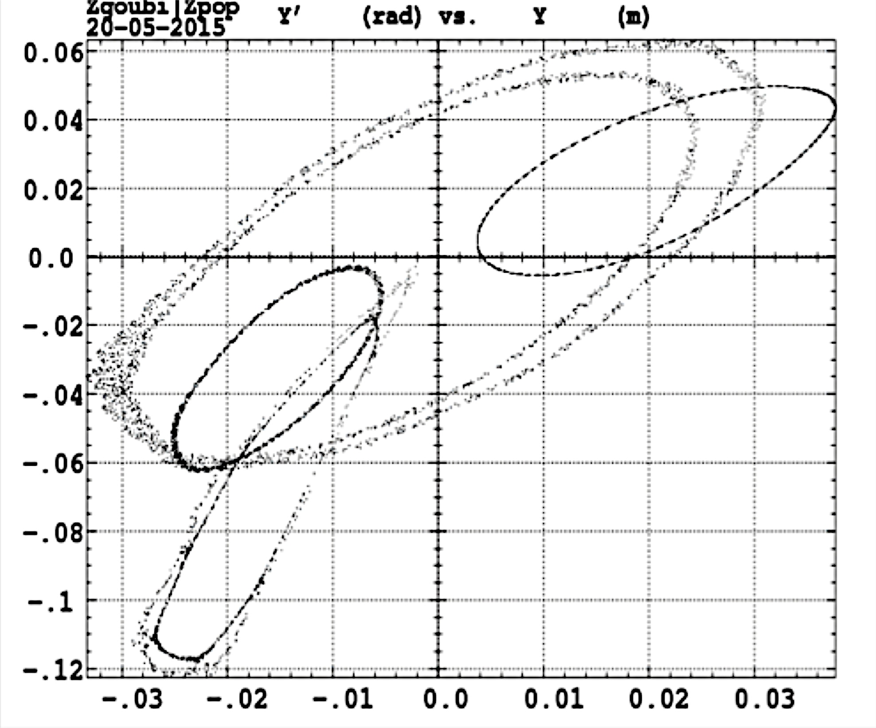
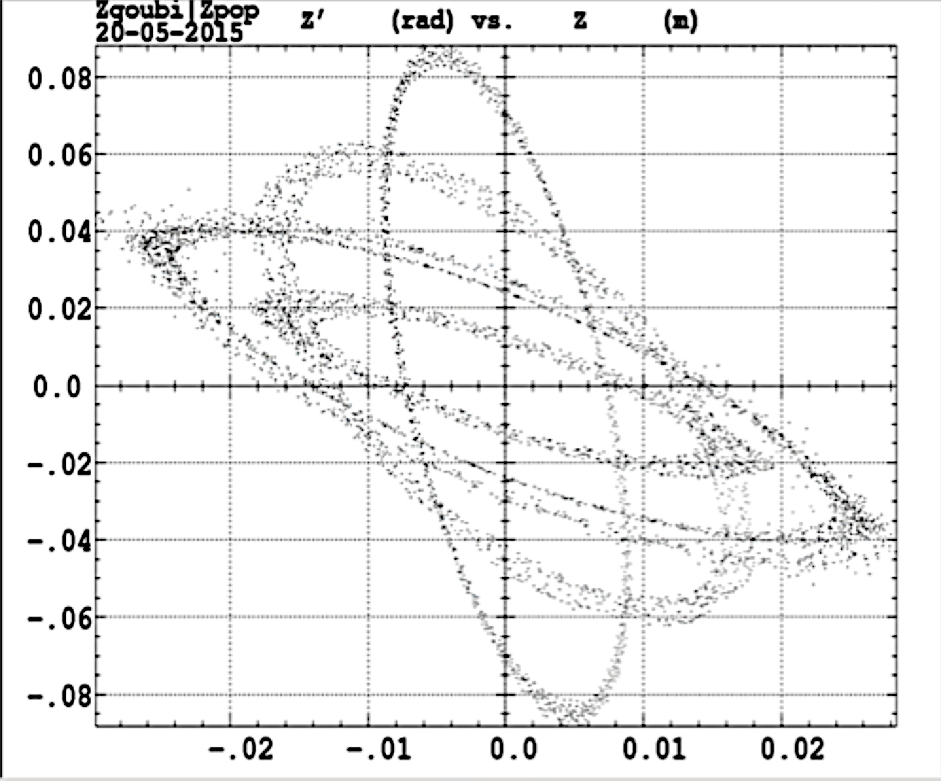
OPERA cell is QF-QD-drift. Axis is straight.
MAXIMAL STABLE AMPLITUDES, H, V :
From Francois Meot and Nick Tsoupas

Slide 22
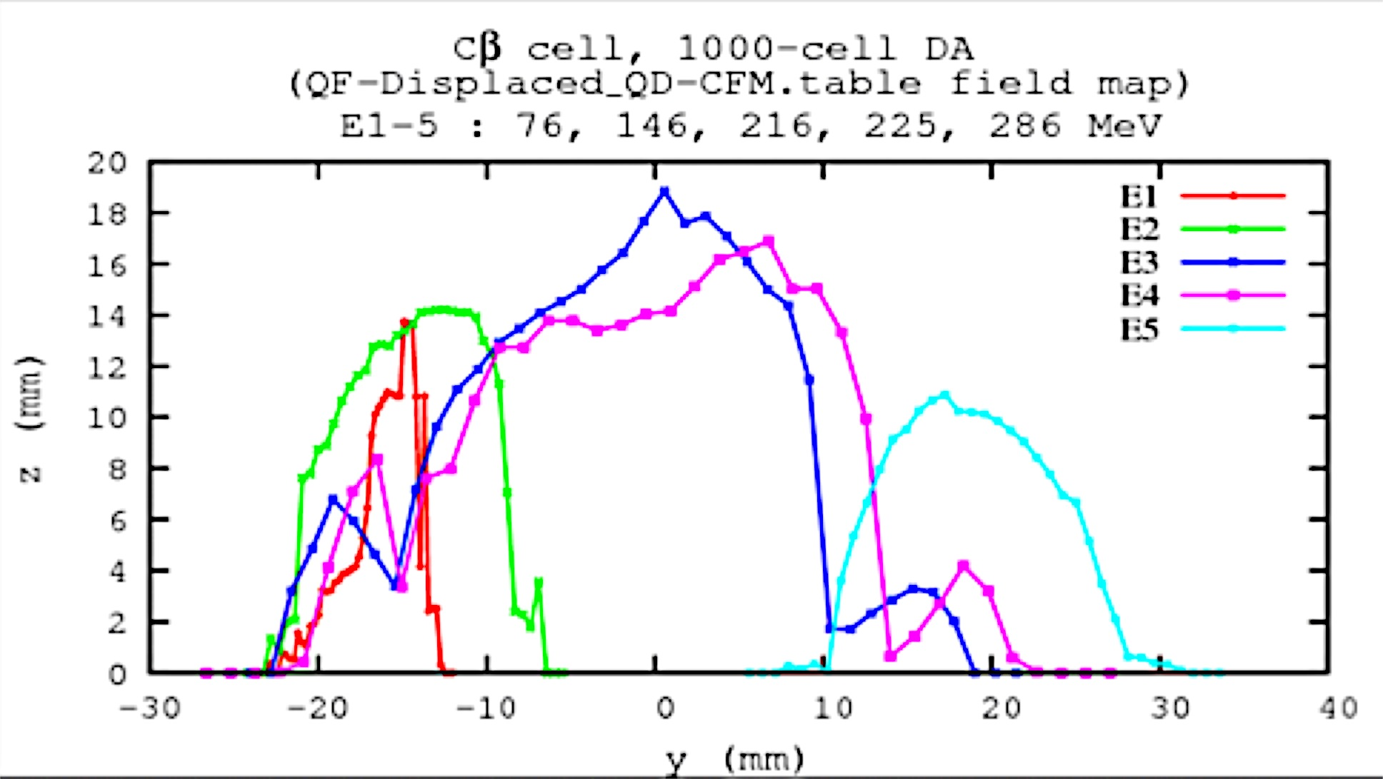
OPERA cell is QF-QD-drift. Axis is straight.
DYNAMICAL ACCEPTANCE
From Francois Meot and Nick Tsoupas

Slide 23
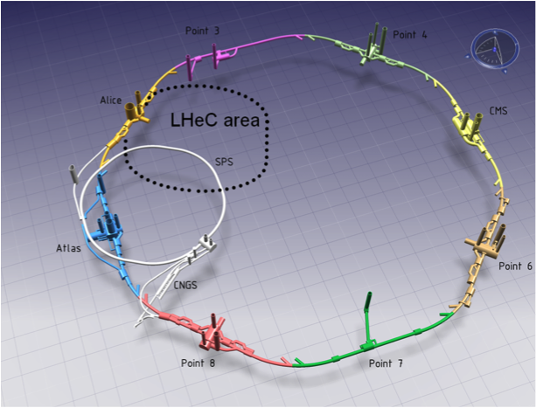
Layout of the LHeC-LHC-SPS
From Oliver Brüning

Slide 24
#2
54.547 GeV
43.641 GeV
32.735 GeV
21.829 GeV
10.923 GeV
#1
Thomas Roser’s idea
El. GUN
17 MeV
60 GeV
5.453 GeV
LHC
60 GeV
λ/2
5.453 GeV
# 1 NS-FFAG beam line:
3 passes for acceleration
3 passes for recovery
# 2 NS-FFAG beam line:
2 passes for acceleration
2 passes for recovery
Beam
Dump
32.735 GeV
21.829 GeV
10.923 GeV
#1
#2
54.547 GeV
43.641 GeV

Slide 25
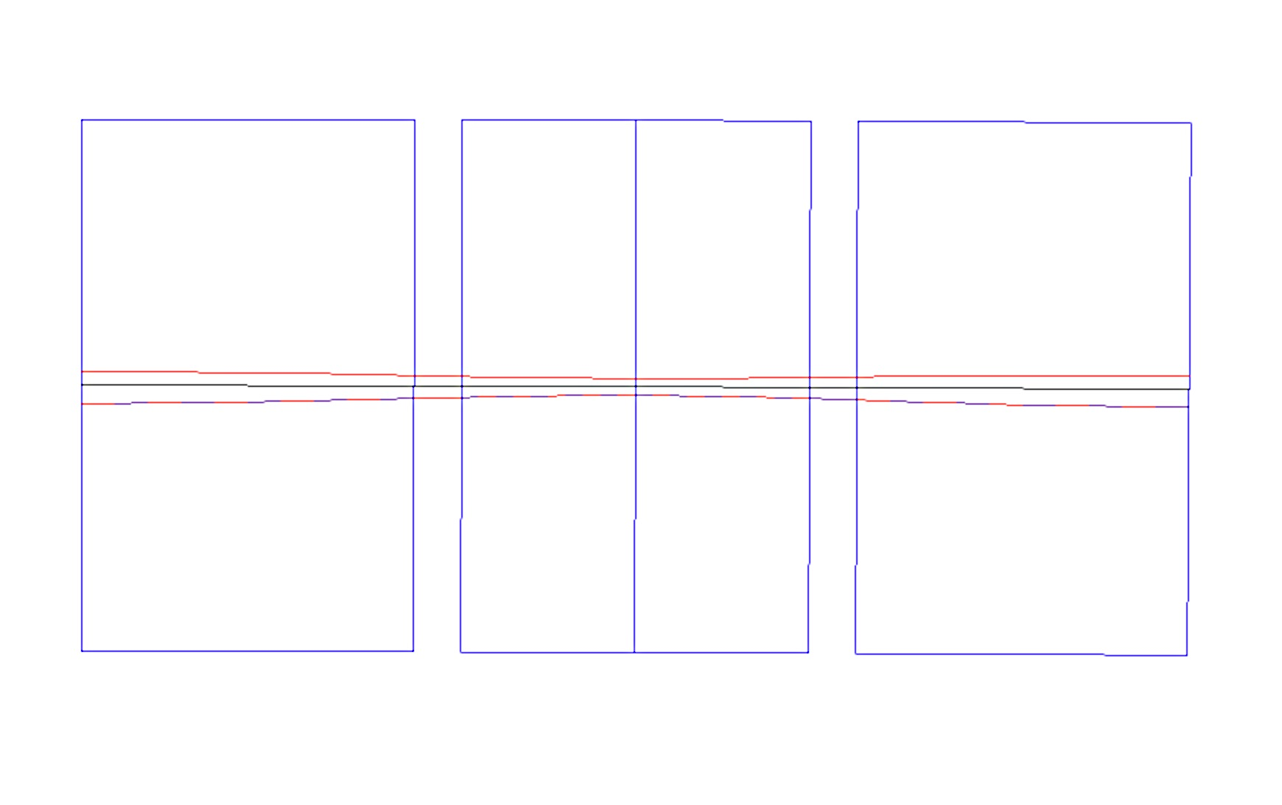
LHeC ARC– 2 x 5.453 GeV linacs:
Orbits in the basic cell of the High energy NS-FFAG 54.55 - 43.644 GeV
GF= 30.299 T/m
GD=-40.127 T/m
GF= 30.299 T/m
B_{F}= 0.182 T
B_{D}= 0.182 T
B_{F}=0.182 T
x(mm)
1.33
54.550 GeV
0.0
50.0 GeV
-2.26
43.600 GeV
0.30 m
0.30 m
4.2/2=2.1
2.2 m
4.2/2=2.1 m
θ_{F}=4.594 /2 mrad
θ_{D}=2.4063 mrad
θ_{F}=4.594/2 mrad
ρ_{F}=914.286 m
ρ_{D}=914.286 m
ρ_{F}=914.286 m
7.00 m (897.5 cells = 2π∗1000 m)

Slide 26
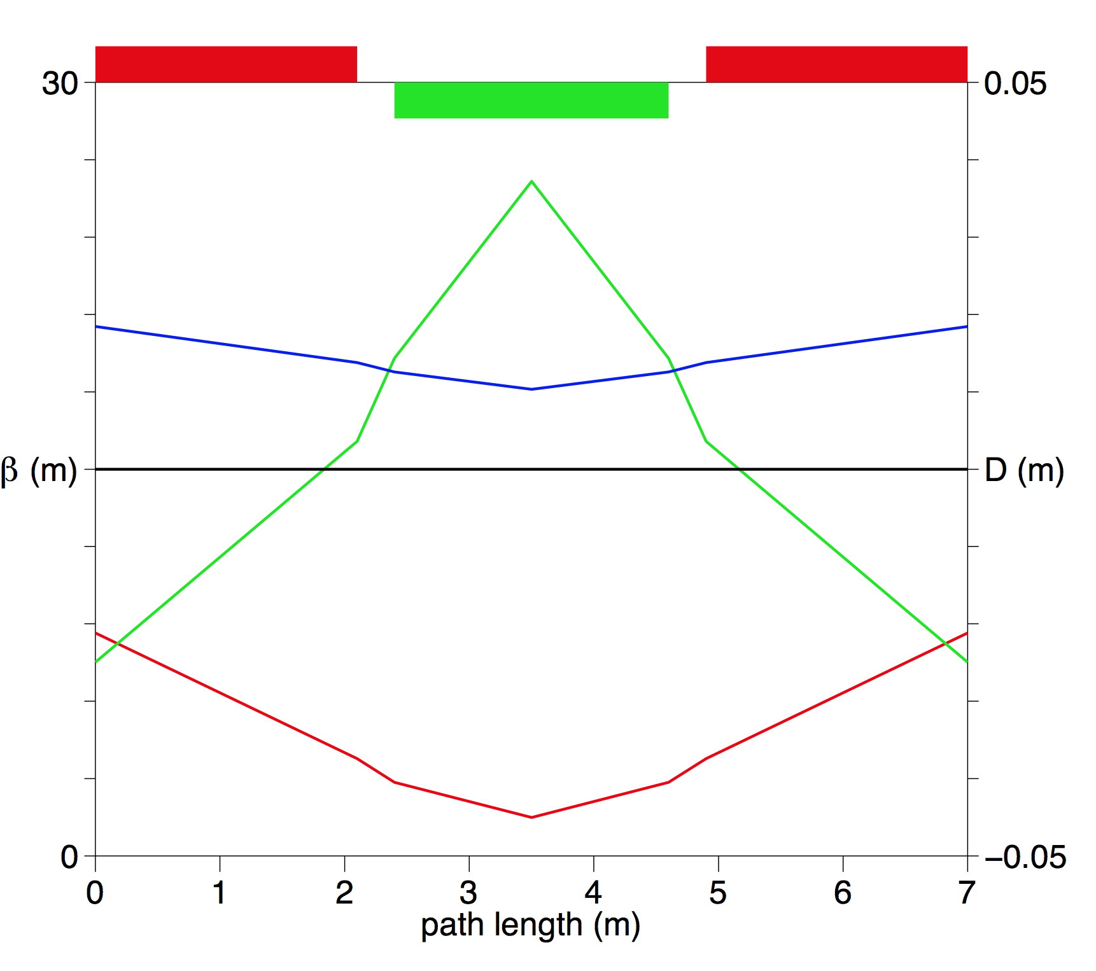
Betatron Functions for E_{c}=50 GeV, 2 x 5.453 GeV linacs
β_{y}
D_{x}
β_{x}

Slide 27
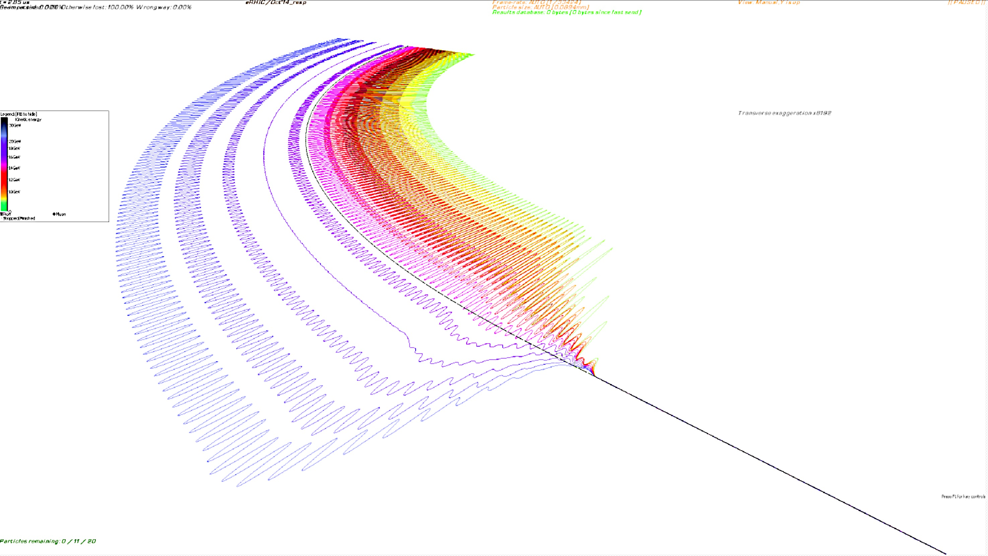
Merging FFAG arcs to the straight section in eRHIC
7.75 mm

Slide 28
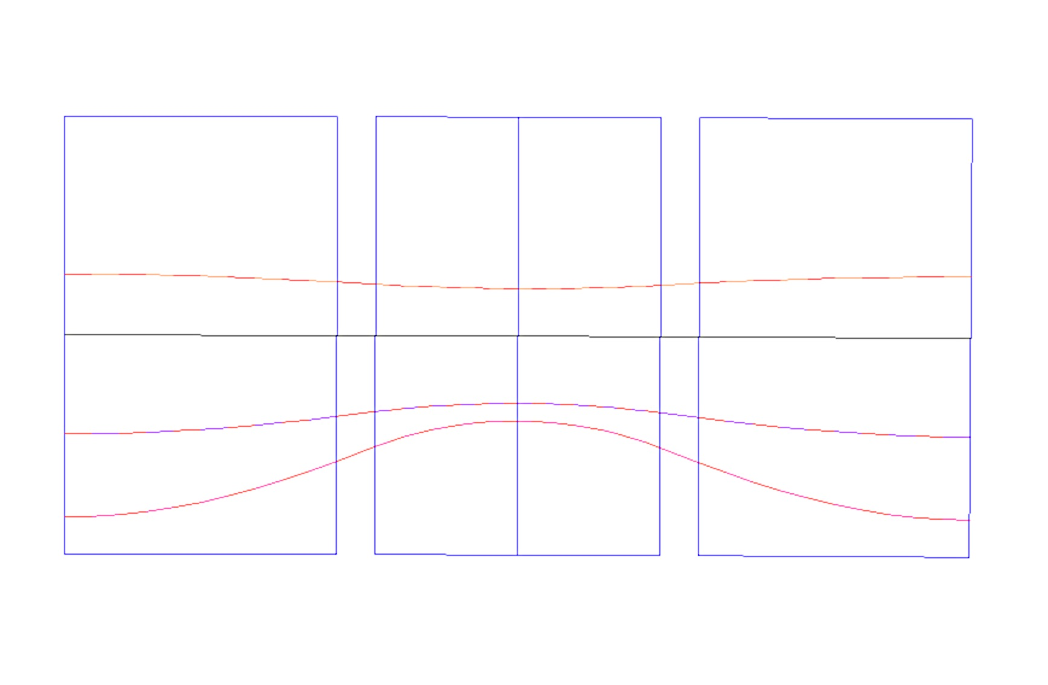
LHeC-ERL with 2 x 5.453 GeV linacs
Orbits in the basic cell of the Low energy NS-FFAG 10.923 - 32.735 GeV
GF= 8.576 T/m
GD=-13.935 T/m
GF= 8.576 T/m
B_{F}= 0.1058T
B_{D}= 0.1058 T
B_{F}=0.1058 T
x(mm)
16.3
13.7
36.004 GeV
0.0
E_{CEN}=29 GeV
-9.8
24.006 GeV
-14.9
-24.3
10.923 GeV
0.30 m
0.30 m
4.2/2=2.1
2.2 m
4.2/2=2.1 m
θ_{F}=4.594 /2 mrad
θ_{D}=2.4063 mrad
θ_{F}=4.594 mrad
ρ_{F}=914.286 m
ρ_{D}=914.286 m
ρ_{F}=914.286 m
7.00 m (897.5 cells = 2π∗1000 m)

Slide 29
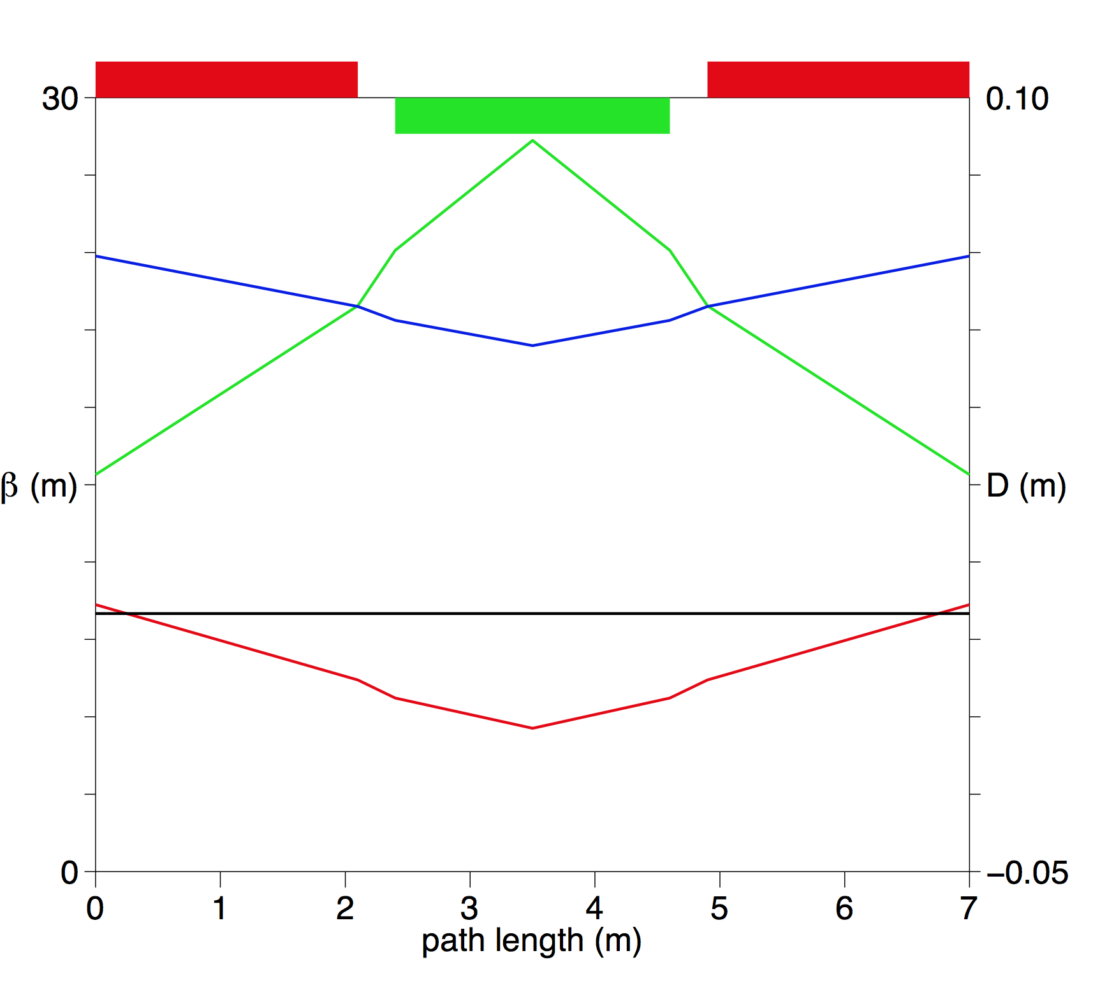
Betatron Functions for E_{c}=29 GeV, 2 x 5.453 GeV linacs
β_{y}
D_{x}
β_{x}

Slide 30
Synchrotron Radiation in LHeC with 2 x 5.453 GeV linacs
Two NS-FFAG 43.6-54.6 GeV and 10.9-32.7 GeV
Maximum Collision Energy 60 GeV
E(GeV) | Total Power (MW) 8.87035 mA | Total Power (MW) 6.6 mA
54.550 | 7.5779 | 5.6383
43.644 | 4.2080 | 3.1310
32.735 | 1.3902 | 1.0344
21.829 | 1.2881 | 0.9584
10.923 | 0.5359 | 0.3987
TOTAL | 15.000 | 11.1608

Slide 31
NS-FFAG for the LHeC ERL-ONE 12 GeV LINAC
60.000 GeV
60.000 GeV
60 GeV
48.002 GeV
48.002 GeV
36.004 GeV
36.004 GeV
24.006 GeV
24.006 GeV
12.008 GeV
12.008 GeV
CIRCUMFERENCE 8.9 km
#2
60.000 GeV
48.002 GeV
#1
36.004 GeV
24.006 GeV
10 passes through
the linac
12.008 GeV
#2
60.000 GeV
48.002GeV
DUMP
El. GUN
#1
36.004 GeV
0.010 GeV
0.010 GeV
0.010 GeV
12.008 GeV
24.006 GeV
24.006 GeV
12.008 GeV
Linac 11.998 GeV
36.004 GeV
60 GeV after collisions
60 GeV

Slide 32
Synchrotron Radiation in LHeC with one 12 GeV linac
Two NS-FFAG 48-60 GeV and 12-36 GeV
Maximum Collision Energy 60 GeV
E(GeV) | Total Power (MW) 6.7834 mA | Total Power (MW) 6.6 mA
54.550 | 6.4562 | 6.2816
43.644 | 4.6537 | 4.5279
32.735 | 2.5812 | 2.5115
21.829 | 0.8544 | 0.8313
10.923 | 0.4546 | 0.4423
TOTAL | 15.000 | 14.5945

Slide 33
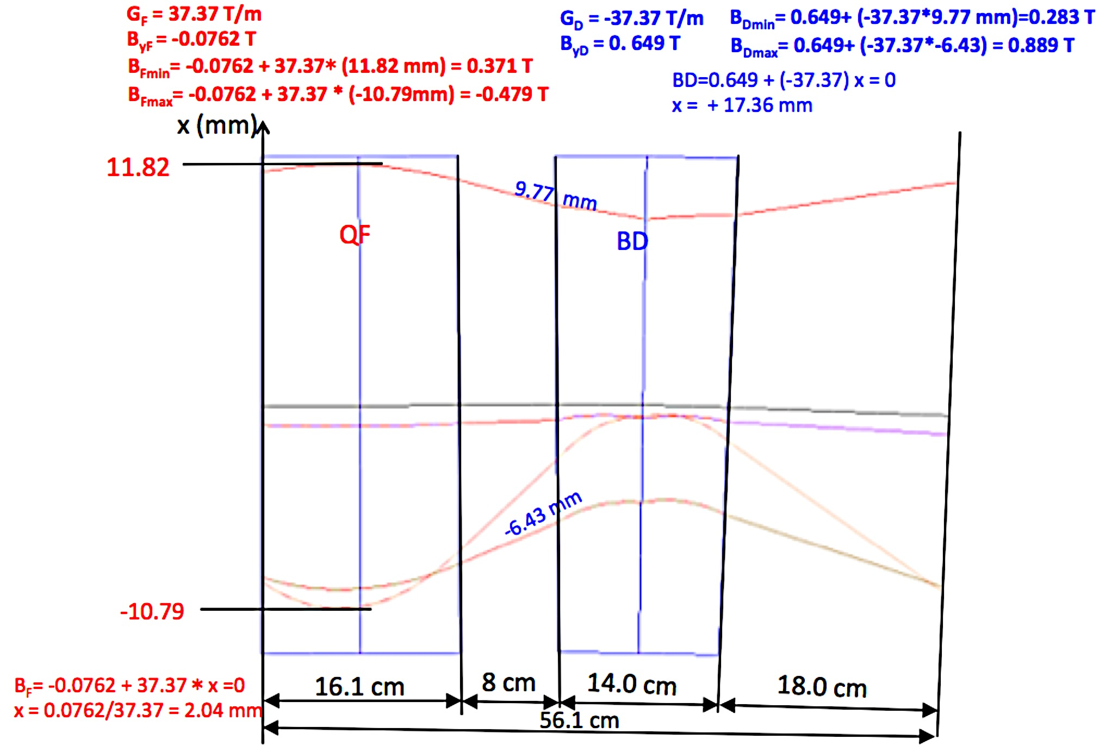
FFAG-ERL at CERN 240 m circumference
72.9 m
47.1 m
30.0 m
Dejan Trbojevic, Workshop on the LHeC, June 24-26, 2015

Slide 34
CONCLUSION
A cost effective eRHIC design with 1.332 GeV linac and maximum energy of 21.2 GeV is shown.
A proposal for replacement of the 2 x 10 GeV linacs and three arcs, with 2 x 5.453 GeV linacs and two NS-FFAG arcs, respectively.
A cost-effective solution with lower synchrotron radiation, hence 34 % larger luminosity for the same limit on the value of 15 MW for the total loss from synchrotron radiation.

Slide 35
Scaling down LHeC energies
Circumference of the LHC: C_{LHC} = 26,658.88320 m
1/3 C_{LHC} = 8,886.29440 m [60 GeV - Linacs 2x10x3] 10 GeV Linac ~2x 1 km+6.283+4x0.151
1/4 C_{LHC} = 6,664.72080 m [45 GeV - Linacs 2x7.5x3]7.5 GeV linac 0.75 km
1/5 C_{LHC} = 5,331.77664 m [36 GeV –Linacs 2x6x3]
FFAG solutions:
1/3 C_{LHC} = 8,886.29440 m [60 GeV - Linacs 2x5.453x2]
    Or [ 60 GeV – one linac 12 GeVx2 FFAG lines]
1/4 C_{LHC} = 6,664.72080 m [45 GeV –Linacs 2x4.125 GeV]
    Or [ 45 GeV one linac 11.245 GeV[
1/5 C_{LHC} = 5,331.77664 m [36 GeV –one linac 8.99 GeV]

