Slide 1
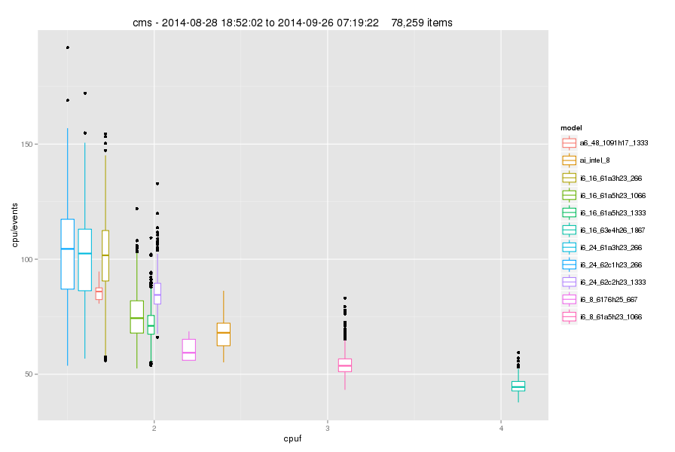
Normalization of Cpu Time
Correlation= -0.74

Slide 2
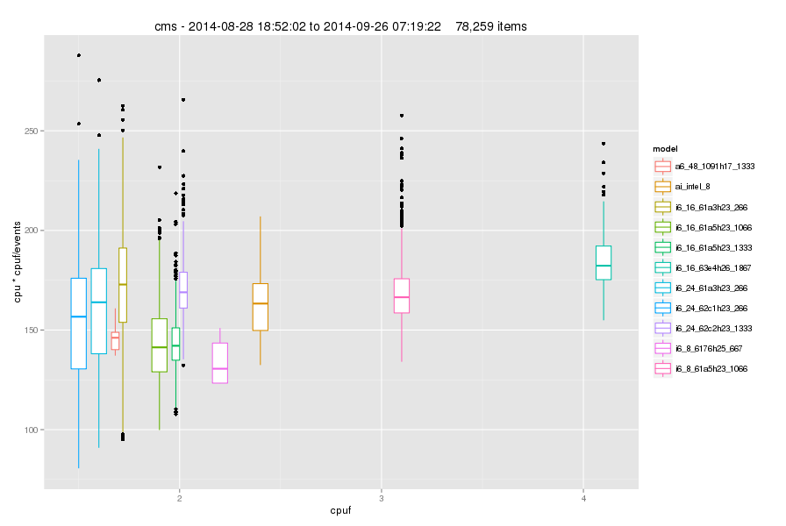
Normalization of Cpu Time
Correlation= 0.12

Slide 3
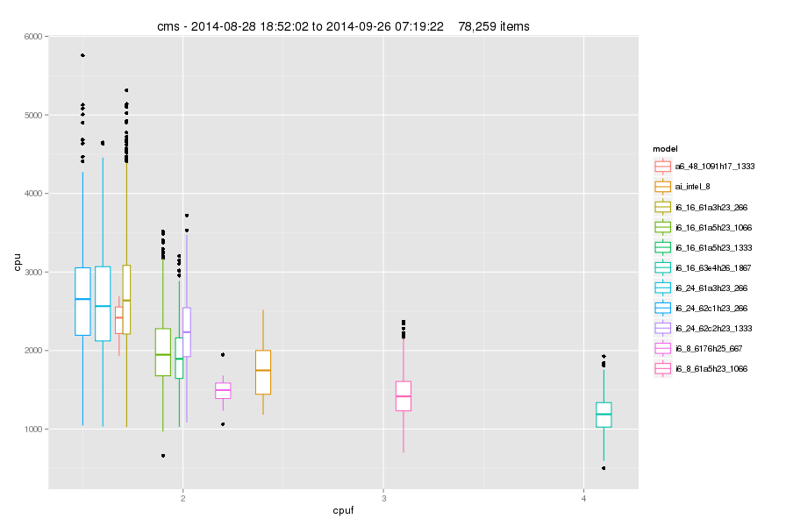
Normalization of Cpu Time
Correlation= -0.61

Slide 4
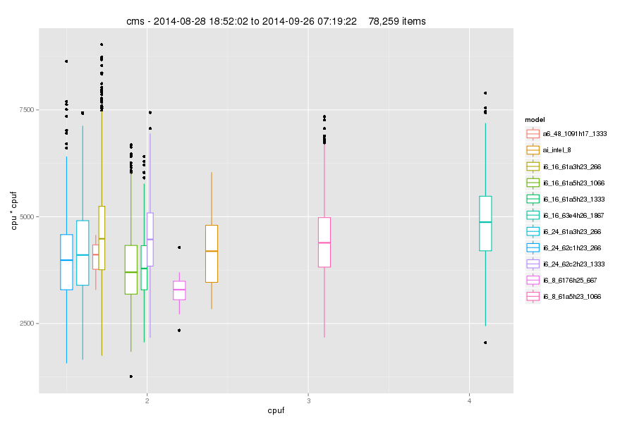
Normalization of Cpu Time
Correlation= 0.08

Slide 5
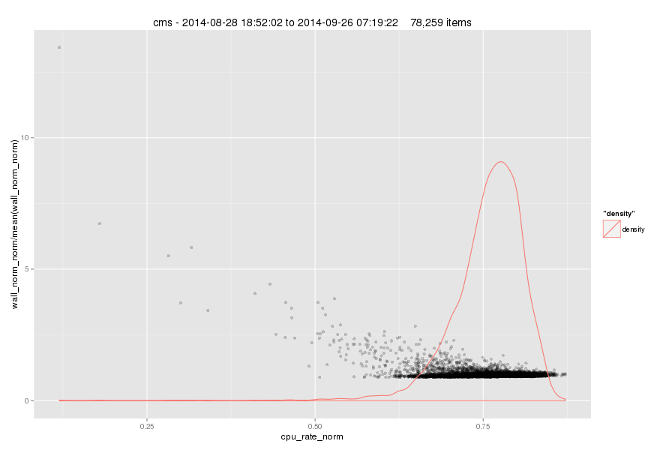
“Cpu-Efficiency” vs. Normalized Wall

Slide 6
Summary
Cpu factor is a good representation of the performance differences between hosts
Nr of events is helpful to normalize runtime for a given job
“Cpu efficiency” is not directly correlated to performance
  …but a drastic drop can be an indicator of problems

