Slide 1
The road to Indico 2.0
On the way to a clean and extensible codebase

Slide 2
Indico v1.9.1
Second internal release with SQLAlchemy
Massive plugin rewrite
Some UI improvements
Removed lots of legacy code (>35k lines)
Removed CERN-specific code from the core

Slide 3
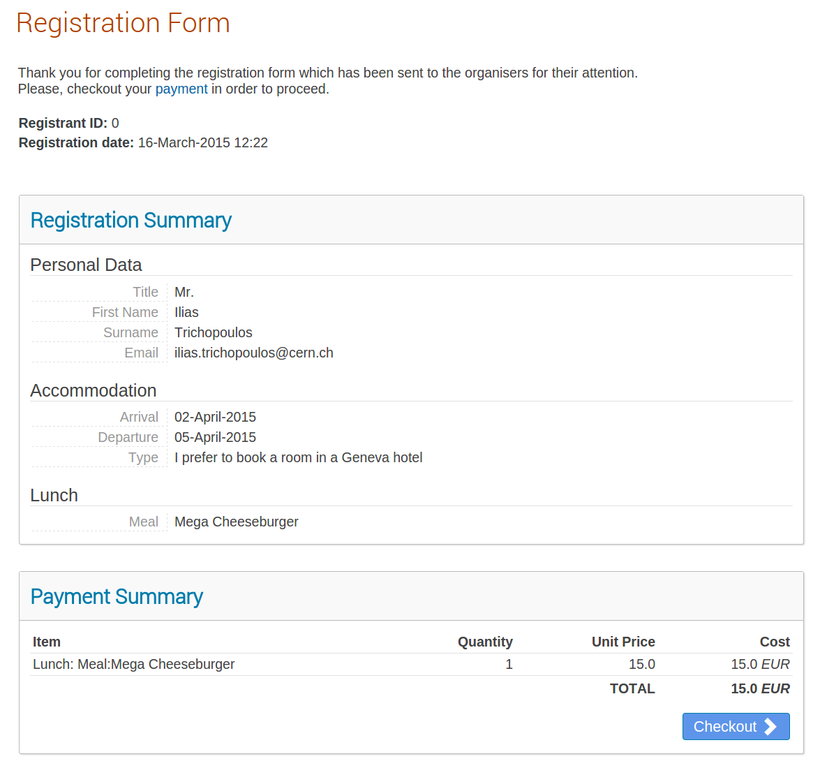
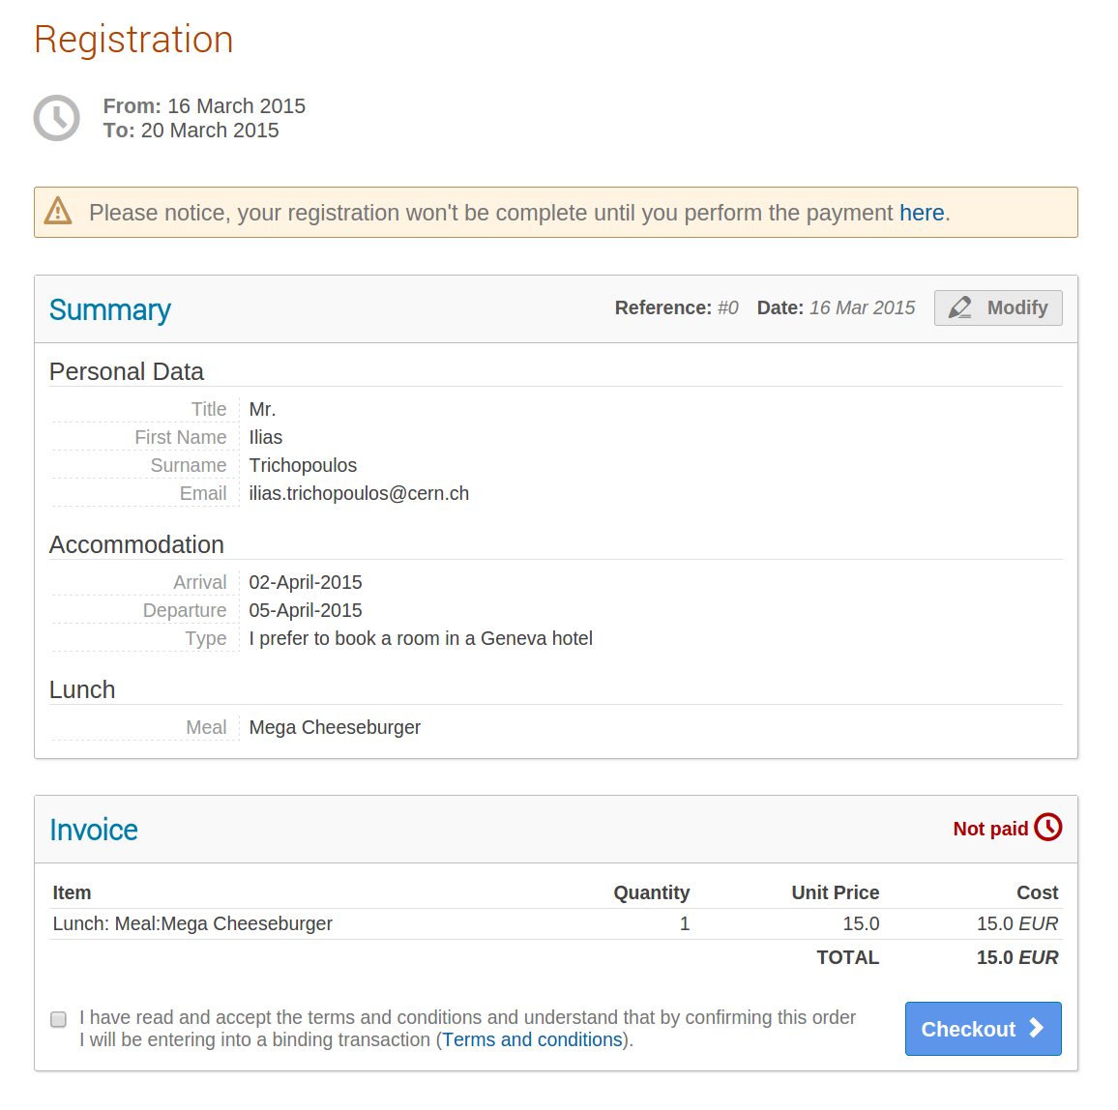
UI: Registration

Slide 4
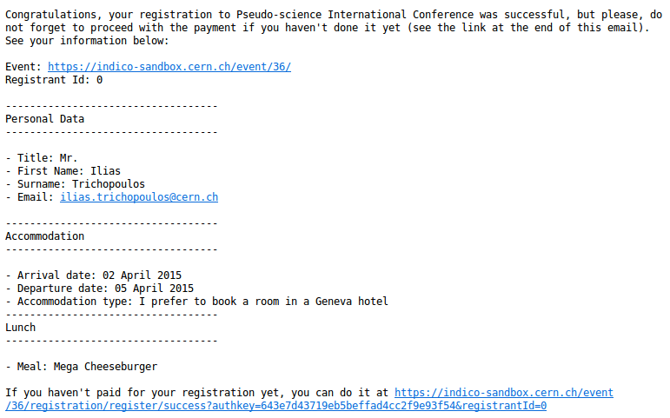
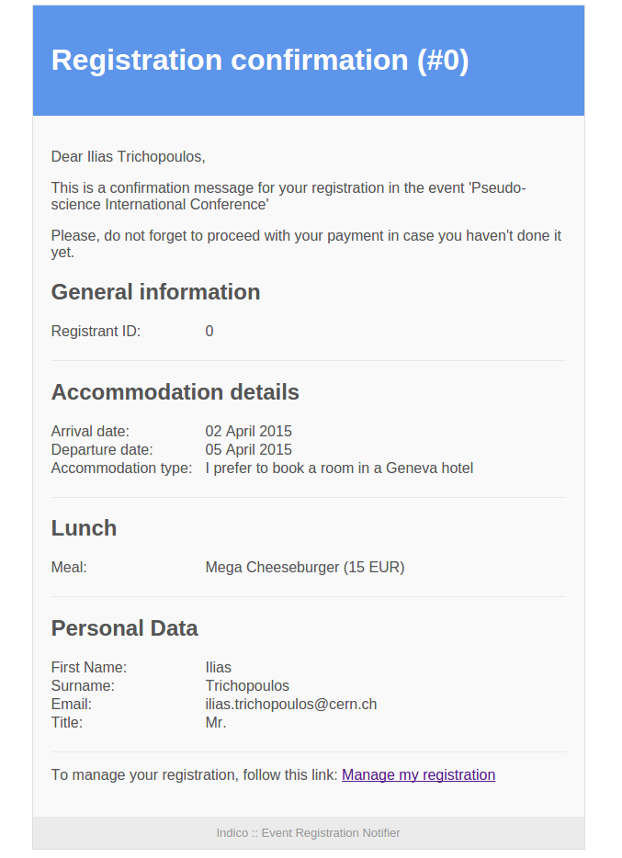
UI: Registration email

Slide 5
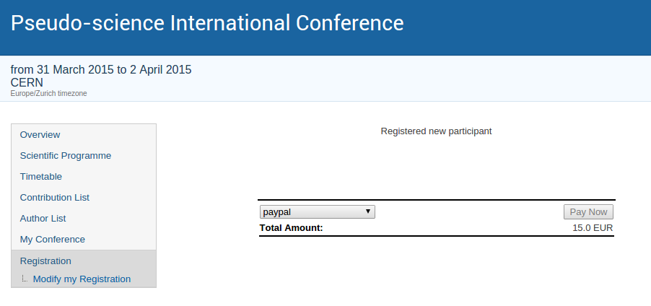
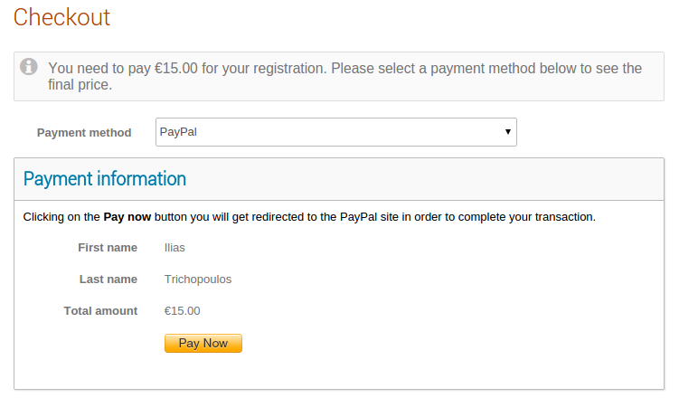
UI: Payment

Slide 6
Collaboration (pre-1.9.1)
One huge plugin type (with different plugins)
Webcast/Recording request, Vidyo, ...
Very different tools
Completely different workflows

Slide 7
“Collaboration” (v1.9.1)
No single “Collaboration” module
Split into three core modules
Video Conference
Services
Agreements

Slide 8
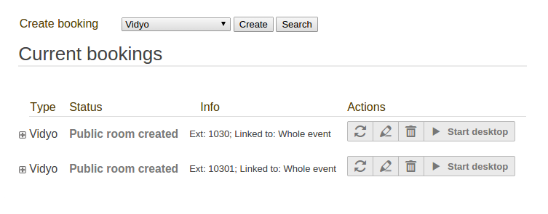
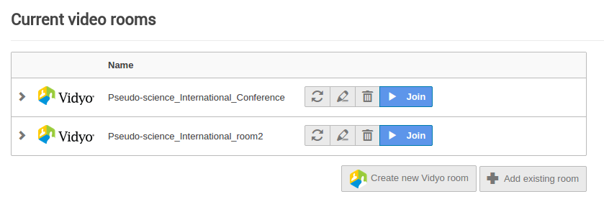
UI: Video Conference

Slide 9
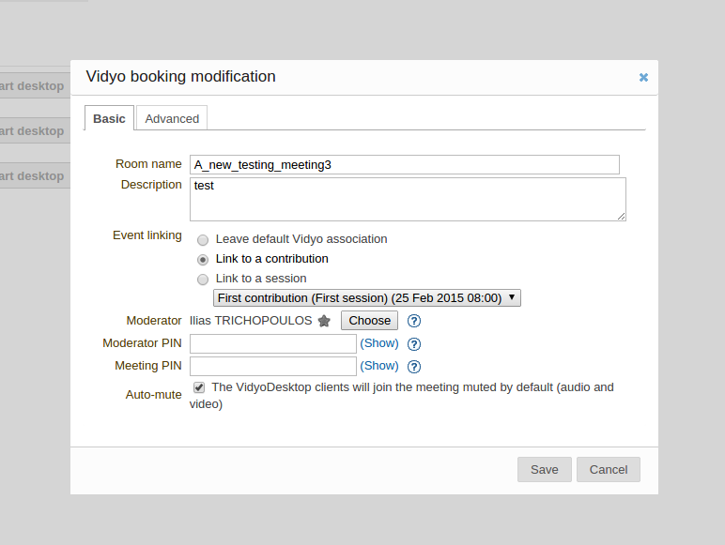
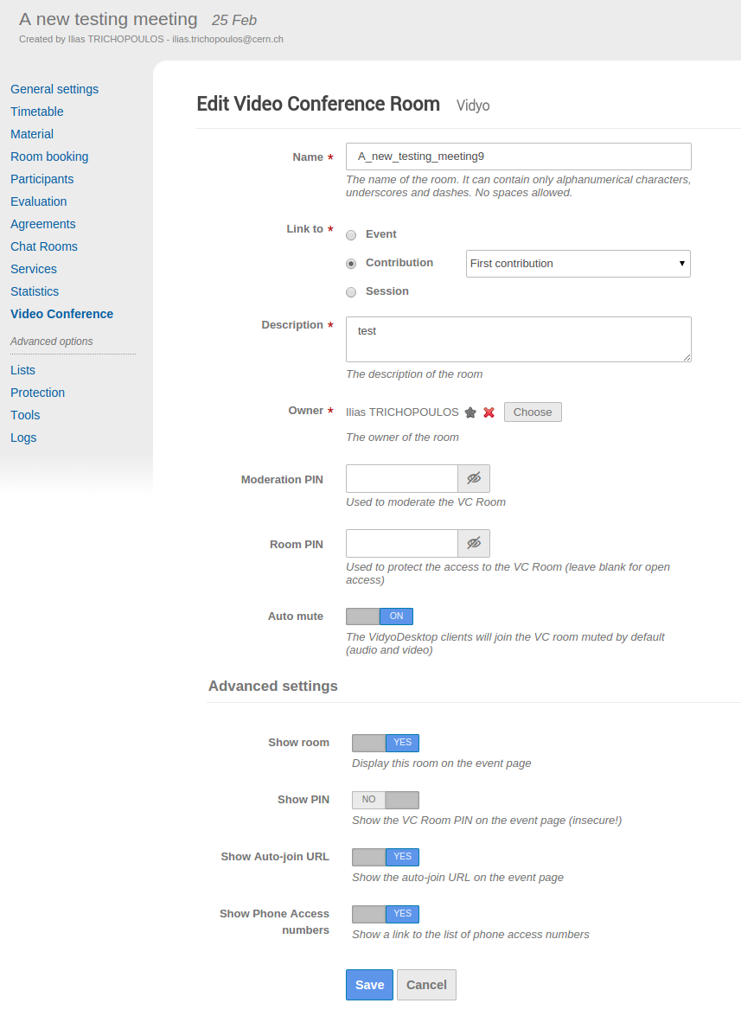
UI: Video Conference

Slide 10
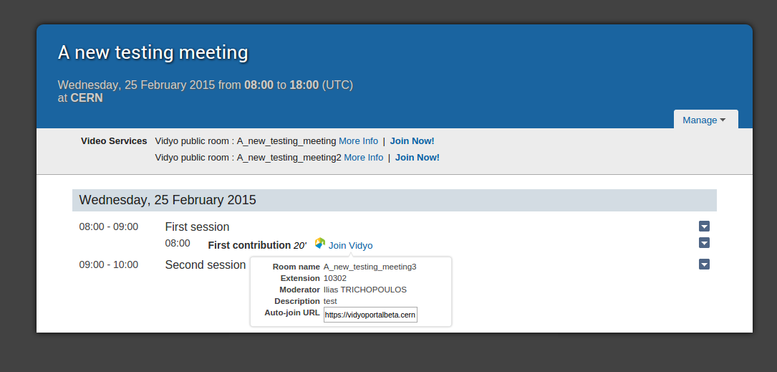
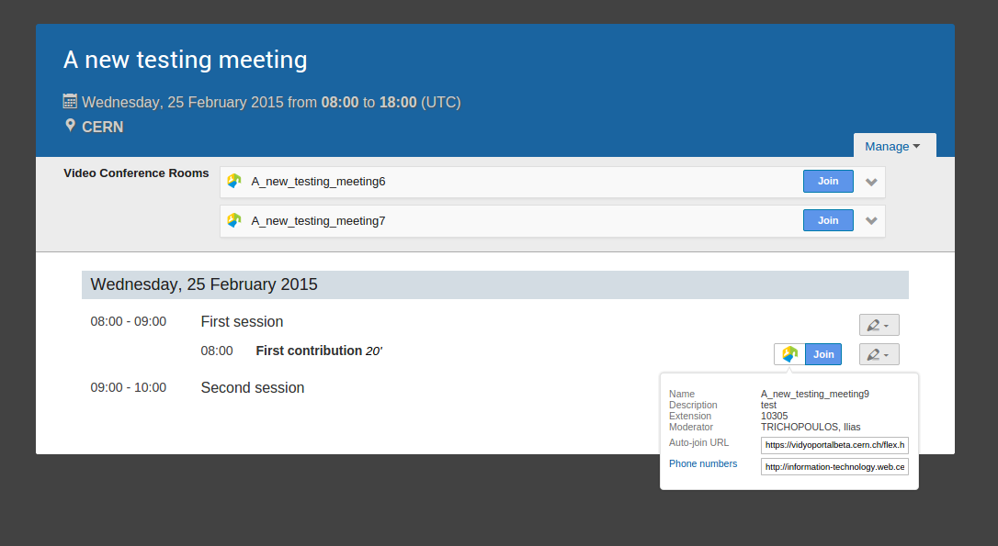
UI: Meeting Page

Slide 11
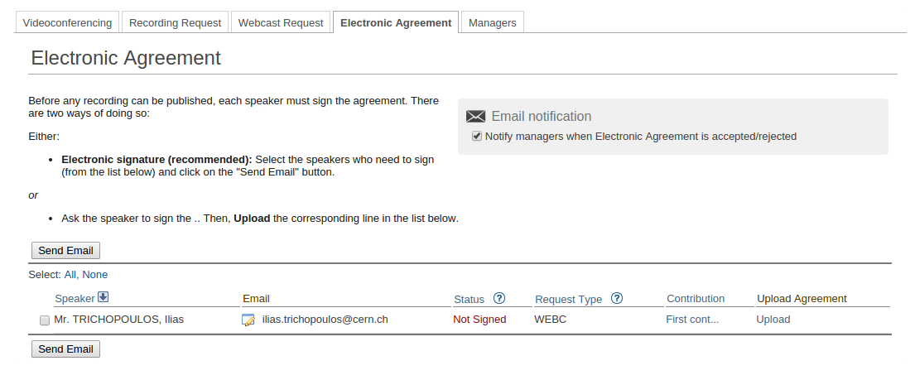
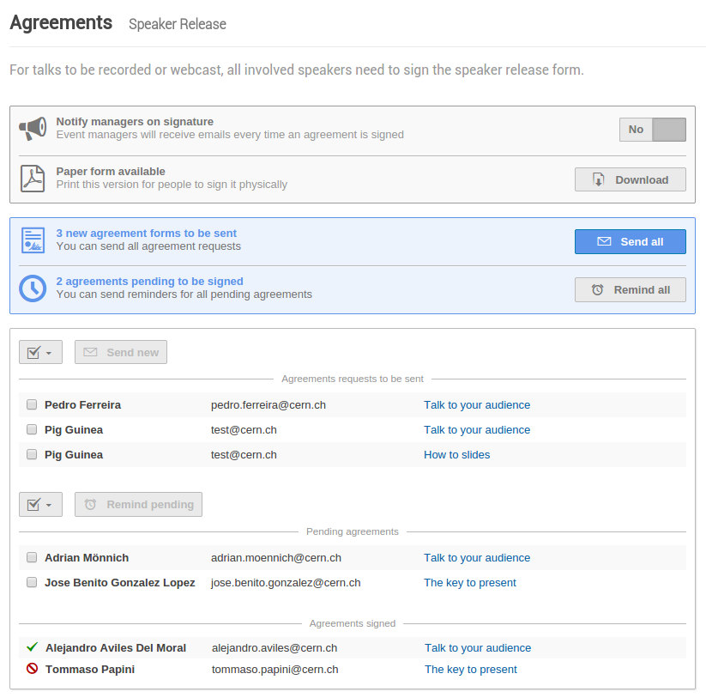
UI: Speaker Release

Slide 12
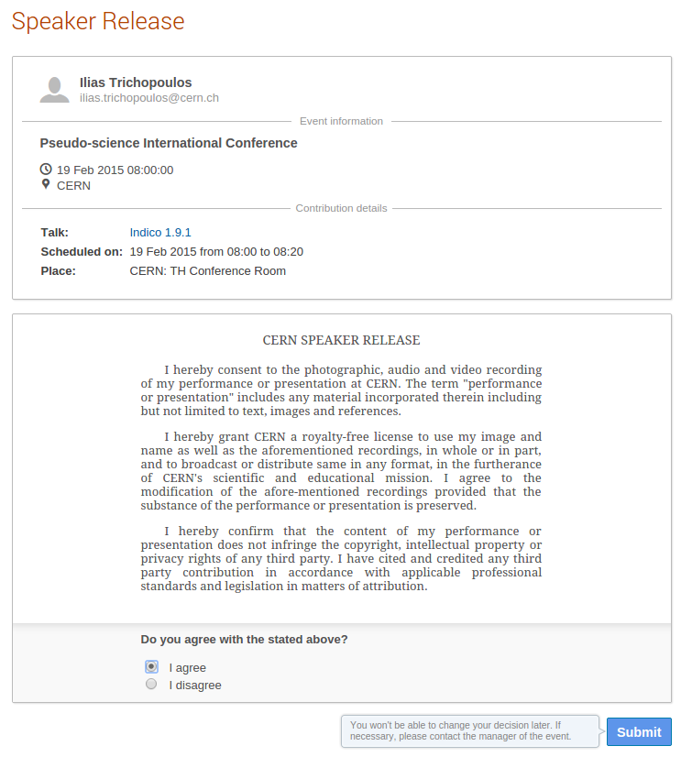
UI: Speaker Release

Slide 13
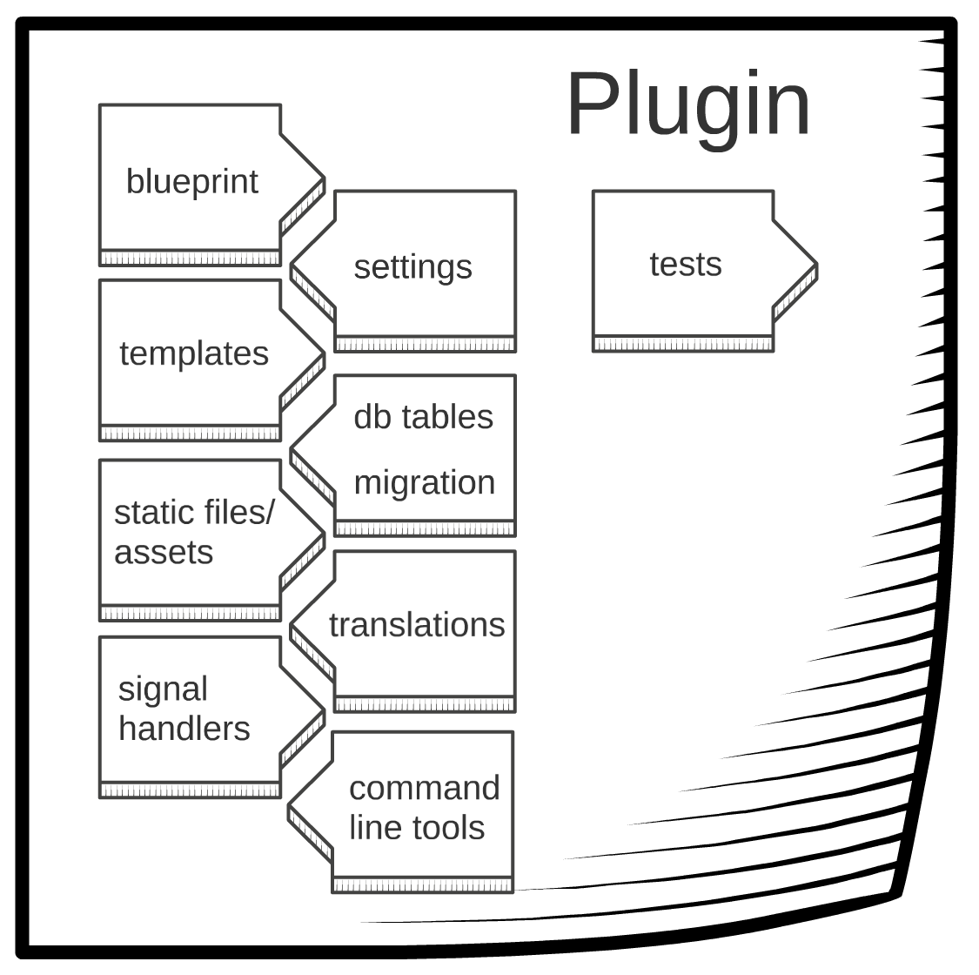
Plugins
Chat
Invenio Importer
LiveSync
CERN Payment
Paypal Payment
Manual Payment
Piwik
CERN Search
Invenio Search
Vidyo
RAVEM
Audiovisual
Outlook
FoundationSync
New plugin system
Written from scratch
Plugins loaded during startup

Slide 14
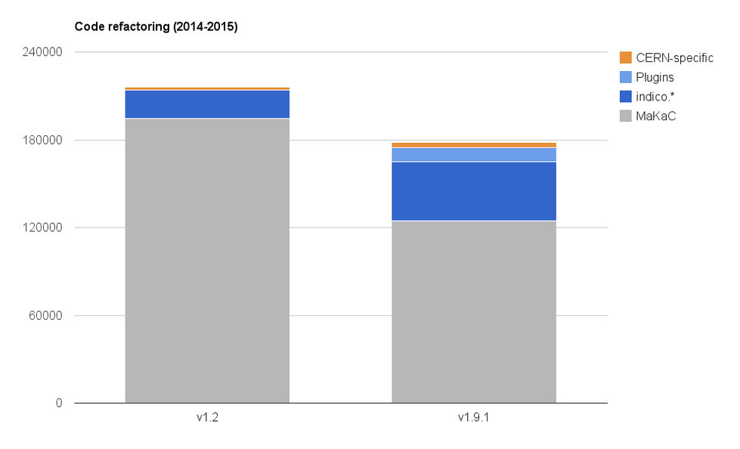
Refactoring

Slide 15
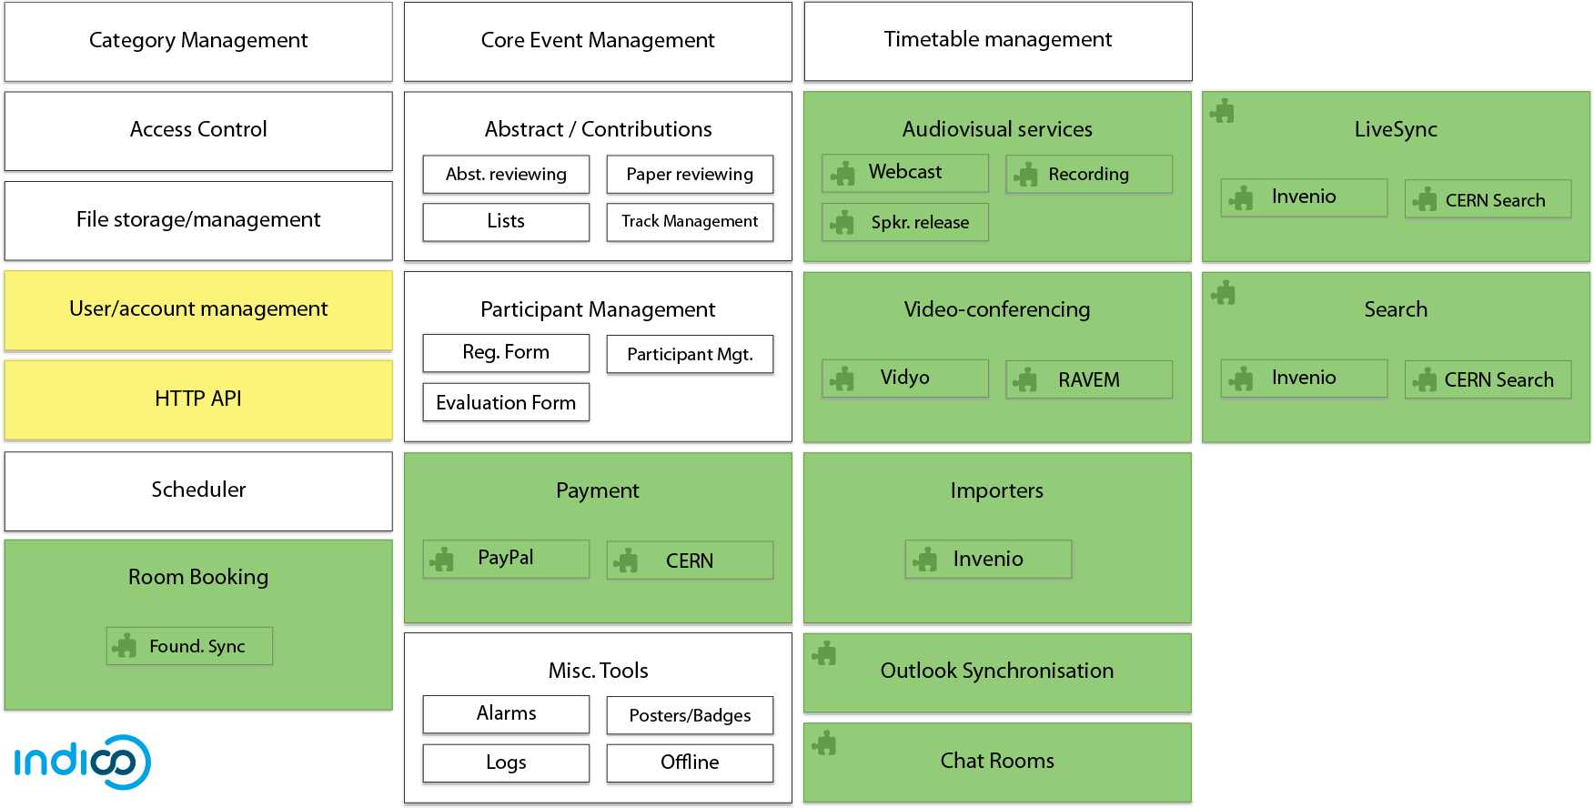
What’s done / missing

Slide 16
Indico v1.9.2
Planned for end of April
API keys in SQL DB (already finished)
Profile page re-design
Avatars Users in SQL DB
Complete authentication system refactoring
More modular
Extensible with plugins

Slide 17
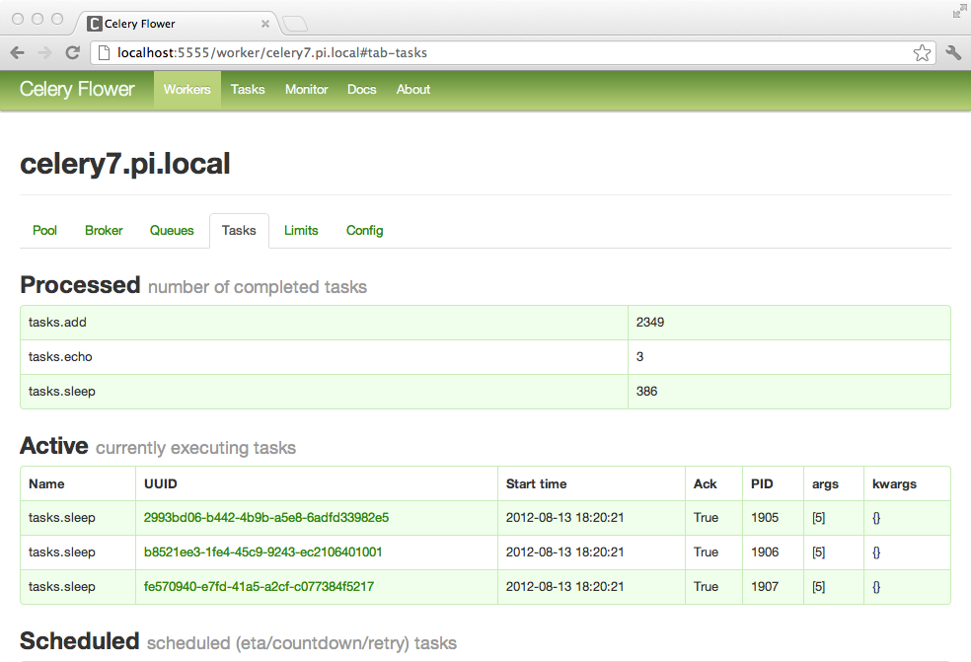
Indico v1.9.3
Planned for end of May
Scheduler
Replace with Celery
OAuth provider
Alarms
Category statistics

Slide 18
Indico v1.9.4
Planned for July
Event materials
Big task, lots of legacy code
File storage
Offline event website generation
Event logs

Slide 19
Indico v1.9.5
More parts of Events go SQL!
Participants
Registration form
Posters & Badges
Evaluation
E-tickets

Slide 20
Conclusion
Still many things to do, but we are on the right path!
New plugin system
Reduced codebase size (thanks to third-party libraries)
Code quality over quantity
Test coverage increasing
Easy access to statistical data via SQL
UX improvements
➔ A better Indico! ☺

