Slide 2


Slide 3
Indico Virtual Event
Welcome and Introduction
20th March 2015

Slide 4
Welcome
Indico Virtual Events series
To complement the Indico workshops
About twice a year
Open content: contact us to propose
Recorded and will be made available from the Indico page

Slide 5
Programme
The Road to Indico 2.0 – Pedro Ferreira (30mn)
Improvement of the Indico Software Distribution Channels - Pedro Ferreira (30mn)
Indico Internationalisation – Thomas Baron (10mn)
What’s next – Thomas Baron (5mn)
Open Discussions
Foreseen end: 16:30-17:00

Slide 6
Format
Please keep the questions for the end of the presentations

Slide 7
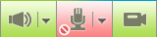

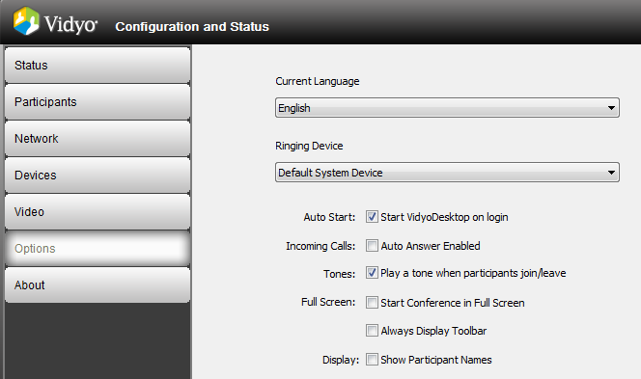

Vidyo Tips
Better stay muted when not speaking
Select the shared content
Double-click on the content window to separate and enlarge it
Avoid tone playing on participants joining/leaving

