Slide 1
SEABAS Firmware/Software Development
Shane Colburn

Slide 2
Overall Goal
Overall goal was to contribute to SEABAS v65 development
Focus changed throughout the quarter
  Initial work was for implementing latency scan (a basic SEABAS calibration scan)
  Shifted toward getting basic v65 functionality up and working in the lab
Presentation will focus on SEABAS System work

Slide 3
v65 SEABAS System
Goals:
Get v65 SEABAS working with SCC
After SCC works, verify functionality for the mux
Sub-goals for achieving primary goals:
  Eliminate system instability
  Improve software/firmware so that triggering is consistent and without timeouts

Slide 4
Motivation: Problems with SEABAS System Software/Firmware
Issues found when trying to run digital tests
Problems first observed with testing by UW-Madison grad student (Laser)
  Timeouts resulted depending on the .bit file used for FPGA configuration
Minoru’s working versions of firmware/software seem to be either misplaced or are corrupted
Following this, established logical process for debug/test to narrow down the problem

Slide 5
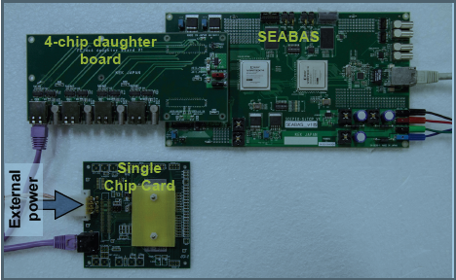
Methods
Used bit files from Bo, Minoru, and Shane
Test with single and multiple triggers
Analyze byte-stream output when tests fail
Software commands
Picture of the hardware test setup [1]

Slide 6
Methods: SEABAS System Testing Protocol
Strict protocol allowed us to rule out causes of the problem and also prevented hardware damage
Protocol steps:
Check power configuration (verify supply voltage with multi-meter and check current limit)
After powering the board, check status LEDs and SEABAS/PC Ethernet connection (make sure current drawn is within limits)
Configure FPGA with top.bit file via IMPACT after checking JTAG connection LED
Check FEI4 and operation parameter configurations in software
Run single and multiple trigger tests (capture/save output with tee command)
Test with different top.bit files, power cycling between each configuration

Slide 7
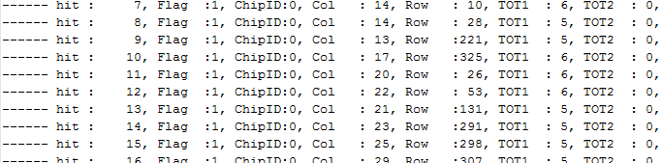
Results: v63 SEABAS Tests
v63 firmware/software worked for all versions of .bit files used (i.e. Bo’s, Minoru’s, and Shane’s)
When v65 tests failed, running v63 could test if something broke
Sample of part of the text sent to stdout during a successful digital test.

Slide 8
Results: Initial v65 Tests
Used SVN versions of firmware/software and SCC
Inconsistent results using different .bit files
Two main observations
  Currents drawn from the supply were abnormal (after configuration the SEABAS board’s nominal 2.5 A was not observed)
  Digital tests succeeded when ntrigger == 1, but failed when ntrigger > 1

Slide 9
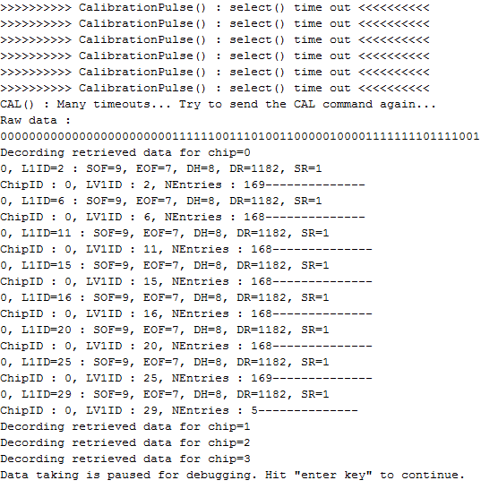
v65 Failed Output Example
When the digital injection tests failed, there would be “timeouts”, the raw data would print to the screen, and then there would be a statement saying data taking is paused for debugging.

Slide 10
Results: First Fix Attempt
Examined logic for data receiving/decoding
“time out” statements printed inside CalibrationPulse() function
Library select() function used for determining if the TCP socket is ready for reading (TCP socket is a file descriptor just like stdin, stdout)
Discrepancy between v63 and v65 decoding software

Slide 11
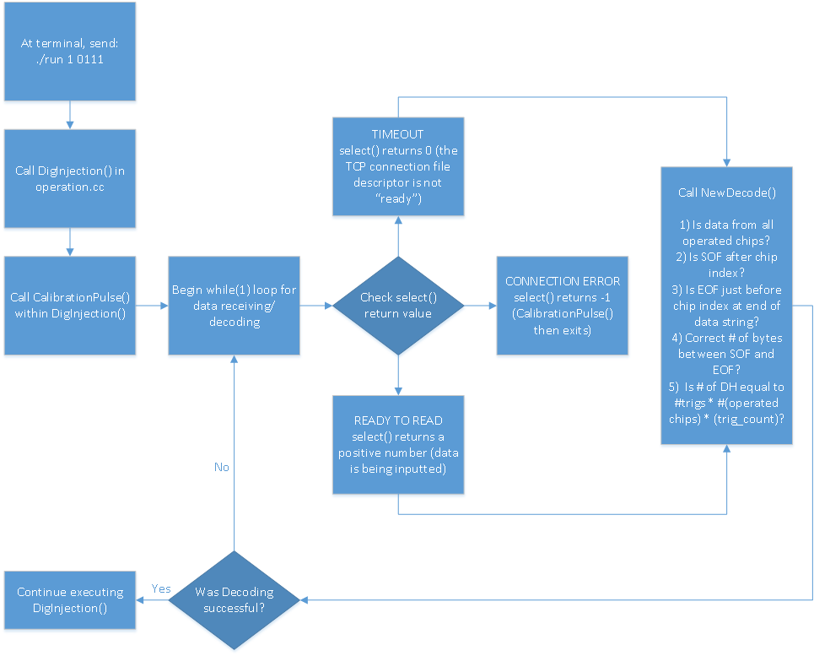
  Discrepancy
  In v63, “time out” prints when select() returns 0
  In v65, “time out” prints when select() returns 0, OR the raw data length exceeds 10% occupancy

Slide 12
Results: First Fix Attempt
The length limit test seemed unnecessary
Seemed logical that with ntrigger > 1, raw data length would increase which could cause “time out” prints
Lifting the length limit helped…but not much
Main test observations
  Minoru’s .bit file worked with ntrigger > 1
  .bit files from Shane and Bo still failed for ntrigger > 1
  Still abnormal currents

Slide 13
Results: Altering Power Configuration
Minoru recommends shorting grounds for the SCC and SEABAS board
Had no noticeable effect on output

Slide 14
Debug statements added after each check

Slide 15
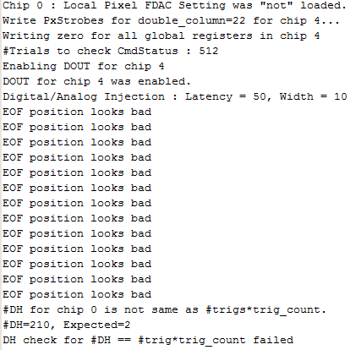
Results: Output + Debug Statements
After tests at LNBL, seems that the position of the EOF is off [2]
Occasionally there are other errors

Slide 16
Discussion
Data is failing the basic data quality checks
Issue is most likely on firmware/hardware side because software is constant throughout testing
Abnormal currents not just at the UW lab
Minoru’s 11/7 version of firmware works
Future work needs to associate decoding with firmware blocks

Slide 17
Summary
v63 SEABAS firmware/software consistently works
v65 SEABAS system unstable
  Works for single trigger
  Generally fails for multiple triggers
  Fails basic data quality checks
  Narrowed cause of problem (not a true timeout, unlikely due to power or software)
SEABAS data checking should be similar to IBLROD style firmware data checking [3]

Slide 18
References
[1] J.J Teoh, “Development of SiTCP Based Readout System for
The ATLAS Pixel Detector Upgrade,” M.S. thesis, Physics Dept., Osaka Univ., Osaka, Japan, 2012
[2] The FE-I4B Integrated Circuit Guide, 2.3 ed., 2012, pp. 91-103
[3] ATLAS Silicon ReadOut Driver (ROD) Users Manual, 1.64 ed., 2009, pp. 21-23

