Slide 1


Development of UW Pixel DAQ System Final Report : Fall 2014
Jimin Kim
University of Washington
Department of Physics/Mathematics
December 11th 2014

Slide 2
Table of Contents
Objective/Motivation
Approach
Results
Summary
Outlook

Slide 3
Project’s Objective
Deploy identical DAQ System for the ATLAS Pixel Detector at LHC in the UW Lab (Similar to SR1 Pixel Lab at CERN)
Use the system setup for the DAQ Software development and various pixel DAQ tasks in an effort to understand and improve the Pixel Detector in future

Slide 4
CERN Pixel DAQ System Setup
Data filtering/processing
Data Transmission
Single Board Computer
Particle collision
Physical Events → Data
Off-detector storage
Pixel Modules
Opto -Board
Back of Crate Card
Readout Driver
Trigger, Timing & Control Module
On-Detector Electronics
Pixel Modules : Store data from the physical event and send it to the readout chain
Opto-Board : Optical electrical interface on the detector side
Back of Crate Card : Interface between the Readout Driver and Optical links. It keeps the timing consistent between the on detector and off detector electronics.
Readout Driver : Main component of the DAQ System. It accepts the serial link from the BOC and processes them into a single set of data called an ‘event fragment’. Processed data are sent out for the next readout chain for further refinement.
Single Board Computer : Controls the ROD with the DAQ Software
Trigger, Timing & Control Module : Interface between a ROD and ATLAS Trigger System
Off-Detector Electronics

Slide 5
UW Pixel DAQ System Setup
Data Transmission
Data Processing
Simulated input data
Pixel Module
ePP0
eBOC
ROD
Output data
Pixel Module : FEI3 Pixel Module with MCC. Stores data from the initial events and send it to the readout chain
ePP0 (Electrical Patch Panel): Replaces Opto-board in LHC, routes the data from the module and send out to the eBOC
eBOC (Electrical Back of Crate Card) : Replaces Back of Crate Card. Acts as interface between the ROD and ePP0. Also synchronizes the timing between the module and the ROD
ROD (Readout Driver) : Pixel ROD Rev D. It accepts the serial link from the eBOC and processes them into a single set of data called an ‘event fragment’. Also carries out pixel calibration processes. Core hardware of the project.
SBC (Single Board Computer) : Model VP-CP1. Controls the ROD with the DAQ Software. Acts as a interface between the user and the ROD (VME interface)
Host Computer : Provides storage space which DAQ Software is installed to the SBC
SBC
Host Computer

Slide 6
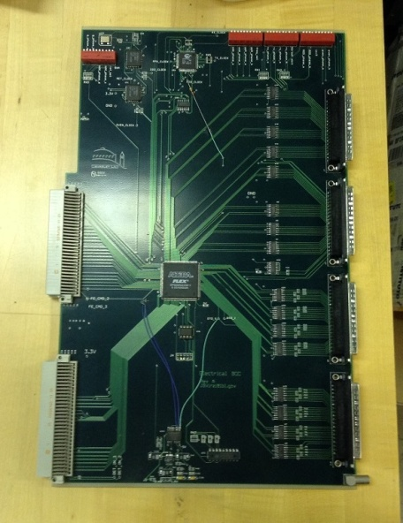
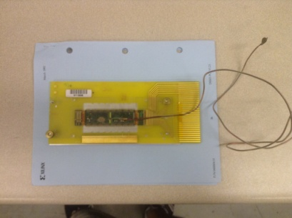
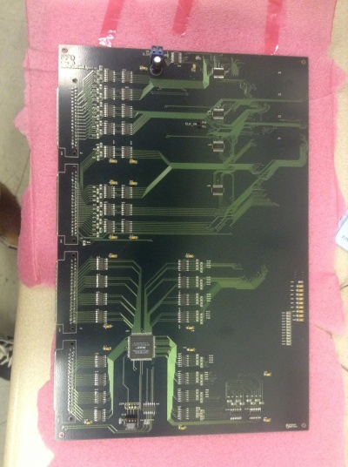
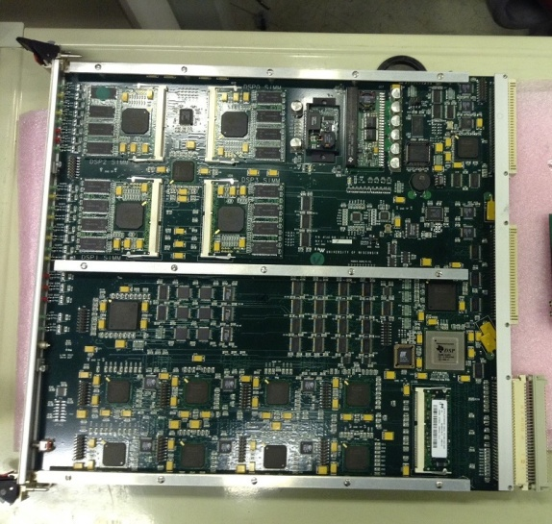
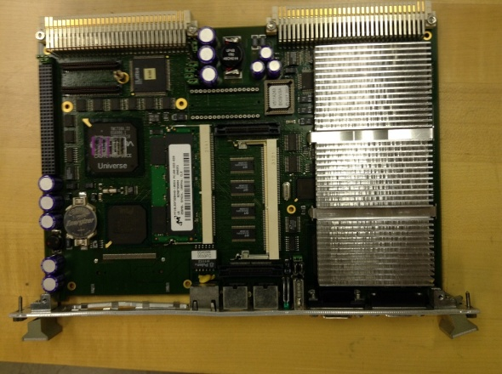
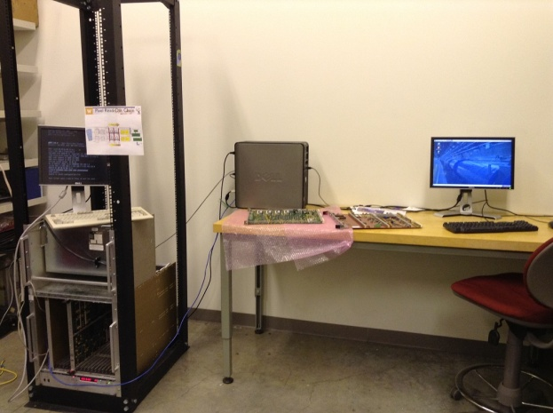
Hardware Pictures
Pixel Module
ePP0
eBOC
Readout Driver
Single Board Computer
Host Computer

Slide 7
Objectives during Fall 2014
Pixel Infrastructure
Update TDAQ to TDAQ-05-04-00 and PixelDAQ-02-00-00-RC5
Test the DummyPixController functionality of the new version
Test the USBPIX mode of the TDAQ (As well as USBPIX on Windows)
Establish and understand local LabDB configuration for UW setup
Establish a complete manual from SLC6 installation to operation of TDAQ that corrects the bugs in current version.
VME Interface
Establish a correct Master Mapping (PCI – VME) for UW local setup
Investigate the source of the VMEBus error (in progress)
Initiate the firmware update sequence for FMT, RTR, EFB, CTR and MDSP

Slide 8
Approach (Pixel Infrastructure)
SLC6 Installation
Create root directory for TDAQ software
Important prior settings
-AFS must be off
-Check ‘Processing Limit’
-Disable auto yumupdate
- Set LAB_SITE = LOCAL
Bug Fixes
Added definition for IBL_ROD_IP for compiling IBLUtils Tools
Added definition of ROD_SLOT environment variable
install latest TDAQ packages (i686)
Installation
Install necessary 32bit libraries
Install PixelDAQ codes in local account (including pixTools and pixRCD)
Make XML
Make XML
Automatically modifies the xml files in partition directory to Local computer environment
LabDB configuration files
-Settings about local hardware setup and Running mode (e.g. USBPIX, DUMMY)
Make Database
-Compiles database files that correspond to LabDB files
Modify LabDB configuration files
Operation
Make Database
Start_infr (Starts up TDAQ GUI)

Slide 9
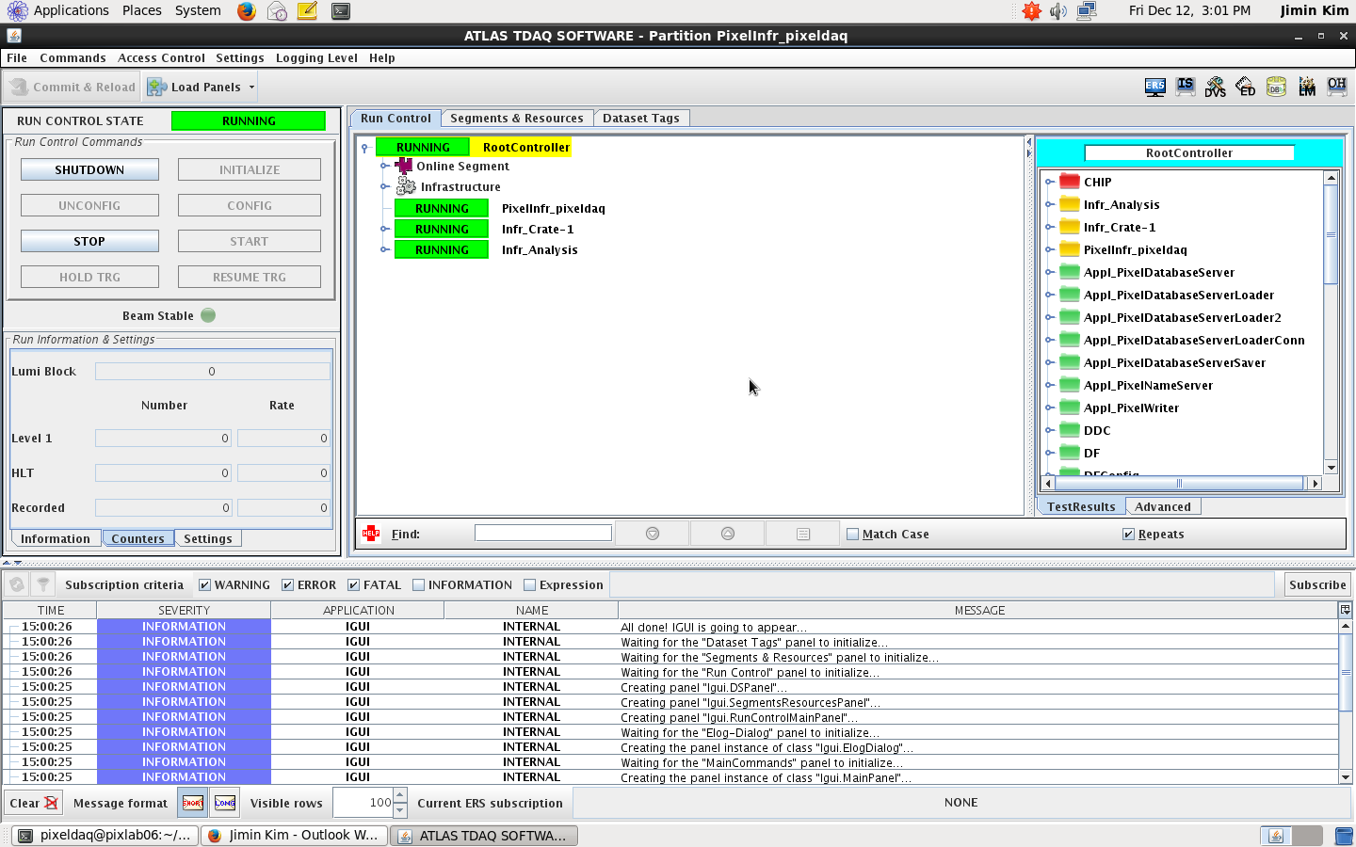
TDAQ GUI

Slide 10
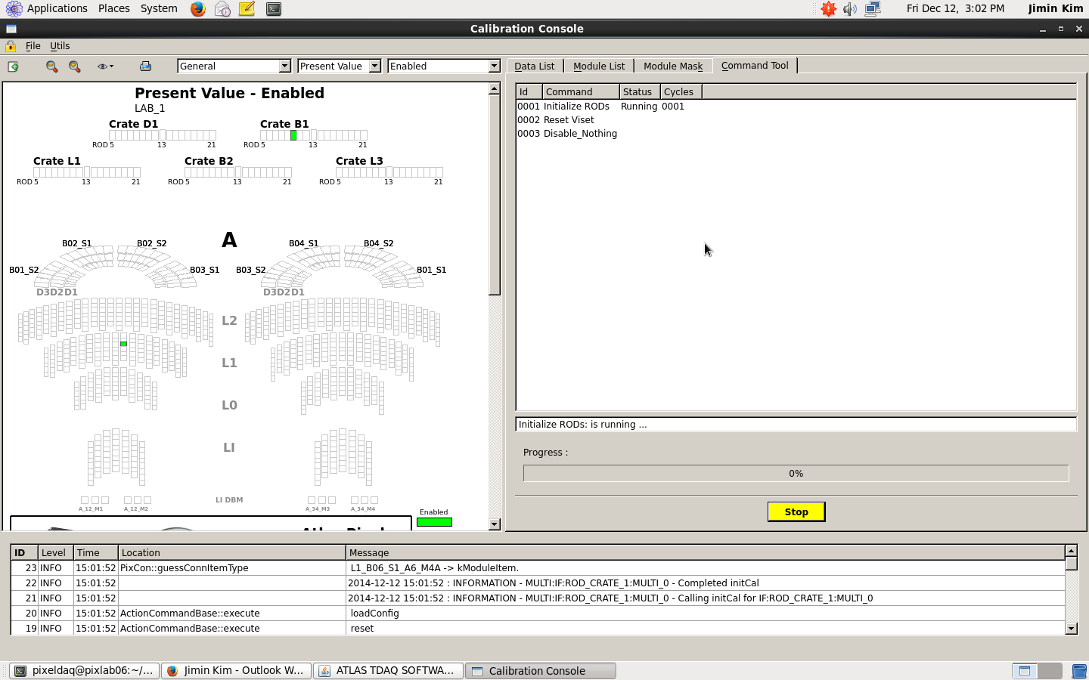
Calibration Console

Slide 11
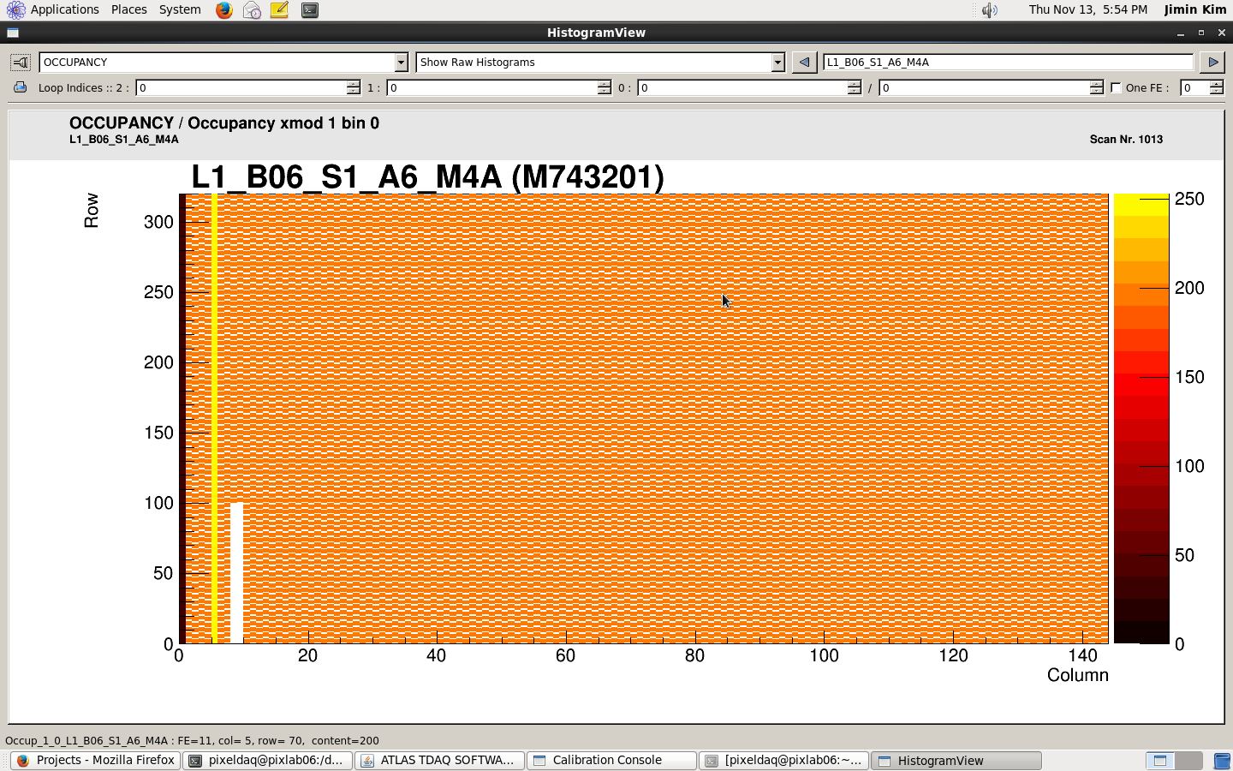

DummyPixController
DummyPixController generates data for the Digital Scan and Analog Scan
Very useful when user wants to test the functionality of the software
- Has a bug of not being able to save the histogram graph file.
Can be fixed by adding
export PIXSCAN_STORAGE_PATH=/daq/results
In zzzz_daq.sh
Digital Test
Analog Test

Slide 12
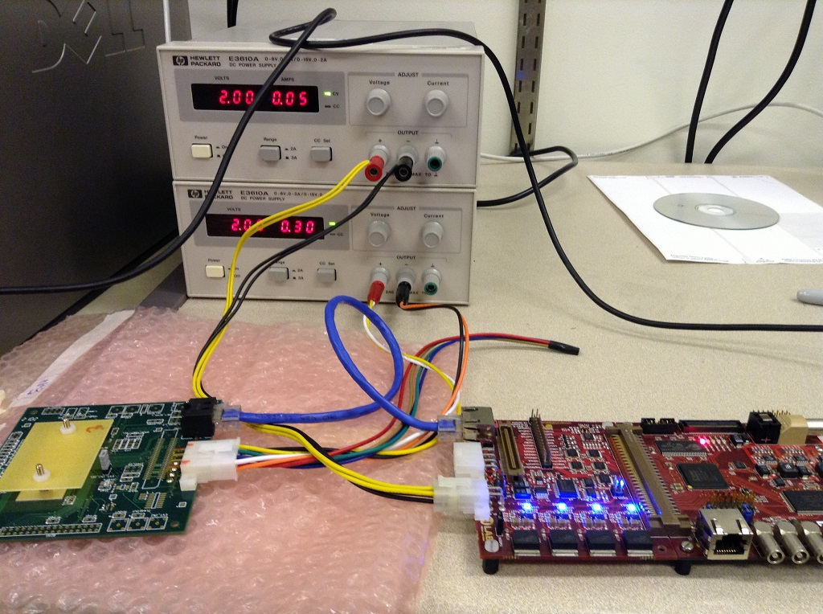
USBPIX
USBPIX is a modular DAQ system that is supported on both Pixel Infrastructure (Linux) and Windows that supports up to two pixel modules
Used for pixel development, pixel calibration and processing in lab scale.
[pixeldaq@pixlab06 USBTest]$ ./USBTest Device USBpix ID 14, class 200, FW ver. 15 with adapter card ID 83
We can successfully ping the Multi-IO board but LED lights on the adaptor doesn’t come on when we initialize USBPIX in TDAQ
Same problem with Windows version USBPIX
Operation of USBPIX in current TDAQ has not been confirmed but it seems like there is no issue with software
Normal initialization of FEI4 Adapter

Slide 13
Understanding LabDB files
M743201 OFFLINEID L1_B06_S1_A6_M4A M743201 PRODID L1_B06_S1_A6_M4A
Alias_LOCAL.dat
- Defines identification name for the Pixel Module
ROOT ROOT PARTITIONS PARTITIONS CONTAINER UP ROOT ROOT PP0S PP0S CONTAINER UP ROOT ROOT OBLINKMAPS OBLINKMAPS CONTAINER UP ROOT ROOT RODBOCLINKMAPS RODBOCLINKMAPS CONTAINER UP PARTITIONS CONTAINER LAB LAB PARTITION UP PP0S CONTAINER PP0_1 PP0_1 PP0 UP OBLINKMAPS CONTAINER EL_TYPE EL_TYPE OBLINKMAP UP RODBOCLINKMAPS CONTAINER ELBOC_1 ELBOC_1 RODBOCLINKMAP UP LAB PARTITION ROD_CRATE_1 ROD_CRATE_1 RODCRATE UP ROD_CRATE_1 RODCRATE SLOT_1 SBC01 SBC UP ROD_CRATE_1 RODCRATE SLOT_10 ROD_B1_S10 RODBOC UP ROD_B1_S10 RODBOC LINK_MAP ELBOC_1 RODBOCLINKMAP ROD_B1_S10 ROD_B1_S10 RODBOC AA L1_B06_S1 OPTOBOARD UP ROD_B1_S10 RODBOC USBPIX -1 CTRLTYPE UP L1_B06_S1 OPTOBOARD LINK_MAP EL_TYPE OBLINKMAP UP L1_B06_S1 OPTOBOARD PP0 L1_B06_S1_A6 PP0 OB L1_B06_S1_A6 PP0 1 L1_B06_S1_A6_M4A MODULE UP
Conn_LOCAL.dat
Defines the hardware, mode setup of the local system.
Third row of ROD_B1_S10 defines the mode
pl_LOCAL.dat
Defines mapping addresses between the PixelROD and eBOC.
Also defines the hostname, IP address and hardware address of the local SBC.
SBC01 SBC STRING Network_ipName pixlab06.phys.washington.edu SBC01 SBC STRING Network_ipAddr 172.28.188.234 SBC01 SBC STRING Network_hwAddr 00:21:9B:3A:8C:16 L1_B06_S1_A6_M4A MODULE BOOL Enable_readout 1 L1_B06_S1_A6_M4A MODULE INT Identifier_ModuleId 1 L1_B06_S1_A6_M4A MODULE INT Identifier_GroupId 1

Slide 14
Approach (VME Interface)
Host Computer
SBC
ROD
Host Computer
VME Master Map
ROD
SBC

Slide 15
VME MasterMap
PCI address range takes from
1.25Gb ~ 1.5Gb
======================================================================================= LSI VME address range PCI address range EN WP VDW VAS AM Type PCI space 0 00000000-ffffffff 00000000-ffffffff No No D32 A32 UD SC PCI MEM 1 00000000-10000000 50000000-60000000 Yes Yes D32 A32 UD SC PCI MEM 2 00000000-00000000 00000000-00000000 No No D32 A32 UD SC PCI MEM 3 00000000-00000000 00000000-00000000 No No D32 A32 UD SC PCI MEM 4 00000000-ffffffff 00000000-ffffffff No No D32 A32 UD SC PCI MEM 5 00000000-00000000 00000000-00000000 No No D32 A32 UD SC PCI MEM 6 00000000-00000000 00000000-00000000 No No D32 A32 UD SC PCI MEM 7 00000000-00000000 00000000-00000000 No No D32 A32 UD SC PCI MEM =======================================================================================
VME address range takes from
0 ~ 256Mb.
Slot 7 is within the range of
112Mb ~ 124Mb

Slide 16
VMEBus Error Debugging
[pixeldaq@sbc01 ~/daq/RodDaq/RodUtils]$ scanvme -a 32 -d 8 -p 0x50000000 ============================== step size = 0x00100000 space = A32 bus width = D8 AM code = Data ============================== PCI base address = 0x50000000 ------------------------------ VMEbus time-out temporarily reduced to 16 us to speed up scanning process Got response from address 0x07000000 Got response from address 0x07200000 Got response from address 0x07400000 Got response from address 0x07600000 Got response from address 0x07c00000
- scanvme is able to detect the ROD at slot7
- vme_rcc_test indicates that we can execute different read cycles on the addresses at slot7
================== R O D S T A T U S ==================== > Slot : 7 > Base adress : 0x07000000 > Byte order OK : Yes > Serial Number : -1 > ROD rev. : 0 > MDSP program rev. : c0ffee > FMT program rev. : 2 > EFB program rev. : 0 > RTR program rev. : 0 > RCF program rev. : 0 > Number of slave DSPs : 4 > > Primitive state : Idle > ====================================================
- After re-plugging in our ROD, ./GetRodStatus outputs result, but VMEBus error is still present in the code
The identification of source of this error is
still ongoing along with understanding the code
Debug(102,3078342352): VME_BusErrorInfoGet: Error from ioctl, errno = 0x208

Slide 17
Outlook
VME Interface
Identify any VMEBus error (Currently using VMDIS 8003)
Step through the firmware update for different components on the ROD
Connect the remaining hardware
Pixel Infrastructure
Run calibration scans with USBPIX using FEI4 (As well as in Windows)
Operation in SBC once the hardware is setup

Slide 18
Summary
TDAQ and PixelDAQ have been updated to TDAQ-05-04-00 and PixelDAQ-02-00-00-RC5
We now have a functioning DummyPixController for the latest TDAQ version
Pixel Infrastructure is ready to run USBPIX scans
Local LabDB configuration files that are consistent with UW setup have been established
Complete manual on TDAQ installation/Operation and Netboot are now online. Previous installation attempts on other two accounts were successful
We now have a correct PCI – VME mapping configuration and a better knowledge about debugging VME communication errors. (Thanks to Markus)
VME software configuration is correct, but we still see a VMEBus error when we run ./GetRodStatus. Analysis work is in progress.

Slide 19
Questions?

Slide 20
Special Thanks to
Nicholas Dreyer (UW)
Joern Grosse Knetter (Gottingen)
Markus Joos (CERN)
Matthias (SLAC)

