Slide 1
SEABAS DAQ development for T3MAPS Readout
Abhijeet Sohni
(with – Max Golub, Raymond Mui and Sean Zhu)
Fall Quarter 2014

Slide 2
SEABAS DAQ development for T3MAPS
Objective: Develop a DAQ system using SEABAS firmware board for T3MAPS readout
Motivation: T3MAPS is a radiation hard, inexpensive sensor that could serve as a replacement for the currently used expensive FEI4 sensor
Status: First version of SEABAS firmware and host software need to be tested out prior to T3MAPS tests

Slide 3
SYSTEM DESIGN
HOST COMPUTER
Virtex4 FPGA (SiTCP protocol firmware)
Virtex5 FPGA
(user firmware)
SEABAS v2
LEVL SHIFTER
T3MAPS

Slide 4
APPROACH
Current Approach: Currently, efforts are focused on having a system ‘ready’ for T3MAPS tests which entail building a very simple SiTCP firmware, User firmware and repurposing the Python code built for tests on Atlys to have T3MAPS tests ready
Final Goal Approach: The goal is to use the existing Basil framework (software and firmware) and develop a SiTCP firmware to be integrated into the SEABAS FPGA board. For this we have been collaborating with Minoru (SiTCP) and Tomasz (Basil)

Slide 5
EFFORTS
First few weeks were spent ramping up on the project by learning:
  Verilog/Xilinx ISE
  Python
  Basic electronic circuits
  Eagle Software
  FEI4 manual
  T3MAPS manual
  TJ Tians thesis
Worked on developing Breakout card, Level shifter card and python software
Worked on the Basil software to figure out the requirement of modification Transfer Layer.
Tried implementing a TCP library in the code and was successfully able to test TCP functionality by updating the yaml code.
However, since the Hardware layer works with USB Pix/Multi IO board, updates need to be made to that as well.

Slide 6
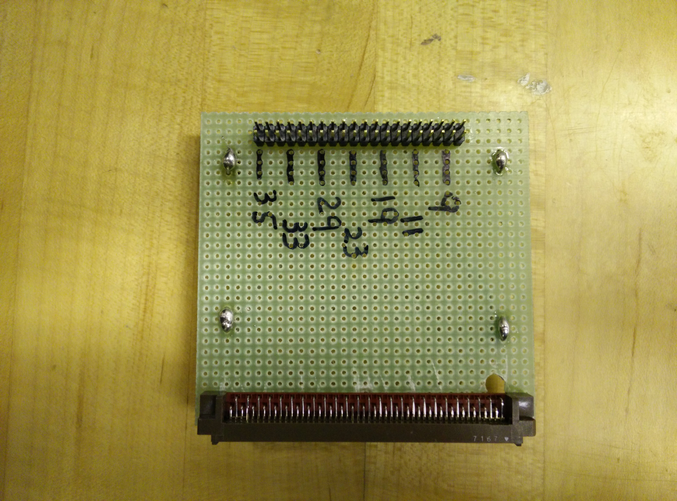
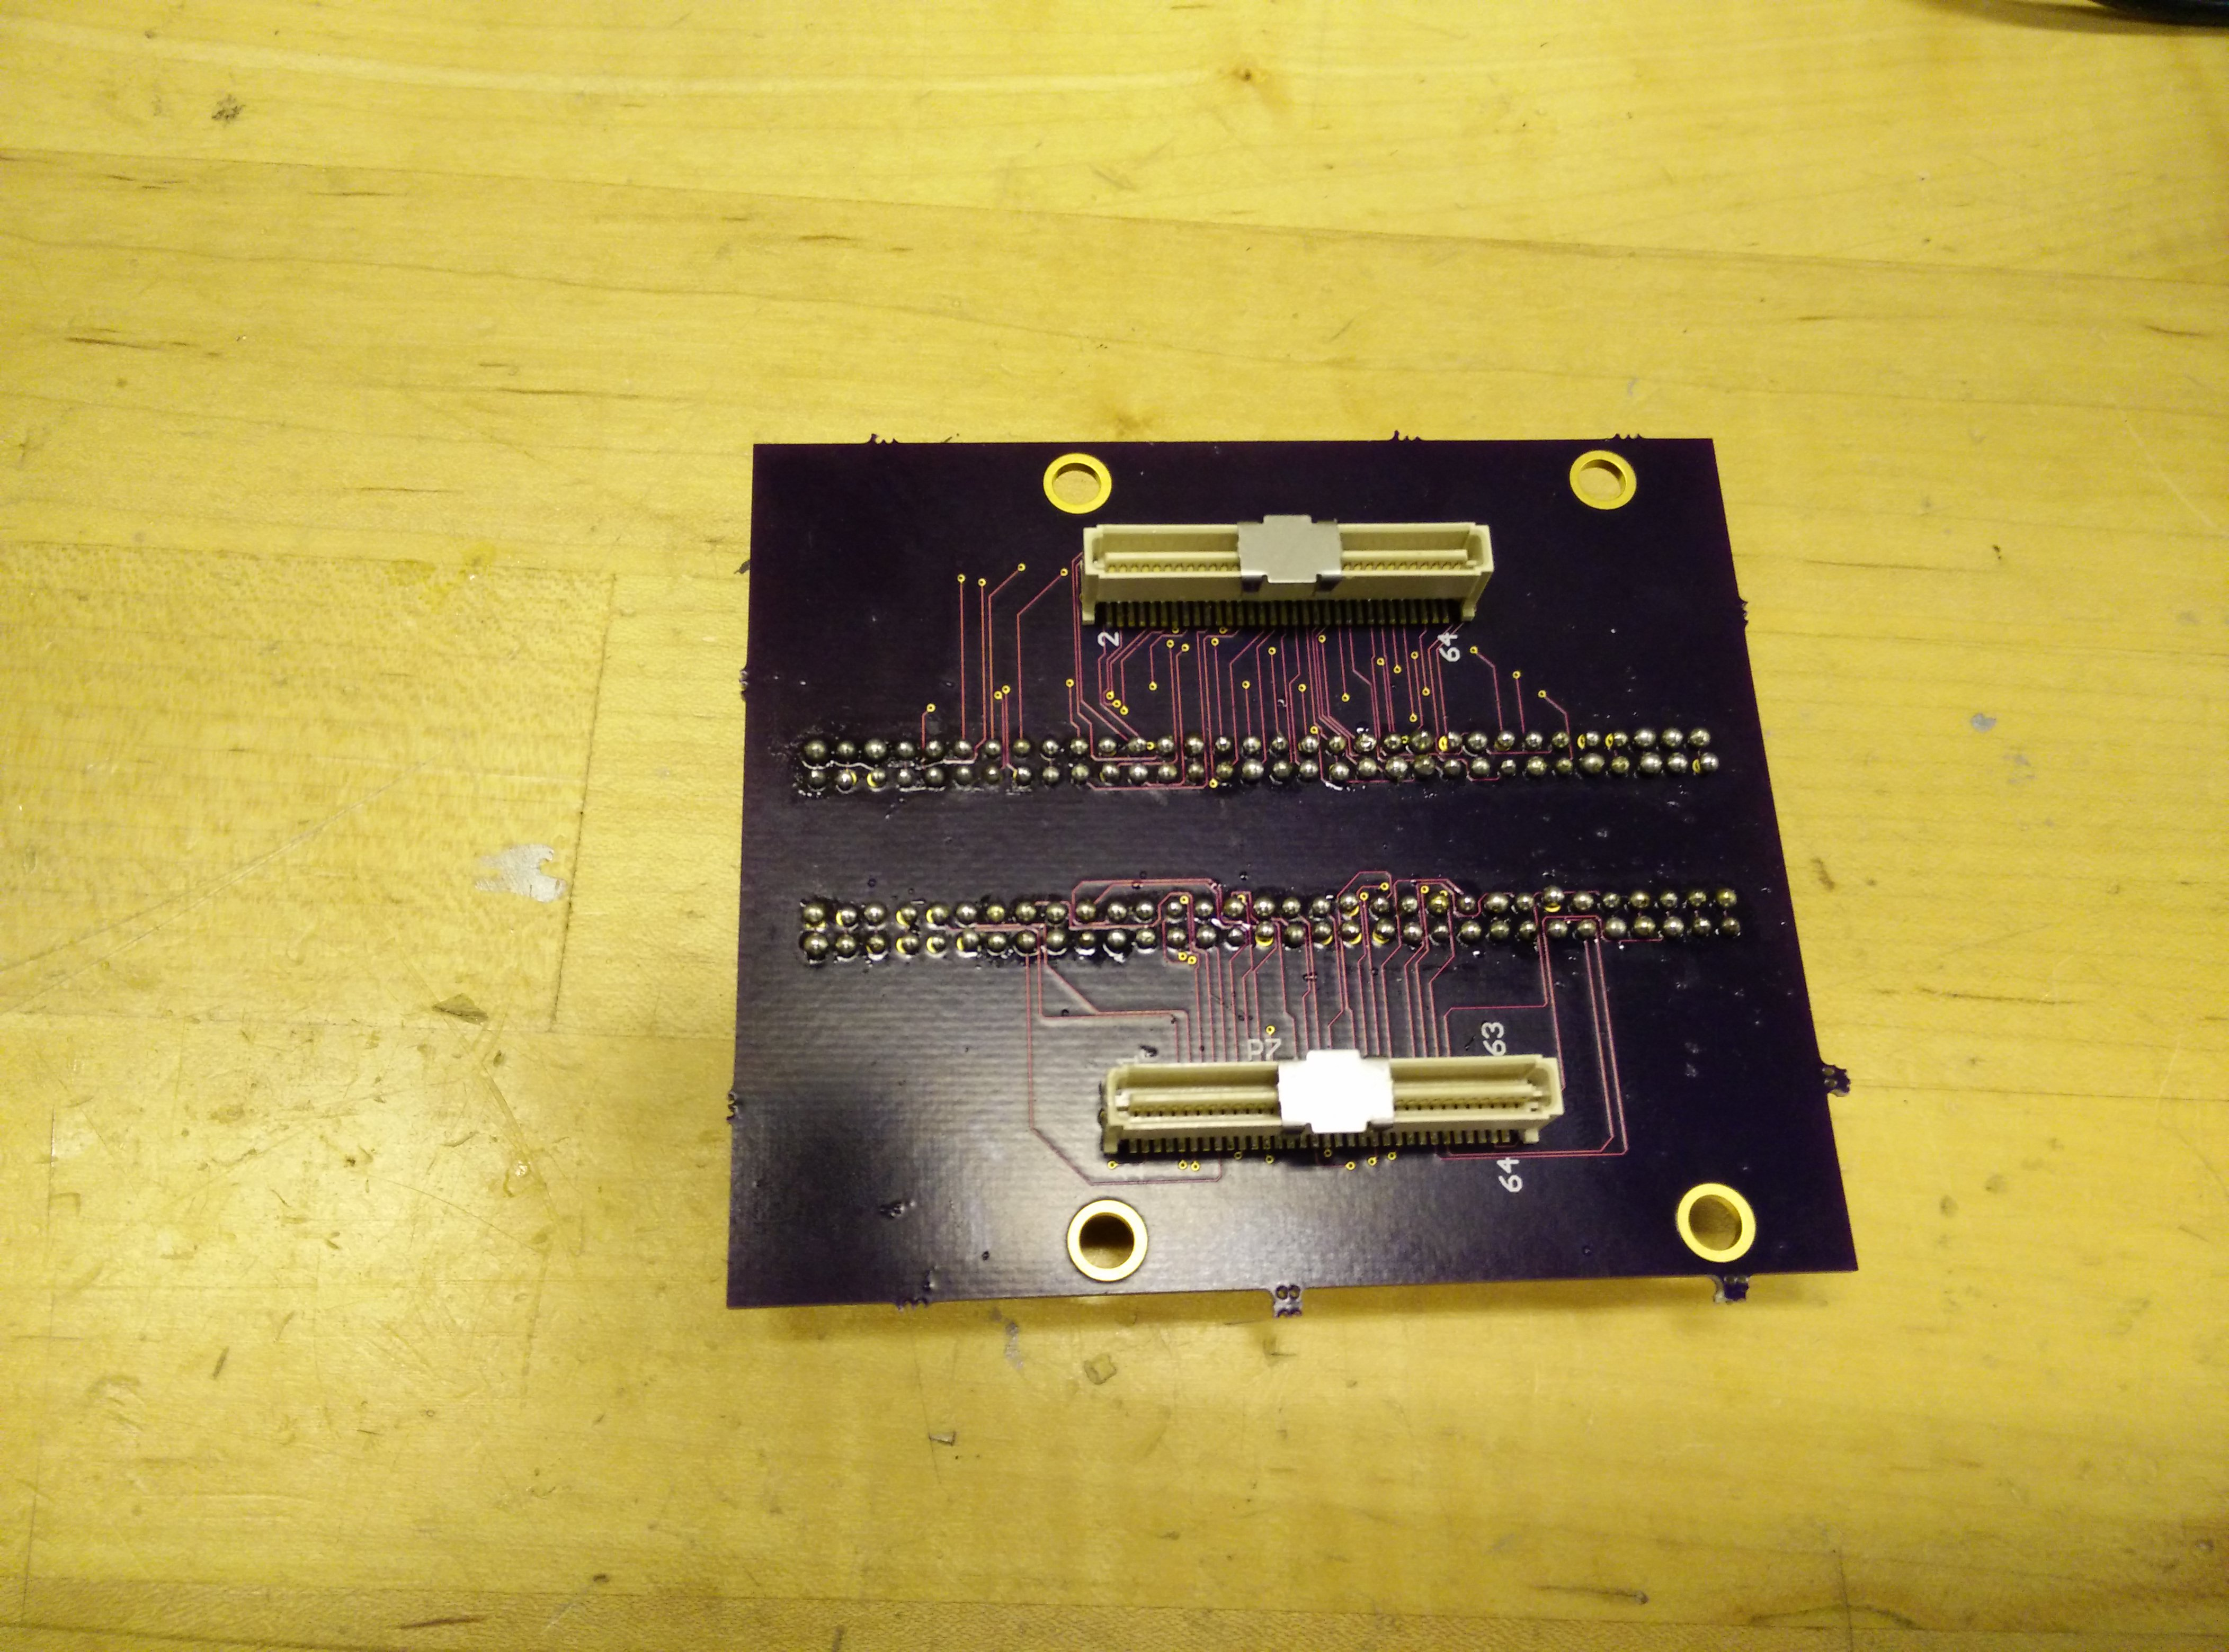
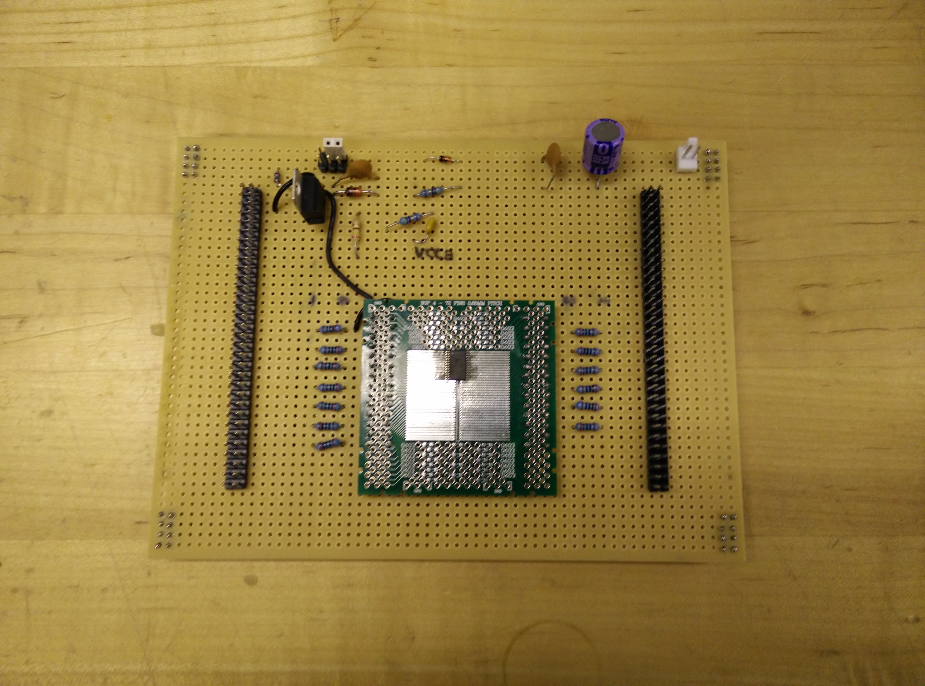
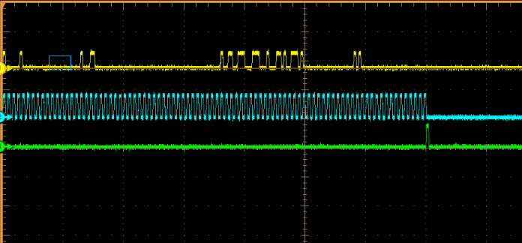
EFFORTS

Slide 7
STATUS: CURRENT APPROACH
The following setup-is complete and needs to be tested on the SEABAS board in the next couple of days:
SiTCP Firmware:
  A simple firmware designed by Max to accept TCP requests and move the data from host to the user FPGA and back has been built.
  Currently collaborating with Tomasz and Minoru to figure out SiTCP interface with Basil for final objective
User FPGA Firmware:
  The firmware module from Atlys setup was ported to SEABAS.
  Next step is to integrate Basil firmware with SEABAS as a part of final goal
Software:
  The software from Atlys setup was fixed and ported to use TCP/UDP
  Next step us to use the existing T3MAPS python code (SAM’s code that uses Basil framework) by integrating TCP/UDP with Basil for final goal

Slide 8
STATUS: CURRENT APPROACH
Level Shifter/Breakout Card:
  A break out card was designed and built to have ease of connection from the fine pitched SEABAS connector to different probes and signal testing
  A Level shifter was designed and built on a vector card
  The voltage regulator functionality works fine on the level shifter but there are some spurious signals showing on the floating pins of the card. Currently working with Bryan to get it fixed.
  SEABAS is capable of outputting 1.5V output (however need to verify if that capability has been enabled) which might make the level shifting redundant. The UCF file has been updated to send a 1.5v output but will know for sure with the tests

Slide 9
SUMMARY
Summary:
An intermediate version of Software/Firmware are ready to test
Intermediate version of breakout is ready and working
A fabricated version of the breakout card is being soldered by LBNL
Level shifter is built but needs to be debugged.
Work on Software and Hardware needs to be done to achieve the long term of having SEABAS work with BASIL

Slide 10
REFERENCES
References:
Development of SiTCP Based Readout System for The ATLAS Pixel Detector Upgrade - Teoh Jia Jian
The FE-I4B Integrated Circuit Guide
Verilog HDL by Samir Palnitkar
Learn Python the hard way by Zed A. Shaw
Digital VHDL design with Verilog John Williams
Other web resources including – Kek website (http://rd.kek.jp/project/soi/SEABAS/)

