Slide 1
InnerDetector Alignment Summary
Tun Sheng Tan
University of Washington
12 DEC 2014

Slide 2
ATLAS
Large Hadron Collider (LHC) is currently the world’s largest particle collider. It consists of seven detector experiments: ATLAS, CMS, LHCb, ALICE, TOTEM, LHCf, MoEDAL.
A Toroidal LHC Apparatus (ATLAS) is a particle physics experiment that is investigating new discoveries in the head-on collisions of protons at high energy.

Slide 3
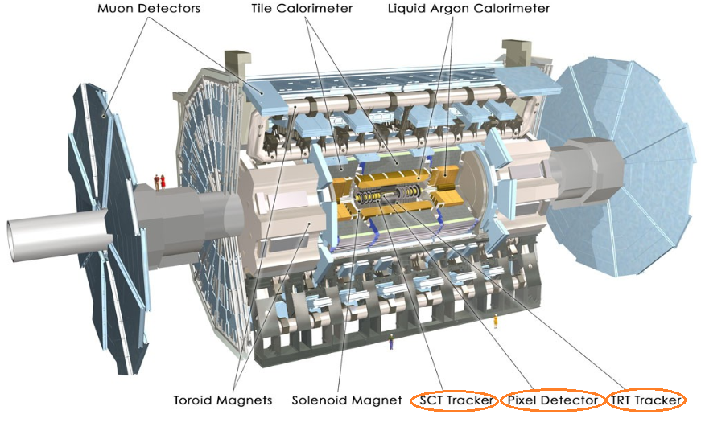
Atlas Detector

Slide 4
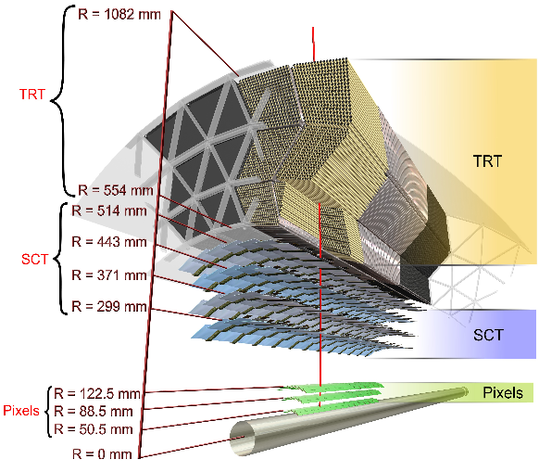
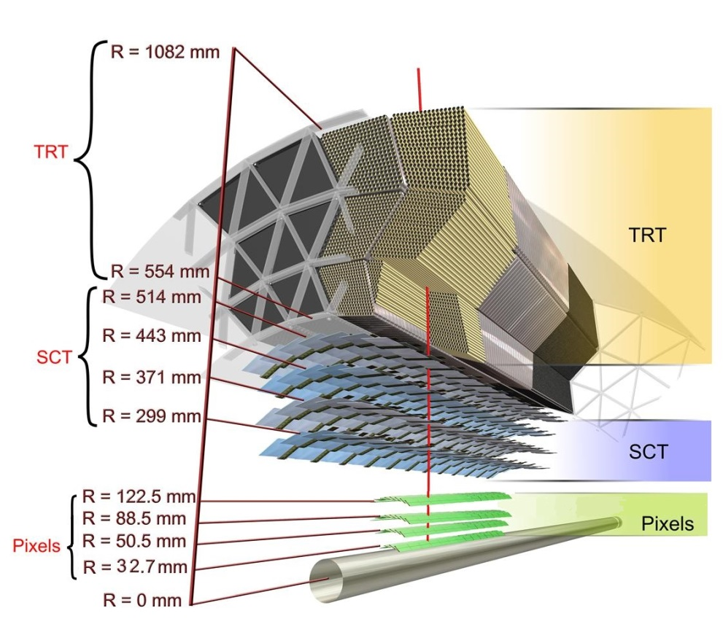
Old InnerDector
New InnerDetector with IBL-layer at R = 32.7 mm

Slide 5
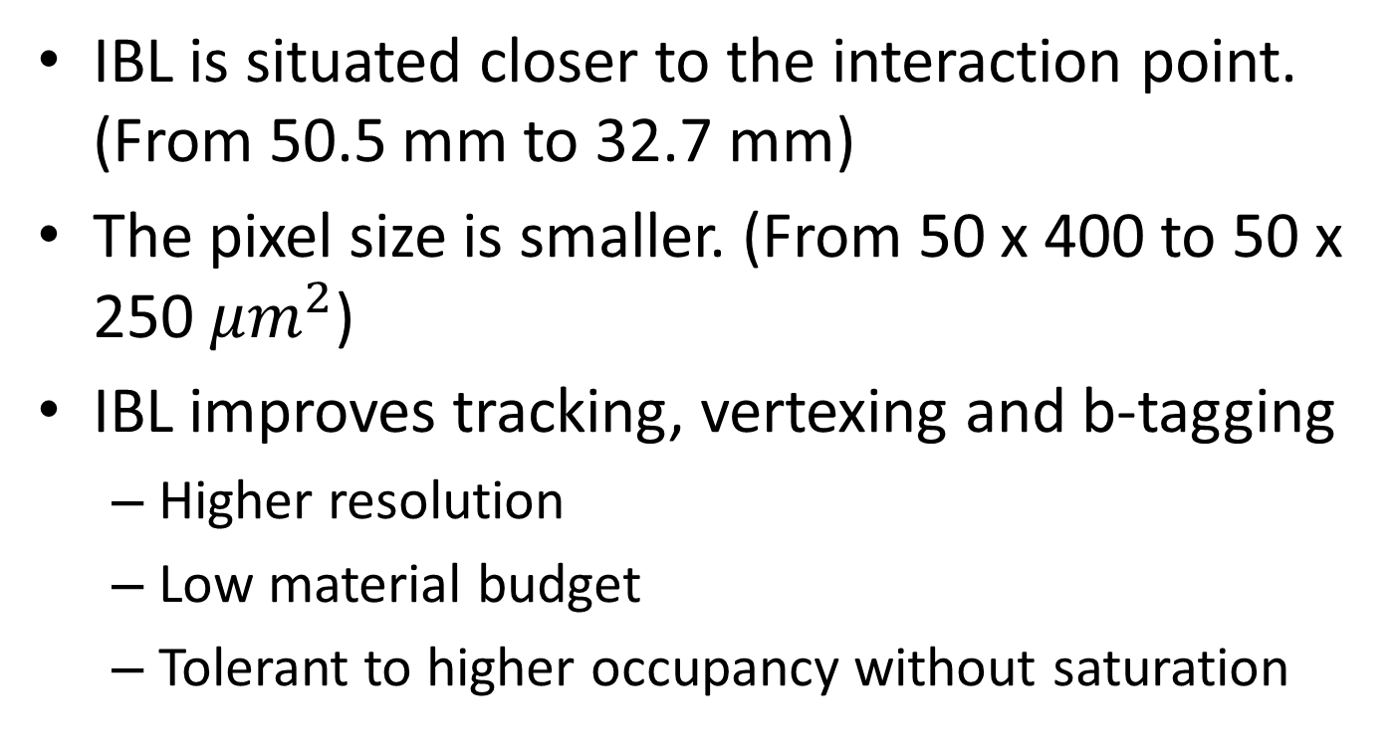
Why IBL
IBL is situated closer to the interaction point. (From 50.5 mm to 32.7 mm)
The pixel size is smaller. (From 50 x 400 to 50 x 250 $μm^{2}$)
IBL improves tracking, vertexing and b-tagging
  Higher resolution
  Low material budget
  Tolerant to higher occupancy without saturation

Slide 6
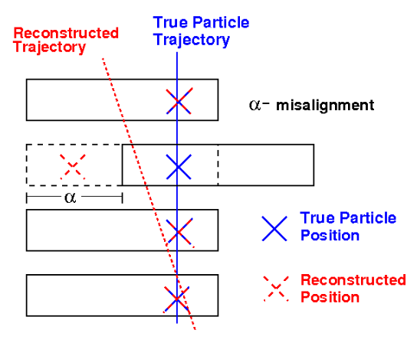
What is alignment and why?
Alignment is the determination of the position and orientation of the detector components.
When reconstructing the event, the detector positions used in the reconstruction algorithm often does not correspond to the actual relative position of the installed detector.
Spatial misalignment of the detector affect track parameters which then leads to incorrect physics results (eg. invariant mass)
Spatial misalignment also leads to decreased resolution accuracy and quality.
Only through the alignment procedure that we can achieve a resolution close to the intrinsic resolution.

Slide 7
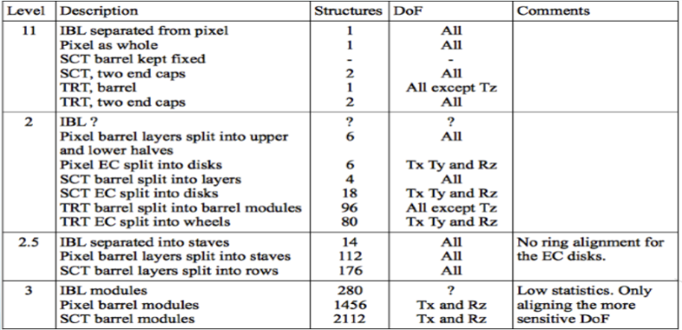
Alignment Level

Slide 8
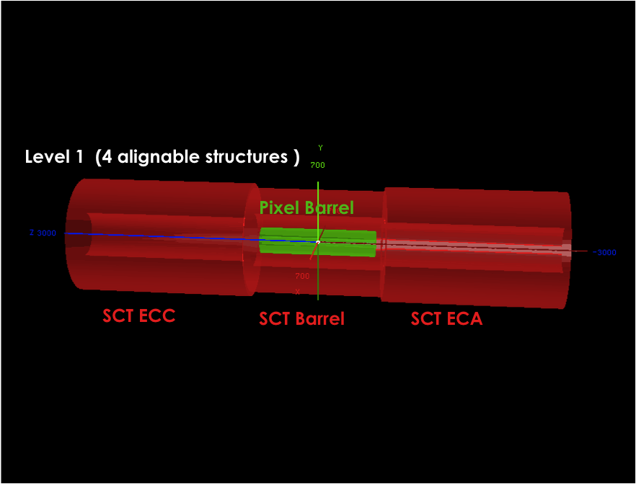
***This is a old visualization of the Level 1 alignment level before inserting the IBL.

Slide 9
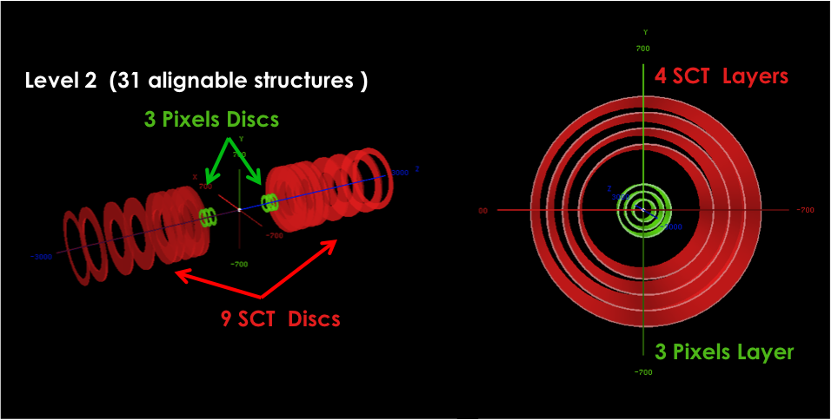

Slide 10
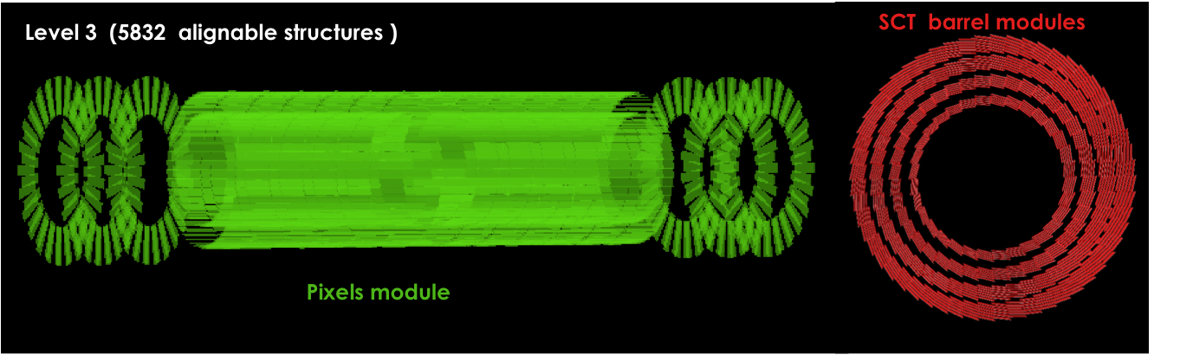

Slide 11
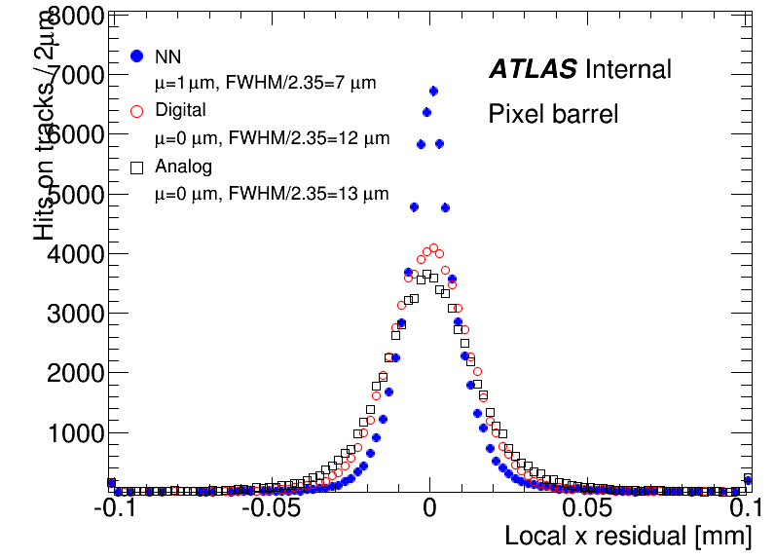
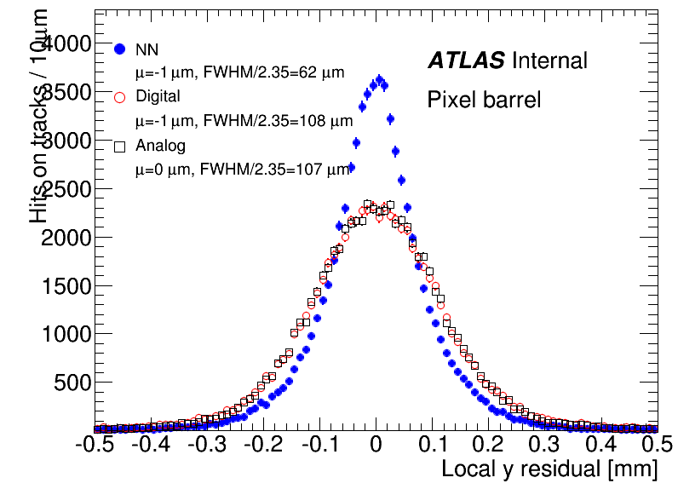
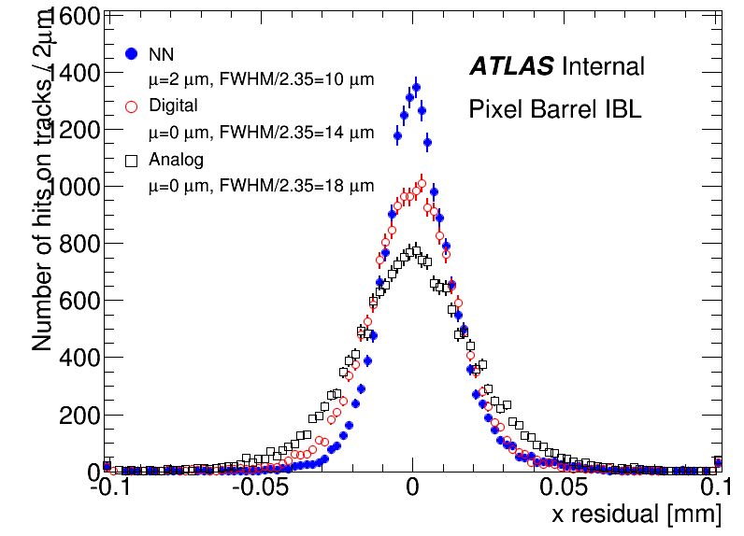
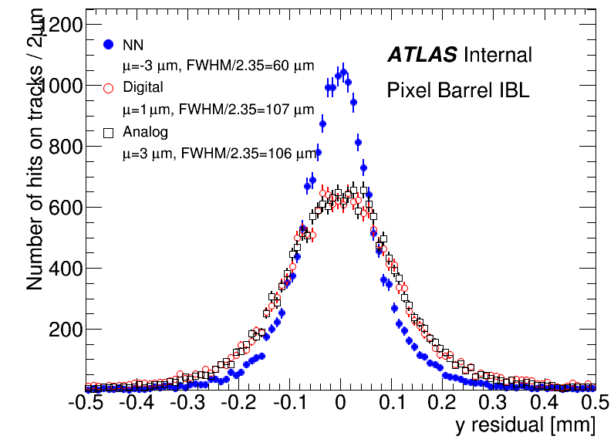
Comparisons between residual clustering algorithms (Rel19)
Digital seems
to have better
performance
than analog
The Pixel local x and y unbiased residual distributions for the example of a multi-muon simulated sample.

Slide 12
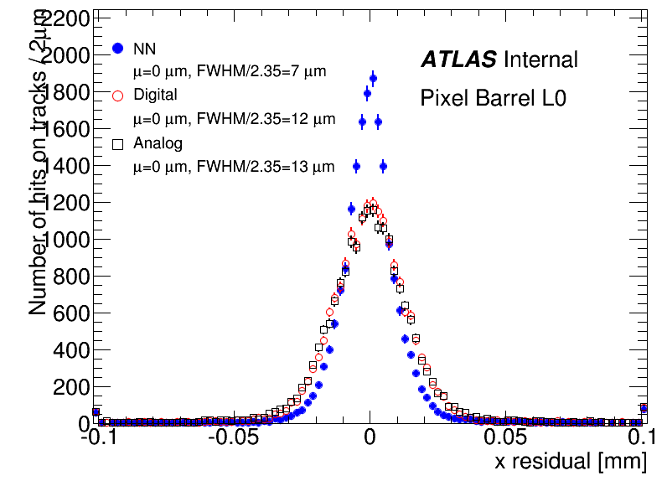
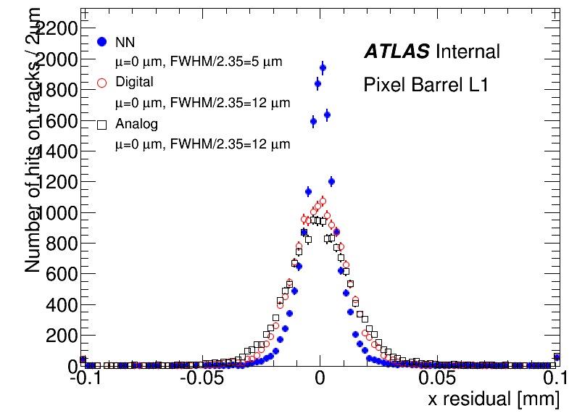
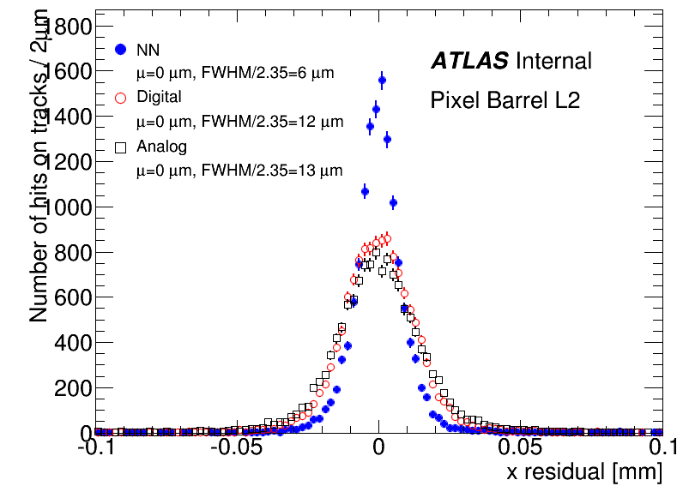
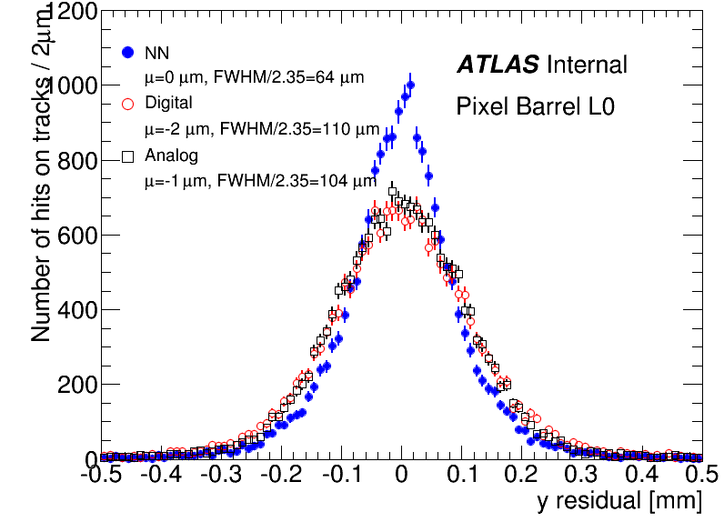
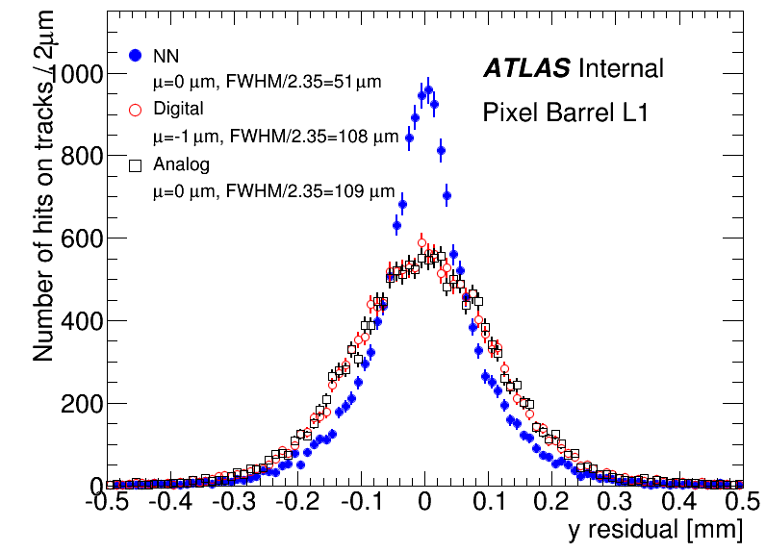
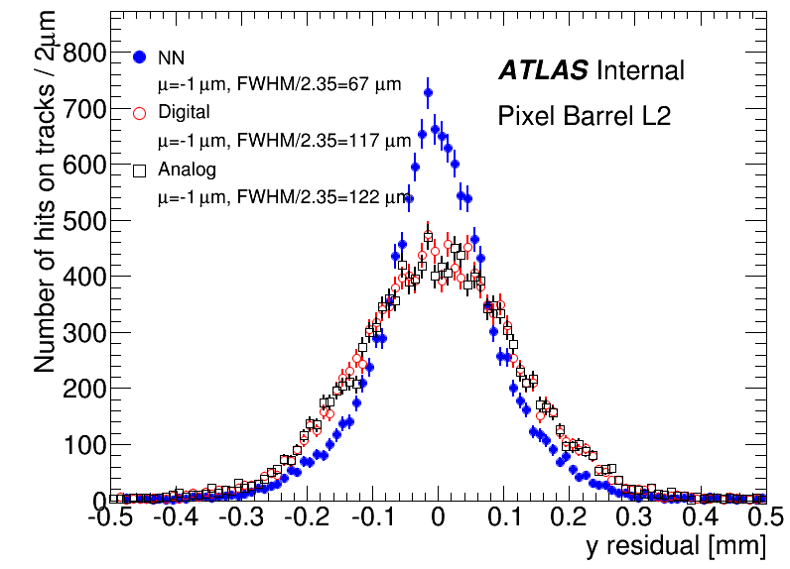
The Pixel local x and y unbiased residual distributions for the example of a multi-muon simulated sample.
Observation: The performance of analog and digital are almost identical in all of the pixel barrel layers except for IBL layer

Slide 13
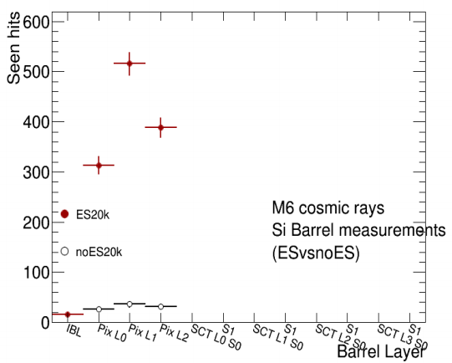
M6 Alignment Results
A comparison between error scaling on and error scaling off with 20k events.

Slide 14
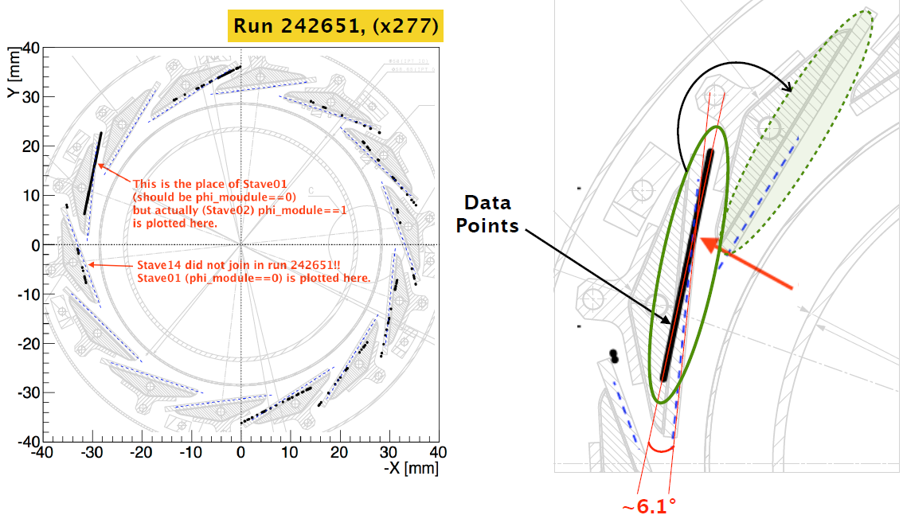
Geometry Issues with M6
Stave N is mapped to Stave (N-1). To solve, need to rotate the staves globally around z-axis by 19.58 degrees
Refer to: https://indico.cern.ch/event/348223/contribution/3/material/slides/0.pdf

Slide 15
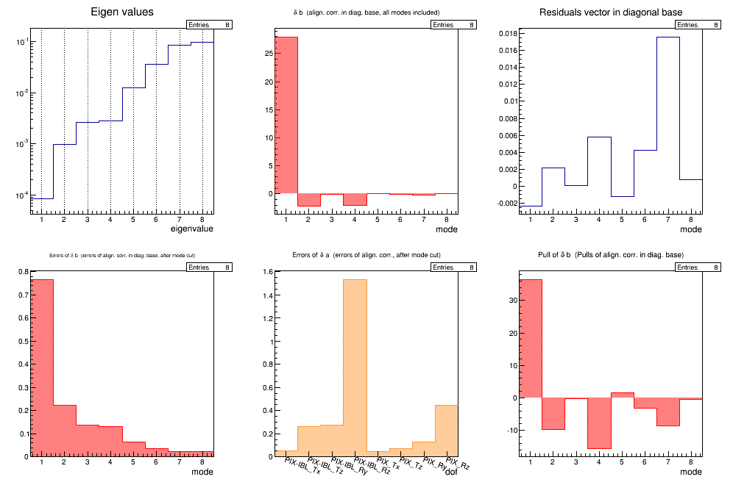
Eigenvector Analysis with Rotated Geometry

Slide 16
Conclusion
I did a clustering algorithm comparison.
I performed a eigenvector analysis with the rotated geometry.
Setting up batch job submission on lxplus.
Will look into M7.

Slide 17
Reference
https://indico.cern.ch/event/357106/contribution/0/material/slides/0.pdf

