Slide 1
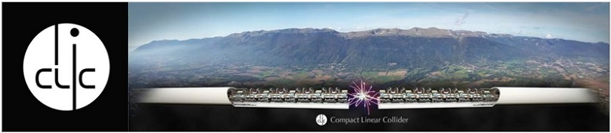

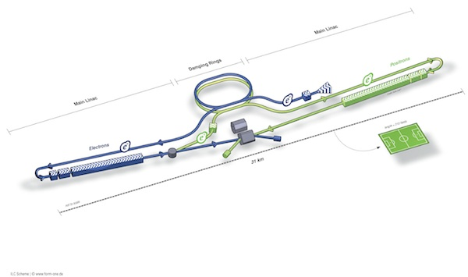

Linear Colliders in the HSF
Jan Strube (PNNL)

Slide 2
Introduction
Large Data rates (comparable to Belle-II)
  ~ 18 PB / year raw data at nominal running at ILC
  High Luminosity option, High Energy option ~factor 4
  CLIC ~factor 10
  Start of data taking ~2029 for ILC, after LHC for CLIC
Low-noise environment
  Many Billions of channels – low occupancy
  High-precision tracking / vertexing
  Particle Flow with extreme granularity
Mature Collaborations
  First proposals ~2 decades ago
  Existing collaborations ~1 decade

Slide 3
Computing
Production campaigns mostly using the Grid(s)
ILCDIRAC (developed at CERN)
  LC applications on top of DIRAC
  used by all LC collaborations
Currently in stable state, minimal development needed, mostly user support
Computing model still being developed

Slide 4
Common Simulation / Reconstruction Codes
(thanks to the common event data format LCIO, all of it works in multiple detector concepts)
slic / lcgeo
  GEANT4 – based detector simulation. Standalone. Allows detector description in XML format or code.
LCFIPlus
  Flavor tagging package based on SLD’s ZVTOP algorithm
PandoraPFA
  Sophisticated particle flow reconstruction, used throughout the LC community, being adapted for LAr-TPC (LBNE)
DD4HEP
  Unified detector description for both simulation
  and reconstruction
aidaTT (under construction)
  Pattern recognition / track fitting package
Notes:
DD4hep: generic HEP detector description for simulation and reconstruction
(depends only on ROOT and geant4, which are both used by everyone)
aidaTT: generic tracking toolkit
no a priory dependency other than GBL if you want to run the GBL fit
provides optional interfaces to DD4hep and LCIO
PandoraPFA: generic toolkit for PFA algorithms: no external dependency
used by ILC/CLIC and currently adopted for LAr-TPCs at neutrino
experiements (LBNE)

Slide 5
What would the LC community like from HSF
No immediate need to improve computational efficiency
If software packages leave the boundaries of a single experiment, support for code hosting / documentation / testing might be useful. (Github might also fill this need)
Would take advantage of more efficient simulation (simulation ~3 times as much CPU as reconstruction)
aidaTT, DD4HEP developed as AIDA projects
  Would be interested to develop other components under HSF umbrella, if other experiments benefit from this

Slide 6
What can the LC community bring to HSF?
Experience in community building
  Two of the regional detector concepts merged
  Continuous move towards common software, enabled by common EDM from the start
Experience in common / generic software, supporting new users
  First CLIC detector model in a day
  First toy simulation events in a couple of weeks
  Detector concepts (and simulations) are very different, reconstruction software works in all of them (see slide 4).
  Muon Collider, HPS, …
Open source reconstruction software
  All of our tools are accessible by anybody

Slide 7
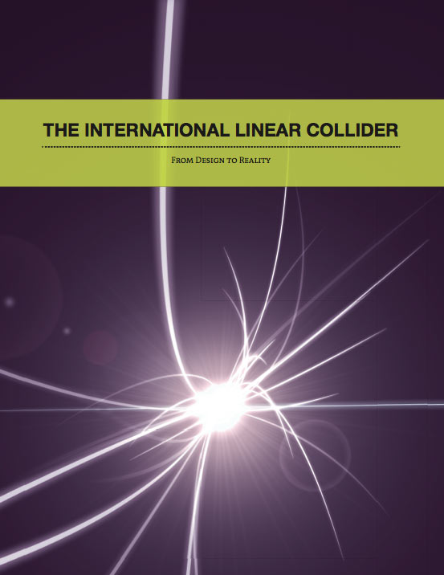
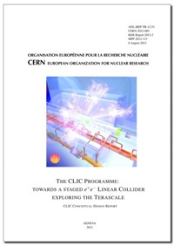
Linearcollider.org for more information

