Slide 1

International Collaboration for Data Preservation and
Long Term Analysis in High Energy Physics
http://dphep.org
refs:
arXiv:1205.4667 (the blueprint)
arXiv:0912.0255
Preliminary Views of HSF
Marcello Maggi (INFN)
On behalf of DPHEP
presented by Andrea Valassi (CERN)

Slide 2
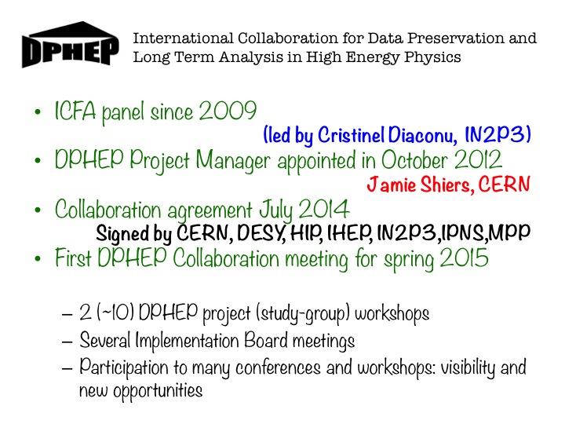
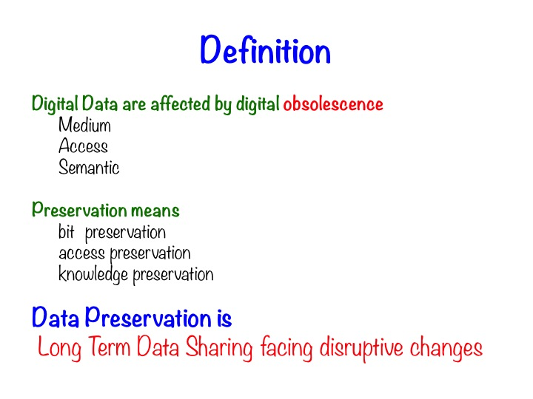
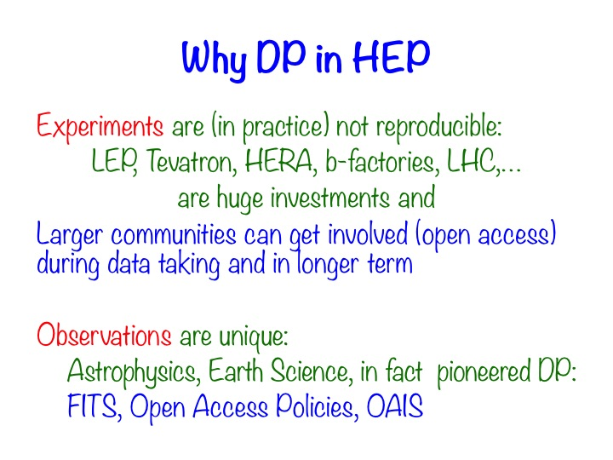
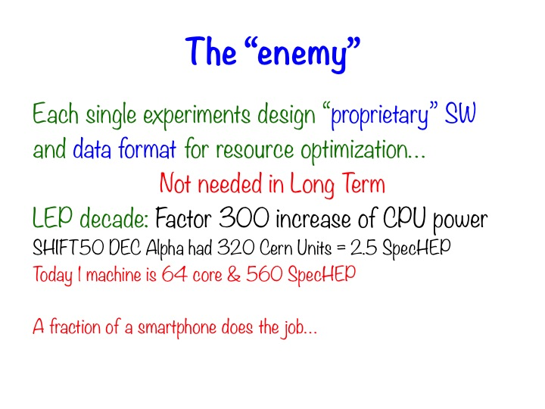

Slide 3
DPHEP Objectives -1
Preserve data, SW, and know-how in the collaborations
Foundation for long-term DP strategy
Analysis reproducibility: Data preservation alongside software evolution
Share data and SW with larger scientific community
Additional requirements:
  Storage and distributed computing
  Accessibility issues, intellectual property
Formalising and simplifying data format and analysis procedure
Documentation

Slide 4
DPHEP Objectives -2
Open access to reduced data set to general public
Education and outreach
Continuous effort to provide meaningful examples and demonstrations
Bit preservation
Data taken by the experiments should be preserved
Strategy and scope in approved policy documents for all LHC collaborations
http://opendata.cern.ch/collection/data-policies
many other initiatives (DASPOS, PREDON, etc.)

Slide 5
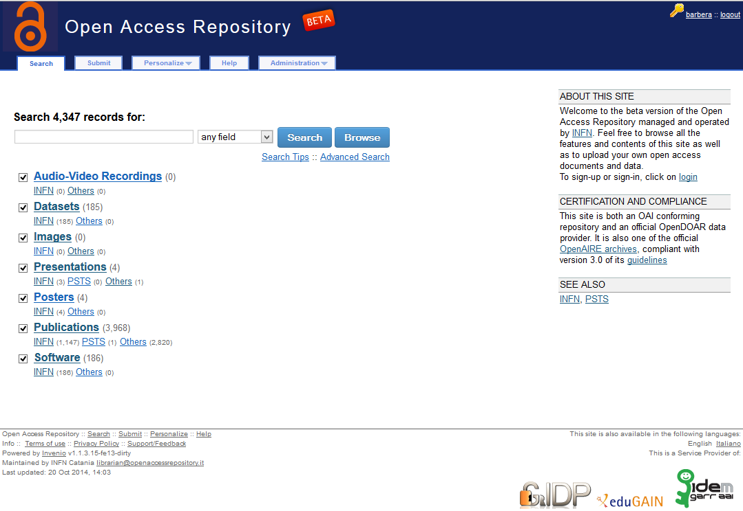




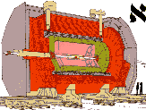


Technologies:
INVENIO
CERNVM
CERNVM-fs
+…
Services:
OpenData CERN
OpenAccessRepository INFN
M. Maggi (presented by A. Valassi) – Data Preservation

Slide 6
The views
DPHEP Collaboration provides the framework for inter-experiment and inter-laboratory cooperation on data preservation
HSF is the opportunity to extend
  the collaboration around the main technological pillars of the DP framework: INVENIO CERNVM CERNVM-fs, …
  And the SW collaboration for Common Data Analysis framework on preserved data & Validation

Slide 7
Relevance of DP to HSF and vice versa
(some ideas from myself and other HSF startup team members )
HSF gives visibility to common software projects by many experiments
  DPHEP hosts common software developments (data analysis/validation framework)
HSF and DP are both concerned with the long-term evolution of software
  They both recommend using data format standards and following best practices
  Software sustainability, maintenance and documentation for future users are vital
  Continuous porting to new platforms/compilers/externals and disruptive changes are an issue for both (DP may also use frozen configurations and virtualised environments)
  (“Re[peatable|producible|computable] research” in Neil’s presentation yesterday)
Both HSF and DPHEP recommend Open Access policies
  For all of data, software source code and publications
  And both require the implementation of open access repositories for all such categories (the implementation itself being a candidate for sharing knowledge and developments)
HSF and DP are both committed to engage with non-HEP communities
  Other scientific communities and possibly beyond
  DPHEP, DASPOS, PREDON, RDA are projects with several non-HEP links for DP

