Slide 1
Electronic challenges in ITER
Towards high-availability applications
Bruno Soares Gonçalves,
A. Batista, M. Correia, J. Sousa, B.B. Carvalho, B. Santos, A. Duarte, A. P. Rodrigues, R. Pereira, P.F. Carvalho, A. Fernandes, A. Combo, N. Cruz, C. Leong, A.R. Ramos, J. P. Santos, J. G. Marques, I. C. Teixeira, J. P. Teixeira
Partners

Slide 2
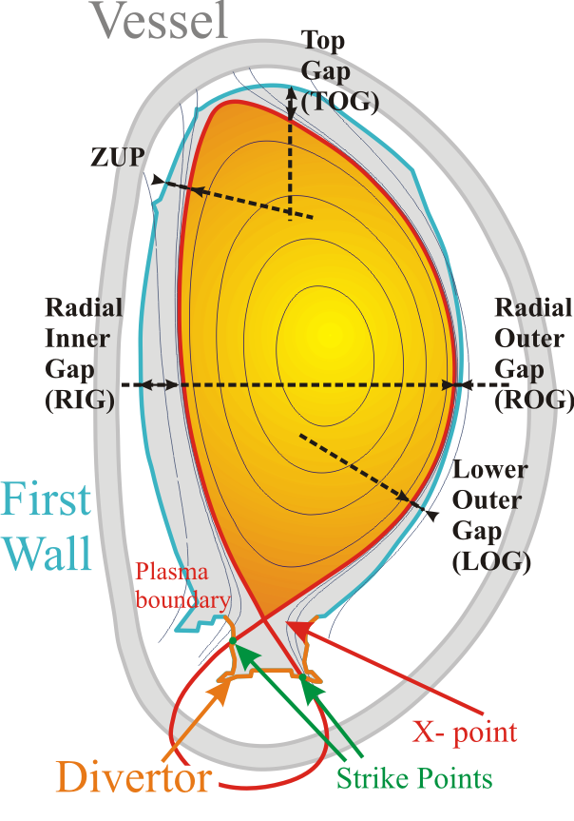
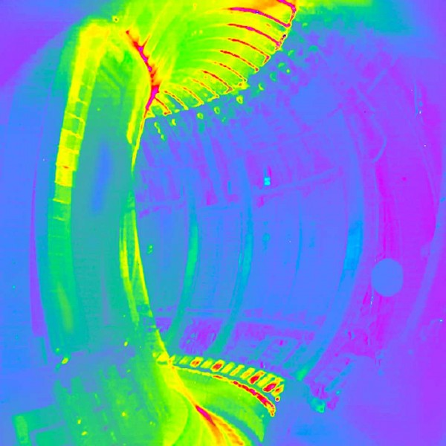
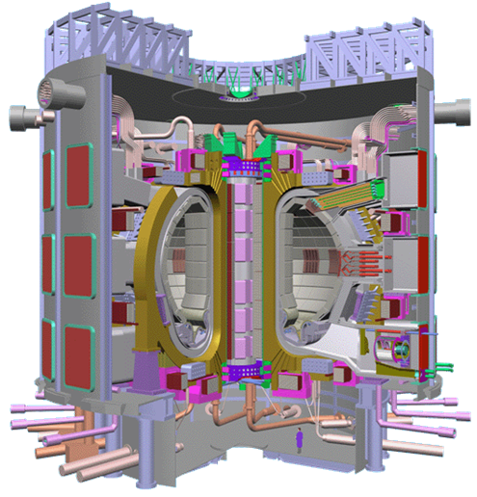
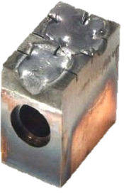
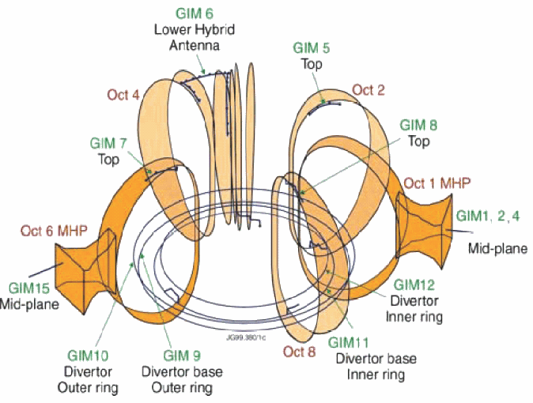
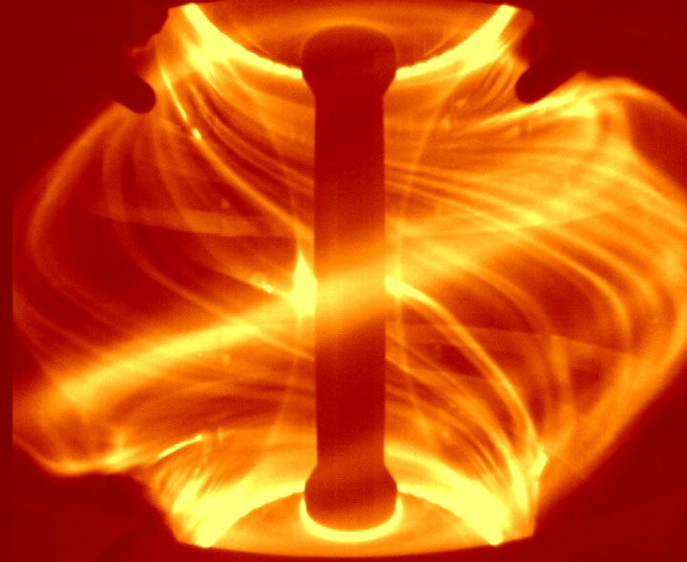
Control in fusion plasmas is critical for safe operation and to achieve high performance
Magnetic control
position, shape & vertical stabilization
Wall protection
Instabilities mitigation
& control
Density
control
Notes:
r

Slide 3
Nuclear Fusion control systems are highly complex
Magnetic control
position, shape & vertical stabilization
Wall protection
Malfunction of a single component may originate relevant damage to entire infrastructure
Instabilities mitigation
& control
Density
control
Notes:
r

Slide 4

When something fails… on position control
Notes:
Example of jet disruption due to loss of vertical stabilization

Slide 5

On ITER similar events will cause huge thermal loads on Plasma Facing Components
Will require a far higher level of availability and reliability than previous/existing tokamaks
.
30-60 MJ/m² for ~0.1s
  PFCs cannot be designed to sustain such (repetitive) thermal loads
~90 MN
~20-45 MN
EM loads

Slide 6
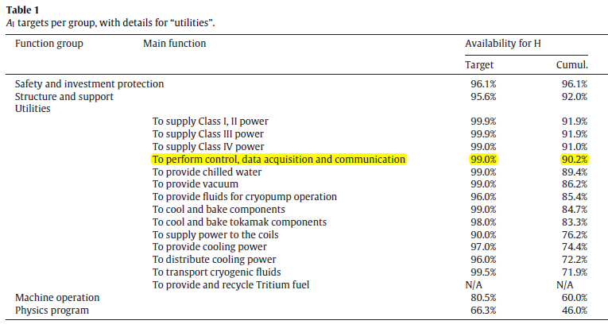
Availability goal in Fusion – similar to Nuclear Fission (70-80%) at full power
R. Buende, Fusion Engineering and Design 29 (1995) 262-285
RAMI analysis for ITER
Inherent Availability A_{i} = 60%
Operational Availability A_{o} = 32%
D. van Houtte et al. / Fusion Engineering and Design 86 (2011) 680–683
Notes:
Necessary to build our C&DA system from inst. Standards which provide HA

Slide 7

Steady-state operation calls for High Availability
99.999% up-time (reference for HA), correspond to
~5 minutes of down-time per year
Resilience to failure
Sensors - backup set
Redundant acquisition channels
Fault detection & mitigation
Risk reduction
Requires the use of robust instrumentation standards designed for high availability!

Slide 8
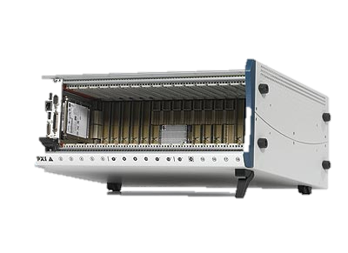
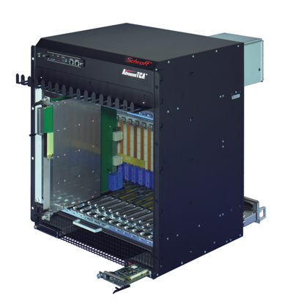
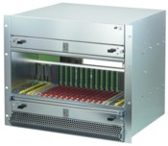
Example | ITER roadmap for fast controllers according to ITER Plant Control Design Handbook (PCDH)
Category
I&C
DAQ
DAQ
Technology
PCIe/PXIe
MTCA.4/μTCA
ATCA
Slow Controller
(PLC) I&C applications
Fast Control
I&C
Interlock
Diagnostics
Data acquisition
Demanding diagnostics, I&C and Interlock tasks
e.g Plasma Control
Control loop frequency, Processing power network capacity,
Real-time constraints, Complexity, Price, Availability

Slide 9
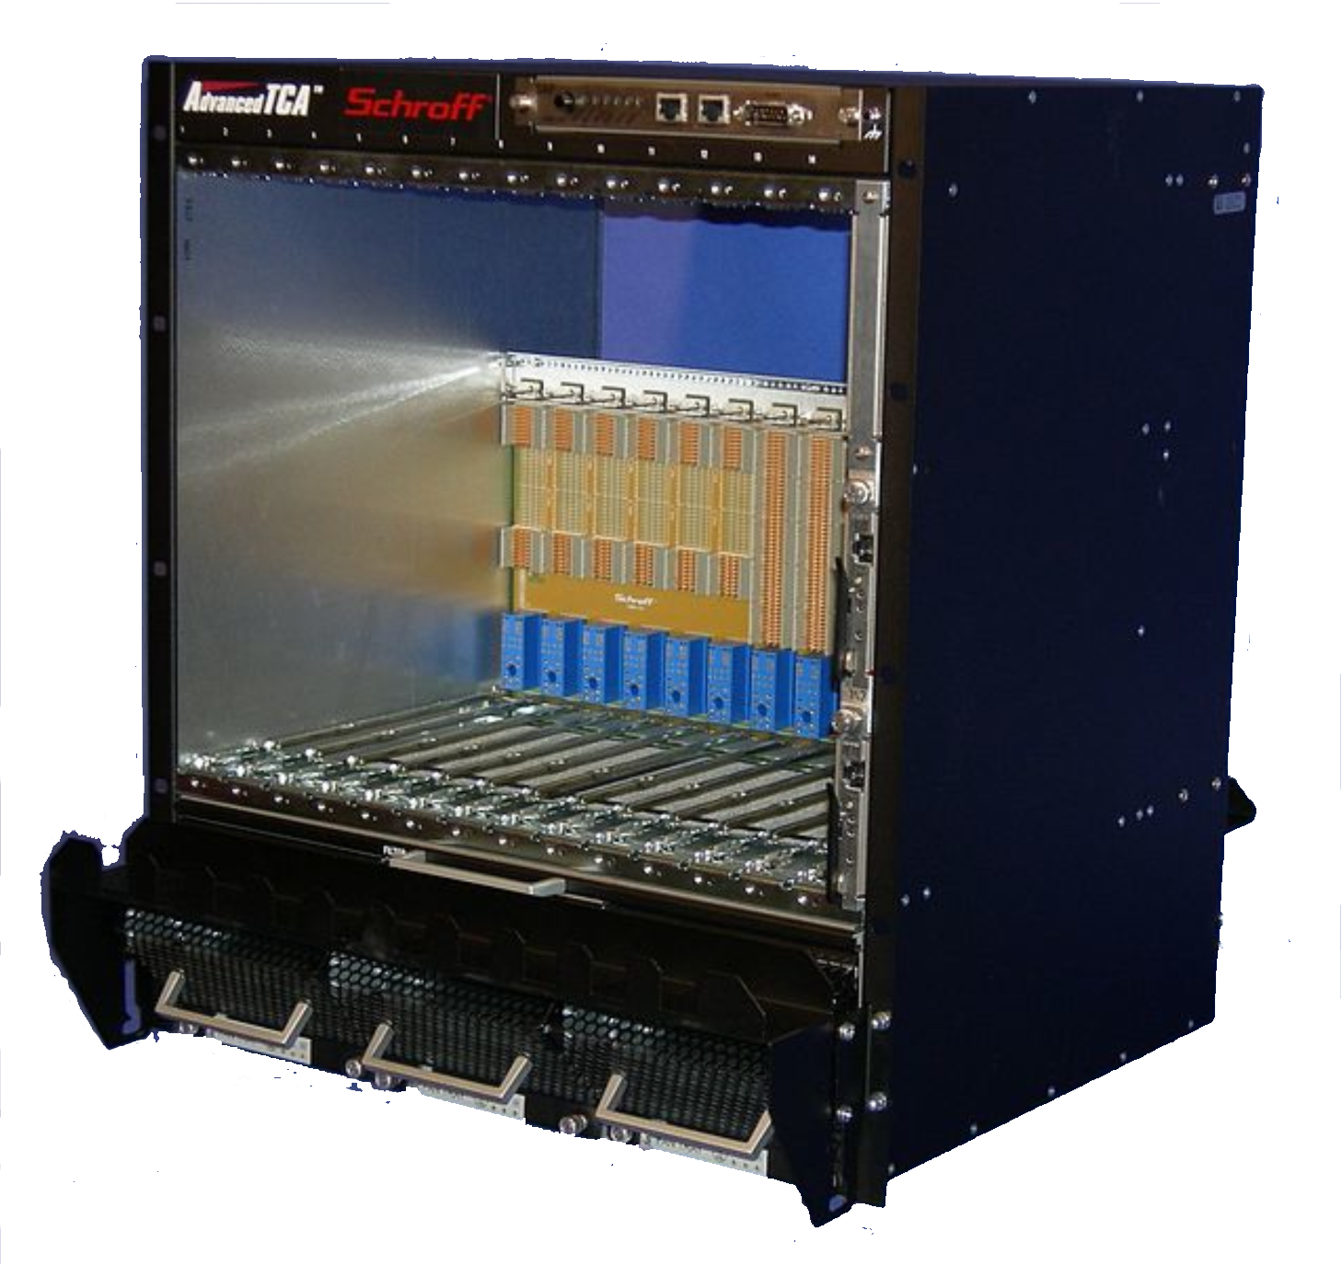
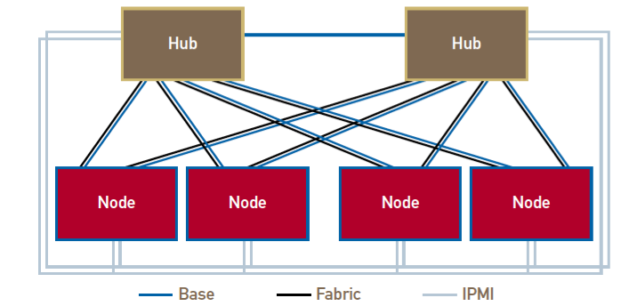
ATCA standard is already designed for high availability & high throughput
Redundant Shelf managers
Redundant backplane interconnect
Redundant power supplies
Redundant fans
Redundant controller

Slide 10

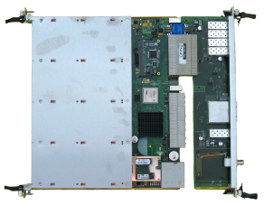
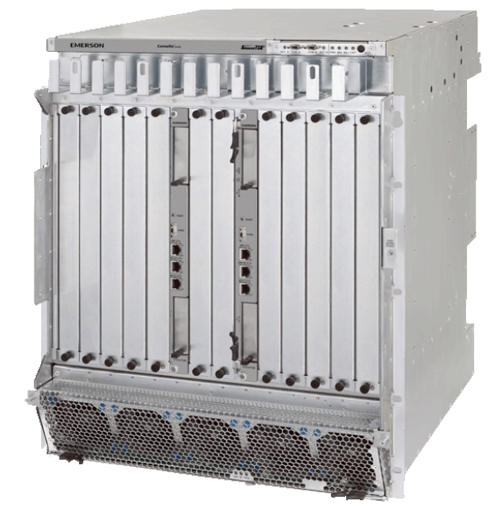
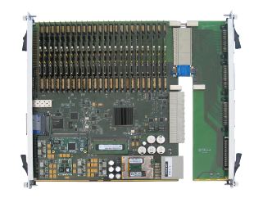
IPFN ATCA subsystem overview
PCIe host
Data & Timing Switch
hub slots
PCIe switch
Host interface
Timing switch
Timing sync
PCIe cable
Digitizer
node slots
PCIe endpoints
ATCA shelf

Slide 11
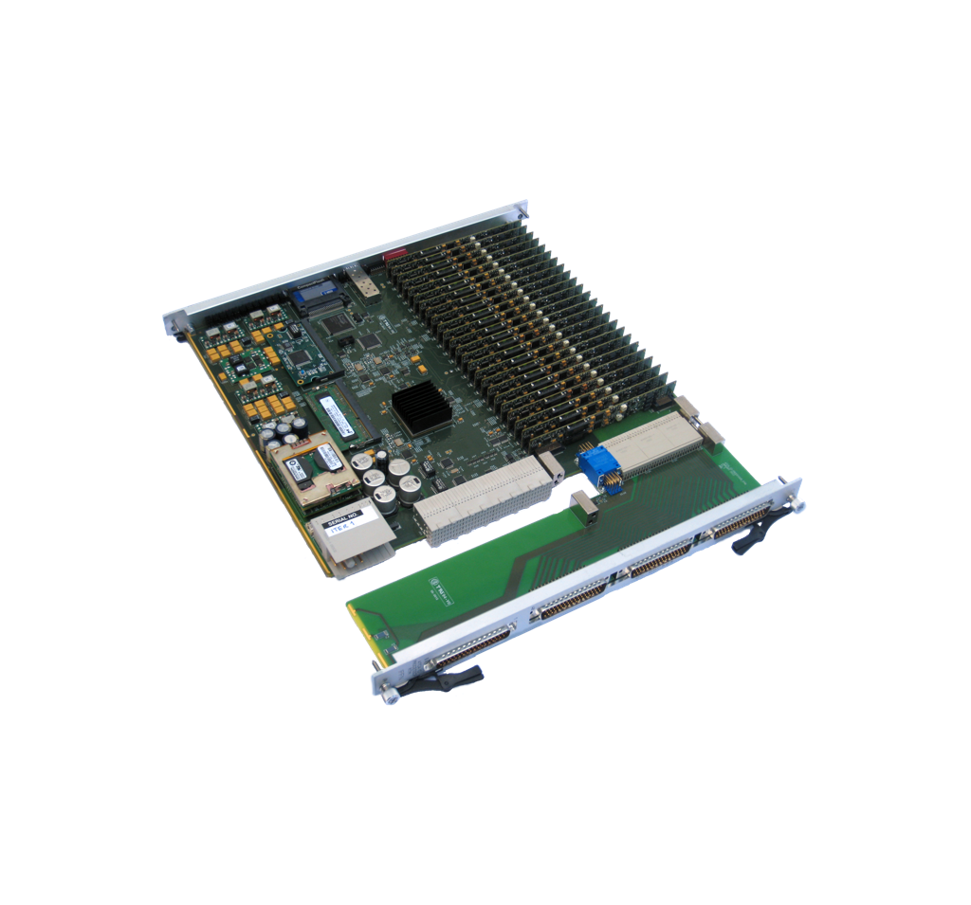
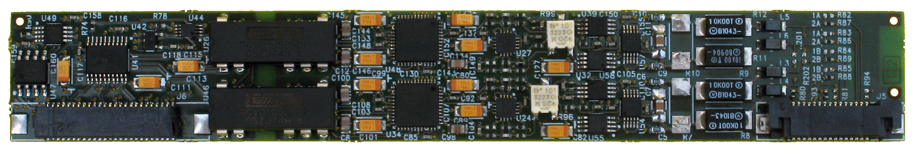
ATCA galvanic isolated digitizer node board for MIMO Systems | high channel density & modularity
PICMG 3.0/3.4 & AXIe compatible
48 analog inputs, outputs or a combination of both
IPFN’s ATCA-IO-Processor*
ADC module , 1-2 MSPS, 18 bit
with ADC x2 and chopper mode
RTM
DAC module
with DAC x2
*added to ITER catalogue of I&C products
Notes:
ATCA-MIMO-ISOL board
modular

Slide 12
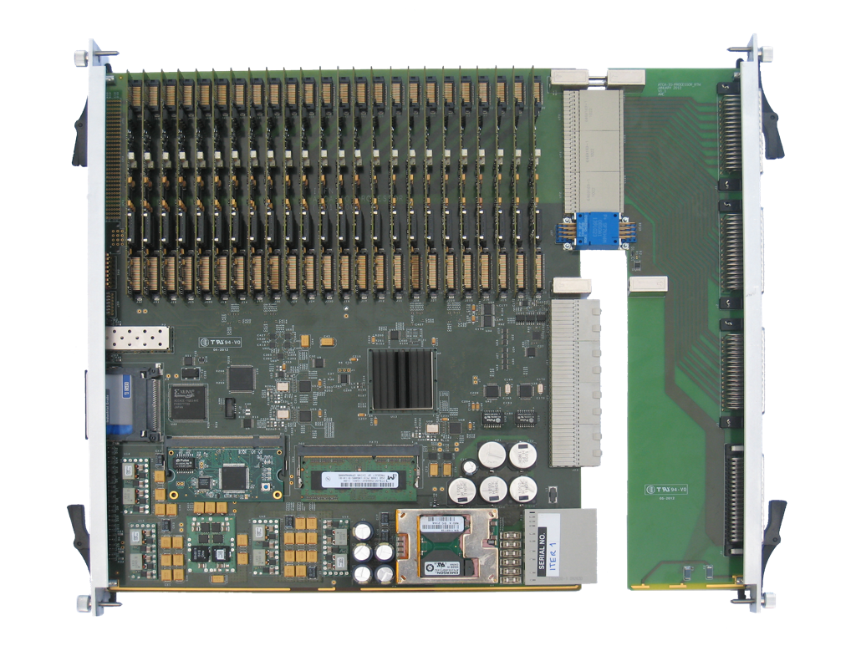
ATCA-IO-Processor | Anatomy
IO modules
(customizable)
Optical or elecrical SFP interface
(Full duplex)
CF Card
Virtex 6
IPMC
RTM
(passive)
DDR memory

Slide 13
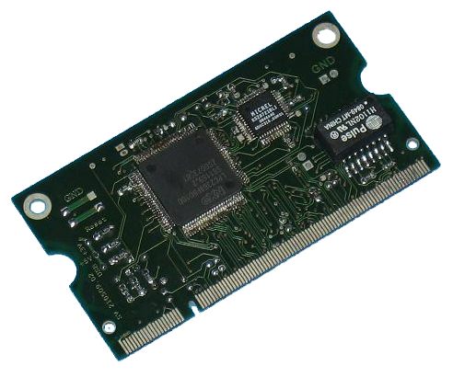
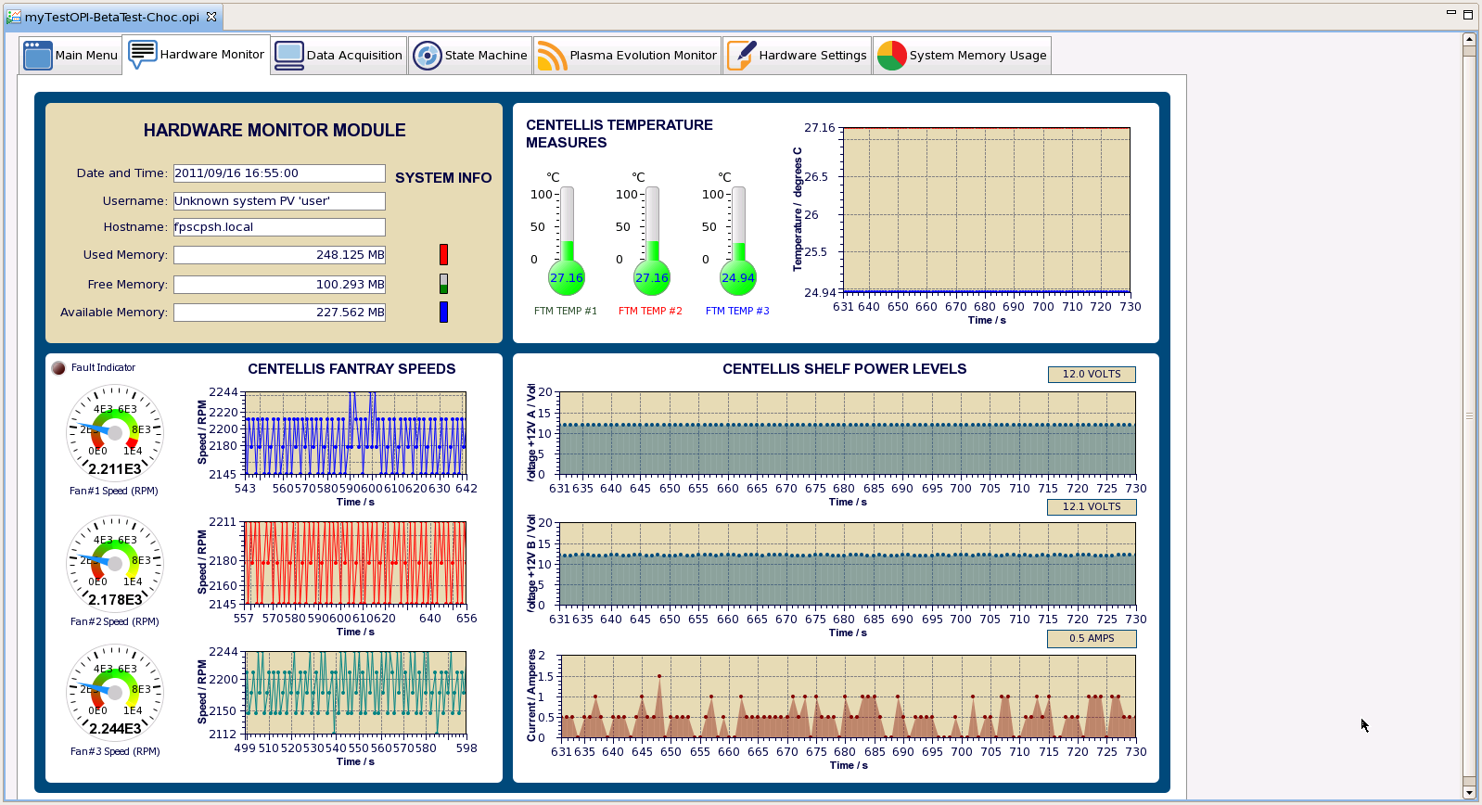
Hardware (shelf & board) continuous monitoring
IPMC
CoreIPM OPMA2368 Module
RTM Passive
Hardware Monitoring

Slide 14
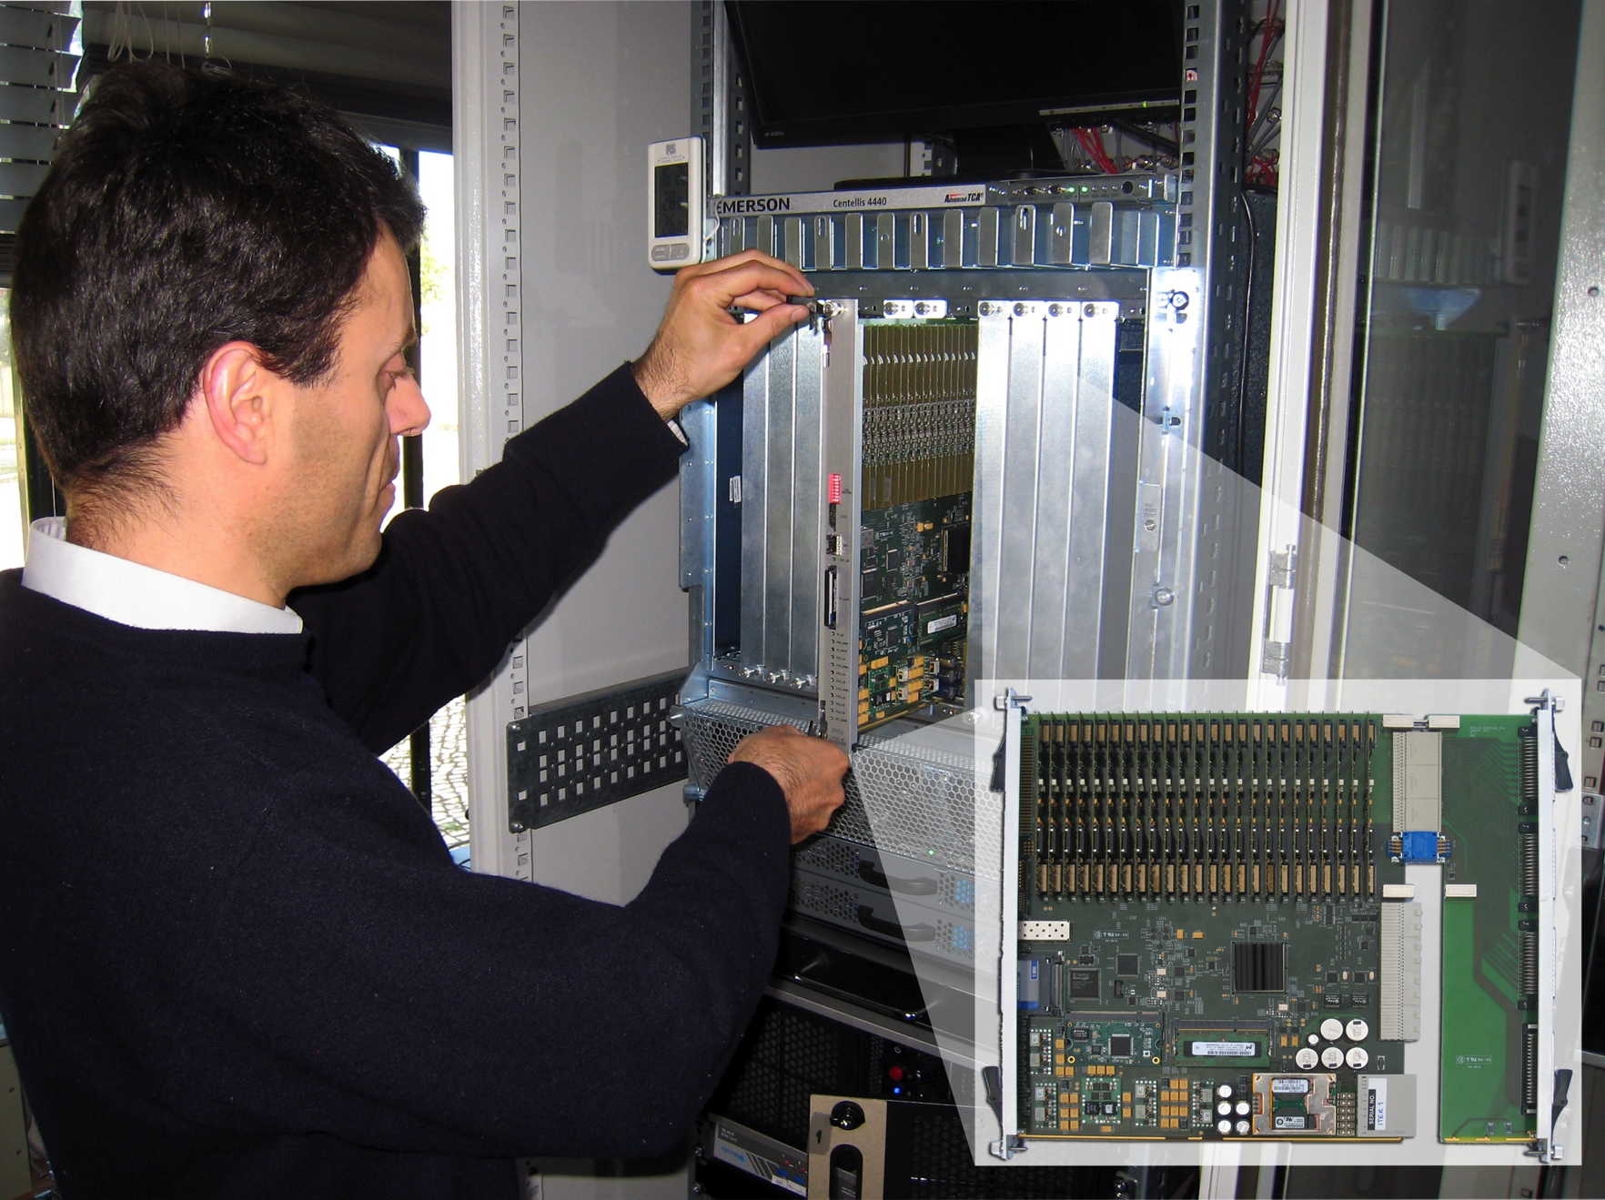
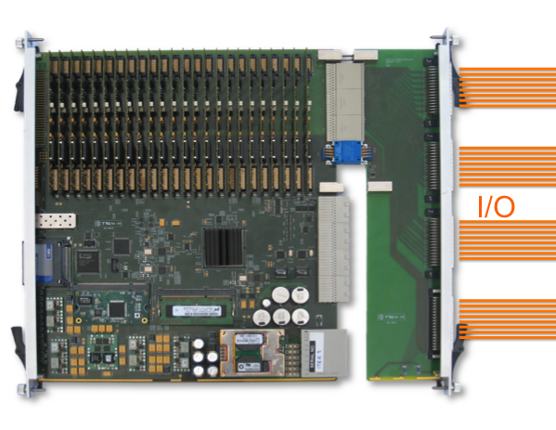
RTM I/O connectivity for “Hot Swap”

Slide 15
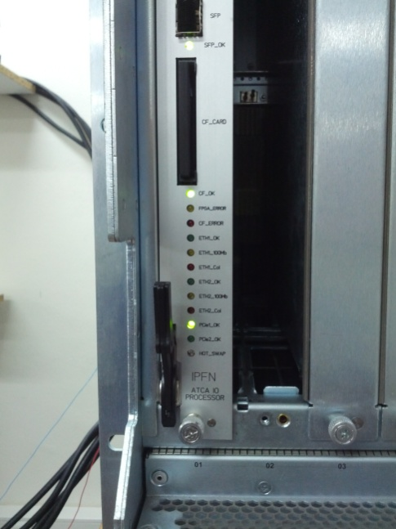
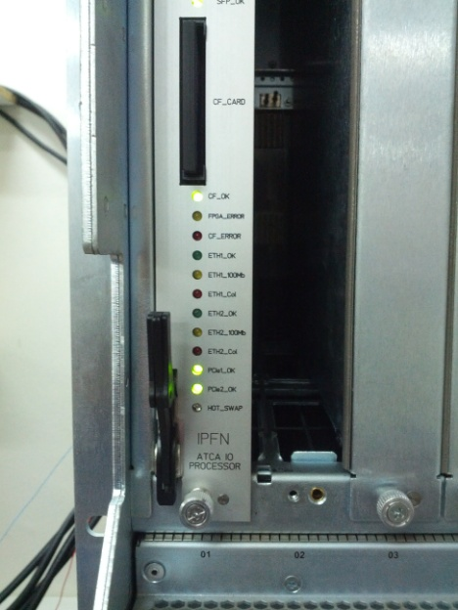
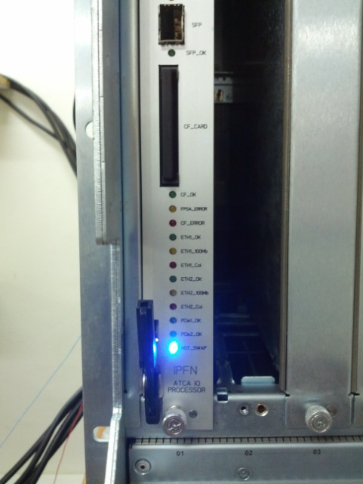
Hot-swap allows runtime replacement
1
Pull fixing handle to remove board
3
2
IO board on ATCA slot
Push handle to fix board
Board detected and ready for use!

Slide 16

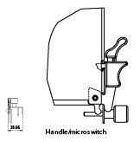
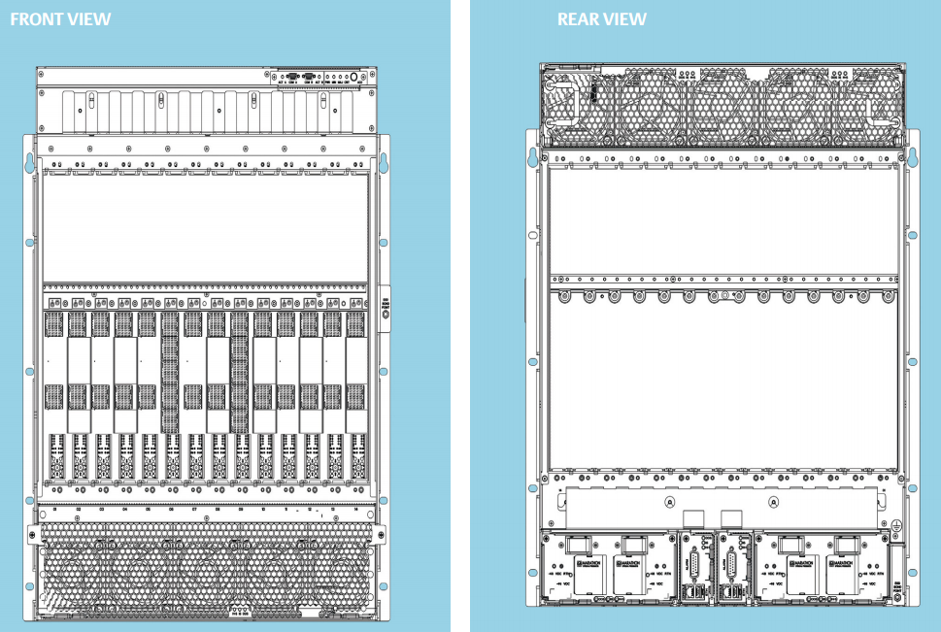
Hot-swap allows runtime replacement
BLUE LED
Payload Power
network
PCIe
ShM
IPMC
IPMB-0
ShMC
ShMC
Handle Switch
@ hardware level
Insertion/extraction of ATCA modules with use of Handle switch
IPMC negotiates with ShM payload power ON/OFF for safe module insertion/removal
BLUE LED signals to operator if board may be inserted/removed
@ software level
Corresponding PCIe devices need to be inserted/removed at software layers
Applications using/communicating with PCIe slots need to be successfully opened/closed
Set relationship between ATCA Hot Swap and PCIe Hotplug (software device insertion/removal) | also being developed by IPFN
Notes:
ATCA Hot Swap solves the problem of insertion-extraction of blades at the hardware level. Basically controlling the power that is given to the slot and managed by the IPMC to the blade Payload Power network
But - what happens at the software level? At the PCI Express network - we haven’t yet mentioned too much about it. There is a good reason for it.

Slide 17
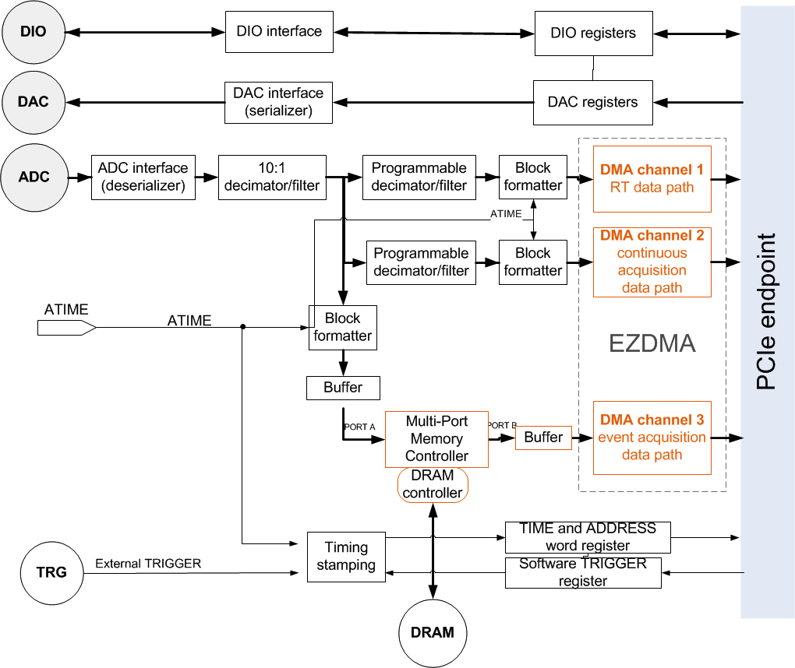
  DMA Channel implementation allows changing output rate dynamically according to external events distributed through SDN
DMA #1
Real-time data at programmable sampling rate
DMA #2
Data for archiving at programmable sampling frequencies
DMA #3
Data for continuous storage on the onboard memory
All data time-stamped before sent through DMA channel.
Circular buffer

Slide 18
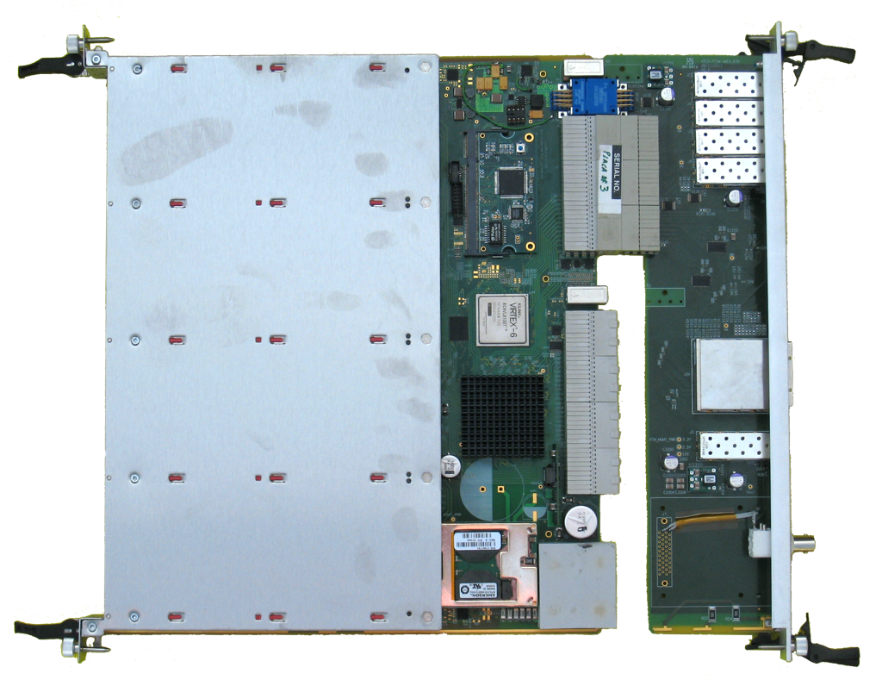
ATCA AMC Carrier / Hub
ATCA-PTSW-AMC4*
IPM controller module
PCIe host x16
PCIe on fabric
not available from industry
Support multiple processors
on AMC slots or external through PCIe cable connection
Mid/full-size COTS AMC modules can be installed
FPGA for timing & synchronization
IEEE-1588 to IRIG on backplane + 100 MHz clock
AMC
AMC
AMC
AMC
FPGA for timing & synchronization
IEEE-1588 to IRIG on backplane + 100 MHz clock
IEEE-1588
*added to ITER catalogue of I&C products

Slide 19
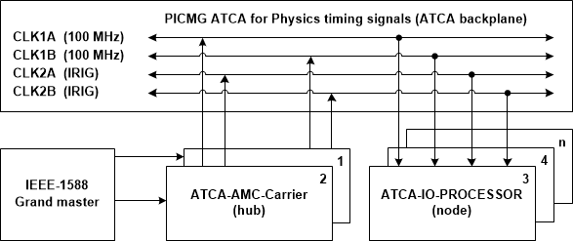

ATCA backplane synchronization | signals distribution
Hub card
Data time stamping using IRIG time distributed by hub card
Internal time counter synchronized with IEEE-1588-2008 card
Programmable timing unit for generating specific clock or trigger sequences for sampling
Common synchronized clock
White Rabbit PTP core being developed
Notes:
Any method using single line for time stamp can be used
IRIG is most well known implementation
Adapted using LVDS signaling
Compatibility for future expansion

Slide 20
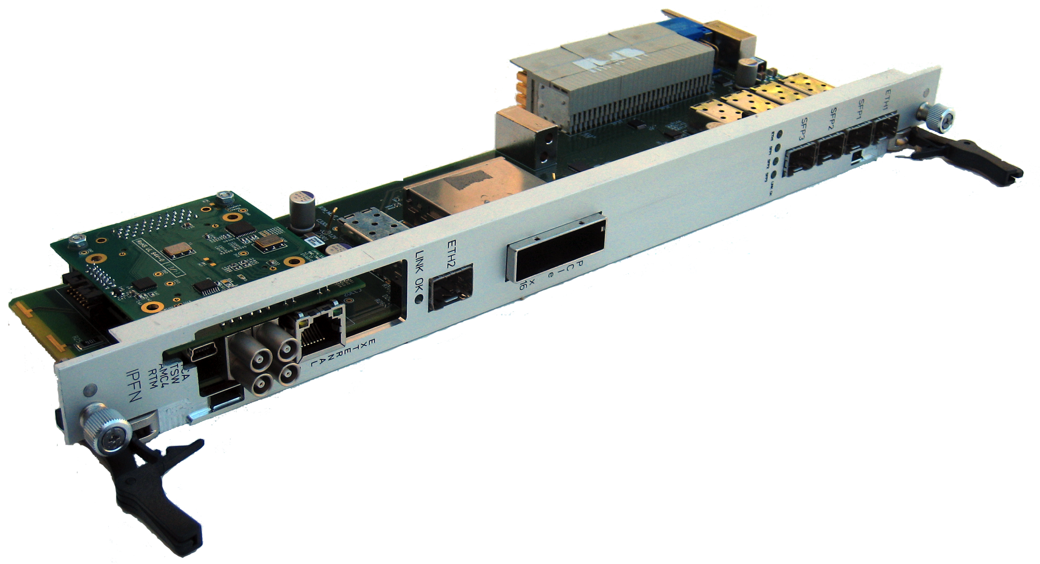
FPGA-based programmable timing module
Trenz Gigabee Spartan 6 FPGA
10/100/1000 GbE | IEEE-1588-2008 master clock
ATCA-PTSW-AMC4 RTM
IRIG-B timing signals | 2 ns synchronization between boards
IEEE-1588-2008 over Ethernet synchronization | ZHAW core
~25 ns RMS time resolution

Slide 21

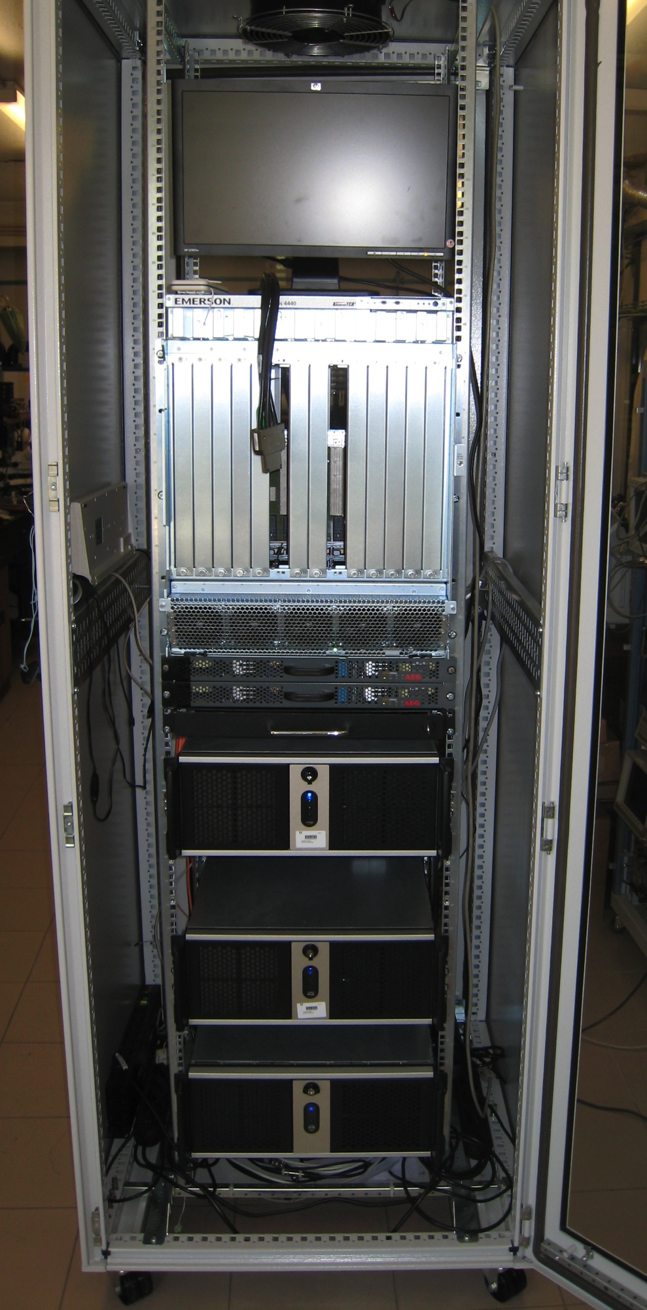
ITER prototype Fast Plant System Controller
ATCA Shelf
TCN
(IEEE-1588)
ATCA-PTSW-AMC4
PCIe
Networks
Hardware
DAN
PON
ATCA-IO-Processor
Controller/PSH
SDN
Mini-CODAC & archiving server
beta version
HPC

Slide 22
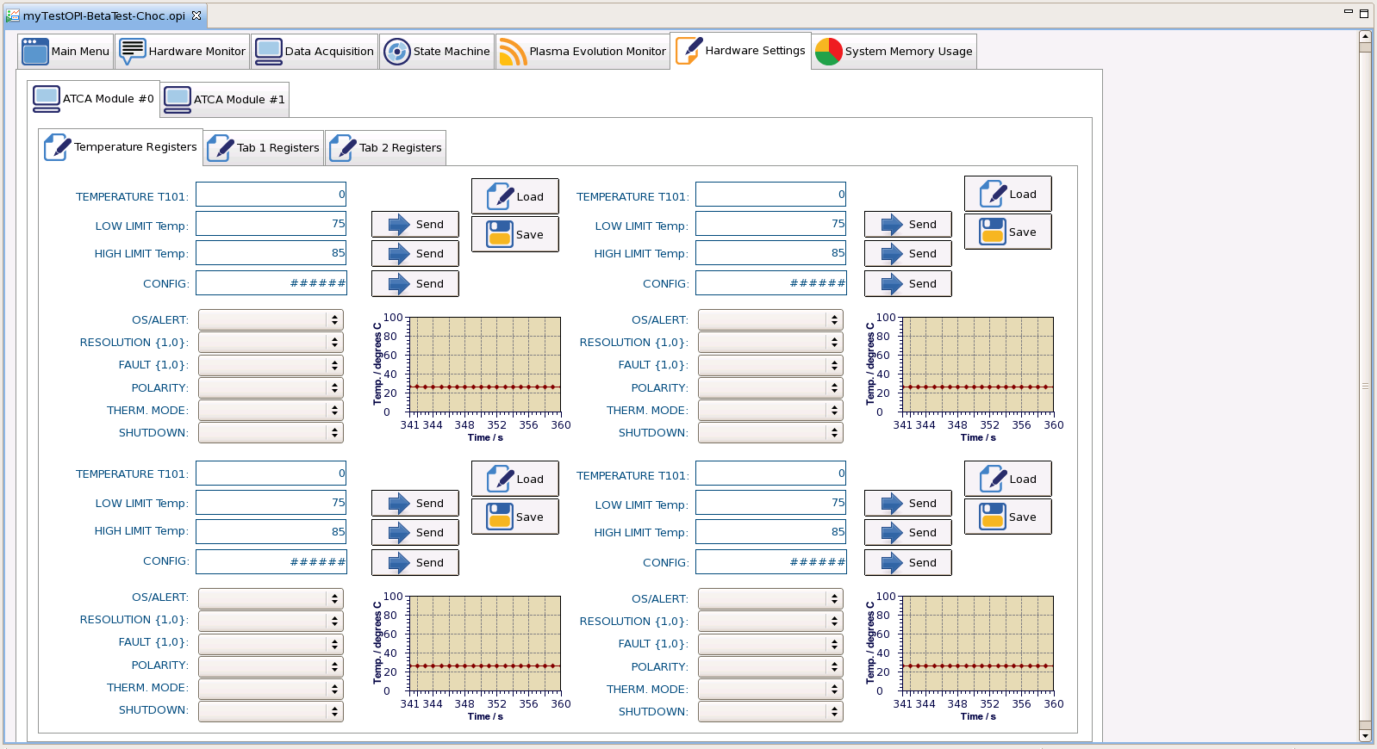
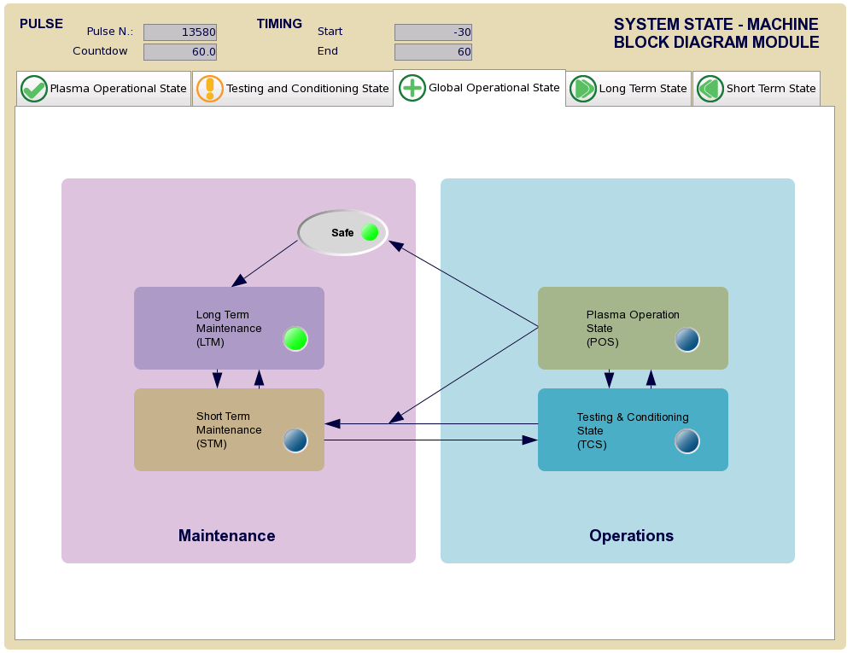
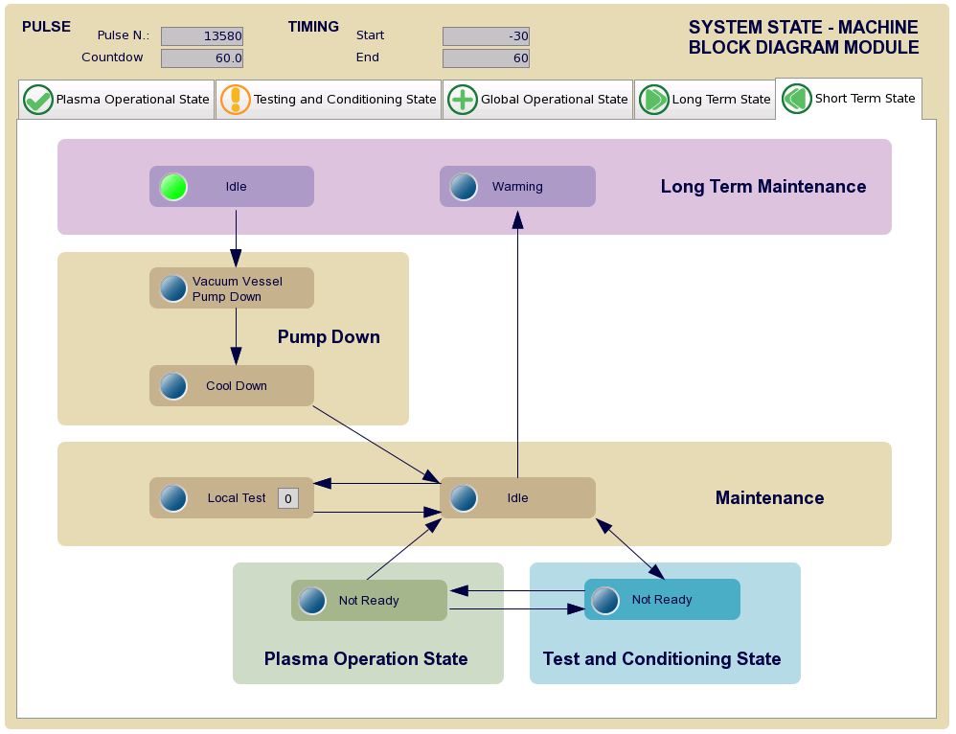
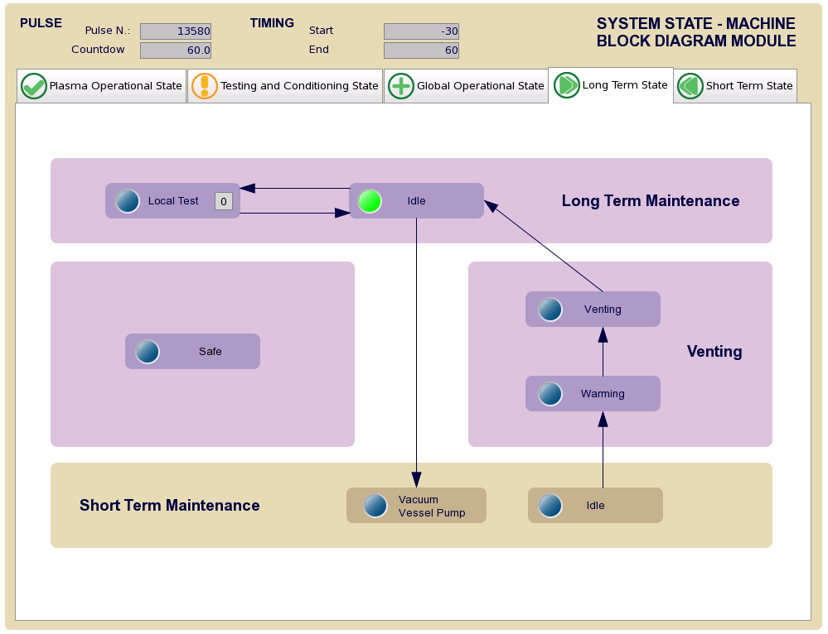
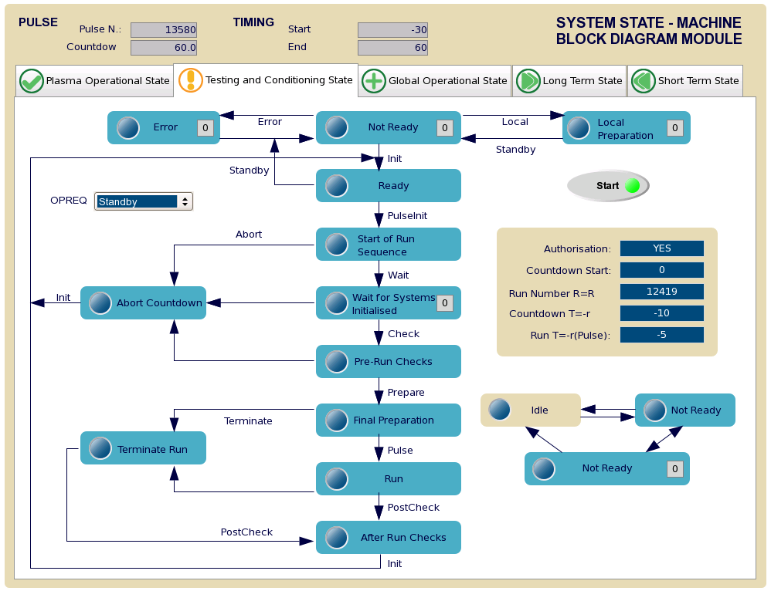
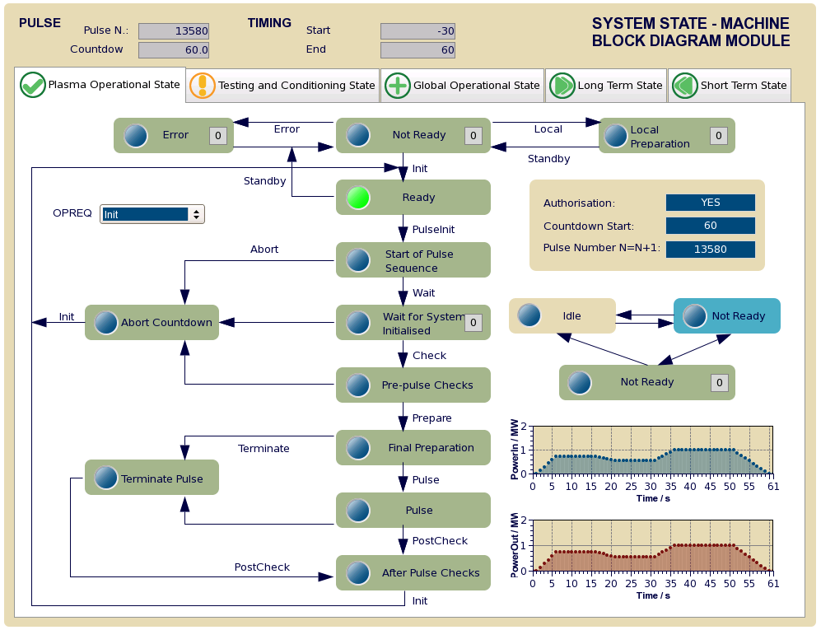
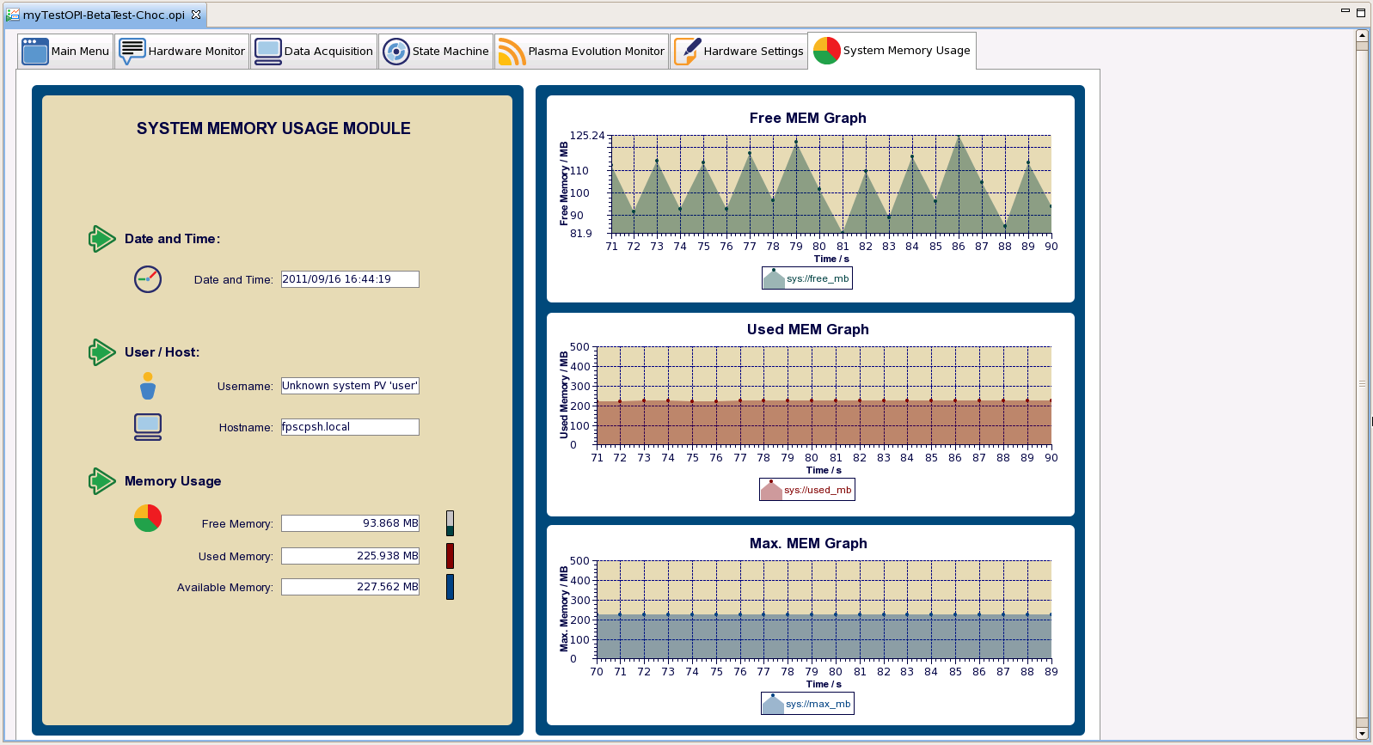
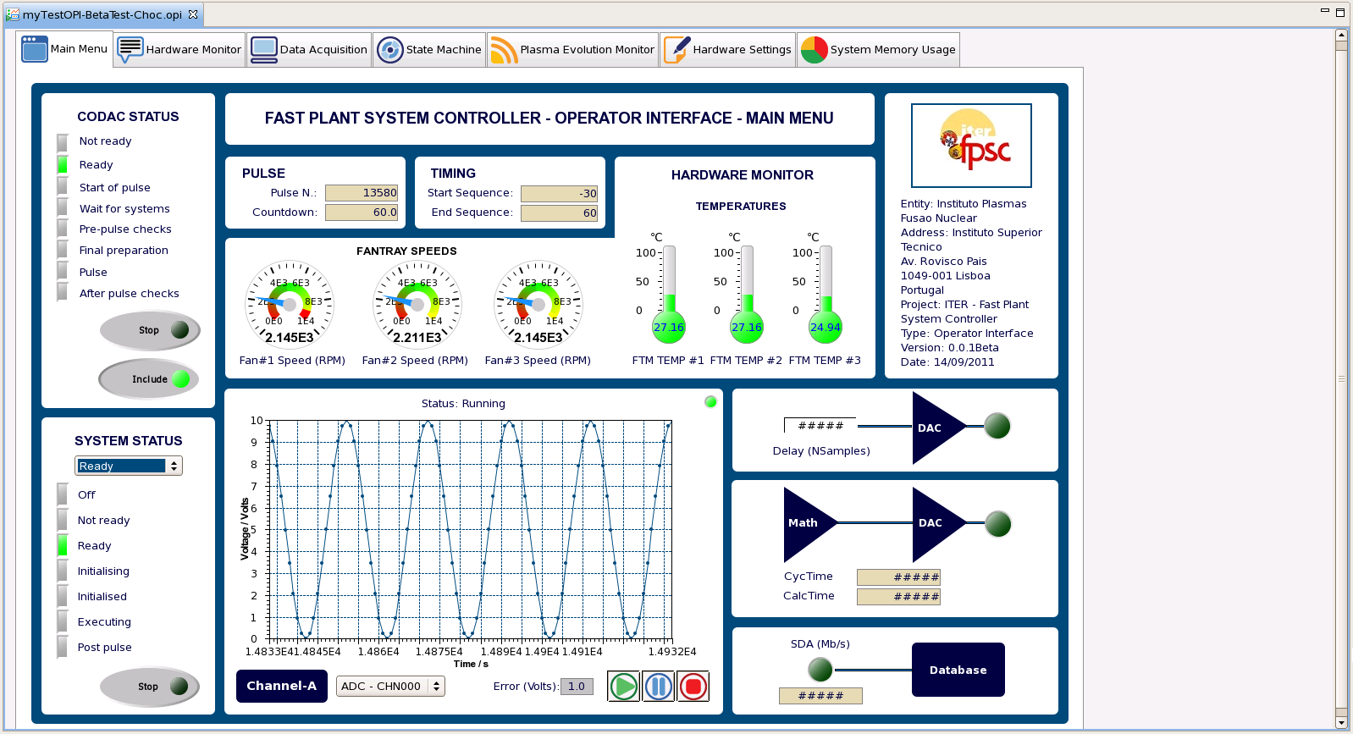
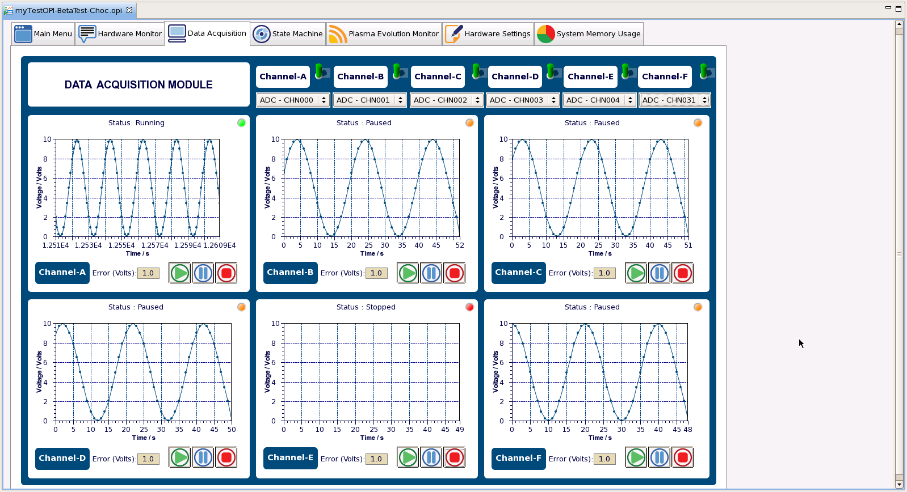
EPICS interface @ Mini-CODAC
Hardware Monitoring & Settings
System State Machines
High Performance Networks Monitoring
Control & Data Acquisition

Slide 23
Fault-tolerance benefits system’s availability
Fault-tolerance directly linked with redundancy capabilities
Fault-tolerance features automatically mitigate possible failures while still maintaining a stable and satisfactory performance
Redundant resources are managed by the system to establish the desired level of functionality, compensating for eventual failures

Slide 24
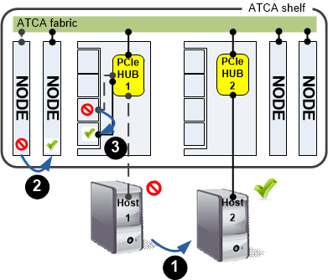
Redundancy schemes for High Availability
Several redundancy schemes can be implemented, supported by ATCA/IPMC
Data assigned to spare units upon fault detection
Spare PCIe host stands in for faulty host (“active-standby” 1+1 redundancy)
N+1 redundancy of node boards
N+1 redundancy of AMC cards
1
2
3

Slide 25
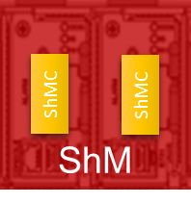
Full (2N) (1+1) Redundancy
System
manager
Dual-star topology
Redundant hosts
N active + N spares (Active-Standby mode)
In case of failure of hub/node blade the whole standby system takes over
The faulty blade is hot-swapped by a spare, while being repaired
Highest availability scenario
Does not require cable changes on Hot Swap (Full redundant cabling)
Host 1
(active)
Host 2
(standby)
IPMC
IPMC
IPMC
IPMC
IPMC
IPMC
IPMC
IPMC
IPMC
IPMC
IPMC
IPMC
IPMC
IPMC

Slide 26
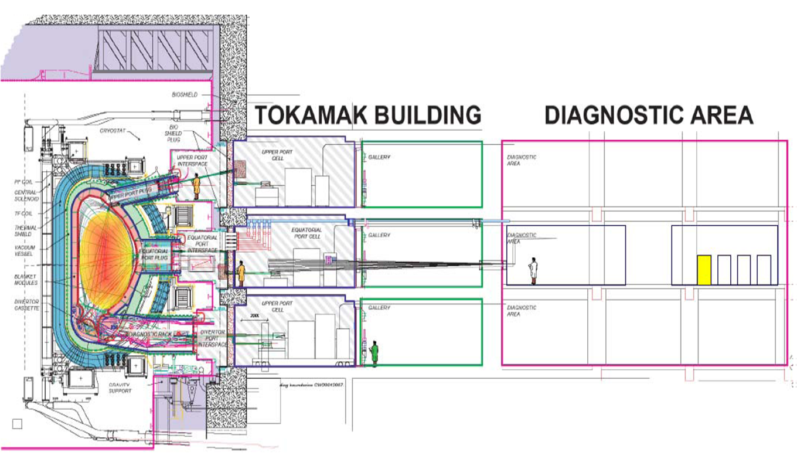
Instrumentation in ITER port cells subjected to high level of radiation (neutrons and γ-rays) and high magnetic field
.
Port Cell
10⁵ neutrons/cm²/s @ ~0.1 MeV
10² neutrons/cm²/s @ ~14 MeV
2 mGy/h from γ-rays
B = 20-50 mT
1 SEU / min. for fast controller boards
corrupt data or system hangs-up
Life time limit of 50 Gy γ-exposure for analog COTS
HV power supply failure due to SEB
Careful components selection necessary ~1 SEB / 10 hours for COTS PS@ 300 V
Bioshield
1-2 Gy/h from γ-rays

Slide 27
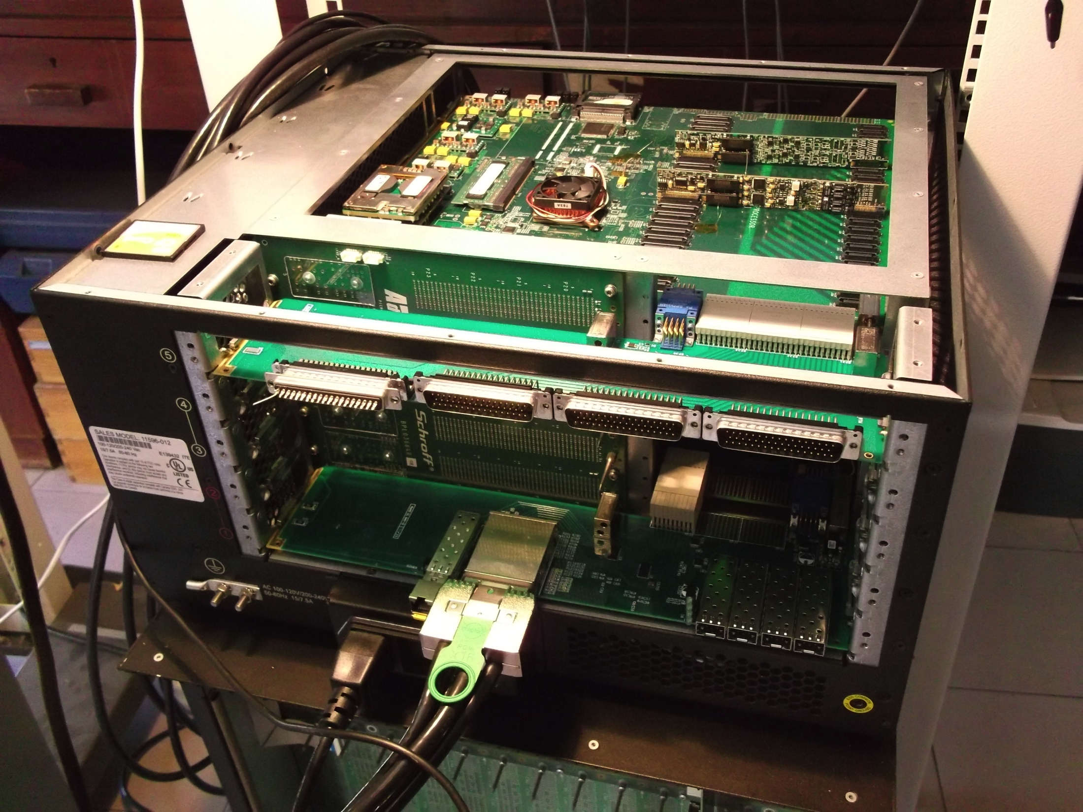
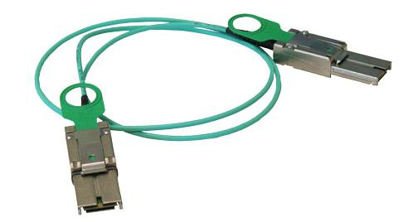
Secluding the controller from radiation areas
RTM with PCIe over Optical Fiber for ATCA PCIe Switch card
One Stop Systems fiber optic PCIe x4 connection kit (10 and 100 m length)

Slide 28
Secluding the controller from radiation areas
IPFN ATCA demonstration system with hardware and software level Hot Swap exhibited at ANIMMA 2015
100 meter fiber optics link to computer allows host to be located far from risk of hazardous radiation exposure
The platform can be configured for other redundancy schemes (N+M)

Slide 29
Advanced Methodologies for radiation-tolerant sYSTems
AMETHYST
Non radiation hardned COTS products, based on SRAM FPGAs
Minimize radiation immediate effects (SEU) and transient effects
Functional & performance monitoring through system life-cycle to diagnose long- term effects
Implement in high-availability ATCA systems
Perform functional testing on irradiation testing facility
n

Slide 30
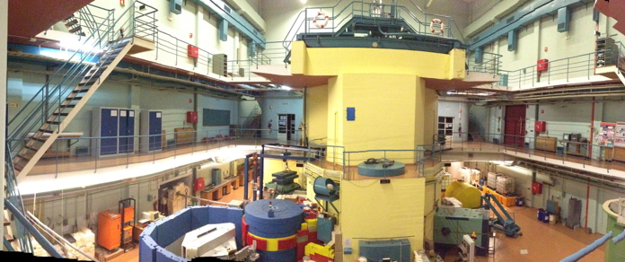
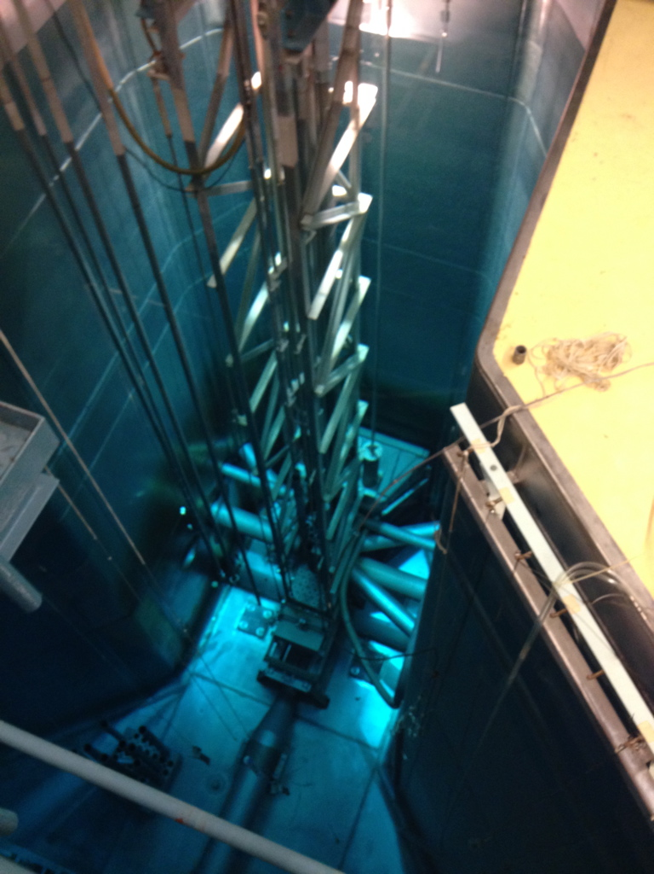
Irradiation Test Facility | RPI @ IST
Neutron fission spectrum
Maximum intensity @ 2 MeV
Maximum practical energy @ 17 MeV.
For a 1 MW operation
Total neutron flux 2.74 x 10⁸ n/cm²/s
decreases linearly with reactor operating power
The neutron fission spectrum at the irradiation facility E4 has a maximum intensity around 2 MeV and a maximum practical energy around 17 MeV. For a 1 MW operation the total neutron flux is 2.74ₓ10⁸ n/cm²/s and decreases linearly with the reactor operating power.
Fast neutron irradiation facility E4:
Irradiation chamber at the exit of the neutron beam tube;
Prolongation inside the tube;
Neutron and gamma filter;
Periphery of the fission reactor core inside the water cooling/shielding pool.

Slide 31
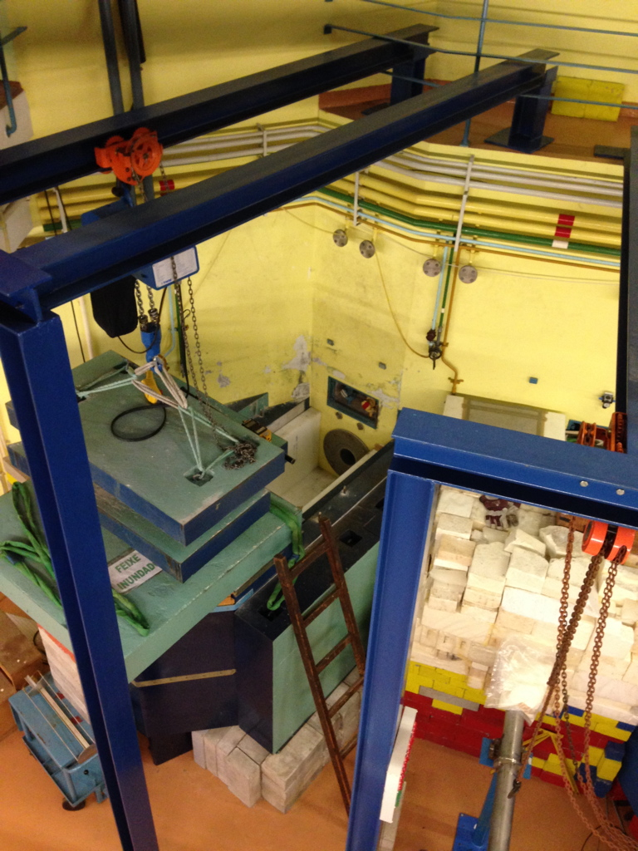
Irradiation Test Facility | RPI @ IST
The neutron fission spectrum at the irradiation facility E4 has a maximum intensity around 2 MeV and a maximum practical energy around 17 MeV. For a 1 MW operation the total neutron flux is 2.74ₓ10⁸ n/cm²/s and decreases linearly with the reactor operating power.
Fast neutron irradiation facility E4:
Irradiation chamber at the exit of the neutron beam tube;
Prolongation inside the tube;
Neutron and gamma filter;
Periphery of the fission reactor core inside the water cooling/shielding pool.

Slide 32
Virtex 6 irradiation results and conclusions
FPGA irradiation test with
SEM controller and BRAM sensor performing real-time SEU detection-correction, using Error Correction Code (ECC) for repairing SEU bit-flips in the Block RAM and configuration memories
FPGA clocks stopped performing only BRAM and configuration read-back afterwards
Detected SEU increase linearly with reactor power
SEU detected by the SEM controller are higher than SEU detected by BRAM sensors, since the configuration memory is larger relatively to BRAM
For irradiation fluxes higher than the fluxes for ITER port cells the number of unrecoverable errors was low
SEU detection and mitigation techniques can increase the reliability and availability of FPGAs used in ITER port cells
Notes:
O IP core da Xilinx, o SEM, monitoriza a memória de configuração, mas a reparação dos bit-flips nessa memória pode obrigar a reconfigurar a FPGA, portanto a expressão “tempo real” para a memória de configuração pode ser um pouco ambígua. O tempo de reprogramar a memória de configuração (ms) pode ser excessivo, relativamente ao tempo disponível para o controlador actuar correctamente. Os sensores de BRAM detectam muito mais rapidamente a ocorrência de SEU, e os BRAMs com ECC podem corrigir os valores lógicos incorrectos, daí a vantagem de monitorizar os blocos de memória associados à lógica que implementa a funcionalidade. Sobretudo quando se verificar uma rápida variação da intensidade de radiação do reactor (com a correspondente rápida variação de incidência de SEUs), a rapidez com que os sensores BRAM detectam essa variação pode ser uma vantagem decisiva na activação de mecanismos de aumento de robustez do controlador.

Slide 33
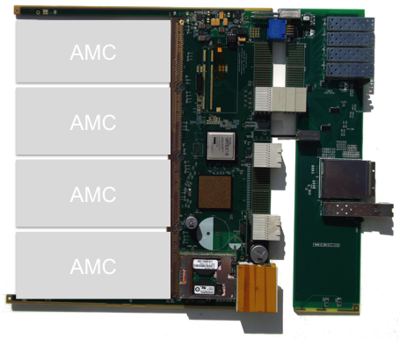


Roadmap for ATCA HA systems
PCIe over optical fiber | RTM
Timing | White Rabbit
Channel Density
ADC MIMO *
10 MSPS, 16 bit
6 MSPS
Magnetics Soft X-rays
Bolometry
ECRH monitoring
…
AMC* 100 MSPS+
X-rays | PHA
G-ray spectroscopy
Neutron spectroscopy
…
AMC* 1-3 GSPS
Plasma Position Reflectometry
Thomson Scattering
Low Level RF (ESS-B)
ITER Radial Neutron Camera
…
* Under development
Sampling rate

Slide 34


Fast digitizer | AMC and FMC cards
180.60 × 73.50 mm
AMC-MKX1, a single-width, full size AMC card
Processing capability: Xilinx® KintexTM 7 (XC7K325T);
AMC Storage capability: 2 GB of DDR3 SDRAM, 128 MB DDR3 ;
AMC PCIe protocol: 1 PCIe Endpoint (×4 PCIe 2.0) ;
Hardware Management: Module Management Controller (MMC);
Standards Compliance: Suitable for μATCA and ATCA platforms;
I/O expansion : High-pin-count VITA 57 (FPGA Mezzanine Card (FMC) site);
Applications: Demanding physic experiments with high-performance processing needs (eg. Nuclear Fusion);
FMC-AD-1Gx, full-size FMC digitizer module
Dual-channel ultra-high speed analog-to-digital converter up to
3.2 GSPS @ 12 bits; or
Single-channel sampling rate up to 1.6 GSPS @ 12 bits;
AC or DC coupling;
83 × 69 mm

Slide 35
High availability research programe | Key pillars
  MIMO system | high channel density
  High-availability for long operation | very reduced downtime
  Serviceability | Remote hardware management, hot-swap, modularity
  Integration into CODAC | HMI, alarm handlers, databases
  Timing and Event management
  Modularity / Expandability
  High performance & Computational power | Real-time complex algorithms
  Redundancy | sensor level, system level, software/firmware level
  Fault detection and mitigation
  Resilience to errors
  Resilience to neutrons | Single Event Upsets
  Resilience to magnetic fields
  COTS availability
ongoing
These activities are ITER-relevant (but also for other experiments), urgent & scientifically interesting
Notes:
(per channel/groups of channel)
On the next slides I’l present some of the thcnical solution solutions chosen in the engeneering phasee

Slide 36



IPFN ATCA dissemination
W7-X
JET
Implemented /ongoing
Discussion / Pending
ASDEX-Up
COMPASS
ESS-B
ISTTOK
CERN
xTCA interest Group
RFX
TCA-Br
ITER

