Slide 1
SEU Mitigation Techniques for SRAM based FPGAs
Ken Chapman
30th September 2015
TWEPP2015
Notes:
From an email received from Jorgen Christiansen (TWEPP2015 chair) on 19 May 2015…
Final confirmation of invited talk at TWEPP 2015
We contact you to make the final confirmation of the agreed invited talk at TWEPP2015 on “SEU Mitigation techniques in SRAM based FPGAs”.
We can propose that your invited talk of 40min + 5min for questions is scheduled Wednesday September 30 at 14:00.
The abstract that I submitted for this talk….
SEU Mitigation Techniques for SRAM based FPGAs
Since the Wright brothers first powered flight 112 years ago, aircraft have become incredibly capable machines with an amazing safety record. Unfortunately, there are still incidents and accidents, but don’t worry, the airlines provide you with a life jacket! Since Xilinx introduced their first device 30 years ago, FPGAs are up to 10,000 times larger and tens of millions of them are used throughout the world (including those flying in aircraft). How susceptible are FPGAs to SEU and what will you provide and do should the worst happen?
My objectives….
Soft error rates in Xilinx devices (i.e. FIT/Mb) has been reducing and is in the process of reducing even more significantly with the release of 20nm and 16nm products. As such my first objective is to ‘re-calibrate’ the audience and make them aware that the game is really changing. At the same time, to point out that ASIC technology is rarely implemented with SEU as a priority design rule so they are really starting to look worse (i.e. you probably do need to implement your own TMR scheme when implementing an ASIC because the technology itself won’t help you).
There will be a review of the built-in mitigation schemes available in Xilinx devices with the aim of helping people understand it they need to do anything themselves or not. This will be an opportunity to talk about interleaving of cells so that ECC can actually work when there are multiple bit upsets that are (relatively speaking) on the increase. Just saying you have used a memory with ECC don’t mean you are protected; Xilinx are looking after you and BRAM and CRAM are not standard ASIC library components.
When implementing mitigation schemes it is vital to consider what forms ‘failures’ actually take. However clever you think you are at guessing what might happen there’s nothing quite like experiencing it. Not only do you find out if you were right but you also get to see if your mitigation schemes actually work. Typically a mitigation scheme involves more than the FPGA and therefore you need to be certain that all parts of the system know what to do and that they actually do their job the correct way. We need to avoid making issues worse rather than better and that’s ever more possible with the fundamental FIT rates falling.
Finally, I will suggest a few user implemented mitigation schemes depending on what is important to the user. In particular I will consider the use of delay to qualify outputs and event logging to validate results.

Slide 2
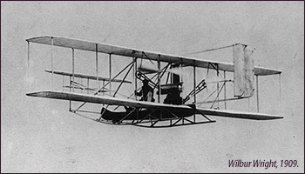

Some Aviation History
Wright Flyer Model A
1 × 35hp piston engine
DH.89 Dragon Rapide
Introduced 1934
2 × 200hp piston engine
Notes:
17th December 1903 - The heavier than air first powered flight by the Wright Brothers lasted fro 12 seconds and covered 121 feet.
By 1909 they had actually mastered flight as seen in this picture of a Wright Flyer.
25-years later and aircraft had really come along way.
The de Havilland DH.89 Dragon Rapide was from 1934 onwards a
British short-haul biplane airliner for 6 - 8 passengers.
2 × de Havilland Gipsy Six inline engines each of 200hp
Aircraft could now be considered capable enough, and maybe more significantly, reliable enough to regularly carry passengers.
But you probably wouldn’t want to fly in something like this today but of course that’s progress for you and we now have much better aircraft.
My point being that things move on and generally things get better with time and experience.
Flying shouldn’t be something to worry about today but that’s because others have cared when designing and producing ever better aircraft.

Slide 3
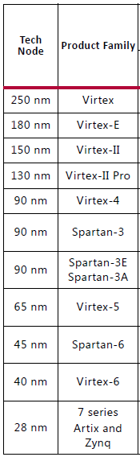
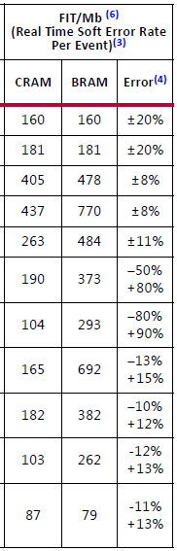


Some Xilinx SEU History
1998
Xilinx is the only FPGA vendor that openly publishes SEU and Soft Error Rate measurements (see UG116).
Observations and experiences of devices in the real atmosphere as well as during beam experiments have enabled Xilinx to understand the susceptibility of our devices.
Improvements are often ‘by design’.
We didn’t just get lucky!
Use known published data to make informed and relevant decisions about today’s devices.
2015
Notes:
Real figures for a particular technology are extremely valuable but so too is the history of information collected over many years.
If someone says they can’t use anything less than 90nm because SEU is worse then it just isn’t true when you look at the 7-Series figures.
We design our silicon to be resilient to SEU and that can make us many times better than other devices implemented in he same or larger geometries.
Help the numbers to talk to your customers. Most of all, just make sure they know this table is there to be looked at.
7-Series compared with Virtex-5
2× better configuration cells
9× better BRAM cells
At this time UltraScale is still very new and we have not observed an adequate number of real time soft errors to be statistically meaningful at this time.
So for now we have inserted guidance figures based on LANSCE neutron beam data.
Note that due to the lower susceptibility of UltraScale it will take longer (and/or more devices) to observe an adequate number of upsets so we couldn’t wait that long! ;-)

Slide 4
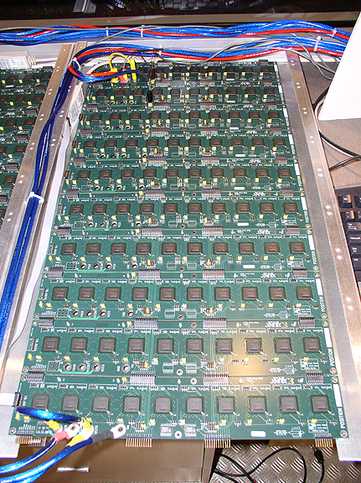
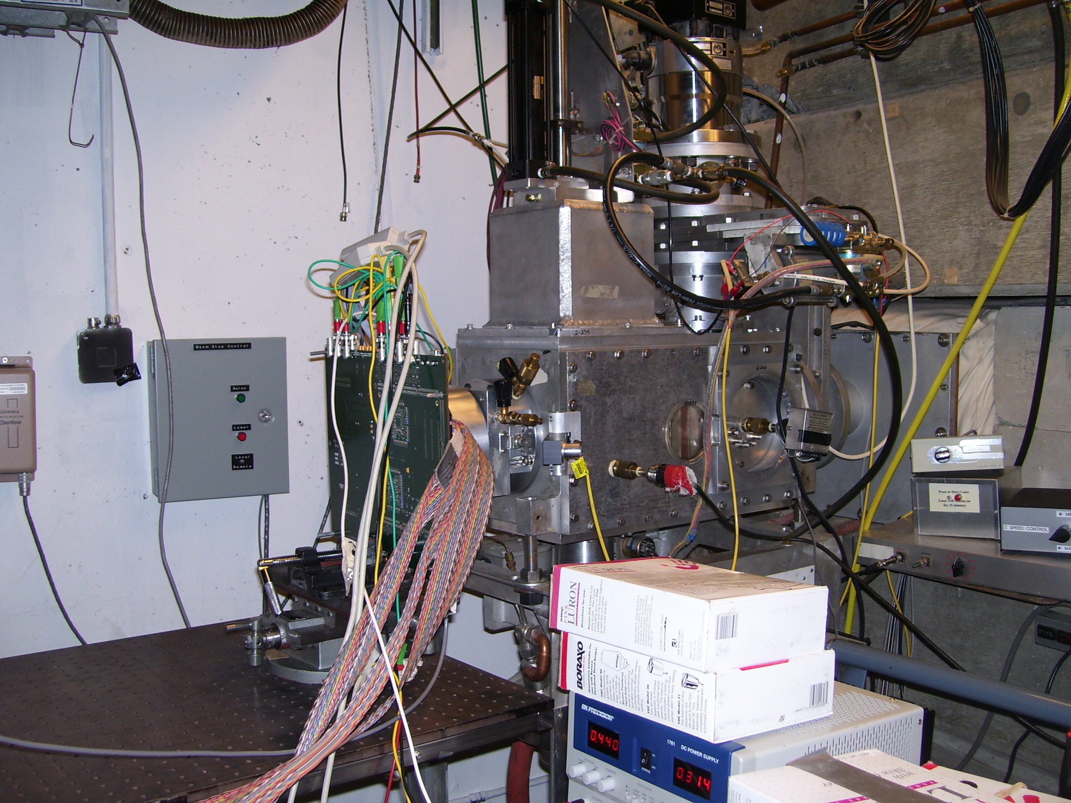
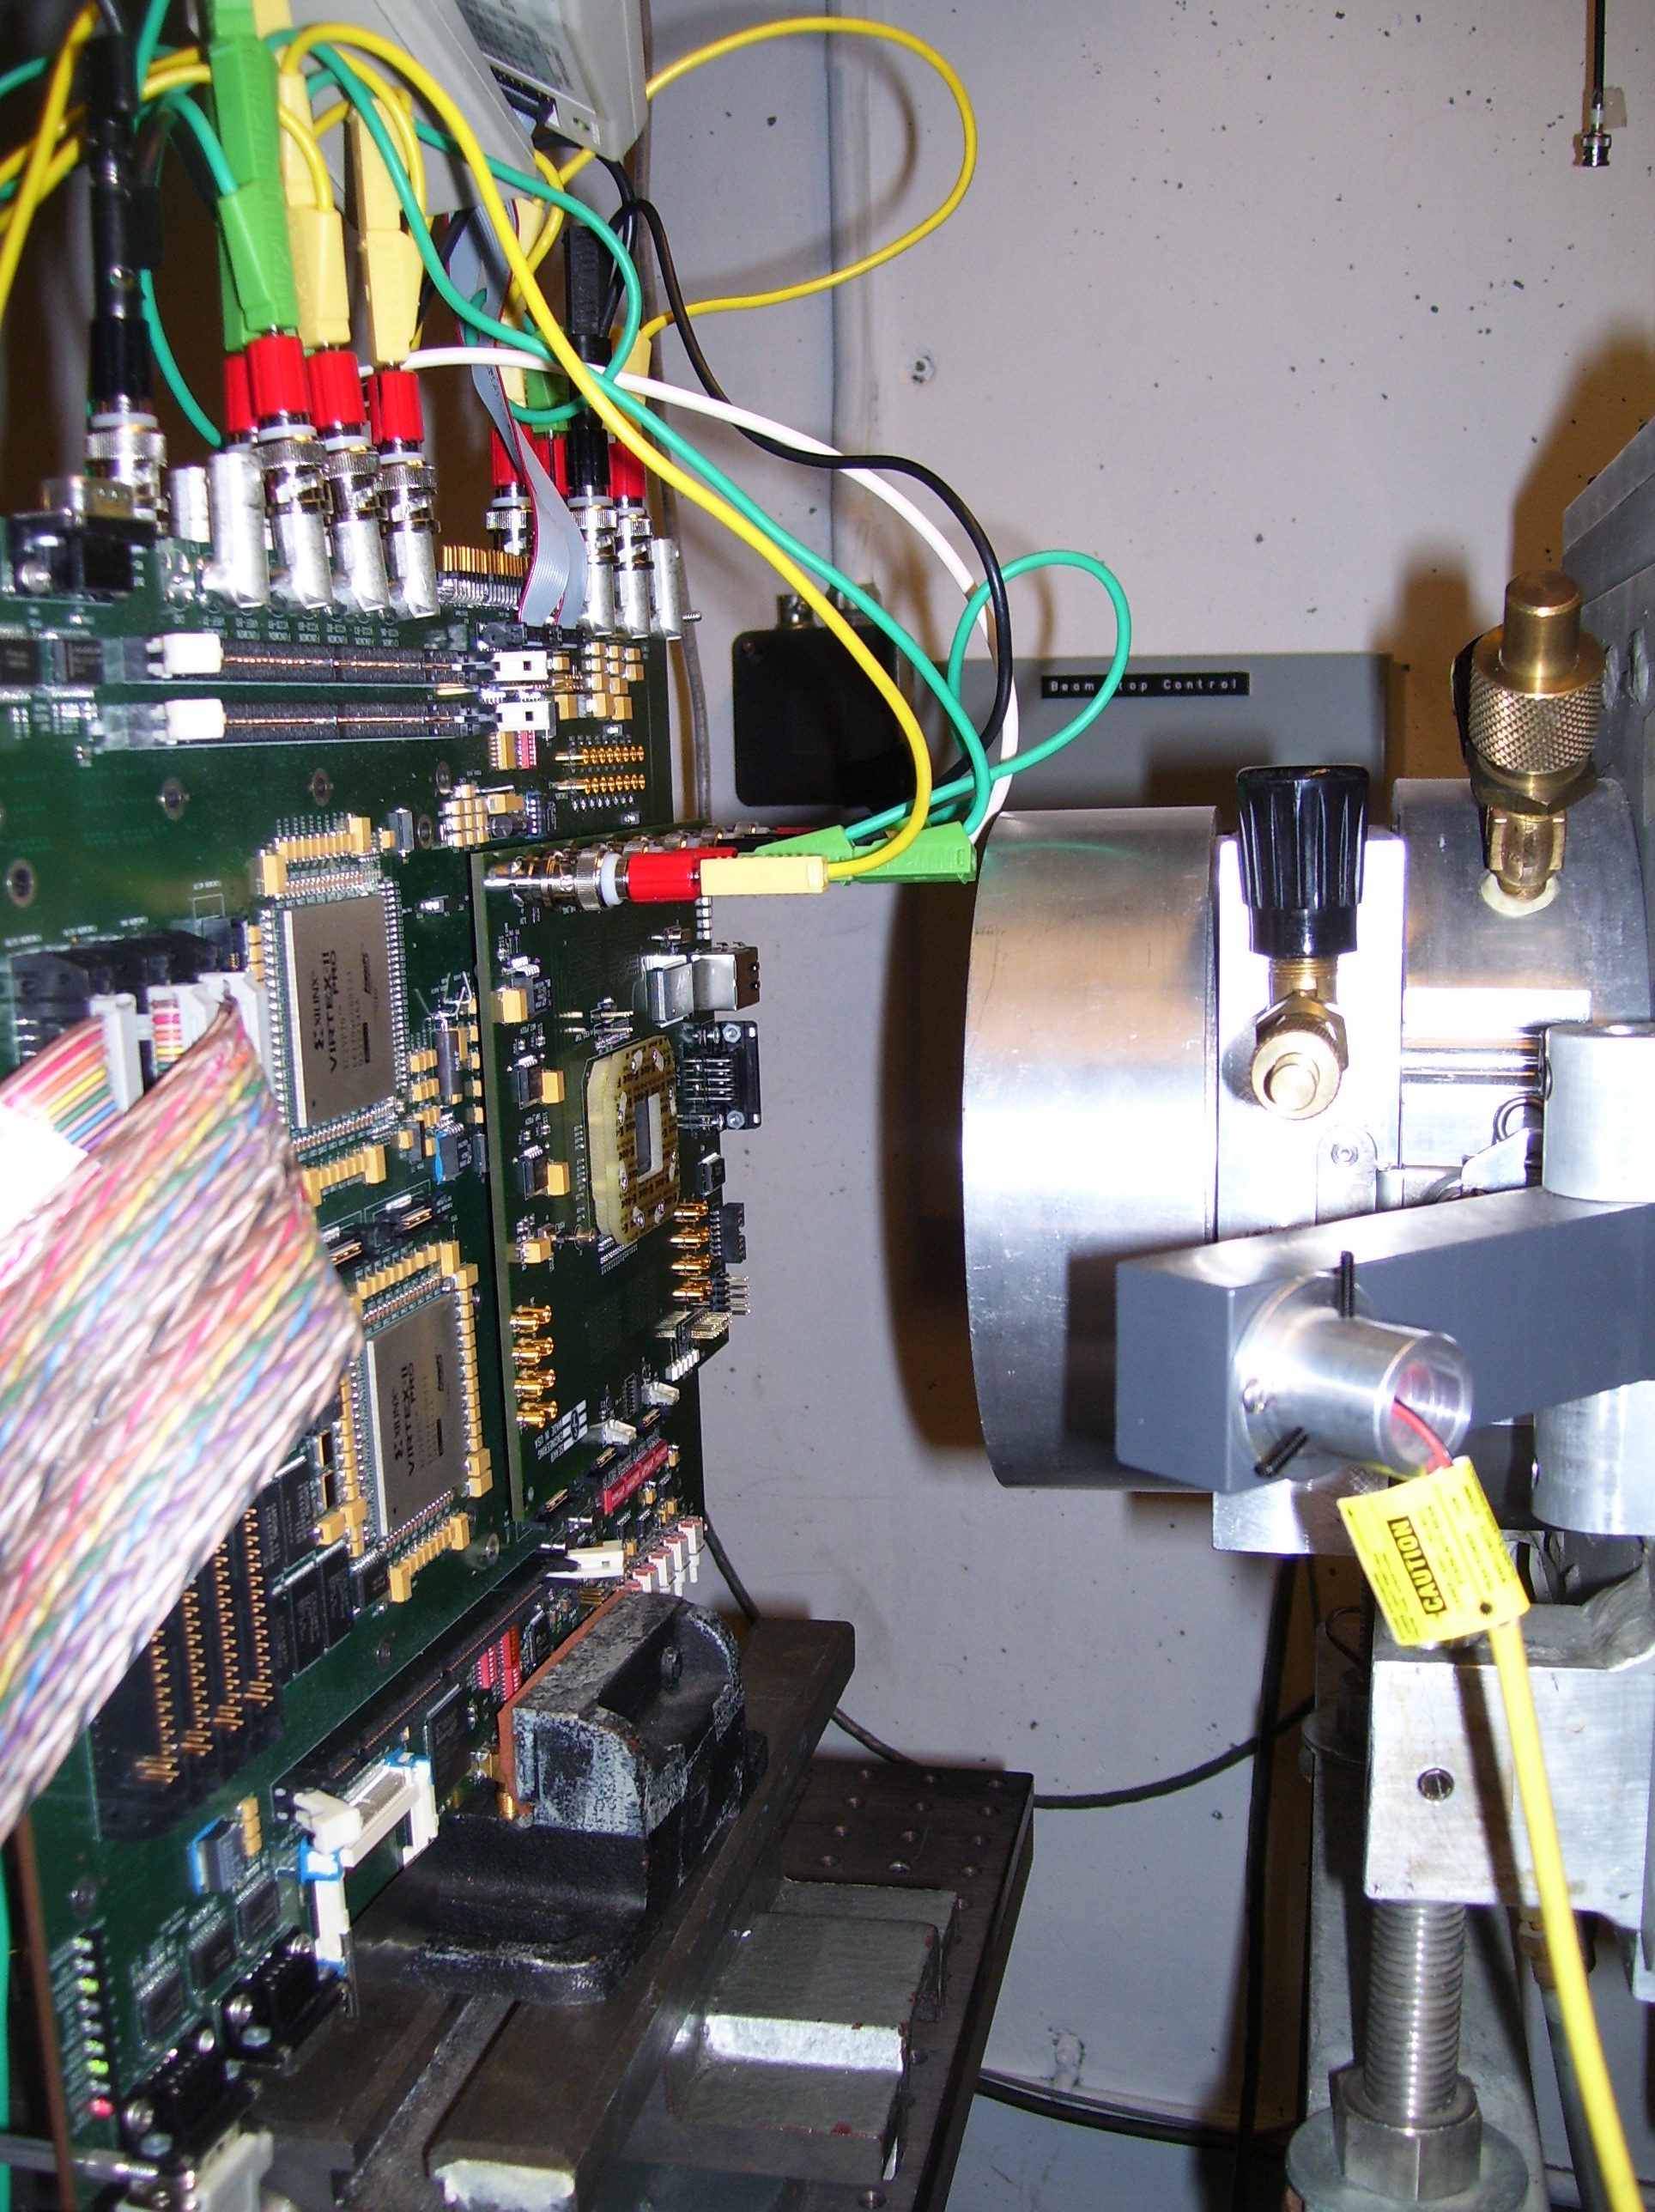
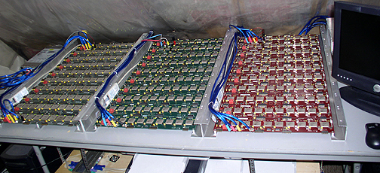
Over 17 Years of ‘Rosetta’ and Beam Testing
Notes:
Rosetta collects REAL upsets from various locations and altitudes and tells us what really happens to our devices in our atmosphere.
Please remember that this covers the vast majority of customer applications (i.e. not everyone is involved in particle physics with high energy particle accelerators).
The majority of accelerate beam testing and evaluation takes place at LANSCE (neutron) and UC Davis Crocker Laboratory (protons).
This gives us early indications of susceptibility which will be refined by the REAL data as it is collected over time.
Most of all, beam testing gives us the opportunity to test the detection and correction mitigation schemes as well as stress test the devices.

Slide 5








Xilinx SEU; Past, Present and Future
UG116
Soft Event Rates at sea level New York
Events per million bits per 10⁹ hours.
Configuration memory (CRAM) and
Block Memory (BRAM) in user design.
1998
2002
Things were definitely getting worse so this had to be addressed by design.
Xilinx FPGAs now have a lower susceptibility than they have ever had.
2012
(Now)
2015
(Now)
Source
Gate
Coming soon…
Advanced 16nm FinFET
5× reduction in sensitive area
Drain
Channel
STI
Tests indicate
Design Rules
40+ Patents & Trade Secrets
<5 FIT/Mb
STI
Substrate
FinFET Transistor
Notes:
Things were definitely not looking so good 10 to 15 years ago and some people remember that!
No way could we offer FPGAs today if the upset rates had continued to get worse.
Actually, because they are so much bigger today we would not offer the devices we do today if the upset rates had stayed the same.
7-Series today is 5 to 10 times less susceptible than Virtex-IIPRO was 15 years ago.
This improvement did not happen because of the smaller technology node; it required design rules and techniques to make it happen.
Some techniques are only applicable when creating an FPGA architecture and device so don’t assume that all ASICs benefit from 28nm and beyond.
20nm UltraScale is 3 times less susceptible than 7-Series.
16nm UltraScale+ is on target to be 30 times less susceptible than 7-Series.
FinFET technology will help reduce susceptibility of all devices that use it but it is a very advanced technology and that will limit who will be able to use and benefit from it.
It is very important to make decisions based on the facts and design accordingly. If you don’t do that you could waste time and could actually make things worse.

Slide 6


Which is Safer?
Piper Seneca PA-34
- 6 Seats
- 2 × 220hp Piston Engine
Piper Meridian M500
- 6 Seats
- 1 × 500hp Turboprop Engine
Notes:
On the face of it, these two aircraft offer very similar experiences for the same number of occupants but they clearly have a different number of engines.
Piper Seneca PA-34
- 6 Seats
- 2 × 220hp engine
Piper Meridian M500
- Turboprop Single
- 6 Seats
Pratt & Whitney Canada PT6A-42A Flat Rated Horsepower 500 SHP (shaft horsepower)
Are two engines really safer than one?
Turboprop (jet) engines are many times more reliable than piston engines.
(In many cases of so called ‘engine failure’ it has actually been one of the other systems that fails but more of that later).
When you have 2 engines there is twice the probability that at least one engine will fail.
- Ok, we accept that because ‘by design’ we then know that the twin engine aircraft can continue to fly.
- But as we will see later, a failure is not without further risks and statistically speaking more people have been killed
following a single engine failure on a twin than following an engine failure in a turboprop single engine aircraft.
The turboprop is less likely to fail than both of the piston engines.
So which would you rather be in?
Well that really depends on where and how the aircraft is operated. I might still favour the piston engine twin for a long flight over water.
The aviation authorities used to say that single engine aircraft could not be used over large built-up areas (i.e. cities) in case of engine failure.
Now they allow single engine turboprop aircraft to do so.

Slide 7
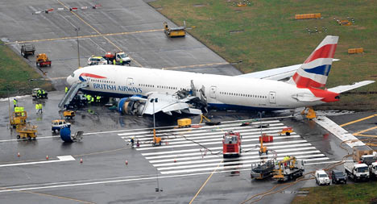

The Weakest Link!
17th January 2008
Boeing 777 with 2 Pratt & Whitney Engines
London Heathrow – Final approach to 27L
Why did both engines fail at the same time?
Notes:
British Airways Flight 38
Both engines stop producing power during the last minute of final approach into London Heathrow
Ice crystals formed in the fuel and blocked filters restricting fuel supply to engines
Determine EXACTLY what is the weakest link in the system and address that first.
The ENGINES did NOT fail; it was the fuel system that failed the work and both engines were starved of fuel.
Be very aware of…
Other factors that are more of a risk
Single points of failure
Common points of failure

Slide 8
Risk Assessment – Whole Device
Let’s take a look at the XC7K325T which is a mid-range Kintex-7 device
326,000 logic cells (i.e. not small!)
1Mb
0.5Mb of available user flip-flops
75.1Mb of static configuration
16.5Mb of available user RAM
Notes:
This slide represents the number of ‘bits’ that could be upset by an area so we can see the relative sizes of the potential risk.
XC7K325T
50,950 Slices = 203,800 LUT6 and 407,600 flip-flops
[ 203,800 LUT6 × 1.6 = = 326,080 Logic Cells! ]
There are more flip-flops in I/O, DSP blocks and BRAMs so let’s round that up to about 0.5 million bits.
445 BRAM(36kb) = 16,404,480 bits so we’ll call that 16.5 million bits and cover things like DRP ports.
75,144,416 static configuration cells. Configuration image is larger but these are the bits that should remain static following configurartion.
This is probably still too big but near enough for estimates and we’ll call it 75.1 million bits.

Slide 9
Risk Assessment – Resources Actually Used
Every design is different so obviously better to work with actual values.
But let’s accept some typical figures for now…
0.15Mb of
used flip-flops
30Mb of used or ‘Essential Bits’
12Mb of used RAM
1-7Mb of ‘Critical Bits’
Notes:
No design ever uses all of the available resources.
Flip-Flops: I’ve show 30% usage and that would probably be rather too high. Even so, we see this area becoming very small.
BRAM: Highly design dependant but it is a valuable resource for use as RAM, ROM and buffers (e.g. FIFOs).
Lets’ not forget that even when a BRAM is ‘used’, a design probably doesn’t use the full capacity.
Configuration: Here we have to introduce the meaning of ‘essential bits’ and ‘critical bits’.
Essential bits are the bits actually associated with the definition of a design and there will be a definitive number that can be reported.
It should be no surprise that since you don’t use every feature in a device that this number is typically in the 20-45% range (here I have shown 40%).
Critical bits are those which, when flipped do actually impact the operation of the design.
It is extremely unlikely that 10% of the total bits will fall into this category.
In practice, the percentage will be significantly lower, and more significantly, the nature of the disturbance needs to be considered critical to operation.
For example, many systems have to deal with other sources of ‘noise’ and failures so is it even possible to attribute a disturbance to an SEU?
The key point being that bits that do not influence the design operation are not a risk and this should be taken into account in your risk assessment.

Slide 10
Risk Assessment – Scaling for Susceptibility
Different cells have different susceptibly.
Let’s normalise for CRAM FIT Rate…
0.15Mb of
used flip-flops
30Mb of used or ‘Essential Bits’
12Mb of used RAM
1-7Mb of ‘Critical Bits’
Still little doubt that Configuration and BRAM cells are the area of concern
Notes:
7-Series
CRAM = 87 FIT/Mb
BRAM = 79 FIT/Mb (91%)
We don’t publish figures for flip-flop FIT rates because we don’t have enough data to give a decent confidence interval but it’s unlikely to be more than 5 FIT/Mb (6%)
[ When FIT rate is that low and there are relatively so few flip-flops it would really take a long time to collect enough data to be statistically meaningful ]
It becomes clear that configuration cells are still the biggest potential risk but actually it’s a close run thing with BRAM contents when it comes to what actually matters in a design.
Flip-flops are a really tiny issue when you use a Xilinx FPGA.

Slide 11
Risk Assessment – Comparing Different ‘Engines’
20nm UltraScale
20nm UltraScale
Base your design decisions of today on what is really happening today!
Notes:
We can see that Xilinx PPGA technology is making things better and the issues of configuration less significant.
7-Series
CRAM = 87 FIT/Mb
20nm UltraScale
CRAM = 29 FIT/Mb (33%)
BRAM = 50 FIT/Mb (57% relative to 7-Series CRAM)

Slide 12
Risk Assessment – Comparing Different ‘Engines’
16nm UltraScale+
20nm UltraScale
20nm UltraScale
Base your design decisions of today on what is really happening today!
Notes:
We can see that Xilinx PPGA technology is making things better and the issues of configuration less significant.
7-Series
CRAM = 87 FIT/Mb
160nm UltraScale+
CRAM = 5 FIT/Mb (6% relative to 7-Series CRAM)
Assume BRAM is similar for now

Slide 13
Risk Assessment – Comparing Different ‘Engines’
16nm UltraScale+
0.15Mb of flip-flops fabricated using a typical ASIC process
20nm UltraScale
20nm UltraScale
Base your design decisions of today on what is really happening today!
Notes:
Theoretically a good way to eliminate the configuration issue is to not have configuration at all.
But if you implement an ASIC you won’t know how susceptible it is until you have built it and then you don’t get to play with different mitigation schemes.
A typical ASIC will use standard libraries to implement things like memory and flip-flops and these will typically be driven by cost (area), yield and power consumption rather than SEU resilience.
In this slide I have illustrated that the relative susceptibility of flip-flops in an ASIC as being just over 200 times greater than the flip-flops in a 7-Series device.
The range could be anything from tens to a few thousand times so I’m not being too ridiculous on this slide.
Note how the area of the green box is about the same size of the ‘essential bits’ back in the 7-Series slide so when you compare an XC7K325T will an ASIC the OVERALL susceptibility is likely to be similar but the nature of upsets are going to be different because the elements being upset are different. This will lead to different mitigation schemes.
[Ok, you could look at a flash-based FPGA but it is unlikely to be on a process that provides all the other benefits of size, performance, power and low RAM & FF susceptibility]
7-Series
CRAM = 87 FIT/Mb
BRAM = 79 FIT/Mb (91%)
20nm UltraScale
CRAM = 29 FIT/Mb (33%)
BRAM = 50 FIT/Mb (57% relative to 7-Series CRAM)
160nm UltraScale+
CRAM = 5 FIT/Mb (33%)
We don’t publish figures for flip-flop FIT rates because we don’t have enough data to give a decent confidence interval but it’s unlikely to be more than 5 FIT/Mb (6%)
[ When FIT rate is that low and there are relatively so few flip-flops it would really take a long time to collect enough data to be statistically meaningful ]
It becomes clear that configuration cells are still the biggest potential risk but actually it’s a close run thing with BRAM contents when it comes to what actually matters in a design.
Flip-flops are a really tiny issue when you use a Xilinx FPGA.

Slide 14
What effects do upsets actually have?
Switch Matrix (i.e. routing)
LUT
Is the flip-flop used or bypassed?
I₃
I₂
O
I₁
I₀
D
Q
IIII
3210 O
IIII
3210 O
0000 0
0001 0
0010 0
0011 1
0100 0
0101 0
0110 0
0111 1
1000 0
1001 0
1010 0
1011 1
1100 0
1101 0
1110 0
1111 1
Each Look Up Table (LUT) is just a good old fashioned truth table
D
Q
Notes:
There is a generation (and maybe the start of another generation) of people that actually don’t know how and FPGA actually works.
So this is a really quick summary of a few fundamental ways in which configuration bits define what a circuit does.
First look at the LUT implementing a 2-input AND gate.
This LUT has 4 inputs so it is a truth table of 16 entries and that corresponds with 16 configuration cells.
[ These days a LUT has 6 inputs so a look up table has 64-bits ]
In this case only 2 inputs are used so only 4-bits of the truth table are used.
Key point – Even though this LUT is being used, 75% of the configuration cells are not being used and flips to these will have no effect.
The other 2 inputs are not being used and would default to a static state (i.e. effectively tied High or Low internally).
IF something should start driving one of those unused inputs then the otherwise unused cells would come into play but it doesn’t matter because the required truth table pattern is repeated.
In this architecture the output of the LUT is always connected to the flip-flop.
A multiplexer controlled by a configuration cell simply decides whether the output of the logic cell is taken from the LUT or the flip-flop.
So a change to this bit would change the circuit.
Finally, in the upper-left we see the representation of routing and switch matrix.
In this architecture, a configuration cell controls a switch that connects (or doesn’t connect) a vertical routing channel to a horizontal routing channel.
In this example only 2 switches are closed to decide which 2 vertical ‘wires’ connect to the 2 used inputs of the LUT.
Simple as this example is, it is actually quite representative of just how few ‘routing’ configuration bits are used (i.e. 2 out of 16 in this case).
As discussed above, should an SEU cause one of the 8 switches to close such that the I2 or I3 inputs are driven then this has no effect on the AND gate implementation.
Disconnecting a used switch would be seen as a break in the circuit.
Closing a second switch onto the same used horizontal line could result in local contention…
No worries; not enough current to cause any permanent damage.
Contention only occurs if the incorrect switch actually connects to a vertical that is being used.
Contention only occurs if the incorrect switch connects to a vertical that is being used and is of a different state.
Contention only occurs if the incorrect switch actually connects to a vertical that is being used.
Even if contention occurs then either a High (1) or Low(0) will win the battle and one of those will be the correct state for this circuit anyway.
Essential bits are the bits actually associated with the definition of a design and there will be a definitive number that can be reported.
Critical bits are those which, when flipped do actually impact the operation of the design.

Slide 15
What effects do upsets actually have?
Switch Matrix (i.e. routing)
LUT
Is the flip-flop used or bypassed?
I₃
I₂
O
I₁
I₀
D
Q
IIII
3210 O
IIII
3210 O
0000 0
0001 0
0010 0
0011 1
0100 0
0101 0
0110 0
0111 0
1000 0
1001 0
1010 0
1011 1
1100 0
1101 0
1110 0
1111 1
Each Look Up Table (LUT) is just a good old fashioned truth table
D
Q
Notes:
There is a generation (and maybe the start of another generation) of people that actually don’t know how and FPGA actually works.
So this is a really quick summary of a few fundamental ways in which configuration bits define what a circuit does.
First look at the LUT implementing a 2-input AND gate.
This LUT has 4 inputs so it is a truth table of 16 entries and that corresponds with 16 configuration cells.
[ These days a LUT has 6 inputs so a look up table has 64-bits ]
In this case only 2 inputs are used so only 4-bits of the truth table are used.
Key point – Even though this LUT is being used, 75% of the configuration cells are not being used and flips to these will have no effect.
The other 2 inputs are not being used and would default to a static state (i.e. effectively tied High or Low internally).
IF something should start driving one of those unused inputs then the otherwise unused cells would come into play but it doesn’t matter because the required truth table pattern is repeated.
In this architecture the output of the LUT is always connected to the flip-flop.
A multiplexer controlled by a configuration cell simply decides whether the output of the logic cell is taken from the LUT or the flip-flop.
So a change to this bit would change the circuit.
Finally, in the upper-left we see the representation of routing and switch matrix.
In this architecture, a configuration cell controls a switch that connects (or doesn’t connect) a vertical routing channel to a horizontal routing channel.
In this example only 2 switches are closed to decide which 2 vertical ‘wires’ connect to the 2 used inputs of the LUT.
Simple as this example is, it is actually quite representative of just how few ‘routing’ configuration bits are used (i.e. 2 out of 16 in this case).
As discussed above, should an SEU cause one of the 8 switches to close such that the I2 or I3 inputs are driven then this has no effect on the AND gate implementation.
Disconnecting a used switch would be seen as a break in the circuit.
Closing a second switch onto the same used horizontal line could result in local contention…
No worries; not enough current to cause any permanent damage.
Contention only occurs if the incorrect switch actually connects to a vertical that is being used.
Contention only occurs if the incorrect switch connects to a vertical that is being used and is of a different state.
Contention only occurs if the incorrect switch actually connects to a vertical that is being used.
Even if contention occurs then either a High (1) or Low(0) will win the battle and one of those will be the correct state for this circuit anyway.
Essential bits are the bits actually associated with the definition of a design and there will be a definitive number that can be reported.
Critical bits are those which, when flipped do actually impact the operation of the design.

Slide 16
What effects do upsets actually have?
Switch Matrix (i.e. routing)
LUT
Is the flip-flop used or bypassed?
I₃
I₂
O
I₁
I₀
D
Q
IIII
3210 O
IIII
3210 O
0000 0
0001 0
0010 0
0011 1
0100 0
0101 0
0110 0
0111 1
1000 0
1001 0
1010 0
1011 1
1100 0
1101 0
1110 0
1111 1
Each Look Up Table (LUT) is just a good old fashioned truth table
D
Q
Notes:
There is a generation (and maybe the start of another generation) of people that actually don’t know how and FPGA actually works.
So this is a really quick summary of a few fundamental ways in which configuration bits define what a circuit does.
First look at the LUT implementing a 2-input AND gate.
This LUT has 4 inputs so it is a truth table of 16 entries and that corresponds with 16 configuration cells.
[ These days a LUT has 6 inputs so a look up table has 64-bits ]
In this case only 2 inputs are used so only 4-bits of the truth table are used.
Key point – Even though this LUT is being used, 75% of the configuration cells are not being used and flips to these will have no effect.
The other 2 inputs are not being used and would default to a static state (i.e. effectively tied High or Low internally).
IF something should start driving one of those unused inputs then the otherwise unused cells would come into play but it doesn’t matter because the required truth table pattern is repeated.
In this architecture the output of the LUT is always connected to the flip-flop.
A multiplexer controlled by a configuration cell simply decides whether the output of the logic cell is taken from the LUT or the flip-flop.
So a change to this bit would change the circuit.
Finally, in the upper-left we see the representation of routing and switch matrix.
In this architecture, a configuration cell controls a switch that connects (or doesn’t connect) a vertical routing channel to a horizontal routing channel.
In this example only 2 switches are closed to decide which 2 vertical ‘wires’ connect to the 2 used inputs of the LUT.
Simple as this example is, it is actually quite representative of just how few ‘routing’ configuration bits are used (i.e. 2 out of 16 in this case).
As discussed above, should an SEU cause one of the 8 switches to close such that the I2 or I3 inputs are driven then this has no effect on the AND gate implementation.
Disconnecting a used switch would be seen as a break in the circuit.
Closing a second switch onto the same used horizontal line could result in local contention…
No worries; not enough current to cause any permanent damage.
Contention only occurs if the incorrect switch actually connects to a vertical that is being used.
Contention only occurs if the incorrect switch connects to a vertical that is being used and is of a different state.
Contention only occurs if the incorrect switch actually connects to a vertical that is being used.
Even if contention occurs then either a High (1) or Low(0) will win the battle and one of those will be the correct state for this circuit anyway.
Essential bits are the bits actually associated with the definition of a design and there will be a definitive number that can be reported.
Critical bits are those which, when flipped do actually impact the operation of the design.

Slide 17
What effects do upsets actually have?
Switch Matrix (i.e. routing)
LUT
Is the flip-flop used or bypassed?
I₃
I₂
O
I₁
I₀
D
Q
IIII
3210 O
IIII
3210 O
0000 0
0001 0
0010 0
0011 1
0100 0
0101 0
0110 0
0111 1
1000 0
1001 0
1010 0
1011 1
1100 0
1101 0
1110 0
1111 1
Each Look Up Table (LUT) is just a good old fashioned truth table
D
Q
Notes:
There is a generation (and maybe the start of another generation) of people that actually don’t know how and FPGA actually works.
So this is a really quick summary of a few fundamental ways in which configuration bits define what a circuit does.
First look at the LUT implementing a 2-input AND gate.
This LUT has 4 inputs so it is a truth table of 16 entries and that corresponds with 16 configuration cells.
[ These days a LUT has 6 inputs so a look up table has 64-bits ]
In this case only 2 inputs are used so only 4-bits of the truth table are used.
Key point – Even though this LUT is being used, 75% of the configuration cells are not being used and flips to these will have no effect.
The other 2 inputs are not being used and would default to a static state (i.e. effectively tied High or Low internally).
IF something should start driving one of those unused inputs then the otherwise unused cells would come into play but it doesn’t matter because the required truth table pattern is repeated.
In this architecture the output of the LUT is always connected to the flip-flop.
A multiplexer controlled by a configuration cell simply decides whether the output of the logic cell is taken from the LUT or the flip-flop.
So a change to this bit would change the circuit.
Finally, in the upper-left we see the representation of routing and switch matrix.
In this architecture, a configuration cell controls a switch that connects (or doesn’t connect) a vertical routing channel to a horizontal routing channel.
In this example only 2 switches are closed to decide which 2 vertical ‘wires’ connect to the 2 used inputs of the LUT.
Simple as this example is, it is actually quite representative of just how few ‘routing’ configuration bits are used (i.e. 2 out of 16 in this case).
As discussed above, should an SEU cause one of the 8 switches to close such that the I2 or I3 inputs are driven then this has no effect on the AND gate implementation.
Disconnecting a used switch would be seen as a break in the circuit.
Closing a second switch onto the same used horizontal line could result in local contention…
No worries; not enough current to cause any permanent damage.
Contention only occurs if the incorrect switch actually connects to a vertical that is being used.
Contention only occurs if the incorrect switch connects to a vertical that is being used and is of a different state.
Contention only occurs if the incorrect switch actually connects to a vertical that is being used.
Even if contention occurs then either a High (1) or Low(0) will win the battle and one of those will be the correct state for this circuit anyway.
Essential bits are the bits actually associated with the definition of a design and there will be a definitive number that can be reported.
Critical bits are those which, when flipped do actually impact the operation of the design.

Slide 18
What Happens to ‘X’.....
Enable
D
Q
A
D
Q
I₂
LUT
B
I₁
D
Q
CE
O
X
I₀
D
Q
C
R
D
Q
Reset
Notes:
Animated example
Time for a bit of audience participation ☺

Slide 19
What Happens to ‘X’.....
Enable
D
Q
A
D
Q
What defines the value of ‘X’?
I₂
LUT
B
I₁
D
Q
CE
O
X
I₀
D
Q
C
R
D
Q
Reset
Notes:
In this case we assume that an SEU has flipped one of the configuration cells associated with a routing matrix and has disconnected one of the signals forming part of the design.
We know that this is one of the ‘Essential Bits’ but does that make it critical?
How will this break impact the value of ‘X’?
Ask the question; what defines the value of ‘X’?
What conditions need to be in place for ‘A’ to play a part in defining the value of ‘X’?

Slide 20
What Happens to ‘X’.....
Enable
D
Q
Can only matter if
Enable = ‘1’
A
D
Q
I₂
LUT
B
I₁
D
Q
CE
O
X
I₀
D
Q
C
R
D
Q
Can only matter if B = ‘0’ and C = ‘1’
Can only matter if
Reset = ‘0’
Reset
Notes:
Here we review all the conditions that need to be in place before the ‘A’ signal is even important.
But there is one more thing that counts…. What must ‘A’ do?

Slide 21
What Happens to ‘X’.....
Enable
D
Q
Can only matter if
Enable = ‘1’
Can only matter if
A changes state
A
D
Q
I₂
LUT
B
I₁
D
Q
CE
O
X
I₀
D
Q
C
R
D
Q
Can only matter if B = ‘0’ and C = ‘1’
Can only matter if
Reset = ‘0’
Reset
Notes:
The un-driven ‘wire’ into ‘I2’ will want to float High (1) but it will take about 1 second to do that.
If ‘A’ is High (1) already then nothing changes and ‘X’ will still be good.
If ‘A’ is Low (0) and all the other conditions are met then ‘X’ will go wrong after about 1 second.
Only if ‘A’ is changing state and all the other conditions are met will ‘X’ will go wrong sooner.

Slide 22
What Happens to ‘X’.....
Enable
D
Q
Is anything actually using ‘X’ at this time?
A
D
Q
I₂
LUT
B
I₁
D
Q
CE
O
X
I₀
D
Q
C
R
D
Q
Reset
Notes:
Finally, all this only matters if ‘X’ is observed to be wrong.
It is quite common for complete circuits to only be used some of the time. Some may only be used during initialisation.
An aircraft instrument landing system does not need to work at 40,000 feet ☺

Slide 23



Detecting and Correcting Errors Quickly
7-Series and UltraScale devices have dedicated error detection and correction circuits.
- Primarily for SEU but acts as an ongoing comprehensive BIST during device lifetime.
Automatic scan of all static configuration cells
(continuously happening in the background)
Device-level
CRC Detection
(verifies corrections)
ECCERROR=1
4.6ms to 70.7ms depending size of device
INIT_B=1
CRCERROR=0
Frame-level ECC detection and correction
3,232 bits in each 7-Series Frame
Including 13-bit ECC (0.4% of bits!)
Notes:
Error detection and correction is there because we care about SEU. However, having all the configuration cells checked multiple times every second also means that defects caused by any other means will be detected (and may or may not be corrected). In higher radiation environments then Total Ionising Dose (TID) could become a factor and accelerated aging of the device just might be detected by this mechanism.
If an error can be fixed BEFORE the right combination of conditions exist to propagate erroneous states then no defective behaviour will occur.
Rather like if I borrow a stapler from your desk whilst you are not there and return it before you get back then you will be none the wiser (unless you count staples!).
The built-in Readback CRC mechanism detects errors and the built-in error correction based on ‘frame-ECC’ and can correct most errors.
Even when errors do propagate then the fix will generally lead to full recovery without taking any further action (i.e. new data washes away anything ugly!).
Aircraft don’t fly very well when their wings are covered in ice but as long as it melts (naturally or using a de-icing system) the plane will once again fly quite normally.
Describe the built-in mechanisms we have provided.
Dedicated silicon circuits mean that this is very reliable and you don’t actually need to do anything yourself (unlike in the past).
The ‘Readback CRC’ mechanism consists of two parts; the thing that scans the whole device and the thing that computes and checks the CRC value.
Only if the scan reaches the end of the device with an error present in the configuration will there be a CRC error indicating that the error could not be repaired.
CRC detects up to 31 bits of error with 100% certainty.
The ‘Frame ECC’ mechanism rides piggy-back to the scanning mechanism and checks each frame looking for an error in each 3,232 bits.
If an error is detected then then it will use the computed Syndrome and partial reconfiguration to read-modify-write the frame and correct the error.
Since the scan restarts following each correction there will be no device level CRC errors providing ECC is successful.
The ECC bits represent 0.4% of all configuration cells – Any error in the ECC bits will be detected and corrected but definitely won’t impact operation of the design.
NOTE – Errors will be detected and corrected wherever that are.
No accumulation of errors.
Unlike a processor that only finds out there is a problem when it reads an instruction, Xilinx FPGAs give it every chance of being in good shape when needed.

Slide 24
When ECC is not enough!
Upset rates are decreasing but the proportion of Multiple Bit Upsets are increasing.
Single Bit Error (SBE)
Double Bit Error
(DBE)
Same Frame Double Bit Error (DBE)
= 2 × SBE
Notes:
Historically speaking, multiple bit upsets were rare but the migration to ever smaller geometries has seen an increase in the RELATIVE number of multiple bit upsets (MBU).
Here we are focussing on Xilinx FPGA devices and mitigation techniques but the audience should be mindful of ‘alternative engines’.
Just because someone says that have ECC doesn’t mean that you have good error detection and correction.
ECC can detect 1 and 2 bit errors; with larger numbers of erroneous bits the syndrome will ‘alias’ and can look like single bit errors or no errors at all.
ECC can only correct a single bit error in the data that it covers (including the ECC code itself).
Animation…
First we see a column of configuration cells and clearly only one cell has been changed (shown in red). ECC can both detect this and tell us which bit needs to be corrected so all good there then! SBE are also the most common type and the built-in mechanism can handle these (i.e. you wouldn’t have to use the SEM IP if you really didn’t want to).
Next we reveal what is clearly a 2-bit (or double bit) error which is the next most likely to occur. ECC can detect a 2-bit error but it is unable to tell us the location for correction purposes. So next we reveal that Xilinx have physically interleaved the memory cells so that adjacent cells are actually mapped to different frames. This converts a double bit error into a pair of single bit errors both of which can be detected and corrected even by the built-in mechanism.
Finally we show what a true double bit error looks like. These are the most rare but they do occur. They are rare because of the increased physical separation of cells belonging to the same frame.
Note that the DBE could in fact be a 3-bit or 4-bit upset with the interleaved frame containing an SBE or a DBE but again all of that would be repaired.
7-Series - ECC can not deal with this but the SEM IP can be implemented with ‘enhanced repair’ to cover this case using an alternative algorithm.
UltraScale – This device has 2-way physical interleaving and 4-way virtual interleaving (every 4th bit of a frame contributing to one of four separate ECC in the same physical frame).
Equivalent to 8-way interleaving with an error detection and correction rate of 99.9%.
SEM IP won’t even attempt to do anything more that the device can do (it might even lower reliability if it did!).

Slide 25
When ECC is not enough!
UltraScale has 2-way physical and 4-way virtual interleaving.
8 Bit Error
(MBE)
= 8 × SBE
Same ‘ECC Frame’ Double Bit Error (DBE)
Highly unlikely
upset!
Notes:
UltraScale – This device has 2-way physical interleaving and 4-way virtual interleaving (every 4th bit of a frame contributing to one of four separate ECC in the same physical frame).
Equivalent to 8-way interleaving with an error detection and correction rate of 99.9%.
SEM IP won’t even attempt to do anything more that the device can do (it might even lower reliability if it did!).

Slide 26

Aviate, Navigate, Communicate
17th January 2008
Boeing 777 with 2 Pratt & Whitney Engines
London Heathrow – Final approach to 27L
Captain Peter Burkill & Senior first officer John Coward did an outstanding job in giving the highest priority to ‘Aviate’.
Unfortunately, rather more accidents are the result of ‘pilot error’.
Notes:
Back to the Heathrow incident…
‘Aviate, Navigate, Communicate’ is a common approach to all flying situations but especially useful during emergency conditions. Aviation studies have found that pilots get so focused on solving a problem in an emergency that they sometimes forget to fly the airplane.
17 January 2008
Boeing 777
2 Pratt & Whitney engines
British Airways Flight 38
Thanks to the best possible actions of Captain Peter Burkill (left) and Senior first officer John Coward everyone survived the extremely heavy landing.
TRAINING for emergencies would really have helped these gentlemen to do an outstanding job.

Slide 27


Training and Simulation
Enables pilots to experience situations and learn how to deal with them in the best ways.
Boeing 777 Simulator
Also an opportunity to refine emergency procedures based on observations of ‘Human Factors and Performance’.
Notes:
You can tell pilots what to do in an emergency but it’s far better to show them and let them experience emergencies under controlled conditions.
EVERYONE learns from these sessions.
- Pilots learn what it feels like.
- Pilots learn what actions to take.
- Operators can see if a pilot is good enough.
- Operators can see if it is possible for pilots to cope.
- Operators can refine procedures to make it easier for pilots to cope.
- Designers and manufactures can learn how to present the high priority information to pilots and not distract them.
- Designers and manufactures can decide what the plane should do instead of the pilots (scary!).
We can simulate SEU to see how an FPGA design AND the system reacts.
It is one thing to have an idea about what is a good thing to do when and error occurs but it can be extremely useful to see what actually happens.

Slide 28
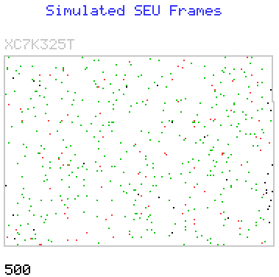
Observe What Happens & What Actions Are Needed
Aircraft have become extremely reliable so are the pilots now the weakest link?
Must not overload and distract pilots but also need to keep them engaged.
UltraScale+ will be ~50× less susceptible to SEU than Virtex-5 – That’s a big change.
Do not implement mitigation schemes that make things less reliable!
Soft Error Mitigation (SEM) exploits partial reconfiguration to facilitate controlled simulation of SEUs (not everyone has a particle accelerator you know ☺).
500 simulated SEU in XC7325T.
Red dots = Disturbance observed
(‘Critical Bits’).
Experiments = Knowledge (not guessing)
Do you need mitigation?
Where do you need mitigation?
What type of mitigation is suitable?
Will mitigation be more disruptive
than doing nothing?
Notes:
With such a dramatic reduction in upsets rates and improvements in automatic detection and correction of upsets when they do occur then we really need to take a step back and consider if it is appropriate to apply further mitigation techniques.
There are a set of questions to ask but how can you answer them unless you know your design, your application AND how it actually behaves when upsets occur?
The answer is that you run experiments using error injection facilitated by the SEM IP.
This image is a simple graphical view of an XC7K325T device illustrating where 500 simulated SEU have been injected.
The colours represent what was observed to happen as a result of each injection.
This was a super sensitive design deliberately made to test SEM IP and our devices.
Unlike most reals designs, it also detected and ‘latched’ every disturbance so that it wasn’t missed.
i.e. Every disturbance was considered to be ‘catastrophic’ and ‘unacceptable’ which again would rarely be the case in a real design.
Black = Memory map has ‘holes’; these cells don’t even exist so they could never be flipped by a real SEU either.
Green = Error injected and corrected but nothing was observed.
– Some of these will be ‘essential bits’ but no effect observed as a result of the error being present for ~20ms.

Slide 29
Yes, But Two Engines Are Still Better Than One
Ok, let’s put you in the pilot’s seat of the Piper Seneca PA-34…
Notes:
Audience participation…

Slide 30
Yes, But Two Engines Are Still Better Than One
Q. When is it most likely that that one of your engines will quit?
Notes:
Audience participation…

Slide 31
Yes, But Two Engines Are Still Better Than One
Q. When is it most likely that that one of your engines will quit?
A. Just after take off when low, slow and climbing.
Notes:
The engine is most likely to fail at the point of most stress (high power setting).
The issue is that this is also the most unhelpful time!

Slide 32
Yes, But Two Engines Are Still Better Than One
Q. Now what do you need to do?
Notes:
Tempting to think that with 2 engines you don’t have to do anything because the other engine is there to see you through it.
But no…

Slide 33
Yes, But Two Engines Are Still Better Than One
A. Stay calm and apply everything you learnt during your training!
Drag
Weight
Thrust
Notes:
Lost HALF of your power.
Failed engine is now dead weight to carry AND the propeller becomes drag.

Slide 34
Yes, But Two Engines Are Still Better Than One
A. Stay calm and apply everything you learnt during your training!
Notes:
Lost HALF of your power.
Failed engine is now dead weight to carry AND the propeller becomes drag.

Slide 35
Yes, But Two Engines Are Still Better Than One
QUICKLY…
1. Lots of right rudder to stop the aircraft yawing to the left.
2. Lower the nose to maintain airspeed with reduced power.
3. Feather the port propeller to reduce drag.
Notes:
Lost HALF of your power.
Failed engine is now dead weight to carry AND the propeller becomes drag.

Slide 36
Yes, But Two Engines Are Still Better Than One
If you don’t……
Drag
Lift
Lift
Weight
Thrust
Notes:
Lost HALF of your power.
Failed engine is now dead weight to carry AND the propeller becomes drag.

Slide 37
Two Engines Are NOT The Whole Answer!
…You yaw and roll to the left, stall and spiral into the ground!
With an otherwise perfectly good aeroplane and one working engine.
Notes:
Lost HALF of your power.
Failed engine is now dead weight to carry AND the propeller becomes drag.

Slide 38
Only One Engine
Now let’s put you in the pilot’s seat of the Piper Meridian M500…
Much lower probability of experiencing an engine failure.
Notes:
2 engines; lose control and even if you recover you haven’t been looking for somewhere to land.
Single engine failure does mean that you are going down but all you have to do is push the stick forward to maintain airspeed and look for somewhere to land.

Slide 39
Only One Engine
But….
Not ideal to know that we are going down but we KNOW that is what is happening and we have a simple plan of action…
Notes:
The bad news is that we are going down!
BUT that means we have a plan and we know that is the plan!

Slide 40
Only One Engine
Stable
1. Lower the nose to maintain airspeed for best glide range.
2. Look for somewhere suitable to land.
Notes:
Although the propeller will result in some drag a turboprop propeller will be free to windmill.
The key thing to notice is that the aircraft is fundamentally stable and all the pilot needs to do first is to maintain airspeed.

Slide 41
Only One Engine
Stable
With minimal effort needed to continue flying….
3. Feather propeller to reduce drag.
4. Use available time to see if there is anything you can do to restart the engine.
Notes:
You are not having to wrestle the controls to remain stable so much easier and quicker to focus on the next tasks

Slide 42
Upsets in ‘Data’ Flip-Flops
0.15Mb of
used flip-flops
Flip-flops in Xilinx FPGAs are the lowest risk but if their contents are really that critical then you must include mitigation in your design. But can your design truly improve the reliability without making things worse?
7-Series
Mitigation schemes typically employ one or combinations of the following…
- Parity bits and calculations for detection.
- ECC bits and calculations for detection and correction.
- Dual Modular Redundancy (DMR) detects errors but not location.
- Triple Modular Redundancy (TMR) detects and can isolate failing module.
Key Observations
- All schemes increase design size and therefore increase underlying upset rates.
- Watch out for single and common points of failure: where is the weakest link?
- Extreme care needed to avoid introducing ‘complexity related failures’ (emulate).
- In-circuit error detection and/or correction should reveal anything you really care
about so these schemes should, by default, cover all ‘critical bits’.
Notes:
So with all that about aircraft in mind we return to our FPGA and at all times we should consider if ‘simple’ outweighs ‘complicated’ when it comes to achieving a reliable solution even when failure (upsets) occur.
On the scale of risk the flip-flops are the lowest in a Xilinx FPGA so it really is highly questionable as to if you should attempt any form of mitigation for this.
In contrast, flip-flops could well be your main concern in an ASIC design and this has almost certainly been the main driver for the TMR schemes.
Schemes like DMR and TMR only improve reliability ‘by design’. Just like having 2 engines on an aircraft, the probability of any one module failing increased because there are more modules there to fail! TMR may well mean that you need a larger device and will therefore increase the upset rate for configuration as well.
As with the B777 crash at Heathrow, don’t just think that adding TMR means you won’t have failures. You must look out for common points of failure.
Isolation Design Flow is a way to create a design in which modules are physically isolated inside the device when placing and routing.
But watch out for the ‘weakest link’; there is little point making a super reliable FPGA design that will then be brought down by a bad power supply or board connector.
All of these mitigation schemes add complexity to the design so need to be very careful not to create new issues.
The ability to simulate/emulate SEU in the configuration is also a ‘back door’ way to create data errors and at least prove that mitigation schemes are working.

Slide 43
Upsets in ‘Data’ RAM
7-Series
Mainly driven by sheer quantity, the risk of data corruption in memory is significantly greater that that held in flip-flops.
BRAM has multiple applications…
Data and sample storage (RAM)
Data buffers (e.g. FIFO mode)
Program memory (ROM)
Coefficients and Tables (ROM)
State Machines (ROM)
16nm UltraScale+
12Mb of used RAM
If you care about BRAM contents then you must provide mitigation in your design.
In this case Xilinx have provided you with ECC protection…
- Every BRAM has this option; you decide where and when to enable it.
- 64-bit data with 8-bit ECC (Simple Dual Port and FIFO).
- 4-way physical interleaving of memory cells.
Key Observations
- Zero un-correctable errors observed during any real SEU testing.
- Very unlikely that any redundancy schemes would improve reliability.
- ECC corrects a value as it is read so consider writing back ROM contents.
Notes:
The highest risk inside your design are BRAM contents.
Typically way more ‘bits’ of RAM are used than flip-flops and they have a higher susceptibility (as represented by the area in my slide).
You decide which BRAMs to protect using the ECC feature.
The only issue is that the ECC scheme results in some restrictions.
64-bit data path.
11.1% of the memory is now used to hold 8-bit ECC for each 64-bit word and is no longer available for user data.
512 × 64-bits won’t be a natural fit for every data path so this may lead to wasted memory or other ‘formatting’ logic (which has it’s own risk of upsets).
Simple Dual Port (SDP) only so ‘A’ is only for reading and ‘B’ is only for writing but this covers most cases including FIFO buffers.
BRAM is NOT a standard memory from an ASIC library.
Not just ‘ECC’; this is ‘ECC with 4-way interleaving’.
Multiple bit upsets are converted into sets of single bit errors spread across different ‘words’.
No double bit errors in the same frame have ever been observed during our testing (we can inly test through writing deliberate faults into memory for testing).

Slide 44
Upsets in Configuration
16nm UltraScale+
The ‘Engine’ is becoming ever more reliable..
7-Series
Only the ‘critical bits’ really matter.
30Mb of used or ‘Essential Bits’
1-7Mb of ‘Critical Bits’
Built-in error detection and correction means that the vast majority of upsets only result in a temporary soft error (e.g. 4.6ms to 70.7ms in 7-Series).
Notes:
Certainly by the time we get UltraScale+ the percentage of non-correctable upsets will be incredibly small.
A key message in this presentation is to make people stop and think about this changing situation.
Relatively speaking, even the critical bits of a Xilinx FPGA are less of an issue than the flip-flops in a typical ASIC.
The consideration for design operation is that an upset may have an impact on operation until it is detected and corrected.
So unlike a flip to single flip-flop in a design, a flip to a configuration cell could result in corrupted data for several milliseconds.

Slide 45
Categorisation of Configuration Upsets
All Configuration Cells
Observed results for a variety of real applications
( normalised for device utilisation )
100% Detection
60-80% Completely miss the design so have no effect.
- All detections are reported.
- Be careful NOT to overreact and lower reliability.
- ‘Essential Bit Mask’ can classify upset locations.
10-40% ‘Touch’ the design.
- Typically less than 1 in 3 have any effect.
- Be careful NOT to overreact and lower reliability.
- Consider ‘Prioritised Essential Bits Mask’
<10% will be observed to have any effect.
- 1% to 5% is a more typical observation rate.
<1% have an undesirable effect on operation.
- ‘Critical bits’ are those that really matter.
Exploit error injection (SEU simulation/emulation) to learn and appreciate which circuits really matter.
Notes:
Since non-essential bits are the highest proportion of the configuration cells, a proportionally high number of upsets will occur in these non-essential bits and have no effect on the operation of the design. However, all upsets are detected so if you overreact to every reported detection then you can have a more negative effect on operation than doing nothing. This is particularly true if the reaction is incorrect which is always possible when mitigation schemes are over complicated.
Once you have a design you can know which are the essential bits (EBD file). You can therefore filter out upsets related to non-essential bits and only react to those that MIGHT have an effect. Even then, you could easily be reacting 30 times more than you need to (i.e. 30% essential bits but you only care about 1% critical bits).
Using ‘Prioritised Essential Bits’ (available in ISE in a limited way or more comprehensively in Vivado) you can tag different parts of your design and then generate a mask of only the essential bits that relate to circuits that are important to you.
The majority of upsets will oc demo was made to fail!
- It was designed to be deliberately sensitive to upsets.
- It was designed to make very upset observable.
You can even put out the challenge to the audience to create a ‘crazy design’ that has a higher susceptibility ☺
Real designs are not this sensitive.
More significantly, the majority of upsets that actually do occur to a design pass by unobserved.
This is where an example can be helpful…
e.g. Processing a video image an upset results in a spot on a display for 25ms (detection and correction time).
- This may have been observable but did it really impact the operation of the product? NO ☺

Slide 46
Mitigation Of Configuration Upsets
1. Enable error detection and correction.
2a. Use SEM IP to emulate SEU and understand the susceptibility of YOUR design.
~1,000 random injections really will help you to appreciate what happens.
2b. Scale results using published soft error rates (UG116) and expected flux density.
Once you actually know what happens and you actually know what you need…
3. Choose a mitigation strategy.
4. Ensure that everyone knows what the strategy is and will implement it.
5. Implement your strategy.
6. Use SEM IP to emulate SEU and verify that your strategy works.
- Check that your ‘pilots’ know how to do their job and are not get confused!
Notes:
Don’t choose and implement a mitigation strategy without information that allows you to make sensible decisions.
I have yet to experience any customer that has been alarmed by a real SEU occurring in their device and impacting the operation of their design in a unacceptable way.
However, I have know of several cases in which the inappropriate reaction to the detection of an error has resulted in significant aggravation!
Most of those cases have been the result of people not understanding the mitigation strategy and overreacting to the situation.

Slide 47
Configuration Upsets: Do (almost) Nothing?
Situation ‘A’
You’ve evaluated the susceptibility and effects on your design and have determined that the ‘failure’ rate and nature of ‘failures’ are of an acceptable level.
Enable built-in error detection and correction and worry about other weaker links ☺
Situation ‘B’
You are totally paranoid about everything and need to keep operating correctly regardless of what happens. You have already decided that you cannot even accept an upset to a single flip-flop in your design so you have implement a TMR scheme.
Enable built-in error detection and correction.
Your design should be more than capable of looking after itself (but is it really?).
Auto correction means that configuration errors will be temporary.
- No ‘dead engine’ to carry around after an event.
- Redundancy quickly restored reducing reliance on remaining module(s).
Notes:
Consider the ‘light touch’ and lower the potential to make things worse.
‘A’ = Things are actually good enough so worry about something else.
‘B’ = If your design can cope with tiny errors like the content of one flip-flop for one clock cycle then it can cope with configuration errors.
Once you lose one module of a DMR or TMR scheme then you are left to rely on the other modules to keep going.
Unlike a dead engine, configuration errors are corrected and all modules can come back on line.

Slide 48
Configuration Upsets: Do (almost) Nothing?
Situation ‘C’
Of course it would be better if we didn’t have any errors but I can cope with a few just as long as I know about them. Silent errors are unacceptable.
Enable built-in error detection and correction.
Report and log errors (time stamps).
Consider discarding any potentially corrupt data.
Scan
Time
‘Flush’
Time
FPGA
Data In
Data Out
Processing
Error Detection
Was data at that time actually needed?
Can the data be received again?
Notes:
Consider the ‘light touch’ and lower the potential to make things worse.
‘C’ = Accept that things go wrong but then qualify the outputs of your design.
For example, this could be a sensor application.
All you need to know is of the data collected during the period the configuration was corrupted was valid or not.
In this case we show that data streams out of the device.
When an error detection is reported we become aware that something MIGHT be wrong with the data.
The detection which has just occurred may relate to an SEU that occurred up to one scan of the device earlier.
Once the error is corrected (i.e. almost immediately compared with detection time) it will take some time for the design to recover and potentially invalid data to be flushed out.
If the sensor information was used to control something then it’s just possible that something was incorrectly controlled.
However, it will then start receiving good information again and the control will be corrected.
Most things (including humans) take time to respond to inputs so the overall deviation from desired behaviour should be small.

Slide 49
Configuration Upsets: Do (almost) Nothing?
Situation ‘C’
Of course it would be better if we didn’t have any errors but I can cope with a few just as long as I know about them. Silent errors are unacceptable.
Enable built-in error detection and correction.
Report and log errors (time stamps).
Consider discarding any potentially corrupt data.
FPGA
Data In
Data Out
Processing
20ms FIFO
Error Detection
Data Valid
SEM IP
Inserting a delay equivalent to one Readback CRC scan period of the device would ensure that validity of presented output data is ensured.
Notes:
Continuing with ‘C’…
If we add delay to our system (either internally as shown here or externally), then we can identify when data is valid or when it is potentially invalid.
In this way we could simply ignore potentially erroneous data and prevent it from doing anything nasty (e.g. do nothing rather than something wrong).
Note that even if the device does a perfect job, data itself can be misleading!
For example, a forward looking camera on a car providing driver assistance should NOT apply the brakes when a fly passes in front of the lens ☺
As such, control systems will often need to consider data acquired over a period of time before reacting too significantly and therefore ‘delay’ is often a requirement rather than undesirable.

Slide 50
Configuration Upsets: Error Classification
Situation ‘D’
I’m Ok discarding some of my data but I don’t want to discard too much.
Enable built-in error detection and correction.
Report error locations and timestamps.
Use ‘Essential Bits’ or ‘Prioritised essential Bits’ to classify each location detected.
Only consider discarding the data that has a higher probability of being corrupted.
EBD
EBD
EBD
Classification
Essential = false
Classification
Essential = true
Classification
Essential = false
Notes:
Consider the ‘light touch’ and lower the potential to make things worse.
‘D’ = If you discard data on every upset to any configuration cell then that would be a case of overacting.
Essential bits would reduce the number of data sets that you would reject.
Prioritised Essential Bits would further reduce the number of data sets being rejected but relies on you defining the critical circuits.
Note that the more refined your essential bit map then they higher the probability that a reported upset will indeed include corrupted data.

Slide 51
Configuration Upsets: Error Classification
Situation ‘E’
When I run an experiment I don’t want to discard anything that could be important during analysis.
Enable built-in error detection and correction.
Report and log errors including locations and time stamps.
?
?
?
LOG
LOG
LOG
Post Collection Data Validation
- Use ‘Essential Bits’ or ‘Prioritised essential Bits’ to eliminate ‘false alarms’.
- Evaluate if data associated with remaining events could be useful.
- Exploit error injection to evaluate likelihood that upset location corrupted data.
Notes:
Consider the ‘light touch’ and lower the potential to make things worse.
‘E’ = Experiments often involve intense (or very prolonged) periods of data gathering followed by a separate analysis of the data.
This scheme is really the same as the previous ones but the classification is deferred until later so nothing is discarded.
Although we wouldn’t want to do it too much, error injection can be used to repeat the same upset and evaluate the likely effect that it had.

Slide 52
Configuration Upsets: Local Reset
Situation ‘F’
I can tolerate a temporary interruption to service but need high certainly of correct operation following the event. I can’t afford TMR and/or I don’t want to implement it!
Enable built-in error detection and correction.
Use report of error correction to locally ‘reset’ circuits with feedback.
Where possible arrange ‘reset’ to reinforce the normal operational state.
Use ‘Essential Bits’ to reduce interruption rates (but only if required).
e.g. A state machine could be forced into a different state and then remain in one or more incorrect states for a prolonged period.
RST
A pipeline will ‘flush through’
error_corrected
High quality of design is vital (i.e. be very careful not to make things worse!)
e.g. ‘Global asynchronous resets’ should be forbidden!
Notes:
In all previous schemes the user design and built-in error detection/correction mechanism operated independently.
As such, there was no linkage between what the built-in detection and correction reported and the design so the design did not react to it.
[Ok, a hybrid approach might use the detection and correction reports to help a TMR system recover but it wouldn’t have to].
In this case the design needs to take the ‘error_corrected’ status into consideration and implement suitable logic to react to it.
Compared with implementing a full TMR scheme this is much lower cost and design overhead but you still need to be careful.
Once again we must emphasize that with ever lower susceptibility to SEU the potential to overreact and/or introduce other issues becomes higher.
‘F’ = Many applications can tolerate a temporary loss of service but there must be a full recovery that avoids prolonged incorrect behaviour.
A full TMR scheme should keep a unit running without interruption to service but that comes at a cost in terms of size, $£ and design effort.
When implemented correctly, the safe solution is to react to each report of an error being detected and corrected.
Once the error has been corrected we know the circuit is able to work correctly and it may only be so old corrupted information that is preventing full recovery.
As shown, a pipeline will naturally ‘flush through’ over time so little requirement to touch that type of circuit (just ignore the output for a little longer).
In contrast, anything with FEEDBACK could remain in an incorrect state or remain de-synchronised from the other processes so a local reset would restore operation.
The local reset will interrupt service even if everything is Ok so…
- Can use essential bits mask to classify loactions a reduce rate at which interruptions occur.

Slide 53

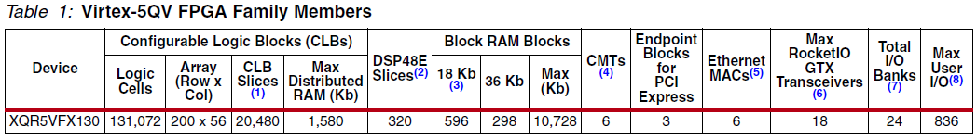
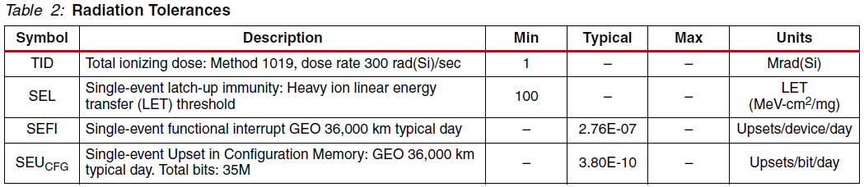

What Did The Space Program Ever Do For Me?
MTBF
9,926yrs
75 days
Great for space and very special situations but is it affordable?
Standard products have benefitted from our space program.
Engineer solutions for lower cost.
Notes:
Let’s face it, these devices are very expensive! We don’t give out free samples of these ☺
The points being made by the presenter are…
1) Xilinx really know what they are doing – We make devices that work this well in SPACE.
2) If you (Mr. Customer) really value reliability then are you prepared to pay for it?
3) In all likelihood, you need an engineering compromise.
Remember, that a ‘compromise’ means that you may need to…
1) Put in a bit of engineering effort yourself.
2) Take further decisions concerning what factors are more important than others.

Slide 54
The ‘Game’ has changed…
16nm UltraScale+
0.15Mb of flip-flops fabricated using a typical ASIC process
Implement a mitigation scheme that actually mitigates the highest risks.
Notes:
Text

