Slide 1
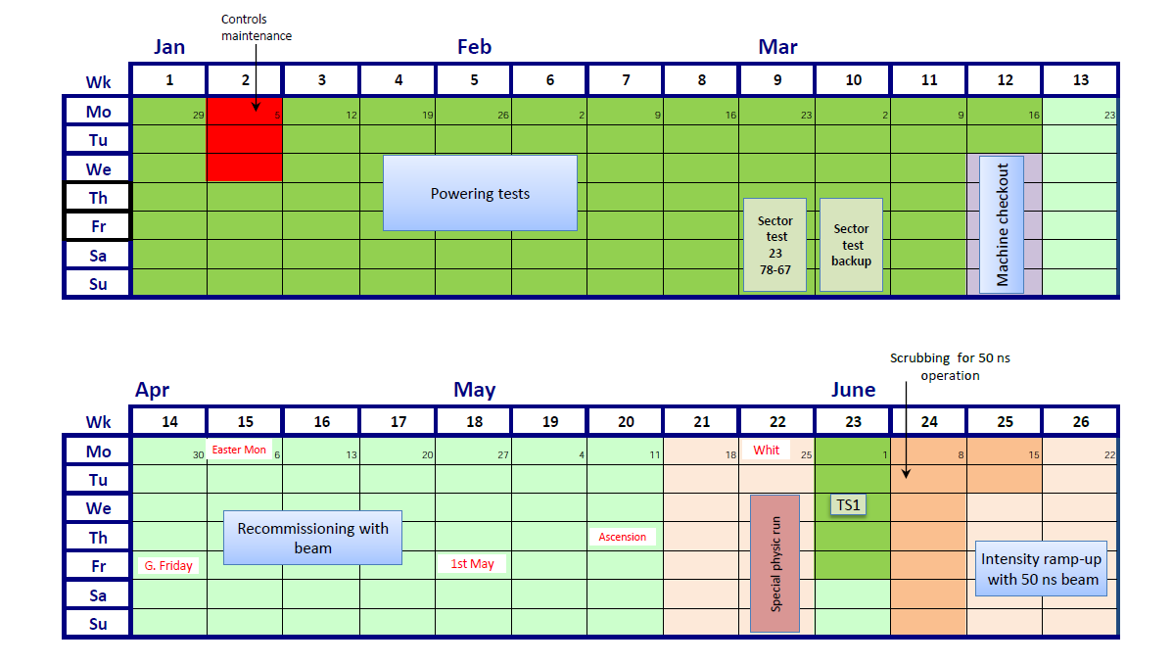
LHC: Getting ready for run 2 !
8 weeks beam commissioning
LHCf and VdM (β* = 19m) just before TS1
TS1 shifted by a week

Slide 2
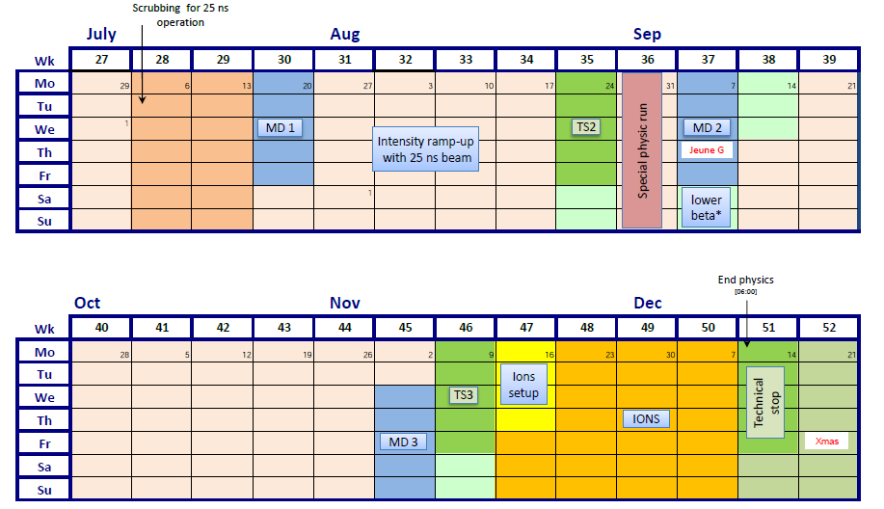
4 day floating MD removed
Otherwise as was
Courtesy Mike Lamont

Slide 3
LHC schedule 2015 version 1.1
Phase | Days
Initial Commissioning | 56
Scrubbing (for 50 and 25 ns) | 23
Early LHCf/VdM1 | 5
Proton physics 50 ns | 9 + 19
Proton physics 25 ns – phase 1 | 30
Change in beta* | 5
Proton physics phase 2 (including ramp-up) | 48
Special physics runs (TOTEM/VdM2) Intermediate energy run - to be scheduled | 7
MD | 15
Technical stops | 15
Technical stop recovery | 6
Ion setup/Ion run | 4 + 24
Total | 266 (38 weeks)
- 10
- 4
Courtesy Mike Lamont

