Slide 1
WLCG critical services update
Maria Dimou, Andrea Sciabà
WLCG Management board meeting,
March 17, 2015

Slide 2
Introduction
WLCG maintains a list of Tier-0 services used by the experiments, rated by impact and urgency
  Impact: “damage” made by a service unavailability to operations or to people
  Urgency: delay after which the full impact is reached
  Rated in a scale from 1 to 10, where each number has a specific meaning
  Full details at https://twiki.cern.ch/twiki/bin/view/LCG/WLCGCritSvc

Slide 3
Criticality update
Information used by the Tier-0 to understand how important each service is for each experiment and prioritise them accordingly
A new update was required before Run2 starts
Experiments sent their updates and they have been discussed with the Tier-0 in a dedicated meeting
  Agenda and minutes at http://indico.cern.ch/event/357668/

Slide 4
General remarks
Experiment services should run behind load-balanced aliases whenever possible
  The Tier-0 will provide assistance
  It should be seen as a long term project
Configuration management services (Puppet, etc.) have defined a business continuity plan which will be rolled out in the next months
Experiments can raise ALARM tickets when they think it is appropriate independently of urgency/impact ratings
  Almost no misuse in the past
Most IT services are on “best effort” (not really an issue)
Tier-0 plans to produce SIRs after each ALARM
  Considered useful to have a “post-mortem” analysis

Slide 5
Databases
Oracle was the only service with piquet support during Run1 data taking in addition to IT sysadmin team
For Run2, following discussion with the LHC experiments:
  Oracle piquet support will start mid May 2015 (and be re-evaluated after one year)
  DB-on-demand services have grown from being “nice to have” to being essential to both experiment and Grid services
    Service being improved in the management interface and monitoring (AppDynamics)
    A best effort SLA will be provided for a number of critical databases (not before mid 2015)

Slide 6
Common changes
gLiteWMS decommissioned, and LFC for LHCb will be once the green light is given (expected in two months from now)
Savannah and CVS replaced by JIRA, GIT and SVN
The Agile Infrastructure services are introduced and supersede the old “VO box” service
The Castor disk-only endpoints have been replaced by EOS
CVMFS is now critical for everybody
  Release nodes implicitly “included” in the Stratum0
  Stratum1 not very critical as it is distributed
Added Xrootd redirectors for CMS and ATLAS
Vidyo and Indico have a big impact on people

Slide 7
Highlights from the experiments
ALICE
  GIT and JIRA used to start new productions
ATLAS
  Slightly increased criticality for WLCG network, offline databases, AFS, batch system and EOS
  Lower importance of BDII
CMS
  Lower impact for FTS at CERN
    Assuming that PhEDEx will be able to automatically switch to other instances (not for start of Run2)
LHCb
  Oracle online and offline DB will be merged
    Increases the urgency for the Point 8 → Meyrin network and for the offline DB
    Dependency on Oracle streaming removed
  Lower criticality for AFS (still used for home directories, to access machines, etc.)
  Critical dependence on DB-on-demand

Slide 8
Conclusions
The new version of the WLCG critical services map is final
  The changes are not drastic and are mostly common for all the experiments
Very useful to clarify the expectations of the experiments and the Tier-0 on several topics

Slide 9
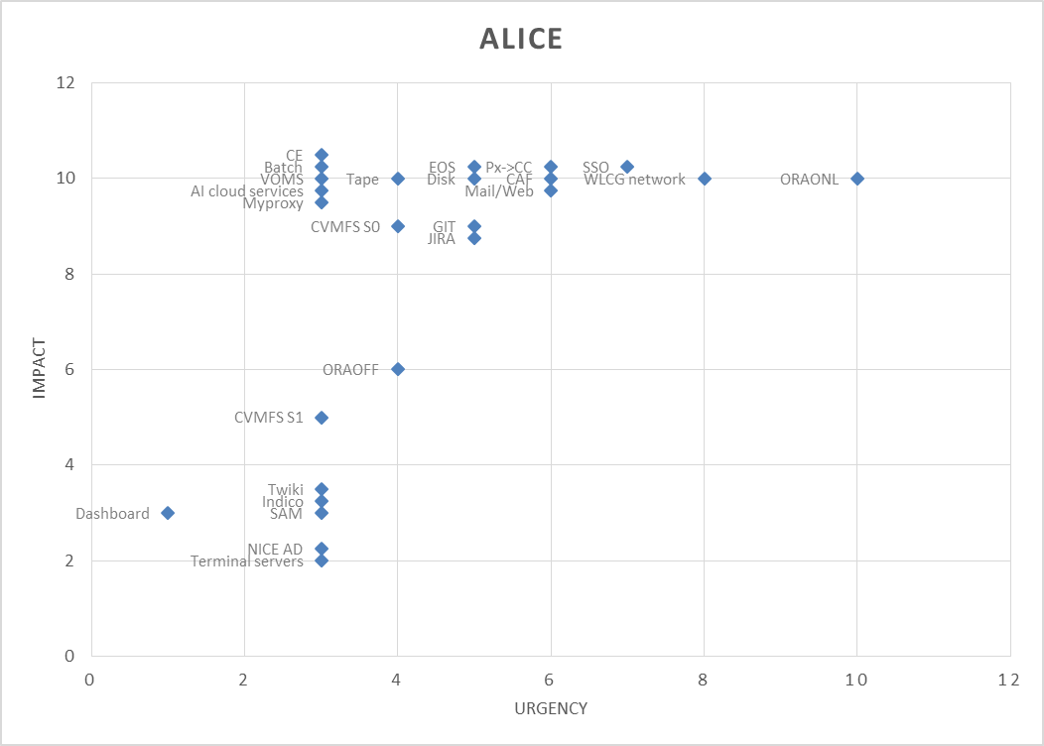
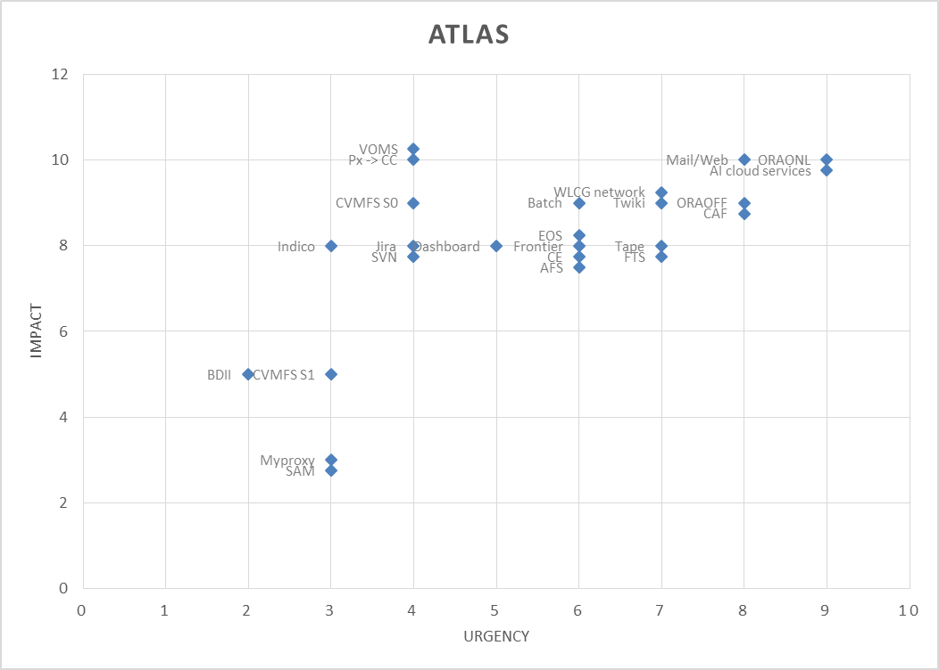
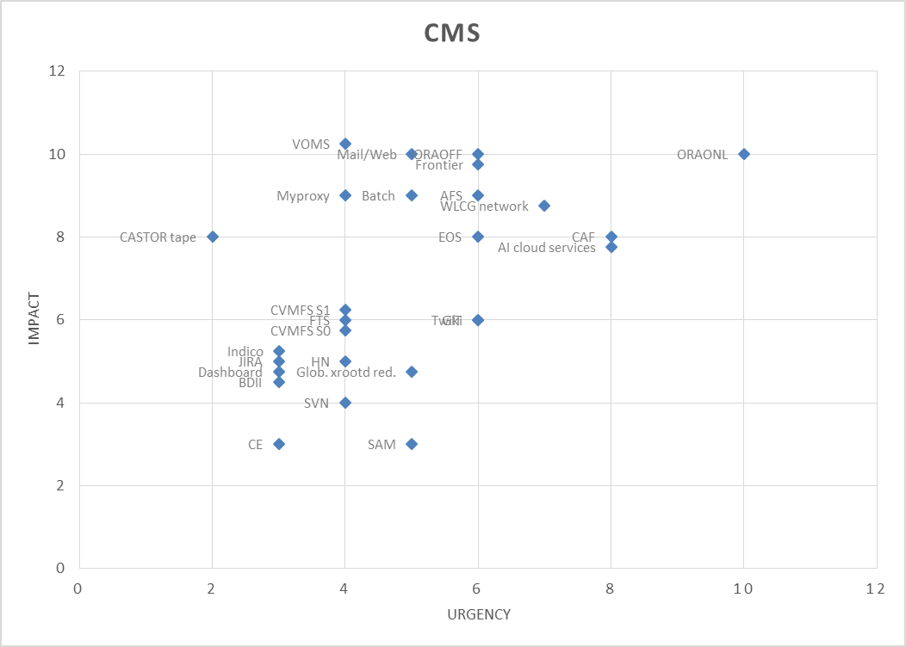
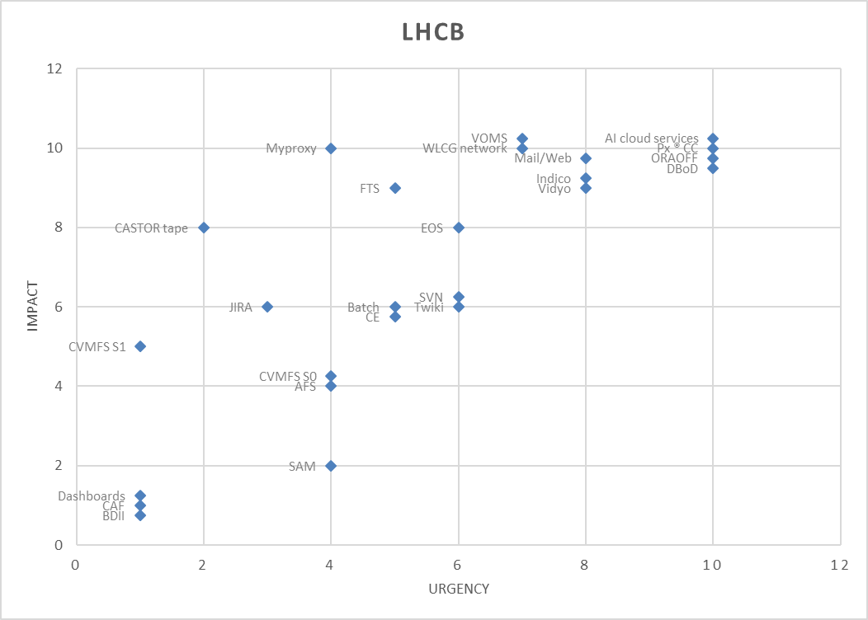
Criticality plots

