Slide 1
Dual grid PIC solver in FASTION
L. Mether, G.Rumolo
Thanks to: Kevin Li, Gianni Iadraola

Slide 2
Outline
Introduction
  Fast beam-ion instability
FASTION
  Simulation procedure
  FFT PIC solver in FASTION
Dual grid PIC solver
  Motivation
  Implementation
  Performance

Slide 3
Fast beam-ion instability
Gas molecules ionized by beam
Beam electrons accelerated by ions
Coupled electron-ion oscillations
Ions oscillate in beam field
Instability
Tune shift
Emittance growth
In circular accelerator without clearing gap, ion density builds up over several turns
  Conventional beam-ion instability
For bunch train followed by gap, ions build up only during one train passage
  Fast beam-ion instability

Slide 4
FASTION
Simulation code developed at CERN, by Giovanni, for studying FBII in CLIC structures
  Used for scanning the effect of vacuum pressure and composition on instability
  Previously applied to linear structures: Main linac, transfer line, BDS
  Optimization for rings on-going
  Code is still in “development“ phase for rings, systematic scans with realistic vacuum pressures and compositions have not yet been done
2D particle-in-cell (PIC) multi-bunch tracking code
  Strong-strong code: both beam and ions represented by macro-particles
  Based on old version of Headtail e-cloud
  Written in C
  Available on GitHub
  https://github.com/lmether/FASTION
    Currently only one branch: master

Slide 5
FASTION simulation outline
An electron bunch train is tracked through the lattice
  In every interaction point, the beam is passed, bunch by bunch
Lattice is sampled through selected interaction points (β_{min}, β_{max})
N = N_{lattice}*N_{turns}
Calculate e-fields
Generate ions
Give velocity kick
Introduce bunch

Slide 6
FASTION simulation outline
An electron bunch train is tracked through the lattice
  In every interaction point, the beam is passed, bunch by bunch
Ions generated correspond to ionization probability over s distance to next interaction point
Calculate e-fields
Generate ions
Give velocity kick
Drift ions
Introduce bunch
Transport bunch

Slide 7
FASTION simulation outline
An electron bunch train is tracked through the lattice
  In every interaction point, the beam is passed, bunch by bunch
Typical CLIC-DR simulation:
Lattice with 260 ip’s
Beam = 10 000 macro-particles,
ions = 312*500 = 156000
Computation time ~ 15 mins/turn
Calculate e-fields
Generate ions
Give velocity kick
Drift ions
Introduce bunch
Transport bunch

Slide 8
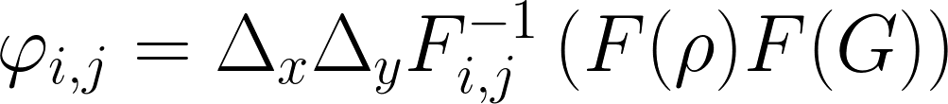
FFT PIC solvers
There are (at least) two types of FFT PIC solvers
Direct matrix solver
  Discretize the Poisson equation and rewrite as a matrix equation M*φ + φ*M = Ρ
  M constant valued matrix, can be factorized M = Q Λ Q⁻¹ with Λ diagonal
  -> Λ (Q⁻¹ φ Q) + (Q⁻¹ φ Q) Λ = (Q⁻¹ Ρ Q), which can be solved element-wise for (Q⁻¹ φ Q)
  Q = Q⁻¹ related to FFT -> matrix multiplications Q⁻¹ Ρ Q etc can be done by FFT
Green’s function solver
  Discretize the solution of the Poisson equation in terms of the Green’s function
  Calculate convolution using FFT
  This is the one used in FASTION

Slide 9

Green’s function PIC solver
Free space Green’s function in 2D:
Use integrated Green’s function to approximate contribution from entire cell
  Calculating Green’s function costs 3 trigonometric functions + 1 FFT
  Note: F_{i,j} is not Green’s function for cell i,j but distance i*Δx, j*Δy

Slide 10
FASTION PIC routine
FASTION PIC solver
  Green’s function solver with open boundary (free space)
  Evaluate Green’s function for all grid-spacings
  For every grid point, calculate potential by summing over charge distribution*Green’s function of every other grid point, using FFT
Separate treatment of ions and beam
  Ion and beam charges are stored separately but using same grid
  (as real and imaginary parts of arrays for FFT)
  Potential for ions is calculated using only beam distribution and vice versa
    No ion-ion, or electron-electron interactions
  Velocity kick is applied according to electric field induced by opposite particles

Slide 11
Outline
Introduction
  Fast beam-ion instability
FASTION
  Simulation procedure
  FFT PIC solver in FASTION
Dual grid PIC solver
  Motivation
  Implementation
  Performance

Slide 12
Resolving beam & tracking ions
Simultaneously resolving the beam and tracking ions is computationally challenging
  CLIC beam is very small, σ = 2-4 µm in vertical direction
  Ions can oscillate with very large amplitudes > 1mm
  -> extent of ion distribution up to 1000 * beam size
  Good beam resolution necessary, but also want to track at least most of the ions
Current approach: rescale grid during simulations
  Check physical dimensions: max electron coordinate, max ion coordinate, etc.
  Rescale physical size of grid-cells to match physical dimensions at every bunch passage
    Recalculate Green’s functions
  Not possible to track all ions
    Cut grid at whichever is larger: 10*electron r_{max} or 5*σ_{ion}
  Ions outside of grid
    No longer kicked, but drift with constant velocity
    Not taken into account when calculating kick on beam

Slide 13
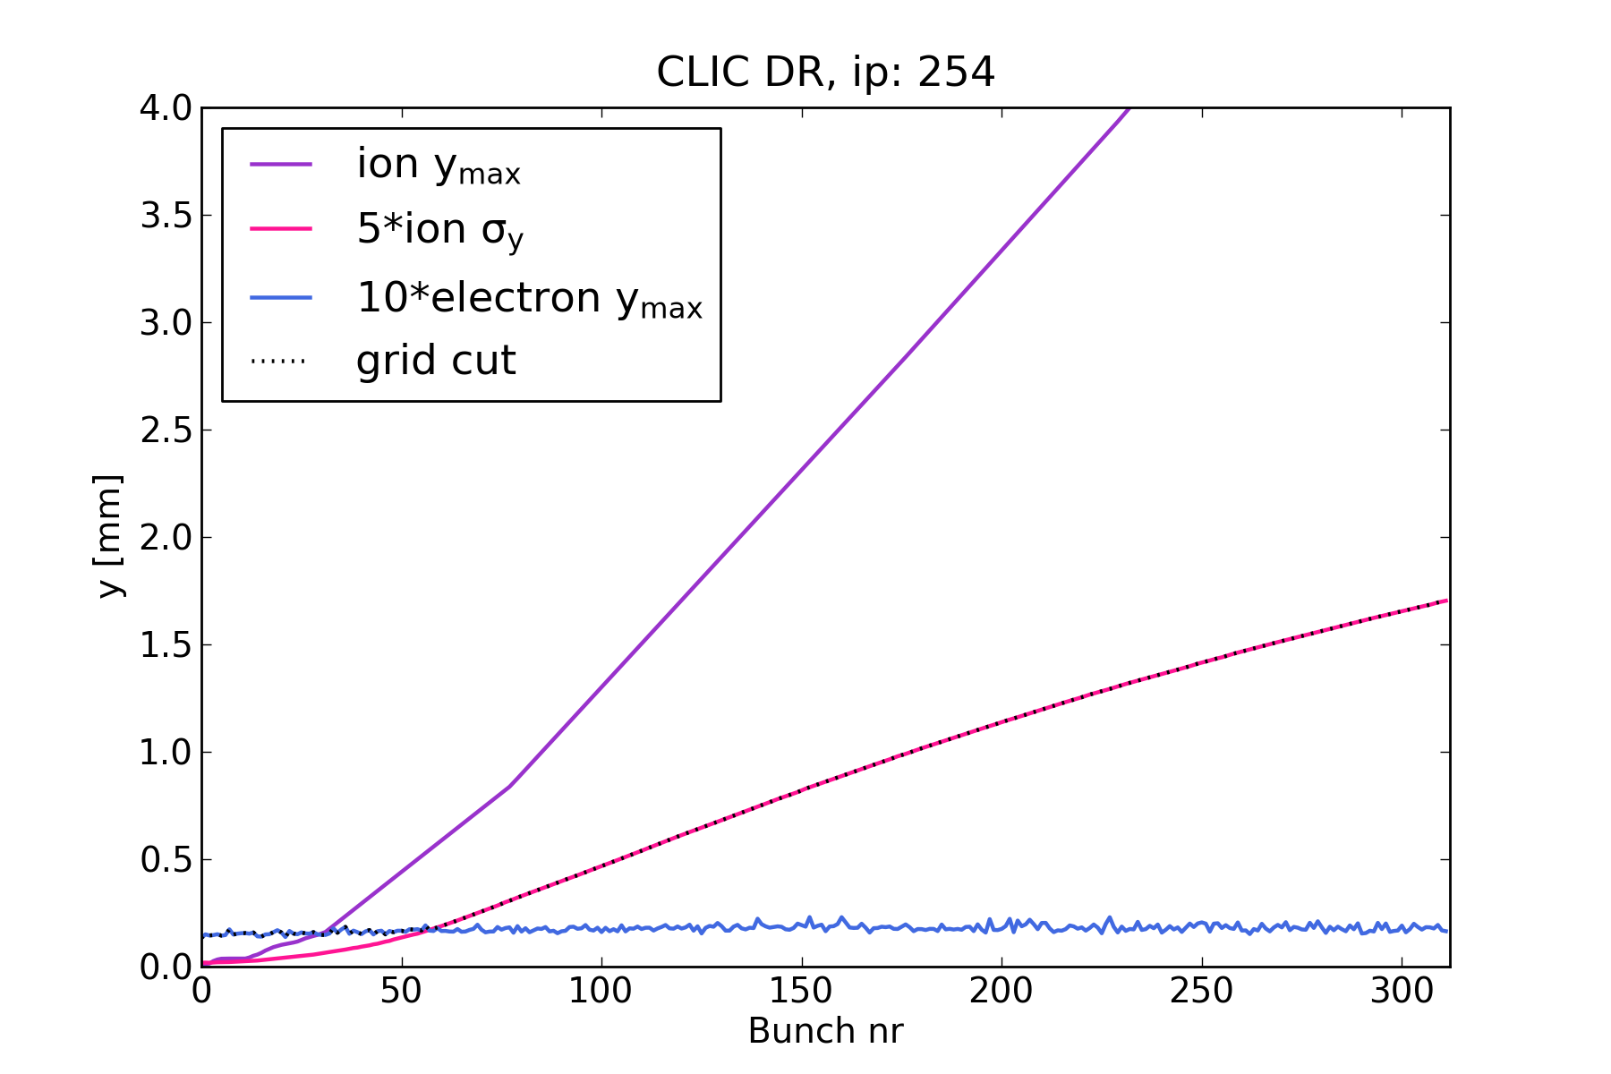
Resolving beam & tracking ions
Simultaneously resolving the beam and tracking ions is computationally challenging
  CLIC beam is very small, σ = 2-4 µm in vertical direction
  Ions can oscillate with very large amplitudes > 1mm
  -> extent of ion distribution up to 1000 * beam size
  Good beam resolution necessary, but also want to track at least most of the ions
Previous approach: rescale grid during simulations
  Check physical dimensions: max electron coordinate, max ion coordinate, etc.
  Rescale physical size of grid-cells to match physical dimensions at every bunch passage
    Recalculate Green’s functions
  Not possible to track all ions
    Cut grid at whichever is larger: 10*electron r_{max} or 5*σ_{ion}
  Ions outside of grid
    No longer kicked, but drift with constant velocity
    Not taken into account when calculating kick on beam
Limits for cutting grid

Slide 14
Problems with current approach
As σ_{ion} grows beam resolution becomes very poor
  Large grid required for convergence, but even then resolution eventually poor
    In fact, no simulations made for the CLIC-DR until this point were properly converged,
    and even less for the CLIC Main Linac, where past simulations completely missed the instability

Slide 15
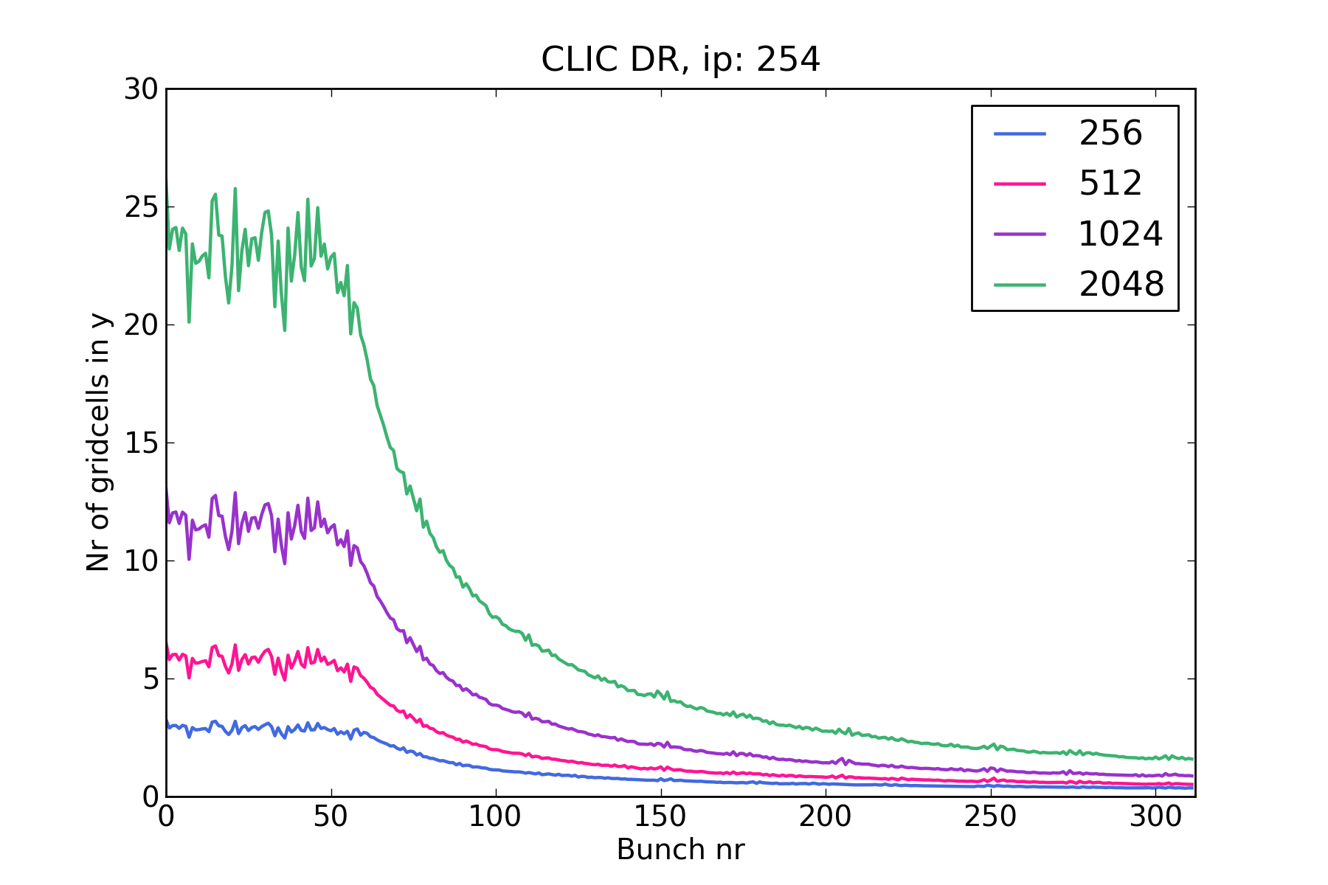
Problems with current approach
As σ_{ion} grows beam resolution becomes very poor
  Large grid required for convergence, but even then resolution eventually poor
    In fact, no simulations made for the CLIC-DR until this point were properly converged,
    and even less for the CLIC Main Linac, where past simulations completely missed the instability
Beam resolution with varying grid size

Slide 16
Problems with current approach
As σ_{ion} grows beam resolution becomes very poor
  Large grid required for convergence, but even then resolution eventually poor
    In fact, no simulations made for the CLIC-DR until this point were properly converged,
    and even less for the CLIC Main Linac, where past simulations completely missed the instability
Cutting out ions leads to incorrect trajectories
  Ions outside grid give unphysical contribution to σ_{ion}, making resolution even worse
… but tracking all ions is also unpractical
  Ion trajectories “correct”, but grid domain grows even faster, giving ever worse resolution
  Or requires an unfeasibly large grid

Slide 17
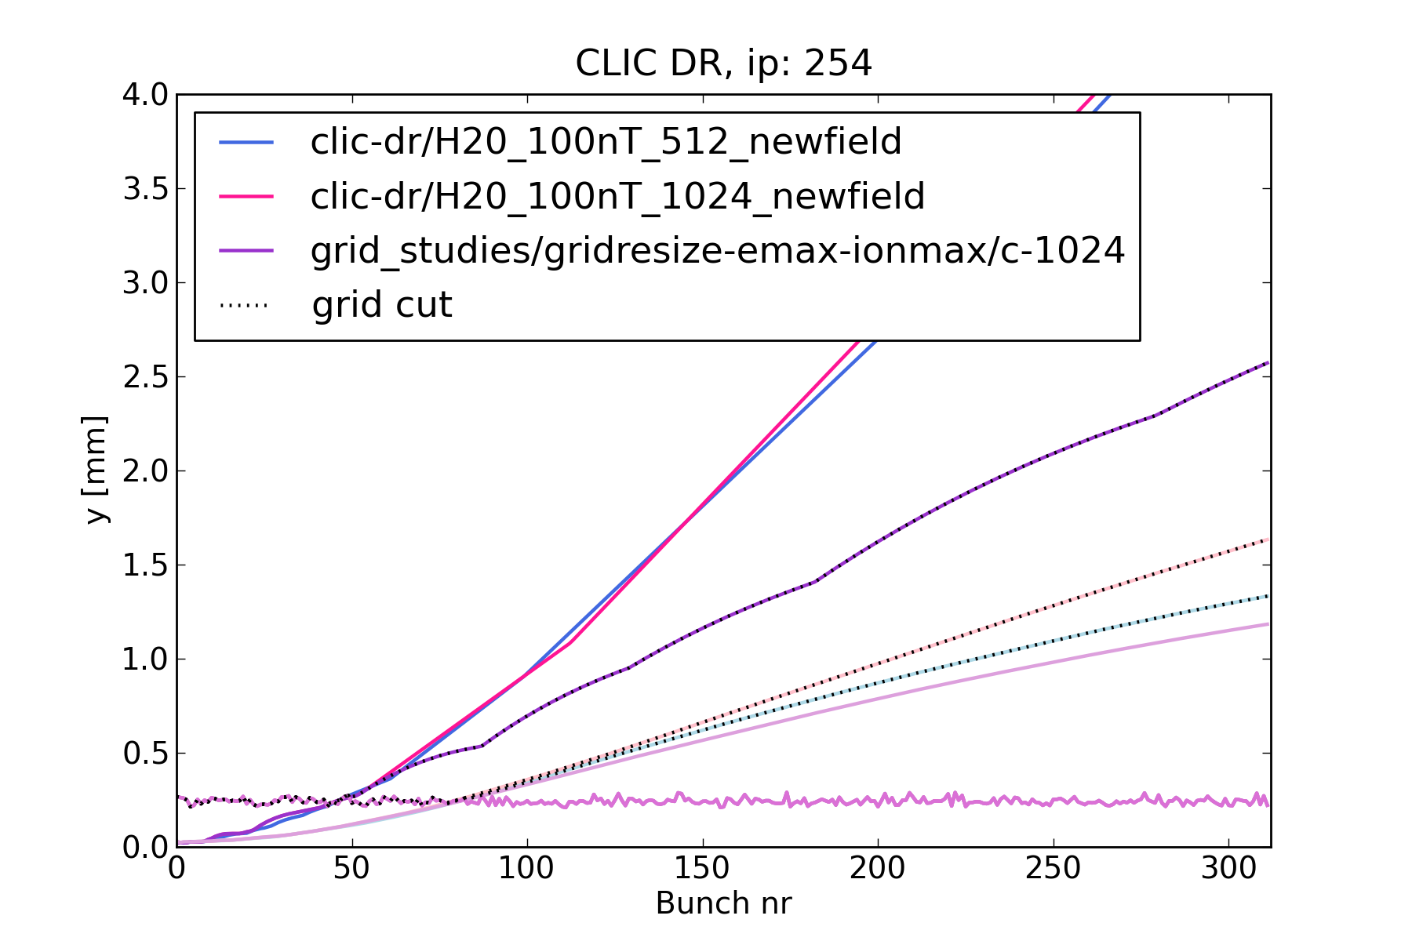
Problems with current approach
As σ_{ion} grows beam resolution becomes very poor
  Large grid required for convergence, but even then resolution eventually poor
    In fact, no simulations made for the CLIC-DR until this point were properly converged,
    and even less for the CLIC Main Linac, where past simulations completely missed the instability
Cutting out ions leads to incorrect trajectories
  Ions outside grid give unphysical contribution to σ_{ion}, making resolution even worse
… but tracking all ions is also unpractical
  Ion trajectories “correct”, but grid domain grows even faster, giving ever worse resolution
  Or requires an unfeasibly large grid
Grid cut limits

Slide 18
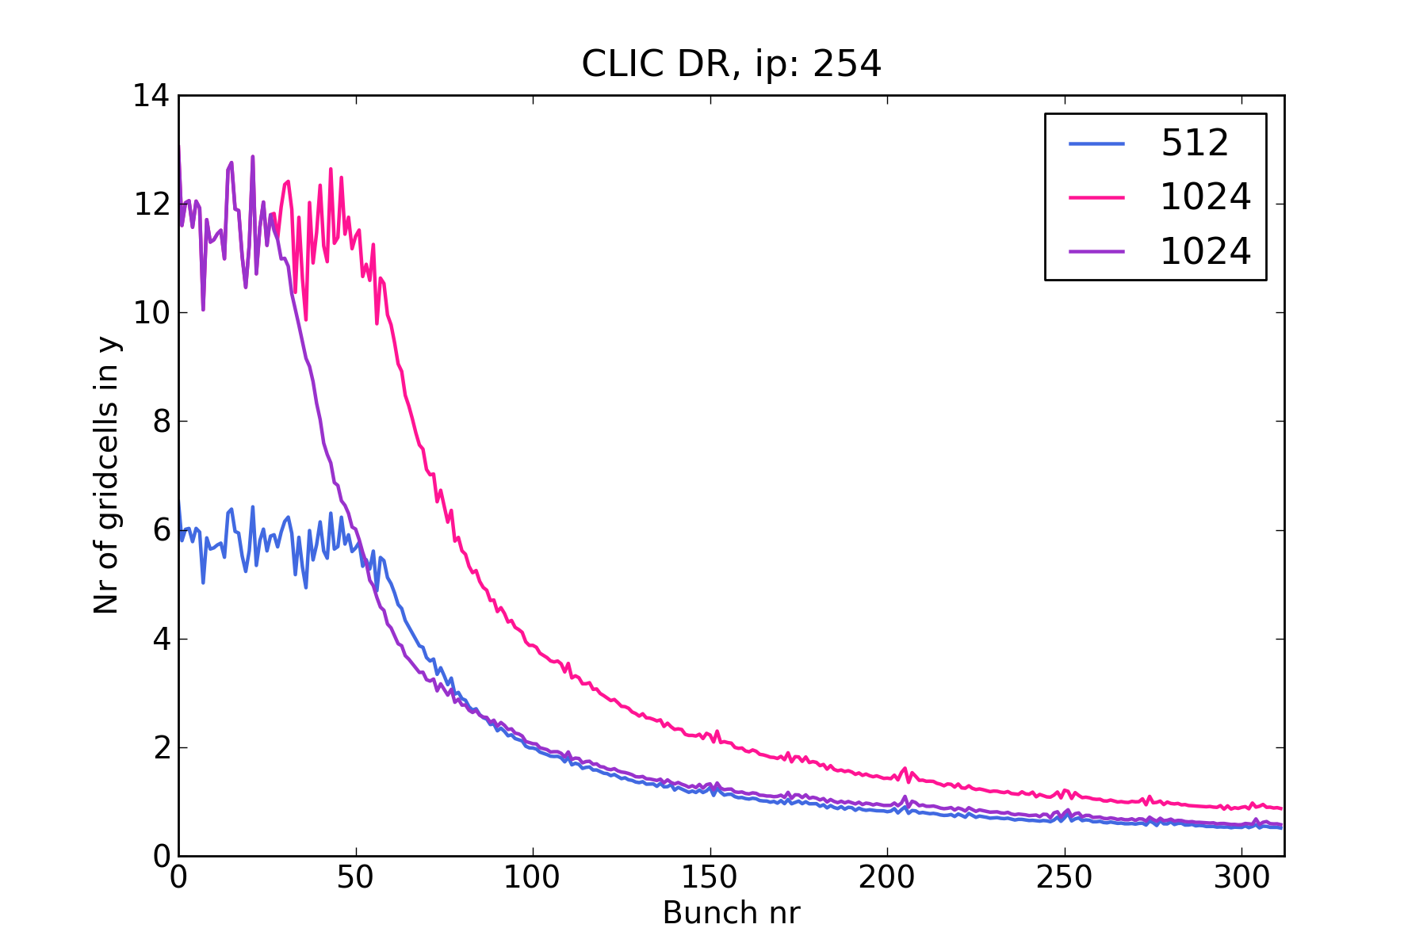
Problems with current approach
As σ_{ion} grows beam resolution becomes very poor
  Large grid required for convergence, but even then resolution eventually poor
    In fact, no simulations made for the CLIC-DR until this point were properly converged,
    and even less for the CLIC Main Linac, where past simulations completely missed the instability
Cutting out ions leads to incorrect trajectories
  Ions outside grid give unphysical contribution to σ_{ion}, making resolution even worse
… but tracking all ions is also unpractical
  Ion trajectories “correct”, but grid domain grows even faster, giving ever worse resolution
  Or requires an unfeasibly large grid
Grid cut limits

Slide 19
Problems with current approach
As σ_{ion} grows beam resolution becomes very poor
  Large grid required for convergence, but even then resolution eventually poor
    In fact, no simulations made for the CLIC-DR until this point were properly converged,
    and even less for the CLIC Main Linac, where past simulations completely missed the instability
Cutting out ions leads to incorrect trajectories
  Ions outside grid give unphysical contribution to σ_{ion}, making resolution even worse
… but tracking all ions is also unpractical
  Ion trajectories “correct”, but grid domain grows even faster, giving ever worse resolution
  Or requires an unfeasibly large grid
Large grids require long runtimes
  Also rescaling grid increases runtime, as Green’s function has to be recalculated and FFT’d

Slide 20
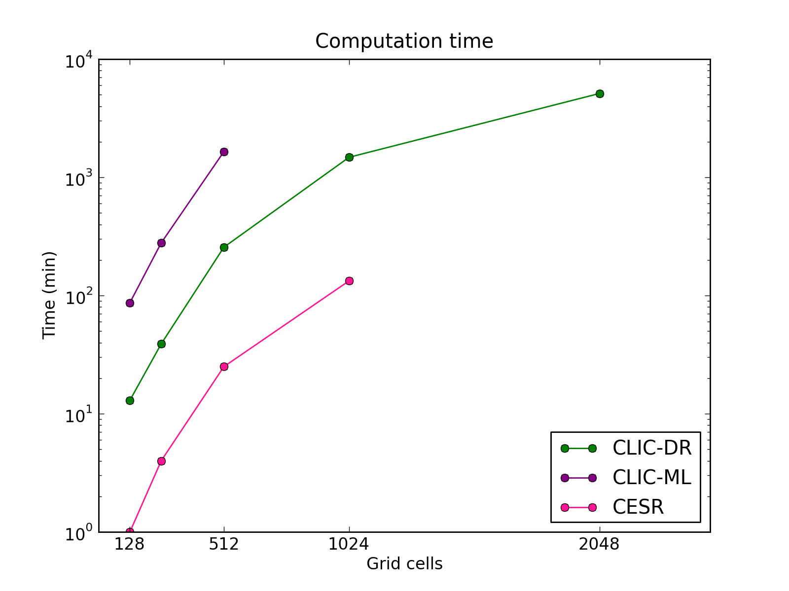
Problems with current approach
As σ_{ion} grows beam resolution becomes very poor
  Large grid required for convergence, but even then resolution eventually poor
    In fact, no simulations made for the CLIC-DR until this point were properly converged,
    and even less for the CLIC Main Linac, where past simulations completely missed the instability
Cutting out ions leads to incorrect trajectories
  Ions outside grid give unphysical contribution to σ_{ion}, making resolution even worse
… but tracking all ions is also unpractical
  Ion trajectories “correct”, but grid domain grows even faster, giving ever worse resolution
  Or requires an unfeasibly large grid
Run-time increased by a lot
Solution: track all ions to avoid artificial trajectories, but keep resolution around beam constant -> dual-grid model (or N-grid)

Slide 21
Problems with current approach
As σ_{ion} grows beam resolution becomes very poor
  Large grid required for convergence, but even then resolution eventually poor
    In fact, no simulations made for the CLIC-DR until this point were properly converged,
    and even less for the CLIC Main Linac, where past simulations completely missed the instability
Cutting out ions leads to incorrect trajectories
  Ions outside grid give unphysical contribution to σ_{ion}, making resolution even worse
… but tracking all ions is also unpractical
  Ion trajectories “correct”, but grid domain grows even faster, giving ever worse resolution
  Or requires an unfeasibly large grid
Large grids require long runtimes
  Also rescaling grid increases runtime, as Green’s function has to be recalculated and FFT’d
Solution: track all ions to avoid artificial trajectories, but keep resolution around beam constant -> dual-grid model (or N-grid)

Slide 22
Dual-grid solver
Basic idea: use two overlapping grids
  A large, coarse grid
    Scaled around maximum ion trajectory, to keep track of all ions
  Inside the coarse grid, a smaller, fine grid centred around beam
    Kept fixed, to keep beam resolution approximately constant

Slide 23
Implementation
Distribution
  Particles on inner grid are distributed onto inner grid
  and separately on outer grid
  Particles on outer grid are distributed on outer grid only
Potential calculated by convoluting charge distributions and Green’s functions as normal
  Independently for fine and coarse grid
  Potential on coarse grid contains contribution from all particles
  Potential on fine grid contains contribution from fine grid particles only
To calculate electric field kick
  For particle on outer grid, calculate as normal with outer grid potential
  For particles on inner grid
    Calculate separately e-field and kick due to fine grid particles, using fine grid
    Calculate separately e-field and kick due to coarse grid particles on coarse grid
    Sum the two contributions

Slide 24
Implementation details
In principle two coarse grids needed
  To separate fine and coarse particle contribution
  Fine grid is designed to contain all electrons - > no electrons on coarse grid
  In FASTION no ion-ion interaction –> not necessary to do distribute fine ions on coarse grid
  -> Only one coarse grid, containing coarse ions and fine electrons needed

Slide 25
Implementation details
In principle two coarse grids needed
  To separate fine and coarse particle contribution
  Fine grid is designed to contain all electrons - > no electrons on coarse grid
  In FASTION no ion-ion interaction –> not necessary to do distribute fine ions on coarse grid
  -> Only one coarse grid, containing coarse ions and fine electrons needed
Grids must be matched at border
  So that the outer edge of the inner grid coincides with a cell edge in the larger grid
  Start with Δx_{out} = X_{in}/N_{out}, i.e. the two domains the same
  When ion reaches beyond inner grid domain, loop over i, scaling Δx_{out} = X_{in}/(N_{out}-i)
  until reach of outer grid, N_{out}*Δx_{out}, includes ion coordinate
  In consequence outer grid can be scaled with finer steps in the beginning, getting coarser as grid grows
  Maximum achievable outer grid size given by N_{out}*X_{in}
Let’s look at some results!

Slide 26
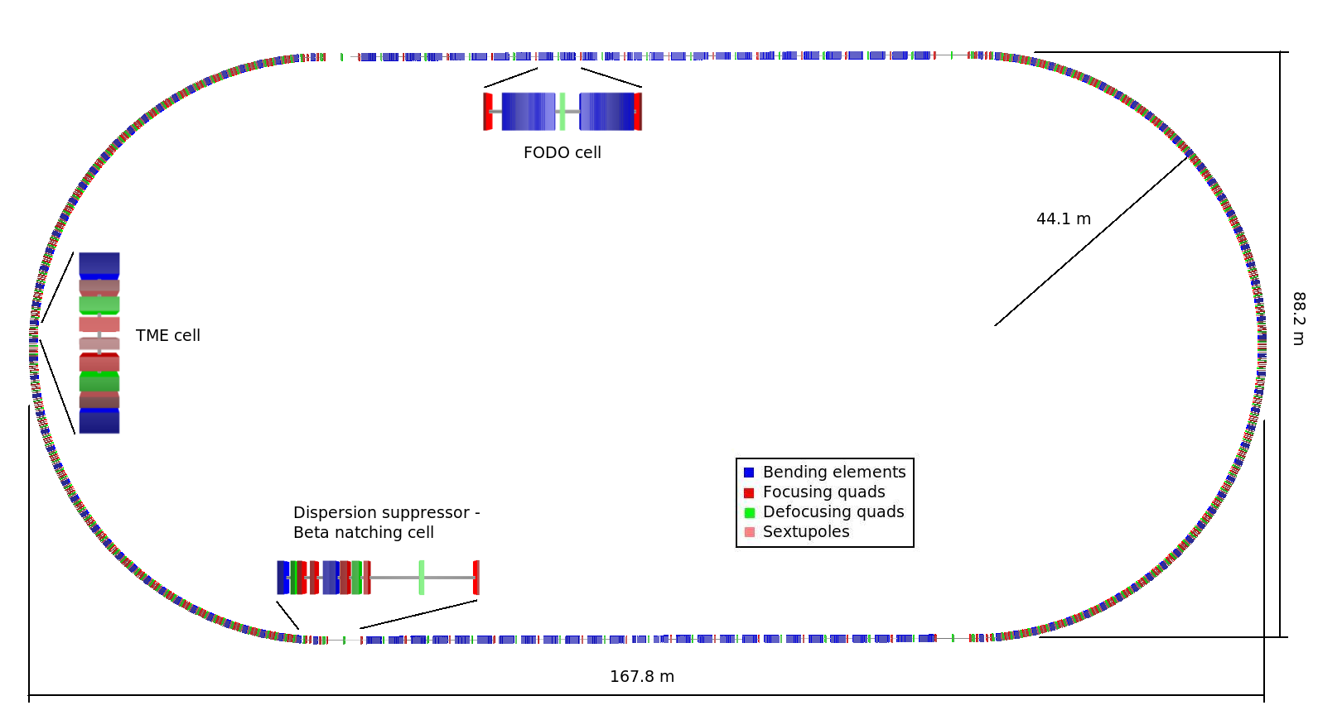
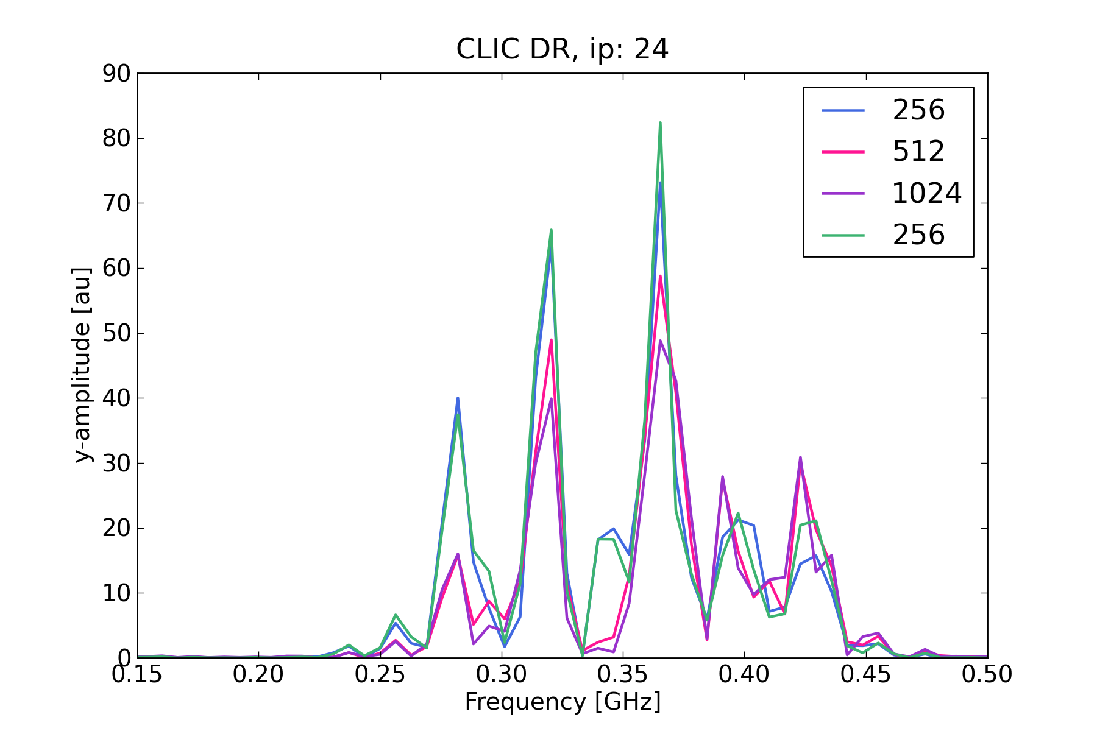
Oscillation frequency of bunch train
Various grid sizes compared to 256x256 dual-grid solver

Slide 27
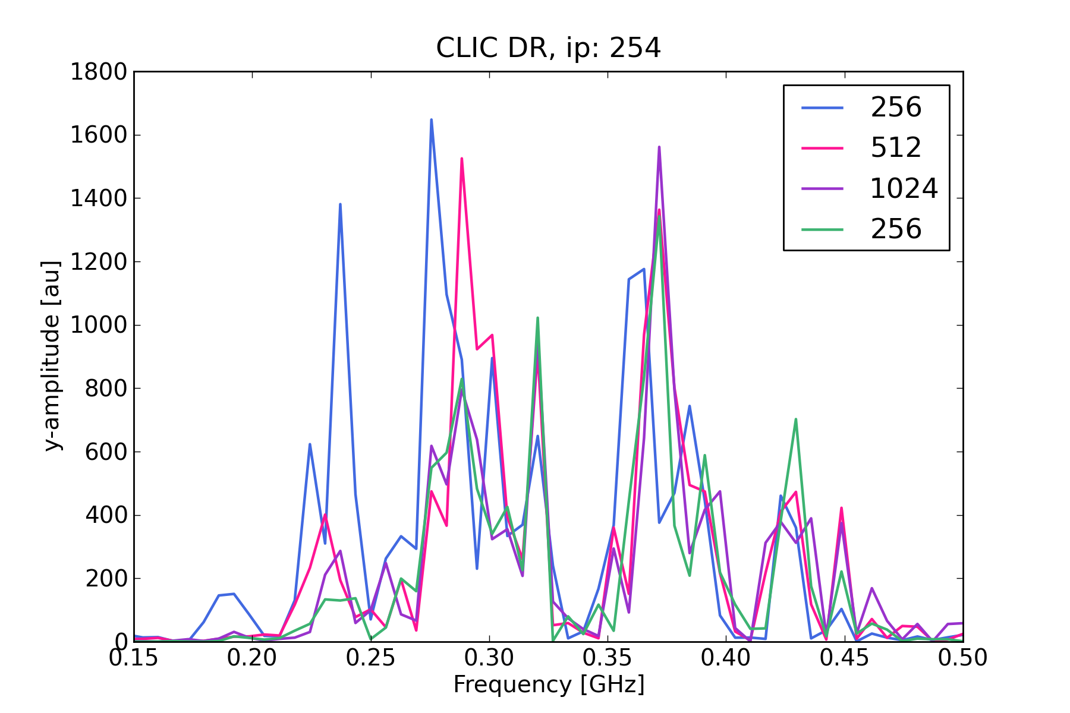
Oscillation frequency of bunch train
Various grid sizes compared to 256x256 dual-grid solver

Slide 28
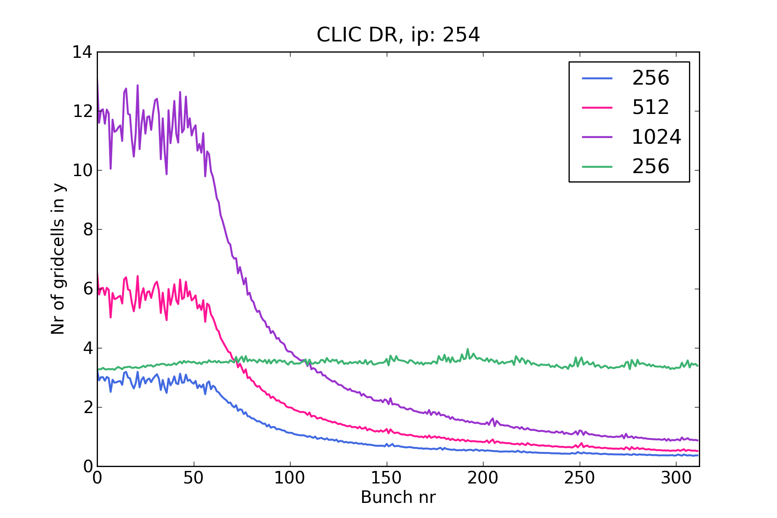
Beam resolution
Various grid sizes compared to 256x256 dual-grid solver

Slide 29
Accuracy
Summing contributions from grids with different Δx introduces an error
  For beam, effect of outer ions can be considered a small correction
  Do not see large effect from this in simulations
  For ion-ion interactions, especially close to grid boundary, effect should be investigated more carefully
Compared to single grid
  A smaller is grid sufficient for convergence compared to single grid, since resolution barely changes during bunch train passage
  In addition, inner grid can safely be cut closer to beam, since outer grid tracks ions

Slide 30
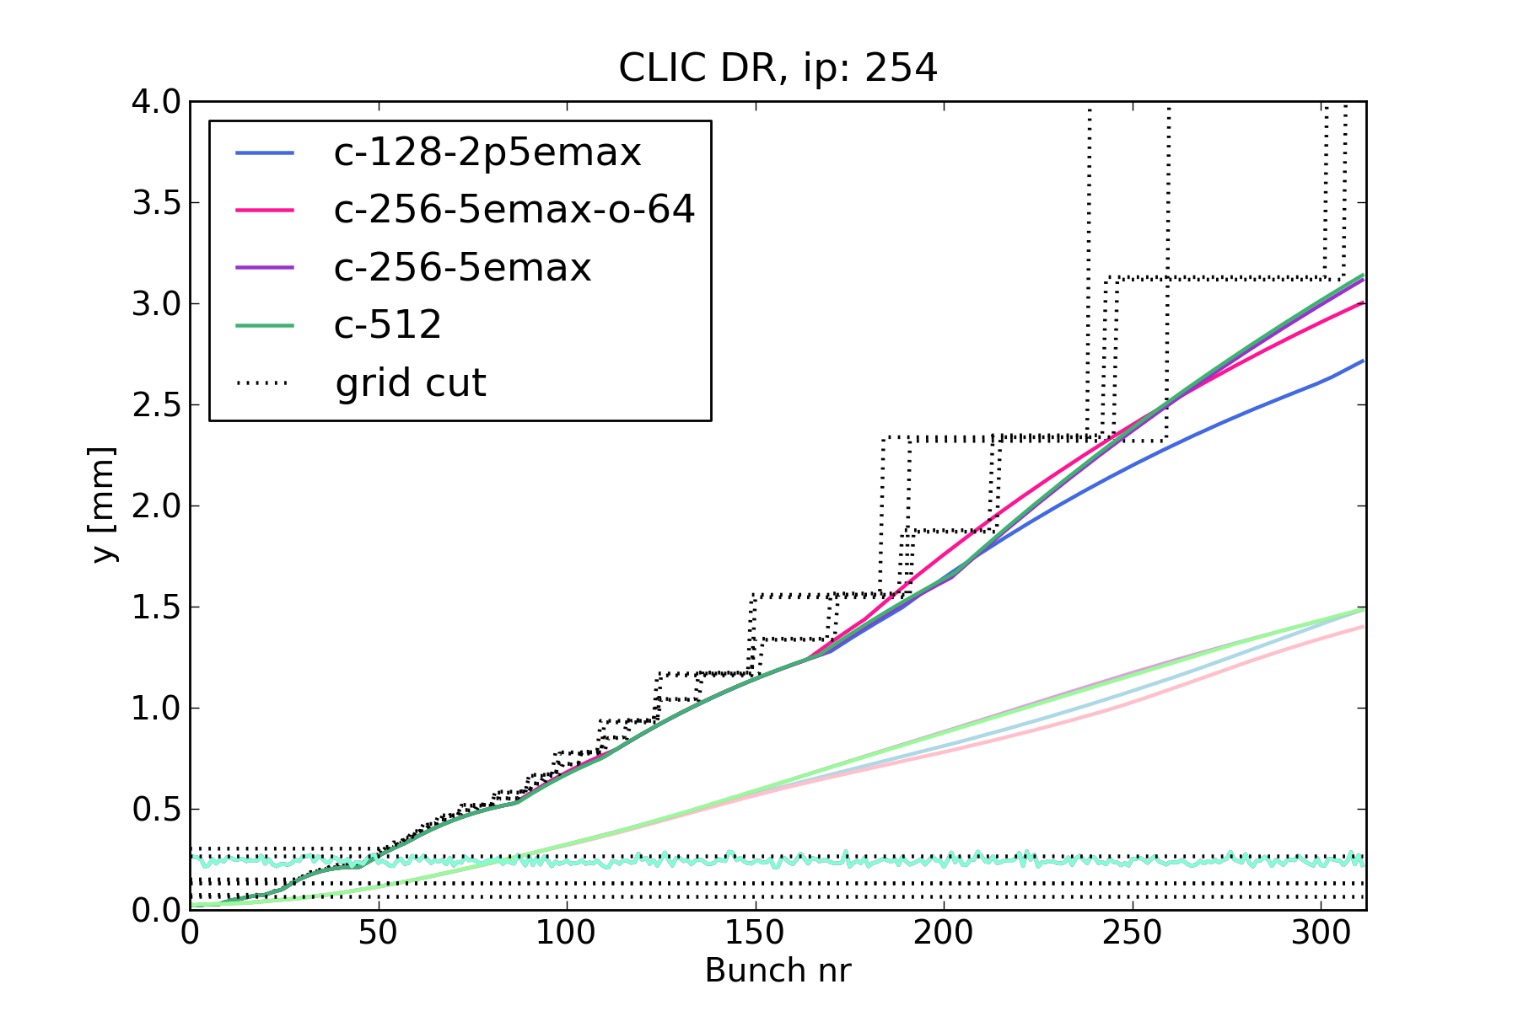
Accuracy
Summing contributions from grids with different Δx introduces an error
  For beam, effect of outer ions can be considered a small correction
  For ion-ion interactions, especially close to grid boundary, effect should be investigated more carefully
Compared to single grid
  A smaller is grid sufficient for convergence compared to single grid, since resolution barely changes during bunch train passage
  In addition, inner grid can safely be cut closer to beam, since outer grid tracks ions
Limits for cutting grid
Limits for grids, with same beam resolution, but different outer grid

Slide 31
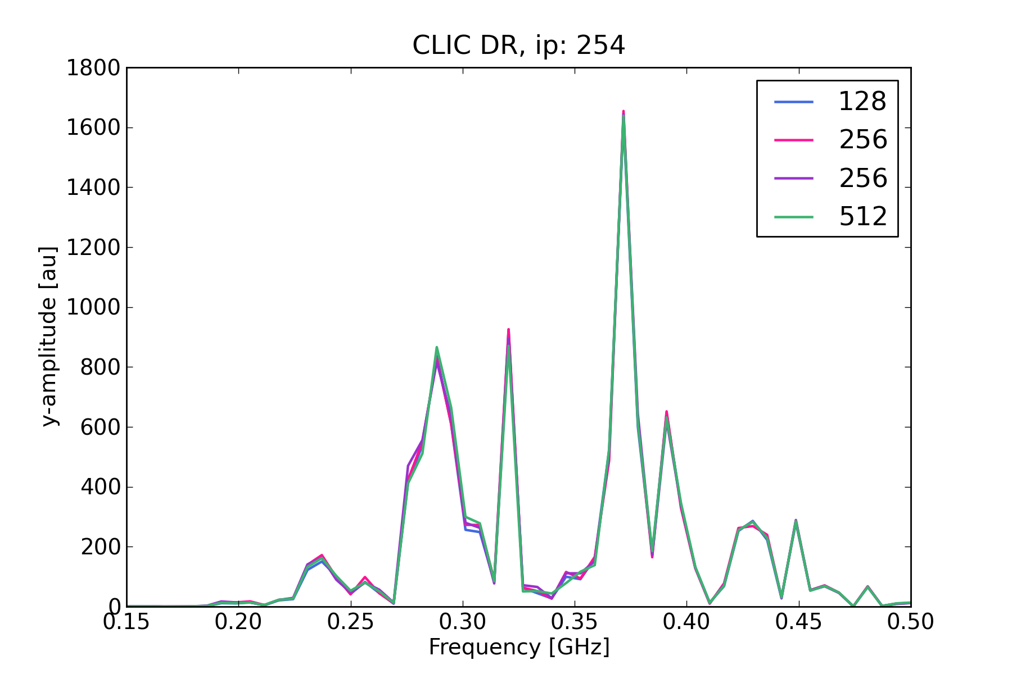
Accuracy
Summing contributions from grids with different Δx introduces an error
  For beam, effect of outer ions can be considered a small correction
  For ion-ion interactions, especially close to grid boundary, effect should be investigated more carefully
Compared to single grid
  A smaller is grid sufficient for convergence compared to single grid, since resolution barely changes during bunch train passage
  In addition, inner grid can safely be cut closer to beam, since outer grid tracks ions
Limits for cutting grid
Oscillation frequency for same beam resolution, but different outer grid

Slide 32
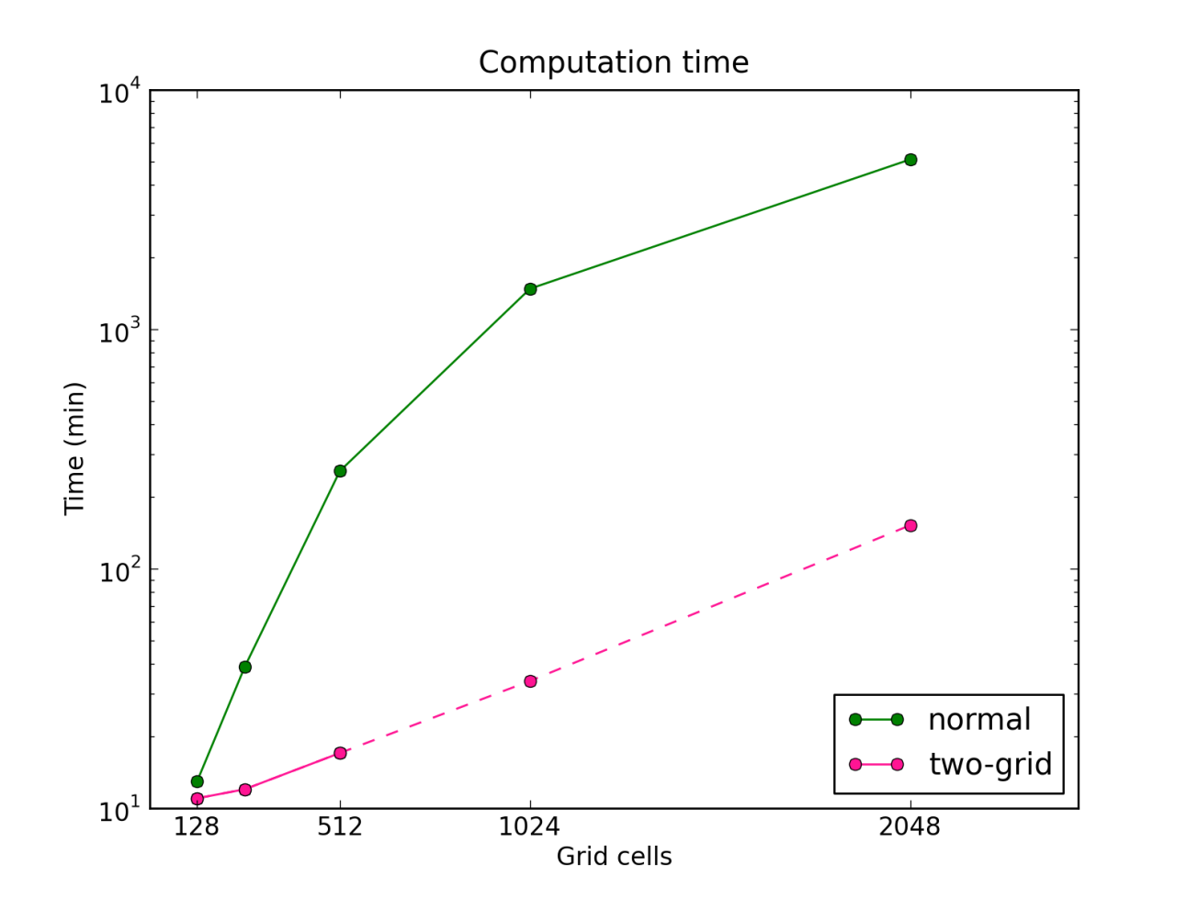
Computation time
Two-grid solver much faster than single grid
  Comparing the smallest possible converged grid that gives similar resolution as single grid

Slide 33
Summary & Outlook
Dual grid was “quick and dirty fix” for FASTION issues
  Implementation is very explicit and quite rigid
  But fast to implement and compatible with existing PIC routine
Might be useful also in other cases where the main charge density is concentrated in a small area, with spread out distribution around
  In particular, when FFT occupies majority of computation time
  However, computation time gain dependent also on number of macro-particles
    Here I used quite low numbers
  Including interactions between all particles will also decrease computation time gain

Slide 34
Summary & Outlook
Dual grid was “quick and dirty fix” for FASTION issues
  Implementation is very explicit and quite rigid
  But fast to implement and compatible with existing PIC routine
Might be useful also in other cases where the main charge density is concentrated in a small area, with spread out distribution around
  In particular, when FFT occupies majority of computation time
  However, computation time gain dependent also on number of macro-particles
    Here I used quite low numbers
  Including interactions between all particles will also decrease computation time gain
Open questions
  Effect of boundary crossing, especially for nearby charges
  Compatibility with boundary conditions
  Eventually explicit N-grid solver could be replaced by adaptive grid?
  Would be nice to look also at other grid methods before deciding which one(s) to develop further

Slide 35
Thank You!

Slide 36
CLIC e- Damping Ring
Ring circumference 427.5 m
Parameters (extraction) | 1 GHZ | 2 GHz
Beam energy, E₀ [GeV] | 2.86
Emittances, ε_{n,x,y} [nm] | 500, 5
Transverse tunes, Q_{x}, Q_{y} | 48.35, 10.40
Bunch population, N_{b} | 4.1 x 10⁹
Bunches per train, n_{b} | 156 | 312
Bunch spacing , Τ_{b} [ns] | 1 | 0.5
Bunch length (rms), σ_{z} [mm] | 1.8 | 1.6

Slide 37
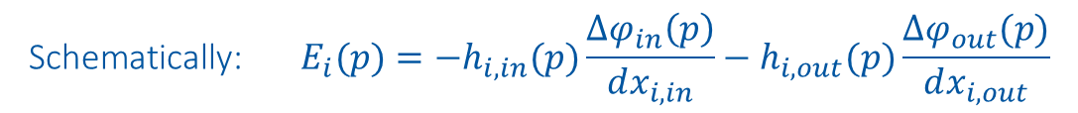
Dual-grid solver
$${\text{Schematically}\text{: } E}_{i}(p)=−h_{i,in}(p)\frac{∆φ_{in}\left(p\right)}{dx_{i,in}}−h_{i,out}(p)\frac{∆φ_{out}(p)}{dx_{i,out}}$$

