Slide 1

Proposal for a common interface
for our PIC Poisson Solvers
--- PyPIC? ;-) ---
G. Iadarola, G. Rumolo
PyHEADTAIL meeting – 16/12/2014

Slide 2
Introduction
  In many of our codes, Particle in Cell (PIC) algorithms are used to compute the Electric Field generated by a set of charged particles in a set of discrete points (can be the locations of the particles themselves, or of another set of particles)
  Typically 4 stages:
  Charge scatter from macroparticles (MPs) to grid
  Calculation of the electrostatic potential at the nodes
  Calculation of the electric field at the nodes (gradient evaluation)
  Field gather from grid to MPs
Notes:
changing with energy

Slide 3
Basic stages of a PIC algorithm
  Standard Particle In Cell (PIC) → 4 stages:
  Charge scatter from macroparticles (MPs) to grid
  Calculation of the electrostatic potential at the nodes
  Calculation of the electric field at the nodes (gradient evaluation)
  Field gather from grid to MPs
Internal nodes
External nodes (optional)
Uniform square grid

Slide 4
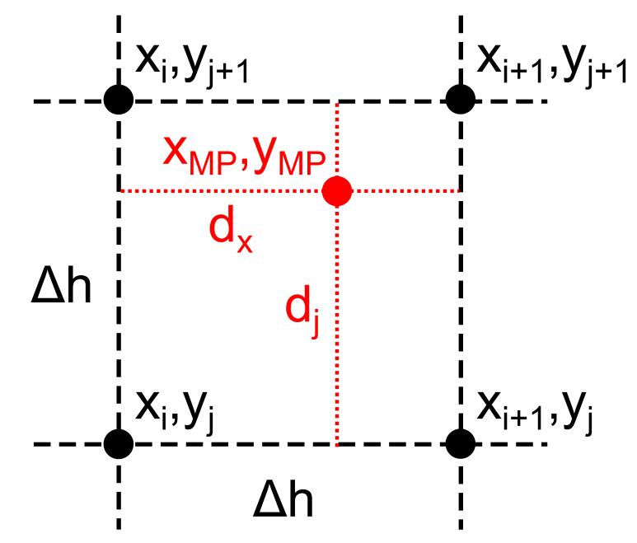
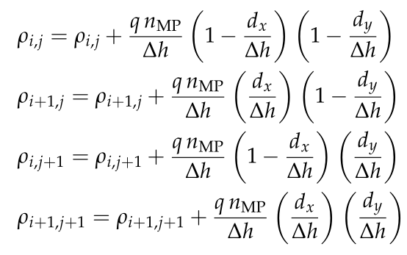
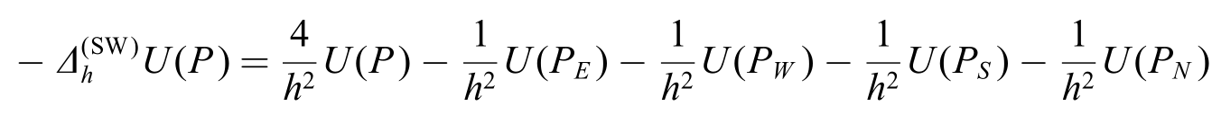
Basic stages of a PIC algorithm
  Standard Particle In Cell (PIC) → 4 stages:
  Charge scatter from macroparticles (MPs) to grid
  Calculation of the electrostatic potential at the nodes
  Calculation of the electric field at the nodes (gradient evaluation)
  Field gather from grid to MPs

Slide 5
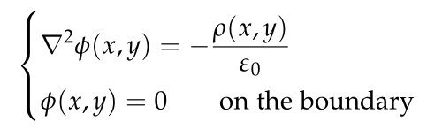
Basic stages of a PIC algorithm
  Standard Particle In Cell (PIC) → 4 stages:
  Charge scatter from macroparticles (MPs) to grid
  Calculation of the electrostatic potential at the nodes
  Calculation of the electric field at the nodes (gradient evaluation)
  Field gather from grid to MPs
  Different numerical approaches to the solution with different advantages and drawbacks.
  Already implemented in our codes:
  FASTION, HEADTAIL and PyHEADTAIL: Open space FFT solver (explicit, very fast but open boundaries)
  HEADTAIL: Rectangular boundary FFT solver (explicit, very fast but only rectangular boundaries)
  FASTION: dual grid (see Lotta’s presentation)
  PyECLOUD (and PyEC4PyHT): Finite Difference implicit Poisson solver (arbitrary chamber shape, sparse matrix, possibility to use Shortley Weller boundary refinement, KLU fast routines, computationally more demanding)
  Boundary conditions (e.g., perfectly conducting, open, periodic)

Slide 6


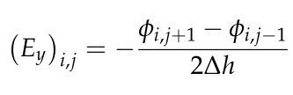
Basic stages of a PIC algorithm
  Standard Particle In Cell (PIC) → 4 stages:
  Charge scatter from macroparticles (MPs) to grid
  Calculation of the electrostatic potential at the nodes
  Calculation of the electric field at the nodes (gradient evaluation)
  Field gather from grid to MPs

Slide 7
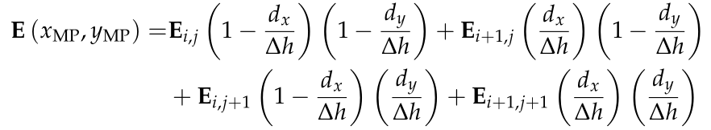
Basic stages of a PIC algorithm
  Standard Particle In Cell (PIC) → 4 stages:
  Charge scatter from macroparticles (MPs) to grid
  Calculation of the electrostatic potential at the nodes
  Calculation of the electric field at the nodes (gradient evaluation)
  Field gather from grid to MPs

Slide 8
Advantages of a common interface
  We could collect all the code we already have in a common tool (PyPIC? ;-)), with a common interface. This would mean:
  A single implementation for common features (scatter, gather, etc…)
  All implementations become naturally available for all users (fast rectangular or dual grid in PyECLOUD and PyHEADTAIL, Finite Difference in FASTION)
  With a bit of tweaking we could get a first space charge module for PyHEADTAIL (?) (practically already debugged…)
  New implementations easier to test and debug and immediately available for all usages
Something like this…

Slide 9
First idea on a possible interface
  class ACertainPIC:
  def __init__ (self, geometry, grid, numerical_param):
  ……..
  def scatter(self, x_mp, y_mp, q_mp):
  ……..
  def solve(self)
  ……..
  def gather (self, x_mp, y_mp):
  ……..
  return Ex_mp, Ey_mp
  ……..

Slide 10
First idea on a possible interface
  Example of usage:
  import PyPIC.PIC_FFT as PyPICFFT
  mypic = PyPICFFT(xmin, xmax, dx, ymin, ymax,dy)
  <some code which gives x_mp, y_mp, q_mp>
  mypic.scatter(x_mp, y_mp, q_mp)
  mypic.solve()
  Ex_mp, Ey_mp = mypic.gather(x_mp, y_mp)

Slide 11
First idea on a possible interface
  Now I want to change the solver:
  import PyPIC.PIC_FFT as PyPICFFT
  mypic = PyPICFFT(xmin, xmax, dx, ymin, ymax,dy)
  <some code which gives x_mp, y_mp, q_mp>
  mypic.scatter(x_mp, y_mp, q_mp)
  mypic.solve()
  Ex_mp, Ey_mp = mypic.gather(x_mp, y_mp)

Slide 12
First idea on a possible interface
  Now I want to change the solver:
  #import PyPIC.PIC_FFT as PyPICFFT
  import PyPIC.PIC_FD as PyPICFD
  #mypic = PyPICFFT(xmin, xmax, dx, ymin, ymax,dy)
  mypic = PyPICFD(chamber_object, dx, dy)
  <some code which gives x_mp, y_mp, q_mp>
  mypic.scatter(x_mp, y_mp, q_mp)
  mypic.solve()
  Ex_mp, Ey_mp = mypic.gather(x_mp, y_mp)

Slide 13
First idea on a possible interface
  If I want compare the two:
  import PyPIC.PIC_FFT as PyPICFFT
  import PyPIC.PIC_FD as PyPICFD
  mypic1 = PyPICFFT(xmin, xmax, dx, ymin, ymax,dy)
  mypic2 = PyPICFD(chamber_object, dx, dy)
  <some code which gives x_mp, y_mp, q_mp>
  mypic1.scatter(x_mp, y_mp, q_mp)
  mypic1.solve()
  Ex1_mp, Ey1_mp = mypic1.gather(x_mp, y_mp)
  mypic2.scatter(x_mp, y_mp, q_mp)
  mypic2.solve()
  Ex2_mp, Ey2_mp = mypic2.gather(x_mp, y_mp)
  print norm(Ex1-Ex2)/norm(Ex1)
  print norm(Ey1-Ey2)/norm(Ey1)

Slide 14
Thanks for your attention!

Slide 15



Basic stages of a PIC algorithm
  Standard Particle In Cell (PIC) → 4 stages:
  Charge scatter from macroparticles (MPs) to grid
  Calculation of the electrostatic potential at the nodes
  Calculation of the electric field at the nodes (gradient evaluation)
  Field gather from grid to MPs
Internal nodes:
External nodes:
Can be written in matrix form:
A is sparse and depends only on chamber geometry and grid size
→ It can be computed and LU factorized in the initialization stage to speed up calculation

