Slide 1
CERN Single Sign On
http://cern.ch/login
Emmanuel Ormancey
CERN IT/IS

Slide 2
Agenda
History
CERN Authentication
  Main goals
  Authentication methods
  Demo overview
Technical background
  Identity provider
  Service providers
The next steps
Links

Slide 3
History
A few years ago
Every day a CERN user had to type in:
Credentials to open the Windows desktop
Credentials to open Linux
Credentials to read mails
Credentials to verify holidays
Credentials to upload CHEP presentations in Indico
…
Today
Situation is better, but not optimal
Remains mainly 2 credential pairs (not synchronized)
Some are stealing credentials to populate local databases !!!
Many experiments are still using dedicated user databases and credentials
Different logins
Different passwords

Slide 4
CERN Authentication
Main goals
Provide SSO for CERN Web Applications
Simplify !
  Reduce number of user databases
  Reduce number of login/password pairs to remember.
Centralize
  Only one user database, one credential pair to remember
  Handle External accounts (lightweight registration)
  Provide Groups and Roles membership
Improve security
  Block all accesses to applications in one click
  Use permissions and delegation instead of sharing credentials
  Complexity does not increase security !!!

Slide 5
CERN Authentication
Authentication Methods and user information
Different authentication methods
  Classic Forms (login and password)
  Certificates (CERN CA Certificates, smartcards)
  Windows Integrated (reuse windows current credentials)
User information, Groups and Roles
  All user information is available: name, email, building, etc…
  Groups and Mailing Lists membership is available
  No more ‘per application dedicated role system’
Authentication is standalone
  Not linked to calling Web Application
  A Linux/Apache application can use Windows Integrated authentication

Slide 6
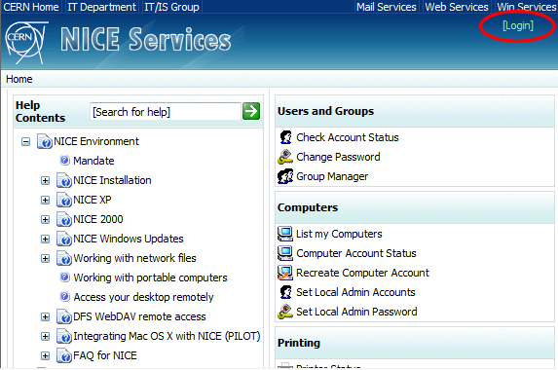
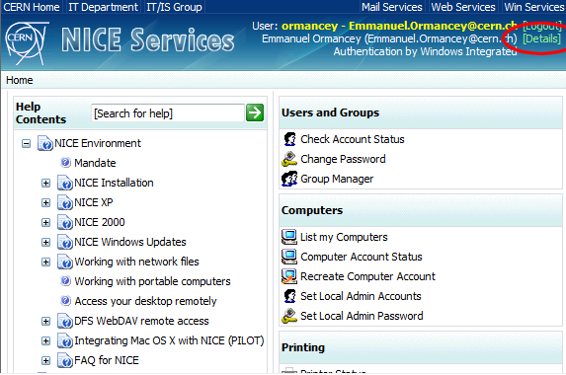
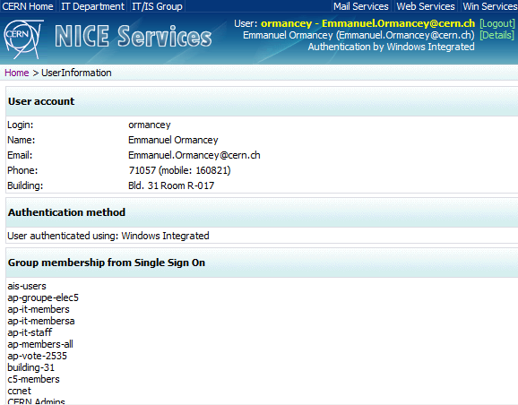
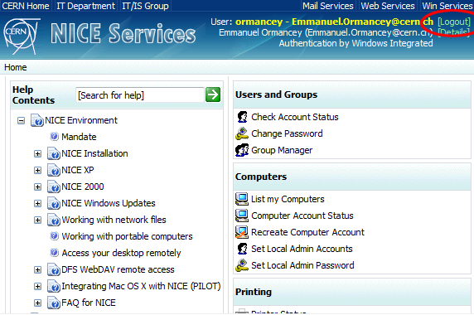
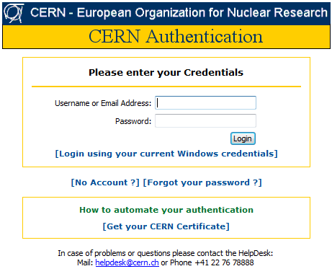
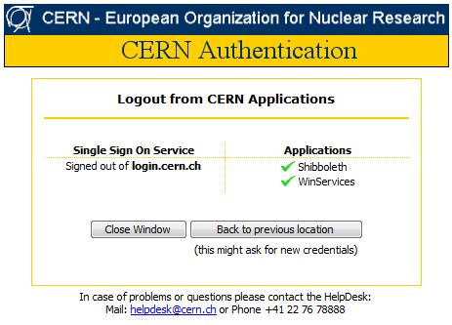
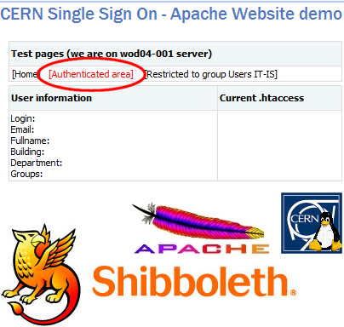
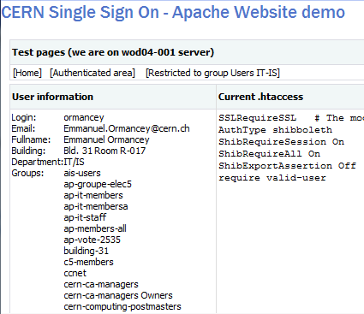
CERN Authentication
Overview

Slide 7
Technical background
Overview
Service Provider
Identity Provider
Windows + IIS
Microsoft ADFS or Shibboleth SP
Microsoft ADFS
Linux or Unix + Apache
Shibboleth SP

Slide 8
Technical background
Identity Provider
Checks identity, supports various authentication methods
Loads and shares user information: “Claims”
Microsoft ADFS based
  Active Directory Federation Services
    Credentials are checked in Active Directory
  WS-Federation Passive Requester Profile (WS-F PRP) compliant
Hosted on load balanced servers, in critical UPS area
  Minimize downtime: authentication is critical !

Slide 9
Technical background
Service Providers
SSO ‘clients’
  Allow identities to access Web Applications
  IIS module, Apache module, or application module (i.e. Java)
Windows hosted Websites
  IIS (Internet Information Services) module comes with Windows 2003 R2.
Linux/Apache hosted Websites
  Shibboleth Apache module, Open Source project (Internet2)
IIS or Apache modules replace the basic authentication modules
  Transparent for the Application

Slide 10
Technical background
Non Web applications
For NON Web ‘clients’
  Use a SOAP Web Service
    To verify credentials
    To get and verify group membership
  Requires some coding:
    Write a SOAP client
    Send credentials and decode return codes
  Not a standard: a CERN made interface (but based on SOAP standard)

Slide 11
Next Steps
Internet Services Websites are using SSO
  No major problems
Several pilots are running
  On many different platforms (Linux SLC, RedHat, Ubuntu, Solaris, Windows…)
  For many different services
Clarify account management
  Cleanup to have only one account for all services
  Use Roles to define resources access control
    No more: “close NICE Account, keep Mail account, block AIS account”
    But: “block Windows access, allow Mail access, block AIS access”.

Slide 12




Next Steps: the view
Identity Management
Made by CERN Administration
Computing Services at CERN:
Mail, Web, Windows, Unix, EDMS,
Administration, Indico, Document Server
Remedy, Oracle, …
Account
Database
HR
Database
Authentication
Access granted
Global
E-Group management
Group
membership
Authorization
Authenticated and
authorized end-user
receiving services
Unique account
Unique set of groups / roles
(for all services)
Resource owner and Service manager give authorization using :
Accounts
E-groups: default or custom

Slide 13
Links and documentation
Identity Management Plenary session
  05-Sep-2007 at 08:30, by Alberto Pace
CERN Authentication
  http://cern.ch/login
Microsoft ADFS
  http://technet2.microsoft.com/windowsserver/en/technologies/featured/adfs/default.mspx
Shibboleth
  http://shibboleth.internet2.edu

Slide 14
Questions
Questions ? Comments ?
emmanuel.ormancey@cern.ch

