Slide 1

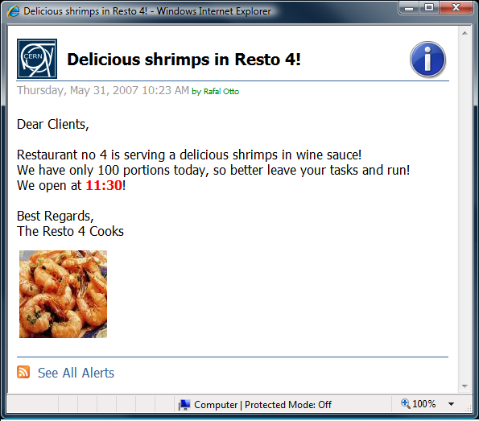









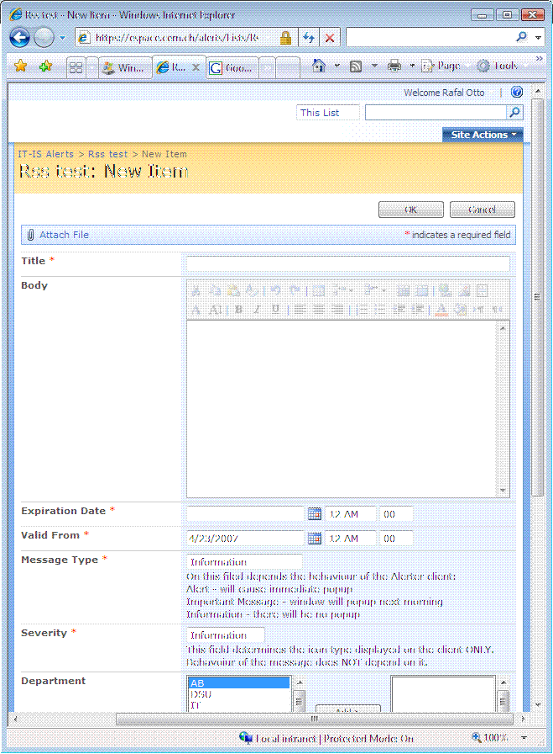
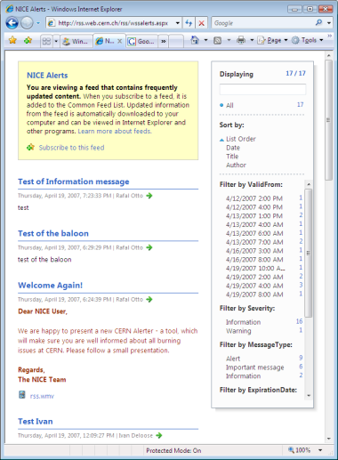

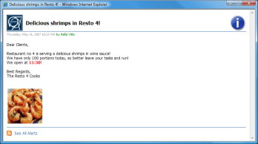



RSS based CERN Alerter
Information broadcast to all CERN Offices
Rafal Otto, Emmanuel Ormancey, CERN IT Department
email: Rafal.Otto@cern.ch, Emmanuel.Ormancey@cern.ch
CHEP 2007
International Conference on Computing
in High Energy and Nuclear Physics
2-7 Sept 2007, Victoria BC Canada
The CERN Alerter is a system giving another way of communication between corporate service managers and users community. It assures that the message has been delivered and displayed to each user who is currently onsite, sitting in front of a Windows computer. It should be used in two cases:
Figure 1. The example of the popup window with an alert message
Message Scope
Any user logged on any Windows computer is automatically subscribed to the dedicated RSS feed. It means that there are as many different feeds as combinations of active users and computers. This is a task of the front-end application to generate those feeds out of the source SharePoint RSS feed.
Each message can be therefore targeted to a group of computers or users. It means that a message, which is targeted to users from IT department will appear only in the feeds, which will have a login name of the IT user specified in the URL.
Figure 5. Messages can be targeted using buildings, departments, operating system and other attributes.
Dept.: IT
Bld.: 4
Bld. 4
PH
IT
Bld. 58
In case of an urgent message which should be broadcast immediately around the site
In case of an important message that service providers need to be sure it was read by the users
Figure 2. CERN Alerter Architecture
Message Attributes
Each message has several attributes, which determine its content, behavior and scope:
An e-mail is a natural system which could be used but it would not assure that the message has been read in case of an urgent message. A user might have an email client closed or just postpone reading it by some time. A user could as well just ignore reading important messages received.
http://cern.ch/cernalerts/alerts.aspx?login=rotto&computername=PCITIS51
https://cern.ch/alerts/_layouts/listfeed.aspx?List=16...
Thin Client
Back-End
Front-End
Message Content
  Title
  Body
  Author
  Publication Date
  Enclosure
  Severity
Message Behavior
  Message Type
  Valid From Date
  Expiration Date
Message Scope
  Department
  Building
  OS
Active Directory
Message Behavior
CERN Alerter distinguishes 3 types of messages: alerts, important messages and information messages. Depending on the type, CERN Alerter behaves differently (see Figure 4).
CMF
Full RSS
Filtered RSS
Almost all attributes determining the content of the message are standard RSS 2.0 attributes. The others are additional but still compliant with RSS 2.0 specification, which actually allows to add custom elements to feed items. It as well means that any RSS reader could be used to read messages.
Alert
Once an alert message is received by the client computer within the validity period, a window with an alert message is immediately displayed on the screen (see Figure 1.).
Posting
Alerting
IT Manager on Duty
History
Users
Important Message
Once an important message is received by the client computer, it first displays a notification balloon (which can be disabled by a user), then it waits until 6AM and then pops-up a window with an alert. It will display a window with an alert immediately after the logon as well if a logon has taken place after the first 6AM following “valid from” date.
Architecture Overview
The CERN Alerter is a solution taking advantage of standard and supported products. Any RSS reader could be used to receive messages, however we provide a Windows thin client application, which provides additional functionality like alert pop-up.
At the back-end the Microsoft SharePoint is used to provide the posting interface. Messages are then populated via the RSS to the front-end C# web application which provides filtering of messages. Filtered messages are then consumed by the Internet Explorer 7.0 RSS store. The CERN Alerter Windows client is only used to popup urgent messages on the screen and provide notification balloons.
Information Message
This type of message never pops-up any window. A user may optionally enable balloon notifications (see Figure 2.).
Figure 3. The example of the balloon notification
Non-Windows Operating Systems
As CERN Alerter is based on RSS (Really Simple Syndication) as a transport protocol which makes the system easily accessible from other platforms. It is enough then to install any RSS reader (all recent web browsers can act as RSS reader including Firefox and Safari). In order to see all messages ever sent by the central services one should then subscribe to the following RSS feed:
http://cern.ch/cernalerts/alerts.aspx
Optionally a user name and a computer name can be added to the URL in order to filter messages and see only those concerning specified user and computer:
http://cern.ch/cernalerts/alerts.aspx?login=MYLOGIN&computername=MYCOMPUTER.
In addition to message type there are two dates, which as well have an impact on the message behavior. First is the “valid from” date. A message posted by the service provider will not appear in the final RSS feed before this date. It can be useful when a service provider wants to post messages in advance. Second, is the “expiration date”. Messages, which have already expired, are still be visible in the feed, however they do not cause any window pop-up nor balloon notification.
Figure 4. Message behavior
References
CERN Alerter User Documentation
https://cern.ch/winservices/Help/?kbid=060810
CERN Alerter Documentation
https://cern.ch/alerts/Internal%20Documentation
RSS 2.0 Specification
http://cyber.law.harvard.edu/rss/rss.html

