Slide 1
FCC-hh Background Estimates
Charles Young (SLAC)

Slide 2
background simulation application

Slide 3
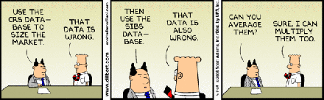
Background Simulation Program
Physics processes by FLUKA
  De facto standard for background calculations
Validated against ATLAS Run-1 measurements
Apply to FCC-hh
Predictions only as good as simulation inputs, e.g. geometry, truly represents reality

Slide 4
Simulation Geometry
Based on “Option 2”
  Twin solenoids: main + shielding
  Dipoles in forward regions
Detectors (material similar to those in ATLAS)
  Tracker
  EM calorimeter
  Hadronic calorimeter
  Muon detector
No final-focus quadrupole, other beam line elements or beam line shielding

Slide 5
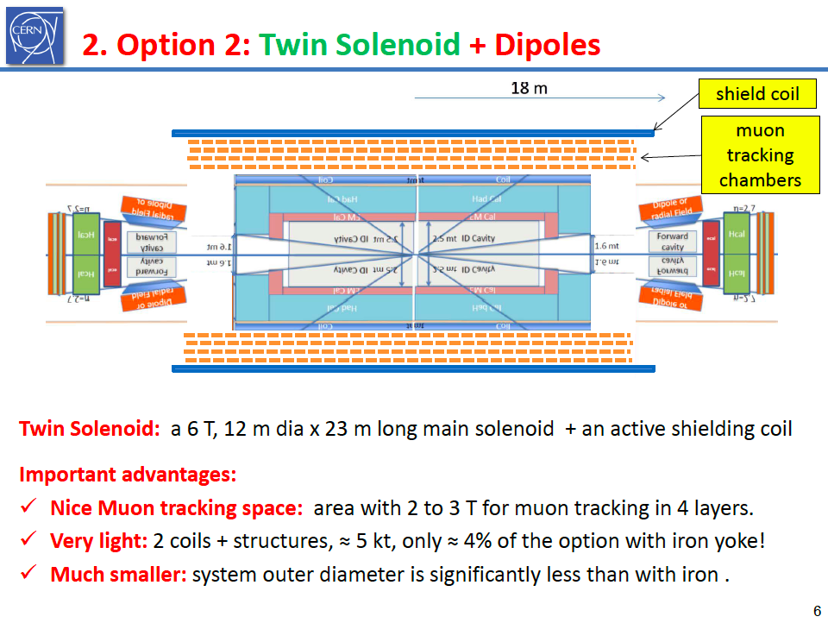
Twin Solenoid + Dipoles

Slide 6
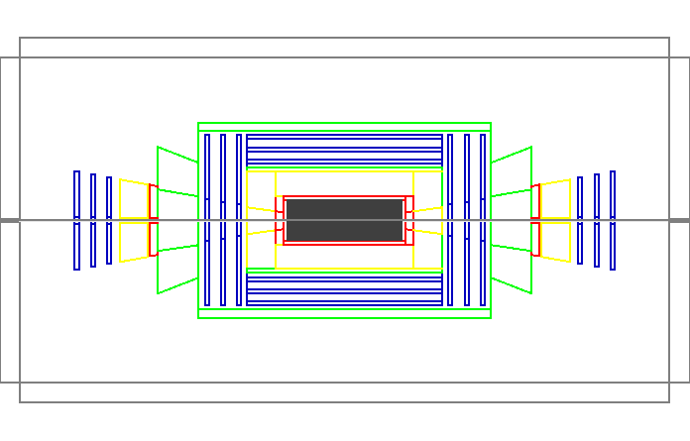
Simulation Geometry
Barrel hadron calorimeter
Shielding solenoid
Endcap dipole
Beam pipe
Main solenoid
Endcap EM calorimeter
Tracker
Barrel EM calorimeter
Endcap hadron calorimeter
Intermediate muon chambers
Endcap muon chambers
Barrel muon chambers

Slide 7
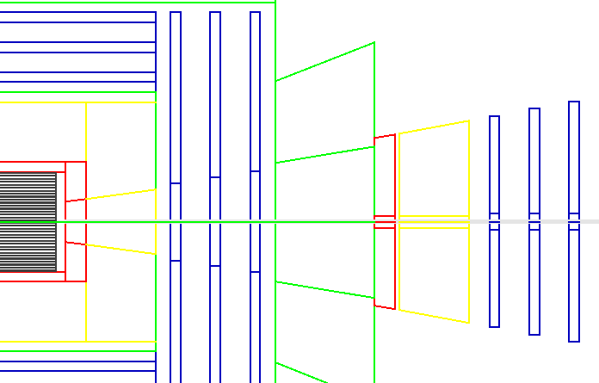
Rapidity Coverage
Shielding solenoid: z = 18 m
η=2.4
η=2.5
η=2.6
η=2.7
Main solenoid: z = 12 m
Muon detector: z = 33 m

Slide 8
Some general comments

Slide 9
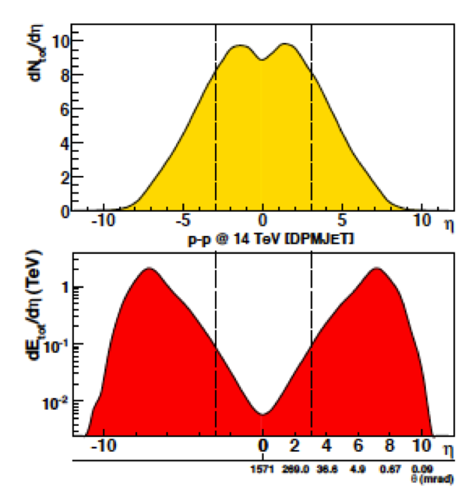
η Dependence of Background
Multiplicity flat in central η and falling for large η
Outgoing energy peak at larger η
  η_{peak} ~ 7 – 8 for √s = 14 TeV
Background typically much more benign in barrel region than in endcap / forward regions
Note logarithmic scale

Slide 10
Beam Pipe
(Radially) thin beam pipe is O(1) interaction length at η_{peak} due to glancing incidence angle
  Flange: near normal incidence ➔ “thin”
Small radius near IP for physics performance
Larger radius (away from IP) ➔ shower initiation point further away in z
  r = 3 cm for z < 7.5 m and 6 cm for z > 7.5 m
z(m) | r = 3 cm | 5 | 10 | 15
η = 4 | 0.8 | 1.4 | 2.7 | 4.1
5 | 2.2 | 3.7 | 7.4 | 11
6 | 6.1 | 10 | 20 | 30
7 | 16 | 27 | 55 | 82
Inside barrel
After endcap

Slide 11
Barrel Tracker
Two broad categories of background
  Direct p-p interaction products
    Multiplicity slow function of √s
    Dose per particle insensitive to particle energy
  Back scatter from calorimeters
    Inner part of calorimeter acts as shield against outer part of calorimeter
    Larger inner radius ➔ lower background density
Background probably not much worse than in LHC (for the same luminosity)
  Beware end of barrel staves, i.e. high η

Slide 12
Barrel Calorimeter
Self shielding (but every shield is also a source)
  Rapid decrease in background farther from IP
Radiation damage concerns primarily for sensors at inner radius locations
  Degree of vulnerability depends on sensor: LAr, crystals, plastic scintillators, Si, etc
Front-end electronics concerns greatly reduced if located at outer radius
  Not obviously a problem if embedded within calorimeter

Slide 13

Barrel Muon Detector
Calorimeter expected to provide better shielding in FCC-hh than in LHC
  Calorimeters becoming thicker
  to contain hadronic showers
  of high p_{T} hadrons in FCC-hh
  Background dominated by min-bias events
    Slow rise in jet and particle energy
    Shower length ~ log(E)
Expect tolerable background when shielded by calorimeter

Slide 14
Unshielded Barrel Muon Detector
Direct line of sight to bare beam pipe

Slide 15
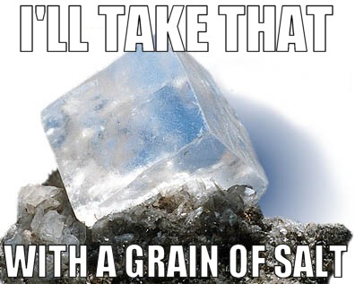
Endcap Background
Very sensitive to details of beam-line geometry
  Arbitrary choice of beam pipe diameter
  No shielding in this simulation
  No final-focus quadrupole
  No masks / collimators
Strong function of radius
Endcap results should be
treated as qualitative at best

Slide 16
Background estimates

Slide 17
Simulation Inputs
Events
  Generated by Phojet
  √s = 100 TeV
Normalization assumptions
  σ_{pp} = 100 mb
  “year” = 10⁷ sec
  Instantaneous luminosity = 10³⁶ cm⁻² s⁻¹
  Rescale to suit your assumptions

Slide 18
Simulation Outputs
2-D distributions in (r,z)
  Implied azimuthal symmetry
Energy deposition map reflects simulation geometry
Dose and fluence maps for background
  Directly read off value at any (r,z)
  Take slice at given z and plot as function of r or vice versa

Slide 19
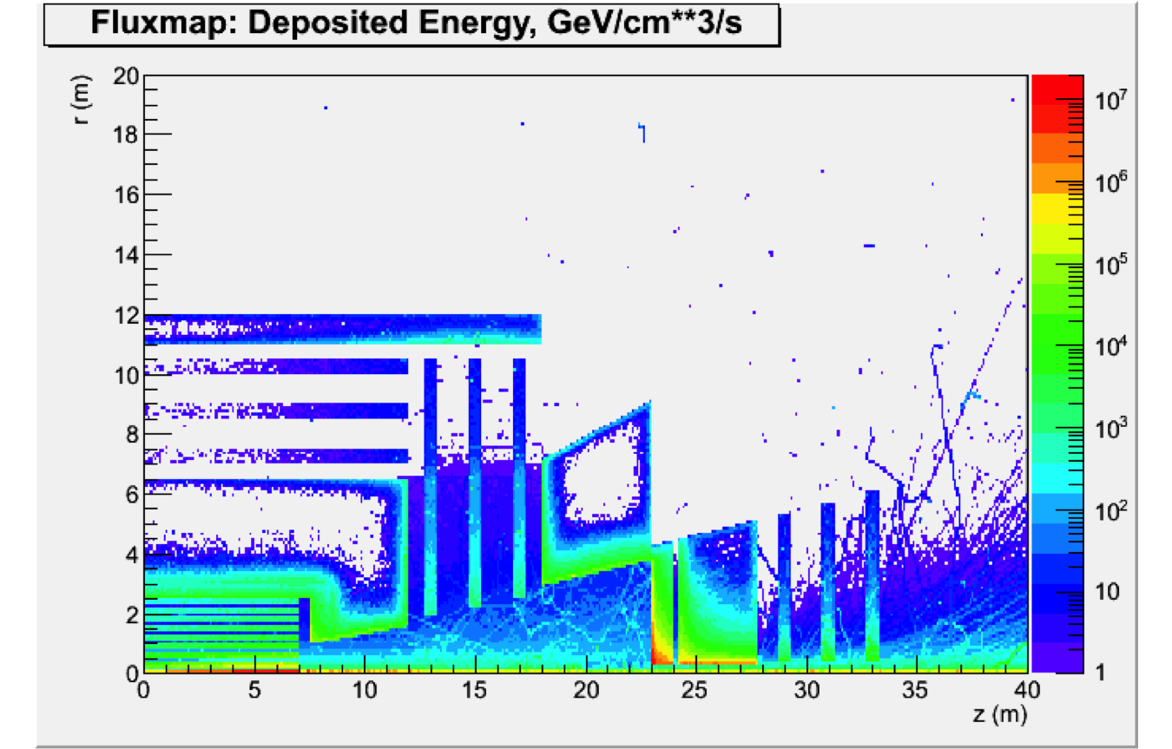
Energy Deposition

Slide 20
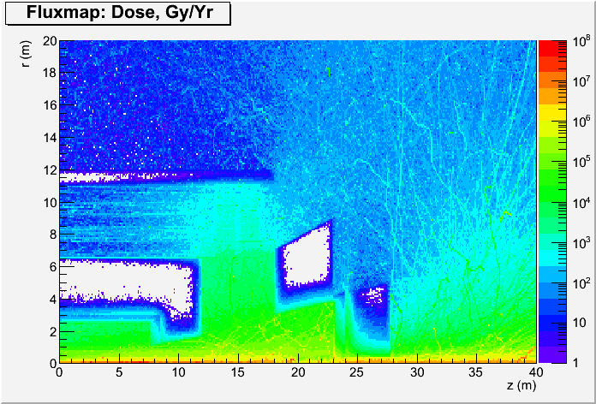
Total Ionizing Dose

Slide 21
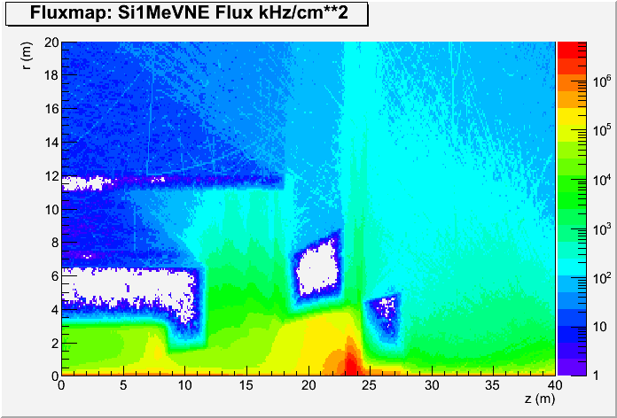
1-MeV n_{eq} Fluence
At least 1 order of magnitude difference between shielded and unshielded muon regions
Endcap calorimeters

Slide 22
Tracker
Background decreases with r and increases with z
  Longer path length in beam pipe
Highest background at end of first layer
  Dose ~ 5 10⁷ Gy / year
  Fluence ~ 1.7 10⁶ kHz / cm²
Results sensitive to input geometry
  Aluminium beam pipe at r = 3 cm
  First detector layer
    r = 5 cm
    Length = +/- 7 m
  No service material
η ~ 5.5 (surely not a rational layout)

Slide 23
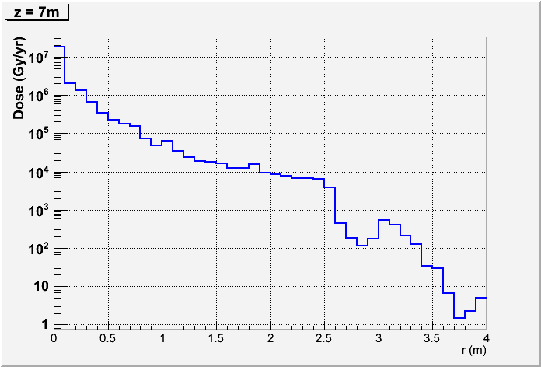
TID in Barrel Calorimeter
ECal
HCal
4000
500

Slide 24
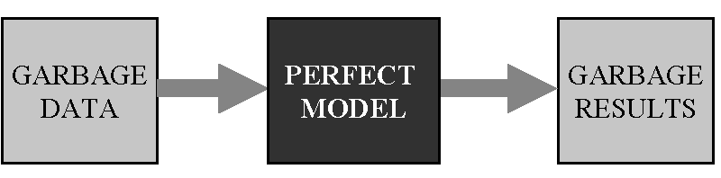
“Maximum” in Calorimeters
More reliable
Depends on position
Very sensitive to beam line shielding etc
ECal
 | Barrel | Extended Barrel | Endcap
Dose (Gy/year) | 4 10³ | 6.5 10⁴
Fluence (KHz/cm²) | 6 10⁴ | 2 10⁵
~ 10x
HCal
 | Barrel | Extended Barrel | Endcap
Dose (Gy/year) | 5 10² | 3 10⁴
Fluence (KHz/cm²) | 7 10³ | 6 10⁵
~ 100x

Slide 25
Muon Detector
Relatively benign environment in shielded barrel region, i.e. z < 12 m in this layout
Much worse background in unshielded barrel region, i.e. 12 < z < 18 m
Endcap background strong function of geometry
 | Barrel Shielded | Barrel Unshielded | Endcap
Dose (Gy/year) | 100 | 1000
Fluence (KHz/cm²) | 10 | 500

Slide 26
conclusion

Slide 27
Summary
Background simulation application validated using ATLAS Run-1 data
  Much can be done on back of envelop
Final-focus quadrupole magnet and beam line shielding missing in FCC-hh geometry
➔ endcap predictions not to be trusted and
therefore numerical results not reported here
Barrel predictions more robust
  Backgrounds likely tolerable
  Avoid unshielded path from beam line

Slide 28
Suggestion
More realistic layout in forward region depends on
  Machine parameters such as luminosity, L*
  Physics requirements such as η coverage
  Beam line shielding (but shielding is also source)
More reliable endcap background estimates
Iteration likely to be required
Do not worry too much about barrel now
Technological advances in next decades will likely supersede any detailed planning today

