Slide 1
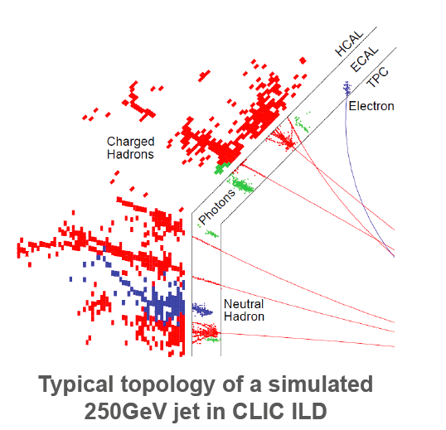
Prospects for Silicon based
High Granularity Calorimeters
at the FCC
Left and right pictures by C0rtada

Slide 2
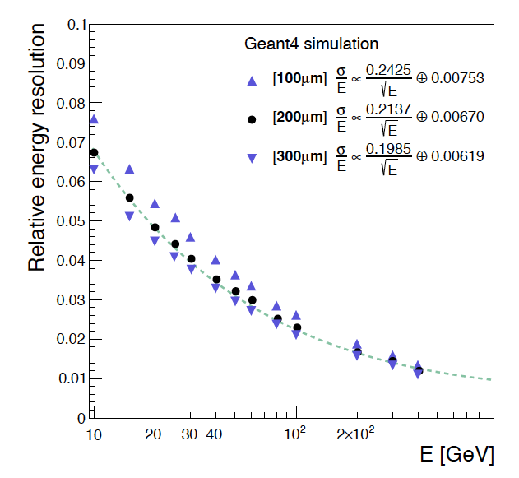
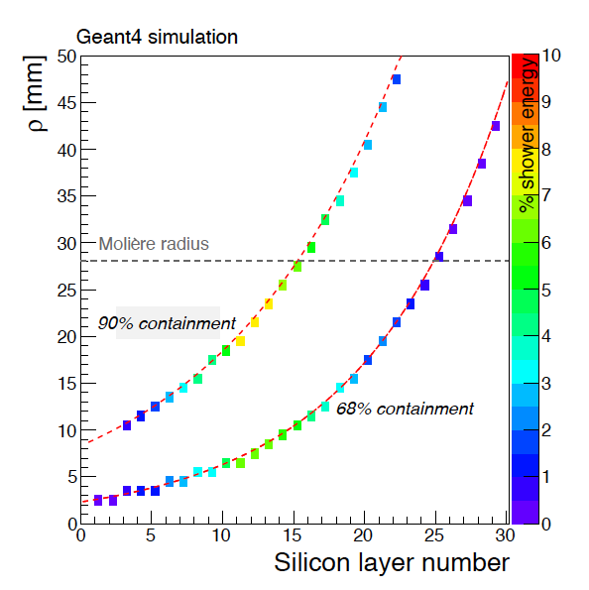
Si-HGC EM Showers

Slide 3
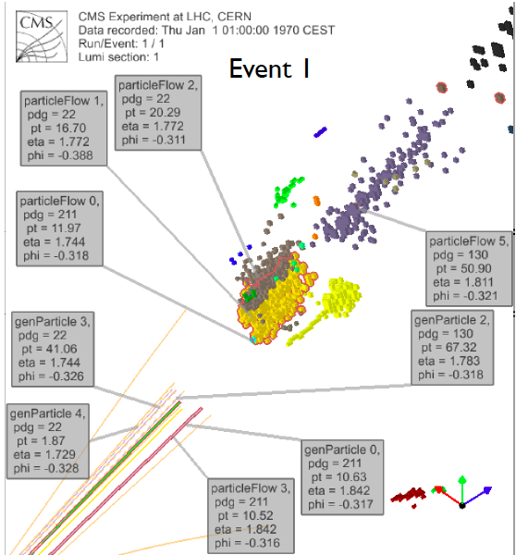
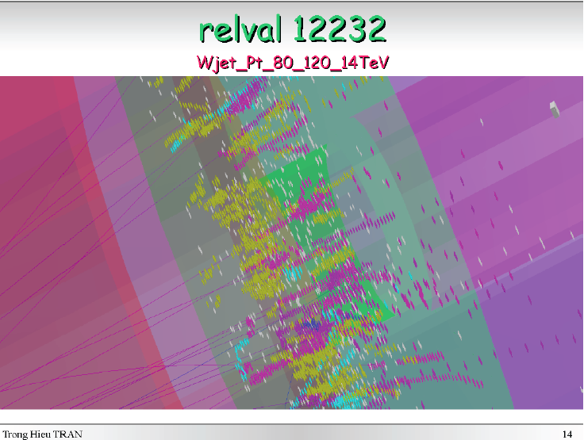
Si-HGC Event Displays
Si-HGC extends Tracking into Calorimeter
Provides good cluster energy resolution,
very detailed topological information
and excellent two-particle cluster res0lving power
Ideally suited for Particle Flow reconstruction
in a high particle density environment

Slide 4
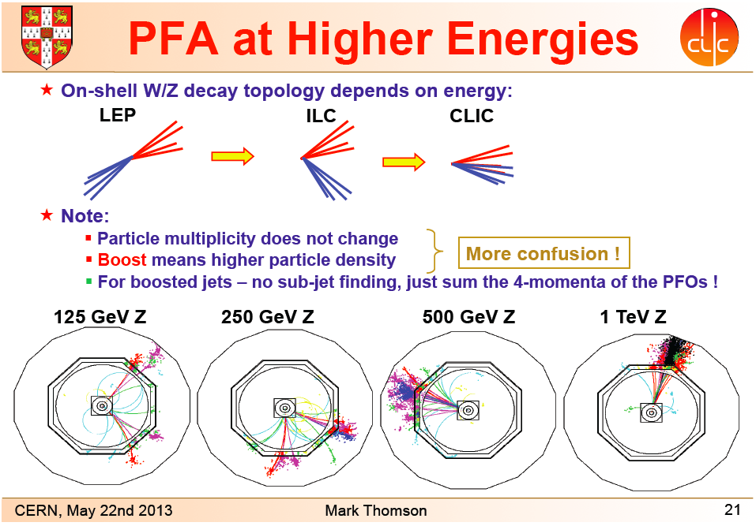
ILC/CLIC

Slide 5
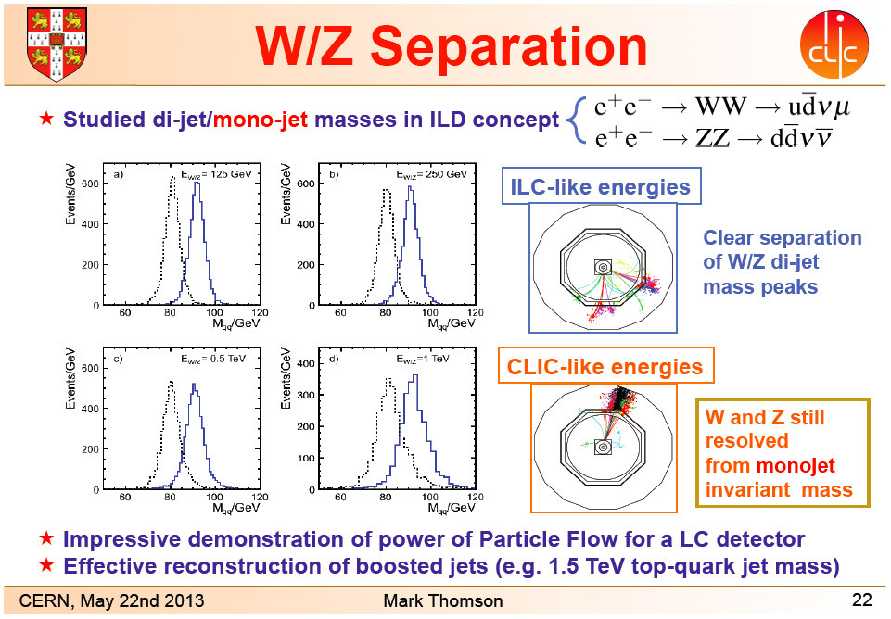
ILC/CLIC

Slide 6
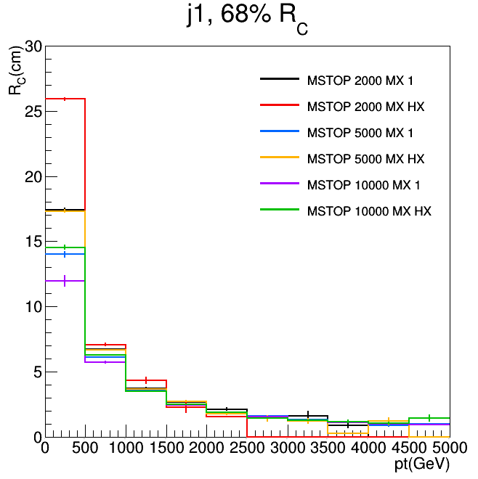
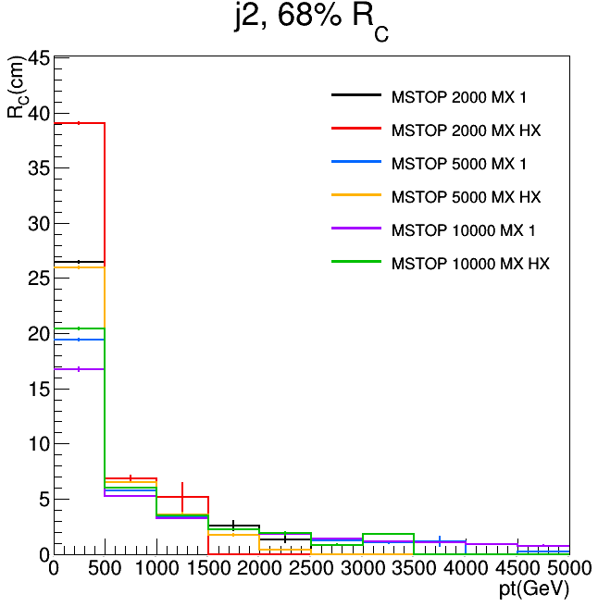
Jet size versus parton p_{T}
Containment of 68%
  Radius is at the level of a few cm for parton p_{T} above 1 TeV

Slide 7
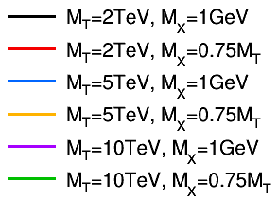
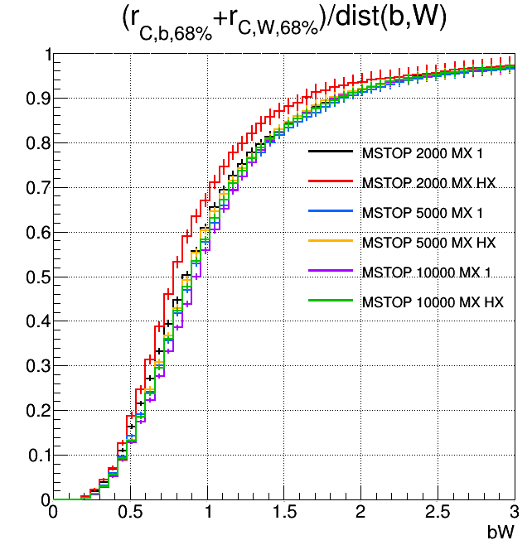
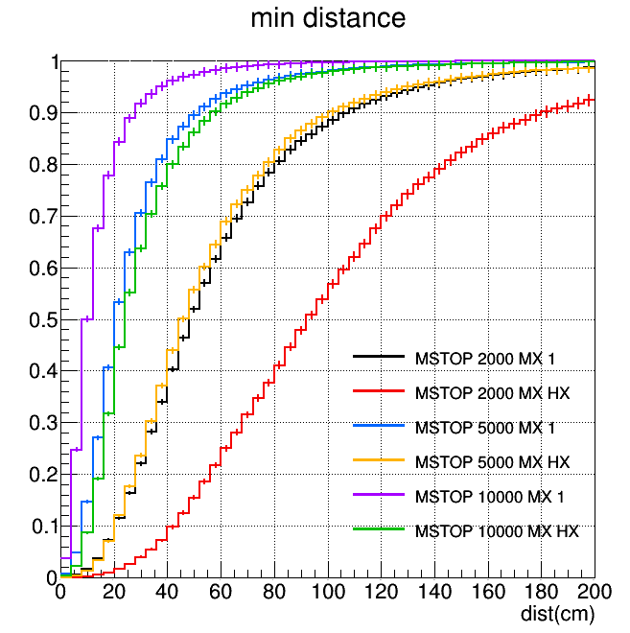
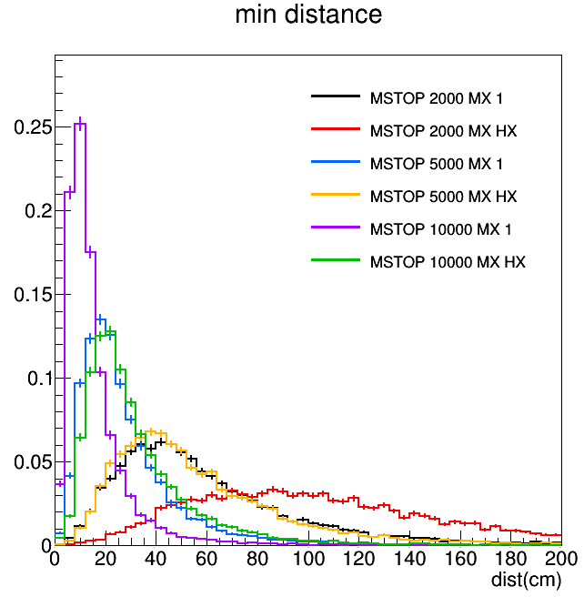
Highly collimated final state
Minimum distance between any two parton’s centroids
Separation of centroids at face of ECAL
  Minimum separation between the centroids of any pair of jets
    Often less than 10 cm for a 10 TeV state
  Can they be separated?
Compare size to separation
  At right the sum of radii at 68% containment of b and ‘W’, divided by centroid separation
  High degree of overlap independent of mass
    But relevant distance scale falls dramatically with p_{T} (see previous slides)

Slide 8
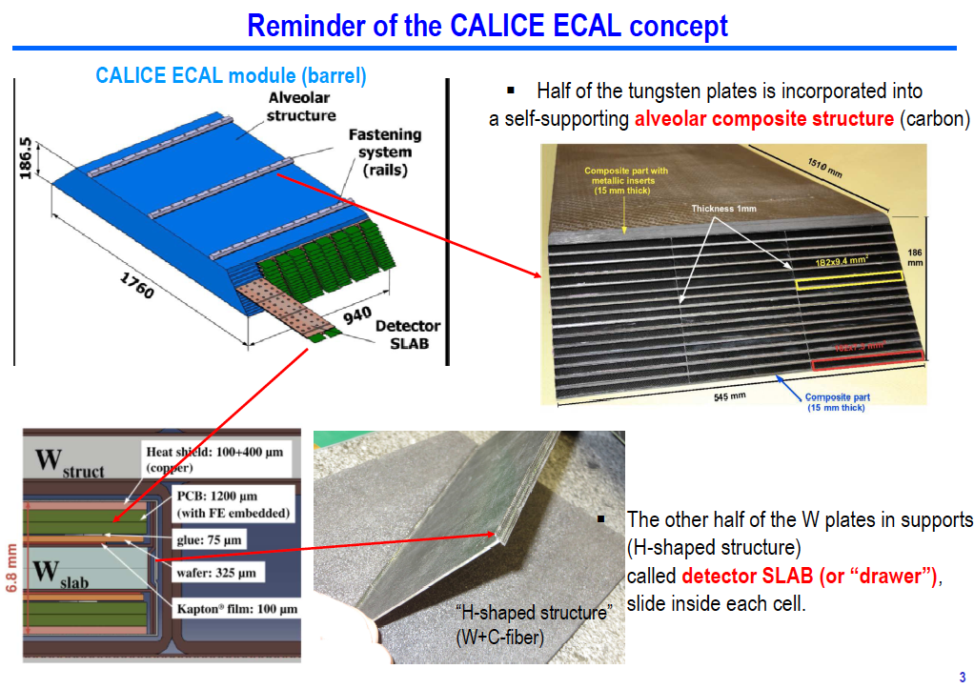
ILC Like structure for FCC-HGC

Slide 9
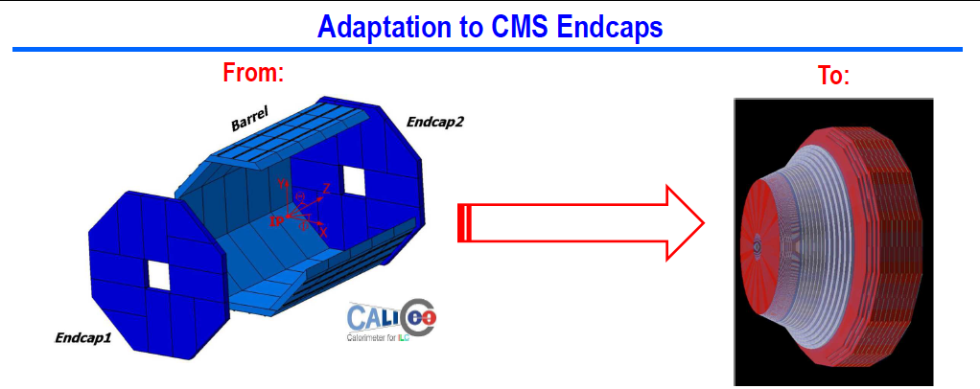
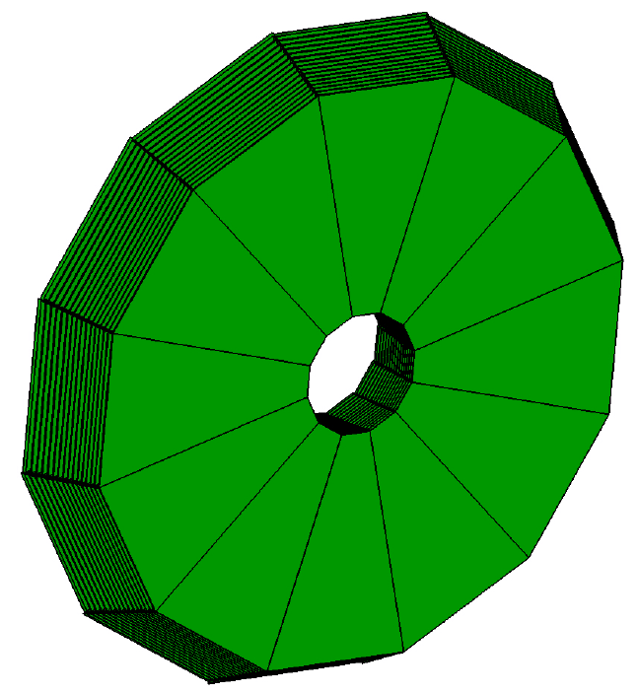
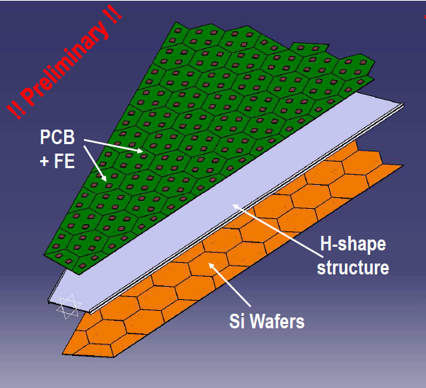
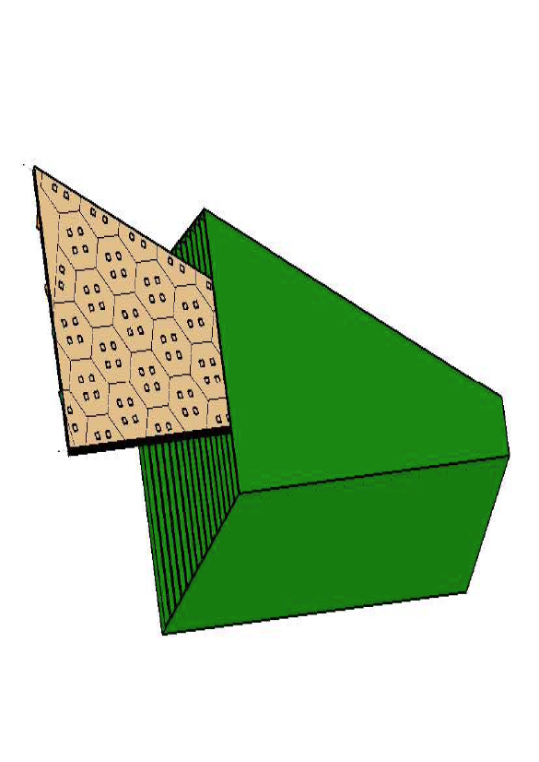
ILC Like structure for EE-HGC

Slide 10
ILC-like structure for FCC-HGC
Big Differences include
Power consumption, cooling, & Data rates
Radiation and -30⁰C operating temperature
  Thermal enclosure & services feed-troughs
Profit from synergy with Tracker R&D
  Sensors, cold operation & CO₂ cooling, Power & Read-Out

Slide 11
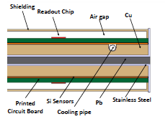
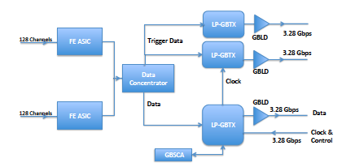
Power consumption, cooling & data rates
The CMS study
Power ranges from ~ 100W/m² in Barrel
(300um thick sensors and 1cm² cell size)
Up to ~ 250W/m² in End-Cap
(100um thick sensors and 0.5cm² cell size)
Operate Silicon at -30C⁰ (-35C⁰ if possible)
Exploit low cell occupancy and steeply falling energy spectrum, with simple data compression algorithm
CMS: from 1~2Gbps/Module up to ~8Gbps/Module in End-Cap; Dominated by L1 Trigger data
Expect ~ *2 at FCC

Slide 12
Typical Si-HGC parameters
Electromagnetic 26 ~ 28 X⁰ ( ~ 1 λ)
  30 sampling layers
    Silicon surface (very rough estimate!)
      For Large CMS-like Solenoid ~ 3’000m²
      For Very Large Double Solenoid ~ 10’000m²
  Cell size 0.25 ~ 1cm²
  Gap between absorber layers ~ 4mm
Front Hadronic ~ 4 λ
  12 ~ 20 samples sampling layers, cell size ~ 1cm²
    Silicon Surface & Number of Channels (very rough estimate!)
      For Large CMS-like Solenoid 3’000 ~ 6’000m²
      For Very Large Double Solenoid 7’000 ~ 14’000m²

Slide 13
Some Issues & Challenges for HGC
Si-HGC: Cell sizes mm² ~ cm²
Radiation tolerance
  Thin sensors vs noise & MIP sensitivity
    Essential for Calibration
Dynamic range vs technology
  MIP -> 100~200pC !
  Complexity, Power dead-time & pile-up sensitivity
Stochastic term
  EM ~20% for ~ 30 layers

Slide 14
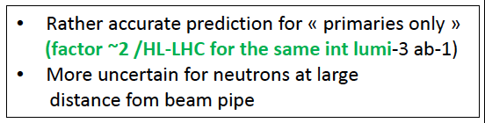

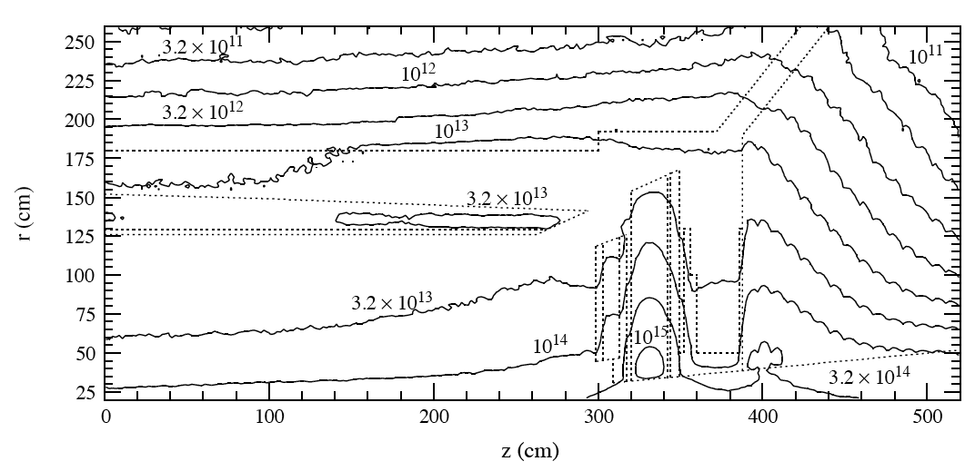
Radiation Maps (CMS ECAL TDR)

Slide 15
HGC Silicon sensors
CMS Preliminary
4’000e⁻
300μm
200μm
120μm
3’000e⁻

Slide 16
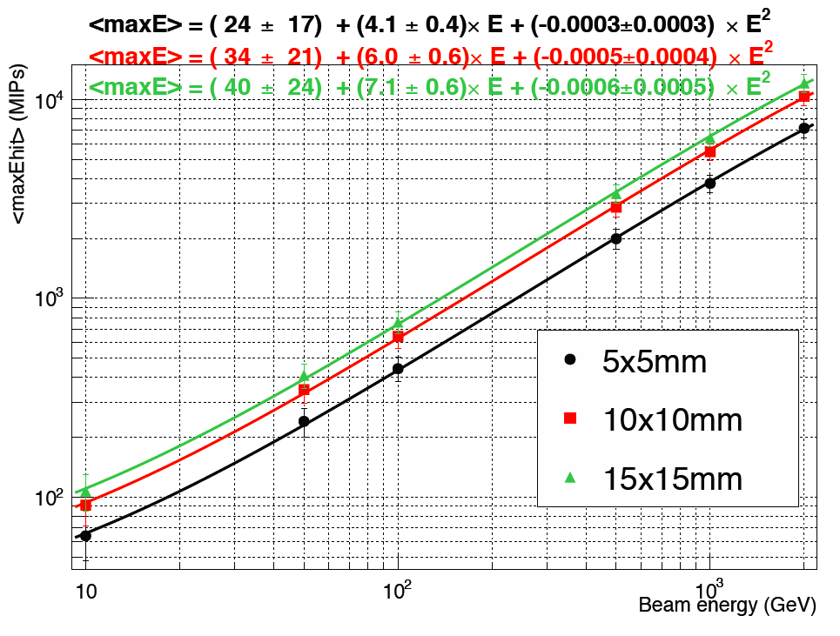
Si-HGC 50-2’000 GeV EM Showers
3’000MIP
~500GeV

Slide 17
CMC HGC FE ASIC Study
Developed HGC FE ASIC design which meets our performance requirements
  Uses ToT to provide low noise (2’000e-) and cover full dynamic range
    Full SPICE simulation of analogue performance
    ADC and TDC based on existing designs
  Potential for ~50ps timing for each cell in core of showers with E_{T} > 2~ 3 GeV
    More on this later
  Potential issues related to this design being investigated
Have also simpler back up design
  Lower gain to avoid issues associated with saturation
    Higher noise (11’000e-) => not sensitive to single MIP, requires dedicated channels for MIP calibration

Slide 18
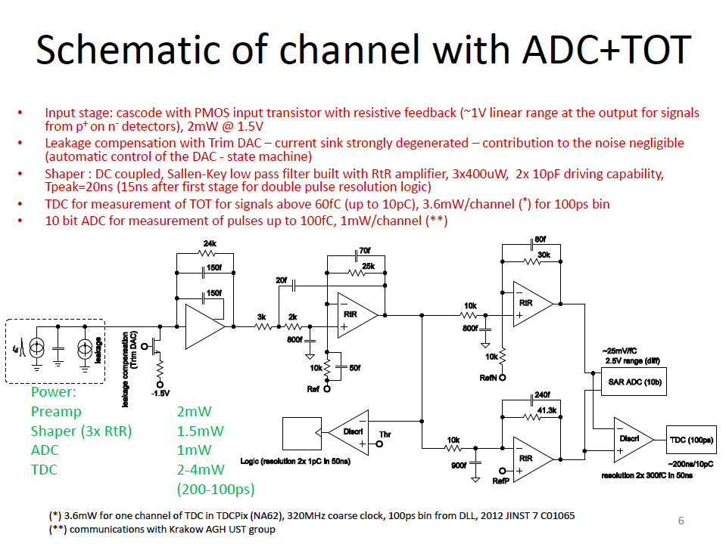
CMS HGC ToT FE ASIC Study
Jan Kaplon (CERN)

Slide 19
HGC ToT in high Pile-Up
Operating an FE ASIC where large energy deposits result in a ToT which can span several bunch crossings raises a number of questions
  Dead-Time due to high energy, long ToT cells, from bx’s prior to the triggered event, could lead to inefficiency
  Integration of PU from bx’s following the triggered event, for high energy, long ToT in-time cells, could degrade the energy resolution
    Nb these concerns were motivations for the back-up up design, which uses low gain to avoid saturation, at the cost of higher noise

Slide 20
What about an UHGC?
Cell sizes << mm²
  Ideal goal would be cell occupancy 0 or 1
    ~10um*10um cell size…
Radiation tolerance
  Very low noise => thin depletion volume ok for MIP
    Essential for calibration
Dynamic range vs technology
  1 ~ few MIP’s depending on cell size
  Complexity shifted to data compression/reduction, clustering
Stochastic term
  In the limit of ideal binary MIP counting regime could remove dominant effect of Landau fluctuations
  EM ~10% for ~ 30 layers
    to be verified

Slide 21
Summary and Conclusions
Si-HGC extends Tracking into Calorimeter
  Provides good cluster energy resolution
  very detailed topological information
  and excellent two-particle cluster resolving power
Ideally suited for Particle Flow reconstruction in a crowded environment
  Baseline choice for ILC/CLIC
Technologically feasible for High Luminosity PP colliders
  An option under study for the CMS HL-LHC End-Cap upgrade
  An interesting option for the FCC
    MAPS technology and UHGC: very interesting avenue to explore
Integrated precision timing an interesting R&D

Slide 22
Backup

