Slide 1
Advanced CMOS and Interconnect Technologies
A. Marchioro / PH-ESE

Slide 2
Topics
CMOS
  Current state of the art
  Obstacles ahead
  Perspective solutions and ITRS predictions
Interconnect
More than Moore
Conclusions
  What to do
Mildly technical
Highly non-technical

Slide 3
What do we want from a transistor anyway? (sorry engineers…)
A transistor (a digital transistor) is a device that has to have the following characteristics:
  to work as a switch (on or off)
  make a transition between the two states in a time as short as possible
  has no leakage current when off (<< 1 nA)
  has to deliver high current when on (to drive strongly the next stage).
    Unfortunately this it is not uncorrelated from the previous requirement
  make a transition between the two states with a voltage drive (Vg) as small as possible
  be physically small (otherwise other “parasitics” ruin the party)
Good “analog” characteristics are desirable but by far not necessary or even important for the the majority of applications.
Notes:
CMOS is not primarily made for HEP, so we want to understand what industry seeks with new generations of technology

Slide 4
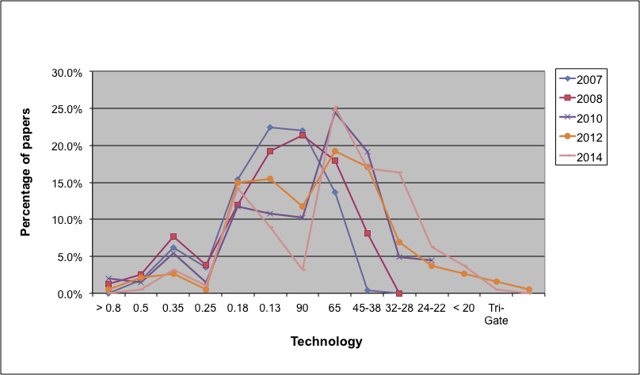
Moore’s law (another view)

Slide 5
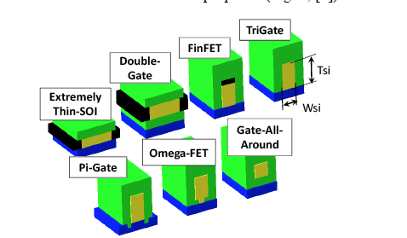
Brief overview of state of the art
Intel Tri-gate
TSMC Finfet
STM FDSOI
from: “The Ultimate CMOS Device and Beyond”,
K. Kuhn, IEDM 2012

Slide 6
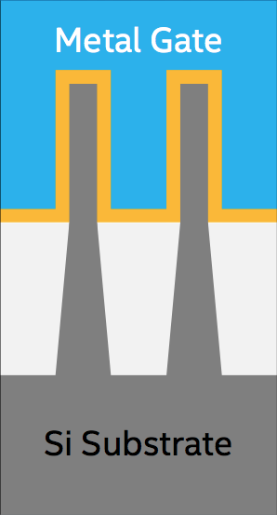
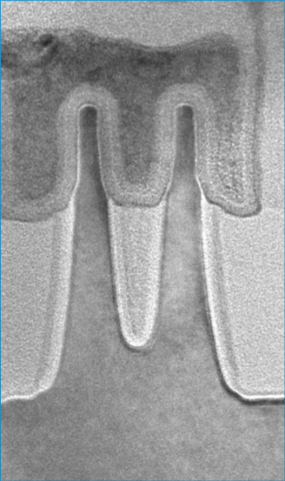
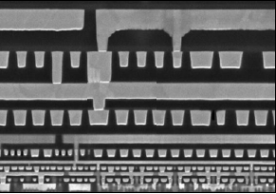
Intel TRI-Gate
42 nm
14 nm
42 nm
Source: Intel
Metalization detail
Notes:
Bring FINFET model
Bring Silicon molecular model

Slide 7
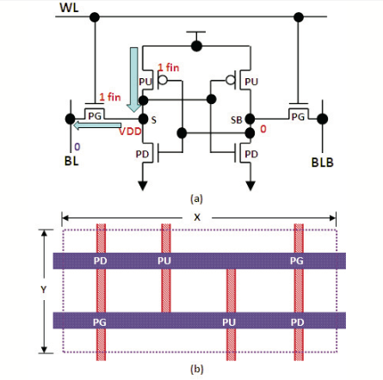
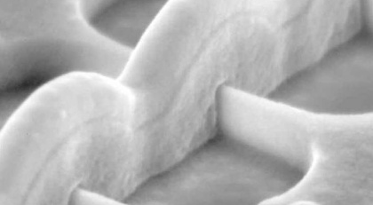
TSMC FinFET
FinFET based SRAM,
0.07 μm² per bit,
presented at ISSCC 2014
Notes:
Frpm ISSCC 2014: 13.5 A 16nm 128Mb SRAM in High-κ Metal-Gate FinFET Technology with Write-Assist Circuitry for Low-VMIN Applications

Slide 8
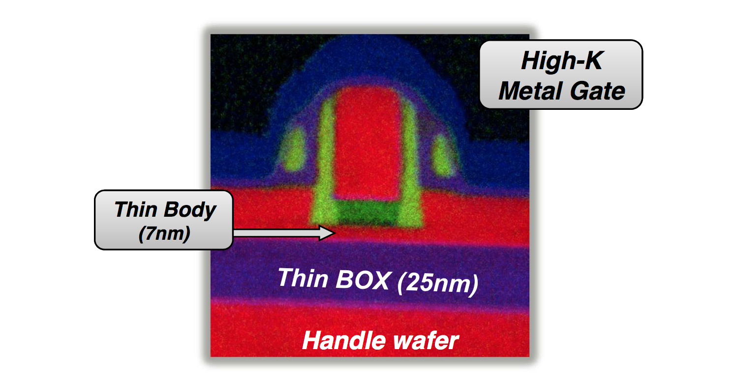
STM FDSOI

Slide 9
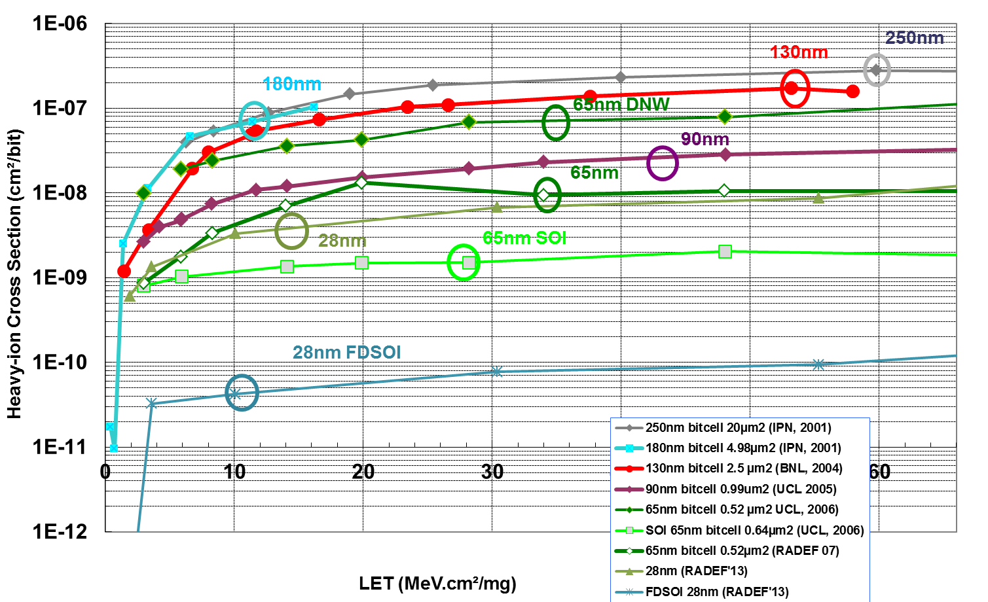


Soft Error Rate in SRAMs for Space
  Lowest (best) error rates against space ions in 28nm UTBB FDSOI
  3 and 2 decades lower respectively than CMOS 65nmn and 28nm (no SEGR/SEL)
Arbitrary units
Normalized heavy ion error rates
no mitigation
28nm FDSOI
Courtesy of P. Roche, STMicroelectronics
Ion’s ionizing power
Roche,
ESA QCA Days
07’09’11’
NSREC’14

Slide 10
CMOS generations ahead
Tricks already in use (apart from geometrical shrinking):
  High K gate dielectric Reduces gate leakage
  Strained SiGe channels Increase mobility
  Metal gate Reduces gate resistance
  More metallization layers Increases density
  Low K inter-metal dielectric Reduces cross-capacitance
  Cu wires Reduces interconnect resistance
In production: 16-14 nm FinFET
…
…
Hard Limit: 7nm, perhaps 5?
Speed of advancement: 1 generation every 2 years
… Not much room ahead

Slide 11
Exotic materials and processes
Higher mobility:
  III-V materials (a la GaAs and others)
  Ge
Better sub-threshold control
  FinFET -> Vertical cylindrical devices
Higher density
  3D assemblies (wafer on wafer)
  Real 3D monolithic ICs
Exotic
  Ferroelectric memories and resistive RAMs
  Quantum devices
…

Slide 12
What is scaling all about?
Speed?
Low Power?
High density?
A combination of the above?
 | Speed | Power | Density
CMOS (until now) | ☺ | ☺ | ☺
III-V or Ge ^{[1]} | ☺ | ☹ | 😐
New devices with enhanced Sub Slope | ☺ | 😐 | 😐
3D | ☺ | ☹ | ☺
Quantum | ? | ? | ??
___NOTES______________________________________________________________________________________________________
[1] Intrinsically not “scalable”, i.e. one generation of advantage, and then?

Slide 13
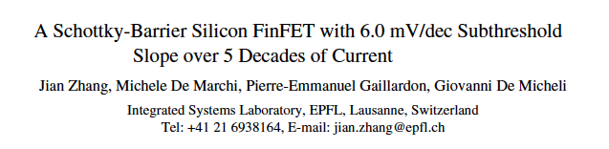
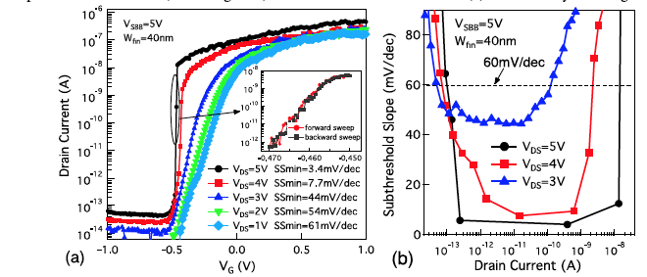
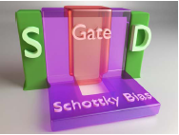
High STS example
(Notice that unfortunately the SS is steep only for high V_{DS}!)

Slide 14
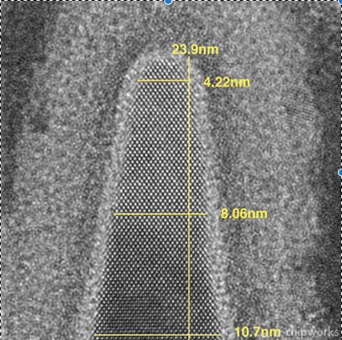
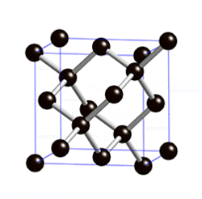
ITRS 2013
from Wikipedia

Slide 15
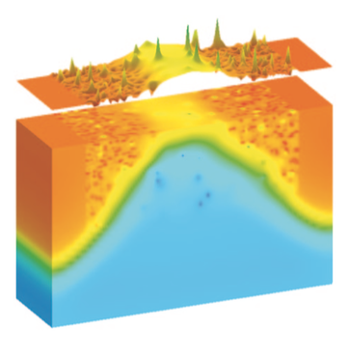
Major Issues to be solved
Lithography below 190nm
  The lack of a “projector” with λ << FS is forcing very expensive solutions (double patterning, OPC etc.) and pushes the level of capital investment necessary for new fabs to ever higher limits.
Manufacturing yield
  Complex lithography results in “slow” wafer exposures, i.e. too low productivity.
Atomic variability
  When number of individual atoms can be counted in insulators, gates and implants, Poisson eventually ruins the party
Intrinsic reliability
  Very small devices may be intrinsically less robust than older generations, but perhaps given our high level of “consumerism” this may not be a problem (except for some applications)
From:
Modeling and Simulation of Statistical Variability in
Nanometer CMOS Technologies
A. Asenov and B. Cheng ,
Springer, 2011

Slide 16
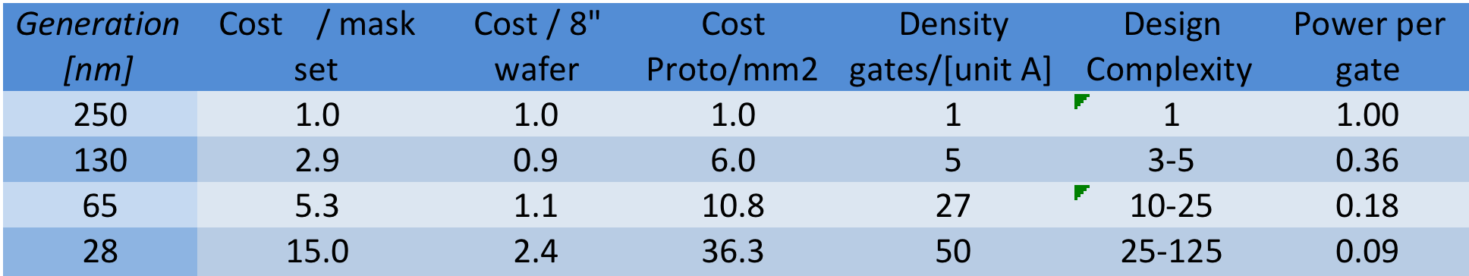
Costs/Performance[$]
Bad news
Good news
__________________________________
[$] Normalized to 250nm generation

Slide 17
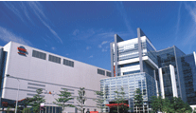
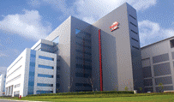
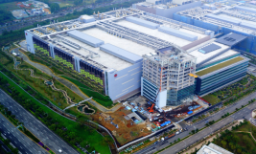
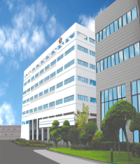
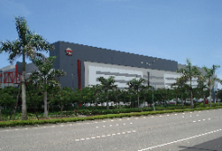
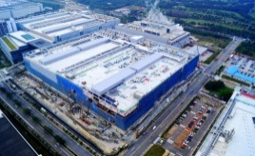

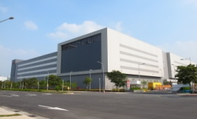
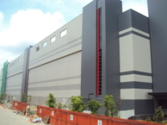
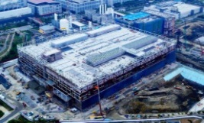
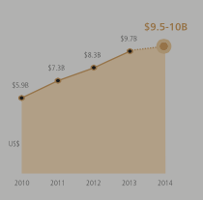
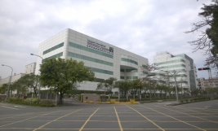
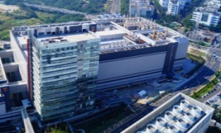
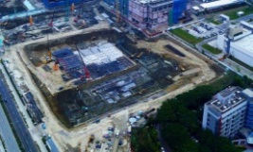








TSMC Manufacturing Fab Locations
6” & 8” Fabs
12” GIGAFABs
6” Fab
8” Fabs
8”Fabs overseas
GIGAFAB 12
GIGAFAB 14
GIGAFAB 15
Fab 2
Fab 3
Fab10 (China)
P1 + P2
P1 + P2
P1 + P2
Fab 5
Fab11 (USA)
P3
P3
P3 + P4
Fab 6
SSMC (Singapore)
P4
P4
Cost > 5B$
Fab 8
P5
P5
Capex
Courtesy of K. Josse, TSMC,
and TSMC 2013 Business Overview
Affiliate Fab (Vanguard)
P6
P6

Slide 18
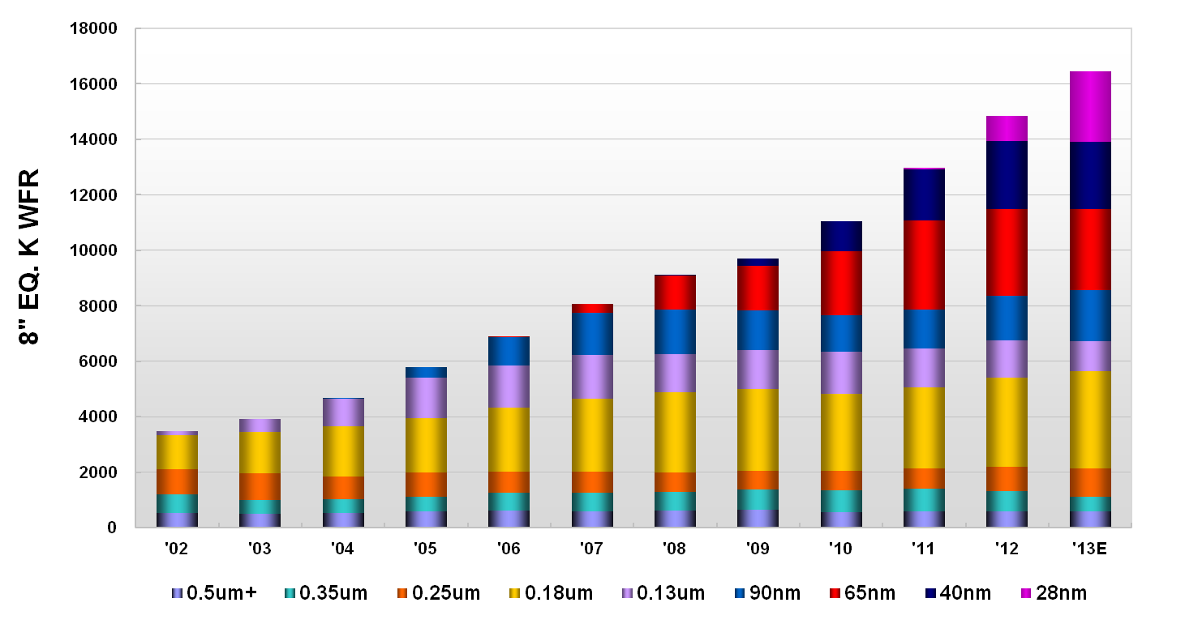
Installed Capacity by Technology
Courtesy of K. Josse, TSMC

Slide 19
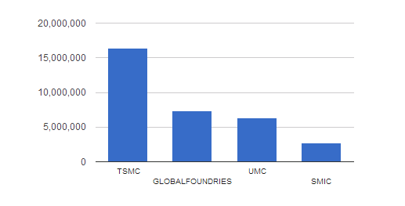
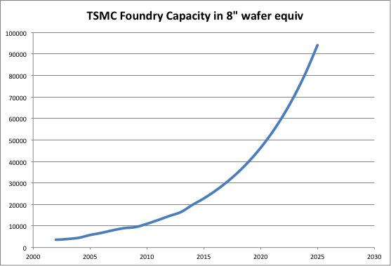
Is HEP a significant customer?
Foundry capacity in 2013
Assuming a 1,000 m² all Si detector, this corresponds to ~33,000 8” wafers
Source: IC Insight
Notice that in 2014 the revenue of TSMC
was ~ 42% that of Intel or 56% that of Samsung.
Data Forecast

Slide 20
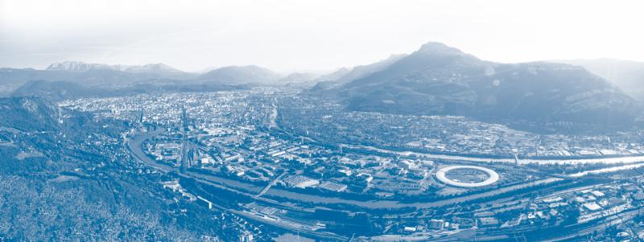
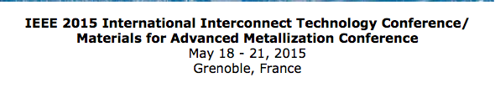
Interconnect and packaging

Slide 21
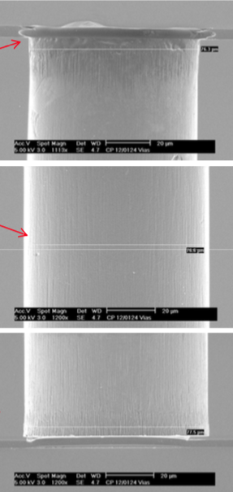
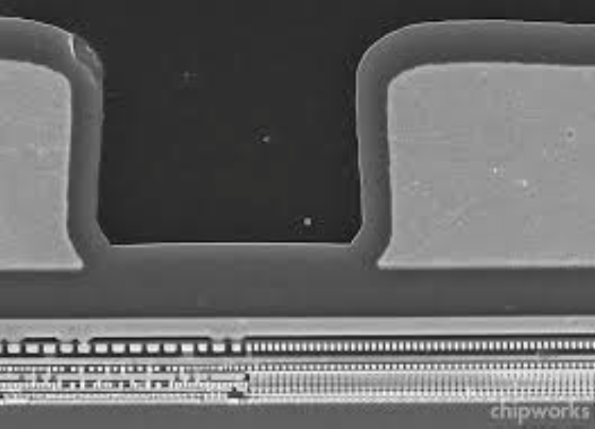
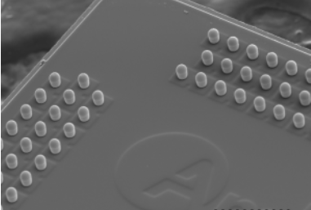


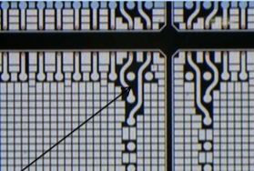
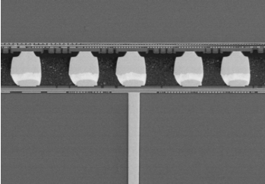
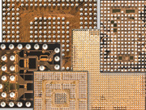
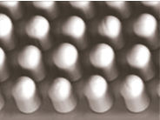
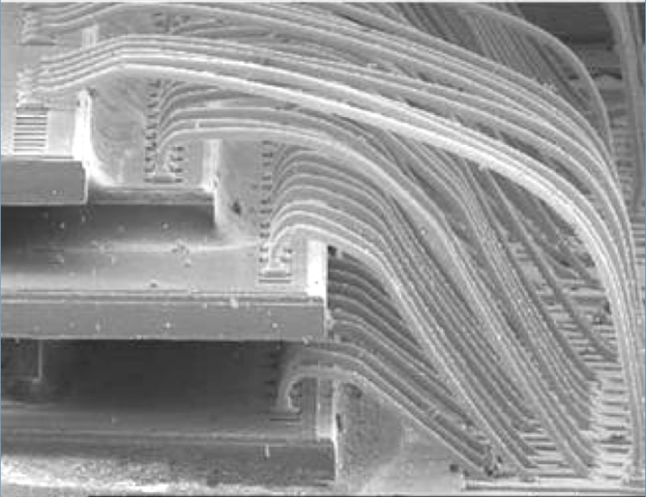
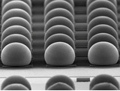
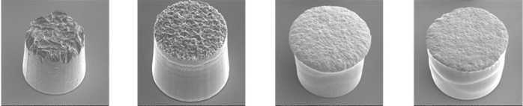
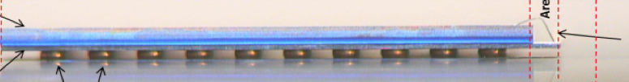
Interconnection and Packaging
TSV
Via First, Middle, Last
PoP
FCmBGA
W-2-W bonding
Cu-Pillar Microbump
WLFO
CoG
Si Interposer
WLCSP
CSP
TSV:
cell level, block level, IO Level
Indium bumps
Flip-Chip
D-2-W

Slide 22
Interconnection solutions
Technology | Cost | Applicable in | Perspective Volume
HD TSV | Very High | Specific ASICs Multi-tier ASICs | Low Low
LD TSV | Medium | Sensor to ROIC | Medium to High
CoG | Low | Strip readouts | Low
Microbumps | Low | Hybrid-pixel | Low
W-2-W | Medium | Large area detectors | High
Interposers | Medium | High density Hybrids | Low to medium

Slide 23

With so many solutions, what is the problem?
The variety of packaging solutions offered by industry is staggering and already today widely sufficient for most and perhaps all HEP applications
Except that:
  There is a huge fragmentation of suppliers
  Entry fees are high
  Our volumes are pathetically small

Slide 24
What about “More than Moore”
Until recently CMOS managed to advance to better speed, power and density figures only through the continuous reduction of sizes of devices that could be fabricated reliably.
With the fast approach to hard limits, manufacturers have proposed the continuation of this spectacular growth through a hybridization of the game, i.e. through a new generation of heterogeneous devices that would cover specific needs and application areas (for instance bio-sensors for medical applications, 3D stacking for imagers etc.) with different solutions.
This model still has to be proven successful, as it violates the basic premise of CMOS development, i.e. “one-technology-fits-all” that worked so well for 40 years.
On the other side, the M-M model might be beneficial for applications in HEP, if we find a market segment from where to ‘borrow’ technological advances that can be ported with a ‘relatively small’ (financial) effort to our field. For instance, the imagers market could be such a leader to be followed as it is by far the one where the intersection with HEP applications is largest.

Slide 25
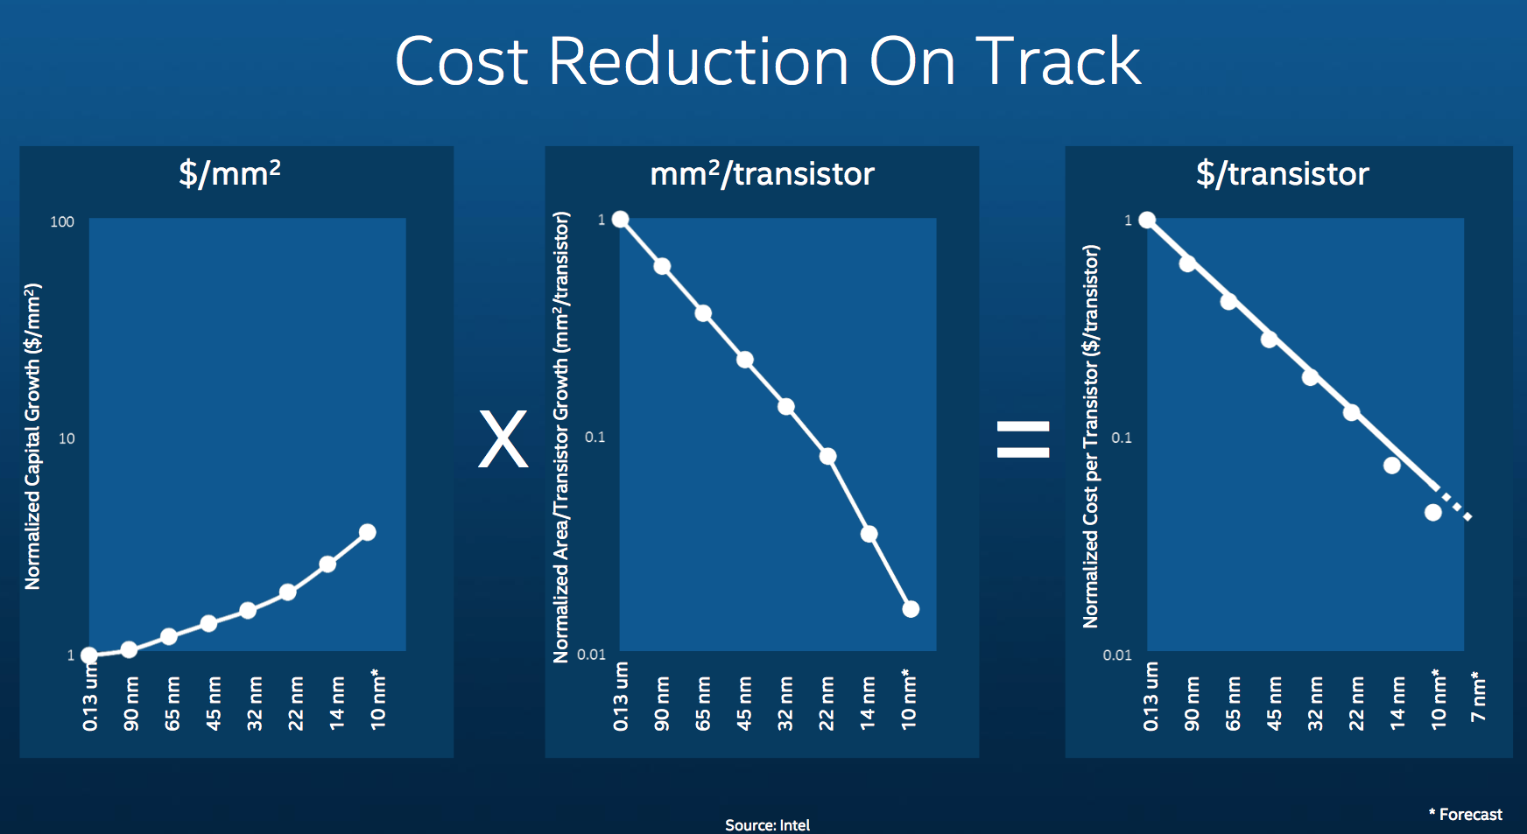
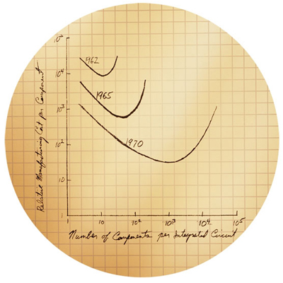
Conclusion (1)
Moore’s Law - 1965
Intel’s Assertion - 2014
But for this industry to continue to exists it must be that:
$/Transistor * Number of transistor produced > Capital Investment

Slide 26
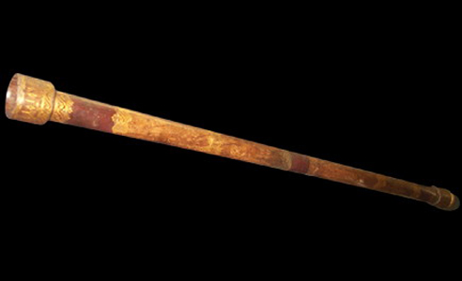
Conclusion (2)
Pretending to predict what microelectronics will be in > 25 years would simply be ludicrous.
  If we look back 25 years (i.e. 1990), none of us could have imagined what technologies we have available today, and not just in semiconductor devices, but mainly in the applications that have created a virtuous cycle of development/investment/new-applications (i.e. Internet, “disposable” computing, telecom, ubiquitous connectivity, cloud)
Other such technological revolutions are very likely ahead of us and we must be ready to profit from their potential fall-out in our field, i.e. on the new instruments that we could build using such technologies
  Beware: Back in 1985 not exactly everybody agreed to start an activity on “microelectronics”, and in fact we had to knock at the door of “visionaries'” to get funded
Real innovation is rarely related to “tech+1”: resources must be allocated to “tech+2”, “tech+3” etc., with the understanding that some or even most will not be fruitful, but that we can not miss the one that eventually will be successful.
certainly

Slide 27
Spare

Slide 28
