Slide 1
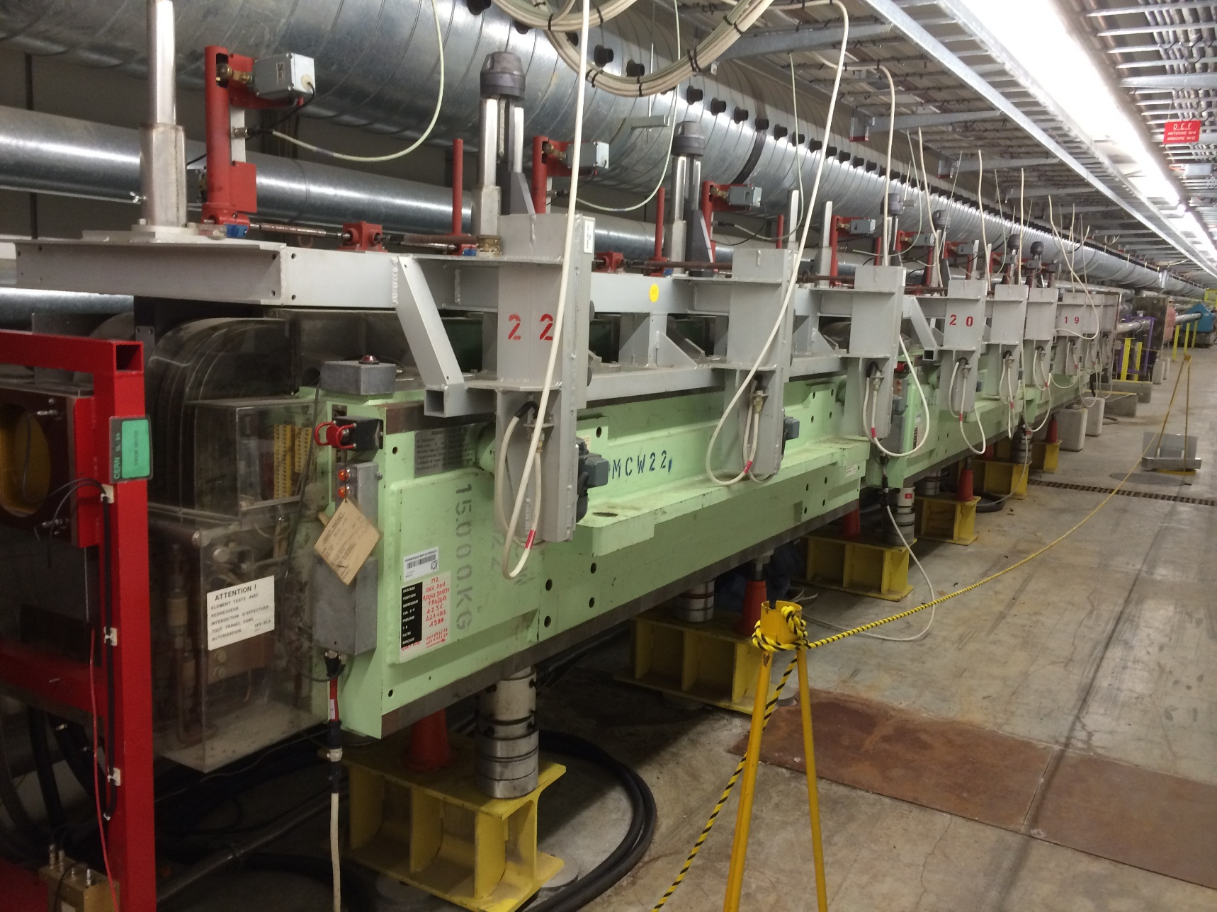
Repair of MCWV magnets (TT84 – M2)

Slide 2
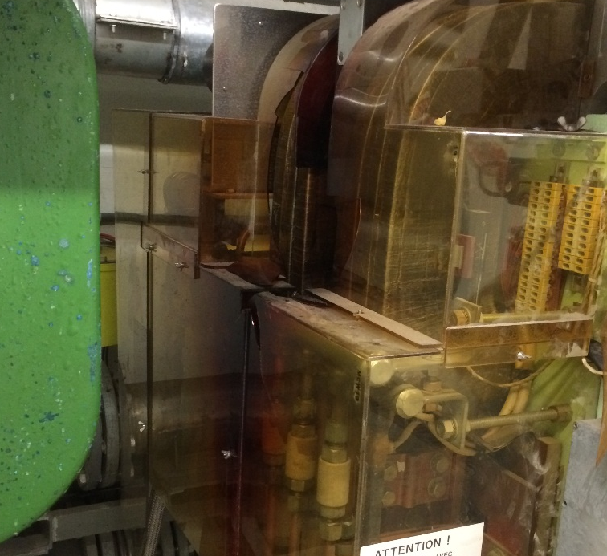
Repair of MCWV magnets (TT84 – M2)
Works on three magnets :
  MCWV 693, MCWV 697, and MCWV 701 and the associated XABS
Cause of the repair :
  XABS jam into magnets because of the corrosion
What we want to do :
  XABS
    Extract ABS from magnets
    Clean out the XABS
    Replace motorisation cables and switches
    Maintenance of mechanical parts
  Magnets
    Internal inspection of magnets
    Clean out the magnets
    Replace magnets hood, emergency stop button, and damaged parts

Slide 3
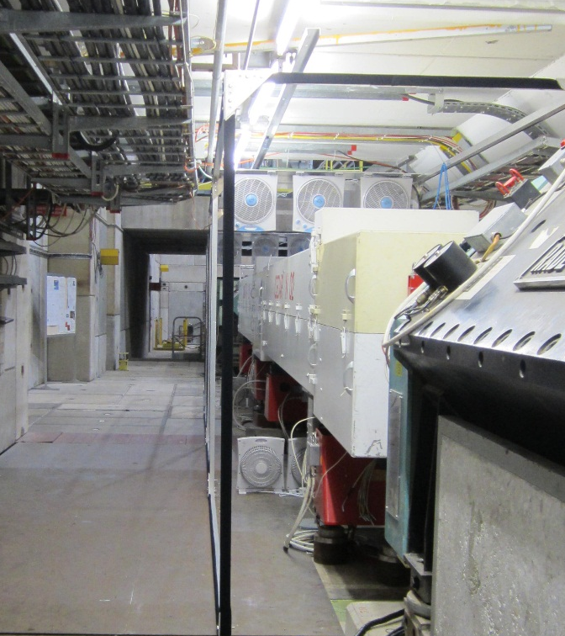
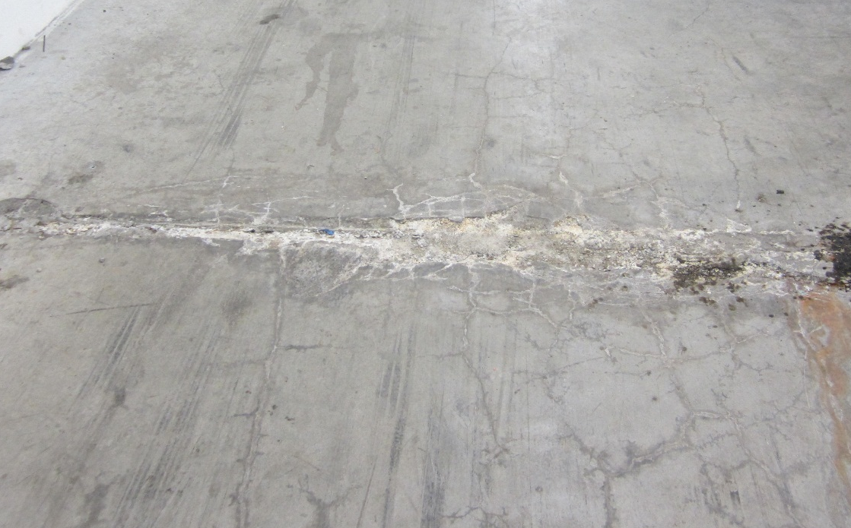
Repair of MCWV magnets (TT84 – M2)
Need to handle magnets and XABS to building 867
Some preparation to do :
  Repair the floor of TT84, 2 cracks, 5 days of work
  One monitor and one pumping window have to be removed
  Four lifting plates has been built
  The gutters needs to be sealed and a rolling plate is needed near EHN2
  CEDAR structure and BMS 6 have to be displaced

Slide 4
Repair of MCWV magnets (TT84 – M2)
Operating mode
  Repair work of the floor
  Handling of the 3 magnets to building 867, less radioactive first
  Disassembly of XABS and magnets in building 867
  XABS will be store in shielding
  Work on XABS (Abu) and magnets (TE-MSC)
  Reassembly of magnets and XABS
  Bring back the magnet in TT84 weeks 15 – 16, most radioactive first
Radioprotection
  Maximum dose rate outside the magnet : 40 uSv/h
  Dose rate of the ABS 3 mSv/h
  Measure with RP 12/11/2014

Slide 5
Repair of MCWV magnets (TT84 – M2)
Dates :
  Civil Engineering : week 51
  Handling to 867 : Week 2
  Beginning of works on magnets : Weeks 3 – 4
  Handling to TT84 : Week 15 – 16
Deadlines
  Return of beam in M2 line week 17

